Slide 1
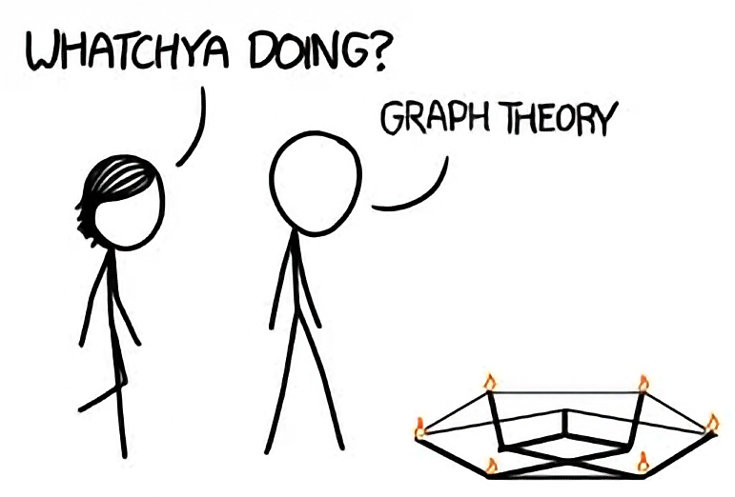
Graphs
CSE 332 – Section 6
Slides by James Richie Sulaeman
Notes:
Animated version.

Slide 2
Graphs

Slide 3
Graphs
A graph is a set of vertices connected by edges
A vertex is also known as a node
An edge is represented as a pair of vertices
A
C
B
D
vertices
F
E
edges
example of a undirected,
unweighted, cyclic graph

Slide 4
Graph Terminology
Degree of vertex V
  Number of edges connected to vertex V
  In-degree: number of edges going into vertex V
  Out-degree: number of edges going out of vertex V
Weight of edge e
  Numerical value/cost associated with traversing edge e
Path
  A sequence of adjacent vertices connected by edges
Cycle
  A path that begins and ends at the same vertex

Slide 5
Graph Terminology
Directed vs. undirected graphs
  Edges can have direction (i.e. bidirectional vs. unidirectional)
Weighted vs. unweighted graphs
  Edges can have weights/costs (e.g. how many minutes to go from vertex A to B)
Cyclic vs. acyclic graphs
  Graph contains a cycle
A
A
A
A
3
7
3
7
1
B
C
B
C
B
C
B
C
5
5
directed, unweighted, acyclic graph
directed, weighted, cyclic graph
undirected, unweighted, acyclic graph
undirected, weighted, cyclic graph

Slide 6
Graph Traversals

Slide 7
Graph Traversals
How do we iterate through a graph?
Depth First Search (DFS)
  Explores the graph by going as deep as possible
  Can be implemented recursively/by using a stack
  O(|V| + |E|) runtime
Depth First Search (DFS)
Breadth First Search (BFS)
  Explores the graph level by level
  Implemented using a queue
  Finds the shortest path in an unweighted, acyclic graph
  O(|V| + |E|) runtime
Breadth First Search (BFS)
Notes:
DFS: Explore everything you can reach via one neighbor, before exploring another neighbor
BFS: Visits everything in order of distance (distance is number of nodes away from origin)

Slide 8
Depth First Search
DFS(Graph g, Vertex curr):
mark curr as visited
for (v : neighbors(current)):
if (!v marked “visited”)
dfs(g, v)
mark curr as “done”;
Explores the graph by going as deep as possible
Implemented recursively/by using a stack
O(|V| + |E|) runtime
Depth First Search (DFS)
Notes:
Recursive way:
dfs(graph, curr):
Mark curr visited
For neighbor of curr:
If unvisited:
dfs(neighbor)

Slide 9
Breadth First Search
BFS(Vertex start):
initialize queue q to hold start
mark start as visited
while q is not empty:
vertex v = q.dequeue()
for each neighbour u of v:
if u is not visited:
mark u as visited
predecessor[u] = v
add u to q
Explores the graph level by level
Implemented using a queue
Finds the shortest path in an unweighted, acyclic graph
O(|V| + |E|) runtime
Breadth First Search (BFS)

Slide 10
Problem 0
DFS(Graph g, Vertex curr):
mark curr as visited
for (v : neighbors(current)):
if (!v marked “visited”)
dfs(g, v)
mark curr as “done”;

Slide 11
Problem 0
S
S
T
Vertex | Visited? | Done?
S | No | No
T | No | No
X | No | No
Y | No | No
Z | No | No
Yes
Y
Z
X
StackFrame (curr):
S
Build stack frame of dfs(g, S)
Mark vertex S as visited

Slide 12
Problem 0
S
T
S
T
Vertex | Visited? | Done?
S | Yes | No
T | No | No
X | No | No
Y | No | No
Z | No | No
Yes
Y
Z
X
StackFrame (curr):
S
T
S Call dfs on unvisited neighbor T
Mark vertex T as visited

Slide 13
Problem 0
S
T
Vertex | Visited? | Done?
S | Yes | No
T | Yes | No
X | No | No
Y | No | No
Z | No | No
T
Yes
Y
Z
X
X
StackFrame (curr):
S
T
X
T Call dfs on unvisited neighbor X
Mark vertex X as visited

Slide 14
Problem 0
S
T
Vertex | Visited? | Done?
S | Yes | No
T | Yes | No
X | Yes | No
Y | No | No
Z | No | No
Yes
Y
Z
X
StackFrame (curr):
S
T
X
No recursive call in X: all neighbors are visited
X
Mark vertex X as done, exit X stack frame

Slide 15
Problem 0
S
T
Vertex | Visited? | Done?
S | Yes | No
T | Yes | No
X | Yes | Yes
Y | No | No
Z | No | No
T
Y
Z
X
Y
Yes
StackFrame (curr):
S
T
X
T Call dfs on unvisited neighbor Y
Mark vertex Y as visited
Y

Slide 16
Problem 0
S
T
Vertex | Visited? | Done?
S | Yes | No
T | Yes | No
X | Yes | Yes
Y | Yes | No
Z | No | No
Y
Y
Z
X
Z
Yes
StackFrame (curr):
S
T
X
Y Call dfs on unvisited neighbor Z
Mark vertex Z as visited
Y
Z

Slide 17
Problem 0
S
T
Vertex | Visited? | Done?
S | Yes | No
T | Yes | No
X | Yes | Yes
Y | Yes | No
Z | Yes | No
Y
Z
X
Yes
StackFrame (curr):
S
T
X
No recursive call in Z: all neighbors are visited
Mark vertex Z as done, exit Z stack frame
Y
Z
Z

Slide 18
Problem 0
S
T
Vertex | Visited? | Done?
S | Yes | No
T | Yes | No
X | Yes | Yes
Y | Yes | No
Z | Yes | Yes
Y
Z
X
Yes
StackFrame (curr):
S
T
X
Finish all recursive in Y: all neighbors are visited
Mark vertex Y as done, exit Y stack frame
Y
Y
Z

Slide 19
Problem 0
S
T
Vertex | Visited? | Done?
S | Yes | No
T | Yes | No
X | Yes | Yes
Y | Yes | Yes
Z | Yes | Yes
Yes
Y
Z
X
StackFrame (curr):
T
Finish all recursive in T: all neighbors are visited
S
T
X
Mark vertex T as done, exit T stack frame
Y
Z

Slide 20
Problem 0
S
T
Vertex | Visited? | Done?
S | Yes | No
T | Yes | Yes
X | Yes | Yes
Y | Yes | Yes
Z | Yes | Yes
Yes
Y
Z
X
StackFrame (curr):
S
T
Finish all recursive in S: all neighbors are visited
S
X
Mark vertex S as done, exit S stack frame
Y
Z

Slide 21
Problem 1
BFS(Vertex start):
initialize queue q to hold start
mark start as visited
while q is not empty:
vertex v = q.dequeue()
for each neighbour u of v:
if u is not visited:
mark u as visited
predecessor[u] = v
add u to q

Slide 22
Problem 1
S
Vertex | Predecessor | Visited?
S | – | No
T | – | No
X | – | No
Y | – | No
Z | – | No
S
T
Yes
Y
Z
X
Queue:
Initialize queue to hold starting vertex S
S
Mark vertex S as visited
front
back
Notes:
Can find paths by reverse engineering predecessor

Slide 23
Problem 1
S
S
T
Vertex | Predecessor | Visited?
S | – | Yes
T | – | No
X | – | No
Y | – | No
Z | – | No
S
T
S
Yes
Y
Z
X
Y
S
Yes
Queue:
Dequeue vertex S
T
Y
Add neighbors T, Y to the queue
front
back

Slide 24
Problem 1
S
T
Vertex | Predecessor | Visited?
S | – | Yes
T | S | Yes
X | – | No
Y | S | Yes
Z | – | No
S
T
T
T
Yes
Y
Z
X
Y
Z
X
T
Yes
Queue:
Dequeue vertex T
Y
X
Z
Add neighbors X, Z to the queue
(ignore Y since already visited)
front
back

Slide 25
Problem 1
S
T
Vertex | Predecessor | Visited?
S | – | Yes
T | S | Yes
X | T | Yes
Y | S | Yes
Z | T | Yes
S
T
Y
Z
X
Y
Y
Z
X
Queue:
Dequeue vertex Y
X
Z
Add neighbors to the queue
(nothing happens since all already visited)
front
back

Slide 26
Problem 1
S
T
Vertex | Predecessor | Visited?
S | – | Yes
T | S | Yes
X | T | Yes
Y | S | Yes
Z | T | Yes
S
T
Y
Z
X
Y
Z
X
X
Queue:
Dequeue vertex X
Z
Add neighbors to the queue
(nothing happens since all already visited)
front
back

Slide 27
Problem 1
S
T
Vertex | Predecessor | Visited?
S | – | Yes
T | S | Yes
X | T | Yes
Y | S | Yes
Z | T | Yes
S
T
Y
Z
X
Y
Z
Z
X
Queue:
Dequeue vertex Z
Add neighbors to the queue
(nothing happens since all already visited)
front
back

Slide 28
Problem 1
S
T
Vertex | Predecessor | Visited?
S | – | Yes
T | S | Yes
X | T | Yes
Y | S | Yes
Z | T | Yes
S
T
Y
Z
X
Y
Z
X
Queue:
Queue is empty; we are done
front
back

Slide 29
BFS Table Interpretation

Slide 30
BFS Table Interpretation
A path exists if and only if the target node has a predecessor in the table
How to find a path from the start node to a target node?
Locate the target node in the table
Backtrack through its predecessors until you reach the start node
The sequence of predecessors form a path from the start to the target
Will be the shortest path by edge count (but not necessarily sum of edge costs)
How to check if a path exists from the start node to a target node?
Vertex | Predecessor | Visited?
S | – | Yes
T | S | Yes
X | T | Yes
Y | S | Yes
Z | T | Yes

Slide 31
BFS/DFS Useful Properties

Slide 32
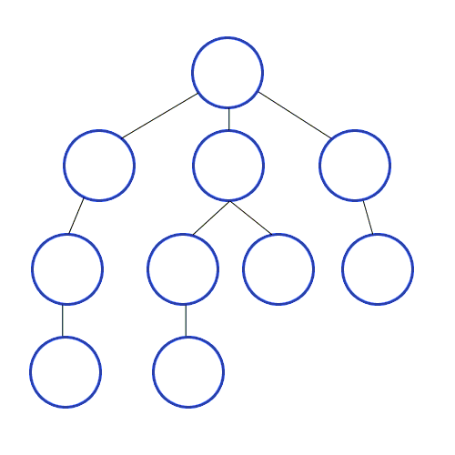
BFS - Shortest Path
BFS always returns the shortest path from source to any other vertex by edge count!
Intuition:
  Each step push neighbors that are one edge away, onto a queue.
  Because we use a queue, we must process the vertices 1 edge away, before vertices farther away
  Each vertex’s predecessor in the table is the one which initially pushes it onto the stack (earliest/shortest path)

Slide 33
DFS – Detect Cycle
Start from A
Use DFS to detect cycle by finding a back edge
a back edge is an edge that connects a node to one of its ancestors in the current recursion stack.

Slide 34
DFS – Detect Cycle
Start from A
Vertex: D
Mark as done
Edge points to a visited node, back edge detected!
A
Vertex: E
Mark as done
Edge points to a visited node, back edge detected!
Vertex: D
Mark D as visited
E
Vertex: C
Mark C as visited
Vertex: C
Mark C as visited
Vertex: E
Mark E as visited
B
Vertex: B
Vertex: B
Mark B as visited
Vertex: B
Go to next unvisited
D
C
Vertex: A
Mark A as visited
Vertex: A
Vertex: A
Mark A as visited

Slide 35
DFS – Detect Cycle
We can find cycles using DFS by finding back edges
Visited : 1
Done: 8
Visited : 2
Done: 7
Visited : 3
Done: 6
Visited: 0
Done: 15
2
5
8
1
Visited : 10
Done: 13
4
9
Visited : 9
Done: 14
3
7
6
Visited : 11
Done: 12
Visited : 4
Done: 5

Slide 36
Back Edges
Behavior of DFS:
  “Visit everything reachable from the current node before going back”
Back Edge:
  The current node’s neighbor is an “in progress” node
  Since that other node is “in progress”, the current node is reachable from it
  The back edge is a path to that other node
  Cycle!
2
5
8
1
4
9
3
7
6

Slide 37
Cycle Detection
Idea: Look for a back edge!
boolean hasCycle(graph, curr){
mark curr as “visited”;
cycleFound = false;
for (v : neighbors(current)){
if (v marked “visited” && ! v marked “done”){
cycleFound=true;
}
if (! v marked “visited” && !cycleFound){
cycleFound = hasCycle(graph, v);
}
}
mark curr as “done”;
return cycleFound;
}
2
5
8
1
4
9
3
7
6

Slide 38
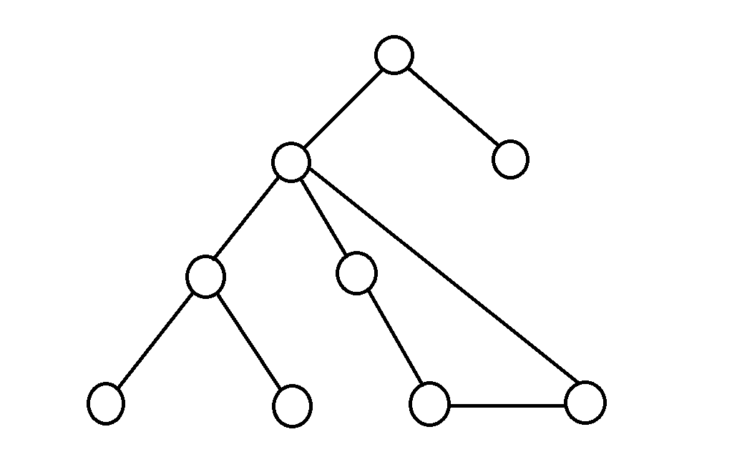
DFS - Finding Cycles
DFS can be used to detect cycles!
Intuition:
  DFS tells us to keep moving along a chosen path until we hit a “dead-end”
  If the “dead-end” is a null pointer (e.g. no more children/neighbors), no cycle
  If the “dead-end” is a visited node, the path is a cycle!

Slide 39
Dijkstra’s Algorithm
(Shortest Path)
Notes:
Dijkstra’s Algorithm won’t be covered until next week! Current + following slides are not relevant to this section, but will be helpful next week.

Slide 40
Dijkstra’s Algorithm
Dijkstra’s algorithm finds the minimum-cost path from a source vertex to every other vertex in a non-negatively weighted graph
O(|V| log |V| + |E| log |V|) runtime
Dijkstra(Vertex source):
for each vertex v:
set v.cost = infinity
mark v as unvisited
set source.cost = 0
while exist unvisited vertices:
select unvisited vertex v with lowest cost
mark v as visited
for each edge (v, u) with weight w:
if u is not visited:
potentialBest = v.cost + w // cost of best path to u through v
currBest = u.cost // cost of current best path to u
if (potentialBest < currBest):
u.cost = potentialBest
u.pred = v
Notes:
Replace with priority queue
Update new priorities (new potential paths) as we find them

Slide 41
Dijkstra(Vertex source):
for each vertex v:
set v.cost = infinity
mark v as unvisited
set source.cost = 0
while exist unvisited vertices:
select unvisited vertex v with lowest cost
mark v as visited
for each edge (v, u) with weight w:
if u is not visited:
potentialBest = v.cost + w
currBest = u.cost
if (potentialBest < currBest):
u.cost = potentialBest
u.pred = v
Problem 2

Slide 42
Problem 2
Initialize each vertex as unvisited with cost ∞
Set cost of source vertex A to 0
F
3
E
Vertex | Visited? | Cost | Predecessor
A |  |  | –
B |  |  | –
C |  |  | –
D |  |  | –
E |  |  | –
F |  |  | –
0
No
No
No
No
No
No
13
∞
∞
∞
∞
∞
∞
1
5
13
50
3
A
D
16
6
8
2
B
C
7

Slide 43
Problem 2
Select unvisited vertex with lowest cost (A)
Mark A as visited
Process each outgoing edge
F
3
E
Vertex | Visited? | Cost | Predecessor
A | No | 0 | –
B | No | ∞ | –
C | No | ∞ | –
D | No | ∞ | –
E | No | ∞ | –
F | No | ∞ | –
13
Yes
1
13
1
5
∞ 8
∞ 16
∞ 50
∞ 13
∞ 1
A
A
A
A
A
13
50
3
A
50
A
D
16
16
6
8
8
2
B
C
7

Slide 44
Problem 2
Select unvisited vertex with lowest cost (F)
Mark F as visited
Process each outgoing edge
3
F
3
F
E
Vertex | Visited? | Cost | Predecessor
A | Yes | 0 | –
B | No | ∞ 8 | A
C | No | ∞ 16 | A
D | No | ∞ 50 | A
E | No | ∞ 13 | A
F | No | ∞ 1 | A
1
13
5
13
3
13
50
A
A
D
16
6
8
2
∞ 13 4
A F
B
C
Yes
7

Slide 45
Problem 2
Select unvisited vertex with lowest cost (E)
Mark E as visited
Process each outgoing edge
F
3
E
F
E
Vertex | Visited? | Cost | Predecessor
A | Yes | 0 | –
B | No | ∞ 8 | A
C | No | ∞ 16 | A
D | No | ∞ 50 | A
E | No | ∞ 13 4 | A F
F | Yes | ∞ 1 | A
1
13
5
5
13
50
3
A
A
D
∞ 50 9
16
6
A E
8
2
Yes
B
C
7

Slide 46
Select unvisited vertex with lowest cost (B)
Problem 2
Mark B as visited
Process each outgoing edge
No outgoing edges; continue
F
3
E
F
E
Vertex | Visited? | Cost | Predecessor
A | Yes | 0 | –
B | No | ∞ 8 | A
C | No | ∞ 16 | A
D | No | ∞ 50 9 | A E
E | Yes | ∞ 13 4 | A F
F | Yes | ∞ 1 | A
1
13
5
Yes
13
50
3
A
A
D
16
6
8
2
B
B
C
7

Slide 47
Problem 2
Select unvisited vertex with lowest cost (D)
Mark D as visited
Process each outgoing edge
(ignore D→B since B is already visited)
F
3
E
F
E
Vertex | Visited? | Cost | Predecessor
A | Yes | 0 | –
B | Yes | ∞ 8 | A
C | No | ∞ 16 | A
D | No | ∞ 50 9 | A E
E | Yes | ∞ 13 4 | A F
F | Yes | ∞ 1 | A
1
13
5
13
50
3
A
A
D
D
∞ 16 11
A D
16
6
Yes
6
8
2
2
B
B
C
7

Slide 48
Select unvisited vertex with lowest cost (C)
Problem 2
Mark C as visited
Process each outgoing edge
(ignore C→B & C→E since B & E are already visited)
No outgoing edges to unvisited nodes; continue
F
3
E
F
E
Vertex | Visited? | Cost | Predecessor
A | Yes | 0 | –
B | Yes | ∞ 8 | A
C | No | ∞ 16 11 | A D
D | Yes | ∞ 50 9 | A E
E | Yes | ∞ 13 4 | A F
F | Yes | ∞ 1 | A
1
13
5
3
13
50
3
A
A
D
D
Yes
16
6
8
2
B
B
C
C
7
7

Slide 49
Problem 2
No more unvisited nodes; we are done
F
3
E
F
E
Vertex | Visited? | Cost | Predecessor
A | Yes | 0 | –
B | Yes | ∞ 8 | A
C | No | ∞ 16 11 | A D
D | Yes | ∞ 50 9 | A E
E | Yes | ∞ 13 4 | A F
F | Yes | ∞ 1 | A
1
13
5
13
50
3
A
A
D
D
Yes
16
6
8
2
B
B
C
C
7

Slide 50
Dijkstra(Vertex source):
for each vertex v:
set v.cost = infinity
mark v as unvisited
set source.cost = 0
while exist unvisited vertices:
select unvisited vertex v with lowest cost
mark v as visited
for each edge (v, u) with weight w:
if u is not visited:
potentialBest = v.cost + w
currBest = u.cost
if (potentialBest < currBest):
u.cost = potentialBest
u.pred = v
Problem 3

Slide 51
Problem 3
Initialize each vertex as unvisited with cost ∞
Set cost of source vertex A to 0
B
3
C
Vertex | Visited? | Cost | Predecessor
A |  |  | –
B |  |  | –
C |  |  | –
D |  |  | –
E |  |  | –
F |  |  | –
0
No
No
No
No
No
No
80
∞
∞
∞
∞
∞
∞
5
-5
70
90
A
D
60
6
4
10
F
E
7

Slide 52
Problem 3
Initialize each vertex as unvisited with cost ∞
Set cost of source vertex A to 0
B
3
C
Vertex | Visited? | Cost of Path | Pred
a | True | 0
b | True | ∞ 05 | a
c | True | ∞ 80 08 | a b
d | True | ∞ 90 03 | a c
e | True | ∞ 60 13 | a d
f | True | ∞ 04 | a
5
80
-5
70
90
A
D
60
6
4
10
F
E
7
Order added to known set: a, f, b, c, d, e

Slide 53
Thank You!

