Slide 1
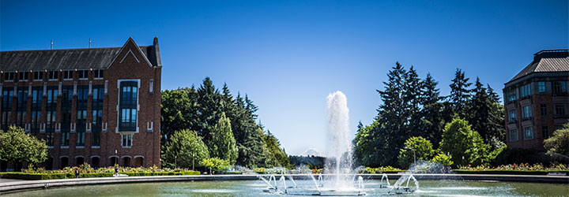
Wrap-Up Hodgepodge
CSE 332 Sp25
Lecture 28

Slide 2
Announcements
 | Monday | Tuesday | Wed | Thursday | Friday
This Week |  |  | Ex 13 (MST,prog) due |  | TODAY Ex 14 (P/NP, gs) due
Next Week |  |  |  | Final :O

Slide 3
Outline
3 topics:
Topological Sort
Strongly Connected Components
P/NP wrap-up

Slide 4
Two More Simple Graph Algorithms

Slide 5
What you need to know
What is a topological sort and a DAG?
When does a topological sort exist and when doesn’t it?
A topological sort can be found in O(V+E) time
Be able to find a topological sort yourself (by hand, don’t need to show separate algorithm steps).

Slide 6
Ordering Dependencies
Today’s next problem: Given a bunch of courses with prerequisites, find an order to take the courses in.
Math 126
CSE 331
CSE 143
CSE 142
CSE 311
CSE 332

Slide 7
Ordering Dependencies
Given a directed graph G, where we have an edge from u to v if u must happen before v.
Can we find an order that respects dependencies?
Given: a directed graph G
Find: an ordering of the vertices so all edges go from left to right.
Topological Sort (aka Topological Ordering)
Uses:
Compiling multiple files
Graduating.

Slide 8
Topological Ordering
A course prerequisite chart and a possible topological ordering.
Math 126
CSE 331
CSE 143
CSE 142
CSE 311
CSE 332
Math 126
CSE 142
CSE 143
CSE 311
CSE 331
CSE 332

Slide 9
Can we always order a graph?
Can you topologically order this graph?
A
B
C
Directed Acyclic Graph (DAG)
A directed graph without any cycles.
A graph has a topological ordering if and only if it is a DAG.
Notes:
3:00

Slide 10
Ordering a DAG
Does this graph have a topological ordering? If so find one.
A
C
D
B
E

Slide 11
Ordering a DAG
Does this graph have a topological ordering? If so find one.
A
C
D
B
E
If a vertex doesn’t have any edges going into it, we can add it to the ordering.
More generally, if the only incoming edges are from vertices already in the ordering, it’s safe to add.

Slide 12
How Do We Find a Topological Ordering?
TopologicalSort(Graph G, Vertex source)
count how many incoming edges each vertex has
Collection toProcess = new Collection()
foreach(Vertex v in G){
if(v.edgesRemaining == 0)
toProcess.insert(v)
}
topOrder = new List()
while(toProcess is not empty){
u = toProcess.remove()
topOrder.insert(u)
foreach(edge (u,v) leaving u){
v.edgesRemaining--
if(v.edgesRemaining == 0)
toProcess.insert(v)
}
}

Slide 13
What’s the running time?
TopologicalSort(Graph G, Vertex source)
count how many incoming edges each vertex has
Collection toProcess = new Collection()
foreach(Vertex v in G){
if(v.edgesRemaining == 0)
toProcess.insert(v)
}
topOrder = new List()
while(toProcess is not empty){
u = toProcess.remove()
topOrder.insert(u)
foreach(edge (u,v) leaving u){
v.edgesRemaining--
if(v.edgesRemaining == 0)
toProcess.insert(v)
}
}
Running Time: $O(\left|V\right|+\left|E\right|)$

Slide 14
Finding a Topological Ordering
Instead of counting incoming edges, you can actually modify DFS to find you one (think about why).
But the “count incoming edges” is a bit easier to understand (for me ☺ )

Slide 15
What you need to know
What is a topological sort and a DAG?
When does a topological sort exist and when doesn’t it?
A topological sort can be found in O(V+E) time
Be able to find a topological sort yourself (by hand, don’t need to show algorithm steps).

Slide 16
Connectivity in Directed Graphs

Slide 17
What you need to know
Definition of strongly connected
Strongly connected components can be found in O(V+E) time via modification of DFS
Find SCCs of a graph (by hand, don’t need to show algorithm steps)

Slide 18
Problem 2: Find Strongly Connected Components
A
B
D
E
K
C
F
J
A subgraph C such that every pair of vertices in C is connected via some path in both directions, and there is no other vertex which is connected to every vertex of C in both directions.
Strongly Connected Component

Slide 19
Problem 2: Find Strongly Connected Components
A
B
D
E
K
C
F
J
A subgraph C such that every pair of vertices in C is connected via some path in both directions, and there is no other vertex which is connected to every vertex of C in both directions.
Strongly Connected Component
{A}, {B}, {C,D,E,F}, {J,K}

Slide 20
Connectedness Definitions
In an undirected graph, a connected component is a “piece” of the graph: a vertex and everything its connected to via a path.
Equivalently, a subgraph C such that every pair of vertices in C is connected via some path and there is no other vertex which is connected to every vertex of C in both directions.
In a directed graph, you might care about
Weakly connected components (ignore the directions on the edges, if it were undirected, would it be connected?)
Strongly connected (can you get in both directions)

Slide 21
Can you find Strongly Connected Components?
A couple of different ways to use DFS to find strongly connected components.
Wikipedia has the details.
High level: need to keep track of “highest point” in DFS tree you can reach back up to.

Slide 22
What you need to know
Definition of strongly connected
Strongly connected components can be found in O(V+E) time via modification of DFS
Find SCCs of a graph (by hand, don’t need to show algorithm steps)

Slide 23
Why P vs. NP matters

Slide 24
The set of all decision problems that have an algorithm that runs in time $O\left(n^{k}\right)$ for some constant $k$.
P (stands for “Polynomial”)
The set of all decision problems such that if the answer is YES, there is a proof of that which can be verified in polynomial time.
NP (stands for “nondeterministic polynomial”)
Problem B is NP-complete if B is in NP and for all problems A in NP, A reduces to B in polynomial time.
NP-complete
Problem B is NP-hard if for all problems A in NP, A reduces to B in polynomial time.
NP-hard

Slide 25
Why is it called NP?
You’ve seen nondeterministic computation before.
Back in 311.
NFAs would “magically” decide among a set of valid transitions.
Always choosing one that would lead to an accept state (if such a transition exists).

Slide 26
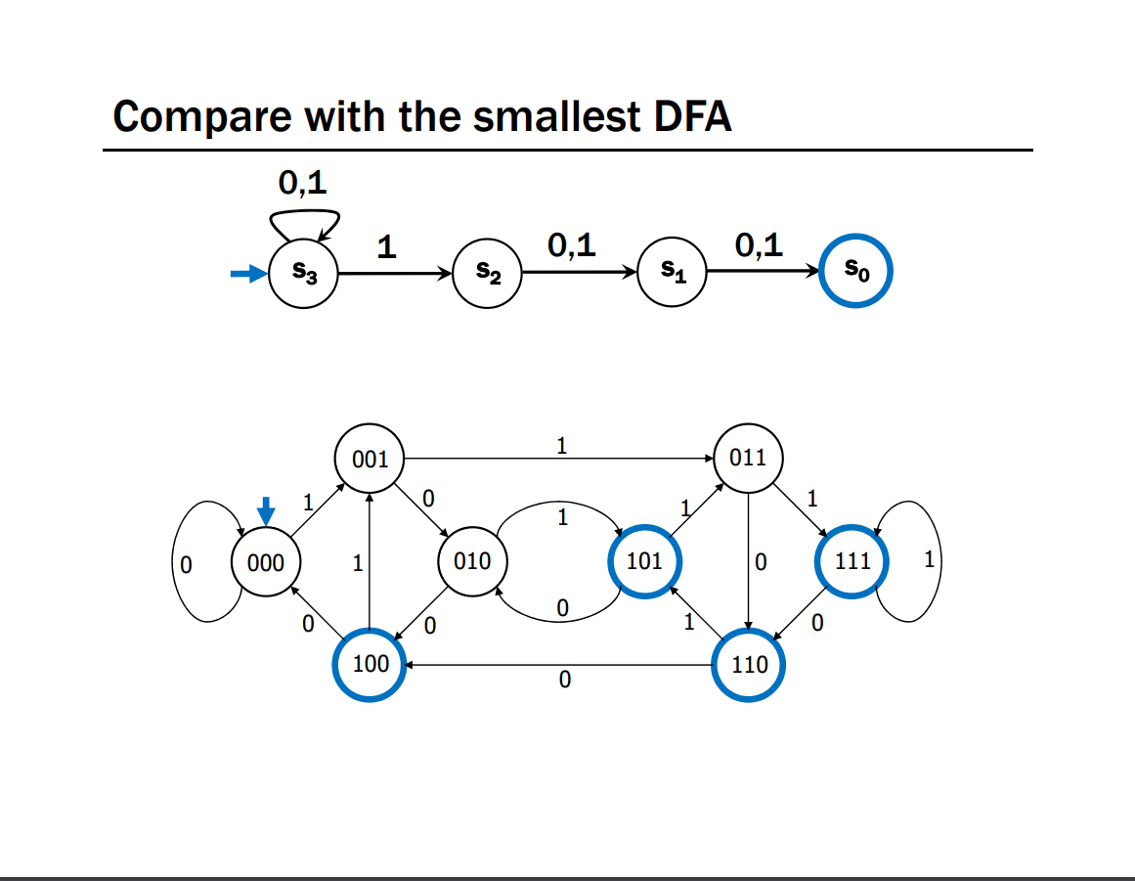
An NFA and a DFA for the language
“binary strings with a 1 in the 3rd position from the end.”
From Kevin & Paul’s 311 Lecture 23.

Slide 27
Nondeterminism
What would a nondeterministic computer look like?
It can run all the usual commands,
But it can also magically (i.e. nondeterministically) decide to set any bit of memory to 0 or 1.
Always choosing 0 or 1 to cause the computer to output YES,
(if such a choice exists).

Slide 28
If we had a nondeterministic computer…
Can you think of a polynomial time algorithm on a nondeterministic computer to:
Solve 2-COLOR?
Solve 3-COLOR?

Slide 29
If we had a nondeterministic computer…
Can you think of a polynomial time algorithm on a nondeterministic computer to:
Solve 2-COLOR?
Just run our regular deterministic polynomial time algorithm
Or nondeterministically guess colors, output if they work.
Solve 3-COLOR?
nondeterministically guess colors, output if they work.

Slide 30
Analogue of NFA/DFA equivalence
You showed in 311 that the set of languages decided by NFAs and DFAs were the same.
I.e. NFAs didn’t let you solve more problems than DFAs.
But it did sometimes make the process a lot easier.
There are languages such that the best DFA is exponentially larger than the best NFA. (like the one from a few slides ago).
P vs. NP is an analogous question. Does non-determinism let us use exponentially fewer resources to solve some problems?

Slide 31
History, and Why P vs. NP?

Slide 32
NP-Completeness
An NP-complete problem is a universal language for encoding “I’ll know it when I see it” problems.
If you find an efficient algorithm for an NP-complete problem, you have an algorithm for every problem in NP
SAT is NP-complete
Cook-Levin Theorem (1971)

Slide 33
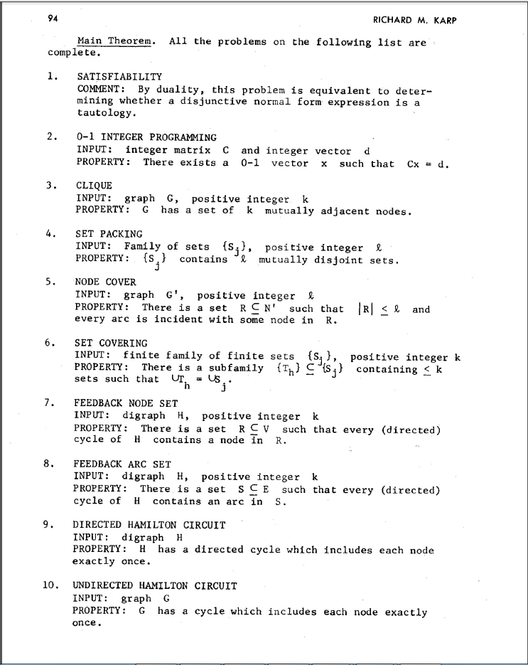
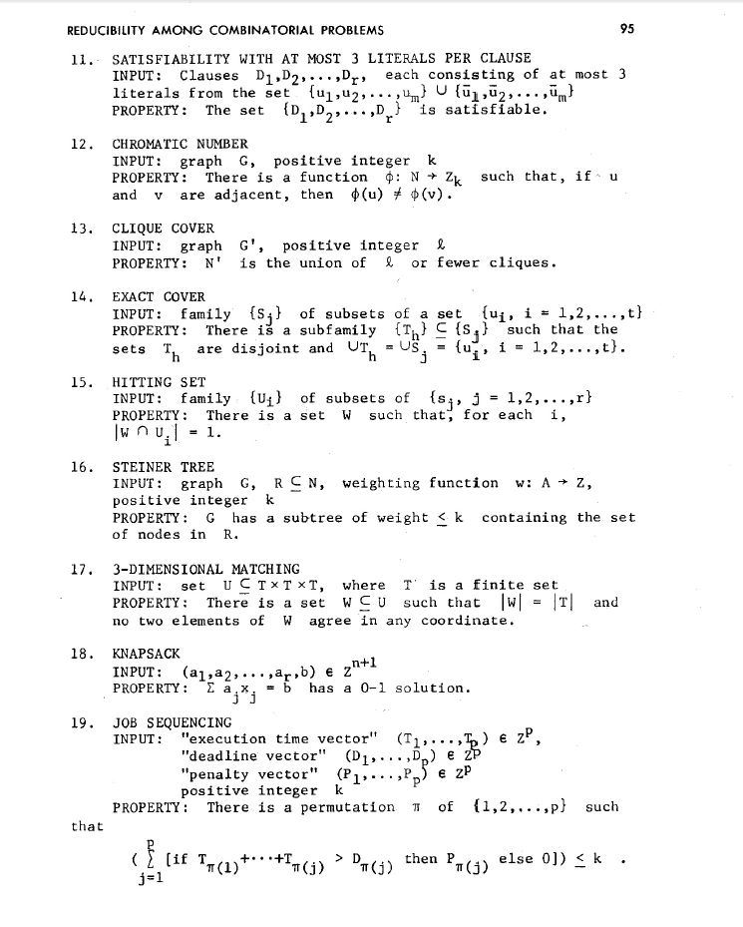
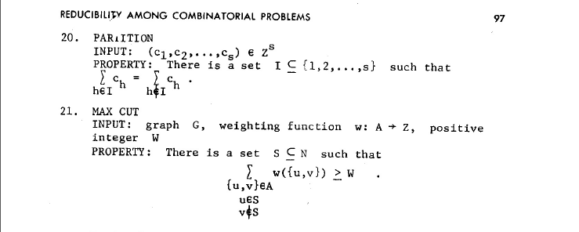
NP-Complete Problems
But Wait! There’s more!
A lot of problems people care about are NP-complete
Karp’s Theorem (1972)

Slide 34
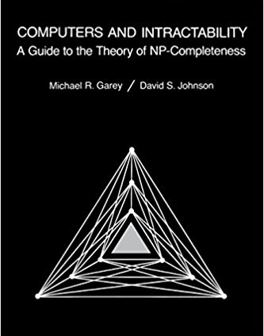
NP-Complete Problems
But Wait! There’s more!
By 1979, at least 300 problems had been proven NP-complete.
Garey and Johnson put a list of all the NP-complete problems they could find in this textbook.
Took them almost 100 pages to just list them all.
No one has made a comprehensive list since.

Slide 35
NP-Complete Problems
But Wait! There’s more!
In the last month, mathematicians and computer scientists have put papers on the arXiv claiming to show (at least) 10 more problems are NP-complete.
If you spend enough time trying to use computers to solve your problems, you will run into an NP-complete problem sooner or later.
What do you do?

Slide 36
Dealing with NP-Completeness
Option 1: Maybe it’s a special case we understand
Maybe you don’t need to solve the general problem, just a special case
2-COLOR vs. 3-COLOR
Option 2: Maybe it’s a special case we don’t understand (yet)
There are algorithms that are known to run quickly on “nice” instances. Maybe your problem has one of those.
One approach: Turn your problem into a SAT instance, find a solver and cross your fingers.

Slide 37
Dealing with NP-Completeness
Option 3: Approximation Algorithms
You might not be able to get an exact answer, but you might be able to get close.
Given a weighted graph, find a tour (a walk that visits every vertex and returns to its start) of minimum weight.
Optimization version of Traveling Salesperson
Algorithm:
Find a minimum spanning tree.
Have the tour follow the visitation order of a DFS of the spanning tree.
Theorem: This tour is at most twice as long as the best one.

Slide 38
Why should you care about P vs. NP
Most computer scientists are convinced that P$≠$NP.
Why should you care about this problem?
It’s your chance for:
$1,000,000. The Clay Mathematics Institute will give $1,000,000 to whoever solves P vs. NP (or any of the 5 remaining problems they listed)
To get a Turing Award

Slide 39
Why should you care about P vs. NP
Most computer scientists are convinced that P$≠$NP.
Why should you care about this problem?
It’s your chance for:
$1,000,000. The Clay Mathematics Institute will give $1,000,000 to whoever solves P vs. NP (or any of the 5 remaining problems they listed)
To get a Turing Award the Turing Award renamed after you.

Slide 40
Why Should You Care if P=NP?
Suppose P=NP.
Specifically that we found a genuinely in-practice efficient algorithm for an NP-complete problem. What would you do?
$1,000,000 from the Clay Math Institute obviously, but what’s next?

Slide 41
Why Should You Care if P=NP?
We found a genuinely in-practice efficient algorithm for an NP-complete problem. What would you do?
Another $5,000,000 from the Clay Math Institute
Put mathematicians out of work.
Decrypt (essentially) all current internet communication.
A world where P=NP is a very very different place from the world we live in now.

Slide 42
Why Should You Care if P$≠$NP?
We already expect P$≠$NP. Why should you care when we finally prove it?
P$≠$NP says something fundamental about the universe.
For some questions there is not a clever way to find the right answer
Even though you’ll know it when you see it.
There is actually a way to obscure information.

Slide 43
Why Should You Care if P$≠$NP?
To prove P$≠$NP we need to better understand the differences between problems.
Why do some problems allow easy solutions and others don’t?
What is the structure of these problems?
We don’t care about P vs NP just because it has a huge effect about what the world looks like.
We will learn a lot about computation along the way.

Slide 44
This is a good time for questions

Slide 45
Optional: Graph practice

Slide 46
Designing New Algorithms
When you need to design a new algorithm on graphs, whatever you do is probably going to take at least $Ω(m+n)$ time.
So you can run any $O(m+n)$ algorithm as “preprocessing”
Finding connected components (undirected graphs)
Finding SCCs (directed graphs)
Do a topological sort (DAGs)

Slide 47
Designing New Algorithms
Finding SCCs and topological sort go well together:
From a graph $G$ you can define the “meta-graph” $G^{SCC}$ (aka “condensation”, aka “graph of SCCs”)
$G^{SCC}$ has a vertex for every SCC of $G$
There’s an edge from $u$ to $v$ in $G^{SCC}$if and only if there’s an edge in $G$ from a vertex in $u$ to a vertex in $v.$

Slide 48
Why Find SCCs?
Let’s build a new graph out of them! Call it $G^{SCC}$
Have a vertex for each of the strongly connected components
Add an edge from component 1 to component 2 if there is an edge from a vertex inside 1 to one inside 2.
A
B
D
E
K
1
2
C
F
J
3
4

Slide 49
Designing New Graph Algorithms
Not a common task – most graph problems have been asked before.
When you need to do it, Robbie recommends:
Start with a simpler case (topo-sorted DAG, or [strongly] connected graph).
A common pattern:
1. Figuring out what you’d do if the graph is strongly connected
2. Figuring out what you’d do if the graph is a topologically ordered DAG
3. Stitching together those two ideas (using $G^{SCC}$).

Slide 50
Graph Modeling
But…Most of the time you don’t need a new graph algorithm.
What you need is to figure out what graph to make and which graph algorithm to run.
“Graph modeling”
Going from word problem to graph algorithm.
Often finding a clever way to turn your requirements into graph features.
Mix of “standard bag of tricks” and new creativity.

Slide 51
Graph Modeling Process
1. What are your fundamental objects?
Those will probably become your vertices.
2. How are those objects related?
Represent those relationships with edges.
3. How is what I’m looking for encoded in the graph?
Do I need a path from s to t? The shortest path from s to t? A minimum spanning tree? Something else?
4. Do I know how to find what I’m looking for?
Then run that algorithm/combination of algorithms
Otherwise go back to step 1 and try again.

Slide 52
Scenario #1
You’ve made a new social networking app, Convrs. Users on Convrs can have “asymmetric” following (I can follow you, without you following me). You decide to allow people to form multi-user direct messages, but only if people are probably in similar social circles (to avoid spamming).
You’ll allow a messaging channel to form only if for every pair of users a,b in the channel: a must follow b or follow someone who follows b or follow someone who follows someone who follows b, or … And the same for b to a.
You’d like to be able to quickly check for any new proposed channel whether it meets this condition.
What are the vertices?
What are the edges?
What are we looking for?
What do we run?

Slide 53
Scenario #1
You’ve made a new social networking app, Convrs. Users on Convrs can have “asymmetric” following (I can follow you, without you following me). You decide to allow people to form multi-user direct messages, but only if people are probably in similar social circles (to avoid spamming).
You’ll allow a messaging channel to form only if for every pair of users a,b in the channel: a must follow b or follow someone who follows b or follow someone who follows someone who follows b, or … And the same for b to a.
You’d like to be able to quickly check for any new proposed channel whether it meets this condition.
What are the vertices?
What are the edges?
What are we looking for?
What do we run?
Users
Directed – from $u$ to $v$ if $u$ follows $v$
If everyone in the channel is in the same SCC.
Find SCCs, to test a new channel, make sure all are in same component.

Slide 54
Scenario #2
Sports fans often use the “transitive law” to predict sports outcomes. In general, if you think A is better than B, and B is also better than C, then you expect that A is better than C.
Teams don’t all play each other – from data of games that have been played, determine if the “transitive law” is realistic, or misleading about at least one outcome.
What are the vertices?
What are the edges?
What are we looking for?
What do we run?

Slide 55
Scenario #2
What are the vertices?
What are the edges?
What are we looking for?
What do we run?
Sports fans often use the “transitive law” to predict sports outcomes -- . In general, if you think A is better than B, and B is also better than C, then you expect that A is better than C.
Teams don’t all play each other – from data of games that have been played, determine if the “transitive law” is realistic, or misleading about at least one outcome.
Teams
Directed – Edge from $u$ to $v$ if $u$ beat $v$.
A cycle would say it’s not realistic.
OR a topological sort would say it is.
Cycle-detection DFS.
a topological sort algorithm (with error detection)

Slide 56
Scenario #3
It’s a
small
world
6
4
7
You are at Splash Mountain. Your best friend is at Space Mountain. You have to tell each other about your experiences in person as soon as possible. Where do you meet and how quickly can you get there?
What are the vertices?
What are the edges?
What are we looking for?
What do we run?
Dumbo
6
16
12
10
8
5
Matter-
horn
14
Thunder
Mtn
4
5
1
13
Splash
Mtn
Castle
9
7
15
17
11
9
3
Space
Mtn
Indiana
Jones
8
10
0
Star
Tours
1
2
Flag
Pole
2
Jungle
Cruise
3

Slide 57
Scenario #3
19
It’s a
small
world
15
6
4
7
You are at Splash Mountain. Your best friend is at Space Mountain. You have to tell each other about your experiences in person as soon as possible. Where do you meet and how quickly can you get there?
What are the vertices?
Rides
What are the edges?
Walkways with how long it would take to walk
What are we looking for?
The “midpoint”
What do we run?
Run Dijkstra’s from Splash Mountain, store distances
Run Dijkstra’s from Space Mountain, store distances
Iterate over vertices, for each vertex remember max of two
Iterate over vertices, find minimum of remembered numbers
Dumbo
33
29
6
16
12
10
8
9
5
22
Matter-
horn
14
Thunder
Mtn
14
32
4
5
1
17
13
Splash
Mtn
Castle
36
19
9
0
7
15
17
0
11
9
3
29
Space
Mtn
Indiana
Jones
8
10
1
15
0
Star
Tours
Flag
Pole
28
1
36
2
2
31
Jungle
Cruise
20
3
37
17

Slide 58
Scenario #4
You’re a Disneyland employee, working the front of the Splash Mountain line. Suddenly, the crowd-control gates fall over and the line degrades into an unordered mass of people.
Sometimes you can tell who was in line before who; for other groups you aren’t quite sure. You need to restore the line, while ensuring if you knew A came before B before the incident, they will still be in the right order afterward. What are the vertices?
People
What are the edges?
Edges are directed, have an edge from X to Y if you know X came before Y.
What are we looking for?
A total ordering consistent with all the ordering we do know.
What do we run?
Topological Sort!

Slide 59
Problem 2: Find Strongly Connected Components
A
B
D
E
K
C
F
J
A subgraph C such that every pair of vertices in C is connected via some path in both directions, and there is no other vertex which is connected to every vertex of C in both directions.
Strongly Connected Component

Slide 60
The set of all decision problems that have an algorithm that runs in time $O\left(n^{k}\right)$ for some constant $k$.
P (stands for “Polynomial”)
The set of all decision problems such that if the answer is YES, there is a proof of that which can be verified in polynomial time.
NP (stands for “nondeterministic polynomial”)
Problem B is NP-complete if B is in NP and for all problems A in NP, A reduces to B in polynomial time.
NP-complete
Problem B is NP-hard if for all problems A in NP, A reduces to B in polynomial time.
NP-hard

