Slide 1
Shortest Paths
CSE 332 25Sp
Lecture 17

Slide 2
Announcements
 | Monday | Tuesday | Wed | Thursday | Friday
This Week |  |  |  |  | TODAY Ex 6 (sorting, gs) due Ex 8 (Dijkstra, gs) out
Next Week | Ex 7 (DFS, prog) due Ex 9 (reductions, gs) out |  |  |  | Ex 8 due Ex 10 (parallel, prog)

Slide 3
Breadth First Search
search(graph)
toVisit.enqueue(first vertex)
mark first vertex as visited
while(toVisit is not empty)
current = toVisit.dequeue()
for (V : current.neighbors())
if (v is not visited)
toVisit.enqueue(v)
mark v as visited
finished.add(current)
F
J
G
D
A
I
H
E
B
C
H
Current node:
Queue:
Finished:
I
A
E
D
B
G
F
C
G
B
D
E
C
F
G
H
I
A
B
D
E
C
F
G
H
I

Slide 4
Breadth First Search
search(graph)
toVisit.enqueue(first vertex)
mark first vertex as visited
while(toVisit is not empty)
current = toVisit.dequeue()
for (V : current.neighbors())
if (v is not visited)
toVisit.enqueue(v)
mark v as visited
finished.add(current)
F
J
G
D
A
I
H
E
B
C
What’s the running time of this algorithm?
We visit each vertex at most twice, and each edge at most once: $O(|V| + |E|)$

Slide 5
Extra Practice
Run Breadth First Search on this graph starting from s.
What order are vertices placed on the queue?
When processing a vertex insert neighbors in alphabetical order.
In a directed graph, BFS only follows an edge in the direction it points.
x
bfs(graph)
toVisit.enqueue(first vertex)
mark first vertex as visited
while(toVisit is not empty)
current = toVisit.dequeue()
for (V : current.outneighbors())
if (v is not visited)
toVisit.enqueue(v)
mark v as visited
finished.add(current)
u
s
t
v
y
w
Notes:
9:22

Slide 6
Extra Practice
Run Breadth First Search on this graph starting from s.
What order are vertices placed on the queue?
When processing a vertex insert neighbors in alphabetical order.
In a directed graph, BFS only follows an edge in the direction it points.
x
bfs(graph)
toVisit.enqueue(first vertex)
mark first vertex as visited
while(toVisit is not empty)
current = toVisit.dequeue()
for (V : current.outneighbors())
if (v is not visited)
toVisit.enqueue(v)
mark v as visited
finished.add(current)
u
s
t
v
y
Correct order: s,u,v,y,x,w,t
w
Notes:
9:22

Slide 7
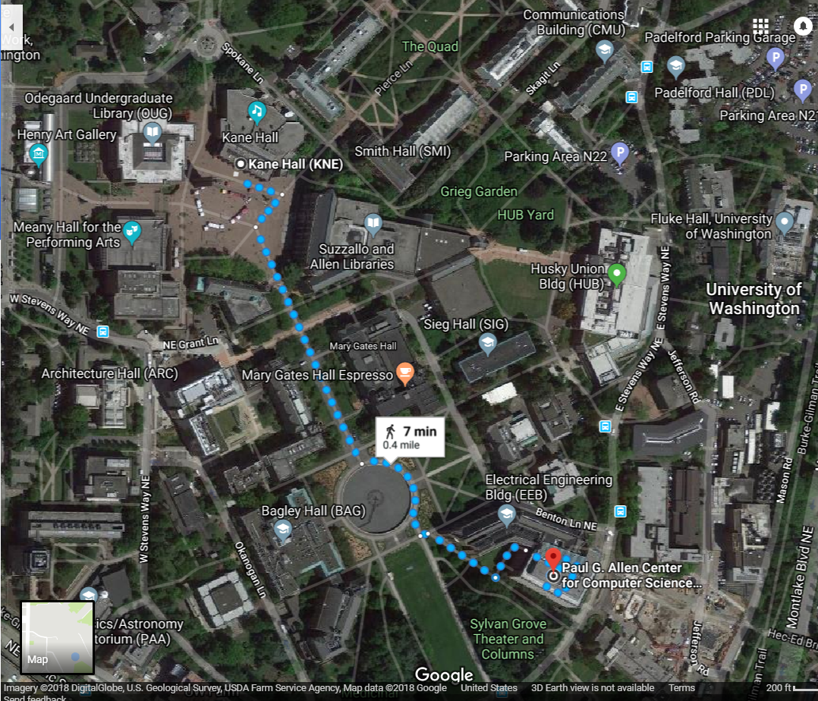
Shortest Paths
How does Google Maps figure out this is the fastest way to get from Kane Hall to CSE?

Slide 8
Representing Maps as Graphs
How do we represent a map as a graph? What are the vertices and edges?

Slide 9
Representing Maps as Graphs
K
2
1
R
2
S
H
4
4
5
D
3
P

Slide 10
Shortest Paths
The length of a path is the sum of the edge weights on that path.
Given a directed graph and vertices s and t
Find: the shortest path from s to t.
Shortest Path Problem
1
y
4
3
w
t
s
5
6
4
5
2
u
v
x
1

Slide 11
Shortest Paths
The length of a path is the sum of the edge weights on that path.
Given a directed graph and vertices s and t
Find: the shortest path from s to t.
Shortest Path Problem
1
y
4
3
w
t
s
5
6
4
5
2
u
v
x
1

Slide 12
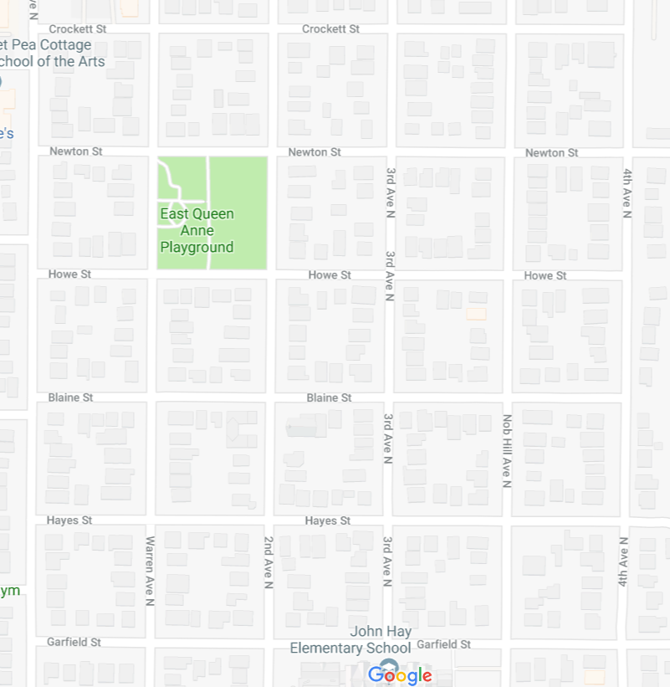
Unweighted Graphs
Let’s start with a simpler version: the edges are all the same weight
If the graph is unweighted, how do we find a shortest paths?
Notes:
9:38:30

Slide 13
Unweighted Graphs
If the graph is unweighted, how do we find a shortest paths?
u
w
s
y
t
v
x
What’s the shortest path from s to s?
Well….we’re already there.
What’s the shortest path from s to u or v?
Just go on the edge from s
From s to w,x, or y?
Can’t get there directly from s, for length 2 path, have to go through u or v.

Slide 14
Unweighted Graphs: Key Idea
To find the set of vertices at distance k, just find the set of vertices at distance k-1, and check for outgoing edge to an undiscovered vertex.
Do we already know an algorithm that does something like that?
Yes! BFS!
bfsShortestPaths(graph G, vertex source)
toVisit.enqueue(source)
source.dist = 0
mark source as visited
while(toVisit is not empty){
current = toVisit.dequeue()
for (v : current.outNeighbors()){
if (v is not yet visited){
v.distance = current.distance + 1
v.predecessor = current
toVisit.enqueue(v)
mark v as visited
}
}
}

Slide 15
Unweighted Graphs
Use BFS to find shortest paths in this graph.
u
w
bfsShortestPaths(graph G, vertex source)
toVisit.enqueue(source)
source.dist = 0
mark source as visited
while(toVisit is not empty){
current = toVisit.dequeue()
for (v : current.outNeighbors()){
if (v is not yet visited){
v.distance = current.distance + 1
v.predecessor = current
toVisit.enqueue(v)
mark v as visited
}
}
}
s
y
t
v
x

Slide 16
Unweighted Graphs
Use BFS to find shortest paths in this graph.
1
2
u
w
bfsShortestPaths(graph G, vertex source)
toVisit.enqueue(source)
source.dist = 0
mark source as visited
while(toVisit is not empty){
current = toVisit.dequeue()
for (v : current.outNeighbors()){
if (v is not yet visited){
v.distance = current.distance + 1
v.predecessor = current
toVisit.enqueue(v)
mark v as visited
}
}
}
2
s
y
t
3
v
x
1
2

Slide 17
What about the target vertex?
Given a directed graph and vertices s and t
Find: the shortest path from s to t.
Shortest Path Problem
BFS didn’t mention a target vertex…
It actually finds the shortest path from s to every other vertex.
If you know your target, you can stop the algorithm early, when the target is removed from the queue.
Notes:
9:48

Slide 18
Weighted Graphs
Each edge should represent the “time” or “distance” from one vertex to another.
Sometimes those aren’t uniform, so we put a weight on each edge to record that number.
The length (or “weight” or “cost”) of a path in a weighted graph is the sum of the weights along that path.
Notes:
9:50

Slide 19
Weighted Graphs: Take 1
BFS works if the graph is unweighted.
Maybe it just works for weighted graphs too?
1
1
w
x
1
s
u
v
t
20
1
1

Slide 20
Weighted Graphs: Take 1
BFS works if the graph is unweighted.
Maybe it just works for weighted graphs too?
$$∞$$
$$1$$
$$∞$$
1
$$2$$
1
w
x
1
s
u
v
t
0
20
$$∞$$
1
$$∞$$
1
$$∞$$
$$20$$
$$22$$
$$3$$
$$21$$
What went wrong?
When we found a shorter path from s to u,
we needed to update the distance to v
but BFS doesn’t do that.

Slide 21
Weighted Graphs: Take 2
So we can’t just do a reduction.
Instead figure out why BFS worked in the unweighted case, try to make the same thing happen in the weighted case.
How did we avoid this problem:
$$1$$
1
$$2$$
1
w
x
1
s
u
v
t
0
20
$$3$$
1
$$21$$
1
$$22$$
Notes:
10:01

Slide 22
Weighted Graphs: Take 2
In BFS When we used a vertex u to update shortest paths we already knew the exact shortest path to u.
So we never ran into the update problem
If we process the vertices in order of distance from s, we have a chance.

Slide 23
Weighted Graphs: Take 2
Goal: Process the vertices in order of distance from s
Idea:
Have a set of vertices that are “known”
(we know at least one path from s to them).
Record an estimated distance
(the best way we know to get to each vertex).
If we process only the vertex closest in estimated distance, we won’t ever find a shorter path to a processed vertex.
This statement is the key to proving correctness.
It’s nice if you want to practice induction/understand the algorithm better.

Slide 24
Dijkstra’s Algorithm
Vertex | Distance | Predecessor | Processed
s
w
x
u
v
t
Dijkstra(Graph G, Vertex source)
initialize distances to $∞$
mark source as distance 0
mark all vertices unprocessed
while(there are unprocessed vertices){
let u be the closest unprocessed vertex
foreach(edge (u,v) leaving u){
if(u.dist+weight(u,v) < v.dist){
v.dist = u.dist+weight(u,v)
v.predecessor = u
}
}
mark u as processed
}
1
1
w
x
1
s
u
v
t
20
1
1

Slide 25
Dijkstra’s Algorithm
Vertex | Distance | Predecessor | Processed
s | 0 | -- | Yes
w | 1 | s | Yes
x | 2 | w | Yes
u | 20 3 | s x | Yes
v | 4 | u | Yes
t | 5 | v | Yes
Dijkstra(Graph G, Vertex source)
initialize distances to $∞$
mark source as distance 0
mark all vertices unprocessed
while(there are unprocessed vertices){
let u be the closest unprocessed vertex
foreach(edge (u,v) leaving u){
if(u.dist+weight(u,v) < v.dist){
v.dist = u.dist+weight(u,v)
v.predecessor = u
}
}
mark u as processed
}
1
1
w
x
1
s
u
v
t
20
1
1

Slide 26
Implementation Details
One of those lines of pseudocode was a little sketchy
> let u be the closest unprocessed vertex
What ADT have we talked about that might work here?
Minimum Priority Queues!
Notes:
10:06

Slide 27
Making Minimum Priority Queues Work
Min Priority Queue ADT
They won’t quite work “out of the box”.
We need the “updatePriority” method, which means we need the KeyToIndex dictionary (like Ex 2).
We’ll ignore the updates to the dictionary, but it’ll be in that method.
state
Set of comparable values
- Ordered by “priority”
behavior
peek() – find the element with the smallest priority
insert(value) – add new element to collection
removeMin() – returns and removes element with the smallest priority
DecreaseKey(e, p) – decreases priority of element e down to p.

Slide 28
Running Time Analysis
Dijkstra(Graph G, Vertex source)
initialize distances to $∞$, source.dist to 0
mark all vertices unprocessed
initialize MPQ as a Min Priority Queue
add source at priority 0
while(MPQ is not empty){
u = MPQ.removeMin()
foreach(edge (u,v) leaving u){
if(u.dist+weight(u,v) < v.dist){
if(v.dist == $∞$ ) //if v not in MPQ
MPQ.insert(v, u.dist+weight(u,v))
else
MPQ.decreaseKey(v, u.dist+weight(u,v))
v.dist = u.dist+weight(u,v)
v.predecessor = u
}
}
mark u as processed
}

Slide 29
Negative Edge Weights

Slide 30
Negative Edge Weights
What’s the shortest way to get from s to t?
3
u
-5
s
2
t
w
v
-2
2
s, u,v,w, u,v,w, u,v,w, …
There is no shortest way. You can always go around u,v,w once more.
If there’s a negative weight cycle shortest paths are undefined.
Undefined means “there is no correct answer” (or “$−∞$ is the closest thing to a correct answer”)

Slide 31
Negative Edge Weights
If there are negative edge weights, but no negative weight cycle, shortest paths are still defined.
For today we’ll assume all of the weights are positive
For GoogleMaps that definitely makes sense.
Sometimes negative weights make sense.
Dijkstra’s algorithm doesn’t work for those graphs
There are other algorithms that do work (ask Robbie later)

Slide 32
One more Graph Algorithm

Slide 33
Ordering Dependencies
Today’s next problem: Given a bunch of courses with prerequisites, find an order to take the courses in.
Math 126
CSE 331
CSE 143
CSE 142
CSE 311
CSE 332

Slide 34
Ordering Dependencies
Given a directed graph G, where we have an edge from u to v if u must happen before v.
Can we find an order that respects dependencies?
Given: a directed graph G
Find: an ordering of the vertices so all edges go from left to right.
Topological Sort (aka Topological Ordering)
Uses:
Compiling multiple files
Graduating.

Slide 35
Topological Ordering
A course prerequisite chart and a possible topological ordering.
Math 126
CSE 331
CSE 143
CSE 142
CSE 311
CSE 332
Math 126
CSE 142
CSE 143
CSE 311
CSE 331
CSE 332

Slide 36
Can we always order a graph?
Can you topologically order this graph?
A
B
C
Directed Acyclic Graph (DAG)
A directed graph without any cycles.
A graph has a topological ordering if and only if it is a DAG.
Notes:
3:00

Slide 37
Ordering a DAG
Does this graph have a topological ordering? If so find one.
A
C
D
B
E

Slide 38
Ordering a DAG
Does this graph have a topological ordering? If so find one.
A
C
D
B
E
If a vertex doesn’t have any edges going into it, we can add it to the ordering.
More generally, if the only incoming edges are from vertices already in the ordering, it’s safe to add.

Slide 39
How Do We Find a Topological Ordering?
TopologicalSort(Graph G, Vertex source)
count how many incoming edges each vertex has
Collection toProcess = new Collection()
foreach(Vertex v in G){
if(v.edgesRemaining == 0)
toProcess.insert(v)
}
topOrder = new List()
while(toProcess is not empty){
u = toProcess.remove()
topOrder.insert(u)
foreach(edge (u,v) leaving u){
v.edgesRemaining--
if(v.edgesRemaining == 0)
toProcess.insert(v)
}
}

Slide 40
What’s the running time?
TopologicalSort(Graph G, Vertex source)
count how many incoming edges each vertex has
Collection toProcess = new Collection()
foreach(Vertex v in G){
if(v.edgesRemaining == 0)
toProcess.insert(v)
}
topOrder = new List()
while(toProcess is not empty){
u = toProcess.remove()
topOrder.insert(u)
foreach(edge (u,v) leaving u){
v.edgesRemaining--
if(v.edgesRemaining == 0)
toProcess.insert(v)
}
}
Running Time: $O(\left|V\right|+\left|E\right|)$

Slide 41
Finding a Topological Ordering
Instead of counting incoming edges, you can actually modify DFS to find you one (think about why).
But the “count incoming edges” is a bit easier to understand (for me ☺ )

Slide 42
More Graph Applications

Slide 43
Another Application of Shortest Paths
Shortest path algorithms are obviously useful for GoogleMaps.
The wonderful thing about graphs is they can encode arbitrary relationships among objects.
I don’t care if you remember all the details.
I just want you to see that these algorithms have non-obvious applications.
Notes:
Need 7 minutes.

Slide 44
Another Application of Shortest Paths
I have a message I need to get from point s to point t.
But the connections are unreliable.
What path should I send the message along so it has the best chance of arriving?
u
0.8
0.7
s
t
0.6
0.2
0.97
v
Given: a directed graph G, where each edge weight is the probability of successfully transmitting a message across that edge
Find: the path from s to t with maximum probability of message transmission
Maximum Probability Path

Slide 45
Another Application of Shortest Paths
Let each edge’s weight be the probability a message is sent successfully across the edge.
What’s the probability we get our message all the way across a path?
It’s the product of the edge weights.
We only know how to handle sums of edge weights.
Is there a way to turn products into sums?
$\log\left(ab\right)=\log{a+\log{b}}$
u
0.8
0.7
s
t
0.6
0.2
0.97
v

Slide 46
Another Application of Shortest Paths
u
-0.32
-0.51
s
t
-0.74
-2.32
-0.04
We’ve still got two problems.
1. When we take logs, our edge weights become negative.
2. We want the maximum probability of success, but that’s the longest path not the shortest one.
Multiplying all edge weights by negative one fixes both problems at once!
We reduced the maximum probability path problem to a shortest path problem by taking $−\log{()}$ of each edge weight.
v

Slide 47
Maximum Probability Path Reduction
Transform Input
u
u
0.8
0.7
0.32
0.51
s
t
s
0.74
t
0.6
0.2
0.97
2.32
0.04
v
v
Weighted Shortest Paths
u
0.32
0.51
s
0.74
t
2.32
0.04
Transform Output
u
v
0.8
0.7
s
0.6
t
0.2
0.97
v

Slide 48
Breadth First Search
search(graph)
toVisit.enqueue(first vertex)
mark first vertex as visited
while(toVisit is not empty)
current = toVisit.dequeue()
for (V : current.neighbors())
if (v is not visited)
toVisit.enqueue(v)
mark v as visited
finished.add(current)
F
J
G
D
A
I
H
E
B
C
H
Current node:
Queue:
Finished:
I
A
E
D
B
G
F
C
G
B
D
E
C
F
G
H
I
A
B
D
E
C
F
G
H
I

