Slide 1
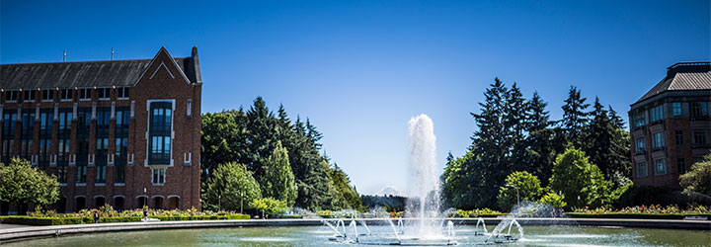
Graph Search
CSE 332 Spring 25
Lecture 16

Slide 2
What do we do with graphs
So many things!
That’s why we said graphs are more general than a single ADT---they don’t have a standard set of operations.
As a starting point---how could we process the entire graph? Examine every vertex and every edge?
Called a “search” of the graph or a “traversal”
Two algorithms (with different purposes)

Slide 3
BFS
Start somewhere…
For every vertex (in some order)
Do whatever you want on that vertex
Sometimes, record some information, store something in there, etc.
At least, we’ll mark it as having been “visited”
You need to process all of its neighbors…store them in some data structure to process them. Then back to the top of the loop.
If you use a Queue for your storage structure, you get BFS.

Slide 4
Breadth First Search
search(graph)
toVisit.enqueue(first vertex)
mark first vertex as visited
while(toVisit is not empty)
current = toVisit.dequeue()
for (V : current.neighbors())
if (v is not visited)
toVisit.enqueue(v)
mark v as visited
finished.add(current)
F
J
G
D
A
I
H
E
B
C
H
Current node:
Queue:
Finished:
I
A
E
D
B
G
F
C
G
B
D
E
C
F
G
H
I
A
B
D
E
C
F
G
H
I

Slide 5
Breadth First Search
search(graph)
toVisit.enqueue(first vertex)
mark first vertex as visited
while(toVisit is not empty)
current = toVisit.dequeue()
for (V : current.neighbors())
if (v is not visited)
toVisit.enqueue(v)
mark v as visited
finished.add(current)
F
J
G
D
A
I
H
E
B
C
What’s the running time of this algorithm?
We visit each vertex at most twice, and each edge at most once: $O(|V| + |E|)$

Slide 6
Depth First Search (DFS)
BFS uses a queue to order which vertex we move to next
Gives us a growing “frontier” movement across graph
Can you move in a different pattern? What if you used a stack instead?
bfs(graph)
toVisit.enqueue(first vertex)
mark first vertex as visited
while(toVisit is not empty)
current = toVisit.dequeue()
for (V : current.neighbors())
if (v is not visited)
toVisit.enqueue(v)
mark v as visited
finished.add(current)
dfs(graph, curr)
mark curr as visited
for(v : curr.neighbors()){
if(v is not visited){
dfs(graph, v)
}
}
mark curr as “done”

Slide 7
Depth First Search
dfs(graph, curr)
mark curr as visited
for(v : curr.neighbors()){
if(v is not visited){
dfs(graph, v)
}
}
mark curr as “done”
F
J
G
D
F
A
G
D;(D,F)
H;(H,G)
H
E
E;(E,H)
B
E;(E,D)
C;(C,E)
Finished:
C
B;(B,C)
F
G
H
C
A
D
E
B
Stack
A; (A,B)

Slide 8
DFS
Running time?
Same as BFS: $Θ(\left|V\right|+\left|E\right|)$ (i.e., $Θ(n+m)$)
You can rewrite DFS to be an iterative method (that explicitly uses a stack data structure). Use that in place of the call stack.
Getting the details right is actually pretty annoying/subtle.
Next: Using BFS, DFS and other algorithms to solve problems!
Notes:
Point out the importance of returning visited and re-assigning it after each call

Slide 9
DFS for applications
Applications for DFS (and BFS) are often:
Run [D/B]FS, and do some extra bookkeeping.
Many applications work (easily) with only one ordering.
For DFS, it’s common to classify based on “start” and “finish” times
When vertices go on the (call) stack, and when they come off.

Slide 10
Depth First Search
(A,B), (B,C), (C,E) cause a new vertex to go on the stack.
(E,B) goes “back” to an edge that’s already on the stack, but not finished.
dfs(graph, curr)
mark curr as visited
record curr.start
for(v : curr.neighbors()){
if(v is not visited){
dfs(graph, v)
}
}
mark curr as “done”
record curr.end
F
10
11
6
7
5
8
J
1
16
G
D
F
A
G
D;(D,F)
H;(H,G)
H
2
15
E
9
E;(E,H)
12
4
B
E;(E,D)
13
C;(C,E)
Finished:
C
3
14
B;(B,C)
F
G
H
C
A
D
E
B
Stack
A; (A,B)

Slide 11
What do we use DFS for?
DFS can be used to detect cycles
How? What happened when we went around a cycle---we had an edge “back” to a vertex we’d discovered already (but that we hadn’t finished processing).
What happened between “steps” 4 and 5?

Slide 12
Depth First Search
(A,B), (B,C), (C,E) cause a new vertex to go on the stack.
(E,B) goes “back” to an edge that’s already on the stack, but not finished.
dfs(graph, curr)
mark curr as visited
record curr.start
for(v : curr.neighbors()){
if(v is not visited){
dfs(graph, v)
}
}
mark curr as “done”
record curr.end
F
1
J
G
D
F
A
G
D;(D,F)
H;(H,G)
H
2
E
E;(E,H)
4
B
E;(E,D)
C;(C,E)
Finished:
C
3
B;(B,C)
F
G
H
C
A
D
E
B
Stack
A; (A,B)

Slide 13
What do we use DFS for?
DFS can be used to detect cycles
How? What happened when we went around a cycle---we had an edge “back” to a vertex we’d discovered already (but that we hadn’t finished processing).
The details are different depending on if your graph is directed or undirected. Your exercise will use directed graphs, so let’s look at that.

Slide 14
Edge Classification (DFS,directed graphs)
Edge type | Definition | When is $(u,v)$ that edge type?
Tree | Edges forming the DFS tree (or forest). | $v$ was not seen before we processed $\left(u,v\right).$
Forward | From ancestor to descendant in tree. | $u$and $v$ have been seen, and u.start < v.start < v.end < u.end
Back | From descendant to ancestor in tree. | $u$and $v$ have been seen, and v.start < u.start < u.end < v.end
Cross | Edges going between vertices without an ancestor relationship. | $u$ and $v$ have not been seen, and v.start < v.end < u.start < u.end
Notes:
The third column doesn’t look like it encompasses all possibilities.
It does – the fact that we’re using a stack limits the possibilities:
e.g. u.start < v.start < u.end < v.end is impossible.
And the rules of the algorithm eliminate some other possibilities.

Slide 15
Try it Yourselves!
DFSWrapper(G)
counter = 0
For each vertex u of G
If u is not “seen”
DFS(u)
End If
End For
1
12
A
back
2
B
C
7
8
11
forward
4
5
3
10
D
cross
DFS(u)
Mark u as “seen”
u.start = counter++
For each edge (u,v) //leaving u
If v is not “seen”
DFS(v)
End If
End For
u.end = counter++
F
E
6
9

Slide 16
Try it Yourselves!
Type | Definition | When is $(u,v)$ that edge type?
Tree | Edges forming the DFS tree (or forest). | $v$ was not seen before we processed $\left(u,v\right).$
Forward | From ancestor to descendant in tree. | $u$and $v$ have been seen, and u.start < v.start < v.end < u.end
Back | From descendant to ancestor in tree. | $u$and $v$ have been seen, and v.start < u.start < u.end < v.end
Cross | Edges going between vertices without an ancestor relationship. | $u$ and $v$ have not been seen, and v.start < v.end < u.start < u.end
DFSWrapper(G)
counter = 0
For each vertex u of G
If u is not “seen”
DFS(u)
End If
End For
A
DFS(u)
Mark u as “seen”
u.start = counter++
For each edge (u,v) //leaving u
If v is not “seen”
DFS(v)
End If
End For
u.end = counter++
B
C
D
F
E

Slide 17
Another Search Application

Slide 18
Breadth First Search
search(graph)
toVisit.enqueue(first vertex)
mark first vertex as visited
while(toVisit is not empty)
current = toVisit.dequeue()
for (V : current.neighbors())
if (v is not visited)
toVisit.enqueue(v)
mark v as visited
finished.add(current)
F
J
G
D
A
I
H
E
B
C
What’s the running time of this algorithm?
We visit each vertex at most twice, and each edge at most once: $O(|V| + |E|)$

Slide 19
Extra Practice
Run Breadth First Search on this graph starting from s.
What order are vertices placed on the queue?
When processing a vertex insert neighbors in alphabetical order.
In a directed graph, BFS only follows an edge in the direction it points.
x
bfs(graph)
toVisit.enqueue(first vertex)
mark first vertex as visited
while(toVisit is not empty)
current = toVisit.dequeue()
for (V : current.outneighbors())
if (v is not visited)
toVisit.enqueue(v)
mark v as visited
finished.add(current)
u
s
t
v
y
w
Notes:
9:22

Slide 20
Extra Practice
Run Breadth First Search on this graph starting from s.
What order are vertices placed on the queue?
When processing a vertex insert neighbors in alphabetical order.
In a directed graph, BFS only follows an edge in the direction it points.
x
bfs(graph)
toVisit.enqueue(first vertex)
mark first vertex as visited
while(toVisit is not empty)
current = toVisit.dequeue()
for (V : current.outneighbors())
if (v is not visited)
toVisit.enqueue(v)
mark v as visited
finished.add(current)
u
s
t
v
y
Correct order: s,u,v,y,x,w,t
w
Notes:
9:22

Slide 21
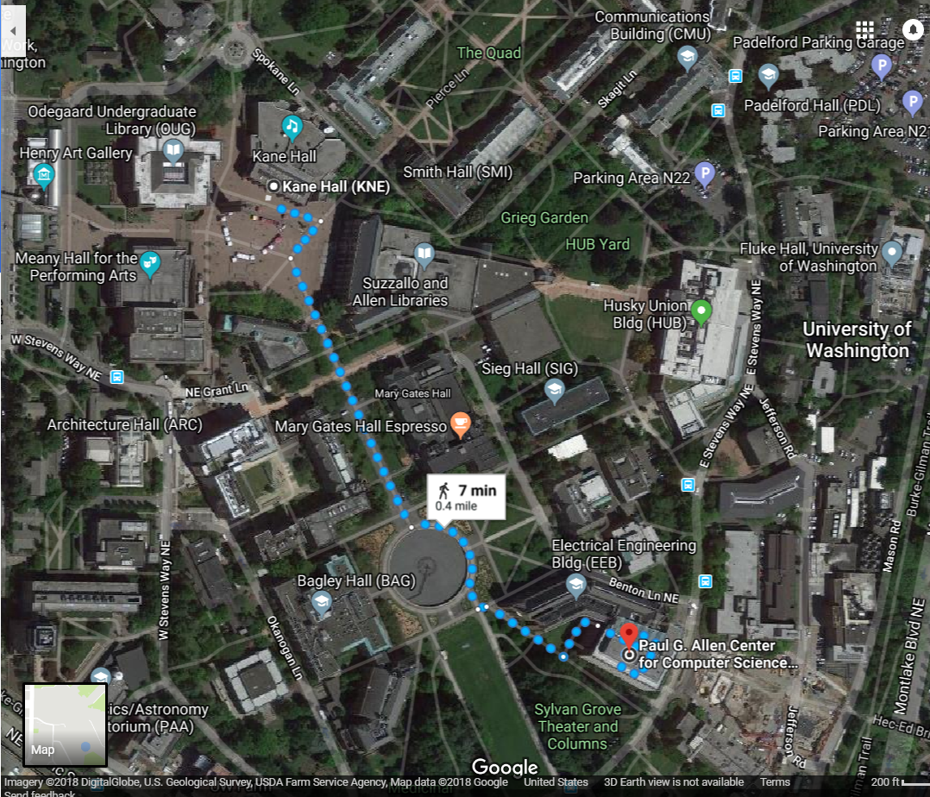
Shortest Paths
How does Google Maps figure out this is the fastest way to get from Kane Hall to CSE?

Slide 22
Representing Maps as Graphs
How do we represent a map as a graph? What are the vertices and edges?

Slide 23
Representing Maps as Graphs
K
2
1
R
2
S
H
4
4
5
D
3
P

Slide 24
Shortest Paths
The length of a path is the sum of the edge weights on that path.
Given a directed graph and vertices s and t
Find: the shortest path from s to t.
Shortest Path Problem
1
y
4
3
w
t
s
5
6
4
5
2
u
v
x
1
Notes:
Some resources say “cost” to differentiate from “number of edges”

Slide 25
Shortest Paths
The length of a path is the sum of the edge weights on that path.
Given a directed graph and vertices s and t
Find: the shortest path from s to t.
Shortest Path Problem
1
y
4
3
w
t
s
5
6
4
5
2
u
v
x
1

Slide 26
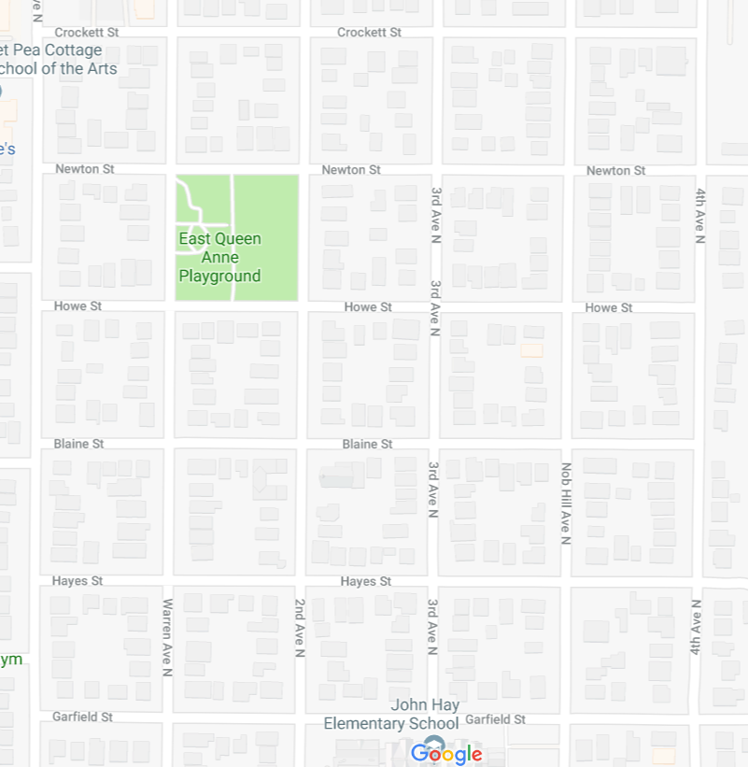
Unweighted Graphs
Let’s start with a simpler version: the edges are all the same weight
If the graph is unweighted, how do we find a shortest paths?
Notes:
9:38:30

Slide 27
Unweighted Graphs
If the graph is unweighted, how do we find a shortest paths?
u
w
s
y
t
v
x
What’s the shortest path from s to s?
Well….we’re already there.
What’s the shortest path from s to u or v?
Just go on the edge from s
From s to w,x, or y?
Can’t get there directly from s, for length 2 path, have to go through u or v.

Slide 28
Unweighted Graphs: Key Idea
To find the set of vertices at distance k, just find the set of vertices at distance k-1, and check for outgoing edge to an undiscovered vertex.
Do we already know an algorithm that does something like that?
Yes! BFS!
bfsShortestPaths(graph G, vertex source)
toVisit.enqueue(source)
source.dist = 0
mark source as visited
while(toVisit is not empty){
current = toVisit.dequeue()
for (v : current.outNeighbors()){
if (v is not yet visited){
v.distance = current.distance + 1
v.predecessor = current
toVisit.enqueue(v)
mark v as visited
}
}
}

Slide 29
Unweighted Graphs
Use BFS to find shortest paths in this graph.
u
w
bfsShortestPaths(graph G, vertex source)
toVisit.enqueue(source)
source.dist = 0
mark source as visited
while(toVisit is not empty){
current = toVisit.dequeue()
for (v : current.outNeighbors()){
if (v is not yet visited){
v.distance = current.distance + 1
v.predecessor = current
toVisit.enqueue(v)
mark v as visited
}
}
}
s
y
t
v
x

Slide 30
Unweighted Graphs
Use BFS to find shortest paths in this graph.
1
2
u
w
bfsShortestPaths(graph G, vertex source)
toVisit.enqueue(source)
source.dist = 0
mark source as visited
while(toVisit is not empty){
current = toVisit.dequeue()
for (v : current.outNeighbors()){
if (v is not yet visited){
v.distance = current.distance + 1
v.predecessor = current
toVisit.enqueue(v)
mark v as visited
}
}
}
2
s
y
t
3
v
x
1
2

Slide 31
What about the target vertex?
Given a directed graph and vertices s and t
Find: the shortest path from s to t.
Shortest Path Problem
BFS didn’t mention a target vertex…
It actually finds the shortest path from s to every other vertex.
If you know your target, you can stop the algorithm early, when the target is removed from the queue.
Notes:
9:48

Slide 32
One more Graph Algorithm

Slide 33
Problem 1: Ordering Dependencies
Today’s next problem: Given a bunch of courses with prerequisites, find an order to take the courses in.
Math 126
CSE 331
CSE 143
CSE 142
CSE 311
CSE 332

Slide 34
Problem 1: Ordering Dependencies
Given a directed graph G, where we have an edge from u to v if u must happen before v.
Can we find an order that respects dependencies?
Given: a directed graph G
Find: an ordering of the vertices so all edges go from left to right.
Topological Sort (aka Topological Ordering)
Uses:
Compiling multiple files
Graduating.

Slide 35
Topological Ordering
A course prerequisite chart and a possible topological ordering.
Math 126
CSE 331
CSE 143
CSE 142
CSE 311
CSE 332
Math 126
CSE 142
CSE 143
CSE 311
CSE 331
CSE 332

Slide 36
Can we always order a graph?
Can you topologically order this graph?
A
B
C
Directed Acyclic Graph (DAG)
A directed graph without any cycles.
A graph has a topological ordering if and only if it is a DAG.
Notes:
3:00

Slide 37
Ordering a DAG
Does this graph have a topological ordering? If so find one.
A
C
D
B
E

Slide 38
Ordering a DAG
Does this graph have a topological ordering? If so find one.
A
C
D
B
E
If a vertex doesn’t have any edges going into it, we can add it to the ordering.
More generally, if the only incoming edges are from vertices already in the ordering, it’s safe to add.

Slide 39
How Do We Find a Topological Ordering?
TopologicalSort(Graph G, Vertex source)
count how many incoming edges each vertex has
Collection toProcess = new Collection()
foreach(Vertex v in G){
if(v.edgesRemaining == 0)
toProcess.insert(v)
}
topOrder = new List()
while(toProcess is not empty){
u = toProcess.remove()
topOrder.insert(u)
foreach(edge (u,v) leaving u){
v.edgesRemaining--
if(v.edgesRemaining == 0)
toProcess.insert(v)
}
}

Slide 40
What’s the running time?
TopologicalSort(Graph G, Vertex source)
count how many incoming edges each vertex has
Collection toProcess = new Collection()
foreach(Vertex v in G){
if(v.edgesRemaining == 0)
toProcess.insert(v)
}
topOrder = new List()
while(toProcess is not empty){
u = toProcess.remove()
topOrder.insert(u)
foreach(edge (u,v) leaving u){
v.edgesRemaining--
if(v.edgesRemaining == 0)
toProcess.insert(v)
}
}
Running Time: $O(\left|V\right|+\left|E\right|)$

Slide 41
Finding a Topological Ordering
Instead of counting incoming edges, you can actually modify DFS to find you one (think about why).
But the “count incoming edges” is a bit easier to understand (for me ☺ )

Slide 42
What we’ve seen so far
Either BFS or DFS traverse a graph (if you’re careful about disconnected graphs).
BFS goes steadily through the graph
Useful for computing shortest paths in unweighted graphs
DFS explores deep into the graph as long as the thing is new
Useful for finding cycles
And for other applications…
Next time: Another algorithm for finding shortest paths, but when you have a weighted graph.

