Slide 1
Graphs
CSE 332 Spring 2025
Lecture 15

Slide 2
Announcements
 | Monday | Tuesday | Wednesday | Thursday | Friday
This Week |  |  | MIDTERM :O |  | Ex 5 due Ex 6 out
Next Week | TODAY Ex 7 out |  |  |  | Ex 6 due Ex 8 out
Extra video coming soon on those two sorts we skipped.
See the extra slides (linked in the spec) for more details on Ex 7.

Slide 3
ADTs so far
We’ve seen:
Queues and Stacks
Our data points have some order we’re maintaining
Priority Queues
Our data had some priority we needed to keep track of.
Dictionaries
Our data points came as (key, value) pairs.

Slide 4
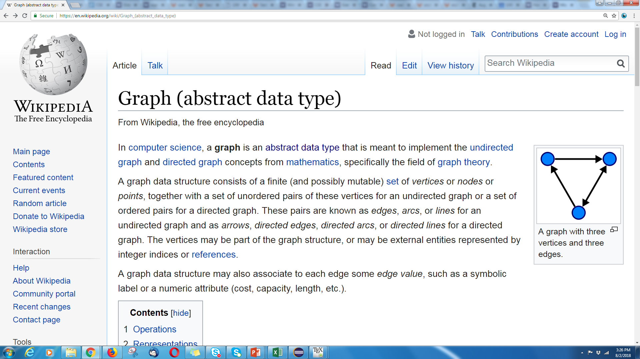
Graphs
Graphs are too versatile to think of them as only one ADT!

Slide 5
Graphs
Represent data points and the relationships between them.
That’s vague.
Formally:
A graph is a pair: G = (V,E)
V: set of vertices (aka nodes)
E: set of edges
Each edge is a pair of vertices.
B
D
A
C
$$\{A,B,C,D\}$$
$$\{(A,B), (B,C), (B,D), (C,D)\}$$

Slide 6
Making Graphs
If your problem has data and relationships, you might want to represent it as a graph
How do you choose a representation?
Usually:
Think about what your “fundamental” objects are
Those become your vertices.
Then think about how they’re related
Those become your edges.

Slide 7
Some examples
For each of the following think about what you should choose for vertices and edges.
The internet.
Facebook friendships
Input data for the “6 degrees of Kevin Bacon” game
Course Prerequisites

Slide 8
Some examples
For each of the following think about what you should choose for vertices and edges.
The internet.
Vertices: webpages. Edges from a to b if a has a hyperlink to b.
Facebook friendships
Vertices: people. Edges: if two people are friends
Input data for the “6 Degrees of Kevin Bacon” game
Vertices: actors. Edges: if two people appeared in the same movie
Or: Vertices for actors and movies, edge from actors to movies they appeared in.
Course Prerequisites
Vertices: courses. Edge: from a to b if a is a prereq for b.

Slide 9
More Graphs
We’ve already used graphs to represent things in this course:
A LOT

Slide 10
Solving Recurrences III
$$5 when n≤4$$
$$T\left(n\right)=$$
$$3T\left(\frac{n}{4}\right)+cn^{2} otherwise$$
$$cn^{2}$$
$$cn^{2}$$
Graph.
Answer the following questions:
What is input size on level $i$?
Number of nodes at level $i$?
Work done at recursive level $i$?
Last level of tree?
Work done at base case?
What is sum over all levels?
$$c{\left(\frac{n}{4}\right)}^{2}$$
$$c{\left(\frac{n}{4}\right)}^{2}$$
$$c{\left(\frac{n}{4}\right)}^{2}$$
$$c{\left(\frac{n}{4}\right)}^{2}$$
$$c{\left(\frac{n}{4}\right)}^{2}$$
$$c{\left(\frac{n}{4}\right)}^{2}$$
$$c{\left(\frac{n}{16}\right)}^{2}$$
$$c{\left(\frac{n}{16}\right)}^{2}$$
$$c{\left(\frac{n}{16}\right)}^{2}$$
$$c{\left(\frac{n}{16}\right)}^{2}$$
$$c{\left(\frac{n}{16}\right)}^{2}$$
$$c{\left(\frac{n}{16}\right)}^{2}$$
$$c{\left(\frac{n}{16}\right)}^{2}$$
$$c{\left(\frac{n}{16}\right)}^{2}$$
$$c{\left(\frac{n}{16}\right)}^{2}$$
…
…
…
…
…
…
…
…
…
…
…
…
…
…
…
…
…
…
…
…
…
…
…
…
…
…
…
5
5
5
5
5
5
5
5
5
5
5
5
5
5
5
5
5
5
5
5
5
5
5
5
5
5
5

Slide 11
BuildHeap: Only One Possibility
But StartBottom() seems to work.
Does it always work?
Graph.
1
7
3
8
1
7
6
7
3
2
1
3
4
1
6
8
2
7

Slide 12
Are These AVL Trees?
6
4
Graph.
3
7
3
7
2
9
2
9
4
6
5
8
10
8
10
5

Slide 13
a<b<c; a<c<b; b<a<c;
b<c<a; c<b<a; c<a<b
Graph.
Ask: is
a < b?
a<b<c; a<c<b; c<a<b
b<a<c; b<c<a; c<b<a
Ask: is
b<c?
Ask: is
a<c?
a<b<c
a<c<b; c<a<b
b<a<c
b<c<a; c<b<a
Ask: is
a<c?
Ask: is
b<c?
a<c<b
c<a<b
b<c<a
c<b<a

Slide 14
More Graphs
EVERYTHING was graphs.
The whole time.
They don’t just show up in data structures.
311: NFAs/DFAs and relations Compilers: Use graphs to figure out valid compilation orders.
Networking: Building a graph
To the point that some CS people call graphs “networks”
Circuits: represented as graphs

Slide 15
Some examples
For each of the following think about what you should choose for vertices and edges.
The internet.
Facebook friendships
Input data for the “6 Degrees of Kevin Bacon” game
Course Prerequisites

Slide 16
Some examples
For each of the following think about what you should choose for vertices and edges.
The internet.
Vertices: webpages. Edges from a to b if a has a hyperlink to b.
Facebook friendships
Vertices: people. Edges: if two people are friends
Input data for the “6 Degrees of Kevin Bacon” game
Vertices: actors. Edges: if two people appeared in the same movie
Or: Vertices for actors and movies, edge from actors to movies they appeared in.
Course Prerequisites
Vertices: courses. Edge: from a to b if a is a prereq for b.
Edges have direction
Edges don’t have direction
Edges have direction

Slide 17
Graph Terms
This graph is disconnected.
Graphs can be directed or undirected.
Degree: 1
Following on twitter.
Dan
Dan
Outdegree: 2
Robbie
Robbie
Degree: 0
Indegree: 1
Friendships on Facebook.

Slide 18
Graph Terms
Path – A sequence of adjacent vertices. Each connected to next by an edge.
(Directed) Path–must follow the direction of the edges
Length – The number of edges in a path
- (A,B,C,D) has length 3.
A,B,C,D is a path.
So is A,B,A
A
B
C
D
A
B
C
D
A,B,C,D,A is a directed path.
A,B,A is not.
Notes:
Terminology here varies by source. This is what the textbook uses – some people use walk instead of path’ and reserve path for what we called a simple path.

Slide 19
Graph Terms
Simple Path –path that doesn’t repeat a vertex. A,B,C,D is a simple path.
Simple Cycle – simple path with an extra edge from last vertex to first.
Be careful looking at other sources.
Some people call our “paths” “walks” and our “simple paths” “paths”
Use the definitions on these slides.
A
B
C
D
A,B,A is not.
A
B
C
D
Notes:
Terminology here varies by source. This is what the textbook uses – some people use walk instead of path’ and reserve path for what we called a simple path.

Slide 20
Representing and Using Graphs

Slide 21
Adjacency Matrix
4
0
1
5
6
2
3
In an adjacency matrix a[u][v] is 1 if there is an edge (u,v), and 0 otherwise.
Time Complexity (|V| = n, |E| = m):
Add Edge:
Remove Edge:
Check edge exists from (u,v):
Get neighbors of u (out):
Get neighbors of u (in):
Space Complexity:
 | 0 | 1 | 2 | 3 | 4 | 5 | 6
0 | 0 | 1 | 1 | 0 | 0 | 0 | 0
1 | 1 | 0 | 0 | 1 | 0 | 0 | 0
2 | 1 | 0 | 0 | 1 | 0 | 0 | 0
3 | 0 | 1 | 1 | 0 | 0 | 1 | 0
4 | 0 | 0 | 0 | 0 | 0 | 1 | 0
5 | 0 | 0 | 0 | 1 | 1 | 0 | 0
6 | 0 | 0 | 0 | 0 | 0 | 0 | 0
O(1)
O(1)
O(1)
O(n)
O(n)
$$O(n^{2})$$
Notes:
It is usual to write |V| = n and |E| = m, though sometimes we’ll abuse notation and just use V and E.

Slide 22
Adjacency List
0
1
4
5
6
2
3
An array where the u’th element contains a list of neighbors of u.
Directed graphs: put the out neighbors (a[u] has v for all (u,v) in E)
Time Complexity (|V| = n, |E| = m):
Add Edge:
Remove Edge:
Check edge exists from (u,v):
Get neighbors of u (out):
Get neighbors of u (in):
Space Complexity:
0
1
2
3
4
5
6
1 → 2
0 → 3
0 → 3
O(1)
1 → 2 → 5
5
O( d )
3 → 4
O( d )
O(d)
O(n + m)
Suppose we use a linked list for each node.
O(n + m)

Slide 23
Adjacency List
0
1
4
5
6
2
3
An array where the u’th element contains a list of neighbors of u.
Directed graphs: put the out neighbors (a[u] has v for all (u,v) in E)
Time Complexity (|V| = n, |E| = m):
Add Edge:
Remove Edge:
Check edge exists from (u,v):
Get neighbors of u (out):
Get neighbors of u (in):
Space Complexity:
0
1
2
3
4
5
6
1 → 2
0 → 3
0 → 3
O(1)
1 → 2 → 5
5
O( 1 )
3 → 4
O( 1 )
O(n)
Switch the linked lists to hash tables, and do average case analysis.
O(n)
O(n + m)

Slide 24
Which do we use?
If your graph is dense (Close to $n^{2}$ edges) or the graph is changing a lot, the adjacency matrix is usually the better choice.
Otherwise, adjacency list is the default choice:
Memory savings are huge for the majority of “real world” graphs
Most graphs are “sparse” ($O(n)$ edges), think about a map (vertices are intersections, edges are roads; most vertices touch 4 roads, not all of them).
The running times look worse, but…
If you make the graph class, you can just call the vertices 0,1,2,…n-1, which mitigates bad hashing concerns if you use that approach.
Most graph algorithms don’t actually use “is edge (a,b) there?” frequently; “iterate over all the edges” is much more common, which linked list does in O(1) time.

Slide 25
Which do we use?
Unless otherwise noted, assume we are using adjacency list.
For the problems in this class, it’s usually best to design assuming the operation you need will turn out to be constant time…and then check at the end which data structures will let you do that.

Slide 26
Graph Search

Slide 27
What do we do with graphs
So many things!
That’s why we said graphs are more general than a single ADT---they don’t have a standard set of operations.
As a starting point---how could we process the entire graph? Examine every vertex and every edge?
Called a “search” of the graph or a “traversal”
Two algorithms (with different purposes)

Slide 28
BFS
Start somewhere…
For every vertex (in some order)
Do whatever you want on that vertex
Sometimes, record some information, store something in there, etc.
At least, we’ll mark it as having been “visited”
You need to process all of its neighbors…store them in some data structure to process them. Then back to the top of the loop.
If you use a Queue for your storage structure, you get BFS.

Slide 29
Breadth First Search
search(graph)
toVisit.enqueue(first vertex)
mark first vertex as visited
while(toVisit is not empty)
current = toVisit.dequeue()
for (V : current.neighbors())
if (v is not visited)
toVisit.enqueue(v)
mark v as visited
finished.add(current)
F
J
G
D
A
I
H
E
B
C
H
Current node:
Queue:
Finished:
I
A
E
D
B
G
F
C
G
B
D
E
C
F
G
H
I
A
B
D
E
C
F
G
H
I

Slide 30
Breadth First Search
search(graph)
toVisit.enqueue(first vertex)
mark first vertex as visited
while(toVisit is not empty)
current = toVisit.dequeue()
for (V : current.neighbors())
if (v is not visited)
toVisit.enqueue(v)
mark v as visited
finished.add(current)
F
J
G
D
A
I
H
E
B
C
What’s the running time of this algorithm?
We visit each vertex at most twice, and each edge at most once: $O(|V| + |E|)$

Slide 31
Depth First Search (DFS)
BFS uses a queue to order which vertex we move to next
Gives us a growing “frontier” movement across graph
Can you move in a different pattern? What if you used a stack instead?
bfs(graph)
toVisit.enqueue(first vertex)
mark first vertex as visited
while(toVisit is not empty)
current = toVisit.dequeue()
for (V : current.neighbors())
if (v is not visited)
toVisit.enqueue(v)
mark v as visited
finished.add(current)
dfs(graph, curr)
mark curr as visited
for(v : curr.neighbors()){
if(v is not visited){
dfs(graph, v)
}
}
mark curr as “done”

Slide 32
Depth First Search
dfs(graph, curr)
mark curr as visited
for(v : curr.neighbors()){
if(v is not visited){
dfs(graph, v)
}
}
mark curr as “done”
F
J
G
D
F
A
G
D;(D,F)
H;(H,G)
H
E
E;(E,H)
B
E;(E,D)
C;(C,E)
Finished:
C
B;(B,C)
F
G
H
C
A
D
E
B
Stack
A; (A,B)

Slide 33
DFS
Running time?
Same as BFS: $O(\left|V\right|+\left|E\right|)$
You can rewrite DFS to be a recursive method.
Use the call stack as your stack.
No easy trick to do the same with BFS.
Next week: Using BFS, DFS and other algorithms to solve problems!
Notes:
Point out the importance of returning visited and re-assigning it after each call

Slide 34
DFS for applications
Applications for DFS (and BFS) are often:
Run [D/B]FS, and do some extra bookkeeping.
For DFS, it’s common to classify based on “start” and “finish” times
When vertices go on the (call) stack, and when they come off.

Slide 35
Depth First Search
(A,B), (B,C), (C,E) cause a new vertex to go on the stack.
(E,B) goes “back” to an edge that’s already on the stack, but not finished.
dfs(graph, curr)
mark curr as visited
record curr.start
for(v : curr.neighbors()){
if(v is not visited){
dfs(graph, v)
}
}
mark curr as “done”
record curr.end
F
1
J
G
D
F
A
G
D;(D,F)
H;(H,G)
H
2
E
E;(E,H)
4
B
E;(E,D)
C;(C,E)
Finished:
C
3
B;(B,C)
F
G
H
C
A
D
E
B
Stack
A; (A,B)

Slide 36
Depth First Search
(A,B), (B,C), (C,E) cause a new vertex to go on the stack.
(E,B) goes “back” to an edge that’s already on the stack, but not finished.
dfs(graph, curr)
mark curr as visited
record curr.start
for(v : curr.neighbors()){
if(v is not visited){
dfs(graph, v)
}
}
mark curr as “done”
record curr.end
F
10
11
6
7
5
8
J
1
16
G
D
F
A
G
D;(D,F)
H;(H,G)
H
2
15
E
9
E;(E,H)
12
4
B
E;(E,D)
13
C;(C,E)
Finished:
C
3
14
B;(B,C)
F
G
H
C
A
D
E
B
Stack
A; (A,B)

Slide 37
Adjacency List
0
1
4
5
6
2
3
An array where the u’th element contains a list of neighbors of u.
Directed graphs: put the out neighbors (a[u] has v for all (u,v) in E)
Time Complexity (|V| = n, |E| = m):
Add Edge:
Remove Edge:
Check edge exists from (u,v):
Get neighbors of u (out):
Get neighbors of u (in):
Space Complexity:
0
1
2
3
4
5
6
1 → 2
0 → 3
0 → 3
1 → 2 → 5
5
3 → 4
Suppose we use a linked list for each node.

Slide 38
Breadth First Search
search(graph)
toVisit.enqueue(first vertex)
mark first vertex as visited
while(toVisit is not empty)
current = toVisit.dequeue()
for (V : current.neighbors())
if (v is not visited)
toVisit.enqueue(v)
mark v as visited
finished.add(current)
F
J
G
D
A
I
H
E
B
C
H
Current node:
Queue:
Finished:
I
A
E
D
B
G
F
C
G
B
D
E
C
F
G
H
I
A
B
D
E
C
F
G
H
I

Slide 39
Depth First Search
dfs(graph, curr)
mark curr as visited
for(v : curr.neighbors()){
if(v is not visited){
dfs(graph, v)
}
}
mark curr as “done”
F
J
G
D
A
H
E
B
Finished:
C
F
G
H
C
A
D
E
B
Stack

