Slide 1
Hash Tables II
CSE 332 Fall 21
Lecture 12

Slide 2
Announcements

Slide 3
Outline
designing hash functions
Collision Resolution part II: Open Addressing

Slide 4
Reaching the Average Case
In general our keys might not be integers.
Given an arbitrary object type E, how do we get an array index?
Hash Function
% TableSize
17,423
17,423
23
Usually Object writer’s responsibility
Usually HashTable writer’s responsibility
How do we make our assumption (keys are uniformly distributed) true?
Or at least true-ish?

Slide 5
Designing a Hash Function
For simplicity, let’s start with Strings.
Question: How many Strings are there compared to ints?
WAY more strings.
Can we always avoid collisions
NO!
We can try to minimize them though.

Slide 6
Some Possible Hash Functions
For each of these hash functions, think about
what Strings will cause collisions
how long it will take to evaluate
Keys: strings of form $s_{0}s_{1}…s_{k−1 }$($s_{i}$ are chars in range [0,256])
$h\left(K\right)=s_{0}$
$h\left(K\right)=\sum_{i=0}^{k−1 }{s_{i}}$

Slide 7
A Better Hash Function
$h\left(K\right)=\sum_{i=0}^{k−1}{s_{i}⋅{31}^{i}}$
Can we do this fast? Avoid calculating ${31}^{i}$ directly
for(i=k-1; i>=0;i--){
h = 31*h + s[i];
}

Slide 8
Other Classes
Should we use that same hash function if the strings are all URLs?

Slide 9
Other Classes
Should we use that same hash function if the strings are all URLs?
No! “https://www.” Is worthless, use the rest of the string

Slide 10
Other Classes
Should we use that same hash function if the strings are all URLs?
No! “https://www.” Is worthless, use the rest of the string
Person Class
String name; Date birthdate; Integer socialSecurityNum
Tradeoff between speed and collision avoidance.
What to hash is often just an unprincipled guess.

Slide 11
General Principles
You have 32 bits, use them.
If you have multiple pieces, have the hashes stretch across bits
Bitwise xor if you have to combine (keeps #1s and #0s balanced)
DON’T DO THIS IF YOU DON’T HAVE TO
Rely on others to get this right if you can.

Slide 12
Java Specific Notes
Every object in Java implements the hashCode method.
If you define a new Object, and want to use a hash table, you might want to override hashCode.
But if you do, you also need to override equals
Such that
If a.equals(b) then a.hashCode() == b.hashCode()
This is part of the contract. Other code makes this assumption!
What about the converse?
Can’t require it, but you should try to make it true as often as possible.

Slide 13
Java Specific Notes
Every object in Java implements the hashCode method.
If you define a new Object, and want to use a hash table, you might want to override hashCode.
But if you do, you also need to override equals
Such that
If a.equals(b) then a.hashCode() == b.hashCode()
This is part of the contract. Other code makes this assumption!
What about the converse?
Can’t require it, but you should try to make it true as often as possible.

Slide 14
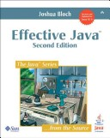
General Purpose hashCode()
int result = 17; // start at a prime
foreach field f
int fieldHashcode =
boolean: (f ? 1: 0)
byte, char, short, int: (int) f
long: (int) (f ^ (f >>> 32))
float: Float.floatToIntBits(f)
double: Double.doubleToLongBits(f), then above
Object: object.hashCode( )
result = 31 * result + fieldHashcode;
return result;

Slide 15
Collision Resolution
Last time: Separate Chaining
when you have a collision, stuff everything into that spot
Using a data structure.
Today: Open Addressing
If the spot is full, go somewhere else.
Where?
How do we find the elements later?

Slide 16
Linear Probing
First idea: linear probing
h(key) % TableSize full?
Try (h(key) + 1) % TableSize.
Also full? (h(key) + 2) % TableSize.
Also full? (h(key) + 3) % TableSize.
Also full? (h(key) + 4) % TableSize.
…

Slide 17
Example
Insert the hashes: 38, 19, 8, 109, 10 into an empty hash table of size 10.
0 | 1 | 2 | 3 | 4 | 5 | 6 | 7 | 8 | 9
8
109
10
38
19

Slide 18
How Does Delete Work?
Just find the key and remove it, what’s the problem?
How do we know if we should keep probing on a find?
Delete 109 and call find on 10.
If we delete something placed via probe we won’t be able to tell!
If you’re using open addressing, you have to use lazy deletion.

Slide 19
Example
Delete 109, find 10.
0 | 1 | 2 | 3 | 4 | 5 | 6 | 7 | 8 | 9
8
109
10
38
19
Not Found?
It looks like we found a blank spot, so it looks like 10 couldn’t have been inserted (if we inserted 10 now, it would be at index 1).
But it’s at index 2 because there used to be something at index 1.

Slide 20
Example
Delete 109, find 10.
0 | 1 | 2 | 3 | 4 | 5 | 6 | 7 | 8 | 9
🪦
38
19
8
109
10
Found it!
When we delete, always mark the spot as “used to have something here” (🪦, lazy deletion)
Find will keep probing on data OR a 🪦.
(You can overwrite a 🪦with data on insert, but only once you’re sure no other copies of the key are later on).

Slide 21
How Long Does Insert Take?
If $λ<1$ we’ll find a spot eventually.
What’s the average running time?
If find is unsuccessful: $\frac{1}{2}\left(1+\frac{1}{{\left(1−λ\right)}^{2}}\right)$
If find is successful: $\frac{1}{2}\left(1+\frac{1}{(1−λ)}\right)$
We won’t prove these (they’re not even in the textbook)
Ask Robbie for references if you’re really interested.
for any pair of elements x,y
the probability that h(x) = h(y) is $\frac{1}{TableSize}$
Uniform Hashing Assumption

Slide 22
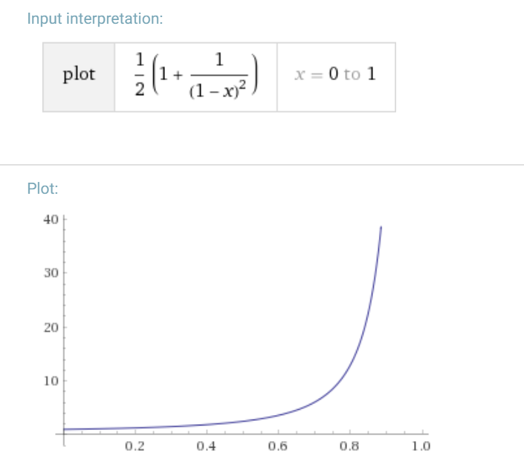
When to Resize
We definitely want to resize before $λ$ gets close to $1$.
Taking $λ=0.5$ as a resize point probably avoids the bad end of this curve.
Remember these are the average find times.
Even under UHA, the worst possible find is a bit worse than this with high probability.

Slide 23
Why are there so many probes?
The number of probes is a result of primary clustering If a few consecutive spots are filled,
Hashing to any of those spots will make more consecutive filled spots.

Slide 24
Quadratic Probing
Want to avoid primary clustering.
If our spot is full, let’s try to move far away relatively quickly.
h(key) % TableSize full?
Try (h(key) + 1) % TableSize.
Also full? (h(key) + 4) % TableSize.
Also full? (h(key) + 9) % TableSize.
Also full? (h(key) + 16) % TableSize.
…

Slide 25
Example
Insert: 89, 18, 49, 58, 79 into an empty hash table of size 10.
Then insert 76, 40, 48, 5, 55,47 into an empty hash table of size 7
0 | 1 | 2 | 3 | 4 | 5 | 6 | 7 | 8 | 9
49
58
79
18
89
0 | 1 | 2 | 3 | 4 | 5 | 6
48
5
55
40
76
47

Slide 26
Quadratic Probing: Proof
Claim: If $λ<\frac{1}{2}$, and TableSize is prime then quadratic probing will find an empty slot.

Slide 27
Quadratic Probing: Proof
Claim: If $λ<\frac{1}{2}$, and TableSize is prime then quadratic probing will find an empty slot.
Enough to show, first TableSize/2 probes are distinct.
For contradiction, suppose there exists some $i≠j$ such that
$\left(h\left(x\right)+i^{2}\right) mod TableSize=\left(h\left(x\right)+j^{2}\right) mod TableSize$
$i^{2} mod TableSize=j^{2} mod TableSize$
$\left(i^{2}−j^{2}\right)mod TableSize=0$

Slide 28
Quadratic Probing: Proof
$\left(i^{2}−j^{2}\right)mod TableSize=0$
$\left(i+j\right)\left(i−j\right)mod TableSize=0$
Thus TableSize divides $\left(i+j\right)\left(i−j\right)$
But TableSize is prime, so
TableSize divides $i+j$ or $i−j$
But that can’t be true -- $i+j<TableSize$

Slide 29
Problems
Still have a fairly large amount of probes (we won’t even try to do the analysis)
We don’t have primary clustering, but we do have secondary clustering
If you initially hash to the same location, you follow the same set of probes.

Slide 30
Double Hashing
Instead of probing by a fixed value every time, probe by some new hash function!
h(key) % TableSize full?
Try (h(key) + g(key)) % TableSize.
Also full? (h(key) + 2*g(key)) % TableSize.
Also full? (h(key) + 3*g(key)) % TableSize.
Also full? (h(key) + 4*g(key)) % TableSize.
…

Slide 31
Example
Insert the following keys into a table of size 10 with the following hash functions: 13, 28, 33, 147, 43
Primary hash function h(key) = key mod TableSize
Second hash function g(key) = 1 + ( (key / TableSize) mod (TableSize-1))
0 | 1 | 2 | 3 | 4 | 5 | 6 | 7 | 8 | 9
13
33
28
147
43

Slide 32
Running Times
Double Hashing will find lots of possible slots as long as g(key) and TableSize are relatively prime.
Under the uniform hashing assumption:
Expected probes for unsuccessful find: $\frac{1}{1−λ}$
Successful: $\frac{1}{1−λ}\ln\left(\frac{1}{1−λ}\right)$
Derivation beyond the scope of this course.
Ask Robbie for references if you want to learn more.

Slide 33
Summary
Separate Chaining
Easy to implement
Running times $O(1+λ)$
Open Addressing
Uses less memory.
Various schemes:
Linear Probing – easiest, but need to resize most frequently
Quadratic Probing – middle ground
Double Hashing – need a whole new hash function, but low chance of clustering.
Which you use depends on your application and what you’re worried about.

Slide 34
Other Topics
Perfect Hashing –
if you have fewer than $2^{32}$ possible keys, have a one-to-one hash function
Hopscotch and cuckoo hashing (more complicated collision resolution strategies)
Other uses of hash functions:
Cryptographic hash functions
Easy to compute, but hard to tell given hash what the input was.
Check-sums
Locality Sensitive Hashing
Map “similar” items to similar hashes

Slide 35
Wrap Up
Hash tables have great behavior on average,
As long as we make assumptions about our data set.
But for every hash function, there’s a set of keys you can insert to grind the hash table to a halt.
The number of keys is consistently larger than the number of ints.
An adversary can pick a set of values that all have the same hash.

Slide 36
Wrap Up
Can we avoid the terrible fate of our worst enemies forcing us to have $O\left(n\right)$ time dictionary operations?
If you have a lot of enemies, maybe use AVL trees.
But some hash table options:
Cryptographic hash functions – should be hard for adversary to find the collisions.
Randomized families of hash functions – have a bunch of hash functions, randomly choose a different one each time you start a hash table.
Done right – adversary won’t be able to cause as many collisions.

Slide 37
Wrap Up
Hash Tables:
Efficient find, insert, delete on average, under some assumptions
Items not in sorted order
Tons of real world uses
…and really popular in tech interview questions.
Need to pick a good hash function.
Have someone else do this if possible.
Balance getting a good distribution and speed of calculation.
Resizing:
Always make the table size a prime number.
$λ$ determines when to resize, but depends on collision resolution strategy.

