Slide 1
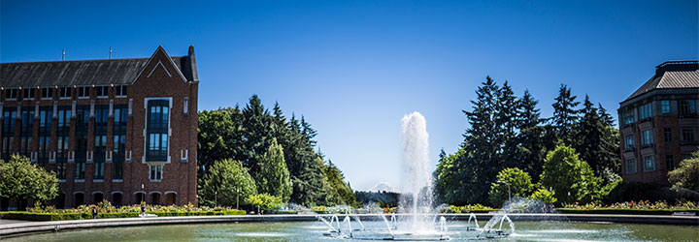
Algorithm Analysis
CSE 332 Spring 2025
Lecture 2

Slide 2
Announcements
Office Hours have started! You can find the schedule on the calendar on the webpage.
Slides and the handout also go up on the calendar (usually before lecture), and inked versions of the slides go up after lecture (usually that afternoon).

Slide 3
Outline
Wrap up CircularArray Queues and Linked List Queues
How do we analyze code?
What is big-O formally?
What will big-O proofs be like?

Slide 4
“Circular” Array
A different queue implementation
Removing elements is expensive. What if we just remember where the next element is?
front
back
10
17
3
4
15
13
//sketch only
Enqueue(item) {
Q[back]=item;
back = (back+1) % size;
}
//sketch only
Dequeue() {
item = Q[front];
front = (front+1) % size;
return item;
}
Notes:
TODO rough pseudocode examples

Slide 5
“Circular” Array
What about insertions?
We can “wrap around” (At least until the array is completely full. )
front
back
5
17
3
4
15
13
10
23
//sketch only
Enqueue(item) {
Q[back]=item;
back = (back+1) % size;
}
//sketch only
Dequeue() {
item = Q[front];
front = (front+1) % size;
return item;
}

Slide 6
“Circular” Array
Sketches don’t handle:
What if queue is empty (for either enqueue or dequeue)
How do you test if it’s empty
What if array is full?
Keeping size up to date
Etc.
A different queue implementation
Removing elements is expensive. What if we just remember where the next element is?
front
back
10
17
3
4
15
13
//sketch only
Enqueue(item) {
Q[back]=item;
back = (back+1) % size;
}
//sketch only
Dequeue() {
item = Q[front];
front = (front+1) % size;
return item;
}
Notes:
Pseudocode from lecture is often rough like this. You’ll work out the edge cases and details when you make your own implementations.

Slide 7
Linked List
What do Enqueue and Dequeue look like? What are their time complexities?
head
tail
7
23
15
14

Slide 8
Linked List
What do Enqueue and Dequeue look like? What are their time complexities?
//sketch only
Enqueue(item) {
tail.next=new Node(item);
tail=tail.next;
}
//sketch only
Dequeue() {
item = head.data;
head = head.next;
return item;
}
Still just sketches!
Ask the same questions from the circular array.
Notice that sometimes the answer is “don’t worry about it”!

Slide 9
Tradeoffs
What makes the circular queue implementation different from the linked list implementation? In what ways is one more desirable than the other?

Slide 10
Tradeoffs
Linked List
Circular Array
$O(1)$ enqueue and dequeue
Pointers lead to slower constants and worse cache behavior (see CSE351)
More space used per element (pointers take space)
Not in Queue ADT, but if you want to insert at position k, must traverse k elements first (or last n-k).
$O\left(1\right)$ enqueue and dequeue unless the array is already full.
Faster constants, but when you resize you get a very slow insert.
Less space when full, but potentially a lot of wasted space if queue gets huge then tiny.
Not in Queue ADT, but if you want to insert at position k, must shift last n-k elements (or first k).
Notes:
Remind “constant time” O(1), “linear time” O(n)

Slide 11
Tradeoffs
This class is built on tradeoffs
If data structure A beats data structure B in every way, you’ll choose A.
Usually, data structure A is better in some ways, and B is better in others.
Knowing the tradeoffs will help you frame the choice.
If you know the size in advance, you might choose the array (no resize worries)
If any one insertion being slow would be very bad, you might choose the linked list
Notes:
Latency sensitive queue? streaming applications (think watching a video without a buffer)

Slide 12
Common Tradeoffs
Often there are multiple unavoidable tradeoffs
Time vs. space
One operation vs. another being as fast as possible
Generality vs. simplicity vs. performance
These tradeoffs are why there are many data structures.
And well-trained computer scientists have internalized those tradeoffs to pick.

Slide 13
Asymptotic Analysis

Slide 14
Algorithm Analysis
I have some problem I need solved.
I ask Alysa and Yafqa. They both have different ideas for how to solve the problem. How do we know which is better? Easy. Have them both write the code and run it and see which is faster.
THIS IS (often) A TERRIBLE IDEA
How can we analyze their suggestions before they have to write the code, and in a way that is independent of their machines?

Slide 15
Algorithm Analysis
“Just code it up and see what happens” isn’t a great strategy for code analysis.
Running time of actual code depends on the computer you’re running on (CPU power, but also OS, other programs running in the background), details of the implementation.
You probably won’t consider all potential inputs in testing
What if you missed a really bad case?
You probably won’t be able to explain patterns clearly
Wasteful if you decide this isn’t the right implementation

Slide 16
Comparing Algorithms
We want to know when one algorithm will be better than another
Better might mean faster.
Or using less memory.
We really care about large inputs.
If n=15, any algorithm will probably finish in less than a second anyway…
Want our answer to be independent of computer speed or programming language.
And we want an answer that’s mathematically rigorous.
In a 311-like sense. We should have a proposition that we can prove true or false.
Notes:
Note we said “algorithm” not “implementation”

Slide 17
Algorithm Analysis
Usually, define a function $f:ℕ→ℕ$
Domain: size of the input to the code (e.g., number of elements in our array, number of characters in our string)
Co-Domain: Counts of resources used (e.g., number of basic operations [time], number of bytes of memory used, etc.)
Be sure you’re clear on the units of your domain and co-domain
It won’t make a big difference for this class, but in complexity theory (e.g. CSE 431, some of 421) bits of input vs. number of elements as input can make a big difference.

Slide 18
What Are We Counting?
Worst case analysis
What’s the $f(N)$ [running time, memory, etc.] for the worst state our data structure can be in or the worst input we can give of size $N$? (i.e. the biggest $f$ could be on an input size $N$)
Best case analysis
What is $f\left(N\right)$ for the best state of our structure and the best question of size $N$? (the smallest $f\left(N\right)$ could be)
Average case analysis
What is the value of $f(N)$ on average over all possible inputs of size $N$?
Have to ask this question very carefully to get a meaningful answer
We usually do worst case analysis.
Notes:
Notice all of these have “of size N”
We are always looking “as N gets arbitrarily large” asymptotic analysis---think asymptote, getting closer as you go off to infinity---getting larger and larger N here.

Slide 19
Analyzing Code
Assume basic operations take the same constant amount of time.
What’s a basic operation?
Adding ints or doubles
Assignment
Incrementing a variable
A return statement
Accessing an array index or an object field
What’s not a basic operation?
Making a method call.
This is a LIE but it’s a very useful lie.
Notes:
It’s a lie because of, e.g., cache behavior, different numbers of actual assembly instructions per high-level language operation, fancy processor stuff (think pipelining), etc. etc. etc.

Slide 20
Example
What is the worst case number of simple operations for this piece of code?
Let A have $n$ entries.
Linear search
int linearSearch(int[] A, int target){
for(int i = 0; i < A.length; i++){
if(A[i] == target)
return i;
}
return -1;
}
Notes:
What’s the worst-case situation? 1 for setting I to 0,
Do 1,2,3, [loop value compare, lookup, if check] 4 (i++) each time through loop
End up with something like 4n+3 It’s OK if you got 5n+2 instead---we’ll describe why these don’t matter in a few slides.

Slide 21
Asymptotic Notation
That’s a nice formula. But does everything in it matter?
Multiplying by constant factors doesn’t matter – let’s just ignore them.
Lower order terms don’t matter – delete them.
Gives us a “simplified big-O”
$10n\log{n}+3n$
$5n^{2}\log{n}+13n^{3}$
$20n\log{\log{n}+2 n\log{n}}$
$2^{3n}$

Slide 22
Asymptotic Notation
That’s a nice formula. But does everything in it matter?
Multiplying by constant factors doesn’t matter – let’s just ignore them.
Lower order terms don’t matter – delete them.
Gives us a “simplified big-O”
$10n\log{n}+3n$
$5n^{2}\log{n}+13n^{3}$
$20n\log{\log{n}+2 n\log{n}}$
$2^{3n}$
$$O(n\log{n)}$$
$$O\left(n^{3}\right)$$
$$O(n\log{n})$$
$$O(8^{n})$$

Slide 23
Formally Big-O
We wanted to find an upper bound on our algorithm’s running time, but
We don’t want to care about constant factors.
We only care about what happens as $n$ gets large.
The formal, mathematical definition is Big-O.
$f(n)$ is $O(g\left(n\right))$ if there exist positive constants $c, n_{0}$ such that for all $n≥n_{0}$,
$$f\left(n\right)≤c⋅g\left(n\right)$$
Big-$O$
We also say that $g\left(n\right)$ “dominates” $f(n)$.

Slide 24
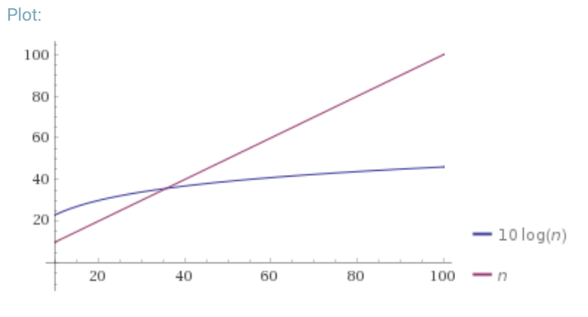
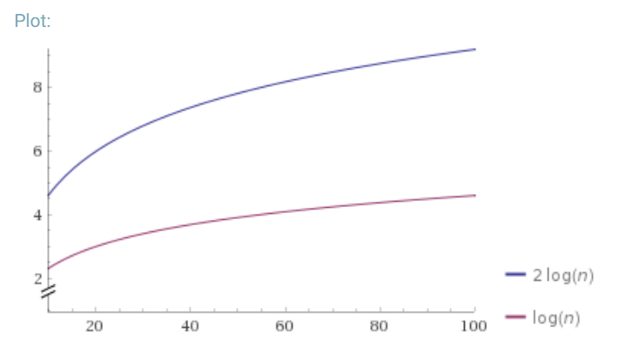
Why is that the definition?
$f(n)$ is $O(g\left(n\right))$ if there exist positive constants $c, n_{0}$ such that for all $n≥n_{0}$,
$$f\left(n\right)≤c⋅g\left(n\right)$$
Big-$O$
Why $n_{0}$?
Why $c$?

Slide 25
Why Are We Doing This?
You already intuitively understand what big-O means.
Who needs a formal definition anyway?
We will.
Your intuitive definition and my intuitive definition might be different.
We’re going to be making more subtle big-O statements in this class.
We need a mathematical definition to be sure we’re on the same page.
Once we have a mathematical definition, we can go back to intuitive thinking.
But when a weird edge case, or subtle statement appears, we can figure out what’s correct.

Slide 26
Edge Cases
True or False: $10n^{2}+15n$ is $O(n^{3})$
[this is an edge case]
It’s true! – it fits the definition.
Big-O is just an upper bound. It doesn’t have to be a good upper bound.
If we want the best upper bound, we’ll ask you for a tight big-O bound.
$O\left(n^{2}\right)$ is the tight bound for this example.
It is (usually) technically correct to say your code runs in time $O(n^{n!})$.
DO NOT TRY TO PULL THIS TRICK ON AN EXAM. Or in an interview.

Slide 27
O, Omega, Theta [oh my?]
Big-O is an upper bound
My code uses at most this many resources (e.g. runs in at most this much time)
Big-Omega is a lower bound
Big Theta is “equal to”
$f(n)$ is $Ω(g\left(n\right))$ if there exist positive constants $c, n_{0}$ such that for all $n≥n_{0}$,
$$f\left(n\right)≥c⋅g\left(n\right)$$
Big-Omega
$f(n)$ is $Θ(g\left(n\right))$ if
$f\left(n\right)$ is $O(g\left(n\right))$ and $f\left(n\right)$ is $Ω(g\left(n\right))$.
Big-Theta

Slide 28
Viewing O as a class
Sometimes you’ll see big-O defined as a family or set of functions.
$O(g\left(n\right))$ is the set of all functions $f\left(n\right)$ such that there exist positive constants $c, n_{0}$ such that for all $n≥n_{0}$, $f\left(n\right)≤c⋅g\left(n\right)$
Big-O (alternative definition)
For that reason, some people write $f\left(n\right)∈O\left(g\left(n\right)\right)$ where we wrote “$f\left(n\right)$ is $O(g\left(n\right))$”.
Other people write “$f\left(n\right)=O\left(g\left(n\right)\right)$” to mean the same thing.
We never write $O(5n)$ instead of $O(n)$ – they’re the same thing!
It’s like writing $\frac{6}{2}$ instead of $3$. It just looks weird.

Slide 29
Useful Vocab
The most common running times all have fancy names:
$O(1)$ constant
$O(\log{n})$ logarithmic
$O\left(n\right)$ linear
$O(n\log{n})$ “n log n”
$O\left(n^{2}\right)$ quadratic
$O(n^{3})$ cubic
$O(n^{c})$ polynomial (where c is a constant)
$O(c^{n})$ exponential (where c is a constant)
Notes:
N log n is an example of a “nearly linear time” algorithm (that’s n*log^c(n) for any constant c).
Some people (by which I mean at least one very active Wikipedia editor) use “linearithmic” for n log n. I’ve only ever seen this on Wikipedia so probably don’t say it.

Slide 30
What’s the base of the log?
If I write $\log{n}$, without specifying a base, I mean $\log_{2}{n}.$
But does it matter for big-O?
Suppose we found an algorithm with running time $\log_{5}{n}$ instead.
Is that different from $O\left(\log_{2}{n}\right)?$
No!
$\log_{c}{n}= \frac{\log_{2}{n}}{\log_{2}{c}}$ If $c$ is a constant, then $\log_{2}{c}$is just a constant, and we can hide it inside the $O()$.

Slide 31
$O,Ω,Θ$ vs. Best, Worst, Average
It’s a common misconception that $Ω()$ is “best-case” and $O$() is “worst-case”. This is a misconception!!
$O()$ says “the complexity of this algorithm is at most” (think $≤$)
$Ω()$ says “the complexity of this algorithm is at least” (think $≥)$
You can use $≤$ on worst-case or best case; you can use $≥$ on worst-case or best-case.
Best/Worst/Average say “what function $f$ am I analyzing?”
$O,Ω,Θ$ say “let me summarize what I know about $f$, it’s $≤,≥,=$…”
Notes:
Why would you do that? Sometimes you don’t know if you’ve done the analysis perfectly (you don’t know if you have the big-$Θ$ bound), so you have to use $O$ or $Ω$.
In a few weeks, we’ll want to say “every algorithm for sorting takes at least n log n time in the worst-case” , that’s Omega in a worst-case context
Or we might say “every algorithm for this problem needs to look at all the elements, so will take at least n time, even in the best case. That’s an Omega(n) best-case statement.

Slide 32
Some Example Sentences
 | $$O$$ | $$Ω$$ | $$Θ$$
Best-Case Analysis | In the best-case, linear search will take at most as much time as binary search ever takes. That is, it’s $O(\log{n)}.$ | In the best case, linear search still has to look at array index 0; those operations still take time, so you will take at least $Ω(1)$ time. | In the best case, linear-search is both $O(1)$ and $Ω\left(1\right)$ so it is $Θ(1)$.
Worst-Case Analysis | In the worst-case, binary search will take at most as much time as linear search ever takes. That is, it’s $O(n)$. | In the worst-case, linear search will check at least as many locations in the array as binary search does in the worst-case, so it will take at least $Ω(log n)$ time | In the worst-case, binary search takes $Θ(\log{n)}$time. In the worst-case, linear search takes $Θ(n)$ time.

Slide 33
Why Might you use it?
 | $$O$$ | $$Ω$$ | $$Θ$$
Best-Case Analysis | In the best case, my algorithm is pretty good, it takes at most $O(time)$ | Even in the best-case, this algorithm still takes a while; it takes at least $Ω(time)$ | In the best case, my algorithm takes exactly $Θ(time)$
Worst-Case Analysis | Even in the worst-case my algorithm, isn’t that bad! It takes at most $O(time)$ time in the worst-case | In the worst-case, there’s still a lot of work the algorithm has to do; it takes at least $Ω(time)$ | In the worst case, my algorithm takes exactly $Θ(time)$

Slide 34
Some Log Review

Slide 35
Logs
$\log\left(n^{k}\right)=k⋅log⁡(n)$.
$\log\left(2^{n}\right)=n$ (logs and exponents are inverse functions.
$\log{(\log\left(x\right))}$is usually written log log x
Grows VERY slowly (as slowly as $2^{(2^{x})}$ grows quickly)
$\log_{2}({\log_{2}{(\# atoms in universe))}}=\log_{2}({\log_{2}{({10}^{80}))=\log_{2}({80⋅log_{2}(10){)≈8.054}}}}$
Don’t confuse with $\log\left(x\right)⋅\log\left(x\right)$ usually written $\log^{2}{(x)}$.
$log⁡log⁡x$ << $log⁡x$ << $\log^{2}{(x)}$(where << is “asymptotically less than”)
Notes:
log_2(10) is 3.something, so we’re looking for log_2(something around 250-ish), which will work out to about 8 (is actually less than 8.1)
Where would we see these?
We’ll see log(log(x)) would mean doing a log-time thing on a log-sized thing for example. Maybe running binary search on a number of elements that’s the height of a balanced tree? log* (a related function) shows up in analyzing union-find/disjoint sets.
log^c(n) is common for (theoretical) randomized algorithms---doing something an extra log(n) times to achieve concentration is common. If you have a randomized algorithm with a randomized subroutine, you’ll need both levels to concentrate and can end up with log^2(n).

Slide 36
Writing Big-O Proofs

Slide 37
Proving Big-O, Formally
Big-O is an $∃c,n_{0}∀n$ statement.
I.e., an exists statement with a “forall” inside.
How do you prove an exists statement?
How do you prove a for-all statement?

Slide 38
Proving Big-O, Formally
Big-O is an $∃c,n_{0}∀n$ statement.
I.e., an exists statement with a “forall” inside.
How do you prove an exists statement?
Show the $c,n_{0}$ that will work. Give specific values.
How do you prove a for-all statement?
Introduce an arbitrary $n.$

Slide 39
Writing Proofs
Claim: For every odd integer $y$, there exists an even integer $x,$such that $x>y$.
Proof:
Let $y$ be an arbitrary odd integer. By definition, $y=2z+1$ for some integer $z$.
Consider $x= 2(z+1)$.
$x$ is even (since it can be written as $2$ times some integer) and
$x=2\left(z+1\right)=2z+2>2z+1=y$. So $x$ meets both of the required properties.

Slide 40
Writing Proofs
Where did that $x=2\left(z+1\right)$ come from?
You probably came up with that even integer first, before you started writing the proof.
That was some “scratch work” – the insight isn’t explained in the final proof
You just say “Consider”
Don’t try to skip the scratch work when drafting your big-O proofs.
But it won’t appear in your final version.

Slide 41
Using the Definition
Let’s show: $10n^{2}+15n$is $O(n^{2})$

Slide 42
Using the Definition
Let’s show: $10n^{2}+15n$is $O(n^{2})$
Recreation of whiteboard:
Scratch work:
$$10n^{2}≤10n^{2}$$
$15n≤15n^{2}$ for $n≥1$
$10n^{2}+15n≤25n^{2}$for $n≥1$
Proof:
Take $c=25$ and $n_{0}=1$.
The inequality $10n^{2}≤10n^{2}$ is always true. The inequality $15n≤15n^{2}$ is true for $n≥1$, as the right hand side is a factor of $n$ more than the right hand side.
As long as both inequalities are true we can add them, thus
$10n^{2}+15n≤25n^{2}$ holds as long as $n≥1$.
This is exactly the inequality we needed to show.

