Slide 1
CSE 332 Winter 2024 Lecture 2: Algorithm Analysis pt.1
Nathan Brunelle
http://www.cs.uw.edu/332

Slide 2
Terminology
Abstract Data Type (ADT)
Mathematical description of a “thing” with set of operations on that “thing”
Algorithm
A high level, language-independent description of a step-by-step process
Data structure
A specific organization of data and family of algorithms for implementing an ADT
Implementation of a data structure
A specific implementation in a specific language

Slide 3
ADT: Queue
What is it?
A “First In First Out” (FIFO) collection of items
What Operations do we need?
Enqueue
Add a new item to the queue
Dequeue
Remove the “oldest” item from the queue
Is_empty
Indicate whether or not there are items still on the queue

Slide 4
Linked List – Queue Data Structure
Front
5
8
3
4
7
Queue represented as a “chain” of items
A “front” variable referencing the oldest item
A “back” variable referencing the most recent item
Each item points to the item enqueued after it
Enqueue Procedure:
Dequeue Procedure:
Is_empty Procedure:
Back

Slide 5
Linked List – Queue Data Structure
Front
5
8
3
4
7
Queue represented as a “chain” of items
A “front” variable referencing the oldest item
A “back” variable referencing the most recent item
Each item points to the item enqueued after it
Enqueue Procedure:
Dequeue Procedure:
Is_empty Procedure:
Back
enqueue(x){
last = new Node(x)
back.next = last
back = last
}
dequeue(){
first = front.item
front = front.next
return first
}
is_empty(){
return front.equals(Null)
}

Slide 6
Circular Array – Queue Data Structure
Front=0
5
8
3
4
7
0
1
2
3
4
5
6
7
8
9
Back=4
Queue represented as a “chain” of items
A “front” variable referencing the oldest item
A “back” variable referencing the most recent item
Each item points to the item enqueued after it
Enqueue Procedure:
Dequeue Procedure:
Is_empty Procedure:

Slide 7
Circular Array – Queue Data Structure
Front=0
5
8
3
4
7
0
1
2
3
4
5
6
7
8
9
Back=4
Queue represented as an array of items
A “front” index to indicate the oldest item in the queue
A “back” index to indicate the most recent item in the queue
Enqueue Procedure:
Dequeue Procedure:
Is_empty Procedure:

Slide 8
Circular Array – Queue Data Structure
Front=0
5
8
3
4
7
0
1
2
3
4
5
6
7
8
9
Back=4
Queue represented as an array of items
A “front” index to indicate the oldest item in the queue
A “back” index to indicate the most recent item in the queue
Enqueue Procedure:
Dequeue Procedure:
Is_empty Procedure:
enqueue(x){
queue[back] = x
back = (back + 1) % queue.length
}
dequeue(){
first = queue[front]
front = (front + 1) % queue.length
}
is_empty(){
return front == back
}

Slide 9
Linked List vs. Circular Array

Slide 10
Warm up:
I have a pile of string
I have one end of the string in-hand
I need to find the other end in the pile
How can I do this efficiently?

Slide 11
Algorithm Ideas
Ideas:

Slide 12
Algorithm Running Times
How do we express running time?
Units of “time”
How to express efficiency?

Slide 13
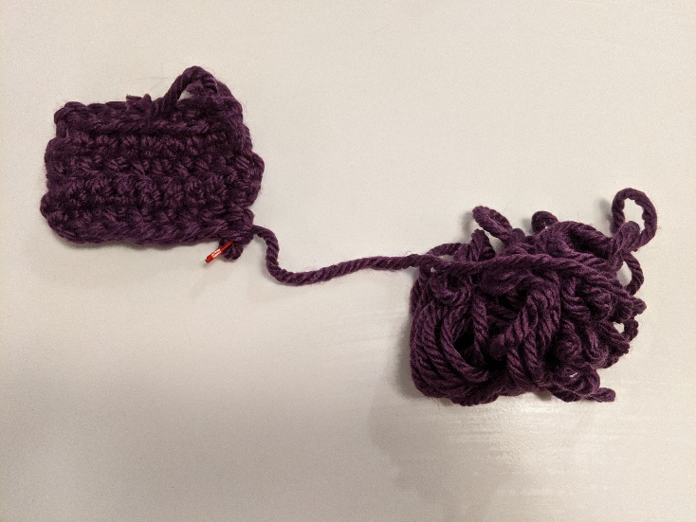
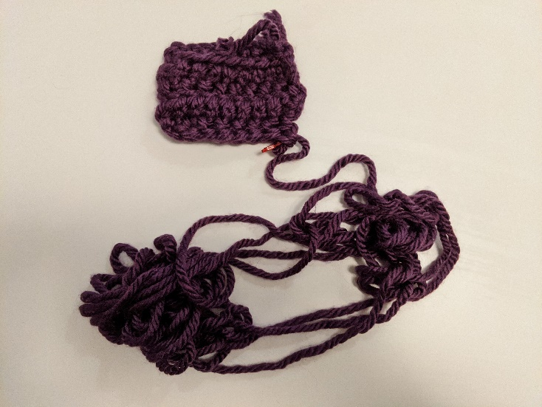
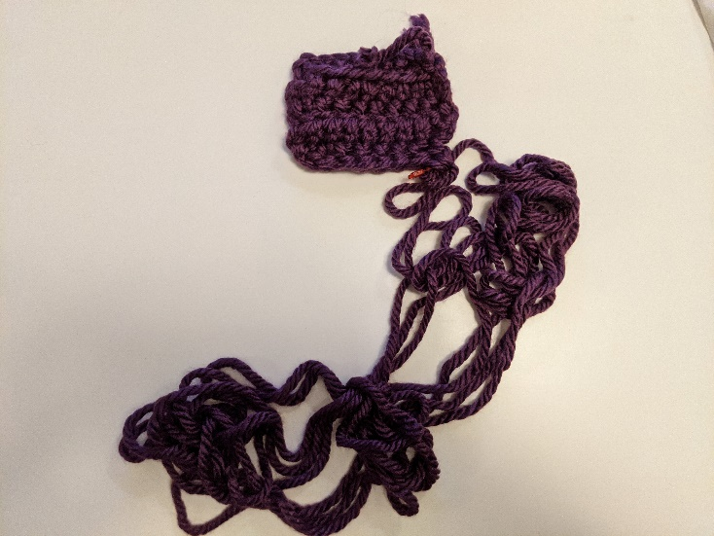
My Approach

Slide 14
End-of-Yarn Finding
Set aside the already-obtained “beginning”
If you see the end of the yarn, you’re done!
Separate the pile of yarn into 2 piles, note which connects to the beginning (call it pile A, the other pile B)
Count the number of strands crossing the piles
If the count is even, pile A contains the end, else pile B does
A
Repeat on pile with end
B

Slide 15
Why Do resource Analysis?
Allows us to compare algorithms, not implementations
Using observations necessarily couples the algorithm with its implementation
If my implementation on my computer takes more time than your implementation on your computer, we cannot conclude your algorithm is better
We can predict an algorithm’s running time before implementing
Understand where the bottlenecks are in our algorithm

Slide 16
Goals for Algorithm Analysis
Identify a function which maps the algorithm’s input size to a measure of resources used
Input of the function: sizes of the input
Number of characters in a string, number of items in a list, number of pixels in an image
Output of the function: counts of resources used
Number of times the algorithm adds two numbers together, number times the algorithm does a > or < comparison, maximum number of bytes of memory the algorithm uses at any time
Important note: Make sure you know the “units” of your domain and codomain!

Slide 17
Worst Case Analysis (in general)
If an algorithm has a worst case resource complexity of $f(n)$
Among all possible size-$n$ inputs, the “worst” one will use $f(n)$ “resources”
I.e. $f(n)$ gives the maximum count of resources needed from among all inputs of size $n$

Slide 18
Worst Case Running Time Analysis
If an algorithm has a worst case running time of $f(n)$
Among all possible size-$n$ inputs, the “worst” one will do $f(n)$ “operations”
I.e. $f(n)$ gives the maximum operation count from among all inputs of size $n$

Slide 19
Worst Case Space Analysis
If an algorithm has a worst case space complexity of $f(n)$
Among all possible size-$n$ inputs, the “worst” one will need $f(n)$ “memory units”
I.e. $f(n)$ gives the maximum memory unit count from among all inputs of size $n$

Slide 20
Worst Case Running Time - Example
myFunction(List n){
b = 55 + 5;
c = b / 3;
b = c + 100;
for (i = 0; i < n.size(); i++) {
b++;
}
if (b % 2 == 0) {
c++;
}
else {
for (i = 0; i < n.size(); i++) {
c++;
}
}
return c;
}
Questions to ask:
What are the units of the input size?
What are the operations we’re counting?
For each line:
How many times will it run?
How long does it take to run?
Does this change with the input size?

Slide 21
Worst Case Running Time – Example 2
beAnnoying(List n){
List m = [];
for (i=0; i < n.size(); i++){
m.add(n[i]);
for (j=0; j< n.size(); j++){
print (“Hi, I’m annoying”);
}
}
return;
}
Questions to ask:
What are the units of the input size?
What are the operations we’re counting?
For each line:
How many times will it run?
How long does it take to run?
Does this change with the input size?

Slide 22
Worst Case Running Time – General Guide
Add together the time of consecutive statements
Loops: Sum up the time required through each iteration of the loop
If each takes the same time, then [time per loop $×$ number of iterations]
Conditionals: Sum together the time to check the condition and time of the slowest branch
Function Calls: Time of the function’s body
Recursion: Solve a recurrence relation

