Slide 1
CSE 332 Winter 2024 Lecture 12: Hashing
Nathan Brunelle
http://www.cs.uw.edu/332

Slide 2
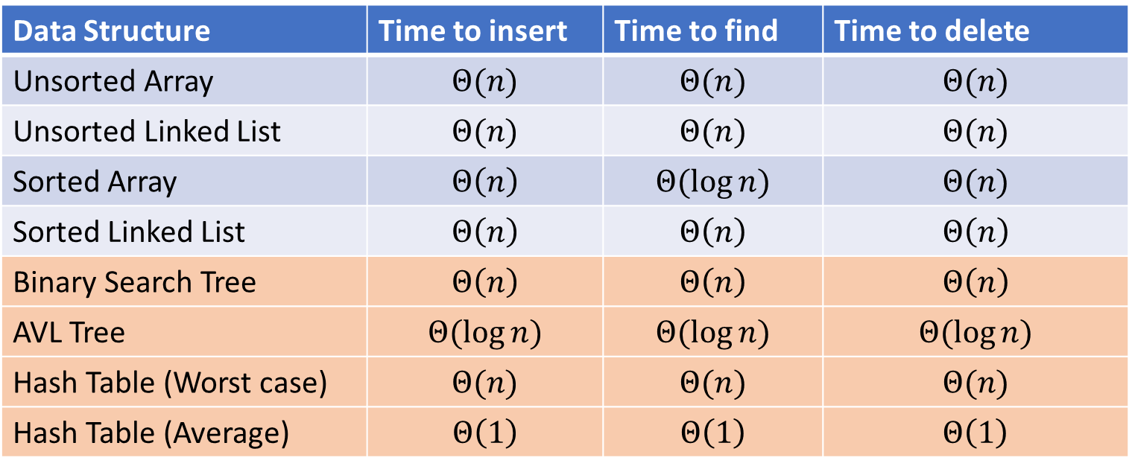
Dictionary Data Structures
Data Structure | Time to insert | Time to find | Time to delete
Unsorted Array | $$Θ(n)$$ | $$Θ(n)$$ | $$Θ(n)$$
Unsorted Linked List | $$Θ(n)$$ | $$Θ(n)$$ | $$Θ(n)$$
Sorted Array | $$Θ\left(n\right)$$ | $$Θ(\log{n})$$ | $$Θ(n)$$
Sorted Linked List | $$Θ\left(n\right)$$ | $$Θ\left(n\right)$$ | $$Θ\left(n\right)$$
Binary Search Tree | $$Θ\left(n\right)$$ | $$Θ\left(n\right)$$ | $$Θ\left(n\right)$$
AVL Tree | $$Θ(\log{n})$$ | $$Θ(\log{n})$$ | $$Θ(\log{n})$$
Hash Table (Worst case) | $$Θ(n)$$ | $$Θ(n)$$ | $$Θ(n)$$
Hash Table (Average) | $$Θ\left(1\right)$$ | $$Θ\left(1\right)$$ | $$Θ\left(1\right)$$

Slide 3
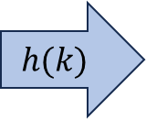
Hash Tables
Idea:
Have a small array to store information
Use a hash function to convert the key into an index
Hash function should “scatter” the keys, behave as if it randomly assigned keys to indices
Store key at the index given by the hash function
Do something if two keys map to the same place (should be very rare)
Collision resolution
Insert / find /
delete
$$h(k)$$
Index between 0 and size-1
& value
Key Object

Slide 4
Properties of a “Good” Hash
Definition: A hash function maps objects to integers
Should be very efficient
Calculating the hash should be negligible
Should randomly scatter objects
Objects that are similar to each other should be likely to end up far away
Should use the entire table
There should not be any indices in the table that nothing can hash to
Picking a table size that is prime helps with this
Should use things needed to “identify” the object
Use only fields you would check for a .equals method be included in calculating the hash
More fields typically leads to fewer collisions, but less efficient calculation

Slide 5
A Bad Hash (and phone number trivia)
$h\left(phone\right)=$ the first digit of the phone number
No US phone numbers start with 1 or 0
If we’re sampling from this class, 2 is by far the most likely
0
1
2
3
4
5
6
7
8
9

Slide 6
Compare These Hash Functions (for strings)
Let $s=s_{0}s_{1}s_{2}…s_{m−1}$ be a string of length $m$
Let $a(s_{i})$ be the ascii encoding of the character $s_{i}$
$h_{1}\left(s\right)=a\left(s_{0}\right)$
$h_{2}\left(s\right)=\left(\sum_{i=0}^{m−1}{a\left(s_{i}\right)}\right)$
$h_{3}\left(s\right)=\left(\sum_{i=0}^{m−1}{a\left(s_{i}\right)⋅{37}^{i}}\right)$

Slide 7
Collision Resolution
A Collision occurs when we want to insert something into an already-occupied position in the hash table
2 main strategies:
Separate Chaining
Use a secondary data structure to contain the items
E.g. each index in the hash table is itself a linked list
Open Addressing
Use a different spot in the table instead
Linear Probing
Quadratic Probing
Double Hashing
0
1
2
3
4
5
6
7
8
9

Slide 8
Separate Chaining Insert
To insert $k,v$:
Compute the index using $i=h\left(k\right) \% size$
Add the key-value pair to the data structure at $table\left[i\right]$
$$k,v$$
$$k,v$$
$$k,v$$
0
1
2
3
4
5
6
7
8
9

Slide 9
Separate Chaining Find
To find $k$:
Compute the index using $i=h\left(k\right) \% size$
Call find with the key on the data structure at $table\left[i\right]$
$$k,v$$
$$k,v$$
$$k,v$$
0
1
2
3
4
5
6
7
8
9

Slide 10
Separate Chaining Delete
To delete $k$:
Compute the index using $i=h\left(k\right) \% size$
Call delete with the key on the data structure at $table\left[i\right]$
$$k,v$$
$$k,v$$
$$k,v$$
0
1
2
3
4
5
6
7
8
9

Slide 11
Formal Running Time Analysis
The load factor of a hash table represents the average number of items per “bucket”
$λ=\frac{n}{size}$
Assume we have a has table that uses a linked-list for separate chaining
What is the expected number of comparisons needed in an unsuccessful find?
What is the expected number of comparisons needed in a successful find?
How can we make the expected running time $Θ(1)$?

Slide 12
Load Factor?
$$k,v$$
$$k,v$$
$$k,v$$
0
1
2
3
4
5
6
7
8
9

Slide 13
Load Factor?
$$k,v$$
$$k,v$$
$$k,v$$
$$k,v$$
$$k,v$$
$$k,v$$
$$k,v$$
$$k,v$$
0
1
2
3
4
5
6
7
8
9

Slide 14
Load Factor?
$$k,v$$
$$k,v$$
$$k,v$$
$$k,v$$
$$k,v$$
$$k,v$$
$$k,v$$
$$k,v$$
$$k,v$$
$$k,v$$
$$k,v$$
$$k,v$$
$$k,v$$
$$k,v$$
$$k,v$$
0
1
2
3
4
5
6
7
8
9

Slide 15
Collision Resolution: Linear Probing
When there’s a collision, use the next open space in the table
0
1
2
3
4
5
6
7
8
9

Slide 16
Linear Probing: Insert Procedure
To insert $k,v$
Calculate $i=h\left(k\right) \% size$
If $table[i]$ is occupied then try $\left(i+1\right)\% size$
If that is occupied try $\left(i+2\right)\% size$
If that is occupied try $\left(i+3\right)\% size$
…
0
1
2
3
4
5
6
7
8
9

Slide 17
Linear Probing: Find
Let’s do this together!

Slide 18
Linear Probing: Find
To find key $k$
Calculate $i=h\left(k\right) \% size$
If $table\left[i\right]$ is occupied and does not contain $k$ then look at $\left(i+1\right) \% size$
If that is occupied and does not contain $k$ then look at $\left(i+2\right) \% size$
If that is occupied and does not contain $k$ then look at $\left(i+3\right) \% size$
Repeat until you either find $k$ or else you reach an empty cell in the table

Slide 19
Linear Probing: Delete
Let’s do this together!

Slide 20

Linear Probing: Delete
Option 1: Find the last thing with a matching hash, move that into the spot you deleted from
Option 2: Called “tombstone” deletion. Leave a special object that indicates an object was deleted from there
The tombstone does not act as an open space when finding (so keep looking after its reached)
When inserting you can replace a tombstone with a new item
$$k,v$$
$$k,v$$
$$k,v$$
$$k,v$$
0
1
2
3
4
5
6
7
8
9

Slide 21
Downsides of Linear Probing
What happens when $λ$ approaches 1?
What happens when $λ$ exceeds 1?

Slide 22
Quadratic Probing: Insert Procedure
To insert $k,v$
Calculate $i=h\left(k\right) \% size$
If $table[i]$ is occupied then try $\left(i+1^{2}\right)\% size$
If that is occupied try $\left(i+2^{2}\right)\% size$
If that is occupied try $\left(i+3^{2}\right)\% size$
If that is occupied try $\left(i+4^{2}\right)\% size$
…
0
1
2
3
4
5
6
7
8
9

Slide 23
Quadratic Probing: Example
Insert:
76
40
48
5
55
47
0
1
2
3
4
5
6

Slide 24
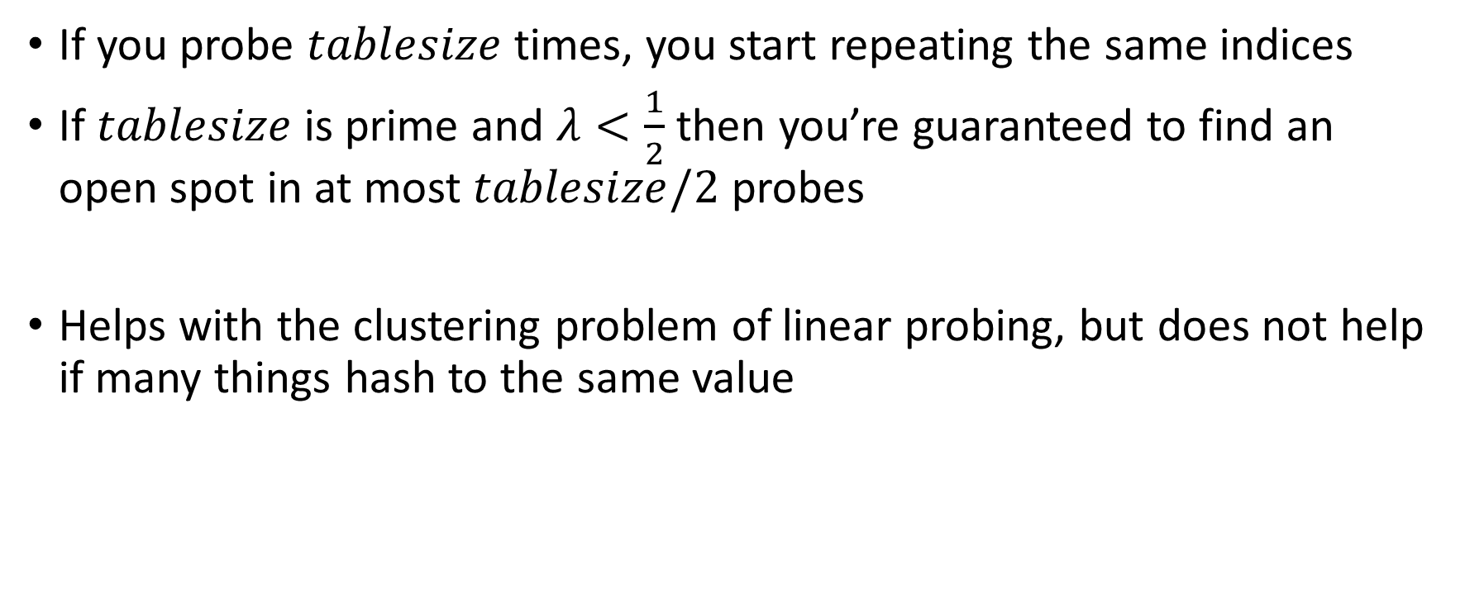
Using Quadratic Probing
If you probe $tablesize$ times, you start repeating the same indices
If $tablesize$ is prime and $λ<\frac{1}{2}$ then you’re guaranteed to find an open spot in at most $tablesize/2$ probes
Helps with the clustering problem of linear probing, but does not help if many things hash to the same value

Slide 25
Double Hashing: Insert Procedure
Given $h$ and $g$ are both good hash functions
To insert $k,v$
Calculate $i=h\left(k\right) \% size$
If $table[i]$ is occupied then try $\left(i+g\left(k\right)\right) \% size$
If that is occupied try $\left(i+2⋅g\left(k\right)\right)\% size$
If that is occupied try $\left(i+3⋅g\left(k\right)\right)\% size$
If that is occupied try $\left(i+4⋅g\left(k\right)\right)\% size$
…
0
1
2
3
4
5
6
7
8
9

Slide 26
Rehashing
If your load factor $λ$ gets too large, copy everything over to a larger hash table
To do this: make a new array with a new hash function
Re-insert all items into the new hash table with the new hash function
New hash table should be “roughly” double the size (but probably still want it to be prime)

