Slide 1
CSE 332 Autumn 2023 Lecture 12: Hashing
Nathan Brunelle
http://www.cs.uw.edu/332

Slide 2
Find
Start at the root node
Binary search internal nodes to identify correct subtree
Repeat until you reach a leaf node
Binary search the leaf to get the value
13
38
3
5
9
20
25
55
1
3
5
9
13
20
25
38
55
2
4
6
10
14
24
27
40
90
7
17
30
50

Slide 3
Insertion Summary
Binary search to find which leaf should contain the new item
If there’s room, add it to the leaf array (maintaining sorted order)
If there’s not room, split
Make a new leaf node, move the larger $\left\lfloor \frac{L+1}{2}\right\rfloor$ items to it
If there’s room in the parent internal node, add new leaf to it (with new key bound value)
If there’s not room in the parent internal node, split that!
Make a new internal node and have it point to the larger $\left\lfloor \frac{M+1}{2}\right\rfloor$
If there’s room in the parent internal node, add this internal node to it
If there’s not room, repeat this process until there is!

Slide 4
Insertion TLDR
Find where the item goes by repeated binary search
If there’s room, just add it
If there’s not room, split things until there is

Slide 5
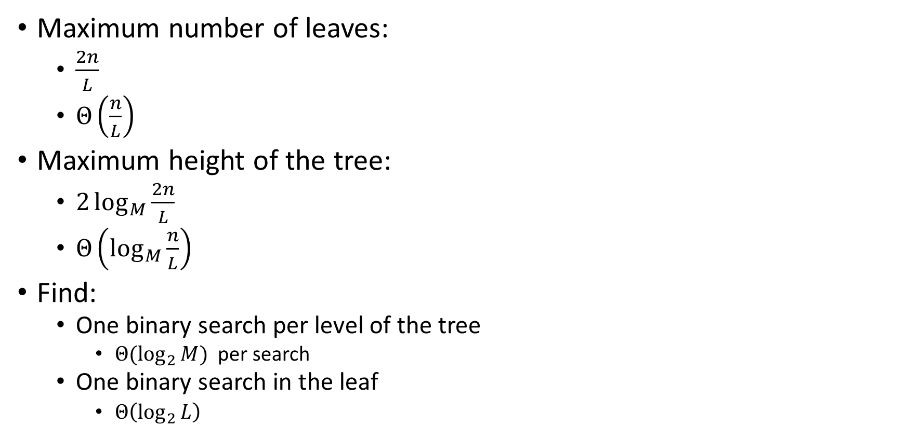
Running Time of Find
Maximum number of leaves:
$\frac{2n}{L}$
$Θ\left(\frac{n}{L}\right)$
Maximum height of the tree:
$2\log_{M}{\frac{2n}{L}}$
$Θ\left(\log_{M}{\frac{n}{L}}\right)$
Find:
One binary search per level of the tree
${Θ(log}_{2}{M})$ per search
One binary search in the leaf
$Θ\left(\log_{2}{L}\right)$
Overall: $Θ\left(\log_{2}{M}⋅\log_{M}{\frac{n}{L}}+\log_{2}{L}\right)$
Usually simplified to:
$$Θ\left(\log_{2}{M}⋅\log_{M}{n}\right)$$

Slide 6

Running Time of Insert
Find:
$Θ\left(\log_{2}{M}⋅\log_{M}{n}\right)$
Add item to leaf:
$Θ(L)$
Split a leaf
$Θ(L)$
Split one internal node:
$Θ(M)$
Overall: $Θ\left(L+M⋅\log_{M}{n}\right)$
Usually simplified to:
$$Θ\left(\log_{2}{M}⋅\log_{M}{n}\right)$$

Slide 7
Delete
Recall: all nodes must be at least half full (except root at startup)
delete 50
7
13
38
3
5
9
20
25
55
1
3
5
7
9
13
20
25
38
55
2
4
6
8
10
14
24
27
40
90
17
30
50

Slide 8
Delete
Recall: all nodes must be at least half full (except root at startup)
delete 24
7
13
38
3
5
9
20
25
55
1
3
5
7
9
13
20
25
38
55
2
4
6
8
10
14
24
27
40
90
17
30

Slide 9
Delete
Recall: all nodes must be at least half full (except root at startup)
delete 24
7
13
38
3
5
9
17
25
55
1
3
5
7
9
13
17
25
38
55
2
4
6
8
10
14
20
27
40
90
30

Slide 10
Delete
Recall: all nodes must be at least half full (except root at startup)
delete 5
7
13
38
3
5
9
17
25
55
1
3
5
7
9
13
17
25
38
55
2
4
6
8
10
14
20
27
40
90
30

Slide 11
Delete
Recall: all nodes must be at least half full (except root at startup)
delete 5
7
13
38
3
9
17
25
55
1
3
5
7
9
13
17
25
38
55
2
4
6
8
10
14
20
27
40
90
6
30

Slide 12
Delete
Recall: all nodes must be at least half full (except root at startup)
delete 1
7
13
38
3
9
17
25
55
1
3
7
9
13
17
25
38
55
2
4
8
10
14
20
27
40
90
30

Slide 13
Delete
Recall: all nodes must be at least half full (except root at startup)
delete 1
7
13
38
9
17
25
55
2
3
7
9
13
17
25
38
55
3
4
8
10
14
20
27
40
90
4
30
50

Slide 14
Delete
Recall: all nodes must be at least half full (except root at startup)
delete 1
13
38
3
9
9
17
25
55
2
7
9
7
9
13
17
25
38
55
3
8
10
8
10
14
20
27
40
90
4
30

Slide 15
Delete Summary
Find the item
Remove the item from the leaf
If that causes the leaf to be under-full, adopt from a neighbor
If that would cause the neighbor to be under-full, merge them
Update the parent
If that causes the parent to be under-full, adopt from a neighbor
If that causes the neighbor to be under-full, merge
Update the parent
…

Slide 16
Delete TLDR
Find and remove from leaf
Keep doing this until everything is “full enough”:
If the node is now too small, adopt from a neighbor
If the neighbor is too small then merge

Slide 17
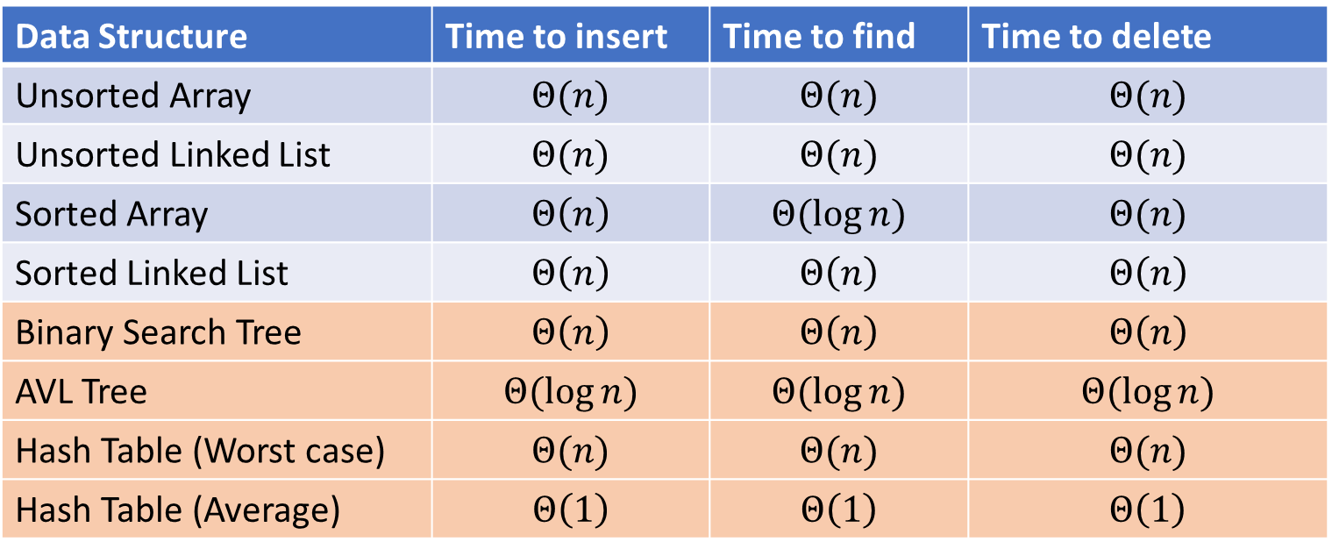
Next topic: Hash Tables
Data Structure | Time to insert | Time to find | Time to delete
Unsorted Array | $$Θ(n)$$ | $$Θ(n)$$ | $$Θ(n)$$
Unsorted Linked List | $$Θ(n)$$ | $$Θ(n)$$ | $$Θ(n)$$
Sorted Array | $$Θ\left(n\right)$$ | $$Θ(\log{n})$$ | $$Θ(n)$$
Sorted Linked List | $$Θ\left(n\right)$$ | $$Θ\left(n\right)$$ | $$Θ\left(n\right)$$
Binary Search Tree | $$Θ\left(n\right)$$ | $$Θ\left(n\right)$$ | $$Θ\left(n\right)$$
AVL Tree | $$Θ(\log{n})$$ | $$Θ(\log{n})$$ | $$Θ(\log{n})$$
Hash Table (Worst case) | $$Θ(n)$$ | $$Θ(n)$$ | $$Θ(n)$$
Hash Table (Average) | $$Θ\left(1\right)$$ | $$Θ\left(1\right)$$ | $$Θ\left(1\right)$$

Slide 18
Two Different ideas of “Average”
Expected Time
The expected number of operations a randomly-chosen input uses
Assumed randomness from somewhere
Most simply: from the input
Preferably: from the algorithm/data structure itself
$f\left(n\right)=$ sum of the running times for each input of size $n$ divided by the number of inputs of size $n$
Amortized Time
The long-term average per-execution cost (in the worst case)
Rather than look at the worst case of one execution, look at the total worst case of a sequential chain of many executions
Why? The worst case may be guaranteed to be rare
$f\left(n\right)=$ the sum of the running times from a sequence of $n$ sequential calls to the function divided by $n$

Slide 19
Amortized Example
ArrayList Insert:
Worst case: $Θ(n)$
0
1
2
3
4
5
6
7
8
0
1
2
3
4
5
6
7
8

Slide 20

Amortized Example
Do $x$ operations with cost 1
Do 1 operation with cost $x$
Do $x$ operations with cost 1
Do 1 operation with cost $2x$
Do $2x$ operations with cost 1
Do 1 operation with cost $4x$
Do $4x$ operations with cost 1
Do 1 operation with cost $8x$
…
Amortized: each operation cost 2 operations
$$Θ(1)$$
ArrayList Insert:
First 8 inserts: 1 operation each
9th insert: 9 operations
Next 7 inserts: 1 operation each
17th insert: 17 operations
Next 15 inserts: 1 operation each
…
0
1
2
3
4
5
6
7
8
0
1
2
3
4
5
6
7
8

Slide 21
Hash Tables
Motivation:
Why not just have a gigantic array?

Slide 22
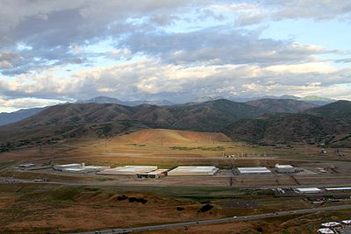
Problem?

Slide 23
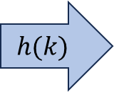
Hash Tables
Idea:
Have a small array to store information
Use a hash function to convert the key into an index
Hash function should “scatter” the keys, behave as if it randomly assigned keys to indices
Store key at the index given by the hash function
Do something if two keys map to the same place (should be very rare)
Collision resolution
Insert / find /
delete
$$h(k)$$
Index between 0 and size-1
& value
Key Object

Slide 24
Example
0
1
2
3
4
5
6
7
8
9
Key: Phone Number
Value: People
Table size: 10
$h\left(phone\right)=$ number as an integer % 10
$h\left(8675309\right)=9$

Slide 25
What Influences Running time?

Slide 26
Properties of a “Good” Hash
Definition: A hash function maps objects to integers
Should be very efficient
Calculating the hash should be negligible
Should “randomly” scatter objects
Even similar objects should be able to be far away
Should use the entire table
There should not be any indices in the table that nothing can hash to
Picking a table size that is prime helps with this
Should use things needed to “identify” the object
Use only fields you would check for a .equals method be included in calculating the hash
More fields typically leads to fewer collisions, but less efficient calculation

Slide 27
A Bad Hash (and phone number trivia)
$h\left(phone\right)=$ the first digit of the phone number
No US phone numbers start with 1 or 0
If we’re sampling from this class, 2 is by far the most likely
0
1
2
3
4
5
6
7
8
9

Slide 28
Compare These Hash Functions (for strings)
Let $s=s_{0}s_{1}s_{2}…s_{m−1}$ be a string of length $m$
Let $a(s_{i})$ be the ascii encoding of the character $s_{i}$
$h_{1}\left(s\right)=a\left(s_{0}\right)$
$h_{2}\left(s\right)=\left(\sum_{i=0}^{m−1}{a\left(s_{i}\right)}\right)$
$h_{3}\left(s\right)=\left(\sum_{i=0}^{m−1}{a\left(s_{i}\right)⋅{37}^{i}}\right)$

Slide 29
Collision Resolution
A Collision occurs when we want to insert something into an already-occupied position in the hash table
2 main strategies:
Separate Chaining
Use a secondary data structure to contain the items
E.g. each index in the hash table is itself a linked list
Open Addressing
Use a different spot in the table instead
Linear Probing
Quadratic Probing
Double Hashing
0
1
2
3
4
5
6
7
8
9

Slide 30
Separate Chaining Insert
To insert $k,v$:
Compute the index using $i=h\left(k\right) \% size$
Add the key-value pair to the data structure at $table\left[i\right]$
$$k,v$$
$$k,v$$
$$k,v$$
0
1
2
3
4
5
6
7
8
9

Slide 31
Separate Chaining Find
To find $k$:
Compute the index using $i=h\left(k\right) \% size$
Call find with the key on the data structure at $table\left[i\right]$
$$k,v$$
$$k,v$$
$$k,v$$
0
1
2
3
4
5
6
7
8
9

Slide 32
Separate Chaining Delete
To delete $k$:
Compute the index using $i=h\left(k\right) \% size$
Call delete with the key on the data structure at $table\left[i\right]$
$$k,v$$
$$k,v$$
$$k,v$$
0
1
2
3
4
5
6
7
8
9

Slide 33
Formal Running Time Analysis
The load factor of a hash table represents the average number of items per “bucket”
$λ=\frac{n}{size}$
Assume we have a has table that uses a linked-list for separate chaining
What is the expected number of comparisons needed in an unsuccessful find?
What is the expected number of comparisons needed in a successful find?
How can we make the expected running time $Θ(1)$?

Slide 34
Load Factor?
$$k,v$$
$$k,v$$
$$k,v$$
0
1
2
3
4
5
6
7
8
9

Slide 35
Load Factor?
$$k,v$$
$$k,v$$
$$k,v$$
$$k,v$$
$$k,v$$
$$k,v$$
$$k,v$$
$$k,v$$
0
1
2
3
4
5
6
7
8
9

Slide 36
Load Factor?
$$k,v$$
$$k,v$$
$$k,v$$
$$k,v$$
$$k,v$$
$$k,v$$
$$k,v$$
$$k,v$$
$$k,v$$
$$k,v$$
$$k,v$$
$$k,v$$
$$k,v$$
$$k,v$$
$$k,v$$
0
1
2
3
4
5
6
7
8
9

Slide 37
Collision Resolution: Linear Probing
When there’s a collision, use the next open space in the table
0
1
2
3
4
5
6
7
8
9

Slide 38
Linear Probing: Insert Procedure
To insert $k,v$
Calculate $i=h\left(k\right) \% size$
If $table[i]$ is occupied then try $\left(i+1\right)\% size$
If that is occupied try $\left(i+2\right)\% size$
If that is occupied try $\left(i+3\right)\% size$
…
0
1
2
3
4
5
6
7
8
9

Slide 39
Linear Probing: Find
Let’s do this together!

Slide 40
Linear Probing: Find
To find key $k$
Calculate $i=h\left(k\right) \% size$
If $table\left[i\right]$ is occupied and does not contain $k$ then look at $\left(i+1\right) \% size$
If that is occupied and does not contain $k$ then look at $\left(i+2\right) \% size$
If that is occupied and does not contain $k$ then look at $\left(i+3\right) \% size$
Repeat until you either find $k$ or else you reach an empty cell in the table

Slide 41
Linear Probing: Delete
Let’s do this together!

Slide 42
Linear Probing: Delete
Let’s do this together!

