Slide 1
CSE 332 Winter 2024 Lecture 10: B Trees and Hashing
Nathan Brunelle
http://www.cs.uw.edu/332

Slide 2
Memory Hierarchy
Large memory is slow to access.
We use different “layers” or memory to balance quantity of storage with speed of access.
Ideally the data we want is in small memory, but we may need to go deep
CPU
Size: 1 KB
Speed: Free
L1 Cache
Size: 128 KB
Speed: 2 cycles per lookup
L2 Cache
Size: 2 MB
Speed: 30 cycles per lookup
Main Memory
Size: 2 GB
Speed: 250 cycles per lookup
Disk
Size: 1 TB
Speed: 8,000,000 cycles per lookup

Slide 3
B Trees Motivation
Memory Locality
Observation: in practice, when you read from memory you’re likely to soon thereafter read from nearby memory
When memory is “fetched”, it’s collected in blocks at a time
Works well for arrays (they’re contiguous is memory)
May not be helpful for linked lists, BSTs, etc. (pointers could go wherever)
Solution: Have a BST-like data structure which can take advantage of locality

Slide 4
First Idea
BST nodes have a lot of information inside them
We don’t need that information for “intermediate” nodes
Solution: Delay loading anything except keys as long as possible
Key = 9
Value = “hello”
Left = Node 3
Right = Node 10
9
3
10
1
6
16
0
5
7

Slide 5
Second Idea
Nodes may not be close to each other in memory
In the worst case, each step in a traversal could go deep in memory
Solution: Increase branching factor of tree, load blocks of keys at a time
M-ary tree: each node has at most M children
Choose M to snugly fit in a block

Slide 6

B Trees (aka B+ Trees)
13
38
3
5
9
20
25
55
Two types of nodes:
Internal Nodes
Sorted array of $M−1$ keys
Has $M$ children
No other data!
Leaf Nodes
Sorted array of $L$ key-value pairs
Subtree between values $a$ and $b$ must contain only keys that are $≥a$ and $<b$
If $a$ is missing use $−∞$
If $b$ is missing use $∞$
1
3
5
9
13
20
25
38
55
2
4
6
10
14
24
27
40
90
7
17
30
50
$$a$$
$$b$$
$$a≤k<b$$

Slide 7
Find
Start at the root node
Binary search internal nodes to identify correct subtree
Repeat until you reach a leaf node
Binary search the leaf to get the value
13
38
3
5
9
20
25
55
1
3
5
9
13
20
25
38
55
2
4
6
10
14
24
27
40
90
7
17
30
50

Slide 8
Aside: Implementation
What an internal node class might look like:
int M
int[] keys
Node[] children
int num_children
What a leaf node class might look like:
int L
E[] data
int num_items

Slide 9
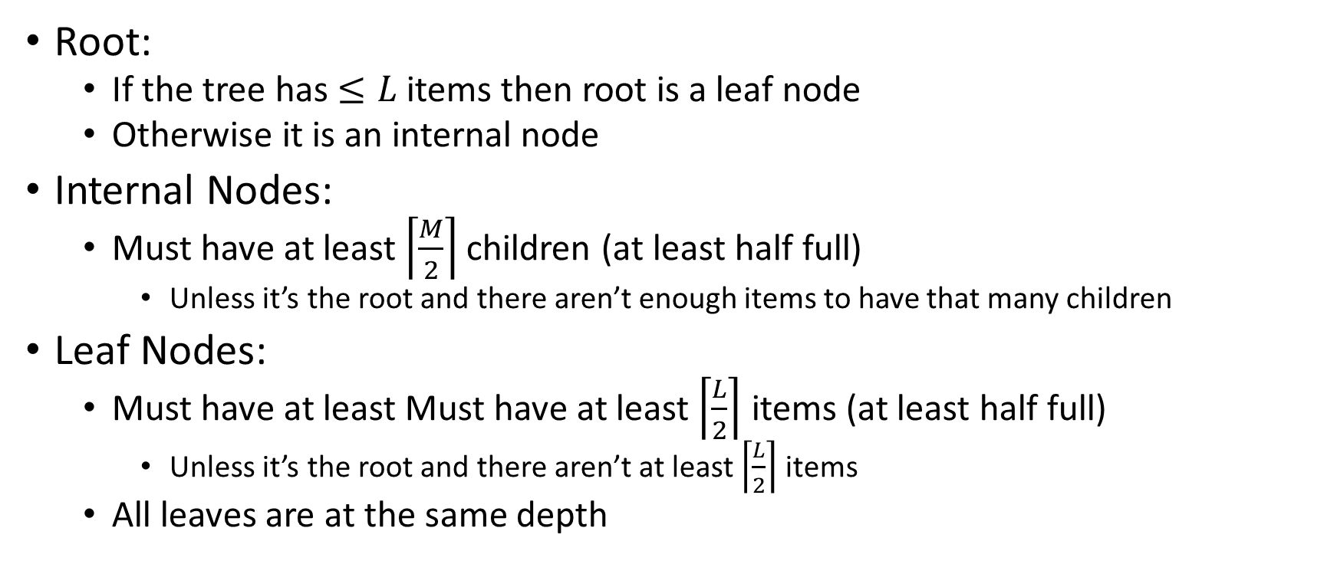
B Tree Structure Requirements
Root:
If the tree has $≤L$ items then root is a leaf node
Otherwise it is an internal node
Internal Nodes:
Must have at least $\left\lceil \frac{M}{2}\right\rceil$ children (at least half full)
Unless it’s the root and there aren’t enough items to have that many children
Leaf Nodes:
Must have at least Must have at least $\left\lceil \frac{L}{2}\right\rceil$ items (at least half full)
Unless it’s the root and there aren’t at least $\left\lceil \frac{L}{2}\right\rceil$ items
All leaves are at the same depth

Slide 10
Insertion Summary
Binary search to find which leaf should contain the new item
If there’s room, add it to the leaf array (maintaining sorted order)
If there’s not room, split
Make a new leaf node, move the larger $\left\lfloor \frac{L+1}{2}\right\rfloor$ items to it
If there’s room in the parent internal node, add new leaf to it (with new key bound value)
If there’s not room in the parent internal node, split that!
Make a new internal node and have it point to the larger $\left\lfloor \frac{M+1}{2}\right\rfloor$
If there’s room in the parent internal node, add this internal node to it
If there’s not room, repeat this process until there is!

Slide 11
Insertion TLDR
Find where the item goes by repeated binary search
If there’s room, just add it
If there’s not room, split things until there is

Slide 12
Insert Example
Insert 22
13
38
3
5
9
20
25
55
1
3
5
9
13
20
25
38
55
2
4
6
10
14
24
27
40
90
7
17
30
50

Slide 13
Insert Example
Insert 22
13
38
3
5
9
20
25
55
1
3
5
9
13
20
25
38
55
2
4
6
10
14
22
27
40
90
7
17
24
30
50

Slide 14
Insert Example
Insert 26
13
38
3
5
9
20
25
55
1
3
5
9
13
20
25
38
55
2
4
6
10
14
24
27
40
90
7
17
30
50

Slide 15
Insert Example
Insert 26
13
38
3
5
9
20
25
27
55
1
3
5
9
13
20
25
27
38
55
2
4
6
10
14
24
26
30
40
90
7
17
50

Slide 16
Insert Example
Insert 8
13
38
3
5
9
20
25
55
1
3
5
9
13
20
25
38
55
2
4
6
10
14
24
27
40
90
7
17
30
50

Slide 17
Insert Example
5
Split!
5
7
Insert 8
6
6
8
7
8
3
5
9
Split!
3
5
9
1
3
5
9
7
1
3
5
7
9
2
4
6
10
8
2
4
6
8
10

Slide 18
Insert Example
13
38
Insert 8
20
25
55
3
5
9
13
20
25
38
55
14
24
27
40
90
1
3
5
7
9
17
30
50
2
4
6
8
10

Slide 19
Insert Example
Insert 8
7
13
38
3
5
9
20
25
55
1
3
5
7
9
13
20
25
38
55
2
4
6
8
10
14
24
27
40
90
17
30
50

Slide 20
Let’s do it together!
$M=3, L=3$
Insert all of these:

Slide 25
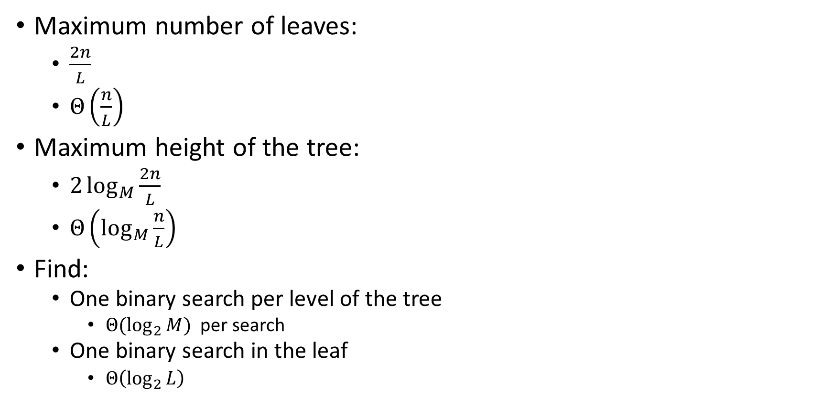
Running Time of Find
Maximum number of leaves:
$\frac{2n}{L}$
$Θ\left(\frac{n}{L}\right)$
Maximum height of the tree:
$2\log_{M}{\frac{2n}{L}}$
$Θ\left(\log_{M}{\frac{n}{L}}\right)$
Find:
One binary search per level of the tree
${Θ(log}_{2}{M})$ per search
One binary search in the leaf
$Θ\left(\log_{2}{L}\right)$
Overall: $Θ\left(\log_{2}{M}⋅\log_{M}{\frac{n}{L}}+\log_{2}{L}\right)$
Usually simplified to:
$$Θ\left(\log_{2}{M}⋅\log_{M}{n}\right)$$

Slide 26

Running Time of Insert
Find:
$Θ\left(\log_{2}{M}⋅\log_{M}{n}\right)$
Add item to leaf:
$Θ(L)$
Split a leaf
$Θ(L)$
Split one internal node:
$Θ(M)$
Overall: $Θ\left(L+M⋅\log_{M}{n}\right)$
Usually simplified to:
$$Θ\left(\log_{2}{M}⋅\log_{M}{n}\right)$$

Slide 27
Delete
Recall: all nodes must be at least half full (except root at startup)
delete 50
7
13
38
3
5
9
20
25
55
1
3
5
7
9
13
20
25
38
55
2
4
6
8
10
14
24
27
40
90
17
30
50

Slide 28
Delete
Recall: all nodes must be at least half full (except root at startup)
delete 24
7
13
38
3
5
9
20
25
55
1
3
5
7
9
13
20
25
38
55
2
4
6
8
10
14
24
27
40
90
17
30
50

Slide 29
Delete
Recall: all nodes must be at least half full (except root at startup)
delete 24
7
13
38
3
5
9
17
25
55
1
3
5
7
9
13
17
25
38
55
2
4
6
8
10
14
20
27
40
90
30
50

Slide 30
Delete
Recall: all nodes must be at least half full (except root at startup)
delete 5
7
13
38
3
5
9
17
25
55
1
3
5
7
9
13
17
25
38
55
2
4
6
8
10
14
20
27
40
90
30
50

Slide 31
Delete
Recall: all nodes must be at least half full (except root at startup)
delete 5
7
13
38
3
9
17
25
55
1
3
5
7
9
13
17
25
38
55
2
4
6
8
10
14
20
27
40
90
6
30
50

Slide 32
Delete
Recall: all nodes must be at least half full (except root at startup)
delete 1
7
13
38
3
9
17
25
55
1
3
7
9
13
17
25
38
55
2
4
8
10
14
20
27
40
90
30
50

Slide 33
Delete
Recall: all nodes must be at least half full (except root at startup)
delete 1
7
13
38
9
17
25
55
2
3
7
9
13
17
25
38
55
3
4
8
10
14
20
27
40
90
4
30
50

Slide 34
Delete
Recall: all nodes must be at least half full (except root at startup)
delete 1
13
38
3
9
9
17
25
55
2
7
9
7
9
13
17
25
38
55
3
8
10
8
10
14
20
27
40
90
4
30
50

Slide 35
Delete Summary
Find the item
Remove the item from the leaf
If that causes the leaf to be under-full, adopt from a neighbor
If that would cause the neighbor to be under-full, merge those two leaves
Update the parent
If that causes the parent to be under-full, adopt from a neighbor
If that causes the neighbor to be under-full, merge
Update the parent
…

Slide 36
Delete TLDR
Find and remove from leaf
Keep doing this until everything is “full enough”:
If the node is now too small, adopt from a neighbor
If the neighbor is too small then merge

Slide 37
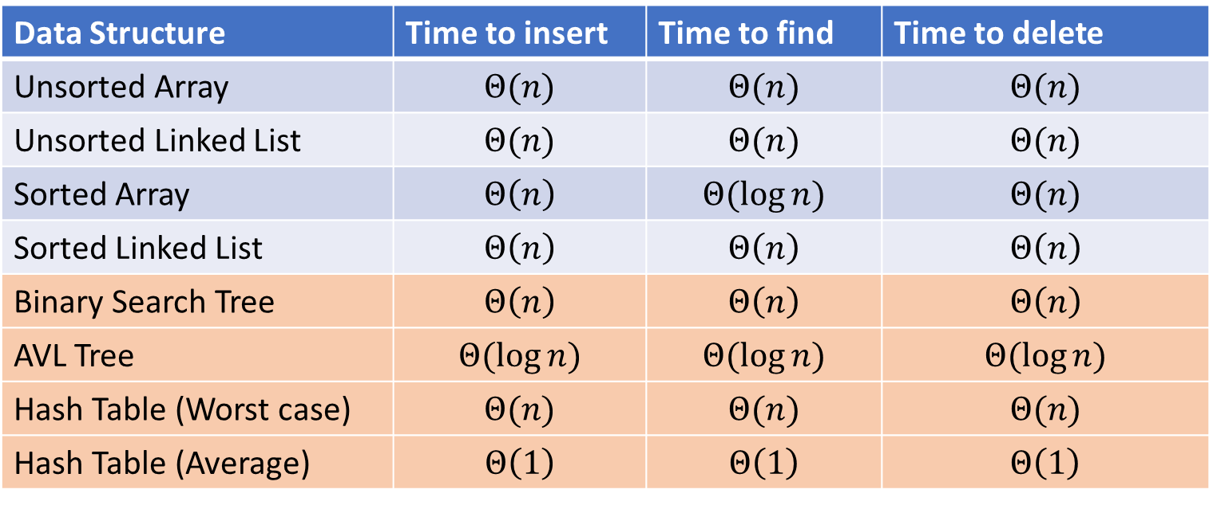
Next topic: Hash Tables
Data Structure | Time to insert | Time to find | Time to delete
Unsorted Array | $$Θ(n)$$ | $$Θ(n)$$ | $$Θ(n)$$
Unsorted Linked List | $$Θ(n)$$ | $$Θ(n)$$ | $$Θ(n)$$
Sorted Array | $$Θ\left(n\right)$$ | $$Θ(\log{n})$$ | $$Θ(n)$$
Sorted Linked List | $$Θ\left(n\right)$$ | $$Θ\left(n\right)$$ | $$Θ\left(n\right)$$
Binary Search Tree | $$Θ\left(n\right)$$ | $$Θ\left(n\right)$$ | $$Θ\left(n\right)$$
AVL Tree | $$Θ(\log{n})$$ | $$Θ(\log{n})$$ | $$Θ(\log{n})$$
Hash Table (Worst case) | $$Θ(n)$$ | $$Θ(n)$$ | $$Θ(n)$$
Hash Table (Average) | $$Θ\left(1\right)$$ | $$Θ\left(1\right)$$ | $$Θ\left(1\right)$$

Slide 38
Two Different ideas of “Average”
Expected Time
The expected number of operations a randomly-chosen input uses
Assumed randomness from somewhere
Most simply: from the input
Preferably: from the algorithm/data structure itself
$f\left(n\right)=$ sum of the running times for each input of size $n$ divided by the number of inputs of size $n$
Amortized Time
The long-term average per-execution cost (in the worst case)
Rather than look at the worst case of one execution, look at the total worst case of a sequential chain of many executions
Why? The worst case may be guaranteed to be rare
$f\left(n\right)=$ the sum of the running times from a sequence of $n$ sequential calls to the function divided by $n$

Slide 39
Amortized Example
ArrayList Insert:
Worst case: $Θ(n)$
0
1
2
3
4
5
6
7
8
0
1
2
3
4
5
6
7
8

Slide 40

Amortized Example
Do $x$ operations with cost 1
Do 1 operation with cost $x$
Do $x$ operations with cost 1
Do 1 operation with cost $2x$
Do $2x$ operations with cost 1
Do 1 operation with cost $4x$
Do $4x$ operations with cost 1
Do 1 operation with cost $8x$
…
Amortized: each operation cost 2 operations
$$Θ(1)$$
ArrayList Insert:
First 8 inserts: 1 operation each
9th insert: 9 operations
Next 7 inserts: 1 operation each
17th insert: 17 operations
Next 15 inserts: 1 operation each
…
0
1
2
3
4
5
6
7
8
0
1
2
3
4
5
6
7
8

Slide 41
Hash Tables
Motivation:
Why not just have a gigantic array?

Slide 42
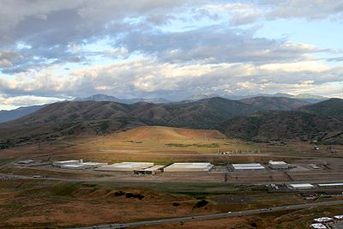
Problem?

Slide 43
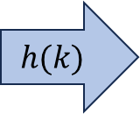
Hash Tables
Idea:
Have a small array to store information
Use a hash function to convert the key into an index
Hash function should “scatter” the keys, behave as if it randomly assigned keys to indices
Store key at the index given by the hash function
Do something if two keys map to the same place (should be very rare)
Collision resolution
Insert / find /
delete
$$h(k)$$
Index between 0 and size-1
& value
Key Object

Slide 44
Example
0
1
2
3
4
5
6
7
8
9
Key: Phone Number
Value: People
Table size: 10
$h\left(phone\right)=$ number as an integer % 10
$h\left(8675309\right)=9$

Slide 45
What Influences Running time?

Slide 46
Properties of a “Good” Hash
Definition: A hash function maps objects to integers
Should be very efficient
Calculating the hash should be negligible
Should randomly scatter objects
Objects that are similar to each other should be likely to end up far away
Should use the entire table
There should not be any indices in the table that nothing can hash to
Picking a table size that is prime helps with this
Should use things needed to “identify” the object
Use only fields you would check for a .equals method be included in calculating the hash
More fields typically leads to fewer collisions, but less efficient calculation

Slide 47
A Bad Hash (and phone number trivia)
$h\left(phone\right)=$ the first digit of the phone number
No US phone numbers start with 1 or 0
If we’re sampling from this class, 2 is by far the most likely
0
1
2
3
4
5
6
7
8
9

Slide 48
Compare These Hash Functions (for strings)
Let $s=s_{0}s_{1}s_{2}…s_{m−1}$ be a string of length $m$
Let $a(s_{i})$ be the ascii encoding of the character $s_{i}$
$h_{1}\left(s\right)=a\left(s_{0}\right)$
$h_{2}\left(s\right)=\left(\sum_{i=0}^{m−1}{a\left(s_{i}\right)}\right)$
$h_{3}\left(s\right)=\left(\sum_{i=0}^{m−1}{a\left(s_{i}\right)⋅{37}^{i}}\right)$

Slide 49
Collision Resolution
A Collision occurs when we want to insert something into an already-occupied position in the hash table
2 main strategies:
Separate Chaining
Use a secondary data structure to contain the items
E.g. each index in the hash table is itself a linked list
Open Addressing
Use a different spot in the table instead
Linear Probing
Quadratic Probing
Double Hashing
0
1
2
3
4
5
6
7
8
9

Slide 50
Separate Chaining Insert
To insert $k,v$:
Compute the index using $i=h\left(k\right) \% size$
Add the key-value pair to the data structure at $table\left[i\right]$
$$k,v$$
$$k,v$$
$$k,v$$
0
1
2
3
4
5
6
7
8
9

Slide 51
Separate Chaining Find
To find $k$:
Compute the index using $i=h\left(k\right) \% size$
Call find with the key on the data structure at $table\left[i\right]$
$$k,v$$
$$k,v$$
$$k,v$$
0
1
2
3
4
5
6
7
8
9

Slide 52
Separate Chaining Delete
To delete $k$:
Compute the index using $i=h\left(k\right) \% size$
Call delete with the key on the data structure at $table\left[i\right]$
$$k,v$$
$$k,v$$
$$k,v$$
0
1
2
3
4
5
6
7
8
9

Slide 53
Formal Running Time Analysis
The load factor of a hash table represents the average number of items per “bucket”
$λ=\frac{n}{size}$
Assume we have a has table that uses a linked-list for separate chaining
What is the expected number of comparisons needed in an unsuccessful find?
What is the expected number of comparisons needed in a successful find?
How can we make the expected running time $Θ(1)$?

Slide 54
Load Factor?
$$k,v$$
$$k,v$$
$$k,v$$
0
1
2
3
4
5
6
7
8
9

Slide 55
Load Factor?
$$k,v$$
$$k,v$$
$$k,v$$
$$k,v$$
$$k,v$$
$$k,v$$
$$k,v$$
$$k,v$$
0
1
2
3
4
5
6
7
8
9

Slide 56
Load Factor?
$$k,v$$
$$k,v$$
$$k,v$$
$$k,v$$
$$k,v$$
$$k,v$$
$$k,v$$
$$k,v$$
$$k,v$$
$$k,v$$
$$k,v$$
$$k,v$$
$$k,v$$
$$k,v$$
$$k,v$$
0
1
2
3
4
5
6
7
8
9

