Slide 1
CSE 332 Summer 2024 Lecture 6: Priority Queues & Dictionaries
Nathan Brunelle
http://www.cs.uw.edu/332

Slide 2
Warm Up
Describe an algorithm for finding the maximum value in a min heap.
The last $\frac{n}{2}$ nodes in the heap are leaves, the max must be a leaf, we just check the last $\frac{n}{2}$ items
What is its running time?

Slide 3
ADT: Priority Queue
What is it?
A collection of items and their “priorities”
Allows quick access/removal to the “top priority” thing
Usually a smaller priority value means the item is “more important”
What Operations do we need?
insert(item, priority)
Add a new item to the PQ with indicated priority
extract
Remove and return the “top priority” item from the queue
Usually the item with the smallest priority value
IsEmpty
Indicate whether or not there are items still on the queue
Note: the “priority” value can be any type/class so long as it’s comparable (i.e. you can use “<“ or “compareTo” with it)

Slide 4
Thinking through implementations
Data Structure | Worst case time to insert | Worst case time to extract
Unsorted Array | $$Θ(1)$$ | $$Θ(n)$$
Unsorted Linked List | $$Θ(1)$$ | $$Θ(n)$$
Sorted Array | $$Θ\left(n\right)$$ | $$Θ(1)$$
Sorted Linked List | $$Θ\left(n\right)$$ | $$Θ\left(1\right)$$
Binary Search Tree | $$Θ\left(n\right)$$ | $$Θ\left(n\right)$$
Binary Heap | $$Θ\left(\log{n}\right)$$ | $$Θ\left(\log{n}\right)$$
For simplicity, Assume we know the maximum size of the PQ in advance (otherwise we’d do an amortized analysis, but get the same answers…)

Slide 5
Trees for Heaps
Binary Trees:
The branching factor is 2
Every node has $≤$ 2 children
Complete Tree:
All “layers” are full, except the bottom
Bottom layer filled left-to-right
1
3
2
4
7
5
6
5
9

Slide 6
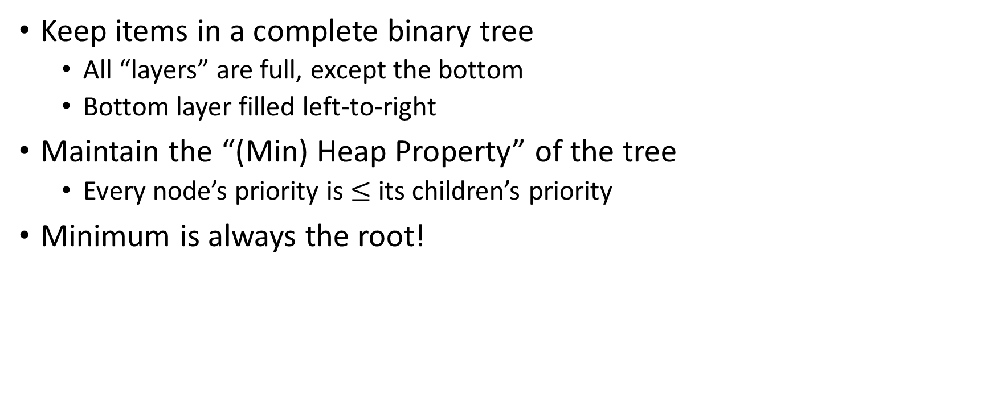
(Min) Heap Data Structure
Keep items in a complete binary tree
All “layers” are full, except the bottom
Bottom layer filled left-to-right
Maintain the “(Min) Heap Property” of the tree
Every node’s priority is $≤$ its children’s priority
Minimum is always the root!
1
3
2
4
7
5
6
5
9

Slide 7
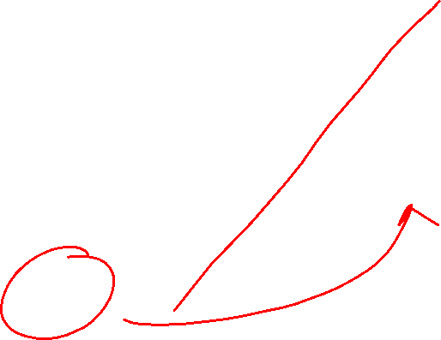
Representing a Heap
1
3
2
4
7
5
6
5
9
0
1
2
3
4
5
6
7
8
9
Every complete binary tree with the same number of nodes uses the same positions and edges
Use an array to represent the heap
Index of root: 1
Parent of node $i$: $\left\lfloor \frac{i}{2}\right\rfloor$
Left child of node $i$: $2i$
Right child of node $i$: $2i+1$
Location of the leaves:
Last $\left\lceil \frac{n}{2}\right\rceil$ indices
1
1
3
2
4
2
7
5
3
6
4
5
6
7
5
9
8
9

Slide 8
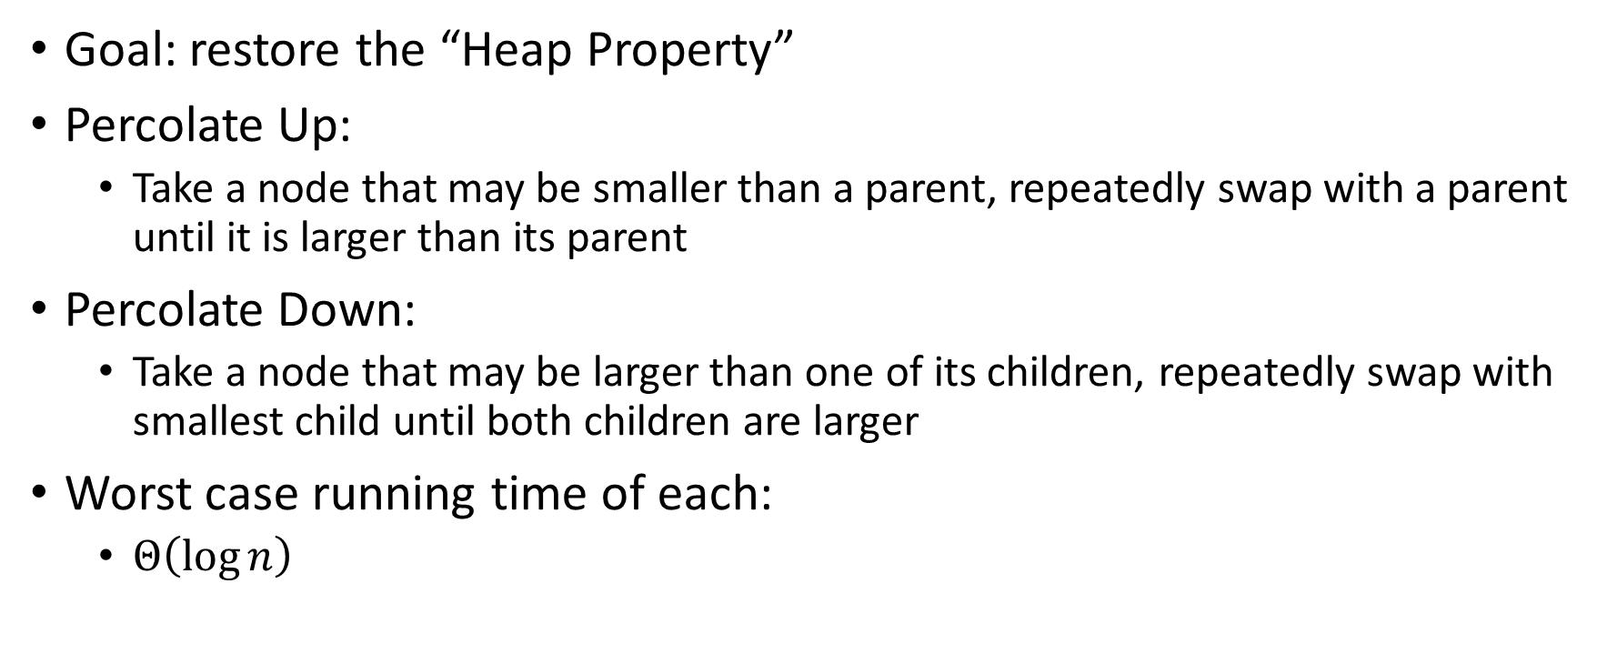
Percolate Up and Down (for a Min Heap)
Goal: restore the “Heap Property”
Percolate Up:
Take a node that may be smaller than a parent, repeatedly swap with a parent until it is larger than its parent
Percolate Down:
Take a node that may be larger than one of its children, repeatedly swap with smallest child until both children are larger
Worst case running time of each:
$Θ\left(\log{n}\right)$

Slide 9
Percolate Up
percolateUp(int i){
int parent = i/2; \\ index of parent
Item val = arr[i]; \\ value at current location
while(i > 1 && arr[i] < arr[parent]){ \\ until location is root or heap property holds
arr[i] = arr[parent]; \\ move parent value to this location
arr[parent] = val; \\ put current value into parent’s location
i = parent; \\ make current location the parent
parent = i/2; \\ update new parent
}
}

Slide 10
Percolate Down
percolateDown(int i){
int left = i*2; \\ index of left child
int right = i*2+1; \\ index of right child
Item val = arr[i]; \\ value at location
while(left <= size){ \\ until location is leaf
int toSwap = right;
if(right > size || arr[left] < arr[right]){ \\ if there is no right child or if left child is smaller
toSwap = left; \\ swap with left
} \\ now toSwap has the smaller of left/right, or left if right does not exist
if (arr[toSwap] < val){ \\ if the smaller child is less than the current value
arr[i] = arr[toSwap];
arr[toSwap] = val; \\ swap parent with smaller child
i = toSwap; \\ update current node to be smaller child
left = i*2;
right = i*2+1;
}
else{ return;} \\ if we don’t swap, then heap property holds
}
}

Slide 11
Operations
Insert
Make the new item last in the array, percolate up
Extract
Move the last item to the root, percolate down
Increase Key
Given the index of an item in the PQ, make its priority value larger
Min Heap: Then percolate Down
Max Heap: Then percolate Up
Decrease Key
Given the index of an item in the PQ, make its priority value smaller
Min Heap: Then percolate Up
Max Heap: Then percolate Down
Remove
Return the item at the given index from the PQ, remove that item from the PQ
Incorrect algorithm: consider the subtree rooted at the given index, perform an extract on that subtree

Slide 12
Operations
Insert
Place new item last in the array, percolate it up
Extract
Save root’s value, move last item to root, percolate it down
Increase Key
Given the index of an item in the PQ, make its priority value larger
Min Heap: Then percolate Down
Max Heap: Then percolate Up
Decrease Key
Given the index of an item in the PQ, make its priority value smaller
Min Heap: Then percolate Up
Max Heap: Then percolate Down
Remove
Return the item at the given index from the PQ, remove that item from the PQ
Save value at the given index, move last item to that index, percolated it down

Slide 13
Aside: Expected Running time of Insert
Assume I have a heap with $n$ items in it. I insert a “random” item.
Probability that the item is a leaf of the heap
Roughly half the nodes in a heap are leaves
There is a 50% chance of needing to do 1 comparison
The new node is the parent of a leaf
We do 2 comparisons
$\frac{n}{4}$
$\frac{1}{2}+2⋅\frac{1}{4}+3⋅\frac{1}{8}+4⋅\frac{1}{16}+…$
$Θ\left(1\right)$

Slide 14
Building a Heap From “Scratch”
Suppose we had $n$ items and wanted to “heapify” them
5
5
6
10
3
15
8
7
14
2
1
Violate Heap Property!
1
0
1
2
3
4
5
6
7
8
9
10
6
10
3
2
15
8
3
7
Two ways for “fix” the heap:
Percolate Up
Percolate Down
4
5
6
7
14
2
1
8
9
10

Slide 15
Floyd’s buildHeap method
Working towards the root, one row at a time, percolate down
buildHeap(){
for(int i = size; i>0; i--){
percolateDown(i);
}
}

Slide 16
Floyd’s buildHeap method
Suppose we had $n$ items and wanted to “heapify” them
Violate Heap Property!
Nodes bigger than a child
5
5
6
10
3
15
8
7
14
2
1
1
0
1
2
3
4
5
6
7
8
9
10
6
10
3
2
8
3
7
buildHeap(){
for(int i = size; i>0; i--){
percolateDown(i);
}
}
15
4
5
6
7
14
2
1
8
9
10

Slide 17
Floyd’s buildHeap method
Suppose we had $n$ items and wanted to “heapify” them
Violate Heap Property!
Nodes bigger than a child
5
5
6
10
3
15
8
7
14
2
1
1
0
1
2
3
4
5
6
7
8
9
10
6
10
3
2
8
3
7
buildHeap(){
for(int i = size; i>0; i--){
percolateDown(i);
}
}
1
4
5
6
7
14
2
15
8
9
10

Slide 18
Floyd’s buildHeap method
Suppose we had $n$ items and wanted to “heapify” them
5
5
6
10
3
15
8
7
14
2
1
Violate Heap Property!
1
0
1
2
3
4
5
6
7
8
9
10
6
10
2
2
8
3
7
buildHeap(){
for(int i = size; i>0; i--){
percolateDown(i);
}
}
1
4
5
6
7
14
3
15
8
9
10

Slide 19
Floyd’s buildHeap method
Suppose we had $n$ items and wanted to “heapify” them
5
5
6
10
3
15
8
7
14
2
1
Violate Heap Property!
1
0
1
2
3
4
5
6
7
8
9
10
6
7
2
2
8
3
10
buildHeap(){
for(int i = size; i>0; i--){
percolateDown(i);
}
}
1
4
5
6
7
14
3
15
8
9
10

Slide 20
Floyd’s buildHeap method
Suppose we had $n$ items and wanted to “heapify” them
5
5
6
10
3
15
8
7
14
2
1
Violate Heap Property!
1
0
1
2
3
4
5
6
7
8
9
10
1
7
2
2
8
3
10
buildHeap(){
for(int i = size; i>0; i--){
percolateDown(i);
}
}
6
4
5
6
7
14
3
15
8
9
10

Slide 21
Floyd’s buildHeap method
Suppose we had $n$ items and wanted to “heapify” them
1
5
6
10
3
15
8
7
14
2
1
Violate Heap Property!
1
0
1
2
3
4
5
6
7
8
9
10
2
7
3
2
8
3
10
buildHeap(){
for(int i = size; i>0; i--){
percolateDown(i);
}
}
6
4
5
6
7
14
5
15
8
9
10

Slide 22
How long did this take?
buildHeap(){
for(int i = size; i>0; i--){
percolateDown(i);
}
}
Worst case running time of buildHeap:
No node can percolate down more than the height of its subtree
When i is a leaf: 1
When i is second-from-last level: 2
When i is third-from-last level: 3
Overall Running time:
$\frac{n}{2}+2⋅\frac{n}{4}+3⋅\frac{n}{8}+…$
$Θ(n)$

Slide 23
Dictionary (Map) ADT
Contents:
Sets of key+value pairs
Keys must be comparable
Operations:
insert(key, value)
Adds the (key,value) pair into the dictionary
If the key already has a value, overwrite the old value
Consequence: Keys cannot be repeated
find(key)
Returns the value associated with the given key
delete(key)
Remove the key (and its associated value)

Slide 24
Naïve attempts
Data Structure | Time to insert | Time to find | Time to delete
Unsorted Array | $$Θ(n)$$ | $$Θ(n)$$ | $$Θ(n)$$
Unsorted Linked List | $$Θ(n)$$ | $$Θ(n)$$ | $$Θ(n)$$
Sorted Array | $$Θ\left(n\right)$$ | $$Θ(\log{n})$$ | $$Θ(n)$$
Sorted Linked List | $$Θ\left(n\right)$$ | $$Θ\left(n\right)$$ | $$Θ\left(n\right)$$
Heap | $$Θ(n)$$ | $$Θ(n)$$ | $$Θ(n)$$

Slide 25
Less Naïve attempts
Binary Search Trees (today)
AVL Trees (Wednesday/Friday)
Hash Tables (Next week)
Red-Black Trees (not included in this course)
Splay Trees (not included in this course)
Tries (not included in this course)
B-Trees (included in 331)

Slide 26
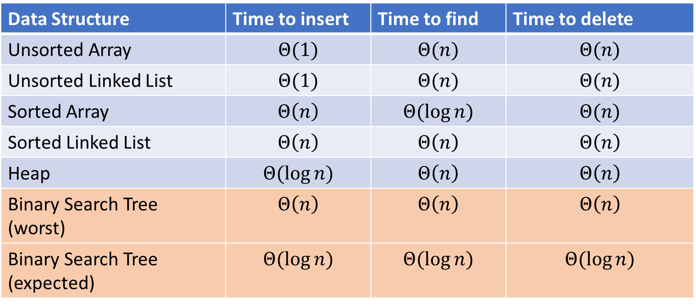
Naïve attempts
Data Structure | Time to insert | Time to find | Time to delete
Unsorted Array | $$Θ(1)$$ | $$Θ(n)$$ | $$Θ(n)$$
Unsorted Linked List | $$Θ(1)$$ | $$Θ(n)$$ | $$Θ(n)$$
Sorted Array | $$Θ\left(n\right)$$ | $$Θ(\log{n})$$ | $$Θ(n)$$
Sorted Linked List | $$Θ\left(n\right)$$ | $$Θ\left(n\right)$$ | $$Θ\left(n\right)$$
Heap | $$Θ(\log{n})$$ | $$Θ\left(n\right)$$ | $$Θ\left(n\right)$$
Binary Search Tree (worst) | $$Θ\left(n\right)$$ | $$Θ\left(n\right)$$ | $$Θ\left(n\right)$$
Binary Search Tree (expected) | $$Θ(\log{n})$$ | $$Θ(\log{n})$$ | $$Θ(\log{n})$$

Slide 27
Tree Height
treeHeight(root){
height = 0;
if (root.left != Null){
height = max(height, treeHeight(root.left));
}
if (root.right != Null){
height = max(height, treeHeight(root.right));
}
return 1 + height;
}

Slide 28
More Tree “Vocab”
D
U
B
Traversal:
An algorithm for “visiting/processing” every node in a tree
Pre-Order Traversal:
Root, Left Subtree, Right Subtree
D (U S 2) B
In-Order Traversal:
Left Subtree, Root, Right Subtree
Post-Order Traversal
Left Subtree, Right Subtree, Root
S
2

Slide 29
Name that Traversal!
AorderTraversal(root){
if (root.left != Null){
process(root.left);
}
if (root.right != Null){
process(root.right);
}
process(root);
}
BorderTraversal(root){
process(root);
if (root.left != Null){
process(root.left);
}
if (root.right != Null){
process(root.right);
}
}
CorderTraversal(root){
if (root.left != Null){
process(root.left);
}
process(root)
if (root.right != Null){
process(root.right);
}
}

Slide 30
Binary Search Tree
7
3
10
1
6
8
16
Binary Tree
Definition:
Order Property
All keys in the left subtree are smaller than the root
All keys in the right subtree are larger than the root
Why?
0
2

Slide 31
Are these BSTs?
7
3
10
7
7
16
1
3
10
0
1
16
16
10
0
7
7
3
10
3
1
8
16
1
0
0

Slide 32
Aside: Why not use an array?
We represented a heap using an array, finding children/parents by index
We will represent BSTs with nodes and references. Why?

Slide 33
Find Operation (recursive)
7
3
10
find(key, root){
if (root == Null){
return Null;
{
if (key == root.key){
return root.value;
}
if (key < root.key){
return find(key, root.left);
}
if (key > root.key){
return find(key, root.right);
}
return Null;
}
1
6
16
0

Slide 34
Find Operation (iterative)
7
3
10
find(key, root){
while (root != Null && key != root.key){
if (key < root.key){
root = root.left;
}
else if (key > root.key){
root = root.right;
}
}
if (root == Null){
return Null;
}
return root.value;
}
1
6
16
0

Slide 35
Insert Operation (recursive)
7
3
10
insert(key, value, root){
root = insertHelper(key, value, root);
}
insertHelper(key, value, root){
if(root == null)
return new Node(key, value);
if (root.key < key)
root.right = insertHelper(key, value, root.right);
else
root.left = insertHelper(key, value, root.left);
return root;
}
1
6
16
0
Note: Insert happens only at the leaves!

Slide 36
Insert Operation (iterative)
7
3
10
insert(key, value, root){
if (root == Null){ this.root = new Node(key, value); }
parent = Null;
while (root != Null && key != root.key){
parent = root;
if (key < root.key){ root = root.left; }
else if (key > root.key){ root = root.right; }
}
if (root != Null){ root.value = value; }
else if (key < parent.key){ parent.left = new Node(key, value); }
else{ parent.right = new Node (key, value); }
}
1
6
16
0
Note: Insert happens only at the leaves!

Slide 38
Delete Operation (iterative)
9
3
10
delete(key, root){
while (root != Null && key != root.key){
if (key < root.key){ root = root.left; }
else if (key > root.key){ root = root.right; }
}
if (root == Null){ return; }
// Now root is the node to delete, what happens next?
}
1
6
16
0
5
7

Slide 39
Delete – 3 Cases
9
3
10
1
6
16
0 Children (i.e. it’s a leaf)
1 Child
2 Children
0
5
7

Slide 40
Finding the Max and Min
9
3
10
maxNode(root){
if (root == Null){ return Null; }
while (root.right != Null){
root = root.right;
}
return root;
}
1
6
16
Max of a BST:
Right-most Thing
Min of a BST:
Left-most Thing
0
5
7
minNode(root){
if (root == Null){ return Null; }
while (root.left != Null){
root = root.left;
}
return root;
}

Slide 41
Delete Operation (iterative)
9
3
10
delete(key, root){
while (root != Null && key != root.key){
if (key < root.key){ root = root.left; }
else if (key > root.key){ root = root.right; }
}
if (root == Null){ return; }
if (root has no children){
make parent point to Null Instead;
}
if (root has one child){
make parent point to that child instead;
}
if (root has two children){
make parent point to either the max from the left or min from the right
}
}
1
6
16
0
5
7

Slide 42
Worst Case Analysis
For each of Find, insert, Delete:
Worst case running time matches height of the tree
What is the maximum height of a BST with $n$ nodes?

Slide 43
Improving the worst case
How can we get a better worst case running time?

