Slide 1
CSE 332 Autumn 2023
Lecture 6: Priority Queues 2
Nathan Brunelle
http://www.cs.uw.edu/332

Slide 2

Warm Up!
What is the maximum number of total nodes in a binary tree of height $h$?
  Height: The number of edges in the path from root to the deepest leaf
If I have $n$ nodes in a binary tree, what is the its minimum height?

Slide 3

Trees for Heaps
Binary Trees:
  The branching factor is 2
  Every node has $≤$ 2 children
Complete Tree:
  All “layers” are full, except the bottom
  Bottom layer filled left-to-right
1
Tree T
3
2
4
7
5
6
5
9

Slide 4
ADT: Priority Queue
What is it?
  A collection of items and their “priorities”
  Allows quick access/removal to the “top priority” thing
What Operations do we need?
  insert(item, priority)
    Add a new item to the PQ with indicated priority
    Usually, smaller priority value means more important
  deleteMin
    Remove and return the “top priority” item from the queue
  Is_empty
    Indicate whether or not there are items still on the queue
Note: the “priority” value can be any type/class so long as it’s comparable (i.e. you can use “<“ or “compareTo” with it)

Slide 5
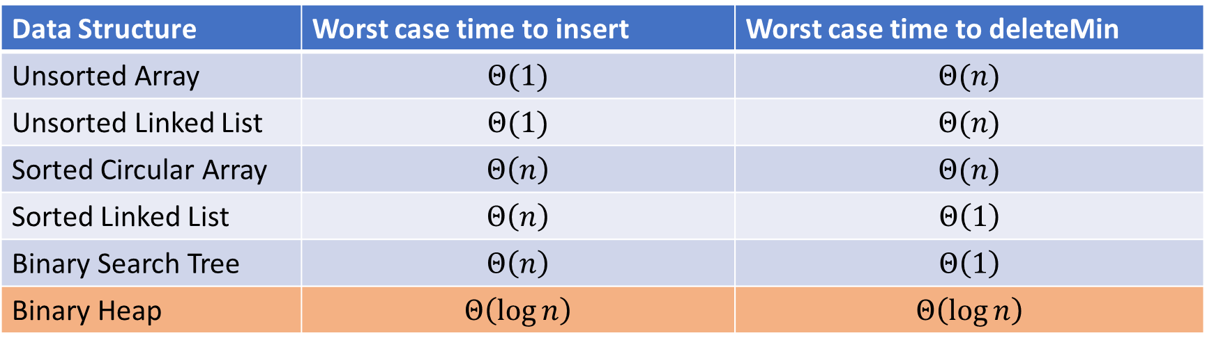
Thinking through implementations
Data Structure | Worst case time to insert | Worst case time to deleteMin
Unsorted Array | $$Θ(1)$$ | $$Θ(n)$$
Unsorted Linked List | $$Θ(1)$$ | $$Θ(n)$$
Sorted Circular Array | $$Θ\left(n\right)$$ | $$Θ(n)$$
Sorted Linked List | $$Θ\left(n\right)$$ | $$Θ\left(1\right)$$
Binary Search Tree | $$Θ\left(n\right)$$ | $$Θ\left(1\right)$$
Binary Heap | $$Θ\left(\log{n}\right)$$ | $$Θ\left(\log{n}\right)$$
Note: Assume we know the maximum size of the PQ in advance

Slide 6

Heap – Priority Queue Data Structure
Idea: We need to keep some ordering, but it doesn’t need to be perfectly sorted
$Θ(\log{n})$ worst case for deleteMin and insert
1
3
2
4
7
5
6
5
9

Slide 7
Heap – Priority Queue Data Structure
Idea: We need to keep some ordering, but it doesn’t need to be perfectly sorted
$Θ(\log{n})$ worst case for deleteMin and insert
1
1
3
2
4
2
7
5
3
6
4
5
6
7
5
9
8
9

Slide 8
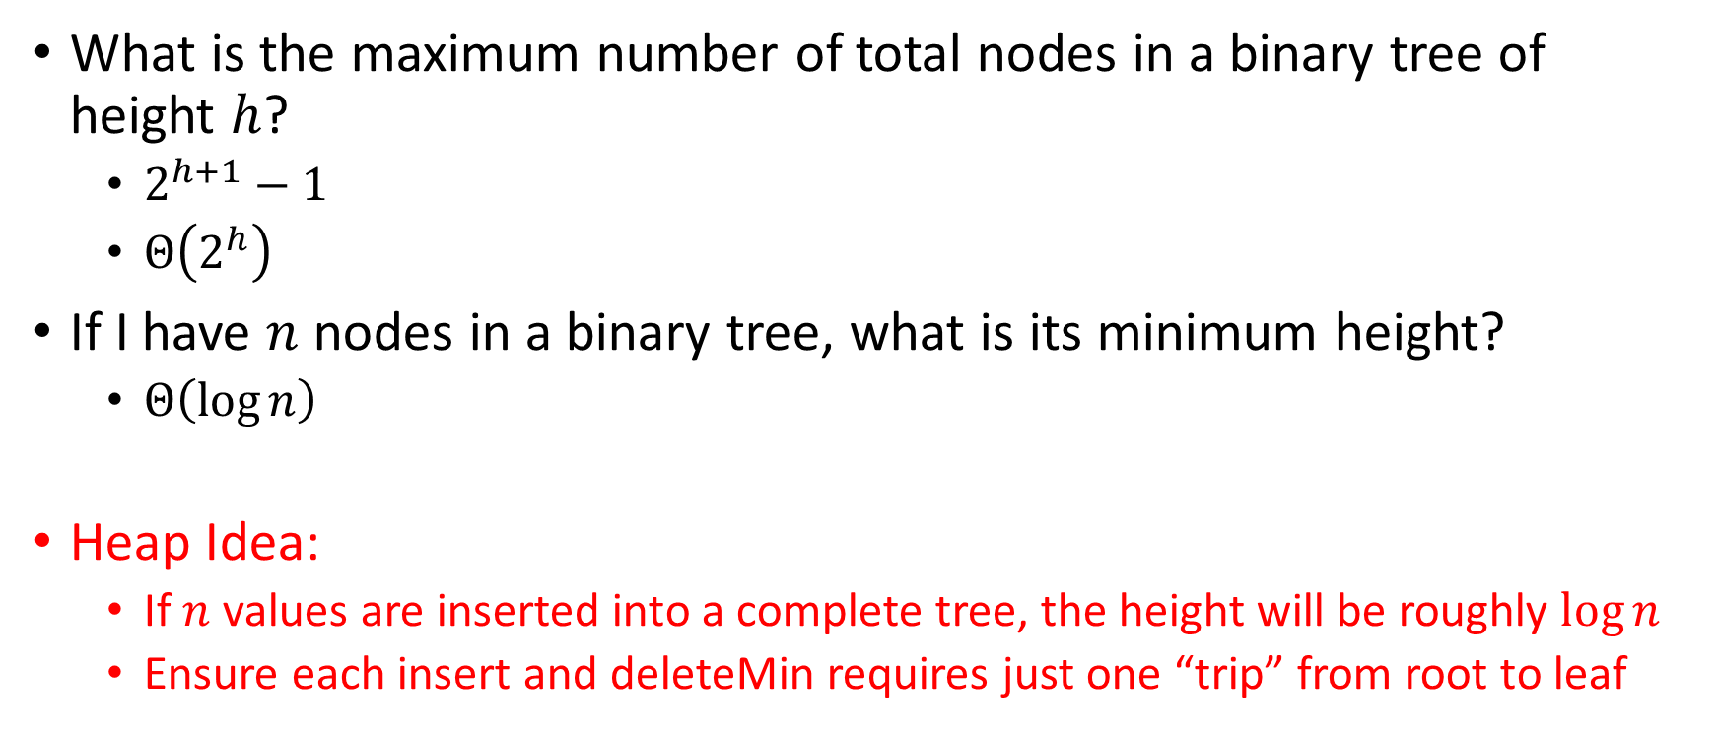
Challenge!
What is the maximum number of total nodes in a binary tree of height $h$?
  $2^{h+1}−1$
  $Θ\left(2^{h}\right)$
If I have $n$ nodes in a binary tree, what is its minimum height?
  $Θ\left(\log{n}\right)$
Heap Idea:
  If $n$ values are inserted into a complete tree, the height will be roughly $\log{n}$
  Ensure each insert and deleteMin requires just one “trip” from root to leaf

Slide 9
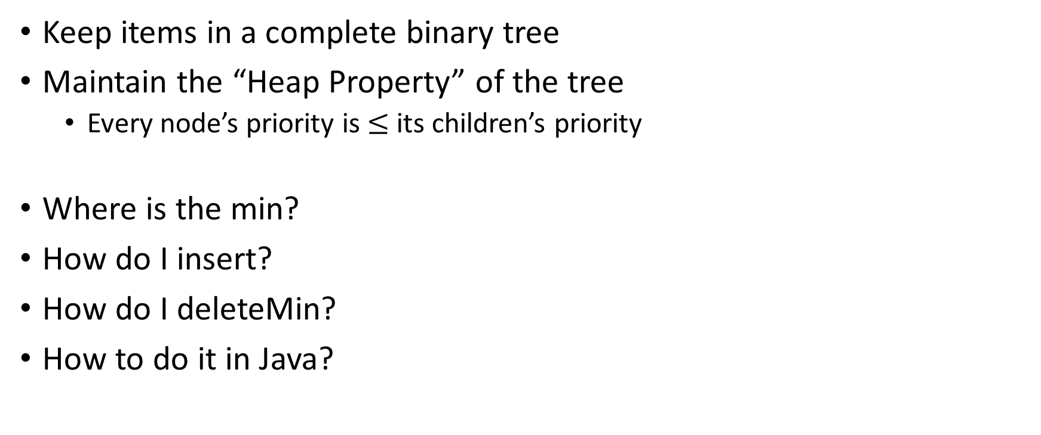
Heap Data Structure
Keep items in a complete binary tree
Maintain the “Heap Property” of the tree
  Every node’s priority is $≤$ its children’s priority
Where is the min?
How do I insert?
How do I deleteMin?
How to do it in Java?
1
3
2
4
7
5
6
5
9

Slide 10
Heap Insert
1
1.5
3
2
4
7
5
6
5
9
insert(item){
put item in the “next open” spot (keep tree complete)
while (item.priority < parent(item).priority){
swap item with parent
}
}

Slide 11
Heap Insert
1
3
2
4
7
5
6
5
9
1.5
insert(item){
put item in the “next open” spot (keep tree complete)
while (item.priority < parent(item).priority){
swap item with parent
}
}

Slide 12
Heap Insert
1
3
2
4
1.5
5
6
5
9
7
insert(item){
put item in the “next open” spot (keep tree complete)
while (item.priority < parent(item).priority){
swap item with parent
}
}
Percolate Up

Slide 13
Heap Insert
1
1.5
2
4
3
5
6
5
9
7
insert(item){
put item in the “next open” spot (keep tree complete)
while (item.priority < parent(item).priority){
swap item with parent
}
}
Percolate Up

Slide 14
Heap Insert
1
1.5
2
4
3
5
6
5
9
7
insert(item){
put item in the “next open” spot (keep tree complete)
while (item.priority < parent(item).priority){
swap item with parent
}
}

Slide 15

Heap deleteMin
1
1.5
2
4
3
5
6
deleteMin(){
min = root
br = bottom-right item
move br to the root
while(br $>$ either of its children){
swap br with its smallest child
}
return min
}
5
9
7

Slide 16

Heap deleteMin
7
1.5
2
4
3
5
6
deleteMin(){
min = root
br = bottom-right item
move br to the root
while(br $>$ either of its children){
swap br with its smallest child
}
return min
}
5
9
7

Slide 17

Heap deleteMin
7
7
2
4
3
5
6
deleteMin(){
min = root
br = bottom-right item
move br to the root
while(br $>$ either of its children){
swap br with its smallest child
}
return min
}
5
9
Percolate Down

Slide 18
Heap deleteMin
7
3
2
4
7
5
6
deleteMin(){
min = root
br = bottom-right item
move br to the root
while(br $>$ either of its children){
swap br with its smallest child
}
return min
}
5
9
Percolate Down

Slide 19

Heap deleteMin
7
3
2
4
7
5
6
deleteMin(){
min = root
br = bottom-right item
move br to the root
while(br $>$ either of its children){
swap br with its smallest child
}
return min
}
5
9

Slide 20
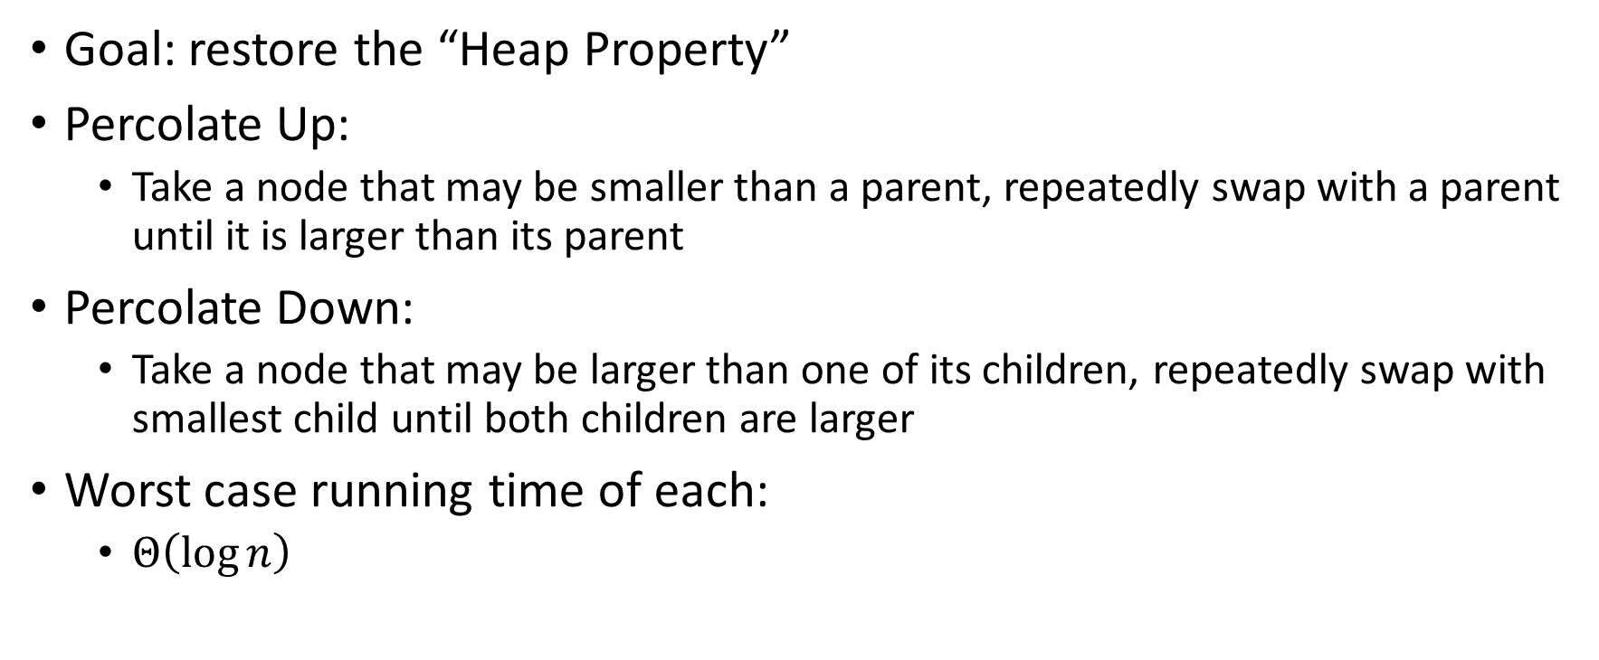
Percolate Up and Down
Goal: restore the “Heap Property”
Percolate Up:
  Take a node that may be smaller than a parent, repeatedly swap with a parent until it is larger than its parent
Percolate Down:
  Take a node that may be larger than one of its children, repeatedly swap with smallest child until both children are larger
Worst case running time of each:
  $Θ\left(\log{n}\right)$

Slide 21
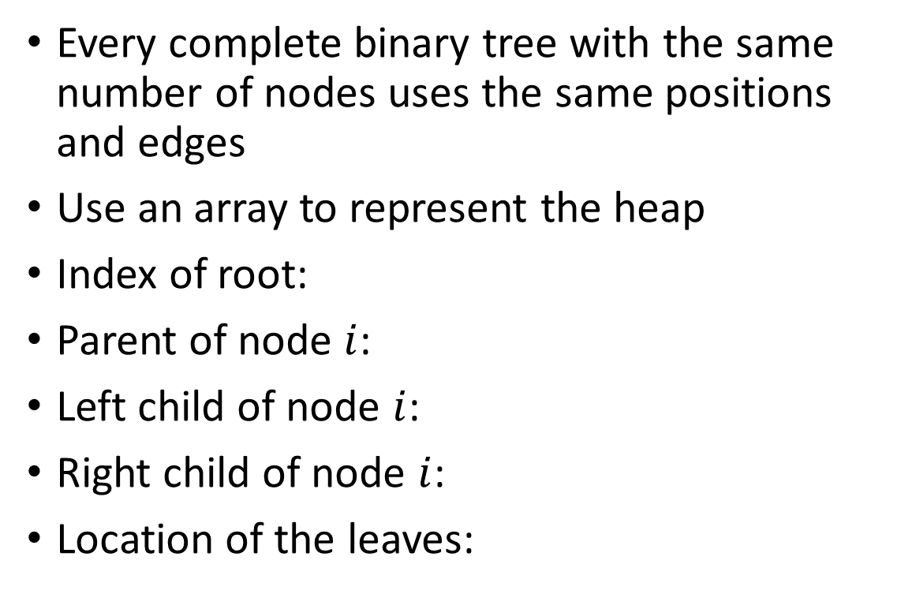
Representing a Heap
1
3
2
4
7
5
6
5
9
0
1
2
3
4
5
6
7
8
9
Every complete binary tree with the same number of nodes uses the same positions and edges
Use an array to represent the heap
Index of root:
Parent of node $i$:
Left child of node $i$:
Right child of node $i$:
Location of the leaves:
1
1
3
2
4
2
7
5
3
6
4
5
6
7
5
9
8
9

Slide 22
Insert Psuedocode
1
3
2
4
7
5
6
5
9
0
1
2
3
4
5
6
7
8
9
10
insert(item){
if(size == arr.length – 1){resize();}
size++;
arr[i] = item;
percolateUp(i)
}
1
1
3
2
4
2
7
5
3
6
4
5
6
7
5
9
8
9

Slide 23
Percolate Up
percolateUp(i){
parent = i/2; \\ index of parent
val = arr[i]; \\ value at location
while(i > 1 && arr[i] < arr[parent]){ \\ until location is root or heap property holds
arr[i] = arr[parent]; \\ move parent value to this location
arr[parent] = val; \\ put current value into parent’s location
i = parent; \\ make current location the parent
parent = i/2; \\ update new parent
}
}

Slide 24
DeleteMin Psuedocode
deleteMin(){
theMin = arr[1];
arr[1] = arr[size];
size--;
percolateDown(1);
return theMin;
}

Slide 25
Percolate Down
percolateDown(i){
left = i*2; \\ index of left child
right = i*2+1; \\ index of right child
val = arr[i]; \\ value at location
while(left <= size){ \\ until location is leaf
toSwap = right;
if(right > size || arr[left] < arr[right]){ \\ if there is no right child or if left child is smaller
toSwap = left; \\ swap with left
} \\ now toSwap has the smaller of left/right, or left if right does not exist
if (arr[toSwap]< val){ \\ if the smaller child is less than the current value
arr[i] = arr[toSwap];
arr[toSwap] = val; \\ swap parent with smaller child
i = toSwap; \\ update current node to be smaller child
left = i*2;
right = i*2+1;
}
else{ break;} \\ if we don’t swap, then heal property holds
}
}

Slide 26
Other Operations
Increase Key
  Given the index of an item in the PQ, subtract from its priority value
Decrease Key
  Given the index of an item in the PQ, add to its priority value
Remove
  Given the item at the given index from the PQ

Slide 27
Aside: Expected Running time of Insert

Slide 28

Building a Heap From “Scratch”
Suppose we had $n$ items and wanted to “heapify” them
5
5
6
10
3
15
8
7
14
2
1
Violate Heap Property!
1
0
1
2
3
4
5
6
7
8
9
10
6
10
3
2
15
8
3
7
Two ways for “fix” the heap:
Percolate Up
Percolate Down
4
5
6
7
14
2
1
8
9
10

Slide 29
Floyd’s buildHeap method
Working towards the root, one row at a time, percolate down
buildHeap(){
for(int i = size; i>0; i--){
percolateDown(i);
}
}

Slide 30
Floyd’s buildHeap method
Suppose we had $n$ items and wanted to “heapify” them
5
5
6
10
3
15
8
7
14
2
1
Violate Heap Property!
1
0
1
2
3
4
5
6
7
8
9
10
6
10
3
2
8
3
7
buildHeap(){
for(int i = size; i>0; i--){
percolateDown(i);
}
}
15
4
5
6
7
14
2
1
8
9
10

Slide 31
Floyd’s buildHeap method
Suppose we had $n$ items and wanted to “heapify” them
5
5
6
10
3
15
8
7
14
2
1
Violate Heap Property!
1
0
1
2
3
4
5
6
7
8
9
10
6
10
3
2
8
3
7
buildHeap(){
for(int i = size; i>0; i--){
percolateDown(i);
}
}
1
4
5
6
7
14
2
15
8
9
10

Slide 32
Floyd’s buildHeap method
Suppose we had $n$ items and wanted to “heapify” them
5
5
6
10
3
15
8
7
14
2
1
Violate Heap Property!
1
0
1
2
3
4
5
6
7
8
9
10
6
10
2
2
8
3
7
buildHeap(){
for(int i = size; i>0; i--){
percolateDown(i);
}
}
1
4
5
6
7
14
3
15
8
9
10

Slide 33
Floyd’s buildHeap method
Suppose we had $n$ items and wanted to “heapify” them
5
5
6
10
3
15
8
7
14
2
1
Violate Heap Property!
1
0
1
2
3
4
5
6
7
8
9
10
6
7
2
2
8
3
10
buildHeap(){
for(int i = size; i>0; i--){
percolateDown(i);
}
}
1
4
5
6
7
14
3
15
8
9
10

Slide 34
Floyd’s buildHeap method
Suppose we had $n$ items and wanted to “heapify” them
5
5
6
10
3
15
8
7
14
2
1
Violate Heap Property!
1
0
1
2
3
4
5
6
7
8
9
10
1
7
2
2
8
3
10
buildHeap(){
for(int i = size; i>0; i--){
percolateDown(i);
}
}
6
4
5
6
7
14
3
15
8
9
10

Slide 35
Floyd’s buildHeap method
Suppose we had $n$ items and wanted to “heapify” them
1
5
6
10
3
15
8
7
14
2
1
Violate Heap Property!
1
0
1
2
3
4
5
6
7
8
9
10
2
7
3
2
8
3
10
buildHeap(){
for(int i = size; i>0; i--){
percolateDown(i);
}
}
6
4
5
6
7
14
5
15
8
9
10

Slide 36
How long did this take?
buildHeap(){
for(int i = size; i>0; i--){
percolateDown(i);
}
}
Worst case running time of buildHeap:
No node can percolate down more than the height of its subtree
  When i is a leaf:
  When i is second-from-last level:
  When i is third-from-last level:
Overall Running time:

