Slide 1
CSE 332 Summer 2024 Lecture 23: P & NP
Nathan Brunelle
http://www.cs.uw.edu/332

Slide 2
Tractability
Tractable:
Feasible to solve in the “real world”
Intractable:
Infeasible to solve in the “real world”
Whether a problem is considered “tractable” or “intractable” depends on the use case
For machine learning, big data, etc. tractable might mean $O(n)$ or even $O(\log{n})$
For most applications it’s more like $O\left(n^{3}\right)$ or $O(n^{2})$
A strange pattern:
Most “natural” problems are either done in small-degree polynomial (e.g. $n^{2}$ ) or else exponential time (e.g. $2^{n}$)
It’s rare to have problems which require a running time of $n^{5}$, for example

Slide 3
Complexity Classes and Tractability
To explore what problems are and are not tractable, we give some complexity classes special names:
Complexity Class $P$:
Stands for “Polynomial”
The set of problems which have an algorithm whose running time is $O(n^{p})$ for some choice of $p∈ℝ$.
We say all problems belonging to $P$ are “Tractable”
Complexity Class $EXP$:
Stands for “Exponential”
The set of problems which have an algorithm whose running time is $O\left(2^{n^{p}}\right)$ for some choice of $p∈ℝ$
We say all problems belonging to $EXP−P$ are “Intractable”
Disclaimer: Really it’s all problems outside of $P$, and there are problems which do not belong to $EXP$, but we’re not going to worry about those in this class

Slide 4
Members
Important!
Some of the problems listed in $EXP$ could also be members of $P$
Since membership is determined by a problem’s most efficient algorithm, knowing if a problem belongs to $P$ requires knowing the best algorithm possible!
$$EXP$$
Sorting
Shortest Path
Euler Path
Hamiltonian Path
Longest Path
Vertex Cover
Independent Set
Satisfiability
Most Board Game Strategies
$$P$$
Tractable
Intractable

Slide 5
Class $NP$
$NP$
The set of problems for which a candidate solution can be verified in polynomial time
Stands for “Non-deterministic Polynomial”
Corresponds to algorithms that can guess a solution (if it exists), that solution is then verified to be correct in polynomial time
Can also think of as allowing a special operation that allows the algorithm to magically guess the right choice at each step of an exhaustive search
$P⊆NP$
Why?

Slide 6
$EXP⊃NP⊇P$
$$EXP$$
Exponential
Upper bounded by $2^{n^{p}}$
$$NP$$
Nondeterministic Polynomial
Verified in $n^{p}$ time
$$P$$
Polynomial
Upper bounded by $n^{p}$
Gap?
Unknown!

Slide 7
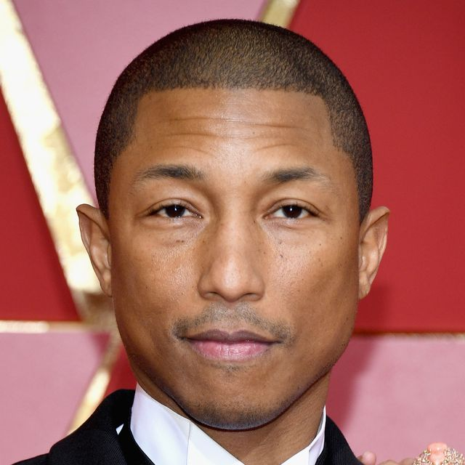
Independent Set
Set of 6 nodes which share no edges

Slide 8
Vertex Cover
Set of 5 nodes which includes an endpoint of every edge

Slide 9
Way Cool!
$S$ is an independent set of $G$ iff $V−S$ is a vertex cover of $G$
Independent Set
Vertex Cover

Slide 10
Way Cool!
$S$ is an independent set of $G$ iff $V−S$ is a vertex cover of $G$
Vertex Cover
Independent Set

Slide 11
Solving Vertex Cover and Independent Set
Algorithm to solve vertex cover
Input: $G=(V,E)$ and a number $k$
Output: True if $G$ has a vertex cover of size $k$
Check if there is an Independent Set of $G$ of size $\left|V\right|−k$
Algorithm to solve independent set
Input: $G=(V,E)$ and a number $k$
Output: True if $G$ has an independent set of size $k$
Check if there is a Vertex Cover of $G$ of size $\left|V\right|−k$
Either both problems belong to $P$, or else neither does!

Slide 12
We need to build this Reduction
Independent Set Input
O(V) Time
Vertex Cover Input
Relate Independent Set input to Vertex Cover output
Use same graph
Set $k=\left|V\right|−k$
$$k$$
$$k$$
Any Algorithm for Vertex Cover
Relate Independent Set output to Vertex Cover output
Independent Set Output
Vertex Cover Ouput
Give same output
Reduction

Slide 13
Reductions
Shows how two different problems relate to each other
MOVIE TIME!

Slide 14
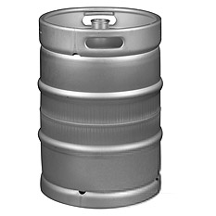
MacGyver’s Reduction
Problem we don’t know how to solve
Problem we do know how to solve
$$A$$
Opening a door
Aim duct at door, insert keg
Lighting a fire
$$B$$
How?
Solution for $A$
Solution for $B$
Keg cannon battering ram
Alcohol, wood, matches
Put fire under the Keg
Reduction

Slide 15
NP-Complete
A set of “together they stand, together they fall” problems
The problems in this set either all belong to $P$, or none of them do
Intuitively, the “hardest” problems in NP
Collection of problems from $NP$ that can all be “transformed” into each other in polynomial time
Like we could transform independent set to vertex cover, and vice-versa
We can also transform vertex cover into Hamiltonian path, and Hamiltonian path into independent set, and …

Slide 16
$EXP⊃NP−Complete⊇NP⊇P$
$P=NP$ iff some problem from $NP−Complete$ belongs to $P$
$$EXP$$
Checkers
Go
Chess
Vertex Cover
Independent Set
Hamiltonian Path
$$NP$$
$$NP−Complete$$
$$P$$
Cryptography
Prime factorization
Sorting
Shortest Path
Euler Path
$$NP−Hard$$
Gap?
Unknown!

Slide 17
NP-Hard
$$EXP$$
$$NP$$
$$P$$
How can we try to figure out if P=NP?
Identify problems at least as “hard” as NP
If any of these “hard” problems can be solved in polynomial time, then all NP problems can be solved in polynomial time.
Definition: NP-Hard:
$B$ is NP-Hard provided EVERY problem within NP reduces to $B$ in polynomial time
$$NP−Hard$$

Slide 18
NP-Hard Idea
For every NP problem
Any NP Problem
$$O(n^{p})$$
An NP-Hard Problem
$$A$$
$$B$$
So if this was $O\left(n^{p}\right)$ we can solve any NP problem in polynomial time
There exists a polynomial-time reduction to each NP-Hard Problem
Solution for $A$
Solution for $B$
$$X$$
$$Y$$
Reduction

Slide 19
Showing NP-Hardness
Any NP Problem
$$O(n^{p})$$
A First NP-Hard
Problem
$$O(n^{p})$$
A new NP-Hard Problem
$$C$$
$$A$$
$$B$$
Solution for $C$
Solution for $A$
Solution for $B$
$$Z$$
$$X$$
$$Y$$
Reduction
Reduction

Slide 20
NP-Complete
$$EXP$$
$$NP$$
$$NP−Complete$$
$$P$$
“Together they stand, together they fall”
Problems solvable in polynomial time iff ALL NP problems are
NP-Complete = NP $∩$ NP-Hard
How to show a problem is NP-Complete?
Show it belongs to NP
Give a polynomial time verifier
Show it is NP-Hard
Give a reduction from another NP-H problem
$$NP−Hard$$

Slide 21
NP-Completeness
Any NP-Complete Problem
$$O(n^{p})$$
Any other NP-Complete Problem
$$A$$
$$B$$
If this could be done in polynomial time
Then this could be done in polynomial time
Solution for $A$
Solution for $B$
$$X$$
$$Y$$
Reduction

Slide 22
NP-Completeness
Any NP-Complete Problem
$$O(n^{p})$$
Any other NP-Complete Problem
$$A$$
$$B$$
Then this cannot be done in polynomial time
If this cannot be done in polynomial time
Solution for $A$
Solution for $B$
$$X$$
$$Y$$
Reduction

Slide 23
Overview
Problems not belonging to $P$ are considered intractable
The problems within $NP$ have some properties that make them seem like they might be tractable, but we’ve been unsuccessful with finding polynomial time algorithms for many
The class $NP−Complete$ contains problems with the properties:
All members are also members of $NP$
All members of $NP$ can be transformed into every member of $NP−Complete$
Because they are both $NP$ and $NP−Hard$
If any one member of $NP−Complete$ belongs to $P$, then $P=NP$
If any one member of $NP−Complete$ is outside of $P$, then $P≠NP$

Slide 24
Why should YOU care?
If you can find a polynomial time algorithm for any $NP−Complete$ problem then:
You will win $1million
You will win a Turing Award
You will be world famous
You will have done something that no one else on Earth has been able to do in spite of the above!
If you are told to write an algorithm a problem that is $NP−Complete$
You can tell that person everything above to set expectations
Change the requirements!
Approximate the solution: Instead of finding a path that visits every node, find a path that visits at least 75% of the nodes
Add Assumptions: problem might be tractable if we can assume the graph is acyclic, a tree
Use Heuristics: Write an algorithm that’s “good enough” for small inputs, ignore edge cases

Slide 25
Why should YOU care?
The entire field of cryptography relies on it (nearly at least)
Requires decrypting with a key is easier than decrypting without a key
This is strongly related to requiring a difference in difficulty between verifying a candidate solution and finding a solution in the first place
If $P≠NP$
Some problems remain intractable
Cryptography persists
If $P=NP$
We may get efficient solutions for important problems
Cryptography is potentially doomed.

Slide 26
Does P=NP?
https://www.cs.umd.edu/users/gasarch/BLOGPAPERS/pollpaper3.pdf

Slide 27
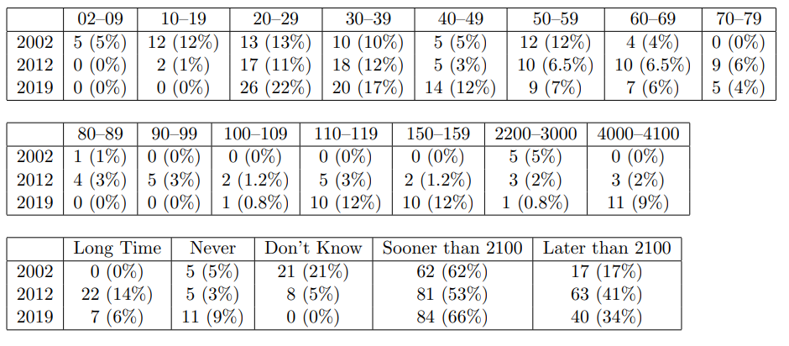
When Will P=NP be resolved?

Slide 28
Notable Statements on P vs NP
Suggested rephrased question:

