Slide 1
CSE 332 Summer 2024 Lecture 16: Graphs
Nathan Brunelle
http://www.cs.uw.edu/332

Slide 2
Definition: Tree
A connected graph with no cycles
10
B
E
7
H
A
Note: A tree does not need a root, but they often do!
D
5
9
I
12
3
C
3
11
G
F

Slide 3
Definition: Tree
A connected graph with no cycles
D
3
7
10
B
E
3
7
H
C
F
E
A
12
D
5
9
5
I
12
3
Pick some arbitrary root node and rearrange tree
3
A
G
C
11
11
G
10
9
F
B
H
I

Slide 4
Definition: Spanning Tree
A Tree $T=(V_{T},E_{T})$ which connects (“spans”) all the nodes in a graph $G=(V,E)$
How many edges does $T$ have?
B
8
10
E
8
$$V−1$$
8
7
H
E
8
A
9
2
10
B
H
D
5
9
5
2
I
12
A
G
I
3
Pick some arbitrary root node and rearrange tree
C
3
6
11
1
F
G
3
1
F
6
C
D
Any set of V-1 edges in the graph that doesn’t have any cycles is guaranteed to be a spanning tree!
Any set of V-1 edges that connects all the nodes in the graph is guaranteed to be a spanning tree!
Notes:
Some set of edges from the graph, which forms a tree with all of the nodes in a graph. Subset of the edges, which has no cycles, and connects all the nodes.

Slide 5
Definition: Minimum Spanning Tree
A Tree $T=(V_{T},E_{T})$ which connects (“spans”) all the nodes in a graph $G=(V,E)$, that has minimal cost
B
8
10
E
8
$$Cost\left(T\right)=\sum_{e∈E_{T}}{w(e)}$$
7
H
A
9
2
D
5
9
I
12
3
C
3
11
G
1
F
6

Slide 6
Kruskal’s Algorithm
Start with an empty tree $A$
Add to $A$ the lowest-weight edge that does not create a cycle
B
8
10
E
8
7
H
A
9
2
D
5
9
I
12
3
C
3
11
G
1
F
6

Slide 7
Kruskal’s Algorithm
Start with an empty tree $A$
Add to $A$ the lowest-weight edge that does not create a cycle
B
8
10
E
8
7
H
A
9
2
D
5
9
I
12
3
C
3
11
G
1
F
6

Slide 8
Kruskal’s Algorithm
Start with an empty tree $A$
Add to $A$ the lowest-weight edge that does not create a cycle
B
8
10
E
8
7
H
A
9
2
D
5
9
I
12
3
C
3
11
G
1
F
6

Slide 9
Kruskal’s Algorithm
Start with an empty tree $A$
Add to $A$ the lowest-weight edge that does not create a cycle
B
8
10
E
8
7
H
A
9
2
D
5
9
I
12
3
C
3
11
G
1
F
6

Slide 10
Kruskal’s Algorithm
Start with an empty tree $A$
Add to $A$ the lowest-weight edge that does not create a cycle
B
8
10
E
8
7
H
A
9
2
D
5
9
I
12
3
C
3
11
G
1
F
6

Slide 11
Kruskal’s Algorithm
Start with an empty tree $A$
Add to $A$ the lowest-weight edge that does not create a cycle
B
8
10
E
8
7
H
A
9
2
D
5
9
I
12
3
C
3
11
G
1
F
6

Slide 12
Definition: Cut
A Cut of graph $G=(V,E)$ is a partition of the nodes into two sets, $S$ and $V−S$
B
8
10
E
8
7
H
A
9
2
D
5
9
$$S$$
I
12
3
C
3
11
G
1
F
6
Edge $\left(v_{1},v_{2}\right)∈E$ crosses a cut if $v_{1}∈S$ and $v_{2}∈V−S$ (or opposite), e.g. $(A,C)$
A set of edges $R$ Respects a cut if no edges cross the cut
e.g. $R=\{\left(A,B\right),\left(E,G\right),\left(F,G\right)\}$
Notes:
Go over some examples of edges that cross the cut and edges that do not

Slide 13
Cut Theorem
If a set of edges $A$ is a subset of a minimum spanning tree $T$, let $(S, V−S)$ be any cut which $A$ respects. Let $e$ be the least-weight edge which crosses $(S, V−S)$. $A∪\{e\}$ is also a subset of a minimum spanning tree.
Notes:
If I take any cut at all in the graph, then the least weight edge across that cut is guaranteed to be part of some minimum spanning tree. The least weight edge that crosses any cut in .
We need a bit more mechanics to make this work for kruskals.
Suppose A is a subset of a minimum spanning tree, meaning, we are on our way to building. There is a minimum spanning tree T, where every edge in A is part of this minimum spanning tree T
Define some cut (S,V-S), which A respects. It is safe to add e to A and we will have made more progress
Repeat v-1 times. If we know we can start with some arbitrary subset, then we can add this edge e . There is some minimum spanning tree that has this edge f,g. If I used some other edge instead, an

Slide 14
Cut Theorem
If a set of edges $A$ is a subset of a minimum spanning tree $T$, let $(S, V−S)$ be any cut which $A$ respects. Let $e$ be the least-weight edge which crosses $(S, V−S)$. $A∪\{e\}$ is also a subset of a minimum spanning tree.
B
8
10
E
8
7
H
A
9
2
D
5
9
I
12
3
C
3
11
G
1
F
6
Notes:
If I take any cut at all in the graph, then the least weight edge across that cut is guaranteed to be part of some minimum spanning tree. The least weight edge that crosses any cut in .
We need a bit more mechanics to make this work for kruskals.
Suppose A is a subset of a minimum spanning tree, meaning, we are on our way to building. There is a minimum spanning tree T, where every edge in A is part of this minimum spanning tree T
Define some cut (S,V-S), which A respects. It is safe to add e to A and we will have made more progress
Repeat v-1 times. If we know we can start with some arbitrary subset, then we can add this edge e . There is some minimum spanning tree that has this edge f,g. If I used some other edge instead, an

Slide 15

Cut Theorem
If a set of edges $A$ is a subset of a minimum spanning tree $T$, let $(S, V−S)$ be any cut which $A$ respects. Let $e$ be the least-weight edge which crosses $(S, V−S)$. $A∪\{e\}$ is also a subset of a minimum spanning tree.
B
8
10
E
8
7
H
A
9
2
D
5
9
I
12
3
C
3
11
G
1
F
6
Notes:
If I take any cut at all in the graph, then the least weight edge across that cut is guaranteed to be part of some minimum spanning tree. The least weight edge that crosses any cut in .
We need a bit more mechanics to make this work for kruskals.
Suppose A is a subset of a minimum spanning tree, meaning, we are on our way to building. There is a minimum spanning tree T, where every edge in A is part of this minimum spanning tree T
Define some cut (S,V-S), which A respects. It is safe to add e to A and we will have made more progress
Repeat v-1 times. If we know we can start with some arbitrary subset, then we can add this edge e . There is some minimum spanning tree that has this edge f,g. If I used some other edge instead, an

Slide 16

Cut Theorem
If a set of edges $A$ is a subset of a minimum spanning tree $T$, let $(S, V−S)$ be any cut which $A$ respects. Let $e$ be the least-weight edge which crosses $(S, V−S)$. $A∪\{e\}$ is also a subset of a minimum spanning tree.
B
8
10
E
8
7
H
A
9
2
D
5
9
I
12
3
C
3
11
G
1
F
6
Notes:
If I take any cut at all in the graph, then the least weight edge across that cut is guaranteed to be part of some minimum spanning tree. The least weight edge that crosses any cut in .
We need a bit more mechanics to make this work for kruskals.
Suppose A is a subset of a minimum spanning tree, meaning, we are on our way to building. There is a minimum spanning tree T, where every edge in A is part of this minimum spanning tree T
Define some cut (S,V-S), which A respects. It is safe to add e to A and we will have made more progress
Repeat v-1 times. If we know we can start with some arbitrary subset, then we can add this edge e . There is some minimum spanning tree that has this edge f,g. If I used some other edge instead, an

Slide 17

Cut Theorem
If a set of edges $A$ is a subset of a minimum spanning tree $T$, let $(S, V−S)$ be any cut which $A$ respects. Let $e$ be the least-weight edge which crosses $(S, V−S)$. $A∪\{e\}$ is also a subset of a minimum spanning tree.
B
8
10
E
8
7
H
A
9
2
D
5
9
I
12
3
C
3
11
G
1
F
6
Notes:
If I take any cut at all in the graph, then the least weight edge across that cut is guaranteed to be part of some minimum spanning tree. The least weight edge that crosses any cut in .
We need a bit more mechanics to make this work for kruskals.
Suppose A is a subset of a minimum spanning tree, meaning, we are on our way to building. There is a minimum spanning tree T, where every edge in A is part of this minimum spanning tree T
Define some cut (S,V-S), which A respects. It is safe to add e to A and we will have made more progress
Repeat v-1 times. If we know we can start with some arbitrary subset, then we can add this edge e . There is some minimum spanning tree that has this edge f,g. If I used some other edge instead, an

Slide 18
Proof of Kruskal’s Algorithm
Start with an empty tree $A$
Repeat $V−1$ times:
Add the min-weight edge that doesn’t cause a cycle
Proof: Suppose we have some arbitrary set of edges $A$ that Kruskal’s has already selected to include in the MST. $e=(F,G)$is the edge Kruskal’s selects to add next
We know that there cannot exist a path from $F$to G using only edges in $A$ because $e$ does not cause a cycle
We can cut the graph therefore into 2 disjoint sets:
nodes reachable from G using edges in $A$
All other nodes
$e$ is the minimum cost edge that crosses this cut, so by the Cut Theorem, Kruskal’s is optimal!
B
8
10
E
8
7
H
A
9
2
D
5
9
I
12
3
C
3
$$e$$
11
G
1
F
6
$$S$$

Slide 19
Kruskal’s Algorithm Runtime
Start with an empty tree $A$
Repeat $V−1$ times:
Add the min-weight edge that doesn’t cause a cycle
Keep edges in a Disjoint-set data structure (very fancy)
$$O\left(E log V\right)$$
B
8
10
E
8
7
H
A
9
2
D
5
9
I
12
3
C
3
$$e$$
11
G
1
F
6
$$S$$

Slide 20
General MST Algorithm
Start with an empty tree $A$
Repeat $V−1$ times:
Pick a cut $(S,V−S)$ which $A$ respects (typically implicitly)
Add the min-weight edge which crosses $(S,V−S)$
B
8
10
E
8
7
H
A
9
2
D
5
9
I
12
3
C
3
11
G
1
F
6

Slide 21
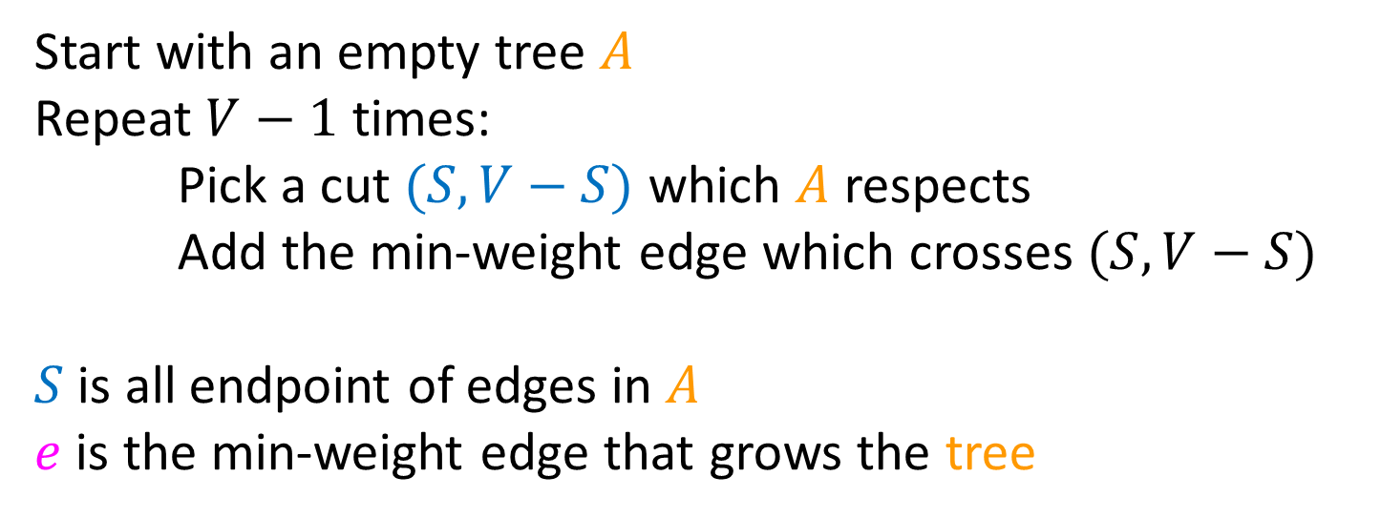
Prim’s Algorithm
Start with an empty tree $A$
Repeat $V−1$ times:
Pick a cut $(S,V−S)$ which $A$ respects
Add the min-weight edge which crosses $(S,V−S)$
$S$ is all endpoint of edges in $A$
$e$ is the min-weight edge that grows the tree
B
8
10
E
6
7
H
A
9
2
D
5
9
I
12
3
C
3
11
G
1
F
7

Slide 22
Prim’s Algorithm
Start with an empty tree $A$
Pick a start node
Repeat $V−1$ times:
Add the min-weight edge which connects to node in $A$ with a node not in $A$
B
8
10
E
6
7
H
A
9
2
D
5
9
I
12
3
C
3
11
G
1
F
7

Slide 23
Prim’s Algorithm
Start with an empty tree $A$
Pick a start node
Repeat $V−1$ times:
Add the min-weight edge which connects to node in $A$ with a node not in $A$
B
8
10
E
6
7
H
A
9
2
D
5
9
I
12
3
C
3
11
G
1
F
7

Slide 24
Prim’s Algorithm
Start with an empty tree $A$
Pick a start node
Repeat $V−1$ times:
Add the min-weight edge which connects to node in $A$ with a node not in $A$
B
8
10
E
6
7
H
A
9
2
D
5
9
I
12
3
C
3
11
G
1
F
7

Slide 25
Prim’s Algorithm
Start with an empty tree $A$
Pick a start node
Repeat $V−1$ times:
Add the min-weight edge which connects to node in $A$ with a node not in $A$
B
8
10
E
6
7
H
A
9
2
D
5
9
I
12
3
C
3
11
G
1
F
7

Slide 26
Prim’s Algorithm
Start with an empty tree $A$
Pick a start node
Repeat $V−1$ times:
Add the min-weight edge which connects to node in $A$ with a node not in $A$
Keep edges in a Heap
$$O\left(E log V\right)$$
B
8
10
E
6
7
H
A
9
2
D
5
9
I
12
3
C
3
11
G
1
F
7

Slide 27
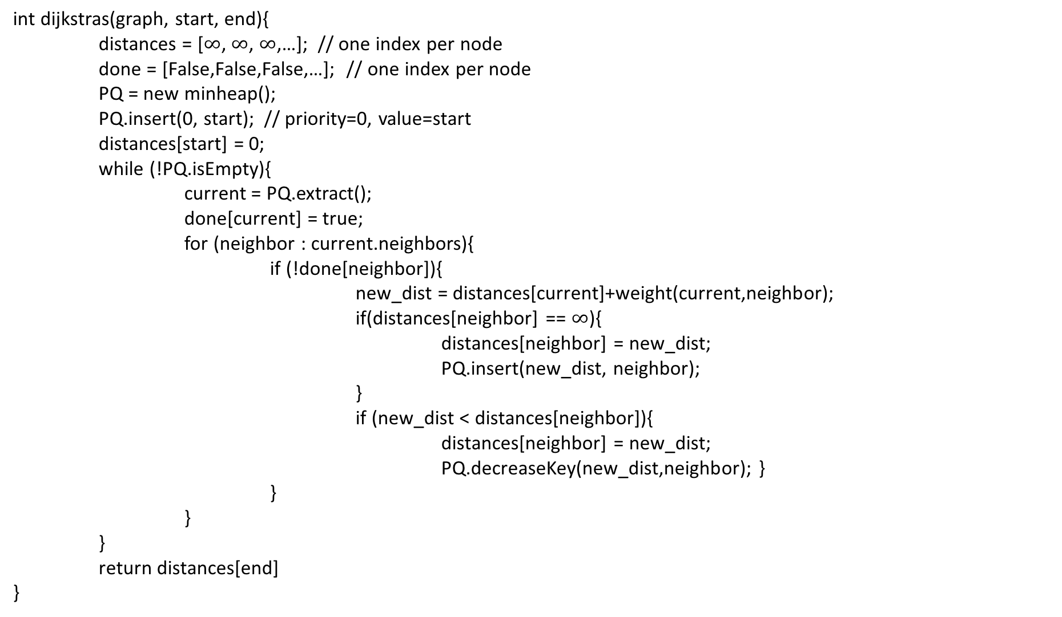
Dijkstra’s Algorithm
int dijkstras(graph, start, end){
distances = [$∞$, $∞$, $∞$,…]; // one index per node
done = [False,False,False,…]; // one index per node
PQ = new minheap();
PQ.insert(0, start); // priority=0, value=start
distances[start] = 0;
while (!PQ.isEmpty){
current = PQ.extract();
done[current] = true;
for (neighbor : current.neighbors){
if (!done[neighbor]){
new_dist = distances[current]+weight(current,neighbor);
if(distances[neighbor] == $∞$){
distances[neighbor] = new_dist;
PQ.insert(new_dist, neighbor);
}
if (new_dist < distances[neighbor]){
distances[neighbor] = new_dist;
PQ.decreaseKey(new_dist,neighbor); }
}
}
}
return distances[end]
}
1
8
10
4
6
7
7
0
9
2
3
5
9
8
12
3
2
3
11
6
1
5
7

Slide 28
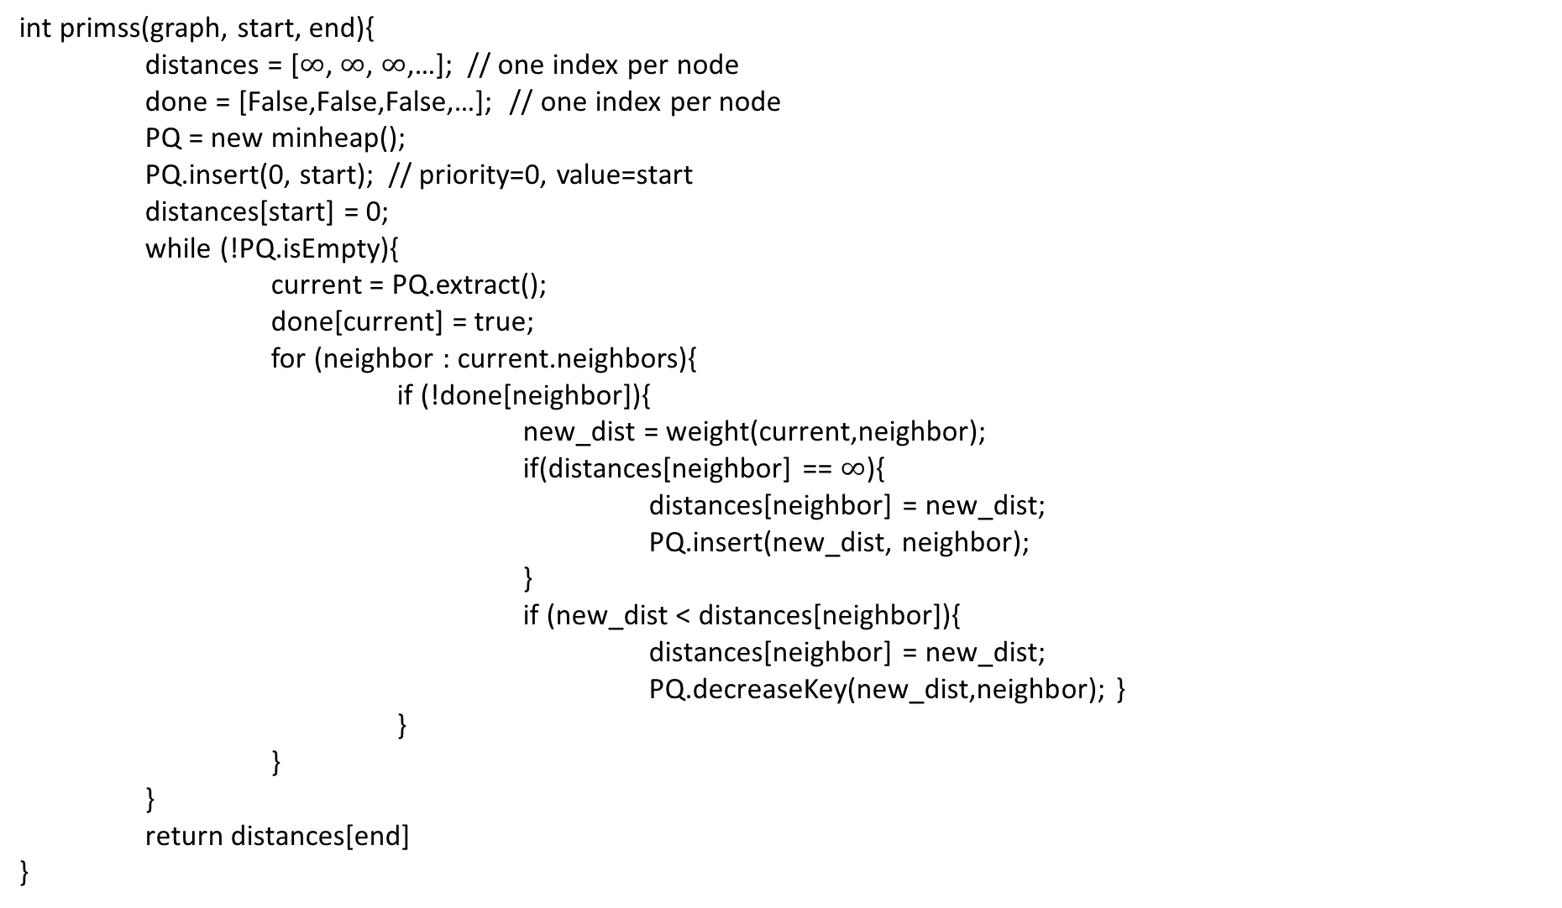
Prims’s Algorithm
int primss(graph, start, end){
distances = [$∞$, $∞$, $∞$,…]; // one index per node
done = [False,False,False,…]; // one index per node
PQ = new minheap();
PQ.insert(0, start); // priority=0, value=start
distances[start] = 0;
while (!PQ.isEmpty){
current = PQ.extract();
done[current] = true;
for (neighbor : current.neighbors){
if (!done[neighbor]){
new_dist = weight(current,neighbor);
if(distances[neighbor] == $∞$){
distances[neighbor] = new_dist;
PQ.insert(new_dist, neighbor);
}
if (new_dist < distances[neighbor]){
distances[neighbor] = new_dist;
PQ.decreaseKey(new_dist,neighbor); }
}
}
}
return distances[end]
}
1
8
10
4
6
7
7
0
9
2
3
5
9
8
12
3
2
3
11
6
1
5
7

Slide 29
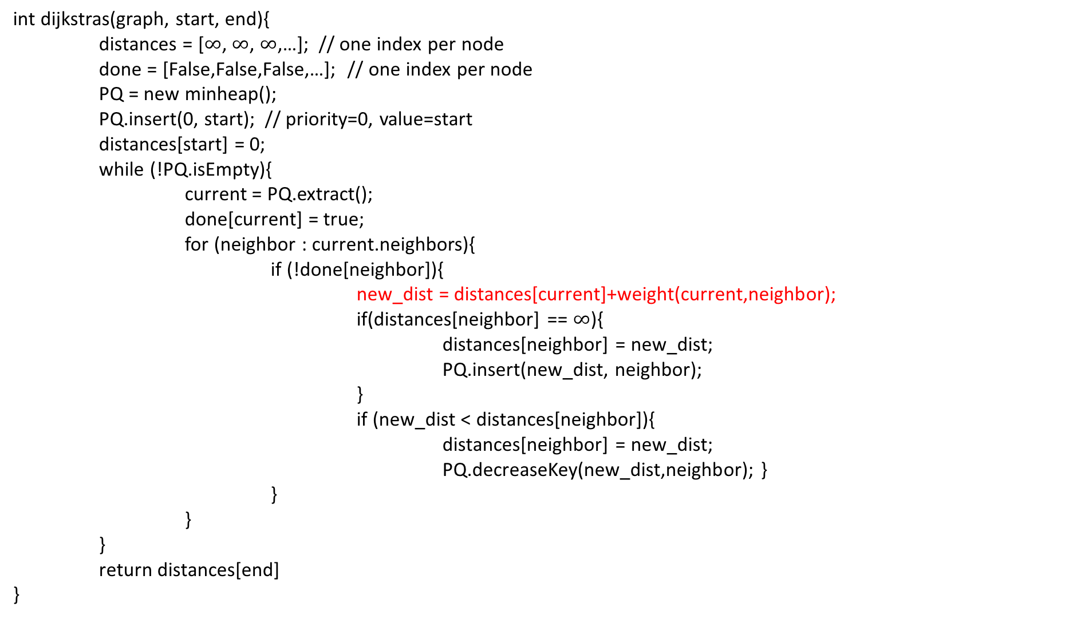
Dijkstra’s Algorithm
int dijkstras(graph, start, end){
distances = [$∞$, $∞$, $∞$,…]; // one index per node
done = [False,False,False,…]; // one index per node
PQ = new minheap();
PQ.insert(0, start); // priority=0, value=start
distances[start] = 0;
while (!PQ.isEmpty){
current = PQ.extract();
done[current] = true;
for (neighbor : current.neighbors){
if (!done[neighbor]){
new_dist = distances[current]+weight(current,neighbor);
if(distances[neighbor] == $∞$){
distances[neighbor] = new_dist;
PQ.insert(new_dist, neighbor);
}
if (new_dist < distances[neighbor]){
distances[neighbor] = new_dist;
PQ.decreaseKey(new_dist,neighbor); }
}
}
}
return distances[end]
}
1
8
10
4
6
7
7
0
9
2
3
5
9
8
12
3
2
3
11
6
1
5
7

Slide 30
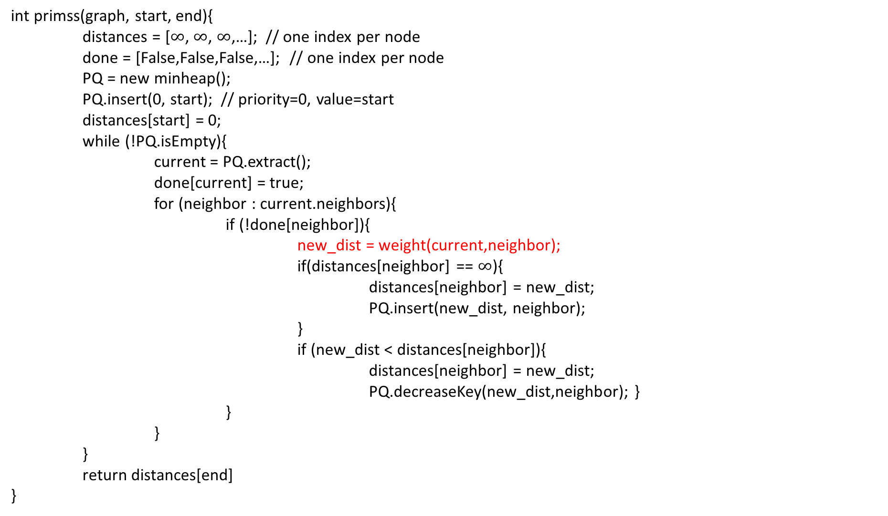
Prims’s Algorithm
int primss(graph, start, end){
distances = [$∞$, $∞$, $∞$,…]; // one index per node
done = [False,False,False,…]; // one index per node
PQ = new minheap();
PQ.insert(0, start); // priority=0, value=start
distances[start] = 0;
while (!PQ.isEmpty){
current = PQ.extract();
done[current] = true;
for (neighbor : current.neighbors){
if (!done[neighbor]){
new_dist = weight(current,neighbor);
if(distances[neighbor] == $∞$){
distances[neighbor] = new_dist;
PQ.insert(new_dist, neighbor);
}
if (new_dist < distances[neighbor]){
distances[neighbor] = new_dist;
PQ.decreaseKey(new_dist,neighbor); }
}
}
}
return distances[end]
}
1
8
10
4
6
7
7
0
9
2
3
5
9
8
12
3
2
3
11
6
1
5
7

