Slide 1
CSE 332 Summer 2024 Lecture 11: Hashing 3
Nathan Brunelle
http://www.cs.uw.edu/332

Slide 2
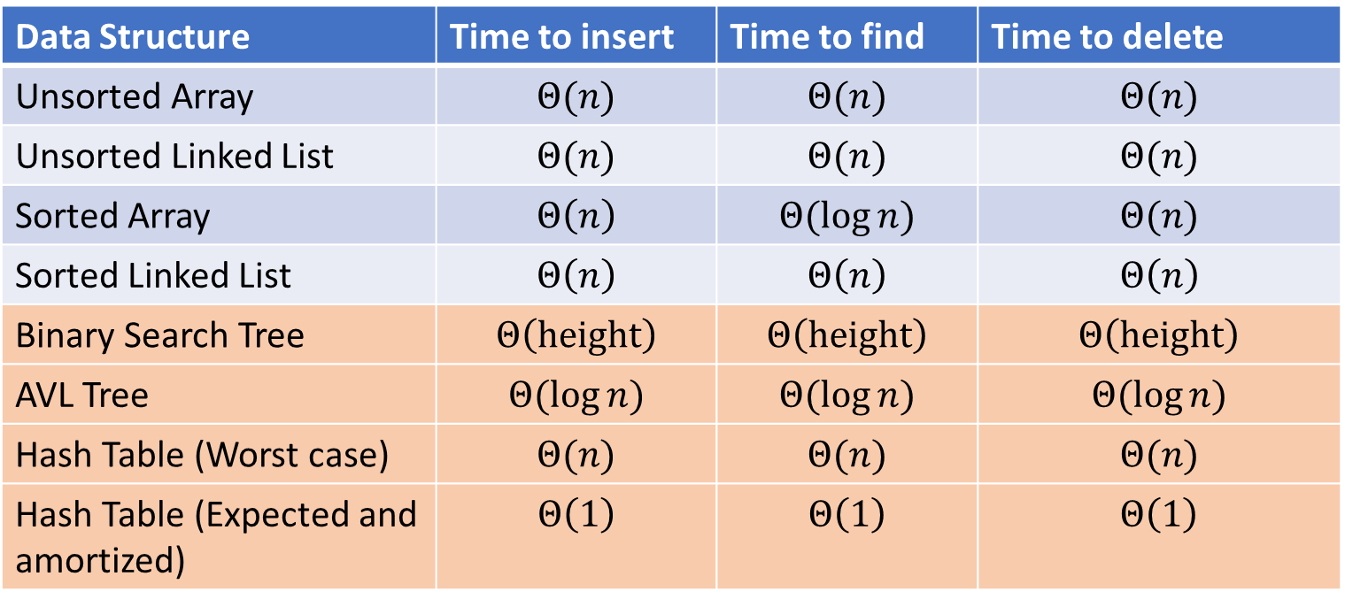
Next topic: Hash Tables
Data Structure | Time to insert | Time to find | Time to delete
Unsorted Array | $$Θ(n)$$ | $$Θ(n)$$ | $$Θ(n)$$
Unsorted Linked List | $$Θ(n)$$ | $$Θ(n)$$ | $$Θ(n)$$
Sorted Array | $$Θ\left(n\right)$$ | $$Θ(\log{n})$$ | $$Θ(n)$$
Sorted Linked List | $$Θ\left(n\right)$$ | $$Θ\left(n\right)$$ | $$Θ\left(n\right)$$
Binary Search Tree | $$Θ\left(height\right)$$ | $$Θ\left(height\right)$$ | $$Θ\left(height\right)$$
AVL Tree | $$Θ(\log{n})$$ | $$Θ(\log{n})$$ | $$Θ(\log{n})$$
Hash Table (Worst case) | $$Θ(n)$$ | $$Θ(n)$$ | $$Θ(n)$$
Hash Table (Expected and amortized) | $$Θ\left(1\right)$$ | $$Θ\left(1\right)$$ | $$Θ\left(1\right)$$

Slide 3
Dictionary (Map) ADT
Contents:
Sets of key+value pairs
Keys must be comparable
Operations:
insert(key, value)
Adds the (key,value) pair into the dictionary
If the key already has a value, overwrite the old value
Consequence: Keys cannot be repeated
find(key)
Returns the value associated with the given key
delete(key)
Remove the key (and its associated value)

Slide 4
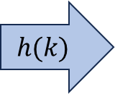
Hash Tables
Idea:
Have a small array to store information
Use a hash function to convert the key into an index
Hash function should “scatter” the keys, behave as if it randomly assigned keys to indices
Store key at the index given by the hash function
Do something if two keys map to the same place (should be very rare)
Collision resolution
Insert / find /
delete
$$h(k)$$
Index between 0 and length-1
& value
Key Object

Slide 5
Collision Resolution
A Collision occurs when we want to insert something into an already-occupied position in the hash table
2 main strategies:
Separate Chaining
Use a secondary data structure to contain the items
E.g. each index in the hash table is itself a linked list
Open Addressing
Use a different spot in the table instead
Linear Probing
Quadratic Probing
Double Hashing
0
1
2
3
4
5
6
7
8
9

Slide 6
Rehashing
If your load factor $λ$ gets too large, copy everything over to a larger hash table
To do this: make a new, larger array
Re-insert all items into the new hash table by reapplying the hash function
We need to reapply the hash function because items should map to a different index
New array should be “roughly” double the length (but probably still want it to be prime)
What does “too large” mean?
For separate chaining, typically we want $λ<2$
For open addressing, typically we want $λ<\frac{1}{2}$

Slide 7
Linear Probing: Insert Procedure
To insert $k,v$
Calculate $i=h\left(k\right) \% length$
If $table[i]$ is occupied then try $\left(i+1\right)\% length$
If that is occupied try $\left(i+2\right)\% length$
If that is occupied try $\left(i+3\right)\% length$
…
$h\left(k\right)=k\%10$
2
32
24
62
54
0
1
2
3
4
5
6
7
8
9

Slide 8
Linear Probing: Find
To find key $k$
Calculate $i=h\left(k\right) \% length$
If $table\left[i\right]$ is occupied and does not contain $k$ then look at $\left(i+1\right) \% length$
If that is occupied and does not contain $k$ then look at $\left(i+2\right) \% length$
If that is occupied and does not contain $k$ then look at $\left(i+3\right) \% length$
Repeat until you either find $k$ or else you reach an empty cell in the table
0
1
2
3
4
5
6
7
8
9

Slide 9
Linear Probing: Delete
To delete key $k$, where $h\left(k\right)=i$
Assume it is present
Beginning at index $i$, probe until we find $k$ (call this location index $j$)
Mark $j$ as empty (e.g. null), then continue probing while doing the following until you find another empty index
If you come across a key which hashes to a value $≤j$ then move that item to index $j$ and update $j$.
0
1
2
3
4
5
6
7
8
9

Slide 10

Linear Probing: Delete
Option 1: Fill in with items that hashed to before the empty slot
Option 2: “Tombstone” deletion. Leave a special object that indicates an object was deleted from there
The tombstone does not act as an open space when finding (so keep looking after its reached)
When inserting you can replace a tombstone with a new item
$$k,v$$
$$k,v$$
$$k,v$$
$$k,v$$
0
1
2
3
4
5
6
7
8
9

Slide 11
Downsides of Linear Probing
What happens when $λ$ approaches 1?
Get longer and longer contiguous blocks
A collision is guaranteed to grow a block
Larger blocks experience more collisions
Feedback loop!
What happens when $λ$ exceeds 1?
Impossible!
You can’t insert more stuff

Slide 12
Quadratic Probing: Insert Procedure
To insert $k,v$
Calculate $i=h\left(k\right) \% size$
If $table[i]$ is occupied then try $\left(i+1^{2}\right)\% size$
If that is occupied try $\left(i+2^{2}\right)\% size$
If that is occupied try $\left(i+3^{2}\right)\% size$
If that is occupied try $\left(i+4^{2}\right)\% size$
…
0
1
2
3
4
5
6
7
8
9

Slide 13
Quadratic Probing: Example
Insert:
76
40
48
5
55
47
0
1
2
3
4
5
6

Slide 14
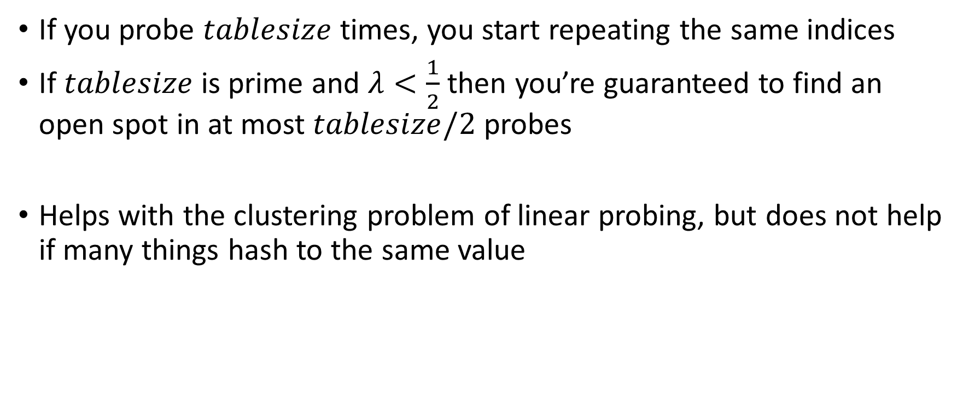
Using Quadratic Probing
If you probe $tablesize$ times, you start repeating the same indices
If $tablesize$ is prime and $λ<\frac{1}{2}$ then you’re guaranteed to find an open spot in at most $tablesize/2$ probes
Helps with the clustering problem of linear probing, but does not help if many things hash to the same value

Slide 15
Double Hashing: Insert Procedure
Given $h$ and $g$ are both good hash functions
To insert $k,v$
Calculate $i=h\left(k\right) \% size$
If $table[i]$ is occupied then try $\left(i+g\left(k\right)\right) \% size$
If that is occupied try $\left(i+2⋅g\left(k\right)\right)\% size$
If that is occupied try $\left(i+3⋅g\left(k\right)\right)\% size$
If that is occupied try $\left(i+4⋅g\left(k\right)\right)\% size$
…
0
1
2
3
4
5
6
7
8
9

Slide 16
Sorting
Rearrangement of items into some defined sequence
Usually: reordering a list from smallest to largest according to some metric
Why sort things?

Slide 17
More Formal Definition
Input:
An array $A$ of items
A comparison function for these items
Given two items $x$ and $y$, we can determine whether $x<y$, $x>y$, or $x=y$
Output:
A permutation of $A$ such that if $i≤j$ then $A\left[i\right]≤A[j]$
Permutation: a sequence of the same items but perhaps in a different order

Slide 18
Sorting “Landscape”
There is no singular best algorithm for sorting
Some are faster, some are slower
Some use more memory, some use less
Some are super extra fast if your data matches particular assumptions
Some have other special properties that make them valuable
No sorting algorithm can have only all the “best” attributes

Slide 19
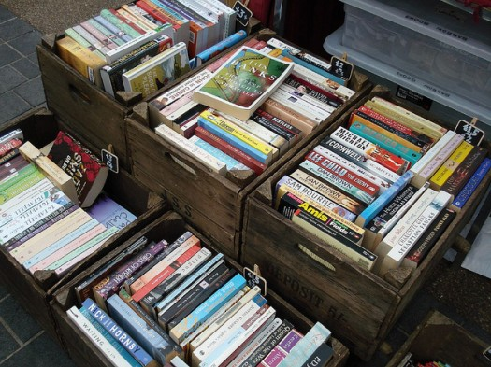
“Moving Day” Sorting Algorithm
2
15
77
5
18
10
41
3
22
64
21
19
30
24
23
33
0
1
2
3
4
5
6
7
8
9
10
11
12
13
14
15

Slide 20
Selection Sort
Idea: Find the next smallest element, swap it into the next index in the array
Already In Position
1
2
3
4
5
6
10
8
7
9
12
11
Already In Position
1
2
3
4
5
6
7
8
10
9
12
11

Slide 21
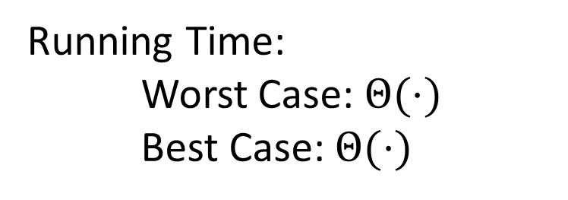
Selection Sort
Swap the thing at index $0$ with the smallest thing in the array
Swap the thing at index $1$ with the smallest thing after index $0$
…
Swap the thing at index $i$ with the smallest thing after index $i−1$
for (i=0; i<a.length; i++){
smallest = i;
for (j=i; j<a.length; j++){
if (a[j]<a[smallest]){ smallest=j;}
}
temp = a[i];
a[i] = a[smallest];
a[smallest] = a[i];
}
Running Time:
Worst Case: $Θ(⋅)$
Best Case: $Θ(⋅)$
10
77
5
15
2
22
64
41
18
19
30
21
3
24
23
33
0
1
2
3
4
5
6
7
8
9
10
11
12
13
14
15

Slide 22
Insertion Sort
Idea: Maintain a sorted list prefix, extend that prefix by “inserting” the next element
Sorted Prefix
3
5
7
8
10
12
9
2
4
6
1
11
3
5
7
8
10
9
12
2
4
6
1
11
3
5
7
8
9
10
12
2
4
6
1
11
Sorted Prefix
3
5
7
8
9
10
12
2
4
6
1
11

Slide 23
Insertion Sort
If the items at index $0$ and $1$ are out of order, swap them
Keep swapping the item at index $2$ with the thing to its left as long as the left thing is larger
…
Keep swapping the item at index $i$ with the thing to its left as long as the left thing is larger
for (i=1; i<a.length; i++){
prev = i-1;
while(a[i] < a[prev] && prev > -1){
temp = a[i];
a[i] = a[prev];
a[prev] = a[i];
i--;
prev--;
}
}
Running Time:
Worst Case: $Θ(⋅)$
Best Case: $Θ(⋅)$
10
77
5
15
2
22
64
41
18
19
30
21
3
24
23
33
0
1
2
3
4
5
6
7
8
9
10
11
12
13
14
15

Slide 24
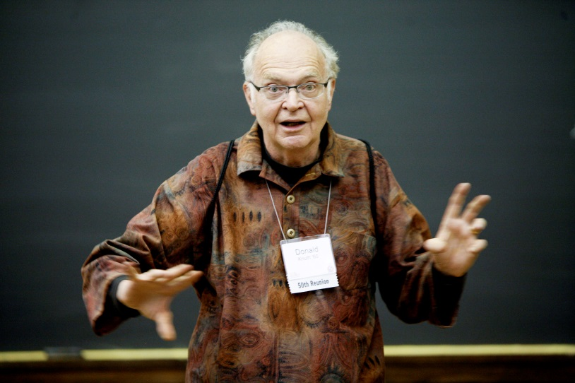
Aside: Bubble Sort – we won’t cover it
"the bubble sort seems to have nothing to recommend it, except a catchy name and the fact that it leads to some interesting theoretical problems” –Donald Knuth, The Art of Computer Programming

Slide 25
Heap Sort
Idea: Build a maxHeap, repeatedly delete the max element from the heap to build sorted list Right-to-Left
10
9
6
8
7
5
2
4
1
3
0
1
2
3
4
5
6
7
8
9
Max Heap Property: Each node is larger than its children
10
9
0
6
8
1
7
5
2
2
3
4
5
6
4
1
3
7
8
9

Slide 26
Heap Sort
Remove the Max element (i.e. the root) from the Heap: replace with last element, call percolateDown(root)
3
9
6
8
7
5
2
4
1
0
1
2
3
4
5
6
7
8
9
3
9
0
6
8
1
7
5
2
2
3
4
5
6
4
1
Percolate Down(node): if node satisfies heap property, done. Else swap with largest child and repeat on that subtree
7
8

Slide 27
Heap Sort
Remove the Max element (i.e. the root) from the Heap: replace with last element, call percolateDown(root)
9
3
6
8
7
5
2
4
1
0
1
2
3
4
5
6
7
8
9
9
3
0
6
8
1
7
5
2
2
3
4
5
6
4
1
Percolate Down(node): if node satisfies heap property, done. Else swap with largest child and repeat on that subtree
7
8

Slide 28
Heap Sort
Remove the Max element (i.e. the root) from the Heap: replace with last element, call percolateDown(root)
9
8
6
3
7
5
2
4
1
0
1
2
3
4
5
6
7
8
9
9
8
0
6
3
1
7
5
2
2
3
4
5
6
4
1
Percolate Down(node): if node satisfies heap property, done. Else swap with largest child and repeat on that subtree
7
8

Slide 29
Heap Sort
Remove the Max element (i.e. the root) from the Heap: replace with last element, call percolateDown(root)
9
8
6
4
7
5
2
3
1
0
1
2
3
4
5
6
7
8
9
9
8
0
6
4
1
7
5
2
2
3
4
5
6
3
1
Percolate Down(node): if node satisfies heap property, done. Else swap with largest child and repeat on that subtree
7
8

Slide 30
Heap Sort
Build a heap
Call deleteMax
Put that at the end of the array
myHeap = buildHeap(a);
for (int i = a.length-1; i>=0; i--){
item = myHeap.deleteMax();
a[i] = item;
}
Running Time:
Worst Case: $Θ(⋅)$
Best Case: $Θ(⋅)$

Slide 31
“In Place” Sorting Algorithm
A sorting algorithm which requires no extra data structures
Idea: It sorts items just by swapping things in the same array given
Definition: it only uses $Θ(1)$ extra space
Selection sort: In Place!
Insertion sort: In Place!
Heap sort: Not In Place!
But we can fix that!

Slide 32
In Place Heap Sort
Idea: When “removing” an element from the heap, swap it with the last item of the heap then “pretend” the heap is one item shorter
10
9
6
8
7
5
2
4
1
3
0
1
2
3
4
5
6
7
8
9
10
9
0
6
8
1
7
5
2
2
3
4
5
6
4
1
3
7
8
9

Slide 33
Heap Sort
Idea: When “removing” an element from the heap, swap it with the last item of the heap then “pretend” the heap is one item shorter
3
9
6
8
7
5
2
4
1
10
0
1
2
3
4
5
6
7
8
9
3
9
0
6
8
1
7
5
2
2
3
4
5
6
4
1
7
8

Slide 34
Heap Sort
Idea: When “removing” an element from the heap, swap it with the last item of the heap then “pretend” the heap is one item shorter
9
8
6
4
7
5
2
3
1
10
0
1
2
3
4
5
6
7
8
9
9
8
0
6
4
1
7
5
2
2
3
4
5
6
3
1
7
8

Slide 35
Heap Sort
Idea: When “removing” an element from the heap, swap it with the last item of the heap then “pretend” the heap is one item shorter
1
8
6
4
7
5
2
3
9
10
0
1
2
3
4
5
6
7
8
9
1
8
0
6
4
1
7
5
2
2
3
4
5
6
3
7

Slide 36
Heap Sort
Idea: When “removing” an element from the heap, swap it with the last item of the heap then “pretend” the heap is one item shorter
1
8
6
4
7
5
2
3
9
10
0
1
2
3
4
5
6
7
8
9
8
7
0
6
4
1
1
5
2
2
3
4
5
6
3
7

Slide 37
Heap Sort
Idea: When “removing” an element from the heap, swap it with the last item of the heap then “pretend” the heap is one item shorter
3
8
6
4
7
5
2
8
9
10
0
1
2
3
4
5
6
7
8
9
3
7
0
6
4
1
1
5
2
2
3
4
5
6

Slide 38
Heap Sort
Idea: When “removing” an element from the heap, swap it with the last item of the heap then “pretend” the heap is one item shorter
3
8
6
4
7
5
2
8
9
10
0
1
2
3
4
5
6
7
8
9
7
4
0
6
3
1
1
5
2
2
3
4
5
6

Slide 39
In Place Heap Sort
Build a heap using the same array (Floyd’s build heap algorithm works)
Call deleteMax
Put that at the end of the array
buildHeap(a);
for (int i = a.length-1; i>=0; i--){
temp=a[i]
a[i] = a[0];
a[0] = temp;
percolateDown(0);
}
Running Time:
Worst Case: $Θ(⋅)$
Best Case: $Θ(⋅)$

Slide 40
Floyd’s buildHeap method
Working towards the root, one row at a time, percolate down
buildHeap(){
for(int i = size; i>0; i--){
percolateDown(i);
}
}

