Slide 1
CSE 332 Summer 2024 Lecture 10: Hashing 2
Nathan Brunelle
http://www.cs.uw.edu/332

Slide 2
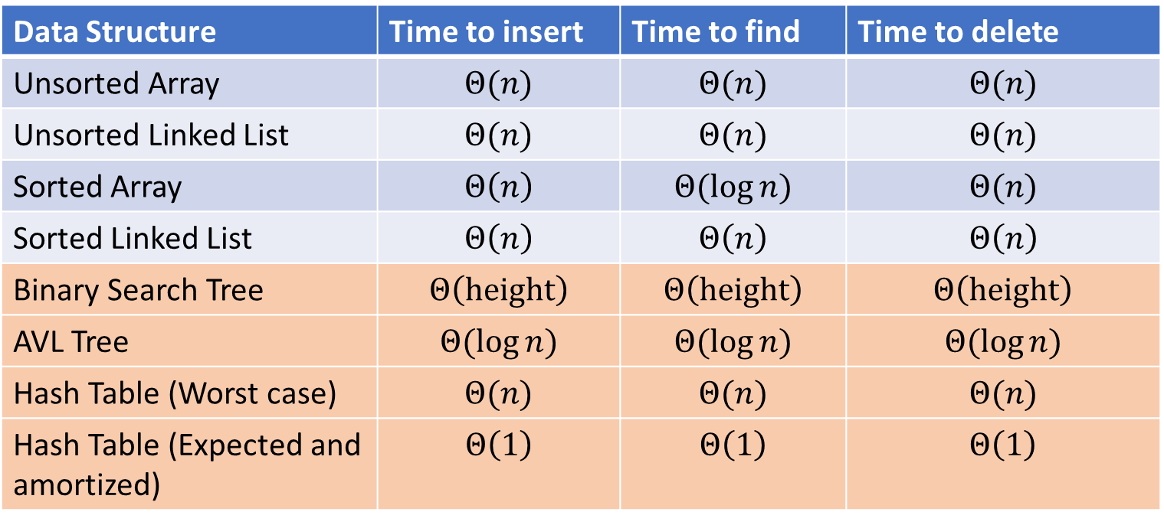
Next topic: Hash Tables
Data Structure | Time to insert | Time to find | Time to delete
Unsorted Array | $$Θ(n)$$ | $$Θ(n)$$ | $$Θ(n)$$
Unsorted Linked List | $$Θ(n)$$ | $$Θ(n)$$ | $$Θ(n)$$
Sorted Array | $$Θ\left(n\right)$$ | $$Θ(\log{n})$$ | $$Θ(n)$$
Sorted Linked List | $$Θ\left(n\right)$$ | $$Θ\left(n\right)$$ | $$Θ\left(n\right)$$
Binary Search Tree | $$Θ\left(height\right)$$ | $$Θ\left(height\right)$$ | $$Θ\left(height\right)$$
AVL Tree | $$Θ(\log{n})$$ | $$Θ(\log{n})$$ | $$Θ(\log{n})$$
Hash Table (Worst case) | $$Θ(n)$$ | $$Θ(n)$$ | $$Θ(n)$$
Hash Table (Expected and amortized) | $$Θ\left(1\right)$$ | $$Θ\left(1\right)$$ | $$Θ\left(1\right)$$

Slide 3
Dictionary (Map) ADT
Contents:
Sets of key+value pairs
Keys must be comparable
Operations:
insert(key, value)
Adds the (key,value) pair into the dictionary
If the key already has a value, overwrite the old value
Consequence: Keys cannot be repeated
find(key)
Returns the value associated with the given key
delete(key)
Remove the key (and its associated value)

Slide 4
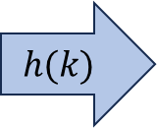
Hash Tables
Idea:
Have a small array to store information
Use a hash function to convert the key into an index
Hash function should “scatter” the keys, behave as if it randomly assigned keys to indices
Store key at the index given by the hash function
Do something if two keys map to the same place (should be very rare)
Collision resolution
Insert / find /
delete
$$h(k)$$
Index between 0 and length-1
& value
Key Object

Slide 5
Properties of a “Good” Hash
Definition: A hash function maps objects to integers
Should be very efficient
Time to calculate the hash should be negligible
Should “randomly” scatter objects
Even similar objects should hash to arbitrarily different values
Should use the entire table
There should not be any indices in the table that nothing can hash to
Picking a table size that is prime helps with this
Should use things needed to “identify” the object
Use only fields you would check for a .equals method be included in calculating the hash
$\left\{fields used for hashing\right\}⊆\left\{fields used for .equals\right\}$
More fields typically leads to fewer collisions, but less efficient calculation

Slide 6
Collision Resolution
A Collision occurs when we want to insert something into an already-occupied position in the hash table
2 main strategies:
Separate Chaining
Use a secondary data structure to contain the items
E.g. each index in the hash table is itself a linked list
Open Addressing
Use a different spot in the table instead
Linear Probing
Quadratic Probing
Double Hashing
0
1
2
3
4
5
6
7
8
9

Slide 7
Separate Chaining Insert
To insert $k,v$:
Compute the index using $i=h\left(k\right) \% length$
Add the key-value pair to the data structure at $table\left[i\right]$
$$k,v$$
$$k,v$$
$$k,v$$
0
1
2
3
4
5
6
7
8
9

Slide 8
Separate Chaining Find
To find $k$:
Compute the index using $i=h\left(k\right) \% length$
Call find with the key on the data structure at $table\left[i\right]$
$$k,v$$
$$k,v$$
$$k,v$$
0
1
2
3
4
5
6
7
8
9

Slide 9
Separate Chaining Delete
To delete $k$:
Compute the index using $i=h\left(k\right) \% length$
Call delete with the key on the data structure at $table\left[i\right]$
$$k,v$$
$$k,v$$
$$k,v$$
0
1
2
3
4
5
6
7
8
9

Slide 10
Formal Running Time Analysis
The load factor of a hash table represents the average number of items per “bucket”
$λ=\frac{n}{length}$
Assume we have a hash table that uses a linked-list for separate chaining
What is the expected number of comparisons needed in an unsuccessful find?
Linear in the size of the linked list we “land in”
$O\left(λ\right)$
What is the expected number of comparisons needed in a successful find?
$O(λ)$
How can we make the expected running time $Θ(1)$?
$λ=c$

Slide 11
Load Factor?
$$k,v$$
$$k,v$$
$$k,v$$
0
1
2
3
4
5
6
7
8
9

Slide 12
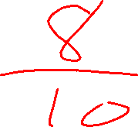
Load Factor?
$$k,v$$
$$k,v$$
$$k,v$$
$$k,v$$
$$k,v$$
$$k,v$$
$$k,v$$
$$k,v$$
0
1
2
3
4
5
6
7
8
9

Slide 13
Load Factor?
$$k,v$$
$$k,v$$
$$k,v$$
$$k,v$$
$$k,v$$
$$k,v$$
$$k,v$$
$$k,v$$
$$k,v$$
$$k,v$$
$$k,v$$
$$k,v$$
$$k,v$$
$$k,v$$
$$k,v$$
0
1
2
3
4
5
6
7
8
9

Slide 14
Rehashing
If your load factor $λ$ gets too large, copy everything over to a larger hash table
To do this: make a new, larger array
Re-insert all items into the new hash table by reapplying the hash function
We need to reapply the hash function because items should map to a different index
New array should be “roughly” double the length (but probably still want it to be prime)
What does “too large” mean?
For separate chaining, typically we want $λ<2$
For open addressing, typically we want $λ<\frac{1}{2}$

Slide 15
Collision Resolution: Linear Probing
When there’s a collision, use the next open space in the table
0
1
2
3
4
5
6
7
8
9

Slide 16
Linear Probing: Insert Procedure
To insert $k,v$
Calculate $i=h\left(k\right) \% length$
If $table[i]$ is occupied then try $\left(i+1\right)\% length$
If that is occupied try $\left(i+2\right)\% length$
If that is occupied try $\left(i+3\right)\% length$
…
$h\left(k\right)=k\%10$
2
32
24
62
54
0
1
2
3
4
5
6
7
8
9

Slide 17
Linear Probing: Find
0
1
2
3
4
5
6
7
8
9

Slide 18
Linear Probing: Find
To find key $k$
Calculate $i=h\left(k\right) \% length$
If $table\left[i\right]$ is occupied and does not contain $k$ then look at $\left(i+1\right) \% length$
If that is occupied and does not contain $k$ then look at $\left(i+2\right) \% length$
If that is occupied and does not contain $k$ then look at $\left(i+3\right) \% length$
Repeat until you either find $k$ or else you reach an empty cell in the table
0
1
2
3
4
5
6
7
8
9

Slide 19
Linear Probing: Delete
Suppose A, B, C, D, and E all hashed to 3
Now let’s delete B
Before:
A
B
C
D
E
0
1
2
3
4
5
6
7
8
9
After:
A
C
D
E
0
1
2
3
4
5
6
7
8
9

Slide 20
Linear Probing: Delete
Suppose A, B, and E all hashed to 3, and C and D hashed to 5
Now let’s delete B
Before:
A
B
C
D
E
0
1
2
3
4
5
6
7
8
9
After:
A
E
C
D
0
1
2
3
4
5
6
7
8
9

Slide 21
Linear Probing: Delete
Suppose A and E hashed to 3, and B,C, and D hashed to 4
Now let’s delete B
Before:
A
B
C
D
E
0
1
2
3
4
5
6
7
8
9
After:
A
C
D
0
1
2
3
4
5
6
7
8
9

Slide 22
Linear Probing: Delete
Let’s do this together!
“rehash” everything after the deleted item until we reach a gap
0
1
2
3
4
5
6
7
8
9

Slide 23
Linear Probing: Delete
To delete key $k$, where $h\left(k\right)=i$
Assume it is present
Beginning at index $i$, probe until we find $k$ (call this location index $j$)
Mark $j$ as empty (e.g. null), then continue probing while doing the following until you find another empty index
If you come across a key which hashes to a value $≤j$ then move that item to index $j$ and update $j$.
0
1
2
3
4
5
6
7
8
9

Slide 24

Linear Probing: Delete
Option 1: Fill in with items that hashed to before the empty slot
Option 2: “Tombstone” deletion. Leave a special object that indicates an object was deleted from there
The tombstone does not act as an open space when finding (so keep looking after its reached)
When inserting you can replace a tombstone with a new item
$$k,v$$
$$k,v$$
$$k,v$$
$$k,v$$
0
1
2
3
4
5
6
7
8
9

Slide 25
Linear Probing + Tombstone: Find
To find key $k$
Calculate $i=h\left(k\right) \% length$
While $table[i]$ has a tombstone or a key other than $k$, $i=\left(i+1\right) \% length$
If you come across $k$ return $table[i]$
If you come across an empty index, the find was unsuccessful
0
1
2
3
4
5
6
7
8
9

Slide 26
Linear Probing + Tombstone: Insert
To insert $k,v$
Calculate $i=h\left(k\right) \% length$
While $table[i]$ has a key other than $k$, $i=\left(i+1\right) \% length$
If $table[i]$ has a tombstone, set $x=i$
That is where we will insert if the find is unsuccessful
If you come across $k$, set $table\left[i\right]=k,v$
If you come across an empty index, the find was unsuccessful
Set $table\left[x\right]=k,v$ if we saw a tombstone
Set $table\left[i\right]=k,v$ otherwise
0
1
2
3
4
5
6
7
8
9

Slide 27
Downsides of Linear Probing
What happens when $λ$ approaches 1?
Get longer and longer contiguous blocks
A collision is guaranteed to grow a block
Larger blocks experience more collisions
Feedback loop!
What happens when $λ$ exceeds 1?
Impossible!
You can’t insert more stuff

Slide 28
Quadratic Probing: Insert Procedure
To insert $k,v$
Calculate $i=h\left(k\right) \% size$
If $table[i]$ is occupied then try $\left(i+1^{2}\right)\% size$
If that is occupied try $\left(i+2^{2}\right)\% size$
If that is occupied try $\left(i+3^{2}\right)\% size$
If that is occupied try $\left(i+4^{2}\right)\% size$
…
0
1
2
3
4
5
6
7
8
9

Slide 29
Quadratic Probing: Example
Insert:
76
40
48
5
55
47
0
1
2
3
4
5
6

Slide 30
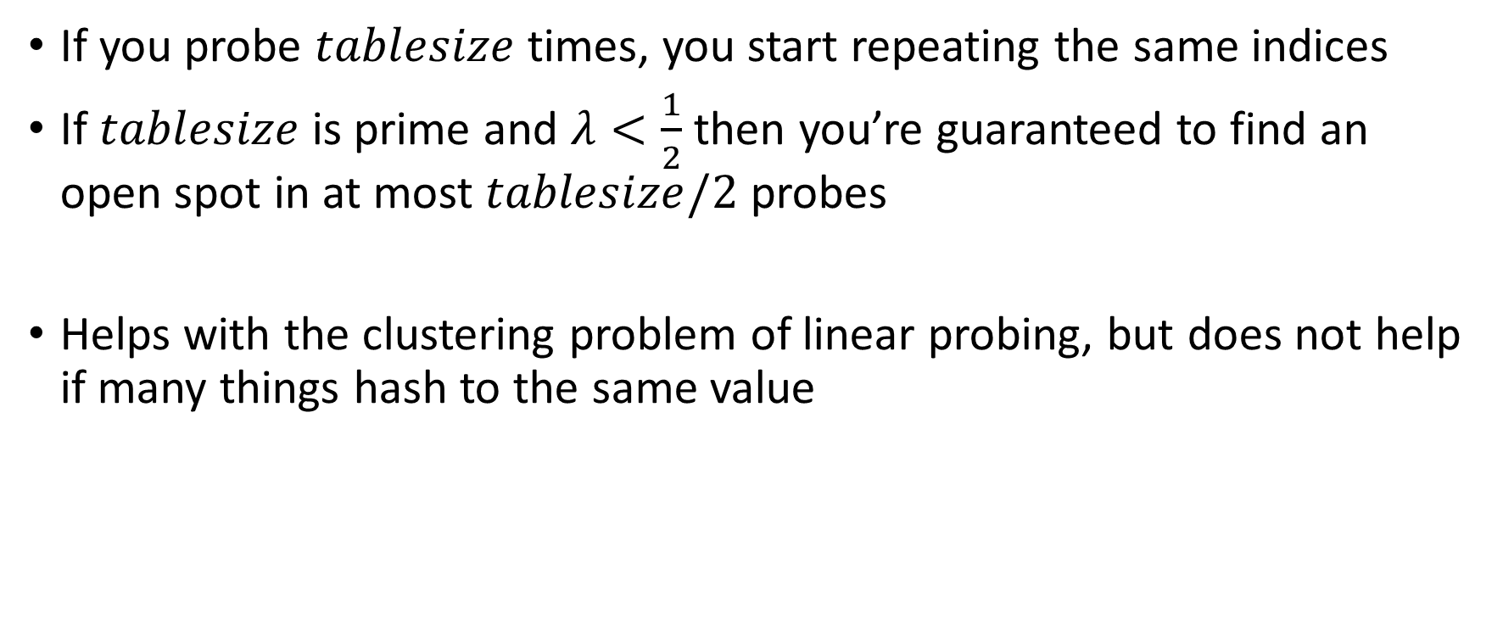
Using Quadratic Probing
If you probe $tablesize$ times, you start repeating the same indices
If $tablesize$ is prime and $λ<\frac{1}{2}$ then you’re guaranteed to find an open spot in at most $tablesize/2$ probes
Helps with the clustering problem of linear probing, but does not help if many things hash to the same value

Slide 31
Double Hashing: Insert Procedure
Given $h$ and $g$ are both good hash functions
To insert $k,v$
Calculate $i=h\left(k\right) \% size$
If $table[i]$ is occupied then try $\left(i+g\left(k\right)\right) \% size$
If that is occupied try $\left(i+2⋅g\left(k\right)\right)\% size$
If that is occupied try $\left(i+3⋅g\left(k\right)\right)\% size$
If that is occupied try $\left(i+4⋅g\left(k\right)\right)\% size$
…
0
1
2
3
4
5
6
7
8
9

