Slide 1
CSE 332
Data Structures & Parallelism
P, NP, NP-Complete (Part 2)
Melissa Winstanley
Spring 2024

Slide 2
Course notes
Course evals
P3 was due LAST NIGHT
Late due date is Saturday night (11:59pm)
Final review session - Tuesday 6/4, 2:30-5:20pm, GWN 301
OH in finals week
Final exam is THURSDAY 6/6 at 8:30am

Slide 3
Agenda (2 lectures)
A Few (graph) Problems:
Euler Circuits
Hamiltonian Circuits
Intractability: P and NP
NP-Complete
What now?

Slide 4
A Glimmer of Hope
If given a candidate solution to a problem, we can check if that solution is correct in polynomial-time, then maybe a polynomial-time solution exists?
Example: can we do this with Hamiltonian Circuit?
Given a candidate path, is it a Hamiltonian Circuit?

Slide 5
The Complexity Class NP
Definition: NP is the set of all problems for which a given candidate solution can be tested in polynomial time
Examples of problems in NP:
Hamiltonian circuit: Given a candidate path, can test in linear time if it is a Hamiltonian circuit
Vertex Cover: Given a subset of vertices, do they cover all edges?
All problems that are in P (why?)

Slide 6
Why do we call it “NP”?
NP stands for Nondeterministic Polynomial time
Why “nondeterministic”? Corresponds to algorithms that can guess a solution (if it exists), the solution is then verified to be correct in polynomial time
Can also think of as allowing a special operation that allows the algorithm to magically guess the right choice at each branch point.
The algorithms we’ve discussed are NOT nondeterministic – purely theoretical idea invented to understand how hard a problem could be
Notes:
Does NOT stand for “not polynomial”

Slide 7
NP
P
Sorting
Shortest Path
Euler Circuit
Hamiltonian Circuit
Satisfiability (SAT)
Vertex Cover
Travelling Salesman
Notes:
P = NP or P != NP
What if P was equal to NP, how would it change?
What if it isn’t?

Slide 8
Your Chance to Win a Turing Award!
It is generally believed that P ≠ NP, i.e. there are problems in NP that are not in P
But no one has been able to show even one such problem!
This is the fundamental open problem in theoretical computer science
Nearly everyone has given up trying to prove it. Instead, theoreticians prove theorems about what follows once we assume P ≠ NP !
Notes:
It would be useful if someone could PROVE this (just like we did with comparison sort) so we can stop trying
And you would DEFINITELY get a CS building named after you

Slide 9
NP-completeness
Set of problems in NP that (we are pretty sure) cannot be solved in polynomial time.
These are thought of as the hardest problems in the class NP.
Interesting fact: If any one NP-complete problem could be solved in polynomial time, then all NP-complete problems could be solved in polynomial time.
Also: If any NP-complete problem is in P, then all of NP is in P
Notes:
One more set!

Slide 10
NP
NP-complete
Hamiltonian Circuit
Satisfiability (SAT)
Vertex Cover
Travelling Salesman
P
Sorting
Shortest Path
Euler Circuit
Notes:
Factoring integers - outside of both (probably)
Halting problem

Slide 11
Saving Your Job
Try as you might, every solution you come up with for the Hamiltonian Circuit problem runs in exponential time…..
You have to report back to your boss.
Your options:
Keep working
Come up with an alternative plan…

Slide 12
Your Third Task
Your boss buys your story that others couldn’t solve the last problem.
Again, your company has to send someone by car to a set of cities. There is a road between every pair of cities.
The primary cost is distance traveled (which translates to fuel costs).
Your boss wants you to figure out how to drive to each city exactly once, then return to the first city, while staying within a fixed mileage budget k.

Slide 13
Travelling Salesperson Problem (TSP)
Your third task is basically TSP:
Given complete weighted graph G, integer k.
Is there a cycle that visits all vertices with cost <= k?
One of the canonical problems.
Note difference from Hamiltonian cycle:
graph is complete
we care about weight.
Notes:
Imagine you don’t know that it’s NPcomplete

Slide 14
In general, what to do with a Hard Problem
Your problem seems really hard.
If you can transform a known NP-complete problem into the one you’re trying to solve, then you can stop working on your problem!

Slide 15
Transforming Hamiltonian Cycle to TSP
We can “reduce” Hamiltonian Cycle to TSP.
Given graph G=(V, E):
Assign weight of 1 to each edge
Augment the graph with edges until it is a complete graph G’=(V, E’)
Assign weights of 2 to the new edges
Let k = |V|.
Notes:
The transformation must take polynomial time
You reduce the known NP-complete problem into your problem (not the other way around)
In this case we are assuming Hamiltonian Cycle is our known NP-complete problem (in reality, both are known NP-complete)

Slide 16
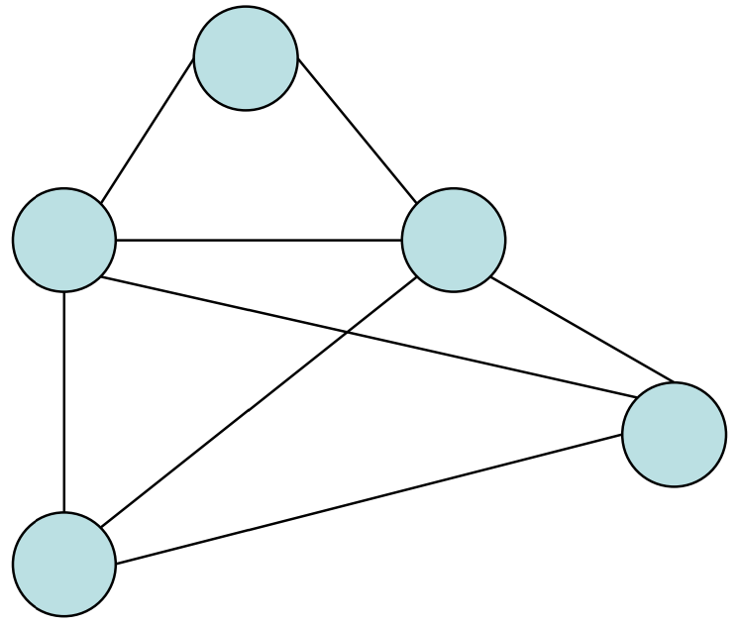
Example
G
Input to Hamiltonian Circuit Problem

Slide 17
Example
Polynomial time transformation
1
1
2
2
1
1
1
1
1
1
G G’
Input to Hamiltonian Input to Traveling Circuit Problem Salesperson Problem
Notes:
Try to solve this problem with a budget of 5

Slide 18
Hamiltonian Circuit -> Traveling Salesperson
Transform
into
TSP
TSP
Input to Hamiltonian Circuit
Hamiltonian Circuit Solution

Slide 19
Polynomial-time transformation
G’ has a TSP tour of weight |V| iff G has a Hamiltonian Cycle.
What was the cost of transforming HC into TSP?
In the end, because there is a polynomial time transformation from HC to TSP, we say TSP is “at least as hard as” Hamiltonian cycle.

Slide 20
What do we do about it?
Approximation Algorithm:
Can we get an efficient algorithm that guarantees something close to optimal? (e.g. Answer is guaranteed to be within 1.5x of Optimal, but solved in polynomial time).
Restrictions:
Many hard problems are easy for restricted inputs (e.g. graph is always a tree, degree of vertices is always 3 or less).
Heuristics:
Can we get something that seems to work well (good approximation/fast enough) most of the time? (e.g. In practice, n is small-ish)

Slide 21
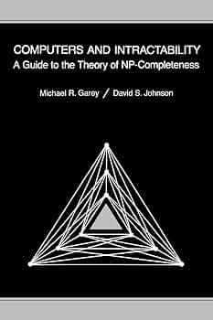
Great Quick Reference
Computers and Intractability: A Guide to the Theory of NP-Completeness, by Michael S. Garey and David S. Johnson

