Slide 1
CSE 332
Data Structures & Parallelism
P, NP, NP-Complete (Part 1)
Melissa Winstanley
Spring 2024
Notes:
Alphabet soup!
CSE 421 - natural successor to 332, graphs, etc
CSE 431 - natural successor to 311, complexity
Going to leave out some details here

Slide 2
Course notes
Course evals
P3 is due TOMORROW (11:59pm)
Late due date is Saturday night
Final review session - Tuesday 6/4, 2:30-5:20pm, GWN 301
OH in finals week
Final exam is THURSDAY 6/6 at 8:30am

Slide 3
Agenda (2 lectures)
A Few (graph) Problems:
Euler Circuits
Hamiltonian Circuits
Intractability: P and NP
NP-Complete
What now?

Slide 4
Try it!

Slide 5
Your First Task
Your company has to inspect a set of roads between cities by driving over each of them.
Driving over the roads costs money (fuel), and there are a lot of roads.
Your boss wants you to figure out how to drive over each road exactly once, returning to your starting point.

Slide 6
Euler Circuits
Euler circuit: a path through a graph that visits each edge exactly once and starts and ends at the same vertex
Named after Leonhard Euler (1707-1783), who cracked this problem and founded graph theory in 1736
An Euler circuit exists iff
the graph is connected and
each vertex has even degree (= # of edges on the vertex)
Notes:
“Oiler”
Aka a cycle

Slide 7
Try it!
Notes:
Even degrees! Can go in and out, easy to know if it’s possible

Slide 8
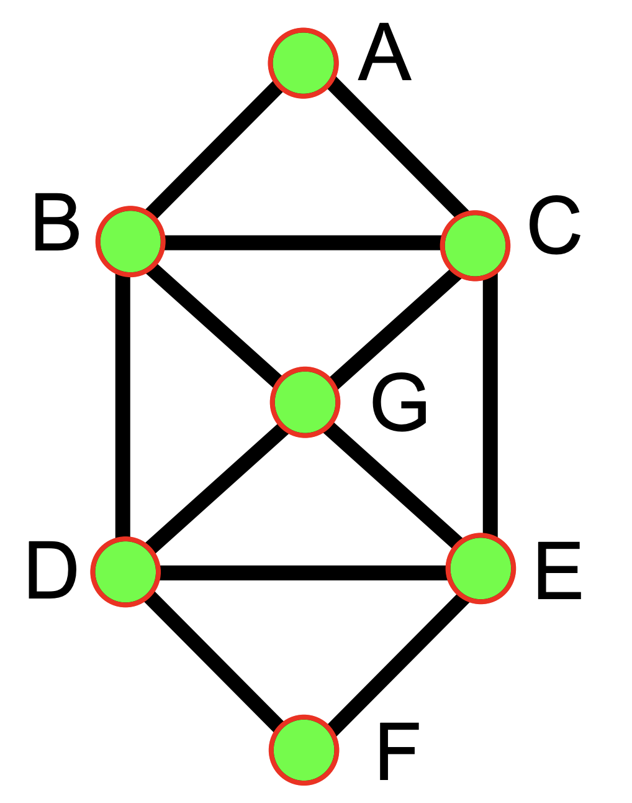
Euler Circuit Example
Euler(A):
Notes:
We can easily calculate if this is possible
To find it, we’ll just do a traversal

Slide 9
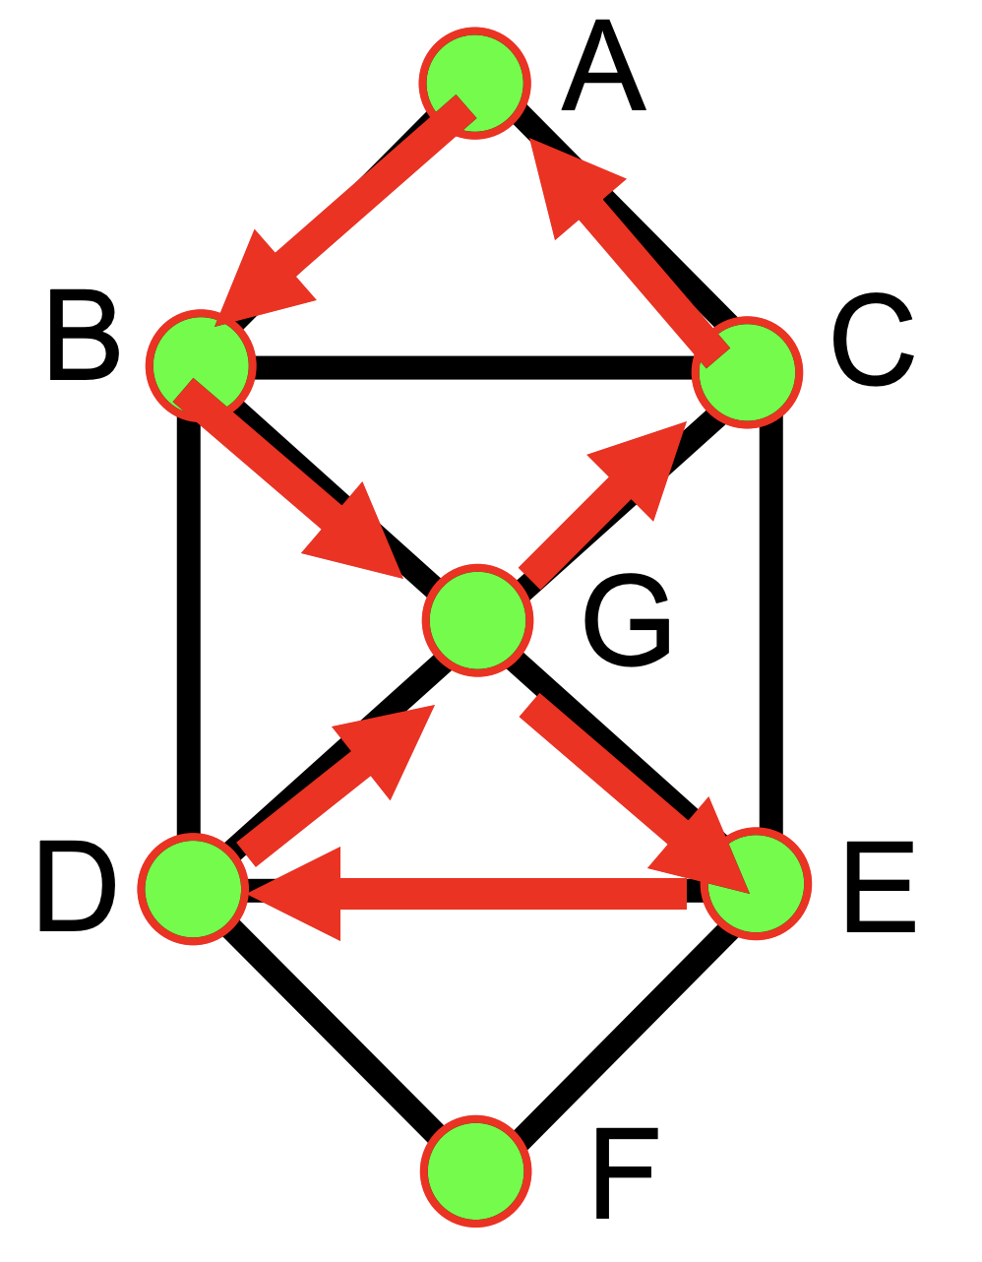
Euler Circuit Example
Euler(A): A B G E D G C A
Notes:
Traversal not enough

Slide 10
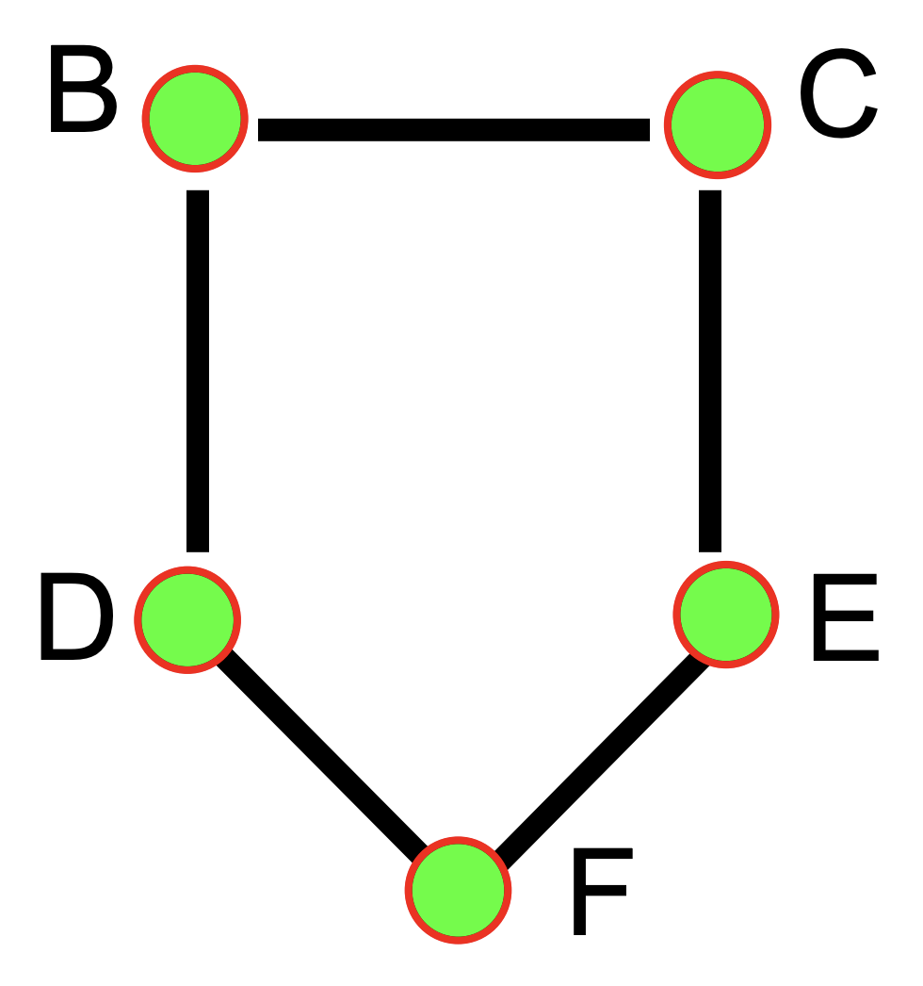
Euler Circuit Example
Euler(A): A B G E D G C A Euler(B):
Notes:
Traversal not enough

Slide 11
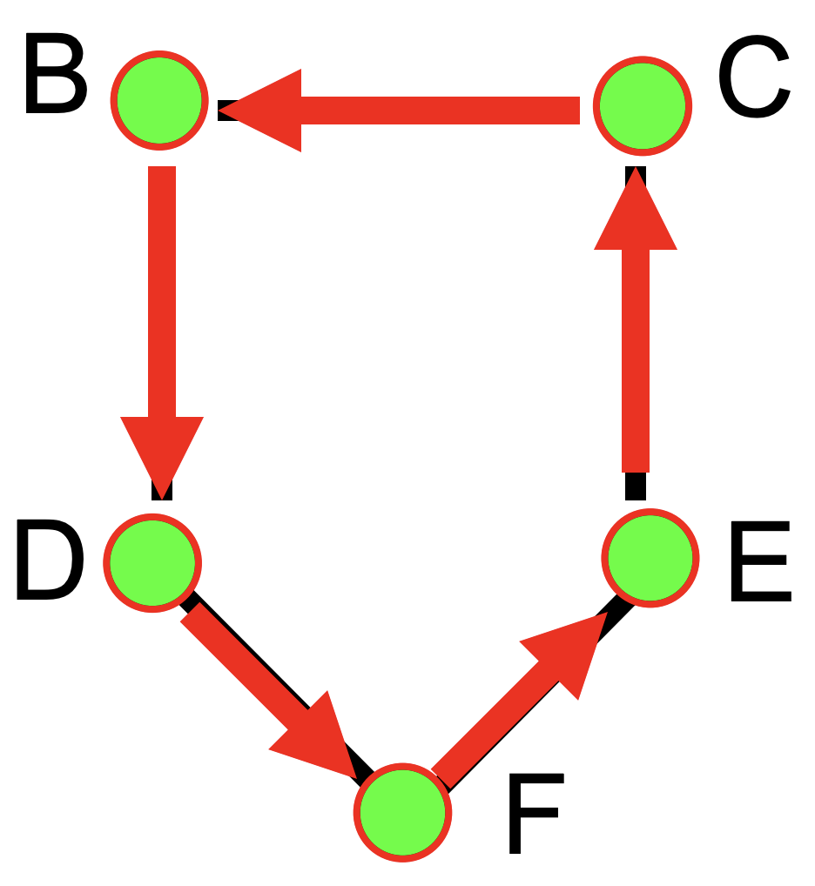
Euler Circuit Example
Euler(A): A B G E D G C A Euler(B): B D F E C B

Slide 12
Euler Circuit Example
Splice! A B D F E C B G E D G C A
Euler(A): A B G E D G C A Euler(B): B D F E C B

Slide 13
Your Second Task
Your boss is pleased…and assigns you a new task.
Your company has to send someone by car to a set of cities.
The primary cost is the exorbitant toll going into each city.
Your boss wants you to figure out how to drive to each city exactly once, returning in the end to the city of origin.

Slide 14
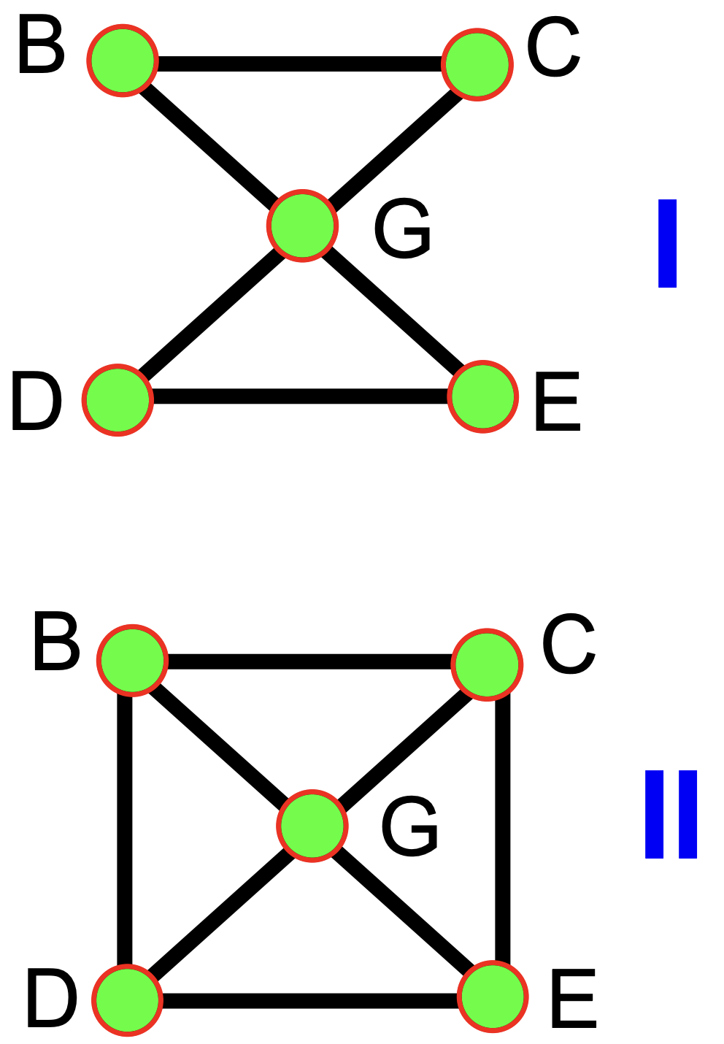
Hamiltonian Circuits
Euler circuit: A cycle that goes through each edge exactly once
Hamiltonian circuit: A cycle that goes through each vertex exactly once
Does graph I have:
An Euler circuit?
A Hamiltonian circuit?
Does graph II have:
An Euler circuit?
A Hamiltonian circuit?
Which problem sounds harder?
Notes:
Not necessarily mutually exclusive!

Slide 15
Finding Hamiltonian Circuits
Problem: Find a Hamiltonian circuit in a connected, undirected graph G
One solution: Search through all paths to find one that visits each vertex exactly once
Can use your favorite graph search algorithm to find paths
This is an exhaustive search (“brute force”) algorithm
Worst case: need to search all paths
How many paths??

Slide 16
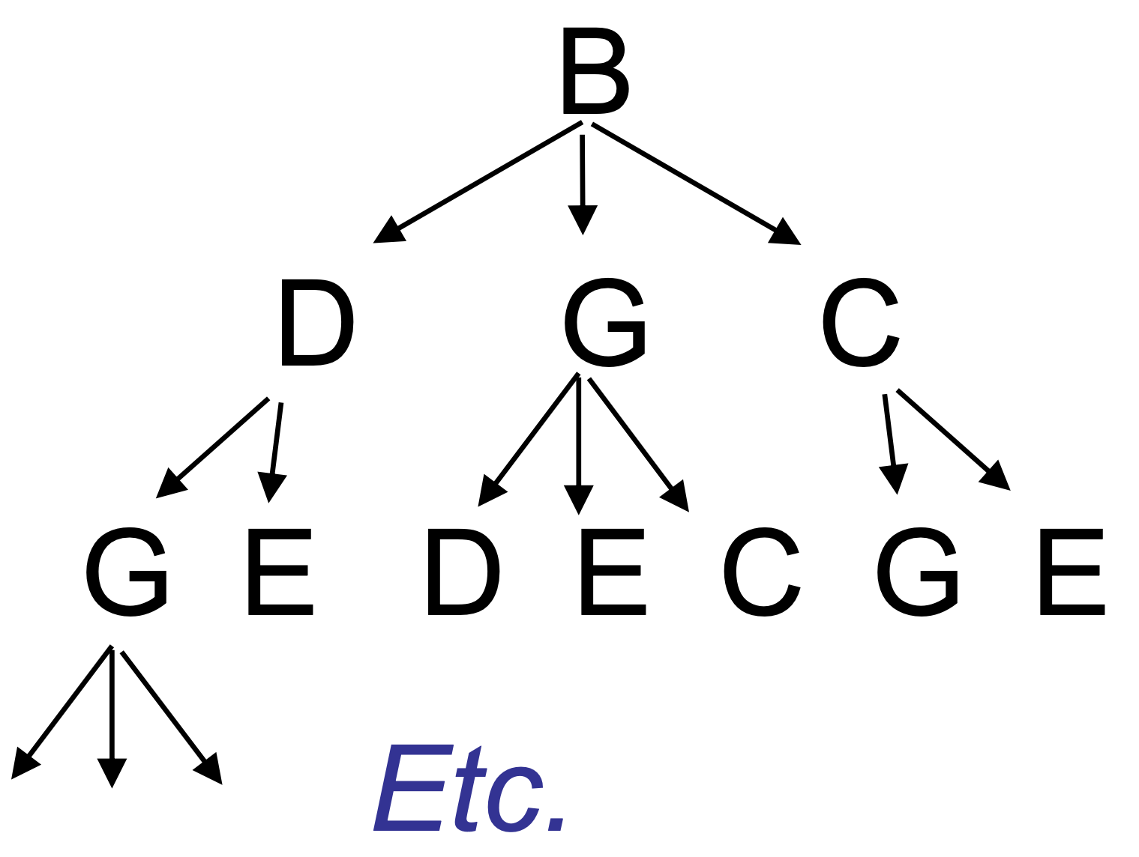
Analysis of Exhaustive Search Algorithm
Worst case: need to search all paths
How many paths?
Can depict these paths as a search tree:
Search tree of paths from B

Slide 17
Analysis of Exhaustive Search Algorithm
Let the average branching factor of each node in this tree be b
|V| vertices, each with ≈ b branches
Total number of paths ≈ b·b·b … ·b
Worst case →
Search tree of paths from B

Slide 18
Running times
Notes:
We haven’t seen anything this bad before
The others are called “polynomial running times”

Slide 19
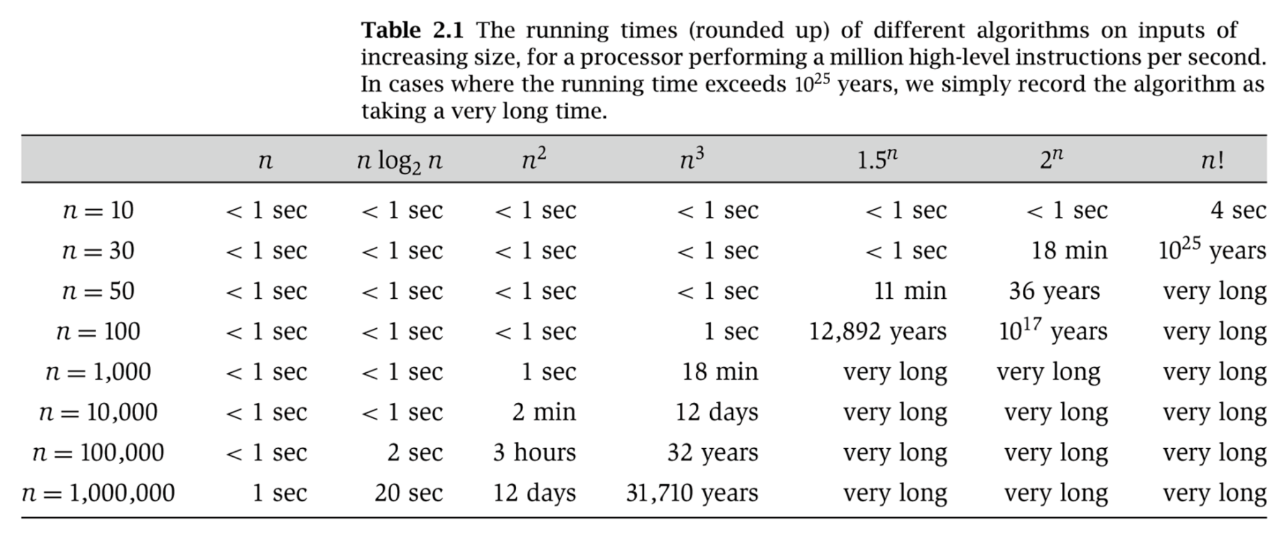
More Running Times
Somewhat old, from Rosen

Slide 20
Analysis of Exhaustive Search Algorithm
Let the average branching factor of each node in this tree be b
|V| vertices, each with ≈ b branches
Total number of paths ≈ b·b·b … ·b
Worst case → b^{V}
Search tree of paths from B

Slide 21
Polynomial vs. Exponential Time
All of the algorithms we have discussed in this class have been polynomial time algorithms:
Examples: O(log N), O(N), O(N log N), O(N²)
Algorithms whose running time is O(N^{k}) for some k > 0
Exponential time b^{N} is asymptotically worse than any polynomial function N^{k} for any k

Slide 22
The Complexity Class P
P is the set of all problems that can be solved in polynomial worst case time
All problems that have some algorithm whose running time is O(N^{k}) for some k
Examples of problems in P:
Sorting
Shortest path
Euler circuit
etc

Slide 23
P
Sorting
Shortest Path
Euler Circuit

Slide 24
Hamiltonian Circuit
P
Sorting
Shortest Path
Euler Circuit

Slide 25
Hamiltonian Circuit
Satisfiability (SAT)
Vertex Cover
Travelling Salesman
P
Sorting
Shortest Path
Euler Circuit

Slide 26
Satisfiability
Input: a logic formula of size m containing n variables
Output: An assignment of Boolean values to the variables in the formula such that the formula is true
Algorithm: Try every variable assignment
Notes:
Real world: applications in formal model checking, hardware design verification

Slide 27
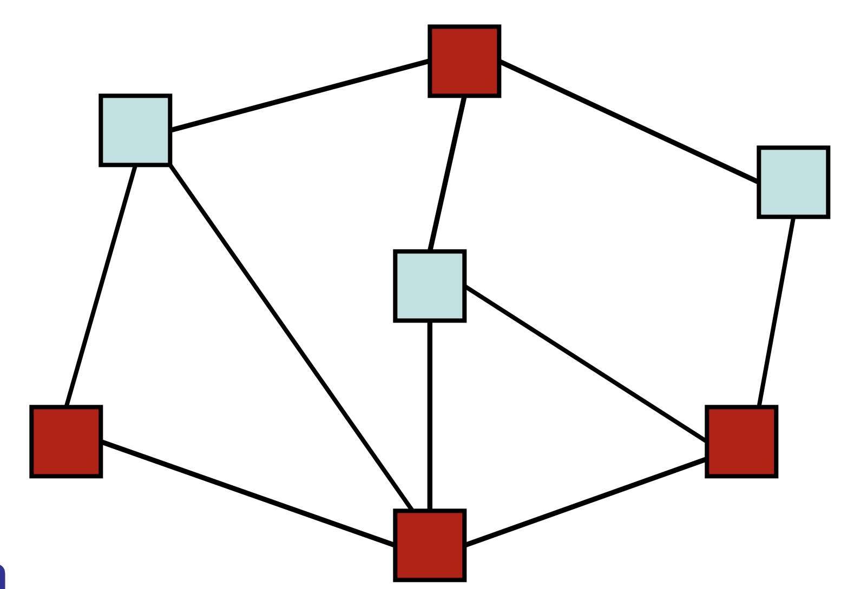
Vertex Cover
Input: A graph (V,E) and a number m
Output: A subset S of V such that for every edge (u,v) in E, at least one of u or v is in S and |S|=m (if such an S exists)
Algorithm: Try every subset of vertices of size m
Notes:
Real world: how many video cameras do you need to surveil a space?

Slide 28
Traveling Salesperson
Input: A complete weighted graph (V,E) and a number m
Output: A circuit that visits each vertex exactly once and has total cost < m if one exists
Algorithm: Try every path, stop if find cheap enough one
Notes:
What does “complete” mean?

