Slide 1
CSE 332
Data Structures & Parallelism
Minimum Spanning Trees (MST)
Melissa Winstanley
Spring 2024

Slide 2
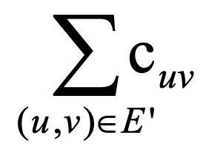
Minimum Spanning Trees
Given an undirected graph G=(V,E), find a graph G’=(V, E’) such that:
E’ is a subset of E
|E’| = |V| - 1
G’ is connected
is minimal
Applications:
Example: Electrical wiring for a house or clock wires on a chip
Example: A road network if you cared about asphalt cost rather than travel time
G’ is a minimum spanning tree.

Slide 3
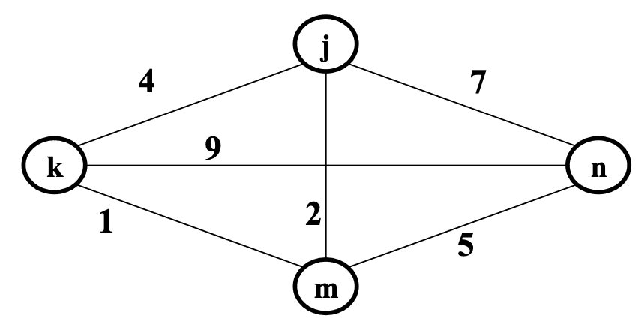
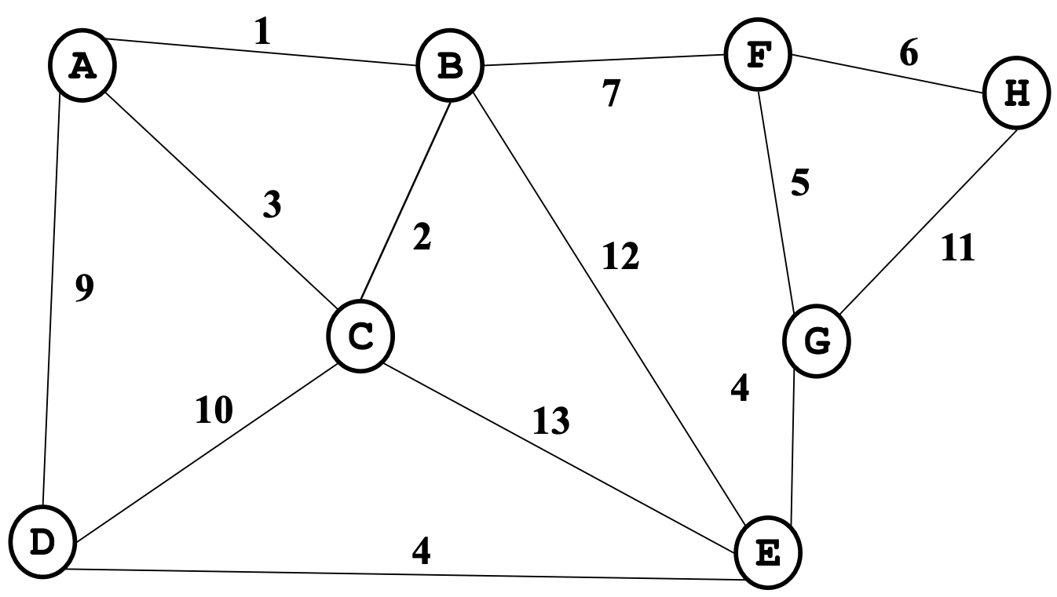
Find the MST
Notes:
Think about what kind of algorithm you’re using

Slide 4
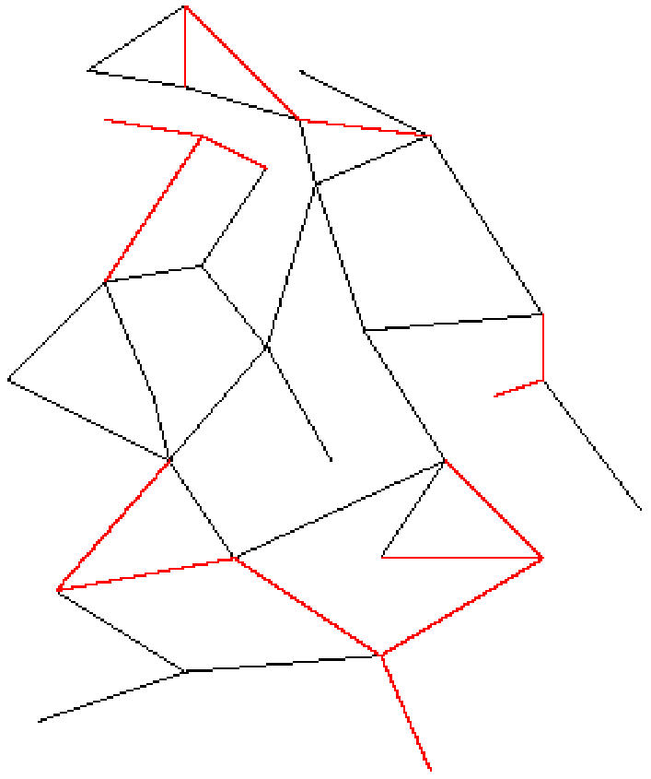
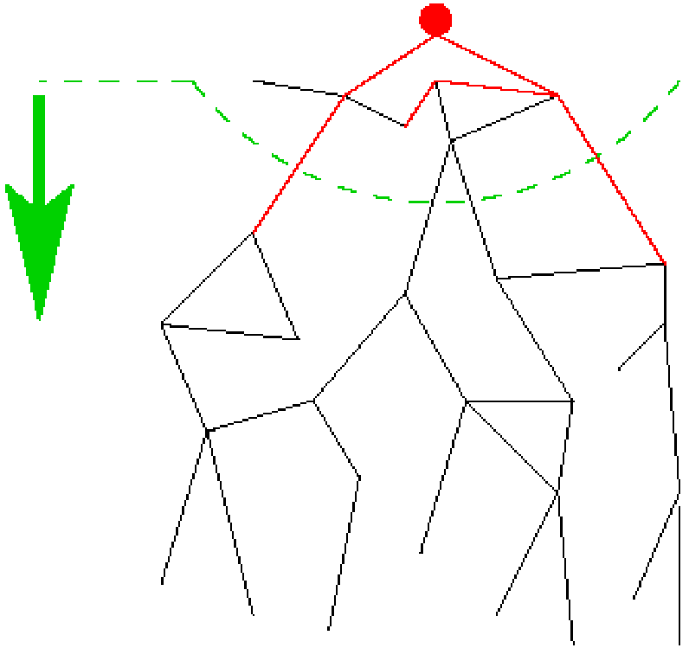
Two Different Approaches
Prim’s Algorithm Kruskal’s Algorithm
Almost identical to Dijkstra’s Completely different!

Slide 5
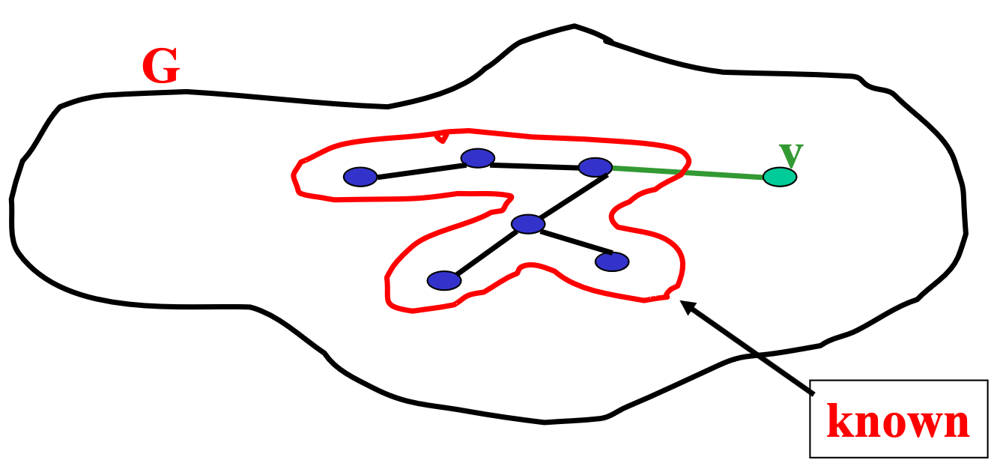
Prim’s algorithm
Idea: Grow a tree by picking a vertex from the unknown set that has the smallest cost. Here cost = cost of the edge that connects that vertex to the known set. Pick the vertex with the smallest cost that connects “known” to “unknown.”
A node-based greedy algorithm Builds MST by greedily adding nodes

Slide 6
Prim’s Algorithm vs. Dijkstra’s
Recall:
Dijkstra picked the unknown vertex with smallest cost where cost = distance to the source.
Prim’s pick the unknown vertex with smallest cost where cost = distance from this vertex to the known set (in other words, the cost of the smallest edge connecting this vertex to the known set)
Otherwise identical
Compare to slides in Dijkstra lecture!

Slide 7
Prim’s Algorithm for MST
For each node v, set v.cost = ∞ and v.known = false
Choose any node v. (this is like your “start” vertex in Dijkstra)
Mark v as known
For each edge (v,u) with weight w: set u.cost=w and u.prev=v
While there are unknown nodes in the graph
Select the unknown node v with lowest cost
Mark v as known and add (v, v.prev) to output (the MST)
For each edge (v,u) with weight w, where u is unknown:
if(w < u.cost) {
u.cost = w;
u.prev = v;
}

Slide 8
Example: Find MST using Prim’s
2
∞
B
1
∞
A
1
5
E
∞
∞
1
2
vertex | known? | cost | prev
A
B
C
D
E
F
G
1
D
3
5
∞
C
6
G
2
∞
F
10
∞
Order added to known set:

Slide 9
Example: Find MST using Prim’s
2
∞
B
1
∞
A
1
5
E
∞
∞
1
2
vertex | known? | cost | prev
A | Y | 0
B | Y | 1 | E
C | Y | 1 | D
D | Y | 1 | A
E | Y | 1 | D
F | Y | 2 | C
G | Y | 3 | E
1
D
3
5
∞
C
6
G
2
∞
F
10
∞
Order added to known set:
A, D, C, E, B, F, G

Slide 10
Your turn: Find MST using Prim’s
2
R
10
Q
1
3
U
7
4
vertex | known? | cost | prev
Q
R
S
T
U
V
W
2
T
6
4
S
8
W
5
V
1
Order added to known set:
Total cost:

Slide 11
Prim’s Analysis
Correctness ??
A bit tricky
Intuitively similar to Dijkstra
Might return to this time permitting (unlikely)
Run-time
Same as Dijkstra
O(|E|log |V|) using a priority queue

Slide 12
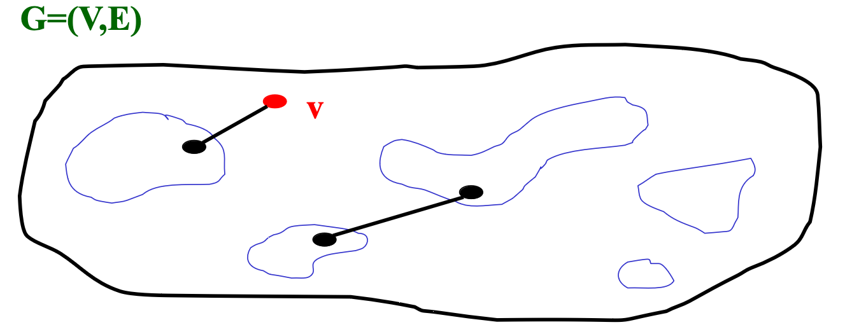
Kruskal’s MST Algorithm
Idea: Grow a forest out of edges that do not create a cycle. Pick an edge with the smallest weight.

Slide 13
6
Notes:
Think about what kind of algorithm you’re using

Slide 14
Example: Find MST using Kruskal’s
2
Edges in sorted order:
1: (A,D), (C,D), (B,E), (D,E)
2: (A,B), (C,F), (A,C)
3: (E,G)
5: (D,G), (B,D)
6: (D,F)
10: (F,G)
B
1
A
1
5
E
1
2
1
D
3
5
C
6
G
2
F
10
Order added to known set:
Note: At each step, the union/find sets are the trees in the forest

Slide 15
Kruskal’s Algorithm for MST
An edge-based greedy algorithm Builds MST by greedily adding edges
Initialize with
empty MST
all vertices marked unconnected
all edges unmarked
While all vertices are not connected
Pick the lowest cost edge (u,v) and mark it
If u and v are not already connected, add (u,v) to the MST and mark u and v as connected to each other

Slide 16
Aside: Union-Find aka Disjoint Set ADT
Union(x,y) – take the union of two sets named x and y
Given sets: {3,5,7} , {4,2,8}, {9}, {1,6}
Union(5,1) Result: {3,5,7,1,6}, {4,2,8}, {9}
To perform the union operation, we replace sets x and y by (x ⋃ y)
Find(x) – return the name of the set containing x.
Given sets: {3,5,7,1,6}, {4,2,8}, {9}
Find(1) returns 5
Find(4) returns 8
We can do Union in constant time.
We can get Find to be amortized constant time O(1) (worst case O(log n) for an individual Find operation).
Red underline is “name” of the set
Notes:
Underline is the “name” of the set

Slide 17
Kruskal’s pseudo code
|V| create disjoint sets
void Graph::kruskal(){
int edgesAccepted = 0;
DisjSet s(NUM_VERTICES);
Build heap of edges
while (edgesAccepted < NUM_VERTICES – 1){
e = smallest weight edge not deleted yet;
// edge e = (u, v)
uset = s.find(u);
vset = s.find(v);
if (uset != vset){
edgesAccepted++;
s.unionSets(uset, vset);
}
}
}
|E| using Floyd’s BH
|E| heap operations
2|E| finds
|V| unions

Slide 18
Kruskal’s pseudo code
|V| create disjoint sets
void Graph::kruskal(){
int edgesAccepted = 0;
DisjSet s(NUM_VERTICES);
Build heap of edges
while (edgesAccepted < NUM_VERTICES – 1){
e = smallest weight edge not deleted yet;
// edge e = (u, v)
uset = s.find(u);
vset = s.find(v);
if (uset != vset){
edgesAccepted++;
s.unionSets(uset, vset);
}
}
}
|E| using Floyd’s BH
|E| heap operations
2|E| finds
|V| unions
O(V + E + E^{times}(logE + 2logV) + V^{times}(constant) )
=> O ( E log E)

Slide 19
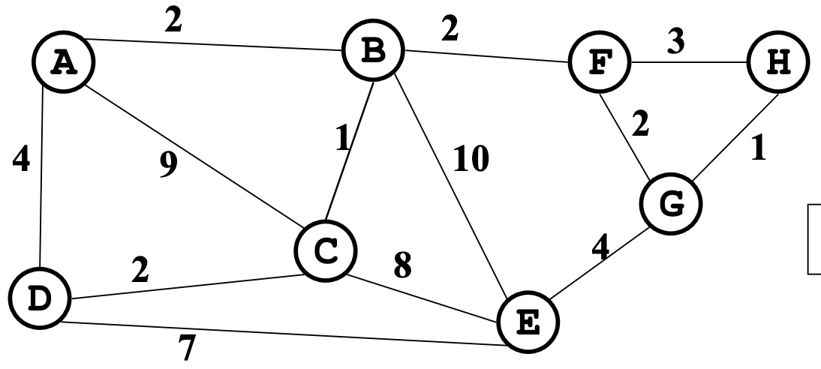
Find MST using Kruskal’s
Now find the MST using Prim’s method.
Under what conditions will these methods give the same result?
Total cost:

Slide 20
Correctness
Kruskal’s algorithm is clever, simple, and efficient
But does it generate a minimum spanning tree?
How can we prove it?
First: it generates a spanning tree
Intuition: Graph started connected and we added every edge that did not create a cycle
Proof by contradiction: Suppose u and v are disconnected in Kruskal’s result. Then there’s a path from u to v in the initial graph with an edge we could add without creating a cycle. But Kruskal would have added that edge. Contradiction.
Second: There is no spanning tree with lower total cost…

Slide 21
The inductive proof set-up
Let F (stands for “forest”) be the set of edges Kruskal has added at some point during its execution.
Claim: F is a subset of one or more MSTs for the graph (Therefore, once |F|=|V|-1, we have an MST.)
Proof: By induction on |F|
Base case: |F|=0: The empty set is a subset of all MSTs
Inductive case: |F|=k+1: By induction, before adding the (k+1)^{th} edge (call it e), there was some MST T such that F-{e} ⊆ T …

Slide 22
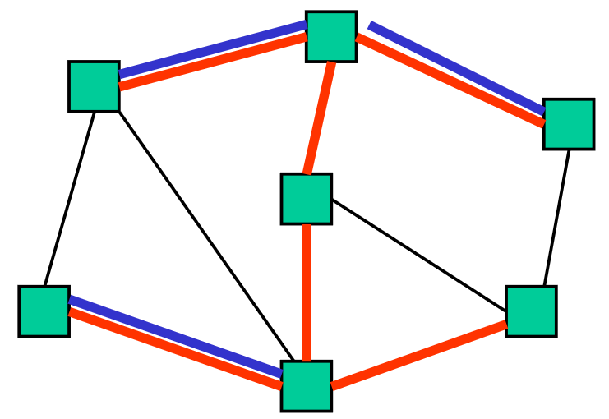
Staying a subset of some MST
Claim: F is a subset of one or more MSTs for the graph
So far: F-{e} ⊆ T:
Two disjoint cases:
If {e} ⊆ T: Then F ⊆ T and we’re done
Else e forms a cycle with some simple path (call it p) in T
Must be since T is a spanning tree

Slide 23
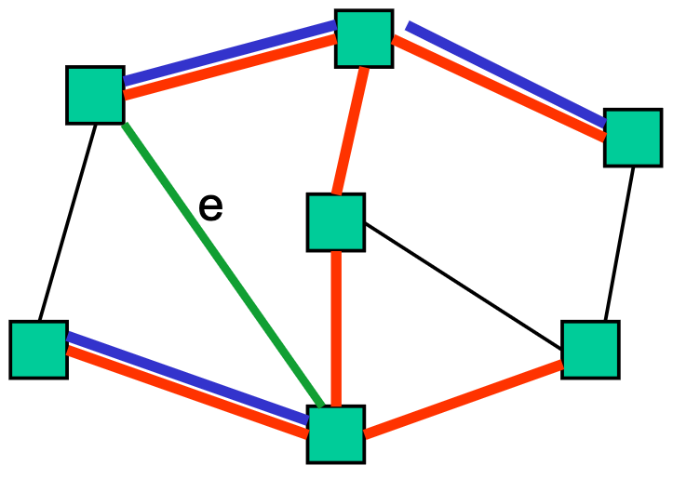
Staying a subset of some MST
Claim: F is a subset of one or more MSTs for the graph
So far: F-{e} ⊆ T and e forms a cycle with p ⊆ T
There must be an edge e2 on p such that e2 is not in F
Else Kruskal would not have added e
Claim: e2.weight == e.weight

Slide 24
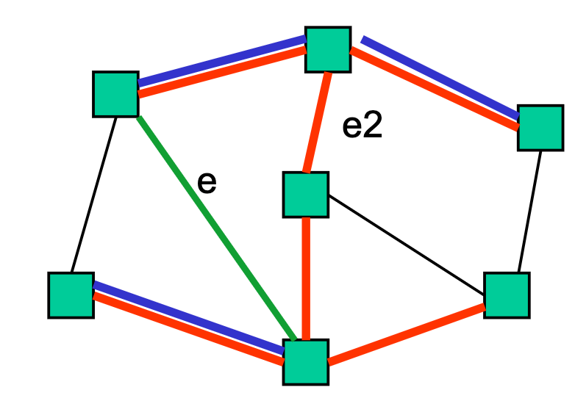
Staying a subset of some MST
Claim: F is a subset of one or more MSTs for the graph
So far: F-{e} ⊆ T and e forms a cycle with p ⊆ T e2 on p is not in F
Claim: e2.weight == e.weight
If e2.weight > e.weight, then T is not an MST because T-{e2}+{e} is a spanning tree with lower cost: contradiction
If e2.weight < e.weight, then Kruskal would have already considered e2. It would have added it since T has no cycles and F-{e} ⊆ T. But e2 is not in F: contradiction

Slide 25
Staying a subset of some MST
Claim: F is a subset of one or more MSTs for the graph
So far: F-{e} ⊆ T and e forms a cycle with p ⊆ T e2 on p is not in F e2.weight == e.weight
Claim: T-{e2}+{e} is a MST
It’s a spanning tree because p-{e2}+{e} connects the same nodes as p
It’s minimal because its cost equals cost of T, an MST
Since F ⊆ T-{e2}+{e}, F is a subset of one or more MSTs. Done.

