Slide 1
CSE 332
Data Structures & Parallelism
Topological Sort
Melissa Winstanley
Spring 2024

Slide 2
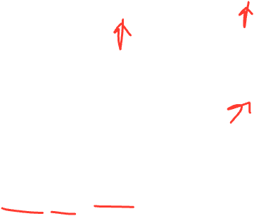
Topological Sort
Problem: Given a DAG G=(V,E), output all the vertices in order such that if no vertex appears before any other vertex that has an edge to it
Example input:
Example output:
121, 126, 122, 123, 311, 331, 332, 312, 341, 351, 333, 440, 352
CSE 331
CSE 332
CSE 440
CSE 121
CSE 122
CSE 123
CSE 311
CSE 312
CSE 341
CSE 333
MATH 126
CSE 351
CSE 352

Slide 3
2
1
4
3
0
Valid Topological Sorts:

Slide 4
2
1
4
3
0
Valid Topological Sorts:
0, 1, 2, 3, 4 0, 1, 3, 2, 4
1, 0, 2, 3, 4 1, 0, 3, 2, 4
1, 2, 0, 3, 4

Slide 5
Questions and comments
Why do we perform topological sorts only on DAGs?
Is there always a unique answer?
What DAGs have exactly 1 answer?
Terminology: A DAG represents a partial order and a topological sort produces a total order that is consistent with it

Slide 6
Topological Sort Uses
Figuring out how to finish your degree
Computing the order in which to recompute cells in a spreadsheet
Determining the order to compile files using a Makefile
In general, taking a dependency graph and coming up with an order of execution

Slide 7
A First Algorithm for Topological Sort
Label (“mark”) each vertex with its in-degree
Think “write in a field in the vertex”
Could also do this via a data structure (e.g., array) on the side
While there are vertices not yet output:
Choose a vertex v labeled with in-degree of 0
Output v and conceptually remove it from the graph
For each vertex w adjacent to v (i.e. w such that (v,w) in E), decrement the in-degree of w

Slide 8
A First Algorithm for Topological Sort
2
1
4
3
Label (“mark”) each vertex with its in-degree
Think “write in a field in the vertex”
Could also do this via a data structure (e.g., array) on the side
While there are vertices not yet output:
Choose a vertex v labeled with in-degree of 0
Output v and conceptually remove it from the graph
For each vertex w adjacent to v (i.e. w such that (v,w) in E), decrement the in-degree of w
0
In- degree
0
3
/
1
2
3
/
2
4
/
3
4
/
4
/
Notes:
First step is O(V+E)

Slide 9
Example
CSE 331
CSE 332
CSE 440
CSE 121
CSE 122
CSE 123
CSE 311
CSE 312
CSE 341
CSE 333
MATH 126
CSE 351
CSE 352
Node: 121 122 123 126 311 312 331 332 333 341 351 352 440
Removed?
In-degree:
Output:

Slide 10
Example
CSE 331
CSE 332
CSE 440
CSE 121
CSE 122
CSE 123
CSE 311
CSE 312
CSE 341
CSE 333
MATH 126
CSE 351
CSE 352
Node: 121 122 123 126 311 312 331 332 333 341 351 352 440
Removed? x x x x x x x x x x x x x
In-degree: 0 1 1 0 2 1 1 1 1 1 1 2 1 0 0 0 1 0 0 0 0 0 0 1 0 0 0
Output: 121, 122, 123, 126, 331, 311, 341, 351, 332, 312, 333, 352, 440

Slide 11
A couple of things to note
Needed a vertex with in-degree of 0 to start
No cycles
Ties between vertices with in-degrees of 0 can be broken arbitrarily
Potentially many different correct orders

Slide 12
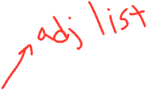
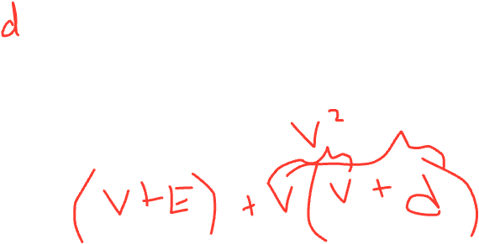
Topological Sort: Running time?
labelEachVertexWithItsInDegree();
for(ctr=0; ctr < numVertices; ctr++){
v = findNewVertexOfDegreeZero();
put v next in output
for each w adjacent to v
w.indegree--;
}
Notes:
O((V+E) + V*(V + 1 + d(1)))
O(V^2 + E)

Slide 13
Doing better
The trick is to avoid searching for a zero-degree node every time!
Keep the “pending” zero-degree nodes in a list, stack, queue, box, table, or something
Order we process them affects output but not correctness or efficiency provided add/remove are both O(1)
Using a queue:
Label each vertex with its in-degree, enqueue 0-degree nodes
While queue is not empty
v = dequeue()
Output v and remove it from the graph
For each vertex w adjacent to v (i.e. w such that (v,w) in E), decrement the in-degree of w, if new degree is 0, enqueue it

Slide 14
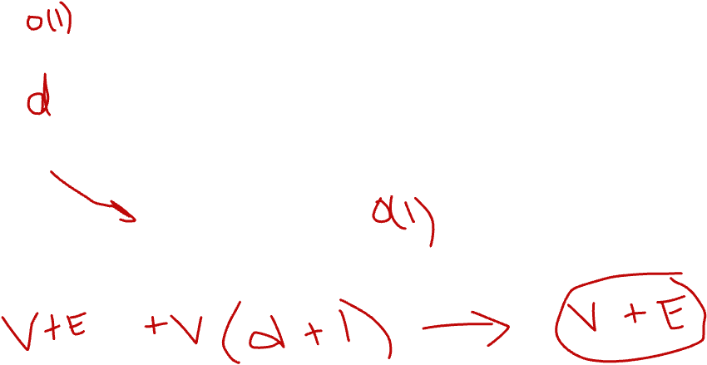
Topological Sort(optimized): Running time?
labelAllAndEnqueueZeros();
for(ctr=0; ctr < numVertices; ctr++){
v = dequeue();
put v next in output
for each w adjacent to v
w.indegree--;
if(w.indegree==0)
enqueue(w);
}
Notes:
O((V+E) + V*(1 + 1 + d(c)))
O(V + E)

