Slide 1
CSE 332
Data Structures & Parallelism
Race Conditions & Deadlock
Melissa Winstanley
Spring 2024

Slide 2
Race Conditions
A race condition occurs when the computation result depends on scheduling (how threads are interleaved)
If T1 and T2 happened to get scheduled in a certain way, things go wrong
We, as programmers, cannot control scheduling of threads;
Thus we need to write programs that work independent of scheduling
Race conditions are bugs that exist only due to concurrency
No interleaved scheduling problems with only 1 thread!
Typically, problem is that some intermediate state can be seen by another thread; screws up other thread
Consider a ‘partial’ insert in a linked list; say, a new node has been added to the end, but ‘back’ and ‘count’ haven’t been updated

Slide 3
Race Conditions: Data Races vs Bad Interleavings
We will make a big distinction between:
data races and bad interleavings
Both are kinds of race-condition bugs
Confusion often results from not distinguishing these or using the ambiguous “race condition” to mean only one

Slide 4
Data Races (briefly)
A data race is a specific type of race condition that can happen in 2 ways:
Two different threads potentially write a variable at the same time
One thread potentially writes a variable while another reads the variable
Not a race: simultaneous reads provide no errors
‘Potentially’ is important
We claim the code itself has a data race independent of any particular actual execution
Data races are bad, but we can still have a race condition, and bad behavior, when no data races are present…through bad interleavings (what we will discuss now).

Slide 5
Stack Example (pseudocode)
class Stack<E> {
private E[] array = (E[]) new Object[SIZE];
private int index = -1;
synchronized boolean isEmpty() {
return index == -1;
}
synchronized void push(E val) {
array[++index] = val;
}
synchronized E pop() {
if (isEmpty()) {
throw new StackEmptyException();
return array[index--];
}
}

Slide 6
Example of a Race Condition, but not a Data Race
class Stack<E> {
// state used by isEmpty, push, pop
synchronized boolean isEmpty() { ... }
synchronized void push(E val) { ... }
synchronized E pop() {
if (isEmpty()) {
throw new StackEmptyException();
...
}
E peek() { // this is wrong
E ans = pop();
push(ans);
return ans;
}
}
Notes:
Don’t implement peek this way! This is hypothetical only
This is NOT a data race - the data is protected
What if I add “print index” at the start of the peek method?

Slide 7
Example 1: peek and isEmpty
Property we want: If there has been a push (and no pop), then isEmpty should return false
With peek as written, property can be violated – how?
Thread 1 (peek):
Thread 2
time
2
E ans = pop();
push(ans);
return ans;
1
push(x);
boolean b = isEmpty();
3
Notes:
Problem is with “intermediate state”

Slide 8
Example 2: Exercise - peek and push
Property we want: Values are returned from pop in LIFO order
With peek as written, property can be violated – how?
Thread 1 (peek):
Thread 2
time
2
E ans = pop();
push(ans);
return ans;
1
push(x);
push(y)
E e = pop()
3
4
5
Notes:
Do this as an exercise

Slide 9
Example 3: Exercise - peek and peek
Property we want: peek doesn’t throw an exception unless stack is empty
With peek as written, property can be violated – how?
Thread 1 (peek):
Thread 2
time
E ans = pop();
push(ans);
return ans;
E ans = pop();
push(ans);
return ans;
Notes:
Do this as an exercise

Slide 10
The fix
In short, peek needs synchronization to disallow interleavings
The key is to make a larger critical section
That intermediate state of peek needs to be protected
Use re-entrant locks; will allow calls to push and pop
Code on right is example of a peek external to the Stack class
class C {
<E> E myPeek(Stack<E> s) {
synchronized (s) {
E ans = pop();
push(ans);
return ans;
}
}
}
class Stack<E> {
synchronized E peek() {
E ans = pop();
push(ans);
return ans;
}
}

Slide 11
Example 1: peek and isEmpty, revisited
Property we want: If there has been a push (and no pop), then isEmpty should return false
With peek as written, property can be violated – how?
Thread 1 (peek):
Thread 2
time
E ans = pop();
push(ans);
return ans;
push(x);
boolean b = isEmpty();
Notes:
Problem is with “intermediate state”

Slide 12
Example (pseudocode not complete)
class Stack<E> {
private E[] array = (E[]) new Object[SIZE];
private int index = -1;
synchronized boolean isEmpty() {
return index == -1;
}
synchronized void push(E val) {
array[++index] = val;
}
synchronized E pop() {
return array[index--];
}
E peek() { // unsynchronized: wrong!
return array[index];
}
}
Notes:
Give an example of a data race - actually array[++index] isn’t a single operation

Slide 13
Why wrong?
It looks like isEmpty and peek can “get away with this” since push and pop adjust the state “in one tiny step”
But this code is still wrong and depends on language-implementation details you cannot assume
Even “tiny steps” may require multiple steps in the implementation: array[++index] = val probably takes at least two steps
Code has a data race, allowing very strange behavior
Compiler optimizations may break it in ways you had not anticipated
See Grossman notes for more details
Moral: Do not introduce a data race, even if every interleaving you can think of is correct

Slide 14
The distinction
The (poor) term “race condition” can refer to two different things resulting from lack of synchronization:
Data races: Simultaneous read/write or write/write of the same memory location
(for mortals) always an error, due to compiler & hardware
Original peek example has no data races
Bad interleavings: Despite lack of data races, exposing bad intermediate state
“Bad” depends on your specification
Original peek had several bad interleavings

Slide 15
Data race?
x = 5
y = x + 4

Slide 16
Data race?
x = z + 12
y = z - 2

Slide 17
Data race?
lst is an unsynchronized ArrayList
lst.get(12)
lst.add(394)

Slide 18
Data race?
lst is an unsynchronized ArrayList
lst.get(12)
lst.size()

Slide 19
Data race?
lst is a synchronized ArrayList
lst.get(12)
lst.add(394)
But depending on what we’re trying to do, we could still get a bad interleaving (like our bad peek implementation)

Slide 20
Getting it right
Avoiding race conditions on shared resources is difficult
What ‘seems fine’ in a sequential world can get you into trouble when multiple threads are involved
Decades of bugs have led to some conventional wisdom: general techniques that are known to work
Next we discuss this conventional wisdom!
Parts paraphrased from “Java Concurrency in Practice”
Chapter 2 (rest of book more advanced)
But none of this is specific to Java or a particular book!
May be hard to appreciate in beginning, but come back to these guidelines over the years!

Slide 21
3 choices
For every memory location (e.g., object field) in your program, you must obey at least one of the following:
Thread-local: Do not use the location in > 1 thread
Immutable: Do not write to the memory location
Shared-and-mutable: Use synchronization to control access to the location
need synchronization
thread-local memory
immutable memory
all memory

Slide 22
1. Thread-local
Whenever possible, do not share resources
Easier to have each thread have its own thread-local copy of a resource than to have one with shared updates
This is correct only if threads do not need to communicate through the resource
That is, multiple copies are a correct approach
Example: Random objects
Note: Because each call-stack is thread-local, never need to synchronize on local variables
In typical concurrent programs, the vast majority of objects should be thread-local: shared-memory should be rare – minimize it

Slide 23
2. Immutable
Whenever possible, do not update objects
Make new objects instead!
One of the key tenets of functional programming (see CSE 341)
Generally helpful to avoid side-effects
Much more helpful in a concurrent setting
If a location is only read, never written, then no synchronization is necessary!
Simultaneous reads are not races and not a problem
In practice, programmers usually over-use mutation – minimize it

Slide 24
3. The rest: Keep it synchronized
After minimizing the amount of memory that is (1) thread-shared and (2) mutable, we need guidelines for how to use locks to keep other data consistent
Guideline #0: No data races
Never allow two threads to read/write or write/write the same location at the same time (use locks!)
Even if it ‘seems safe’
Necessary:
a Java or C program with a data race is almost always wrong
But not sufficient: Our peek example had no data races, and it’s still wrong…

Slide 25
Consistent Locking
Guideline #1: Use consistent locking
For each location needing synchronization, have a lock that is always held when reading or writing the location
We say the lock guards the location
The same lock can (and often should) guard multiple locations (ex. multiple fields in a class)
Clearly document the guard for each location
In Java, often the guard is the object containing the location
this inside the object’s methods
But also often guard a larger structure with one lock to ensure mutual exclusion on the structure

Slide 26
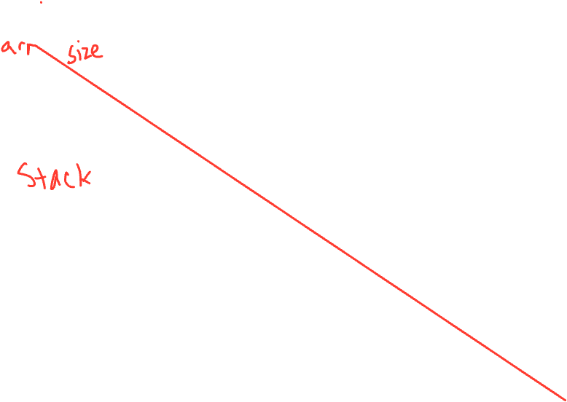
Consistent Locking (continued)
The mapping from locations to guarding locks is conceptual
Must be enforced by you as the programmer
It partitions the shared-and-mutable locations into “which lock”
Consistent locking is:
Not sufficient: It prevents all data races but still allows bad interleavings
Our peek example used consistent locking, but still had exposed intermediate states (and allowed potential bad interleavings)
(Aside) Not necessary: You could have different locking protocols for different phases of your program as long as all threads are coordinated moving from one phase to next. eg. at start of program data structure is being updated (needs locks), later it is not modified so can be read simultaneous (no locks).

Slide 27
Lock granularity
Coarse-grained: Fewer locks, i.e., more objects per lock
Example: One lock for entire data structure (e.g., array)
Example: One lock for all bank accounts
Fine-grained: More locks, i.e., fewer objects per lock
Example: One lock per data element (e.g., array index)
Example: One lock per bank account
“Coarse-grained vs. fine-grained” is really a continuum
Notes:
Tradeoffs?

Slide 28
Example: Separate Chaining Hashtable
Coarse-grained: One lock for entire hashtable
Fine-grained: One lock for each bucket
Which supports more concurrency for insert and lookup?
Which makes implementing resize easier?
How would you do it?
If a hashtable has a numElements field, maintaining it will destroy the benefits of using separate locks for each bucket, why?

Slide 29
Critical-section granularity
A second, orthogonal granularity issue is critical-section size
How much work to do while holding lock(s)?
If critical sections run for too long?
If critical sections are too short?

Slide 30
Critical-section granularity
A second, orthogonal granularity issue is critical-section size
How much work to do while holding lock(s)?
If critical sections run for too long?
Performance loss because other threads are blocked
If critical sections are too short?
Bugs because you broke up something where other threads should not be able to see the intermediate state
Guideline #3: Don’t do expensive computations or I/O in critical sections, but also don’t introduce race conditions; keep it as small as possible but still be correct

Slide 31
Example 1: Critical-section granularity
Suppose we want to change the value for a key in a hashtable without removing it from the table
Assume lock guards the whole table
expensive() takes in the old value, and computes a new one, but takes a long time
synchronized(lock) {
v1 = table.lookup(k);
v2 = expensive(v1);
table.remove(k);
table.insert(k, v2);
}

Slide 32
Example 2: Critical-section granularity
Suppose we want to change the value for a key in a hashtable without removing it from the table
Assume lock guards the whole table
synchronized(lock) {
v1 = table.lookup(k);
}
v2 = expensive(v1);
synchronized(lock) {
table.remove(k);
table.insert(k, v2);
}

Slide 33
Example 3: Critical-section granularity
Suppose we want to change the value for a key in a hashtable without removing it from the table
done = false;
while(!done) {
synchronized(lock) {
v1 = table.lookup(k);
}
v2 = expensive(v1);
synchronized(lock) {
if(table.lookup(k) == v1) {
done = true;
table.remove(k);
table.insert(k, v2);
}}}
Notes:
Are there any scenarios where this might still be wrong?

Slide 34
Atomicity
An operation is atomic if no other thread can see it partly executed
– Atomic as in “appears indivisible”
– Typically want ADT operations atomic, even to other threads running operations on the same ADT
Guideline #4: Think in terms of what operations need to be atomic
Make critical sections just long enough to preserve atomicity
Then design the locking protocol to implement the critical sections correctly
That is: Think about atomicity first and locks second

Slide 35
Don’t roll your own
In “real life”, it is unusual to have to write your own data structure from scratch
Implementations provided in standard libraries
Point of CSE332 is to understand the key trade-offs, abstractions, and analysis of such implementations
Especially true for concurrent data structures
Far too difficult to provide fine-grained synchronization without race conditions
Standard thread-safe libraries like ConcurrentHashMap written by world experts
Guideline #5: Use built-in libraries whenever they meet your needs

Slide 36
Deadlock

Slide 37
Motivating Deadlock Issues
Consider a method to transfer money between bank accounts
Potential problems?
class BankAccount {
synchronized void withdraw(int amount) {...}
synchronized void deposit(int amount) {...}
synchronized void transferTo(int amt,
BankAccount o) {
this.withdraw(amt);
o.deposit(amt);
}
}

Slide 38
Motivating Deadlock Issues
Consider a method to transfer money between bank accounts
Notice during call to o.deposit, thread holds two locks
Need to investigate when this may be a problem
class BankAccount {
synchronized void withdraw(int amount) {...}
synchronized void deposit(int amount) {...}
synchronized void transferTo(int amt,
BankAccount o) {
this.withdraw(amt);
o.deposit(amt);
}
}

Slide 39
The Deadlock
Suppose x and y are static fields holding accounts
Thread 1: x.transferTo(1,y)
Thread 2: y.transferTo(1, x)
acquire lock for x
do withdraw from x
block on lock for y
acquire lock for y
do withdraw from y
block on lock for x
time
Notes:
Problem is with “intermediate state”

Slide 40
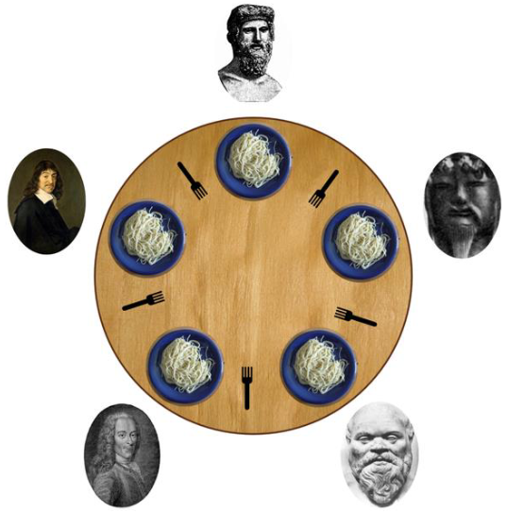
Ex: The Dining Philosophers
5 philosophers go out to dinner together at an Italian restaurant
Sit at a round table; one fork per setting
When the spaghetti comes, each philosopher proceeds to grab their right fork, then their left fork, then eats
‘Locking’ for each fork results in a deadlock

Slide 41
Back to our example
Options for deadlock-proof transfer:
Make a smaller critical section: transferTo not synchronized
Exposes intermediate state after withdraw before deposit
May be okay here, but exposes wrong total amount in bank
Coarsen lock granularity: one lock for all accounts allowing transfers between them
Works, but sacrifices concurrent deposits/withdrawals
Give every bank-account a unique number and always acquire locks in the same order
Entire program should obey this order to avoid cycles
Code acquiring only one lock can ignore the order

Slide 42
Ordering locks
class BankAccount {
private int acctNumber; // must be unique
void transferTo(int amt, BankAccount o) {
if(this.acctNumber < a.acctNumber)
synchronized(this) {
synchronized(a) {
this.withdraw(amt);
a.deposit(amt);
}}
else
synchronized(a) {
synchronized(this) {
this.withdraw(amt);
a.deposit(amt);
}}
}
}

Slide 43
Concurrency summary
Concurrent programming allows multiple threads to access shared resources (e.g. hash table, work queue)
Introduces new kinds of bugs:
Data races and Bad Interleavings
Critical sections too small
Critical sections use wrong locks
Deadlocks
Requires synchronization
Locks for mutual exclusion (common, various flavors)
Other Synchronization Primitives: (see Grossman notes)
Reader/Writer Locks
Condition variables for signaling others
Guidelines for correct use help avoid common pitfalls
Shared Memory model is not only approach, but other approaches (e.g., message passing) are not painless

