Slide 1
CSE 332
Data Structures & Parallelism
Shared-Memory Concurrency &
Mutual Exclusion
Melissa Winstanley
Spring 2024

Slide 2
Course updates
P3 CP1 is due on Thursday
Reading is helpful!

Slide 3
Toward sharing resources (memory)
So far, we have been studying parallel algorithms using the fork-join model
Reduce span via parallel tasks
Fork-Join algorithms all had a very simple structure to avoid race conditions
Each thread had memory “only it accessed”
Example: each array sub-range accessed by only one thread
Result of forked process not accessed until after join() called
So the structure (mostly) ensured that bad simultaneous access wouldn’t occur
Strategy won’t work well when:
Memory accessed by threads is overlapping or unpredictable
Threads are doing independent tasks needing access to same resources (rather than implementing the same algorithm)

Slide 4
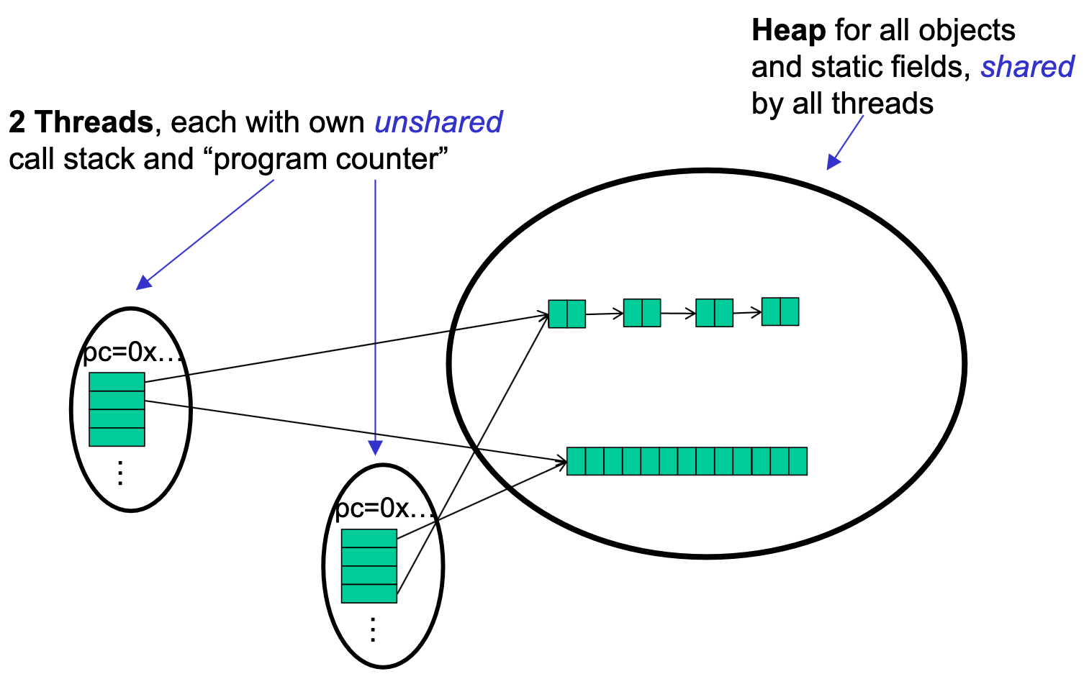
Notes:
So far, the threads weren’t REALLY sharing

Slide 5
Sharing a Queue….
Imagine 2 threads, running at the same time,
both with access to a shared linked-list based queue (initially empty)
enqueue(x) {
if (back == null) {
back = new Node(x);
front = back;
} else {
back.next = new Node(x);
back = back.next;
}
}

Slide 6
Concurrent Programming
Concurrency: Correctly and efficiently managing access to shared resources from multiple possibly-simultaneous clients
Requires coordination, particularly synchronization to avoid incorrect simultaneous access: make somebody block (wait) until the resource is free
join is not what we want
Want to block until another thread is “done using what we need” not “completely done executing”
Even correct concurrent applications are usually highly non-deterministic
how threads are scheduled affects what operations happen first
non-repeatability complicates testing and debugging
Notes:
We don’t control what the Fork-Join framework does - what order it starts threads in. It could be sequential, but it could not
You need to be disciplined in writing this code because debugging is harder

Slide 7
Why threads?
Unlike parallelism, not about implementing algorithms faster
But threads still useful for:
Code structure for responsiveness
Example: Respond to GUI events in one thread while another thread is performing an expensive computation
Processor utilization (mask I/O latency)
If 1 thread “goes to disk,” have something else to do
Failure isolation
Convenient structure if want to interleave multiple tasks and do not want an exception in one to stop the other
Notes:
Instead of just doing 1 task faster, now we can be doing multiple DIFFERENT tasks at the same time.

Slide 8
Canonical example
Correct code in a single-threaded world
class BankAccount {
private int balance = 0;
int getBalance() { return balance; }
void setBalance(int x) { balance = x; }
void withdraw(int amount) {
int b = getBalance();
if (amount > b)
throw new WithdrawTooLargeException();
setBalance(b – amount);
}
… // other operations like deposit, etc.
}

Slide 9
Activity: What is the balance at the end?
Two threads both trying to withdraw() from the same account:
• Assume initial balance 150
class BankAccount {
private int balance = 0;
int getBalance() { return balance; }
void setBalance(int x) { balance = x; }
void withdraw(int amount) {
int b = getBalance();
if (amount > b)
throw new WithdrawTooLargeException();
setBalance(b – amount);
}
… // other operations like deposit, etc.
}
Thread 1
x.withdraw(100);
Thread 2
x.withdraw(75);

Slide 10
Activity: A bad “interleaving”
balance = 150
Interleaved withdraw() calls on the same account
Assume initial balance == 150
This should cause a WithdrawTooLarge exception
Thread 1: withdraw(100)
Thread 2: withdraw(75)
int b = getBalance();
if (amount > b)
throw new …;
setBalance(b – amount);
int b = getBalance();
if (amount > b)
throw new …;
setBalance(b – amount);
1
time
2
3
4
5
6

Slide 11
Activity: Other possible interleavings
How else could two threads interleave?
Thread 1
x.withdraw(100);
void withdraw(int amount) {
int b = getBalance();
if (amount > b)
throw new WithdrawTooLargeException();
setBalance(b – amount);
}
Thread 2
x.withdraw(75);

Slide 12
Activity: A “good” execution is also possible
Interleaved withdraw() calls on the same account
Assume initial balance == 150
This should cause a WithdrawTooLarge exception
Thread 1: withdraw(100)
Thread 2: withdraw(75)
int b = getBalance();
if (amount > b)
throw new …;
setBalance(b – amount);
int b = getBalance();
if (amount > b)
throw new …;
setBalance(b – amount);
time

Slide 13
A bad fix, Another bad interleaving
balance = 150
Interleaved withdraw() calls on the same account
Assume initial balance == 150
This should cause a WithdrawTooLarge exception
Thread 1: withdraw(100)
Thread 2: withdraw(75)
if (amount > getBalance())
throw new …;
setBalance(getBalance()
– amount);
if (amount > getBalance())
throw new …;
setBalance(getBalance()
– amount);
time

Slide 14
Incorrect “fix”
It is tempting and almost always wrong to fix a bad interleaving by rearranging or repeating operations, such as:
This fixes nothing!
Narrows the problem by one statement
(Not even that since the compiler could turn it back into the old version because you didn’t indicate need to synchronize)
And now a negative balance is possible – why?
void withdraw(int amount) {
if (amount > getBalance())
throw new WithdrawTooLargeException();
setBalance(getBalance() – amount);
}

Slide 15
What we want: Mutual exclusion
The fix: Allow at most one thread to withdraw from account A at a time
Exclude other simultaneous operations on A too (e.g., deposit)
Called mutual exclusion:
One thread using a resource (here: a bank account) means another thread must wait
We call the area of code that we want to have mutual exclusion (only one thread can be there at a time) a critical section.
Programmer (you!) must implement critical sections:
“The compiler” has no idea what interleavings should or should not be allowed in your program
But you need language primitives to do it!

Slide 16
Why is this wrong?
Why can’t we implement our own mutual-exclusion protocol?
class BankAccount {
private int balance = 0;
private boolean busy = false;
void withdraw(int amount) {
while (busy) { /* spin-wait */
busy = true;
int b = getBalance();
if (amount > b)
throw new WithdrawTooLargeException();
setBalance(b – amount);
busy = false;
}
… // deposit would spin on the same boolean
}
Say we tried to coordinate it ourselves using a boolean variable – “busy”
It’s technically possible under certain assumptions, but won’t work in real languages anyway

Slide 17
What we need
There are many ways out of this conundrum, but we need help from the programming language…
One solution: Mutual-Exclusion Locks (aka Mutex, or just Lock)
Still on a conceptual level at the moment, ‘Lock’ is not a Java class (though Java’s approach is similar)
We will define Lock as an ADT with operations:
new: make a new lock, initially “not held”
acquire: blocks if this lock is already currently “held”
Once “not held”, makes lock “held” [all at once!]
Checking & setting happen together, and cannot be interrupted
Fixes problem we saw before!!
release: makes this lock “not held”
If >= 1 threads are blocked on it, exactly 1 will acquire it
Notes:
magic!

Slide 18
Almost-correct pseudocode
Note: ‘Lock’ is not an
actual Java class
class BankAccount {
private int balance = 0;
private Lock lk = new Lock();
void withdraw(int amount) {
lk.acquire(); // may block aka “wait”
int b = getBalance();
if (amount > b)
throw new WithdrawTooLargeException();
setBalance(b – amount);
lk.release();
}
}

Slide 19
Questions about the previous slide
Where is the critical section?
How many locks do we need?
One lock per BankAccount object?
Two locks per BankAccount object? (one lock for withdraw and one lock for deposit)
One lock for the bank (containing multiple bank accounts)?
There is a bug in withdraw(), can you find it?
Do we need locks for:
getBalance?
setBalance?

Slide 20
Other operations
If withdraw and deposit use the same lock, then simultaneous calls to these methods are properly synchronized
But what about getBalance and setBalance?
Assume they are public, which may be reasonable
If they do not acquire the same lock, then a race between setBalance and withdraw could produce a wrong result
If they do acquire the same lock, then withdraw would block forever because it tries to acquire a lock it already has!

Slide 21
One (not very good) possibility
int setBalance1(int x) {
balance = x;
}
int setBalance2(int x) {
lk.acquire();
balance = x;
lk.release();
}
void withdraw(int amount) {
lk.acquire();
...
setBalance1(b - amount);
lk.release();
}
Have two versions of setBalance!
withdraw calls setBalance1 (since it already has the lock)
Outside world calls setBalance2
Could work (if adhered to), but not good style; also not very convenient
Alternately, we can modify the meaning of the Lock ADT to support re-entrant locks
Java does this
Then just always use setBalance2

Slide 22
Re-entrant lock idea
A re-entrant lock (a.k.a. recursive lock)
“Remembers”
the thread (if any) that currently holds it
a count
When the lock goes from not-held to held, the count is set to 0
If (code running in) the current holder calls acquire :
it does not block
it increments the count
On release :
if the count is > 0, the count is decremented
if the count is 0, the lock becomes not-held

Slide 23
Re-entrant locks work
int setBalance(int x) {
lk.acquire();
balance = x;
lk.release();
}
void withdraw(int amount) {
lk.acquire();
...
setBalance1(b - amount);
lk.release();
}
This simple code works fine provided lk is a reentrant lock
Okay to call setBalance directly
Okay to call withdraw (won’t block forever)

Slide 24
Java’s Re-entrant Lock
java.util.concurrent.locks.ReentrantLock
Has methods lock() and unlock()
As described above, it is conceptually owned by the Thread, and shared within that thread
Important to guarantee that lock is always released!!!
Recommend something like this:
myLock.lock(); try { // method body } finally { myLock.unlock(); }
Despite what happens in ‘try’, the code in finally will execute afterwards
Notes:
You may not have seen “Finally” before

Slide 25
Synchronized: A Java convenience
Java has built-in support for re-entrant locks
You can use the synchronized statement as an alternative to declaring a ReentrantLock
Evaluates expression to an object
Every object (but not primitive types) “is a lock” in Java
Acquires the lock, blocking if necessary
“If you get past the {, you have the lock”
Releases the lock “at the matching }”
Even if control leaves due to throw, return, etc.
So impossible to forget to release the lock!
synchronized (expression) {
statements
}
Notes:
This is “syntactic sugar”

Slide 26
Java version #1 (correct but can be improved)
class BankAccount {
private int balance = 0;
private Object lk = new Object();
int getBalance()
{ synchronized (lk) { return balance; } }
void setBalance(int x)
{ synchronized (lk) { balance = x; } }
void withdraw(int amount) {
synchronized (lk) {
int b = getBalance();
if (amount > b)
throw new WithdrawTooLargeException();
setBalance(b – amount);
}
}
}

Slide 27
Java version #2
class BankAccount {
private int balance = 0;
int getBalance()
{ synchronized (this) { return balance; } }
void setBalance(int x)
{ synchronized (this) { balance = x; } }
void withdraw(int amount) {
synchronized (this) {
int b = getBalance();
if (amount > b)
throw new WithdrawTooLargeException();
setBalance(b – amount);
}
}
}

Slide 28
Syntactic sugar
Version #2 is slightly poor style because there is a shorter way to say the same thing:
Putting synchronized before a method declaration means the entire method body is surrounded by
synchronized(this){…}
Therefore, version #3 (next slide) means exactly the same thing as version #2 but is more concise
Notes:
We do this so much that Java helps us out with convenient syntax

Slide 29
Java version #3
class BankAccount {
private int balance = 0;
synchronized int getBalance()
{ return balance; }
synchronized void setBalance(int x)
{ balance = x; }
synchronized void withdraw(int amount) {
int b = getBalance();
if (amount > b)
throw new WithdrawTooLargeException();
setBalance(b – amount);
}
}

