Slide 1
CSE 332
Data Structures & Parallelism
Parallel Prefix Sum
Melissa Winstanley
Spring 2024

Slide 2
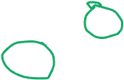
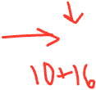
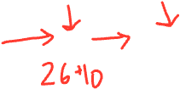
The prefix-sum problem
Given int[] input, produce int[] output where:
output[i] = input[0]+input[1]+…+input[i]
Does not seem parallelizable
Work: O(n), Span: O(n)
This algorithm is sequential, but a different algorithm has Work: O(n), Span: O(log n

Slide 3
The prefix-sum problem
Sequential can be an intro to CS exam problem
int[] prefix_sum(int[] input){
int[] output = new int[input.length];
output[0] = input[0];
for(int i=1; i < input.length; i++)
output[i] = output[i-1]+input[i];
return output;
}

Slide 4
Parallel prefix-sum
The parallel-prefix algorithm does two passes
Each pass has O(n) work and O(log n) span
So in total there is O(n) work and O(log n) span
So like with array summing, parallelism is n/log n
An exponential speedup
First pass builds a tree bottom-up: the “up” pass
Second pass traverses the tree top-down: the “down” pass

Slide 5
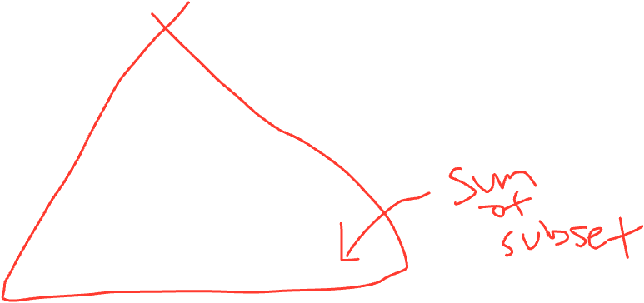
The Passes
Pass #2
Fill in “From Left”
O(log n)
Data Structure
O(log n)
Pass #1
Fill in sum
output

Slide 6
Parallel Prefix: The Up Pass
We build want to build a binary tree where
Root has sum of the range [x,y)
If a node has sum of [lo,hi) and hi>lo,
Left child has sum of [lo,middle)
Right child has sum of [middle,hi)
A leaf has sum of [i,i+1), which is simply input[i]
It is critical that we actually create the tree as we will need it for the down pass
We do not need an actual linked structure
We could use an array as we did with heaps
Analysis of first step: Work = Span =

Slide 7
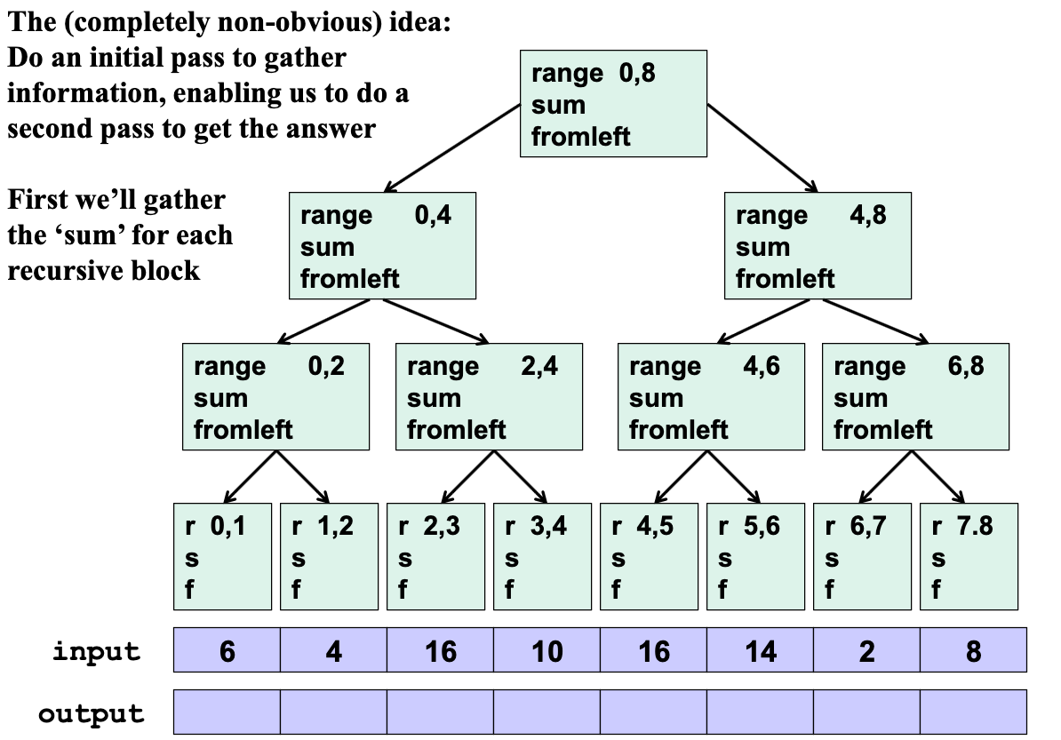

Slide 8
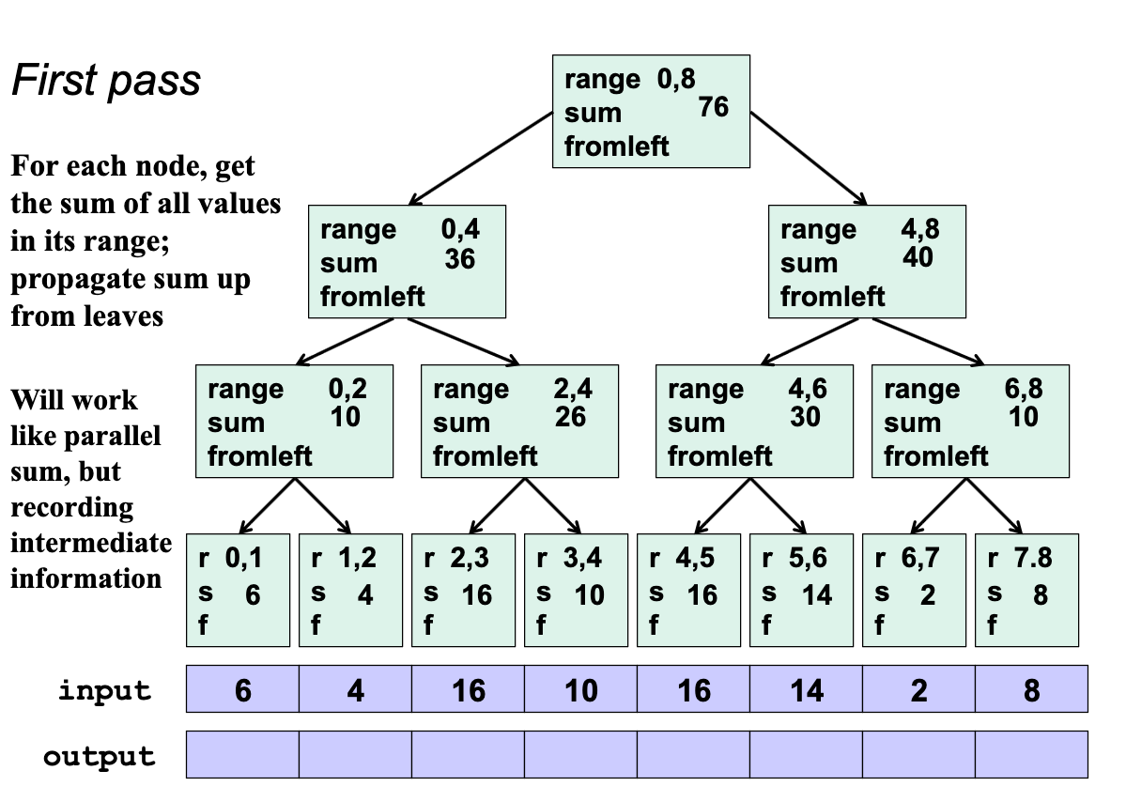
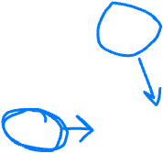
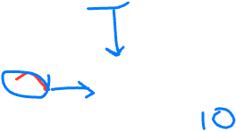
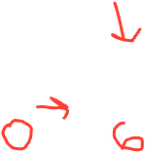
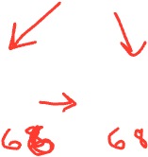

Slide 9
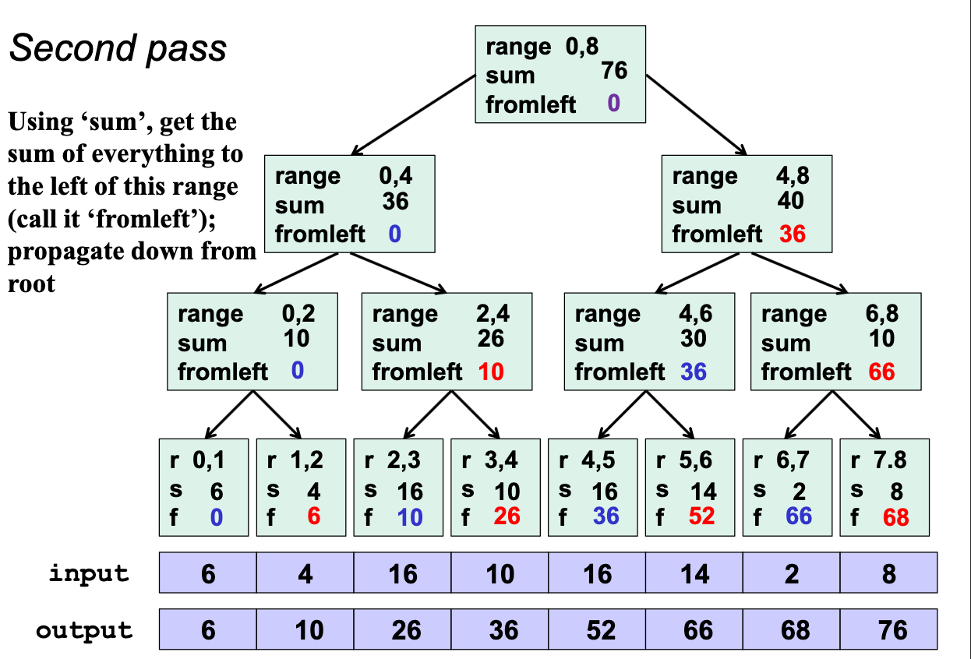
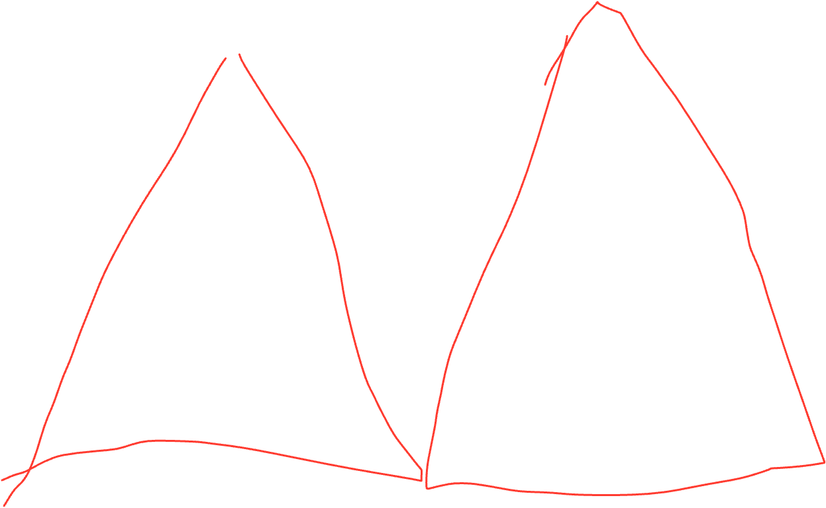
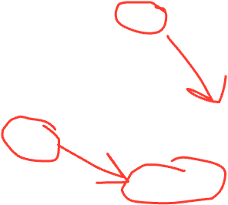

Slide 10
Parallel prefix, generalized
Just as sum-array was the simplest example of a common pattern, prefix-sum illustrates a pattern that arises in many, many problems
Minimum, maximum of all elements to the left of i
Is there an element to the left of i satisfying some property?
Count of elements to the left of i satisfying some property
This last one is perfect for an efficient parallel pack…
Perfect for building on top of the “parallel prefix trick”

Slide 11
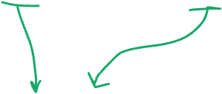
Pack (think “Filter”)
[Non-standard terminology]
Given an array input, produce an array output containing only elements such that f(element) is true
Example: input [17, 4, 6, 8, 11, 5, 13, 19, 0, 24]
f: “is element > 10”
output [17, 11, 13, 19, 24]
Parallelizable?
Determining whether an element belongs in the output is easy
But determining where an element belongs in the output is hard; seems to depend on previous results….

Slide 12
Parallel Pack = (Soln)
parallel map + parallel prefix + parallel map
In this example,
Filter =
element > 10
Parallel map to compute a bit-vector for true elements: input [17, 4, 6, 8, 11, 5, 13, 19, 0, 24] bits [1, 0, 0, 0, 1, 0, 1, 1, 0, 1]
Parallel-prefix sum on the bit-vector:
bitsum [1, 1, 1, 1, 2, 2, 3, 4, 4, 5]
Parallel map to produce the output:
output [17, 11, 13, 19, 24]

Slide 13
Parallel Pack = (Soln)
parallel map + parallel prefix + parallel map
In this example,
Filter =
element > 10
Parallel map to compute a bit-vector for true elements: input [17, 4, 6, 8, 11, 5, 13, 19, 0, 24] bits [1, 0, 0, 0, 1, 0, 1, 1, 0, 1]
Parallel-prefix sum on the bit-vector: bitsum [1, 1, 1, 1, 2, 2, 3, 4, 4, 5]
Parallel map to produce the output: output [17, 11, 13, 19, 24]
output = new array of size bitsum[n-1]
FORALL(i=0; i < input.length; i++){
}

Slide 14
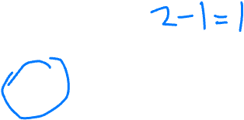
Parallel Pack = (Soln)
parallel map + parallel prefix + parallel map
In this example,
Filter =
element > 10
Parallel map to compute a bit-vector for true elements: input [17, 4, 6, 8, 11, 5, 13, 19, 0, 24] bits [1, 0, 0, 0, 1, 0, 1, 1, 0, 1]
Parallel-prefix sum on the bit-vector: bitsum [1, 1, 1, 1, 2, 2, 3, 4, 4, 5]
Parallel map to produce the output: output [17, 11, 13, 19, 24]
output = new array of size bitsum[n-1]
FORALL(i=0; i < input.length; i++){
if (bits[i] == 1)
Output[bitsum[i]-1] = input[i]
}

Slide 15
Parallel Pack = (Soln)
parallel map + parallel prefix + parallel map
In this example,
Filter =
element > 10
Parallel map to compute a bit-vector for true elements: input [17, 4, 6, 8, 11, 5, 13, 19, 0, 24] bits [1, 0, 0, 0, 1, 0, 1, 1, 0, 1]
Parallel-prefix sum on the bit-vector: bitsum [1, 1, 1, 1, 2, 2, 3, 4, 4, 5]
Parallel map to produce the output: output [17, 11, 13, 19, 24]
Span = O(log n)
Span = O(log n)
Span = O(log n)
output = new array of size bitsum[n-1]
FORALL(i=0; i < input.length; i++){
if (bits[i] == 1)
Output[bitsum[i]-1] = input[i]
}
OVERALL = O(log n)

Slide 16
Sequential Quicksort review
Recall quicksort was sequential, in-place, expected time O(n log n)
Best / expected case work
Pick a pivot element O(1)
Partition all the data into: O(n)
The elements less than the pivot
The pivot
The elements greater than the pivot
Recursively sort A and C 2T(n/2)
Recurrence (assuming a good pivot): T(0)=T(1)=1
T(n)=_________________
Run-time: O(nlogn) How should we parallelize this?

Slide 17
Parallel Quicksort (version 1)
Best / expected case work
Pick a pivot element O(1)
Partition all the data into: O(n)
The elements less than the pivot
The pivot
The elements greater than the pivot
Recursively sort A and C 2T(n/2)
First: Do the two recursive calls in parallel
Work:
Span: T(n) =__________________

Slide 18
Review: Really common recurrences
Should know how to solve recurrences but also recognize some really common ones:
T(n) = O(1) + T(n-1) linear
T(n) = O(1) + 2T(n/2) linear
T(n) = O(1) + T(n/2) logarithmic
T(n) = O(1) + 2T(n-1) exponential
T(n) = O(n) + T(n-1) quadratic
T(n) = O(n) + T(n/2) linear
T(n) = O(n) + 2T(n/2) O(n log n)
Note big-Oh can also use more than one variable
Example: can sum all elements of an n-by-m matrix in O(nm)

Slide 19
Pack (think “Filter”)
[Non-standard terminology]
Given an array input, produce an array output containing only elements such that f(element) is true
Example: input [17, 4, 6, 8, 11, 5, 13, 19, 0, 24]
f: “is element > 10”
output [17, 11, 13, 19, 24]
Parallelizable?
Determining whether an element belongs in the output is easy
But determining where an element belongs in the output is hard; seems to depend on previous results….

Slide 20
Parallel partition (not in place)
Partition all the data into:
The elements less than the pivot
The pivot
The elements greater than the pivot
This is just two packs!
We know a pack is O(n) work, O(log n) span
Pack elements less than pivot into left side of aux array
Pack elements greater than pivot into right size of aux array
Put pivot between them and recursively sort
With a little cleverness, can do both packs at once (!) but no big-O change
With ____________ span for partition, the total span for quicksort is
T(n) =
Notes:
O(log^2 n)

Slide 21
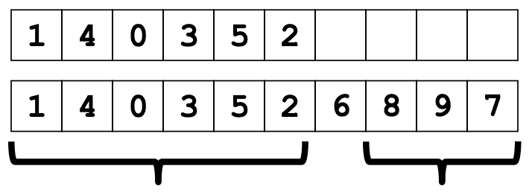
Parallel Quicksort Example (version 2)
Step 1: pick pivot as median of three
Steps 2a and 2c (combinable): pack less than pivot, then pack greater than pivot into a second array
Fancy parallel prefix to pull this off (not shown)
Step 3: Two recursive sorts in parallel
Can sort back into original array (like in mergesort)

Slide 22
Parallelize Mergesort?
Recall mergesort: sequential, not-in-place, worst-case O(n log n)
Sort left half and right half 2T(n/2)
Merge results O(n)
Just like quicksort, doing the two recursive sorts in parallel changes the recurrence for the Span to T(n) = O(n) + 1T(n/2) = O(n)
Again, Work is O(nlogn), and
parallelism is work/span = O(log n)
To do better, need to parallelize the merge
The trick won’t use parallel prefix this time…

Slide 23
Parallelizing the merge
Need to merge two sorted subarrays (may not have the same size)
Idea: Suppose the larger subarray has m elements. In parallel:
Merge the first m/2 elements of the larger half with the “appropriate” elements of the smaller half
Merge the second m/2 elements of the larger half with the rest of the smaller half

Slide 24
Parallelizing the merge (in more detail)
Need to merge two sorted subarrays (may not have the same size) Idea: Recursively divide subarrays in half, merge halves in parallel
Suppose the larger subarray has m elements. In parallel:
Pick the median element of the larger array (here 6) in constant time
In the other array, use binary search to find the first element greater than or equal to that median (here 7)
Then, in parallel:
Merge half the larger array (from the median onward) with the upper part of the shorter array
Merge the lower part of the larger array with the lower part of the shorter array
Notes:
Assume the first half is “larger”
Finding the median is easy in a sorted array!

Slide 25
Example: Parallelizing the merge
Notes:
Finding the median is easy in a sorted array!

Slide 26
Example: Parallelizing the merge
Get median of bigger half: O(1) to compute middle index

Slide 27
Example: Parallelizing the merge
Get median of bigger half: O(1) to compute middle index
Find how to split the smaller half at the same value: O(log n) to do binary search on the sorted small half

Slide 28
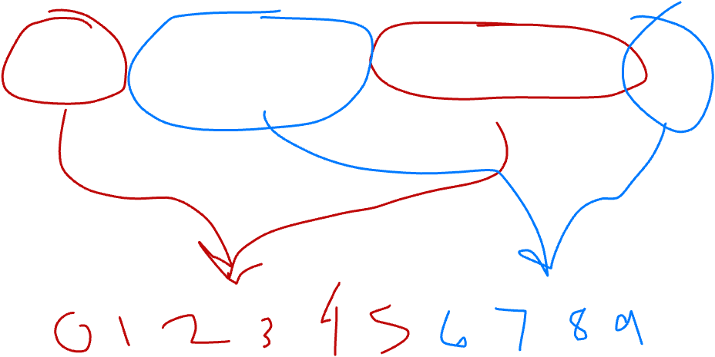
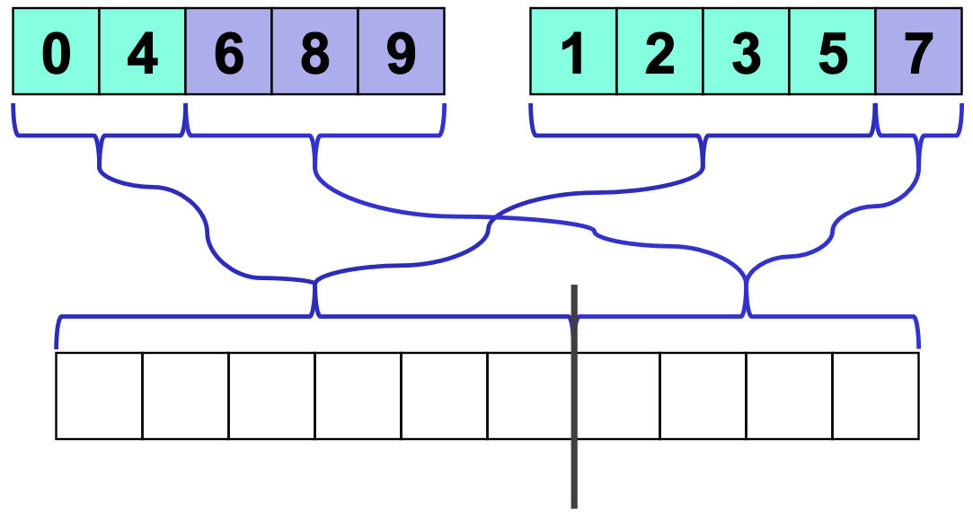
Example: Parallelizing the merge
Get median of bigger half: O(1) to compute middle index
Find how to split the smaller half at the same value: O(log n) to do binary search on the sorted small half
Size of two sub-merges conceptually splits output array: O(1)

Slide 29
Example: Parallelizing the merge
Get median of bigger half: O(1) to compute middle index
Find how to split the smaller half at the same value: O(log n) to do binary search on the sorted small half
Size of two sub-merges conceptually splits output array: O(1)
Do two submerges in parallel

Slide 30
Parallel Merge Pseudocode
left1
left2
Merge(arr[], left₁, left₂, right₁, right₂, out[], out₁, out₂)
int leftSize = left₂ – left₁
int rightSize = right₂ – right₁
// Assert: out₂ – out₁ = leftSize + rightSize
// We will assume leftSize > rightSize without loss of generality
if (leftSize + rightSize < CUTOFF)
sequential merge and copy into out[out1..out2]
int mid = (left₂ – left₁)/2
binarySearch arr[right₁..right₂] to find j such that
arr[j] ≤ arr[mid] ≤ arr[j+1]
Merge(arr[], left₁, mid, right₁, j, out[], out₁, out₁+mid+j)
Merge(arr[], mid+1, left₂, j+1, right2, out[], out₁+mid+j+1, out₂)
right1
right2

Slide 31
Analysis
Doing the two recursive calls in parallel but a sequential merge:
Work: same as sequential O(n log n) Span: T(n)=1T(n/2)+O(n) which is O(n)
Parallel merge makes work and span harder to compute…
Each merge step does an extra O(log n) binary search to find how to split the smaller subarray
To merge n elements total, do two smaller merges of possibly different sizes
But worst-case split is (3/4)n and (1/4)n
Happens when the two subarrays are of the same size (n/2) and the “smaller” subarray splits into two pieces of the most uneven sizes possible: one of size n/2, one of size 0

Slide 32
Analysis continued
For just a parallel merge of n elements:
Work is T(n) = T(3n/4) + T(n/4) + O(log n) which is O(n)
Span is T(n) = T(3n/4) + O(log n), which is O(log² n)
(neither bound is immediately obvious, but “trust me”)
So for mergesort with parallel merge overall:
Work is T(n) = 2T(n/2) + O(n), which is O(n log n)
Span is T(n) = 1T(n/2) + O(log² n), which is O(log³ n)
So parallelism (work / span) is O(n / log² n)
Not quite as good as quicksort’s O(n / log n)
But (unlike Quicksort) this is a worst-case guarantee
And as always this is just the asymptotic result

Slide 33
Summary
Quicksort (best case)
O(n log n) - sequential
--> O(n) span - parallel calls to quicksort
--> O(log² n) span - parallel partition
Mergesort (worst case)
O(n log n) - sequential
--> O(n) span - parallel calls to mergesort
--> O(log³ n) span - parallel merge

Slide 34
Toward sharing resources (memory)
So far, we have been studying parallel algorithms using the fork-join model
Reduce span via parallel tasks
Fork-Join algorithms all had a very simple structure to avoid race conditions
Each thread had memory “only it accessed”
Example: each array sub-range accessed by only one thread
Result of forked process not accessed until after join() called
So the structure (mostly) ensured that bad simultaneous access wouldn’t occur
Strategy won’t work well when:
Memory accessed by threads is overlapping or unpredictable
Threads are doing independent tasks needing access to same resources (rather than implementing the same algorithm)

Slide 35
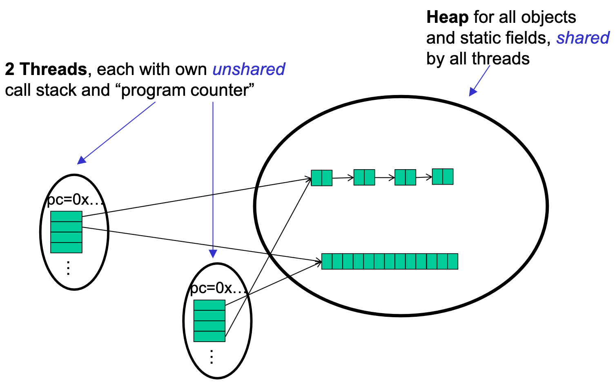
Notes:
So far, the threads weren’t REALLY sharing

