Slide 1
CSE 332
Data Structures & Parallelism
Analysis of Fork-Join Parallel Programs
Melissa Winstanley
Spring 2024

Slide 2
Class Updates
PLEASE BRING YOUR COMPUTERS TO SECTION TOMORROW!
Also please clone the section repo beforehand - it is listed on the course website under tomorrow’s section.
P2 is due TOMORROW at 11:59pm
You can use up to 2 late days
Ex 8 (Dijkstra’s) is due next Tuesday
P3 will be released tomorrow

Slide 3
ForkJoin Framework Version of sum
class SumTask extends RecursiveTask<Integer> {
int lo; int hi; int[] arr;
SumTask(int[] a, int l, int h) { ... }
protected Integer compute() { // override
if(hi – lo < SEQUENTIAL_CUTOFF)
int ans = 0; // not a field
for(int i=lo; i < hi; i++)
ans += arr[i];
return ans;
else {
SumTask left =
new SumTask(arr,lo,(hi+lo)/2);
SumTask right =
new SumTask(arr,(hi+lo)/2,hi);
left.fork(); // forks a thread and calls compute
int rightAns = right.compute(); // call directly
int leftAns = left.join(); // get result from left
return leftAns + rightAns;
}
}
static final ForkJoinPool POOL =
new ForkJoinPool();
int sum(int[] arr){
SumTask task =
new SumTask(arr,0,arr.length)
return POOL.invoke(task);
// invoke returns the value
}
What needs to change to find the max value in an array, instead of sum?
Notes:
What happens if right.compute and left.join calls are switched?
What would you change to make this calculate the MAXIMUM of an array, not the sum?

Slide 4
ForkJoin Framework Version of max
class MaxTask extends RecursiveTask<Integer> {
int lo; int hi; int[] arr;
MaxTask(int[] a, int l, int h) { ... }
protected Integer compute() { // override
if(hi – lo < SEQUENTIAL_CUTOFF)
int ans = -INF;
for(int i=lo; i < hi; i++)
ans = Math.max(ans, arr[i]);
return ans;
else {
MaxTask left =
new MaxTask(arr,lo,(hi+lo)/2);
MaxTask right =
new MaxTask(arr,(hi+lo)/2,hi);
left.fork(); // forks a thread and calls compute
int rightAns = right.compute(); // call directly
int leftAns = left.join(); // get result from left
return Math.max(leftAns, rightAns);
}
}
static final ForkJoinPool POOL =
new ForkJoinPool();
int max(int[] arr){
MaxTask task =
new MaxTask(arr,0,arr.length)
return POOL.invoke(task);
// invoke returns the value
}
What needs to change to find the max value in an array, instead of sum?

Slide 5
Examples
Parallelization (for some algorithms)
Describe how to compute result at the ‘cut-off’
Describe how to merge results
How would we do the following (assuming data is given as an array)?
Maximum or minimum element
Is there an element satisfying some property (e.g., is there a 17)?
Left-most element satisfying some property (e.g., first 17)
Smallest rectangle encompassing a number of points
Counts; for example, number of strings that start with a vowel
Are these elements in sorted order?

Slide 6
Reductions
This class of computations are called reductions
We ‘reduce’ a large array of data to a single item
Produce single answer from collection via an associative operator
Examples: max, count, leftmost, rightmost, sum, product, …
Note: Recursive results don’t have to be single numbers or strings. They can be arrays or objects with multiple fields.
Example: create a Histogram of test results from a much larger array of actual test results
While many can be parallelized due to nice properties like associativity of addition, some things are inherently sequential
How we process arr[i] may depend entirely on the result of processing arr[i-1]

Slide 7
Even easier: Maps (data parallelism)
A map operates on each element of a collection independently to create a new collection of the same size
No combining results
For arrays, this is so trivial some hardware has direct support
Canonical example: Vector addition
a1
int[] vector_add(int[] arr1, int[] arr2){
result = new int[arr1.length];
FORALL(i=0; i < arr1.length; i++) {
result[i] = arr1[i] + arr2[i];
}
return result;
}
+
+
+
+
+
+
+
+
+
+
+
+
+
+
+
+
+
+
+
+
+
a2
res

Slide 8
Maps in ForkJoin Framework
class VecAdd extends RecursiveAction {
int lo; int hi; int[] res; int[] arr1; int[] arr2;
VecAdd(int l, int h, int[] r, int[] a1, int[] a2) { ... }
protected void compute() { // override
if(hi – lo < SEQUENTIAL_CUTOFF)
for(int i=lo; i < hi; i++)
res[i] = arr1[i] + arr2[i];
else {
int mid = (hi+lo)/2;
VecAdd left = new VecAdd(
lo,mid,res,arr1,arr2);
VecAdd right = new VecAdd(
mid,hi,res,arr1,arr2);
left.fork();
right.compute();
left.join();
}
}
static final ForkJoinPool POOL =
new ForkJoinPool();
int[] add(int[] arr1, int[] arr2){
int[] res = new int[arr1.length];
POOL.invoke(new VecAdd(
0,arr.length,res, arr1,arr2));
return ans
}
Notes:
What’s different now compared with our sum and max tasks?

Slide 9
Maps and reductions
Maps and reductions: the “workhorses” of parallel programming
By far the two most important and common patterns
Two more-advanced patterns in next lecture
Learn to recognize when an algorithm can be written in terms of maps and reductions
Use maps and reductions to describe (parallel) algorithms
Programming them becomes “trivial” with a little practice
Exactly like sequential for-loops seem second-nature

Slide 10
Trees
Maps and reductions work just fine on balanced trees
Divide-and-conquer each child rather than array sub-ranges
Correct for unbalanced trees, but won’t get much speed-up
Example: minimum element in an unsorted but balanced binary tree in O(log n) time given enough processors
How to do the sequential cut-off?
Store number-of-descendants at each node (easy to maintain)
Or could approximate it with, e.g., AVL-tree height

Slide 11
Linked Lists
Can you parallelize maps or reduces over linked lists?
Example: Increment all elements of a linked list
Example: Sum all elements of a linked list
Parallelism still beneficial for expensive per-element operations
Once again, data structures matter!
For parallelism, balanced trees generally better than lists so that we can get to all the data exponentially faster O(log n) vs. O(n)
Trees have the same flexibility as lists compared to arrays (in terms of say inserting an item in the middle of the list)

Slide 12
Analyzing algorithms
How to measure efficiency?
Want asymptotic bounds
Want to analyze the algorithm without regard to a specific number of processors
The key “magic” of the ForkJoin Framework is getting expected run-time performance asymptotically optimal for the available number of processors
So we can analyze algorithms assuming this guarantee

Slide 13
Work and Span
Let T_{P} be the running time if there are P processors available
Two key measures of run-time:
Work: How long it would take 1 processor = T₁
Just “sequentialize” the recursive forking
Cumulative work that all processors must complete
Span: How long it would take infinity processors = T∞
The hypothetical ideal for parallelization
This is the longest “dependence chain” in the computation
Example: O(log n) for summing an array
Also called “critical path length” or “computational depth”
Notes:
Not really infinity - but as many as I can practically use

Slide 14
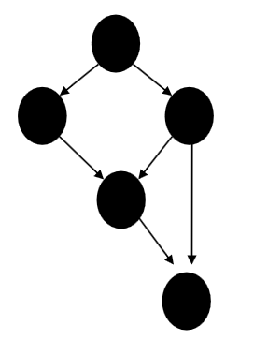
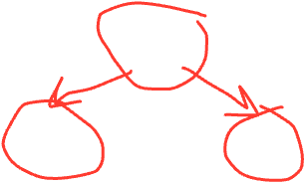
The DAG (Directed Acyclic Graph)
A program execution using fork and join can be seen as a DAG
Nodes: Pieces of work
Edges: Source must finish before destination starts
A fork “ends a node” and makes two outgoing edges
New thread
Continuation of current thread
A join “ends a node” and makes a node with two incoming edges
Node just ended
Last node of thread joined on

Slide 15
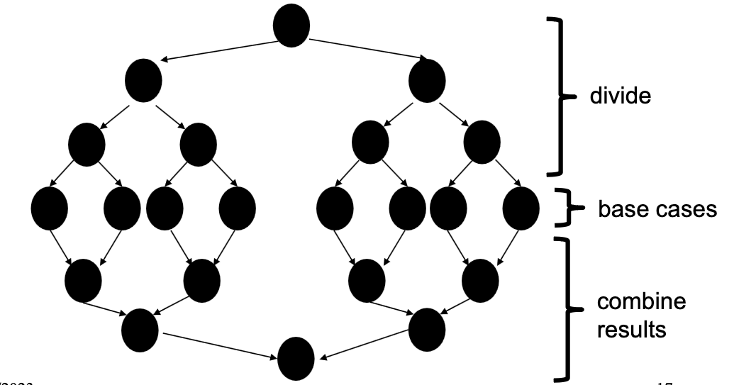
Our simple examples
fork and join are very flexible, but divide-and-conquer maps and reductions use them in a very basic way:
A tree on top of an upside-down tree

Slide 16
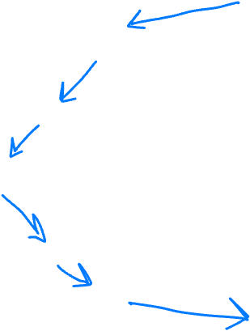
Our simple examples
fork and join are very flexible, but divide-and-conquer maps and reductions use them in a very basic way:
A tree on top of an upside-down tree
T₁ = O( )
T∞ = O( )

Slide 17
Connecting to performance
Recall: T_{P} = running time if there are P processors available
Work = T₁ = sum of run-time of all nodes in the DAG
That lonely processor does everything
Any topological sort is a legal execution
O(n) for simple maps and reductions
Span = T∞ = sum of run-time of all nodes on the most-expensive path in the DAG
Note: costs are on the nodes not the edges
Our infinite army can do everything that is ready to be done, but still has to wait for earlier results
O(log n) for simple maps and reductions

Slide 18
Definitions
A couple more terms:
Speed-up on P processors: T₁ / T_{P}
If speed-up is P as we vary P, we call it perfect linear speed-up
Perfect linear speed-up means doubling P halves running time
Usually our goal; hard to get in practice
Parallelism is the maximum possible speed-up: T₁ / T∞
At some point, adding processors won’t help
What that point is depends on the span
Parallel algorithms are about decreasing span without increasing work too much

Slide 19
Optimal T_{P}: Thanks ForkJoin library!
So we know T₁ and T∞ but we want T_{P} (e.g., P=4)
Ignoring memory-hierarchy issues (caching), T_{P} can’t beat
T₁ / P why not?
T∞ why not?
So an asymptotically optimal execution would be:
T_{P} = O((T₁ / P) + T∞ )
First term dominates for small P, second for large P
The ForkJoin Framework gives an expected-time guarantee of asymptotically optimal!
Expected time because it flips coins when scheduling
How? For an advanced course (few need to know)
Guarantee requires a few assumptions about your code…

Slide 20
Division of responsibility
Our job as ForkJoin Framework users:
Pick a good algorithm, write a program
When run, program creates a DAG of things to do
Make all the nodes a small-ish and approximately equal amount of work
The framework-writer’s job:
Assign work to available processors to avoid idling
Let framework-user ignore all scheduling issues
Keep constant factors low
Give the expected-time optimal guarantee assuming framework-user did his/her job
T_{P} = O((T₁ / P) + T∞ )

Slide 21
And now for the bad news...
So far: talked about a parallel program in terms of work and span
In practice, it’s common that your program has:
parts that parallelize well:
Such as maps/reduces over arrays and trees
…and parts that don’t parallelize at all:
Such as reading a linked list, getting input, or just doing computations where each step needs the results of previous step
These unparallelized parts can turn out to be a big bottleneck, which brings us to Amdahl’s Law …

Slide 22
Amdahl’s Law (mostly bad news)
Let the work (time to run on 1 processor) be 1 unit time
Let S be the portion of the execution that can’t be parallelized
Then: T₁ = S + (1-S) = 1
Suppose we get perfect linear speedup on the parallel portion
Then: T_{P} = S + (1-S)/P
So the overall speedup with P processors is (Amdahl’s Law):
T₁ / T_{P} = 1 / (S + (1-S)/P)
And the parallelism (infinite processors) is:
T₁ / T∞ = 1 / S

Slide 23
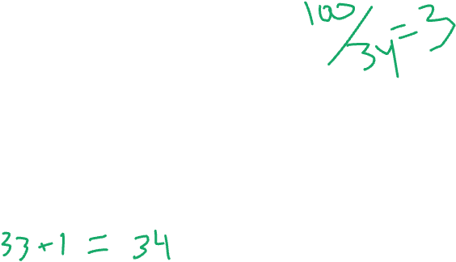
Amdahl’s Law Example
Suppose: T₁ = S + (1-S) = 1 (aka total program execution time) T₁ = 1/3 + 2/3 = 1 T₁ = 33 sec + 67 sec = 100 sec
Time on P processors: T_{P} = S + (1-S)/P
So: T_{P} = 33 sec + (67 sec)/P
T₃ = 33 sec + (67 sec)/3 =
T₆ = 33 sec + (67 sec)/6 =
T₆₇ = 33 sec + (67 sec)/67 =

Slide 24
Why such bad news?
T₁ / T_{P} = 1 / (S + (1-S)/P) T₁ / T∞ = 1 / S
Suppose 33% of a program is sequential
Then a billion processors won’t give a speedup over 3!!!
No matter how many processors you use, your speedup is bounded by the sequential portion of the program

Slide 25
Amdahl’s Law is a bummer - but all is not lost!
Unparallelized parts become a bottleneck very quickly
But it doesn’t mean additional processors are worthless
We can find new parallel algorithms
Some things that seem entirely sequential turn out to be parallelizable
Eg. How can we parallelize the following?
Take an array of numbers, return the ‘running sum’ array
At a glance, not sure; we’ll explore this shortly
We can also change the problem we’re solving or do new things
Example: Video games use tons of parallel processors
They are not rendering 10-year-old graphics faster
They are rendering richer environments and more beautiful (terrible?) monsters

