Slide 1
CSE 332
Data Structures & Parallelism
Introduction to Multithreading &
Fork-Join Parallelism
Melissa Winstanley
Spring 2024

Slide 2
Updates
Project 2 due THURSDAY
Up to 2 late days available
Project 3 will be released on Thursday as well
Ex7 Sorting due TOMORROW
Ex8 Dijkstra’s due next Tuesday
Regrade requests open for the midterm

Slide 3
Changing a major assumption
So far most or all of your study of computer science has assumed
One thing happened at a time
Called sequential programming – everything part of one sequence
Removing this assumption creates major challenges & opportunities
Programming: Divide work among threads of execution and coordinate (synchronize) among them
Algorithms: How can parallel activity provide speed-up (more throughput: work done per unit time)
Data structures: May need to support concurrent access (multiple threads operating on data at the same time)

Slide 4
How did we get here?
Writing correct and efficient multithreaded code is often much more difficult than for single-threaded (i.e., sequential) code
Especially in common languages like Java and C
So typically stay sequential if possible
From roughly 1980-2005, desktop computers got exponentially faster at running sequential programs
About twice as fast every couple years
But nobody knows how to continue this
Increasing clock rate generates too much heat
Relative cost of memory access is too high
But we can keep making “wires exponentially smaller” (Moore’s “Law”), so put multiple processors on the same chip (“multicore”)

Slide 5
What to do with multiple processors?
Your computer and phone probably have at least 4-8 processors
Wait a few years and it will be 16, 32, …
The chip companies have decided to do this (not a “law”)
What can you do with them?
Run multiple totally different programs at the same time
Already do that? Yes, but with time-slicing
Do multiple things at once in one program
Our focus – more difficult
Requires rethinking everything from asymptotic complexity to how to implement data-structure operations

Slide 6
Parallelism vs. Concurrency
Note: Terms not yet standard but the perspective is essential
Many programmers confuse these concepts
Parallelism: Concurrency:
Use extra resources to solve a problem faster Correctly and efficiently manage access to shared resources
There is some connection:
Common to use threads for both
If parallel computations need access to shared resources, then the concurrency needs to be managed
work
requests
resources
resource

Slide 7
An analogy
A program is like a recipe for a cook
One cook who does one thing at a time! (Sequential)
Parallelism: (Let’s get the job done faster!)
Have lots of potatoes to slice?
Hire helpers, hand out potatoes and knives
But too many chefs and you spend all your time coordinating
Concurrency: (We need to manage a shared resource)
Lots of cooks making different things, but only 4 stove burners
Want to allow access to all 4 burners, but not cause spills or incorrect burner settings

Slide 8
Parallelism Example
Pseudocode for array sum: (note FORALL doesn’t exist)
int sum(int[] arr){
res = new int[4];
len = arr.length;
FORALL(i=0; i < 4; i++) { //parallel iterations
res[i] = sumRange(arr,i*len/4,(i+1)*len/4);
}
return res[0]+res[1]+res[2]+res[3];
}
int sumRange(int[] arr, int lo, int hi) {
result = 0;
for(j=lo; j < hi; j++)
result += arr[j];
return result;
}

Slide 9
Concurrency Example
Pseudocode for a hashtable:
class Hashtable<K,V> {
…
void insert(K key, V value) {
int bucket = …;
prevent-other-inserts/lookups in table[bucket]
do the insertion
re-enable access to table[bucket]
}
V lookup(K key) {
(similar to insert, but can allow concurrent
lookups to same bucket)
}
}

Slide 10
Shared Memory with Threads
The model we will assume is shared memory with explicit threads
Old story: A running program has
One program counter (current statement executing)
One call stack (with each stack frame holding local variables)
Objects in the heap created by memory allocation (i.e., new)
(nothing to do with data structure called a heap)
Static fields
New story:
A set of threads, each with its own program counter & call stack
No access to another thread’s local variables
Threads can (implicitly) share static fields / objects
To communicate, write values to some shared location that another thread reads from

Slide 11
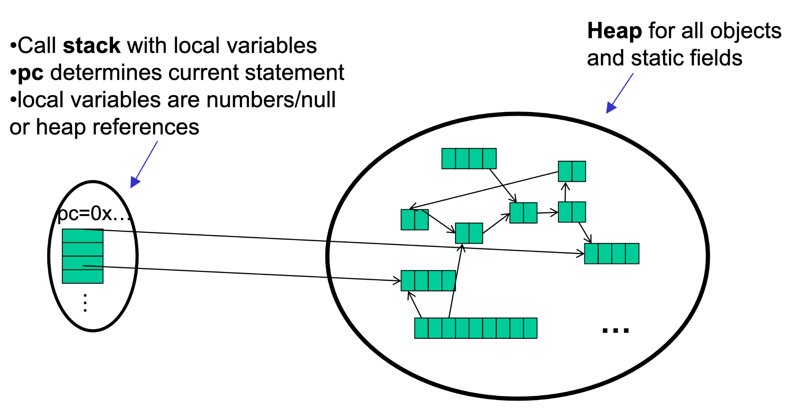
Old Story: one call stack, one pc

Slide 12
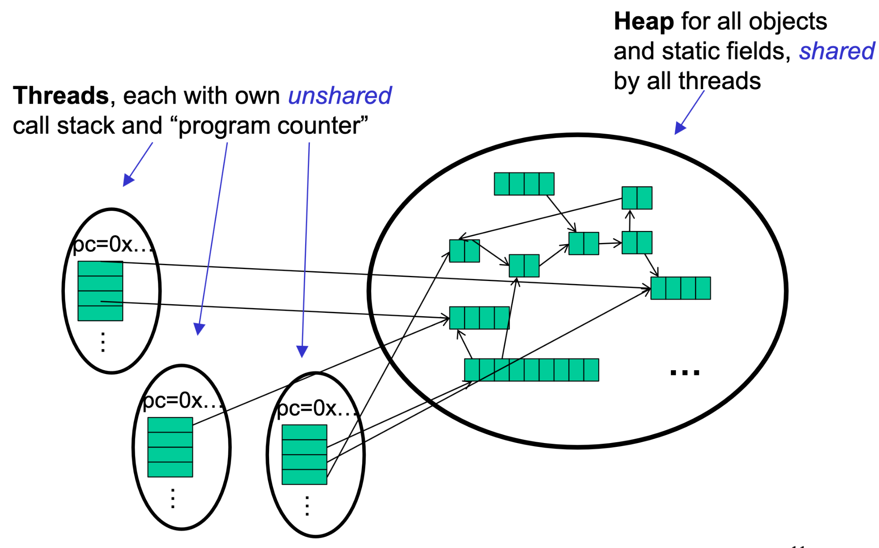
New Story: Shared memory with Threads

Slide 13
Other models
We will focus on shared memory, but you should know several other models exist and have their own advantages
Message-passing: Each thread has its own collection of objects. Communication is via explicitly sending/receiving messages
Cooks working in separate kitchens, mail around ingredients
Dataflow: Programmers write programs in terms of a DAG. A node executes after all of its predecessors in the graph
Cooks wait to be handed results of previous steps
Data parallelism: Have primitives for things like “apply function to every element of an array in parallel”

Slide 14
Our needs
To write a shared-memory parallel program, need new primitives from a programming language or library
Ways to create and run multiple things at once
Let’s call these things threads
Ways for threads to share memory
Often just have threads with references to the same objects
Ways for threads to coordinate (a.k.a. synchronize)
For now, a way for one thread to wait for another to finish
Other primitives when we study concurrency

Slide 15
Java Basics
First learn some basics built into Java via java.lang.Thread
Then a better library for parallel programming
To get a new thread running:
Define a subclass C of java.lang.Thread, overriding run
Create an object of class C
Call that object’s start method
start sets off a new thread, using run as its “main”
What if we instead called the run method of C?
This would just be a normal method call, in the current thread
Let’s see how to share memory and coordinate via an example…
Notes:
Start is the “magic”

Slide 16
Parallelism idea
Example: Sum elements of a large array
Idea: Have 4 threads simultaneously sum 1/4 of the array
Warning: This is an inferior first approach
Create 4 thread objects, each given a portion of the work
Call start() on each thread object to actually run it in parallel
Wait for threads to finish using join()
Add together their 4 answers for the final result

Slide 17
First Attempt, Part 1
class SumThread extends java.lang.Thread {
int lo; // fields, assigned in the constructor
int hi; // so threads know what to do.
int[] arr;
int ans = 0; // result - field used to communicate
// across threads
SumThread(int[] a, int l, int h) {
lo=l; hi=h; arr=a;
}
public void run() { //override must have this type
for(int i=lo; i < hi; i++)
ans += arr[i];
}
}

Slide 18
First attempt, continued (wrong)
class SumThread extends java.lang.Thread {
...
}
int sum(int[] arr){ // can be a static method
int len = arr.length;
int ans = 0;
SumThread[] ts = new SumThread[4];
for(int i=0; i < 4; i++) // do parallel computations
ts[i] = new SumThread(arr,i*len/4,(i+1)*len/4);
for(int i=0; i < 4; i++) // combine results
ans += ts[i].ans;
return ans;
}

Slide 19
Second attempt (still wrong)
class SumThread extends java.lang.Thread {
...
}
int sum(int[] arr){ // can be a static method
int len = arr.length;
int ans = 0;
SumThread[] ts = new SumThread[4];
for(int i=0; i < 4; i++) { // do parallel computations
ts[i] = new SumThread(arr,i*len/4,(i+1)*len/4);
ts[i].start(); // start not run
}
for(int i=0; i < 4; i++) // combine results
ans += ts[i].ans;
return ans;
}

Slide 20
Third attempt (correct in spirit)
fork
join
int sum(int[] arr){ // can be a static method
int len = arr.length;
int ans = 0;
SumThread[] ts = new SumThread[4];
for(int i=0; i < 4; i++) { // do parallel computations
ts[i] = new SumThread(arr,i*len/4,(i+1)*len/4);
ts[i].start();
}
for(int i=0; i < 4; i++) { // combine results
ans += ts[i].ans;
ts[i].join(); // wait for helper to finish!
}
return ans;
}
Notes:
Join is a BLOCKING call

Slide 21
Fourth attempt (better!)
int sum(int[] arr, int numTs) { // parameterize by # of threads
int len = arr.length;
int ans = 0;
SumThread[] ts = new SumThread[numTs];
for(int i=0; i < numTs; i++) {
ts[i] = new SumThread(arr,i*len/numTs,(i+1)*len/numTs);
ts[i].start();
}
for(int i=0; i < numTs; i++) {
ans += ts[i].ans;
ts[i].join();
}
return ans;
}
Notes:
Join is a BLOCKING call

Slide 22
Problem 1: processors available to ME
(think of a “unit of work” as 1 second)
24 units of work
If 1 of those 4 processors is busy with other work
If we had optimally distributed work
4 processors
6 units of work per processor
One unit of work has to wait - twice as long!
8 units of work per processor
Notes:
When we start a task, the OS does not GUARANTEE that that task will be run immediately. All we can say is “hey OS, please run this at your leisure”

Slide 23
Problem 2: unequal work
For some problems, dividing the array “equally” may result in subproblems that take significantly different amounts of time.
Very small numbers
Very big numbers
isPrime()
= 10 sec
isPrime()
= 15 sec
isPrime()
= 30 sec
isPrime()
= 50 sec

Slide 24
Solution attempt #1
The counterintuitive (?) solution to all these problems is to cut up our problem into many pieces, far more than the number of processors
But this will require changing our algorithm
And for constant-factor reasons, abandoning Java’s threads
Forward-portable: Lots of helpers each doing a small piece
Processors available: Hand out “work chunks” as you go
Load imbalance: No problem if slow thread scheduled early enough
Variation probably small anyway if pieces of work are small
...
N

Slide 25
BUT naive algorithm is poor
int sum(int[] arr) {
int numThreads = arr.length / 1000;
SumThread[] ts =
new SumThread[numThreads];
...
}
Suppose we create 1 thread to process every 1000 elements
Then the “combining of results” part of the code will have arr.length / 1000 additions
Linear in size of array (with constant factor 1/1000)
Previously we had only 4 pieces (Ө(1) to combine)
In the extreme, suppose we create one thread per element – If we use a for loop to combine the results, we have N iterations
In either case we get a Ө(N) algorithm with the combining of results as the bottleneck….

Slide 26
A better idea: Divide and Conquer!
1) Divide problem into pieces recursively:
Start with full problem at root
Halve and make new thread until size is at some cutoff
2) Combine answers in pairs as we return from recursion (see diagram)

Slide 27
A better idea: Divide and Conquer!
This will start small, and ‘grow’ threads to fit the problem. This is straightforward to implement using divide-and-conquer.
Parallelism for the recursive calls

Slide 28
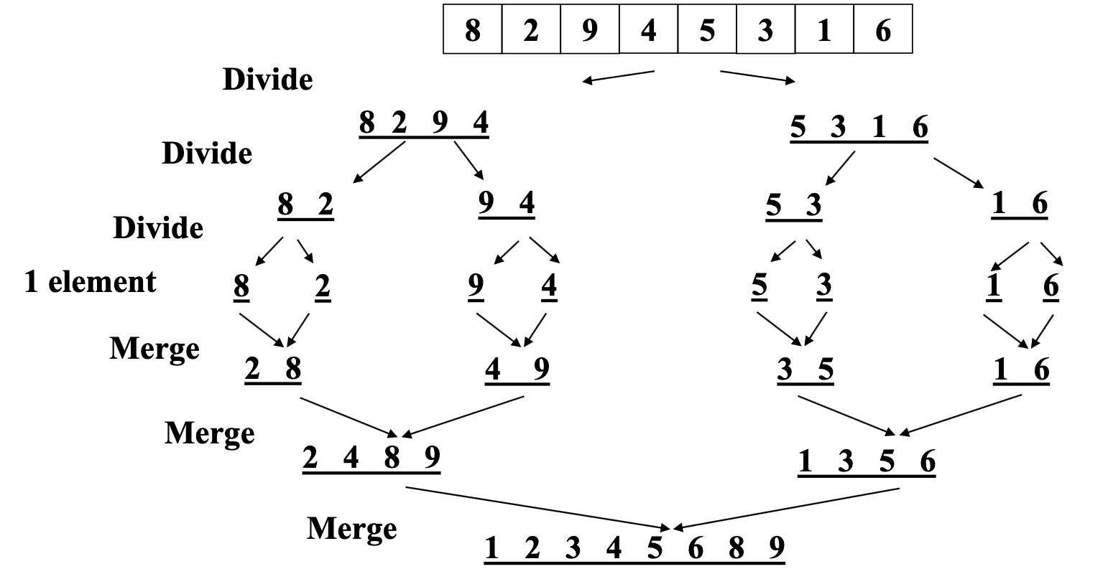
Remember mergesort?

Slide 29
Divide & conquer
Create threads
Create threads
O(log n)
O(n)
Threads doing work
Threads doing work
Join & combine
O(n)
Join & combine
O(log n)
O(n)
Sequential program (no parallelism)
Naive approach (use loops to create threads)
Divide & conquer

Slide 30
Fifth attempt (still using Java Threads)
class SumThread extends java.lang.Thread {
int lo; int hi; int[] arr;
int ans = 0; // result
SumThread(int[] a, int l, int h) { ... }
public void run() { // override
if(hi – lo < SEQUENTIAL_CUTOFF)
for(int i=lo; i < hi; i++)
ans += arr[i];
else {
SumThread left =
new SumThread(arr,lo,(hi+lo)/2);
SumThread right =
new SumThread(arr,(hi+lo)/2,hi);
left.start();
right.start();
left.join(); // don’t move this up a line – why?
right.join();
ans = left.ans + right.ans;
}
}
}
int sum(int[] arr){
// just make one thread!
SumThread t =
new SumThread(arr,0,arr.length);
t.run();
return t.ans;
}
Notes:
Join is a BLOCKING call

Slide 31
Being realistic
In theory, you can divide down to single elements, do all your result-combining in parallel and get optimal speedup
Total time O(n / numProcessors + log n)
In practice, creating all those threads and communicating swamps the savings, so do two things to help:
Use a sequential cutoff, typically around 500-1000
Eliminates almost all the recursive thread creation (bottom levels of tree)
Exactly like quicksort switching to insertion sort for small subproblems, but more important here
Do not create two recursive threads; create one thread and do the other piece of work “yourself”
Cuts the number of threads created by another 2x

Slide 32
Half the threads!
order of last 4 lines
is critical – why?
// wasteful, don’t
SumThread left = …
SumThread right = …
left.start();
right.start();
left.join();
right.join();
ans=left.ans+right.ans;
// better, do!
SumThread left = …
SumThread right = …
left.start();
right.run(); // normal function call!
left.join();
// no right.join needed
ans=left.ans+right.ans;
If a language had built-in support for fork-join parallelism, I would expect this hand-optimization to be unnecessary
But the library we are using expects you to do it yourself
And the difference is surprisingly substantial
Again, no difference in theory

Slide 33
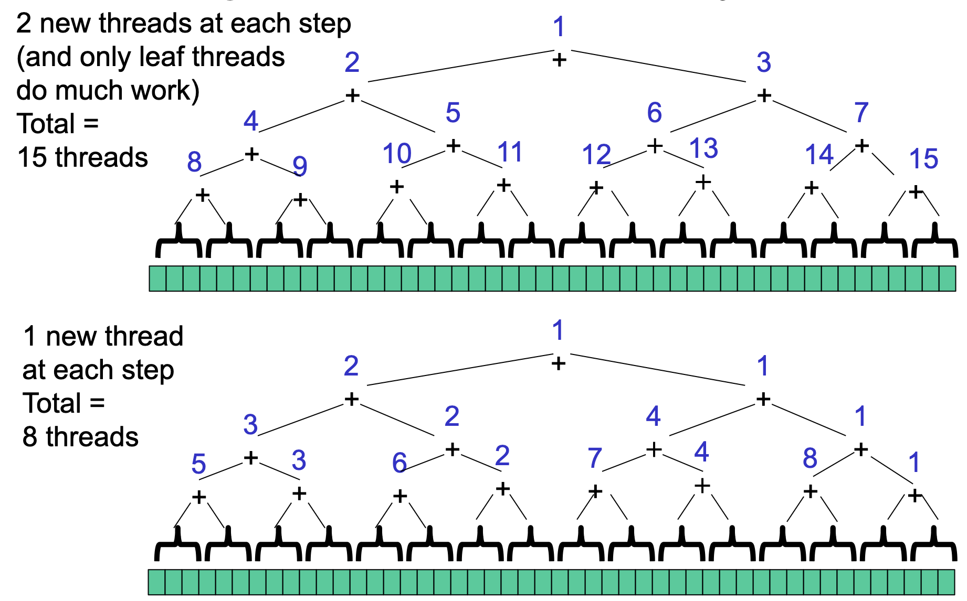

Slide 34
That library, finally
Even with all this care, Java’s threads are too “heavyweight”
Constant factors, especially space overhead
Creating 20,000 Java threads just a bad idea
The ForkJoin Framework is designed to meet the needs of divide-and-conquer fork-join parallelism
In the Java 8 standard libraries
Section will focus on pragmatics/logistics
Similar libraries available for other languages
C/C++: Cilk (inventors), Intel’s Thread Building Blocks
C#: Task Parallel Library
…
Library’s implementation is a fascinating but advanced topic

Slide 35
Different terms, same basic idea
To use the ForkJoin Framework:
A little standard set-up code (e.g., create a ForkJoinPool)
Java Threads: ForkJoin Framework:
Don’t subclass Thread Do subclass RecursiveTask<V>
Don’t override run Do override compute
Do not use an ans field Do return a V from compute
Don’t call start Do call fork
Don’t just call join Do call join (which returns answer)
Don’t call run to hand-optimize Do call compute to hand-optimize
Don’t have a topmost call to run Do create a pool and call invoke

Slide 36
ForkJoin Framework Version (missing imports)
class SumTask extends RecursiveTask<Integer> {
int lo; int hi; int[] arr;
SumTask(int[] a, int l, int h) { ... }
protected Integer compute() { // override
if(hi – lo < SEQUENTIAL_CUTOFF)
int ans = 0; // not a field
for(int i=lo; i < hi; i++)
ans += arr[i];
return ans;
else {
SumTask left =
new SumTask(arr,lo,(hi+lo)/2);
SumTask right =
new SumTask(arr,(hi+lo)/2,hi);
left.fork(); // forks a thread and calls compute
int rightAns = right.compute(); // call directly
int leftAns = left.join(); // get result from left
return leftAns + rightAns;
}
}
static final ForkJoinPool POOL =
new ForkJoinPool();
int sum(int[] arr){
SumTask task =
new SumTask(arr,0,arr.length)
return POOL.invoke(task);
// invoke returns the value
}
Notes:
What happens if right.compute and left.join calls are switched?
What would you change to make this calculate the MAXIMUM of an array, not the sum?

Slide 37
Getting good results in practice
Sequential threshold
Library documentation recommends doing approximately 100-5000 basic operations in each “piece” of your algorithm
Library needs to “warm up”
May see slow results before the Java virtual machine re-optimizes the library internals
Put your computations in a loop to see the “long-term benefit”

