Slide 1
CSE 332
Data Structures & Parallelism
Shortest Paths
Melissa Winstanley
Spring 2024

Slide 2
Shortest Path Applications
Network routing
Driving directions
Cheap flight tickets
Critical paths in project management (see textbook)
…
BFS is great if all we care about is path length
But what if we care about path cost (ie a weighted graph)?

Slide 3
Not as easy
100
100
10
5
100
100
-11
7
500
Why BFS won’t work: Shortest path may not have the fewest edges
Annoying when this happens with costs of flights
We will assume there are no negative weights
Problem is ill-defined if there are negative-cost cycles
Today’s algorithm is wrong if edges can be negative

Slide 4
Dijkstra’s Algorithm
Named after its inventor Edsger Dijkstra (1930-2002)
Truly one of the “founders” of computer science; 1972 Turing Award; this is just one of his many contributions
Sample quotation: “computer science is no more about computers than astronomy is about telescopes”
The idea: reminiscent of BFS, but adapted to handle weights
Grow the set of nodes whose shortest distance has been computed
Nodes not in the set will have a “best distance so far”
A priority queue will turn out to be useful for efficiency

Slide 5
Dijkstra’s Algorithm: Idea
4
2
2
3
2
F
B
H
?
0
A
2
1
5
1
9
10
4
3
G
?
2
C
1
11
4
D
1
7
E
12
Initially, start node has cost 0 and all other nodes have cost
At each step:
Pick closest unknown vertex v
Add it to the “cloud” of known vertices
Update distances for nodes with edges from v
That’s it! (Have to prove it produces correct answers)
Notes:
Assume A is starting vertex A
We’re going to find the shortest path to all other vertices in the graph (can stop early if we only need one destination)
Cloud is “known set”
Imagine “emerging from the cloud” - we can only see what’s nearby

Slide 6
The Algorithm
dijkstra(Graph G, Node start) {
for each node: x.cost=infinity, x.known=false
start.cost = 0
while(not all nodes are known) {
b = find unknown node with smallest cost
b.known = true
for each edge (b,a) in G
if(!a.known)
if(b.cost + weight((b,a)) < a.cost){
a.cost = b.cost + weight((b,a))
a.pred = b
}
}
}

Slide 7
Example #1
?
?
2
3
2
F
B
H
?
0
A
2
1
5
1
10
vertex | known? | cost | pred
A
B
C
D
E
F
G
H
9
4
3
G
?
2
C
?
11
?
D
1
7
E
?
Order added to known set:
Notes:
Finish second half on your own

Slide 8
Example #1
4
2
2
3
2
F
B
H
?
0
A
2
1
5
1
10
vertex | known? | cost | pred
A | T | 0
B | T | 2 | A
C | T | 1 | A
D | T | 4 | A
E |  | ≤ 12 | C
F |  | ≤ 4 | B
G |  | ∞
H |  | ∞
9
4
3
G
?
2
C
1
11
4
D
1
7
E
12
Order added to known set:
A, C, B, D

Slide 9
Example #1
4
2
2
3
2
F
B
H
7
0
A
2
1
5
1
10
vertex | known? | cost | pred
A | T | 0
B | T | 2 | A
C | T | 1 | A
D | T | 4 | A
E |  | ≤ 12 | C
F | T | 4 | B
G |  | ∞
H |  | ∞ ≤ 4+3 = 7 | F
9
4
3
G
?
2
C
1
11
4
D
1
7
E
12
Order added to known set:
A, C, B, D, F

Slide 10
Example #1
4
2
2
3
2
F
B
H
7
0
A
2
1
5
1
10
vertex | known? | cost | pred
A | T | 0
B | T | 2 | A
C | T | 1 | A
D | T | 4 | A
E |  | ≤ 12 | C
F | T | 4 | B
G |  | ∞ ≤ 7+1 = 8 | H
H | T | 7 | F
9
4
3
G
8
2
C
1
11
4
D
1
7
E
12
Order added to known set:
A, C, B, D, F, H

Slide 11
Example #1
4
2
2
3
2
F
B
H
7
0
A
2
1
5
1
10
vertex | known? | cost | pred
A | T | 0
B | T | 2 | A
C | T | 1 | A
D | T | 4 | A
E |  | 12 ≤ 8+3=11 | G
F | T | 4 | B
G | T | 8 | H
H | T | 7 | F
9
4
3
G
8
2
C
1
11
4
D
1
7
E
11
Order added to known set:
A, C, B, D, F, H, G

Slide 12
Example #1
4
2
2
3
2
F
B
H
7
0
A
2
1
5
1
10
vertex | known? | cost | pred
A | T | 0
B | T | 2 | A
C | T | 1 | A
D | T | 4 | A
E | T | 11 | G
F | T | 4 | B
G | T | 8 | H
H | T | 7 | F
9
4
3
G
8
2
C
1
11
4
D
1
7
E
11
Order added to known set:
A, C, B, D, F, H, G, E

Slide 13
Example #1
4
2
2
3
2
F
B
H
7
0
A
2
1
5
1
10
vertex | known? | cost | pred
A | T | 0
B | T | 2 | A
C | T | 1 | A
D | T | 4 | A
E | T | 11 | G
F | T | 4 | B
G | T | 8 | H
H | T | 7 | F
9
4
3
G
8
2
C
1
11
4
D
1
7
E
11
Path from A to E:

Slide 14
Example #1
4
2
2
3
2
F
B
H
7
0
A
2
1
5
1
10
vertex | known? | cost | pred
A | T | 0
B | T | 2 | A
C | T | 1 | A
D | T | 4 | A
E | T | 11 | G
F | T | 4 | B
G | T | 8 | H
H | T | 7 | F
9
4
3
G
8
2
C
1
11
4
D
1
7
E
11
Path from A to E:

Slide 15
Stopping short
​​How would this have worked differently if we were only interested in:
The path from A to G?
The path from A to D?

Slide 16
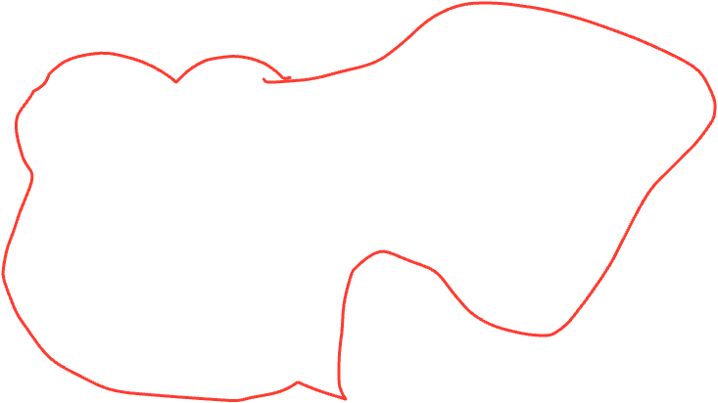
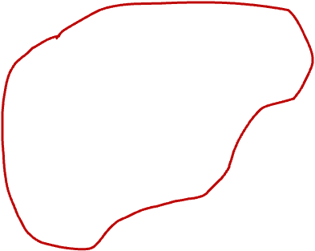
Stopping short
4
2
2
3
2
F
B
H
7
0
A
2
1
5
1
10
vertex | known? | cost | pred
A | T | 0
B | T | 2 | A
C | T | 1 | A
D | T | 4 | A
E | T | 11 | G
F | T | 4 | B
G | T | 8 | H
H | T | 7 | F
9
4
3
G
8
2
C
1
11
4
D
1
7
E
11
Order added to known set:
A, C, B, D, F, H, G, E
How would this have worked differently if we were only interested in:
The path from A to G?
The path from A to D?​​

Slide 17
A Greedy Algorithm
Dijkstra’s algorithm
For single-source shortest paths in a weighted graph (directed or undirected) with no negative-weight edges
An example of a greedy algorithm:
At each step, irrevocably does what seems best at that step
A locally optimal step, not necessarily globally optimal
Once a vertex is known, it is not revisited
Turns out to be globally optimal
Notes:
Like divide and conquer, this is an algorithm design approach
Maybe your default

Slide 18
Greedy failure example
Making change
Use smallest # of coins to make 15 cents Options: 25, 10, 5, 1
Use smallest # of coins to make 15 cents Options: 25, 13, 10, 5, 1

Slide 19
Where are we?
What should we do after learning an algorithm?
Prove it is correct
Not obvious!
We will sketch the key ideas
Analyze its efficiency
Will do better by using a data structure we learned earlier!

Slide 20
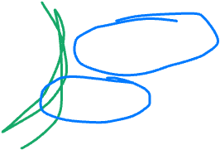
Correctness: The Cloud (Rough Idea)
The Known Cloud
next
v
Better path to v? No!
source
w
Suppose v is the next node to be marked known (“added to the cloud”)
The best-known path to v must have only nodes “in the cloud”
Since we’ve selected it, and we only know about paths through the cloud to a node right outside the cloud
Assume the actual shortest path to v is different
It won’t use only cloud nodes, (or we would know about it), so it must use non-cloud nodes
Let w be the first non-cloud node on this path.
The part of the path up to w is already known and must be shorter than the best-known path to v. So v would not have been picked.
Contradiction!
Notes:
This is why negative weight edges cause the algorithm not to work

Slide 21
The Algorithm - asymptotic running time
Assume adjacency list
dijkstra(Graph G, Node start) {
for each node: x.cost=infinity, x.known=false
start.cost = 0
while(not all nodes are known) {
b = find unknown node with smallest cost
b.known = true
for each edge (b,a) in G
if(!a.known)
if(b.cost + weight((b,a)) < a.cost){
a.cost = b.cost + weight((b,a))
a.pred = b
}
}
}

Slide 22
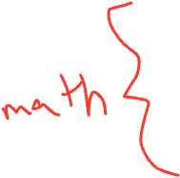
The Algorithm - asymptotic running time
Assume adjacency list
dijkstra(Graph G, Node start) {
for each node: x.cost=infinity, x.known=false
start.cost = 0
while(not all nodes are known) {
b = find unknown node with smallest cost
b.known = true
for each edge (b,a) in G
if(!a.known)
if(b.cost + weight((b,a)) < a.cost){
a.cost = b.cost + weight((b,a))
a.pred = b
}
}
}
O(V)
V times
O(V)
d times
Constant stuff

Slide 23
The Algorithm - asymptotic running time
Assume adjacency list
dijkstra(Graph G, Node start) {
for each node: x.cost=infinity, x.known=false
start.cost = 0
while(not all nodes are known) {
b = find unknown node with smallest cost
b.known = true
for each edge (b,a) in G
if(!a.known)
if(b.cost + weight((b,a)) < a.cost){
a.cost = b.cost + weight((b,a))
a.pred = b
}
}
}
O(V) plus constant
V times
O(V)
d times
Constant stuff
V + c₁ + V * (V + c₂ + d*c₃) => V + V² + V + V*d => O(V² + E)

Slide 24
Improving asymptotic running time
So far: O(|V|²+ |E|)
Due to each iteration looking for the node to process next
We solved it with a queue of zero-degree nodes
But here we need the lowest-cost node and costs can change as we process edges
Solution?

Slide 25
Efficiency, second approach
Assume adjacency list
dijkstra(Graph G, Node start) {
for each node: x.cost=infinity, x.known=false
start.cost = 0
build-heap with all nodes
while(heap is not empty) {
b = deleteMin()
b.known = true
for each edge (b,a) in G
if(!a.known)
if(b.cost + weight((b,a)) < a.cost){
decreaseKey(a, “new cost - old cost”)
a.pred = b
}
}
}

Slide 26
Efficiency, second approach
Assume adjacency list
dijkstra(Graph G, Node start) {
for each node: x.cost=infinity, x.known=false
start.cost = 0
build-heap with all nodes
while(heap is not empty) {
b = deleteMin()
b.known = true
for each edge (b,a) in G
if(!a.known)
if(b.cost + weight((b,a)) < a.cost){
decreaseKey(a, “new cost - old cost”)
a.pred = b
}
}
}
V + c₁ + V + V * (logV + c₂ + d*(c₃+logV)) => V + VlogV + V + E(logV)
=> O(V logV+ E logV)

Slide 27
Dense vs sparse again
First approach: O(|V|²+ |E|) or: O(|V|²)
Second approach: O(|V|log|V| + |E|log|V|)
So which is better?
Sparse: O(|V|log|V|+|E|log|V|) (if |E| > |V|, then O(|E|log|V|))
Dense: O(|V|²+ |E|) , or: O(|V|²)
But, remember these are worst-case and asymptotic
Priority queue might have slightly worse constant factors
On the other hand, for “normal graphs”, we might call decreaseKey rarely (or not percolate far), making |E|log|V| more like |E|

Slide 28
Example #2
2
?
B
1
0
A
1
5
E
?
?
1
2
vertex | known? | cost | pred
A |  | 0
B
C
D
E
F
G
1
D
3
5
?
C
6
G
2
?
F
10
?
Order added to known set:
Notes:
Finish second half on your own

Slide 29
Example #2
2
3
B
1
0
A
1
5
E
2
1
1
2
vertex | known? | cost | pred
A | T | 0
B | T | 3 | E
C | T | 2 | A
D | T | 1 | A
E | T | 2 | D
F | T | 4 | C
G | T | 6 | D
1
D
3
5
2
C
6
G
2
6
F
10
4
Order added to known set:
A, D, C, E, B, F, G
Notes:
Finish second half on your own

Slide 30
But what about negative weight edges?
We said that Dijkstra’s algorithm doesn’t work for negative-weight edges
But what if we want to support that?
Problem: negative-weight edges ruin our correctness proof
The shortest path might involve nodes outside “the cloud”
Solution: just do our edge calculations for all edges, but |V|-1 times
That way we MUST consider all paths that contain all nodes
Enter Bellman-Ford

Slide 31
Bellman-Ford algorithm
bellmanFord(Graph G, Node start) {
for each node: x.cost=infinity, x.known=false
start.cost = 0
for (i = 0; i < |V| - 1)
for each edge (b,a) in G
if(b.cost + weight((b,a)) < a.cost){
a.cost = b.cost + weight((b,a))
a.pred = b
}
// Relax one more time to find a cycle
for each edge (b,a) in G
if(b.cost + weight((b,a)) < a.cost)
// we found a cycle!
}
Notes:
Stopping early?

