Slide 1
CSE 332
Data Structures & Parallelism
Comparison Sorting
Melissa Winstanley
Spring 2024

Slide 2
Introduction to sorting
Stacks, queues, priority queues, and dictionaries all focused on providing one element at a time
But often we know we want “all the data items” in some order
Anyone can sort, but a computer can sort faster
Very common to need data sorted somehow
Alphabetical list of people
Population list of countries
Search engine results by relevance
…
Different algorithms have different asymptotic and constant-factor trade-offs
No single ‘best’ sort for all scenarios
Knowing one way to sort just isn’t enough

Slide 3
Variations on the basic problem
Maybe elements are in a linked list (could convert to array and back in linear time, but some algorithms needn’t do so)
Maybe in the case of ties we should preserve the original ordering
Sorts that do this naturally are called stable sorts
One way to sort twice, Ex: Sort movies by year, then for ties, alphabetically
Maybe we must not use more than O(1) “auxiliary space”
Sorts meeting this requirement are called ‘in-place’ sorts
Not allowed to allocate extra array (at least not with size O(n)), but can allocate O(1) # of variables
All work done by swapping around in the array
Maybe we can do more with elements than just compare
Comparison sorts assume we work using a binary ‘compare’ operator
In special cases we can sometimes get faster algorithms
Maybe we have too much data to fit in memory
Use an “external sorting” algorithm

Slide 4
Sorting: The Big Picture
Simple algorithms: O(n²)
Fancier algorithms: O(n log n)
Comparison lower bound: 𝛀(n log n)
Specialized algorithms: O(n)
Handling huge data sets
Insertion sort
Selection sort
...
Heap sort
Merge sort
Quick sort (avg)
...
Bucket sort
Radix sort
External
sorting

Slide 5
Insertion Sort
Idea: At step k, put the k^{th} element in the correct position among the first k elements
Alternate way of saying this:
Sort first two elements
Now insert 3rd element in order
Now insert 4th element in order
…
“Loop invariant”: when loop index is i, first i elements are sorted relative to each other
Time?
Best-case _____ Worst-case _____ “Average” case _____
Notes:
Think inserting cards into your hand as you draw from a deck

Slide 6
Selection sort
Idea: At step k, find the smallest element among the not-yet-
sorted elements and put it at position k
Alternate way of saying this:
Find smallest element, put it 1st
Find next smallest element, put it 2nd
Find next smallest element, put it 3rd
…
“Loop invariant”: when loop index is i, first i elements are the i smallest elements in sorted order
Time?
Best-case _____ Worst-case _____ “Average” case _____
Notes:
But if you just want to find the smallest N items, this would work better than insertion sort!

Slide 7
Insertion Sort vs. Selection Sort
Different algorithms
Solve the same problem
Have the same worst-case and average-case asymptotic complexity
Insertion-sort has better best-case complexity; preferable when input is “mostly sorted”
Other algorithms are more efficient for non-small arrays that are not already almost sorted
Insertion sort may do well on small arrays

Slide 8
Sorting: The Big Picture
Simple algorithms: O(n²)
Fancier algorithms: O(n log n)
Comparison lower bound: 𝛀(n log n)
Specialized algorithms: O(n)
Handling huge data sets
Insertion sort
Selection sort
...
Heap sort
Merge sort
Quick sort (avg)
...
Bucket sort
Radix sort
External
sorting
Notes:
14.5 minutes here

Slide 9
Heap sort
Sorting with a heap is easy!
insert each arr[i], better yet use buildHeap
for(i=0; i < arr.length; i++) arr[i] = deleteMin();
Worst-case running time:
We have the array-to-sort and the heap
So this is not an in-place sort
There’s a trick to make it in-place…

Slide 10
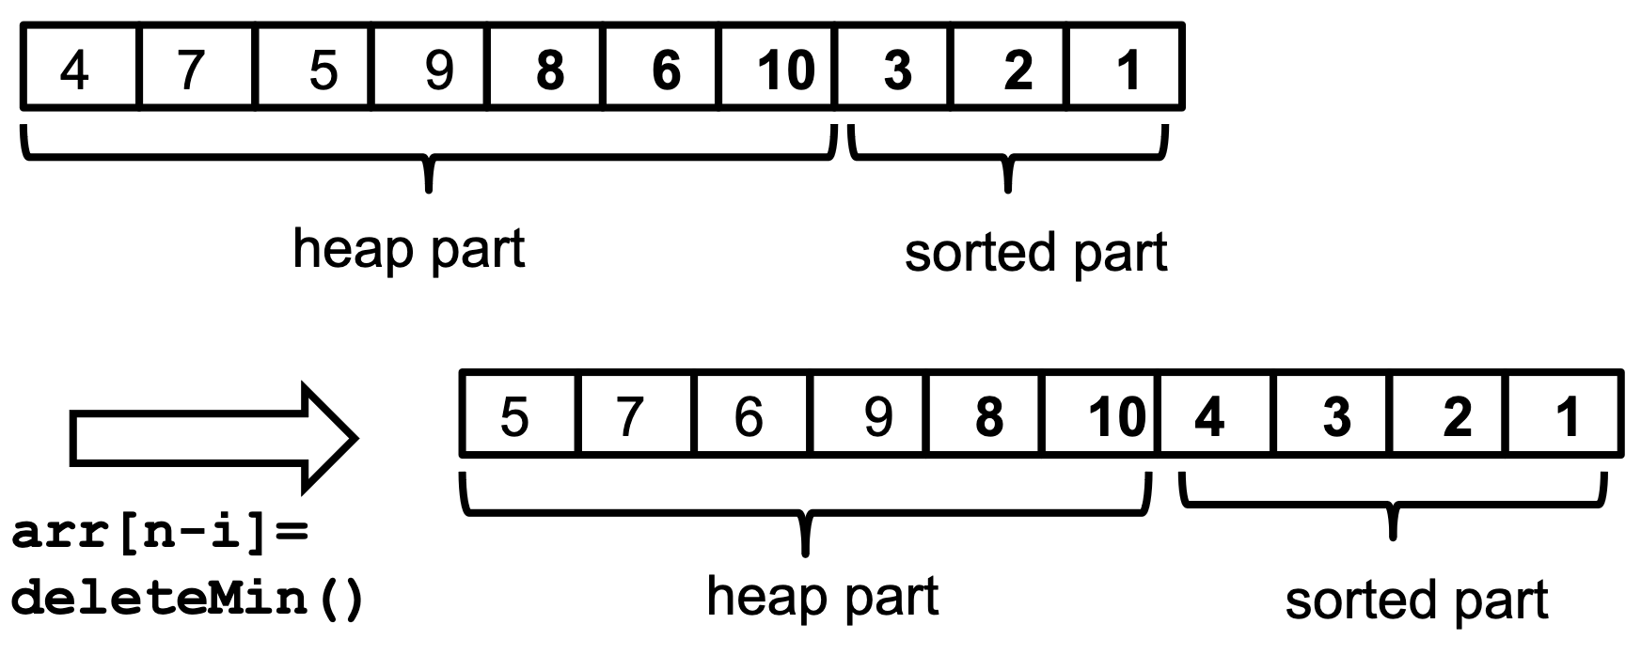
In-place heap sort
But this reverse sorts - how would you fix that?
Treat the initial array as a heap (via buildHeap)
When you delete the i^{th} element, put it at arr[n-i]
It’s not part of the heap anymore!
Notes:
Don’t have to do this for P2, but cool!

Slide 11
Sorting: The Big Picture
Simple algorithms: O(n²)
Fancier algorithms: O(n log n)
Comparison lower bound: 𝛀(n log n)
Specialized algorithms: O(n)
Handling huge data sets
Insertion sort
Selection sort
...
Heap sort
Merge sort
Quick sort (avg)
...
Bucket sort
Radix sort
External
sorting
Notes:
20 minutes here

Slide 12
Divide and conquer
Very important technique in algorithm design
Divide problem into smaller parts
Solve the parts independently
Think recursion
Or potential parallelism
Combine solution of parts to produce overall solution
Ex: Sort each half of the array, combine together; to sort each half, split into halves…

Slide 13
Divide-and-conquer sorting
Two great sorting methods are fundamentally divide-and-conquer
Quicksort: Pick a “pivot” element Divide elements into those less-than pivot and those greater-than pivot Sort the two divisions (recursively on each) Answer is [sorted-less-than then pivot then Sorted-greater-than]
Mergesort: Sort the left half of the elements (recursively) Sort the right half of the elements (recursively) Merge the two sorted halves into a sorted whole

Slide 14
Quicksort
Uses divide-and-conquer
Recursively chop into halves
But, instead of doing all the work as we merge together, we’ll do all the work as we recursively split into halves
Also unlike MergeSort, does not need auxiliary space
O(n log n) on average 😁, but O(n²) worst-case 😢
MergeSort is always O(nlogn)
So why use QuickSort?
Can be faster than mergesort
Often believed to be faster
Quicksort does fewer copies and more comparisons, so it depends on the relative cost of these two operations!

Slide 15
Quicksort Overview
Pick a pivot element
Hopefully an element ~median
Good QuickSort performance depends on good choice of pivot; we’ll see why later, and talk about good pivot selection later
Partition all the data into:
The elements less than the pivot
The pivot
The elements greater than the pivot
Recursively sort A and C
The answer is, “as simple as A, B, C”
(Alas, there are some details lurking in this algorithm)

Slide 16
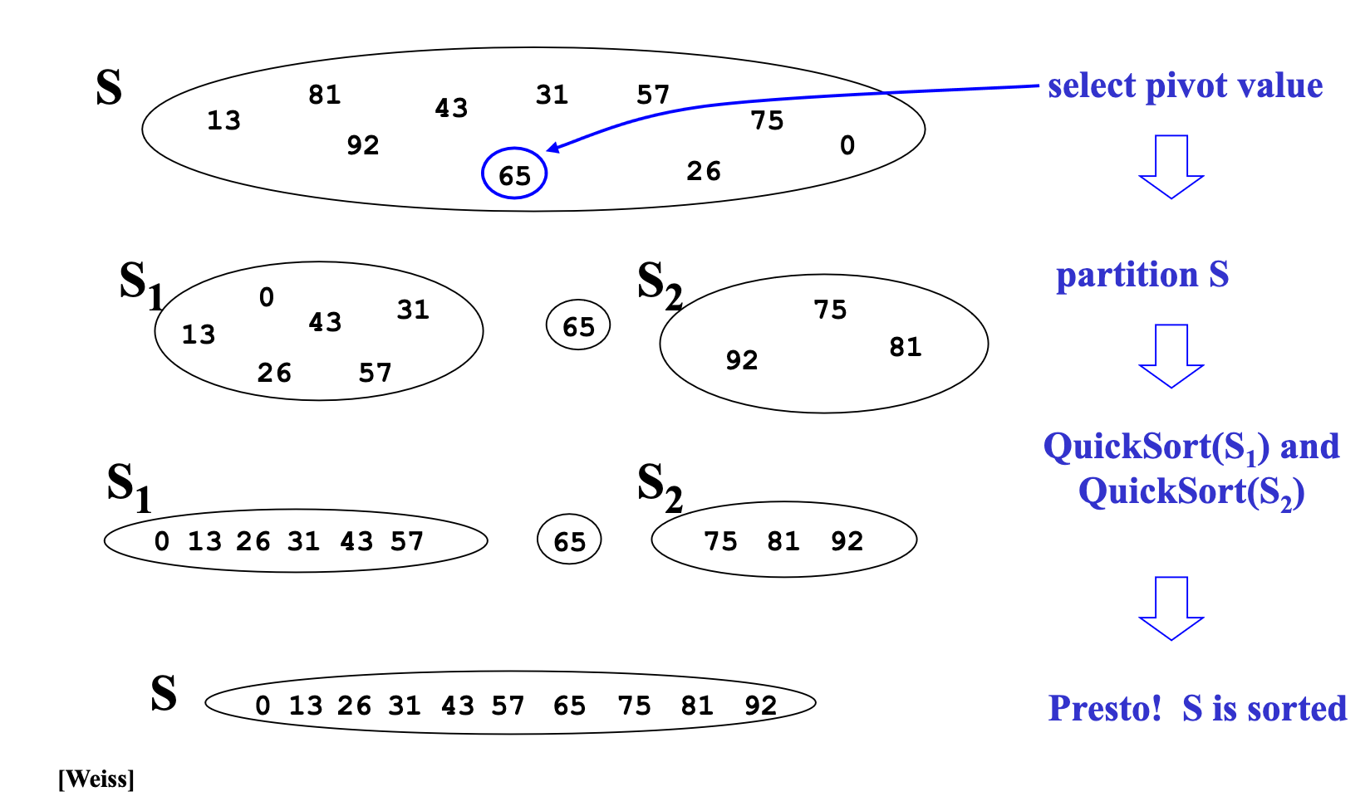
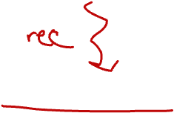
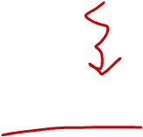
Quicksort: Think in terms of sets
Notes:
Real work is in the partitioning

Slide 17
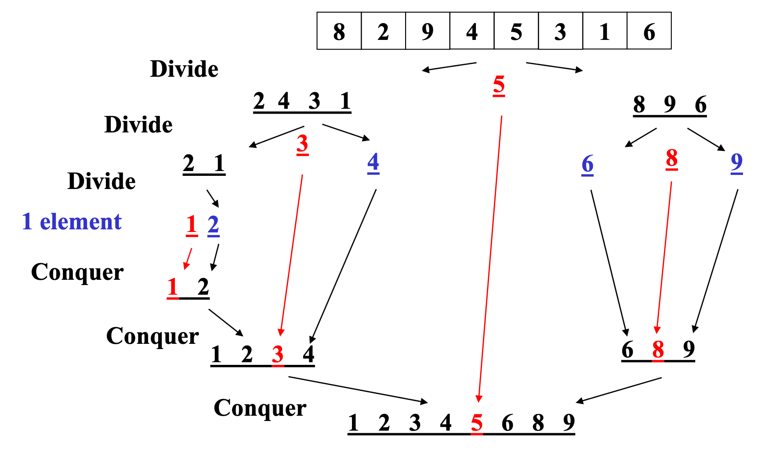
Quicksort Example, showing recursion
Notes:
Runtime: divide n - then hopefully divide in about half, which is logn levels -> n log n
But if bad pivot: n + T(n-1)

Slide 18
Quicksort: Potential pivot rules
While sorting arr from lo (inclusive) to hi (exclusive)…
Pick arr[lo] or arr[hi-1]
Fast, but worst-case is (mostly) sorted input
Pick random element in the range
Does as well as any technique, but (pseudo)random number generation can be slow
(Still probably the most elegant approach)
Median of 3, e.g., arr[lo], arr[hi-1], arr[(hi+lo)/2]
Common heuristic that tends to work wel

Slide 19
Partitioning
One approach (there are slightly fancier ones):
Swap pivot with arr[lo]; move it ‘out of the way’
Use two fingers i and j, starting at lo+1 and hi-1 (start & end of range, apart from pivot)
Move from right until we hit something less than the pivot; belongs on left side Move from left until we hit something greater than the pivot; belongs on right side Swap these two; keep moving inward while (i < j) if (arr[j] > pivot) j-- else if (arr[i] <= pivot) i++ else swap arr[i] with arr[j]
Put pivot back in middle (Swap with arr[i])

Slide 20
Quicksort Example
Pick pivot as median of 3
lo = 0, hi = 10
Step two: move pivot to the lo position

Slide 21
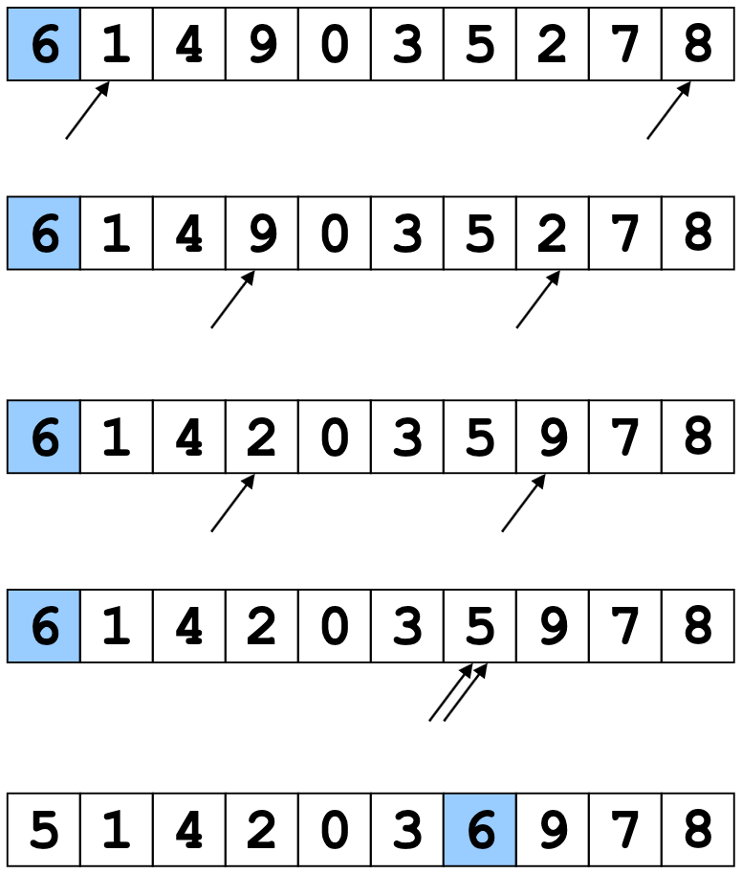
Quicksort Example
Often have more than
one swap during partition –
this is a short example
Now partition in place
Move fingers
Swap
Move fingers
Move pivot

Slide 22
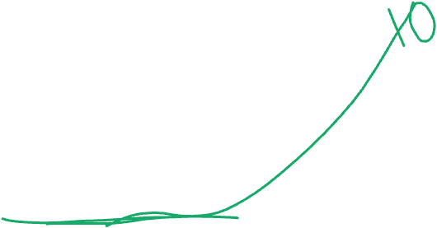
Quicksort Cutoff
void quicksort(int[] arr, int lo, int hi) {
if(hi – lo < CUTOFF)
insertionSort(arr,lo,hi);
else
…
}
Notice how this cuts out the vast majority of the recursive calls
Think of the recursive calls to quicksort as a tree
Trims out the bottom layers of the tree
Works for other recursive or parallel algorithms too!

Slide 23
Sorting: The Big Picture
Simple algorithms: O(n²)
Fancier algorithms: O(n log n)
Comparison lower bound: 𝛀(n log n)
Specialized algorithms: O(n)
Handling huge data sets
Insertion sort
Selection sort
...
Heap sort
Merge sort
Quick sort (avg)
...
Bucket sort
Radix sort
External
sorting
Notes:
20 minutes here

Slide 24
Mergesort
To sort array from position lo to position hi:
If range is 1 element long, it’s sorted! (Base case)
Else, split into two halves:
Sort from lo to (hi+lo)/2
Sort from (hi+lo)/2 to hi
Merge the two halves together
Merging takes two sorted parts and sorts everything
O(n) but requires auxiliary space…

Slide 25
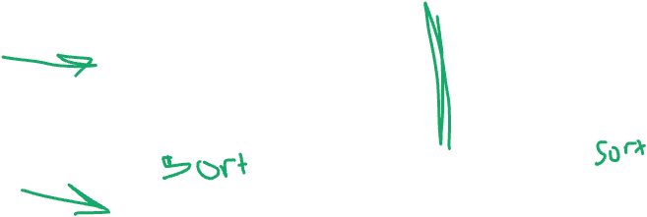
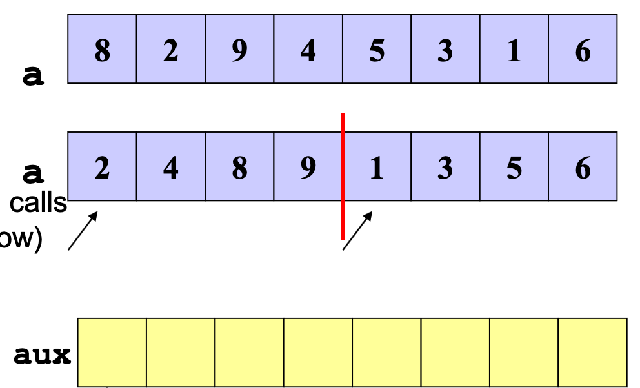
Example, focus on merging
Start with:
After we return from left and right recursive calls (pretend it works for now)
Merge: Use 3 “fingers” and 1 more array
(After merge, copy back to original array)

Slide 26
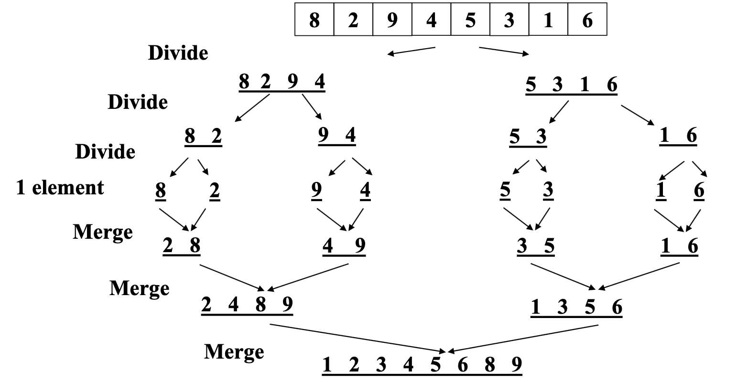
Mergesort example: Recursively splitting in half

Slide 27
Mergesort example: Merge as we return
Don’t forget we need an auxiliary array at each step

Slide 28
Improving constant factors
Don’t create a new auxiliary array at each recursive call
Reuse the same auxiliary array of size n for every merging stage
Allocate auxiliary array at beginning, use throughout
Best (but a little tricky):
Don’t copy back – at 2nd, 4th, 6th, … merging stages, use the original array as the auxiliary array and vice-versa
Need one copy at end if number of stages is odd
Unnecessary to copy ‘dregs’ over to auxiliary array
If left-side finishes first, just stop the merge & copy the auxiliary array
If right-side finishes first, copy dregs directly into right side, then copy auxiliary array

Slide 29
Mergesort Analysis
Having defined an algorithm and argued it is correct, we should analyze its running time (and space):
To sort n elements, we:
Return immediately if n=1
Else do 2 subproblems of size ______ and then a merge of work ______
Recurrence relation?

Slide 30
Mergesort Recurrence
(For simplicity let constants be 1 – no effect on asymptotic answer)
T(1) = 1 So total is 2^{k}T(n/2^{k}) + kn where
T(n) = 2T(n/2) + n n/2^{k} = 1, i.e., log n = k
= 2(2T(n/4) + n/2) + n That is, 2^{log n} T(1) + n log n
= 4T(n/4) + 2n = n + n log n
= 4(2T(n/8) + n/4) + 2n = O(n log n)
= 8T(n/8) + 3n
…. (after k expansions)
= 2^{k}T(n/2^{k}) + kn

Slide 31
Quicksort Recurrence
Best-case?
Worst-case?
Average-case?
Notes:
Best: same as merge sort
Worst: T(n) = T(n-1) + n (same as selection sort)
Average: same as best, see proof in text book if you’re curious

