Slide 1
CSE 332
Data Structures & Parallelism
Hashing 2
Melissa Winstanley
Spring 2024

Slide 2
Today
Last time:
Hash tables
Hash functions
Separate chaining
Today:
Open Addressing
Linear probing
Quadratic probing
Double hashing
Rehashing

Slide 3
Hash Tables: Review
0
Dictionary implementation
Aim for constant-time (i.e., O(1)) find, insert, and delete
“On average” under some reasonable assumptions
A hash table is an array of some fixed size
But growable as we’ll see
1
2
3
...
Client
Hash table library
E
int
index
Collision resolution
hash(key)
mod by table size
collision?
tableSize - 1

Slide 4
Hashing Choices
Choose a Hash function
Fast
Even spread
Choose TableSize
Prime Numbers
Choose a Collision Resolution Strategy from these:
Separate Chaining
Open Addressing
Linear Probing
Quadratic Probing
Double Hashing
Other issues to consider:
What to do when the hash table gets “too full”?

Slide 5
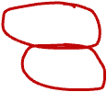
Open Addressing: Linear Probing (simplest)
0
Why not use up the empty space in the table?
Store directly in the array cell (no linked list)
How to deal with collisions?
If h(key) is already full,
try (h(key) + 1) % TableSize. If full,
try (h(key) + 2) % TableSize. If full,
try (h(key) + 3) % TableSize. If full…
Example: insert 38, 19, 8, 109, 10
1
2
3
4
5
6
7
8
9

Slide 6
Open addressing
Linear probing is one example of open addressing
Resolving collisions by trying a sequence of other positions in the table.
Trying the next spot is called probing
We just did linear probing:
i^{th} probe: (h(key) + i) % TableSize
In general have some probe function f:
i^{th} probe: (h(key) + f(i,key)) % TableSize
Open addressing does poorly with high load factor λ
So want larger tables
Too many probes means no more O(1)

Slide 7
Questions: Open Addressing: Linear Probing
How should find work? If key is in table? If not there?
Worst case scenario for find?
How should we implement delete?
How does open addressing with linear probing compare to separate chaining?
0
8
1
109
2
10
3
4
5
6
7
8
38
9
19

Slide 8
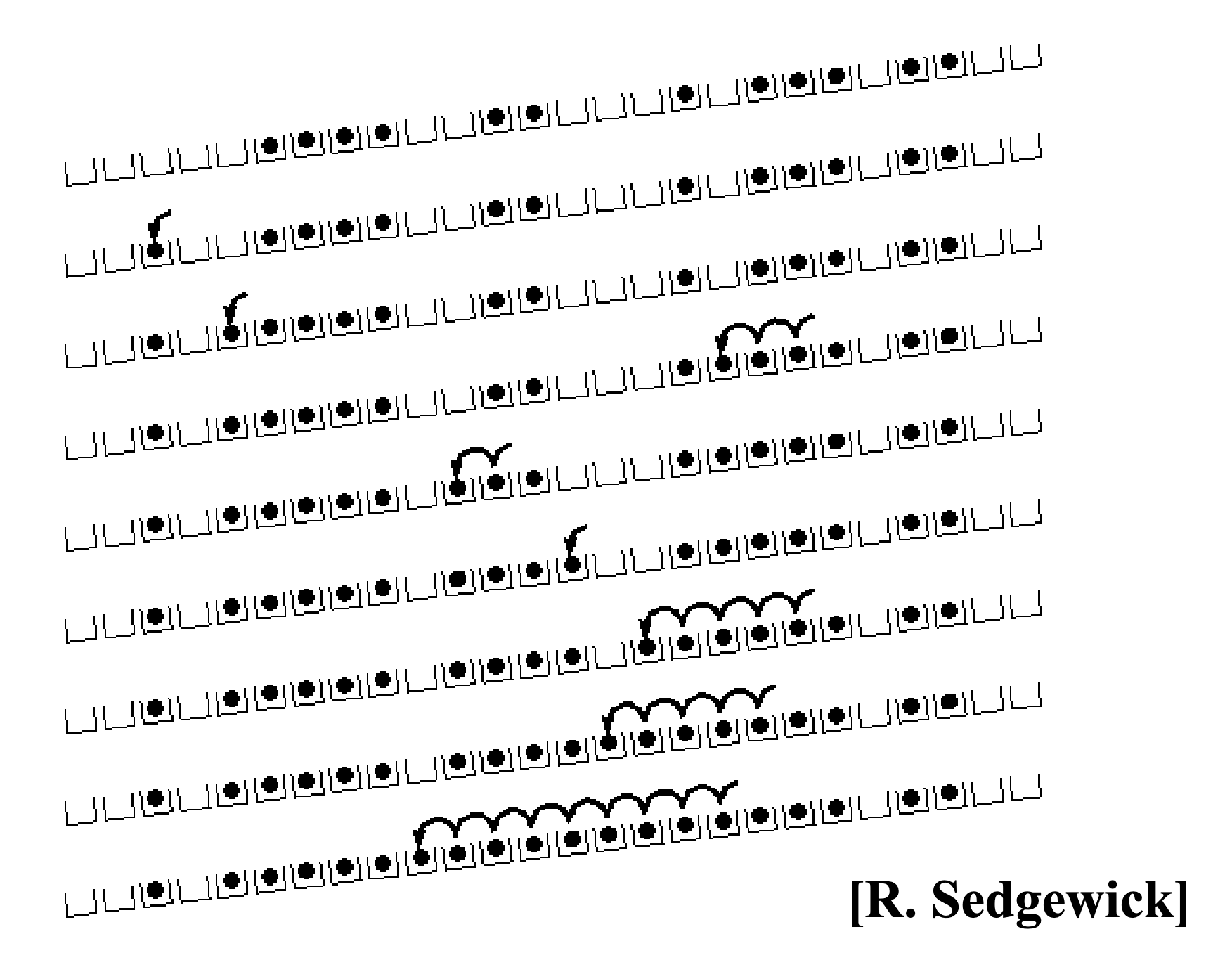
Primary Clustering
It turns out linear probing is a bad idea, even though the probe function is quick to compute (a good thing)
Tends to produce clusters, which lead to long probe sequences
Called primary clustering
Saw the start of a cluster in our linear probing example

Slide 9
Analysis in chart form
Linear-probing performance degrades rapidly as table gets full
(Formula assumes “large table” but point remains)
By comparison, separate chaining performance is linear in λ and has no trouble with λ>1

Slide 10
Open Addressing: Linear probing
index_{i} = (h(key) + f(i, key)) % TableSize
For linear probing:
f(i, key) = i
So probe sequence is:
0th probe: h(key) % TableSize
1st probe: (h(key) + 1) % TableSize
2nd probe: (h(key) + 2) % TableSize
3rd probe: (h(key) + 3) % TableSize
…
i^{th} probe: (h(key) + i) % TableSize

Slide 11
Open Addressing: Quadratic probing
We can avoid primary clustering by changing the probe function…
index_{i} = (h(key) + f(i, key)) % TableSize
For quadratic probing:
f(i, key) = i²
So probe sequence is:
0th probe: h(key) % TableSize
1st probe: (h(key) + 1) % TableSize
2nd probe: (h(key) + 4) % TableSize
3rd probe: (h(key) + 9) % TableSize
…
i^{th} probe: (h(key) + i²) % TableSize
Intuition: Probes quickly “leave the neighborhood”

Slide 12
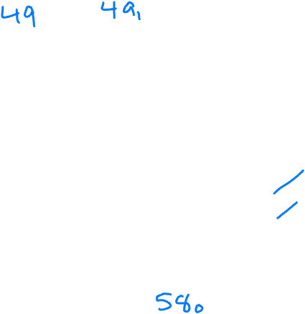
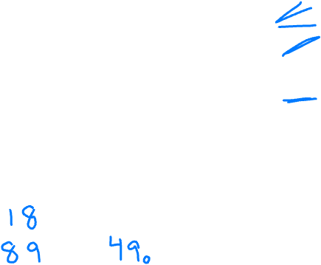
Quadratic Probing Example
i^{th} probe: (h(key) + i²) % TableSize
0
TableSize=10
Insert: 89 18 49 58 79
1
2
3
4
5
6
7
8
9

Slide 13
Another Quadratic Probing Example
i^{th} probe: (h(key) + i²) % TableSize
0
TableSize=7
Insert: 76 (76 % 7 = 6) 40 (40 % 7 = 5) 48 (48 % 7 = 6) 5 ( 5 % 7 = 5) 55 (55 % 7 = 6) 47 (47 % 7 = 5)
1
2
3
4
5
6
Notes:
Do this yourselves

Slide 14
Another Quadratic Probing Example
i^{th} probe: (h(key) + i²) % TableSize
0
48
Insert 47
(47 + 1) % 7 = 6 collision! (47 + 4) % 7 = 2 collision! (47 + 9) % 7 = 0 collision! (47 + 16) % 7 = 0 collision! (47 + 25) % 7 = 2 collision! (47 + 36) % 7 = 6 collision! (47 + 49) % 7 = 5 collision!
Will we ever get a 1 or a 4?!?!
1
2
5
3
55
4
5
40
6
76

Slide 15
From bad news to good news
Bad News:
After TableSize quadratic probes, we cycle through the same indices
Good News:
If TableSize is prime and λ < ½, then quadratic probing will find an empty slot in at most TableSize/2 probes
So: If you keep λ < ½ and TableSize is prime, no need to detect cycles
Proof posted in lecture12.txt (slightly less detailed proof in textbook) For prime TableSize and 0 ≤ i,j ≤ TableSize/2 where i ≠ j, (h(key) + i2) % TableSize ≠ (h(key) + j2) % TableSize
That is, if TableSize is prime, the first TableSize/2 quadratic probes map to different locations (and one of those will be empty if the table is < half full).

Slide 16
Primary clustering reconsidered
Quadratic probing does not suffer from primary clustering: As we resolve collisions we are not merely growing “big blobs” by adding one more item to the end of a cluster, we are looking i² locations away, for the next possible spot
But quadratic probing does not help resolve collisions between keys that initially hash to the same index
Any 2 keys that initially hash to the same index will have the same series of moves after that looking for any empty spot
Called secondary clustering
Can avoid secondary clustering with a probe function that depends on the key: double hashing…

Slide 17
Open Addressing: Double hashing
Idea: Given two good hash functions h and g, and two different keys k1 and k2, it is very unlikely that: h(k1)==h(k2) and g(k1)==g(k2)
index_{i} = (h(key) + f(i, key)) % TableSize
For double hashing:
f(i, key) = i*g(key)
So probe sequence is:
0th probe: h(key) % TableSize
1st probe: (h(key) + g(key)) % TableSize
2nd probe: (h(key) + 2*g(key)) % TableSize
3rd probe: (h(key) + 3*g(key)) % TableSize
…
i^{th} probe: (h(key) + i*g(key)) % TableSize
Detail: Make sure g(key) can’t be 0

Slide 18
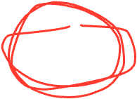
Double Hashing Example
i^{th} probe: (h(key) + i*g(key)) % TableSize
0
TableSize T=10
h(key) = key g(key) = 1 + (key/T) % (T-1)
Insert: 13 28 33 147 43
1
2
3
4
5
6
7
--> g(147) = 1 + 14%9 = 6
8
Oh no!
--> g(43) = 1 + 4%9 = 5
9

Slide 19
Where are we?
Separate Chaining is easy
find, insert, delete proportional to load factor on average if using unsorted linked list nodes
If using another data structure for buckets (e.g. AVL tree), runtime is proportional to runtime for that structure.
Open addressing uses probing, has clustering issues as table fills. Why use it:
Less memory allocation?
Some run-time overhead for allocating linked list (or whatever) nodes; open addressing could be faster
Easier data representation?
Now:
Growing the table when it gets too full (aka “rehashing”)
Relation between hashing/comparing and connection to Java

Slide 20
Rehashing (resizing)
As with array-based stacks/queues/lists, if table gets too full, create a bigger table and copy everything over
With separate chaining, we get to decide what “too full” means
Keep load factor reasonable (e.g., < 1)?
Consider average or max size of non-empty chains?
For open addressing, half-full is a good rule of thumb
New table size
Twice-as-big is a good idea, except, uhm, that won’t be prime!
So go about twice-as-big
Can have a list of prime numbers in your code since you probably won’t grow more than 20-30 times, and then calculate after that
How do we actually do the resizing? We can’t copy elements into same index!

Slide 21
A Generally Good hashCode()
int result = 17; // start at a prime
foreach field f
int fieldHashcode =
boolean: (f ? 1: 0)
byte, char, short, int: (int) f
long: (int) (f ^ (f >>> 32))
float: Float.floatToIntBits(f)
double: Double.doubleToLongBits(f), then above
Object: object.hashCode( )
result = 31 * result + fieldHashcode;
return result;
Even better? Use randomization (chosen on startup)

Slide 22
Final word on hashing
The hash table is one of the most important data structures
Efficient find, insert, and delete
Operations based on sorted order are not so efficient!
Useful in many, many real-world applications
Popular topic for job interview questions
Important to use a good hash function
Good distribution, Uses enough of key’s components
Not overly expensive to calculate (bit shifts good!)
Important to keep hash table at a good size
Prime #
Preferable λ depends on type of table

