Slide 1
CSE 332
Data Structures & Parallelism
Hashing 1
Melissa Winstanley
Spring 2024

Slide 2
Motivating Hash Tables
For dictionary with n key/value pairs
insert find delete
Unsorted linked-list O(n)* O(n) O(n)
Unsorted array O(n)* O(n) O(n)
Sorted linked list O(n) O(n) O(n)
Sorted array O(n) O(log n) O(n)
Balanced tree O(log n) O(log n) O(log n)
* Assuming we must check to see if the key has already been inserted. Cost becomes cost of a find operation, inserting itself is O(1).

Slide 3
Idea: “Big Array”
0
Possible keys = student # 0 .... 9,999,999
insert(2)
find(2)
delete(2)
Runtime of these operations? _______
Why haven’t we been using this?
1
2
3
...
9,999,999

Slide 4
Motivating Hash Tables
For dictionary with n key/value pairs
insert find delete
Unsorted linked-list O(n)* O(n) O(n)
Unsorted array O(n)* O(n) O(n)
Sorted linked list O(n) O(n) O(n)
Sorted array O(n) O(log n) O(n)
Balanced tree O(log n) O(log n) O(log n)
Hash table O(1)** O(1) O(1)
** Average complexity

Slide 5
Hash Tables
m = possible keys (e.g. possible student no., 9,999,999)
n = no. of expected keys (e.g. total students, 180 in CSE332)
We expect our table to have only n items
n is much less than m (often written n << m)
Many dictionaries have this property
Compiler: variable names in a file << possible variable names
Database: enrolled student names << possible student names
AI: Chess-board configurations considered by the current player vs. All possible chess-board configurations

Slide 6
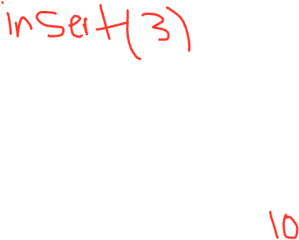
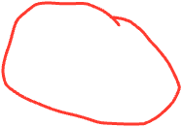
Hash Tables
Aim for constant-time (i.e., O(1)) find, insert, and delete
“On average” under some reasonable assumptions
A hash table is an array of some fixed size
Basic idea:
0
1
2
3
...
key
int
index
hash(key)
mod by table size
Key space (integers, strings, etc)
tableSize - 1

Slide 7
Hash Tables vs Balanced Trees
Both implement the Dictionary ADT:
find, delete, insert
Hash tables O(1) on average (assuming few collisions)
Balanced trees O(log n) worst-case
Constant-time is better, right?
Yes, but what if we want to findMin, findMax, predecessor, successor, printSorted?
Hashtables are not designed to efficiently implement these sortedness operations
Your textbook considers hash tables to be a different ADT
Not so important to argue over the definitions

Slide 8
Hash Functions
An ideal hash function:
Is fast to compute
“Rarely” hashes two “used” keys to the same index
Often impossible in theory; easy in practice
Will handle collisions a bit later
What would be the hash function signature if our keys are student #s?
What would a bad hash function if our keys are student #s?

Slide 9
Who hashes what?
Hash tables can be generic.
To store keys of type E, we just need to be able to:
Test equality: are you the E I’m looking for?
Hash: convert any E to an int
When hash tables are a reusable library, the division of responsibility generally breaks down into two roles:
We will learn both roles, but most programmers “in the real world” spend more time as clients while understanding the library
Client
Hash table library
E
int
index
Collision resolution
hash(key)
mod by table size
collision?

Slide 10
More on roles
Some ambiguity in terminology on which parts are “hashing”
The two roles must both contribute to minimizing collisions (heuristically)
Client should aim for different ints for expected items
Avoid “wasting” any part of E or the 32 bits of the int
Library should aim for putting “similar” ints in different indices
Conversion to index is almost always “mod table-size”
Using prime numbers for table-size is common
Client
Hash table library
E
int
index
Collision resolution
hash(key)
mod by table size
collision?
hashing?
hashing?

Slide 11
What to hash?
We will focus on two most common things to hash: ints and strings
If you have objects with several fields, it is usually best to have most of the “identifying fields” contribute to the hash to avoid collisions
Example:
class Person { String first; String middle; String last; Day birthday; Month birthmonth; Year birthyear; }
An inherent trade-off: hashing-time vs. collision-avoidance
Use all the fields?
Use only the birthdate?
Admittedly, what-to-hash is often an unprincipled guess 😟

Slide 12
Hashing integers
0
key space = integers
Simple hash function:
Client: h(x) = x
Library: g(x) = h(x) % TableSize
index = x % TableSize
Example:
TableSize = 10
Insert 7, 18, 41, 34, 10, 17
(As usual, ignoring corresponding data)
1
2
3
4
5
6
7
8
9

Slide 13
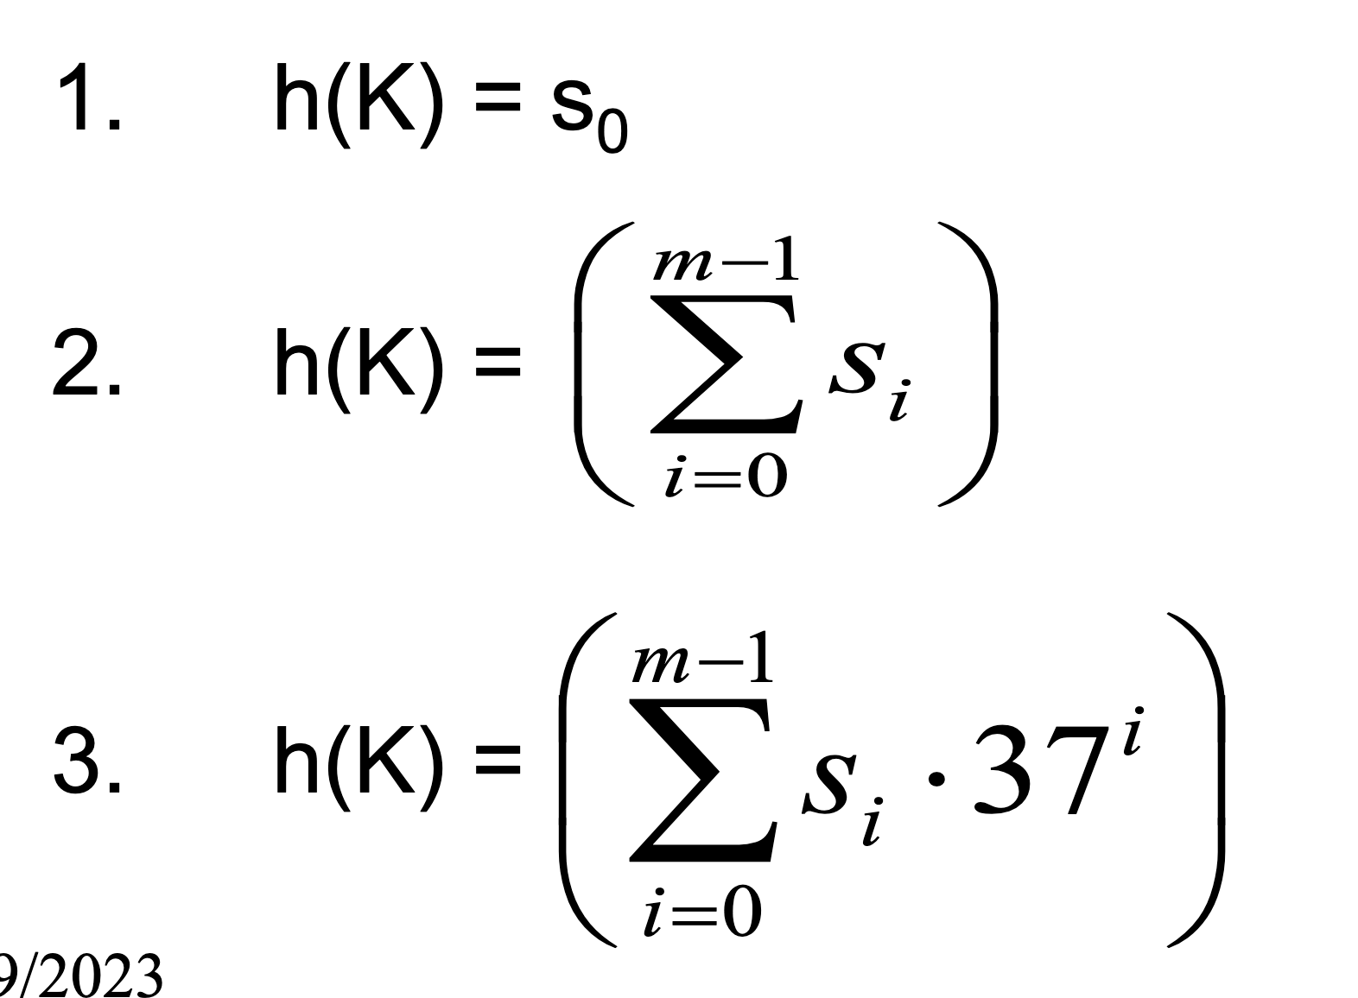
What if the key is not an int?
If keys aren’t ints, the client must convert to an int
Trade-off: speed and distinct keys hashing to distinct ints
Common and important example: Strings
Key space K = s₀s₁s₂…s_{m-1}
where s_{i} are chars: s_{i} ∈ [0,256]
Some choices: Which avoid collisions best?
Then on the library side we
typically mod by TableSize
to find index into the table
Notes:
Characters are actually numbers! Eg ascii

Slide 14
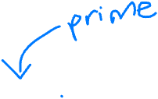
Aside: Don’t use pow
Use Horner’s Rule (to simplify):
= 𝑆₀ + 37 (𝑆₁ + 37 (𝑆₂ + 37 (… + 37 ⋅ 𝑆_{𝑚−1}) ) )

Slide 15
Specializing hash functions
How might you hash differently if all your strings were web addresses (URLs)?

Slide 16
Aside: Combining hash functions
A few rules of thumb / tricks:
Use all 32 bits (careful, that includes negative numbers)
Use different overlapping bits for different parts of the hash
This is why a factor of 37^{i} works better than 256^{i}
When smashing two hashes into one hash, use bitwise-xor
bitwise-and produces too many 0 bits
bitwise-or produces too many 1 bits
Rely on expertise of others; consult books and other resources
If keys are known ahead of time, choose a perfect hash

Slide 17
Collision resolution
Collision:
When two keys map to the same location in the hash table
We try to avoid it, but number-of-possible-keys exceeds table size
So hash tables should support collision resolution
Ideas?

Slide 18
Flavors of Collision Resolution
Separate Chaining
Open Addressing
Linear Probing
Quadratic Probing
Double Hashing

Slide 19
Separate Chaining
0
Chaining: All keys that map to the same table location are kept in a list (a.k.a. a “chain” or “bucket”)
Insertion Algorithm:
Check if duplicate exists
h(K) -> int -> index
LL.find(K) at index
If no duplicate, LL.insert(K) at index
Example: insert 10, 22, 107, 12, 42 with mod hashing and TableSize = 10
Delete?
1
2
3
4
5
6
7
8
9

Slide 20
Separate Chaining
0
Chaining: All keys that map to the same table location are kept in a list (a.k.a. a “chain” or “bucket”)
Worst case time for find?
1
2
3
4
5
6
7
8
9
Notes:
Usually we insert at the front

Slide 21
Thoughts on separate chaining
Worst-case time for find?
Linear
But only with really bad luck or bad hash function
So not worth avoiding (e.g., with balanced trees at each bucket)
Keep # of items in each bucket small
Overhead of AVL tree, etc. not worth it if small # items per bucket
Beyond asymptotic complexity, some “data-structure engineering” can improve constant factors
Linked list vs. array or a hybrid of the two
Move-to-front (part of Project 2)
Leave room for 1 element (or 2?) in the table itself, to optimize constant factors for the common case
A time-space trade-off…

Slide 22
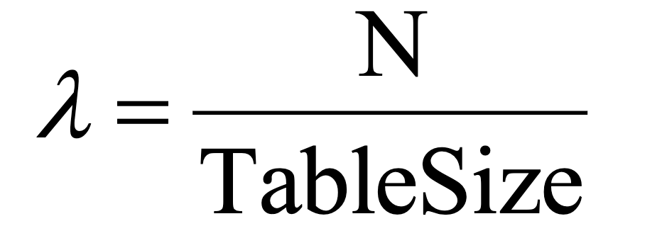
More rigorous separate chaining analysis
Definition: The load factor, 𝝀, of a hash table is:
number of elements
Under chaining, the average number of elements per bucket is _____
So if some inserts are followed by random finds, then on average:
Each unsuccessful find compares against ____ items
Each successful find compares against _____ items
How big should TableSize be??
Notes:
How full

Slide 23
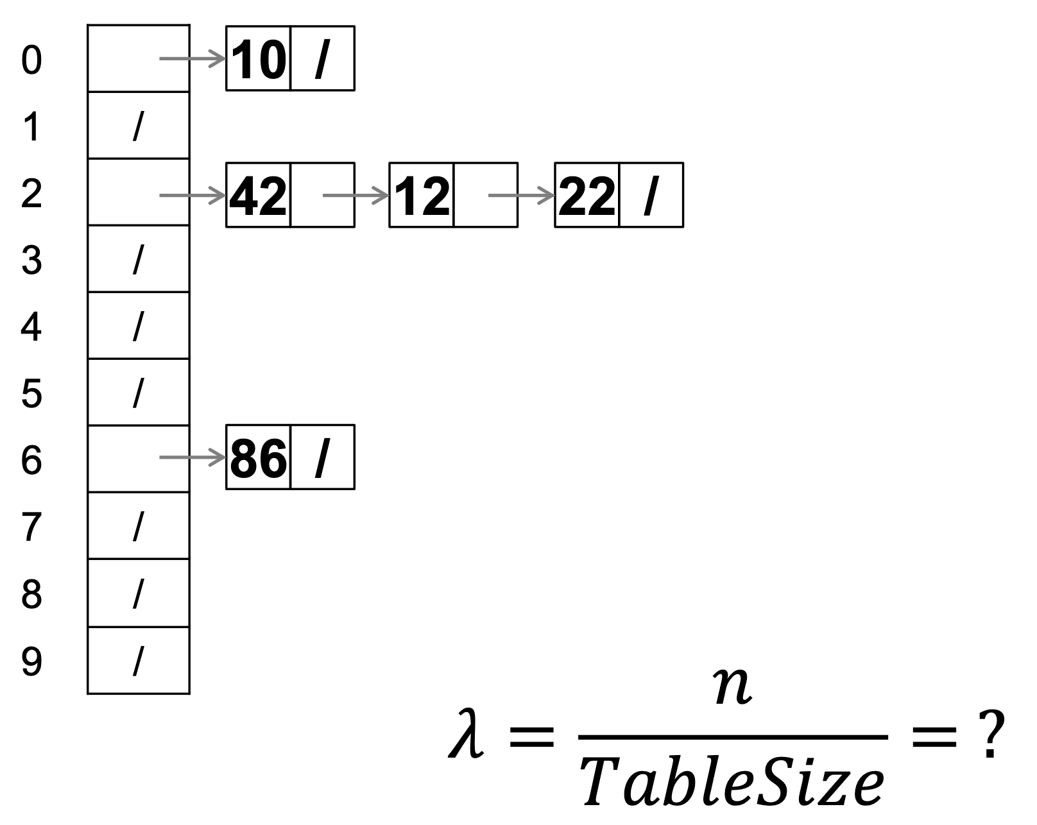
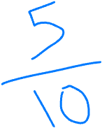
Load factor?

Slide 24
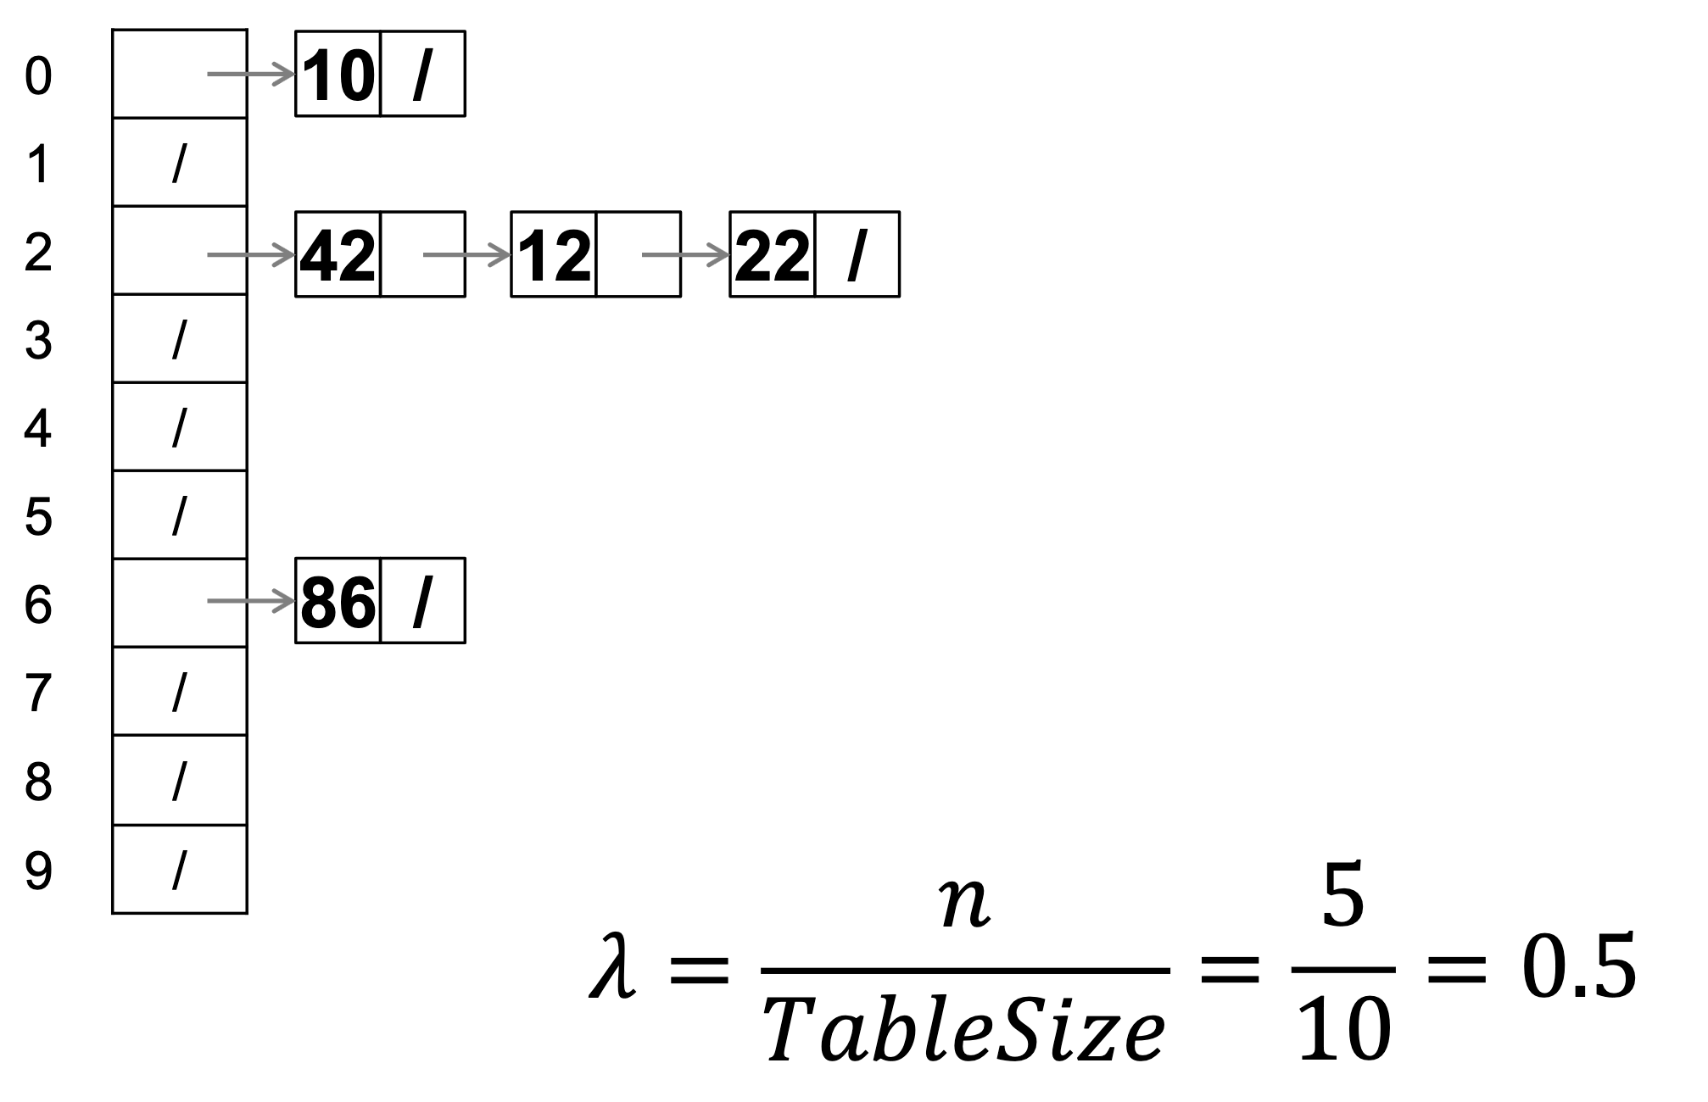
Load factor?

Slide 25
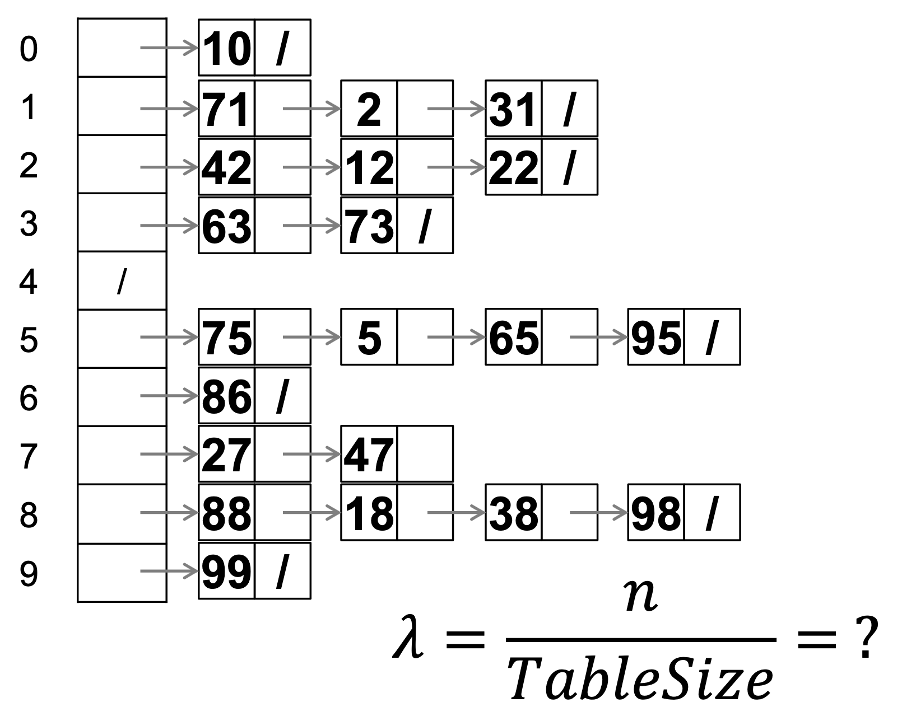
Load factor?

Slide 26
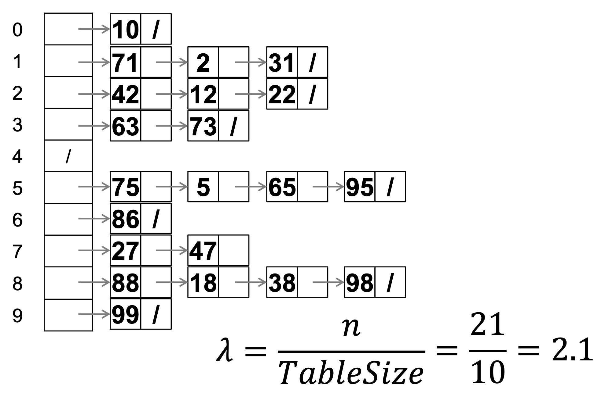
Load factor?

