Slide 1
CSE 332
Data Structures & Parallelism
B Trees 2
Melissa Winstanley
Spring 2024
Notes:
B Trees do NOT have better big-O runtime. But they have good constant factors

Slide 2
Question Time
One of the assumptions that Big-Oh makes is that all operations take the same amount of time.
Is that really true?

Slide 3
A Typical Memory Hierarchy
“Every desktop/laptop/server is different” but here’s a plausible configuration
CPU
instructions (eg addition): 2³⁰/sec
L1 cache: 128KB = 2¹⁷
get data in L1: 2²⁹/sec = 2 instructions
L2 cache: 2MB = 2²¹
get data in L2: 2²⁵/sec = 30 instructions
Main memory: 2GB = 2³¹
get data in main memory: 2²²/sec = 250 instructions
Disk: 1TB = 2⁴⁰
get data from “new place” on disk:
2⁷/sec = 8,000,000 instructions

Slide 4
“Fuggedaboutit”, usually
The hardware automatically moves data into the caches from main memory for you
Replacing items already there
So algorithms much faster if “data fits in cache” (often does)
Disk accesses are done by software (e.g., ask operating system to open a file or database to access some data)
So most code “just runs” but sometimes it’s worth designing algorithms / data structures with knowledge of memory hierarchy
And when you do, you often need to know one more thing…

Slide 5
How does data move up the hierarchy?
Moving data up the memory hierarchy is slow because of latency (think distance-to-travel)
Since we’re making the trip anyway, may as well carpool
Get a block of data in the same time it would take to get a byte
Sends nearby memory because:
It’s easy
And likely to be asked for soon
Side note: Once a value is in cache, may as well keep it around for awhile; accessed once, a particular value is more likely to be accessed again in the near future (more likely than some random other value)
Spatial locality
Temporal locality

Slide 6
Locality
Temporal Locality (locality in time) – If an address is referenced, it will tend to be referenced again soon.
Eg a loop index, size field of a data structure
Spatial Locality (locality in space) – If an address is referenced, addresses that are close by will tend to be referenced soon.
Eg elements in an array
Notes:
Examples?

Slide 7
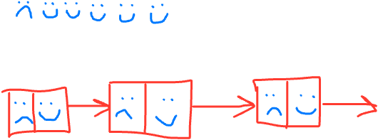
Arrays vs Linked lists
Which has the potential to best take advantage of spatial locality?
Notes:
Smiley faces for access

Slide 8
Block/line size
The amount of data moved from disk into memory is called the “block” size or the “page” size
Not under program control
The amount of data moved from memory into cache is called the cache “line” size
Not under program control

Slide 9
BSTs?
Looking things up in balanced binary search trees is O(log n), so even for n = 2³⁹ (512GB) we need not worry about minutes or hours
Still, number of disk accesses matters:
Pretend for a minute we had an AVL tree of height 55
The total number of nodes could be?_________
Most of the nodes will be on disk: the tree is shallow, but it is still many gigabytes big so the entire tree cannot fit in memory
Even if memory holds the first 25 nodes on our path, we still potentially need 30 disk accesses if we are traversing the entire height of the tree.

Slide 10
Note about numbers
Note: All the numbers in this lecture are “ballpark” “back of the envelope” figures
Moral: Even if they are off by, say, a factor of 5, the moral is the same:
If your data structure is mostly on disk, you want to minimize disk accesses
A better data structure in this setting would exploit the block size and relatively fast memory access to avoid disk accesses…

Slide 11
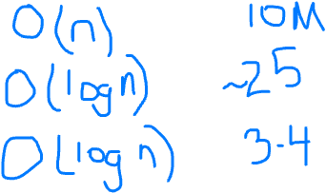
Trees as Dictionaries
(N = 10 million) [Example from Weiss]
In worst case, each node access is a disk access, number of accesses:
Worst case big-O # Disk accesses
BST
AVL
B Tree
Notes:
log(10M) => 25 ish
# disk access is actually less for B Trees

Slide 12
Our goal
Problem: A dictionary with so much data most of it is on disk
Desire: A balanced tree (logarithmic height) that is even shallower than AVL trees so that we can minimize disk accesses and exploit disk-block size
A key idea: Increase the branching factor of our tree

Slide 13
M-ary Search Tree
Build some sort of search tree with branching factor M:
Have an array of sorted children (Node[])
Choose M to fit snugly into a disk block (1 access for array)
Perfect tree of height h has (M^{h+1}-1)/(M-1) nodes (textbook, page 4)
What is the height of this tree?
What is the worst case running time of find?

Slide 14
Complexity of Find in M-ary Search Tree
How many hops?
How much work at each level? (find which child to take)
Overall complexity?

Slide 15
Questions about M-ary search trees
2
Data
What should the order property be?
How would you rebalance (ideally without more disk accesses)?
Storing real data at inner-nodes (like we do in a BST) seems kind of wasteful…
To access the node, will have to load the data from disk, even though most of the time we won’t use it!!
Usually we are just “passing through” a node on the way to the value we are actually looking for.
So let’s use the branching-factor idea, but for a different kind of balanced tree:
Not a binary search tree
But still logarithmic height for any M > 2
1
Data
6
Data
4
Data
5
Data

Slide 16
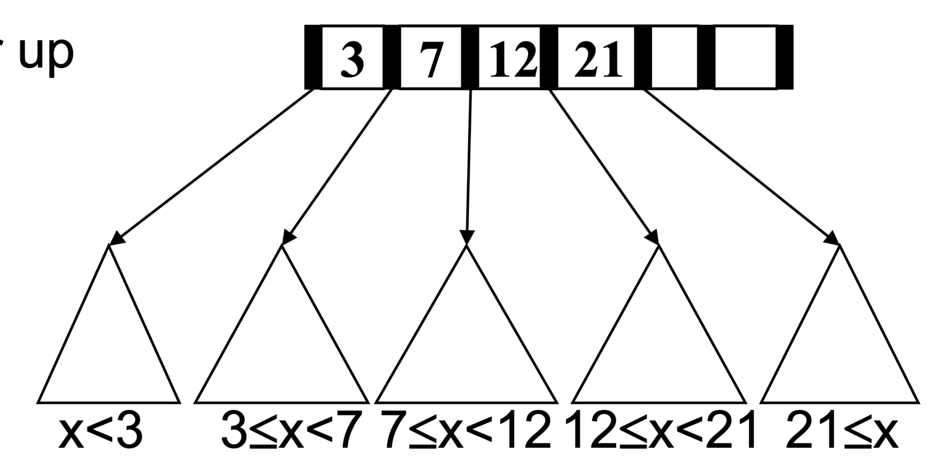
B+ Trees (we and the book say “B Trees”)
Two types of nodes: internal nodes & leaves
Each internal node has room for up to M-1 keys and M children
No other data; all data at the leaves!
Order property: Subtree between keys a and b contains only data that is ≥ a and < b (notice the ≥)
Leaf nodes have up to L sorted data items
As usual, we’ll ignore the “along for the ride” data

Slide 17
B Trees: Leaves vs Internal Nodes
Remember:
Leaves store data
Internal nodes are ‘signposts’
There are different ways to implement these - pay attention to how we talk about them!

Slide 18
Find
Different from BST in that we don’t store data at internal nodes
But find is still an easy root-to-leaf recursive algorithm
At each internal node do binary search on (up to) M-1 keys to find the branch to take
At the leaf do binary search on the (up to) L data items
But to get logarithmic running time, we need a balance condition…

Slide 19
B Tree Structure Properties
Internal nodes
Have between ⌈M/2⌉ and M children, i.e., at least half full
Leaf nodes
All leaves at the same depth
Have between ⌈L/2⌉ and L data items, i.e., at least half full
Root (special case)
If tree has ≤ L items, root is a leaf (occurs when starting up, otherwise unusual)
Else has between 2 and M children
Any M > 2 and L will work, but: We pick M and L based on disk-block size

Slide 20
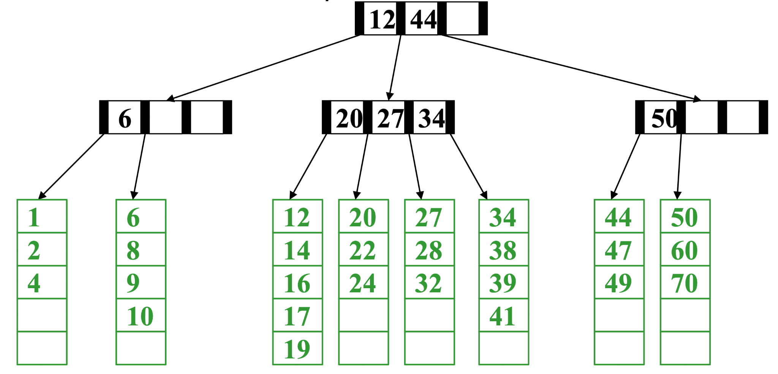
Example
Note on notation: Inner nodes drawn horizontally,
leaves vertically to distinguish. Include empty cells
Suppose M=4 (max # pointers in internal node) and L=5 (max # data items at leaf)
All internal nodes have at least 2 children
All leaves have at least 3 data items (only keys here)
All leaves at same depth
find(28)
How many disk blocks did we touch?

Slide 23
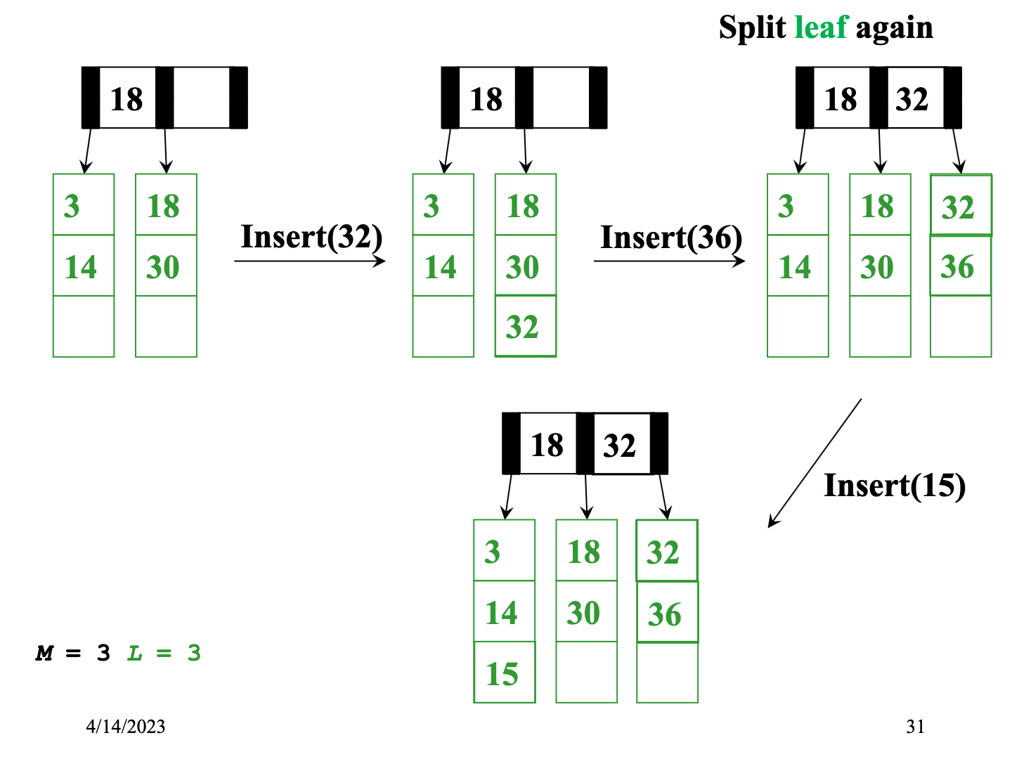

Slide 24
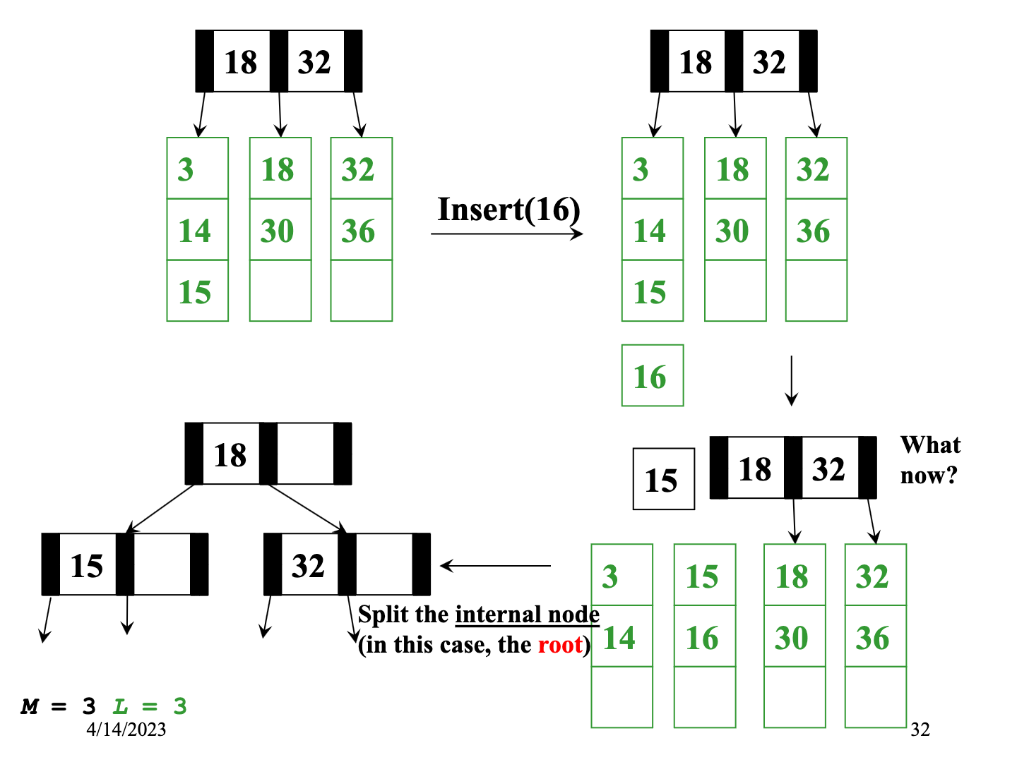

Slide 25
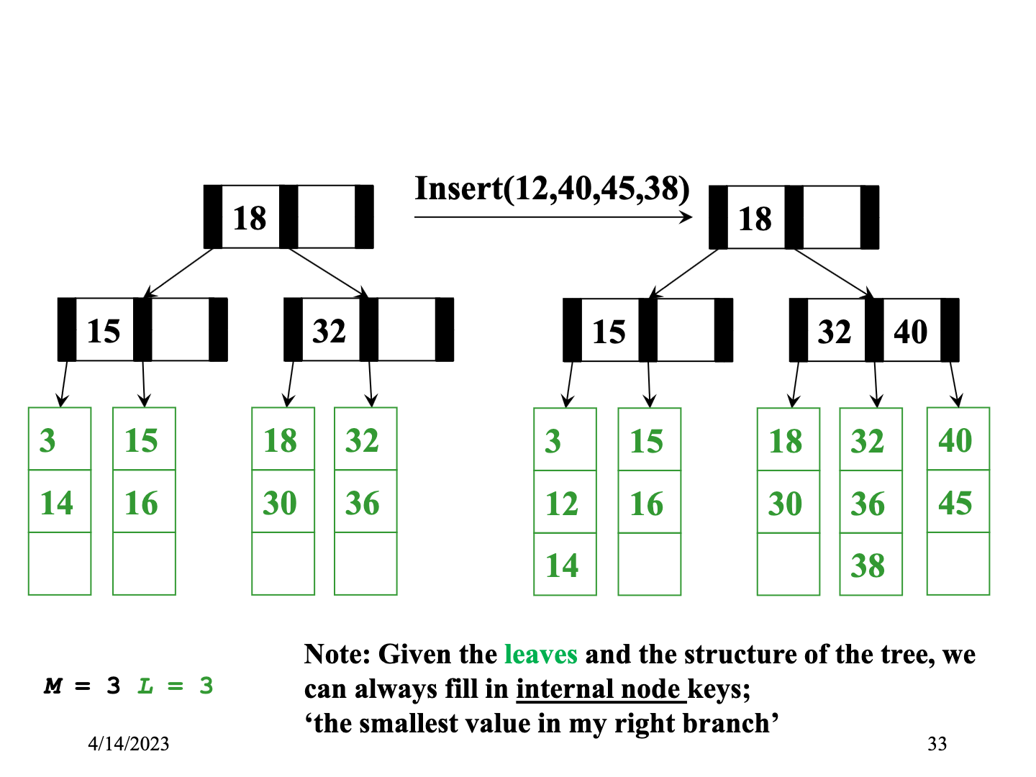

Slide 26
Insertion Algorithm
Insert the data in its leaf in sorted order
If the leaf now has L+1 items, overflow!
Split the leaf into two nodes:
Original leaf with ⌈(L+1)/2⌉ smaller items
New leaf with ⌊(L+1)/2⌋ = ⌈L/2⌉ larger items
Attach the new child to the parent
Adding new key to parent in sorted order

Slide 27
Insertion Algorithm continued
If step (2) caused the internal node parent to have M+1 children,
Split the node into two nodes
Original node with ⌈(M+1)/2⌉ smaller items
New node with ⌊(M+1)/2⌋ = ⌈M/2⌉ larger items
Attach the new child to the parent
Adding new key to parent in sorted order
Splitting at a node (step 3) could make the parent overflow too
So repeat step 3 up the tree until a node doesn’t overflow
If the root overflows, make a new root with two children
This is the only case that increases the tree height

Slide 28
Worst-Case Efficiency of Insert
Find correct leaf: O(log₂M log_{M}n)
Insert in leaf: O(L)
Split leaf: O(L)
Split parents all the way up to root: O(M log_{M}n)
Total: O(L + M log_{M}n)
But it’s not that bad:
Splits are not that common (M & L are likely to be large)
Disk accesses are the name of the game: O(log_{M}n)

Slide 29
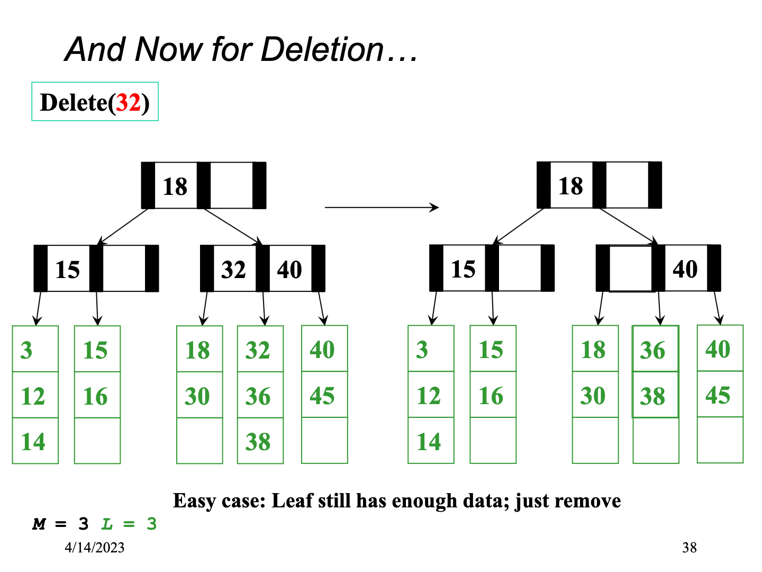

Slide 30
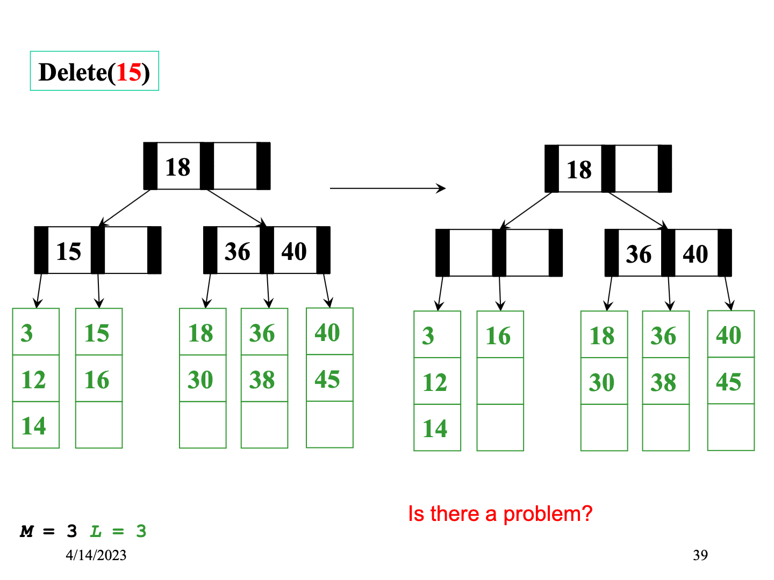

Slide 31
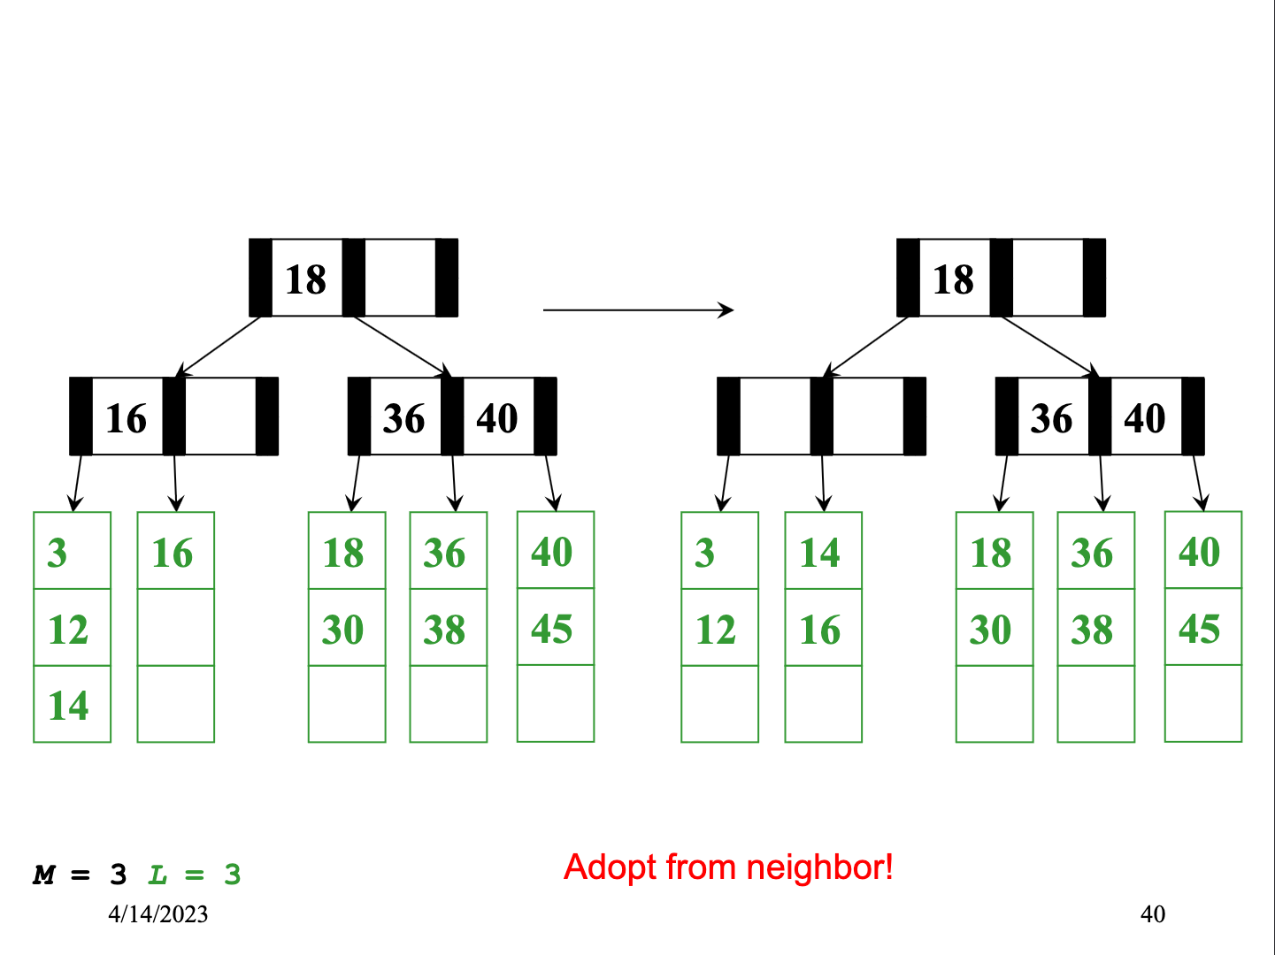

Slide 32
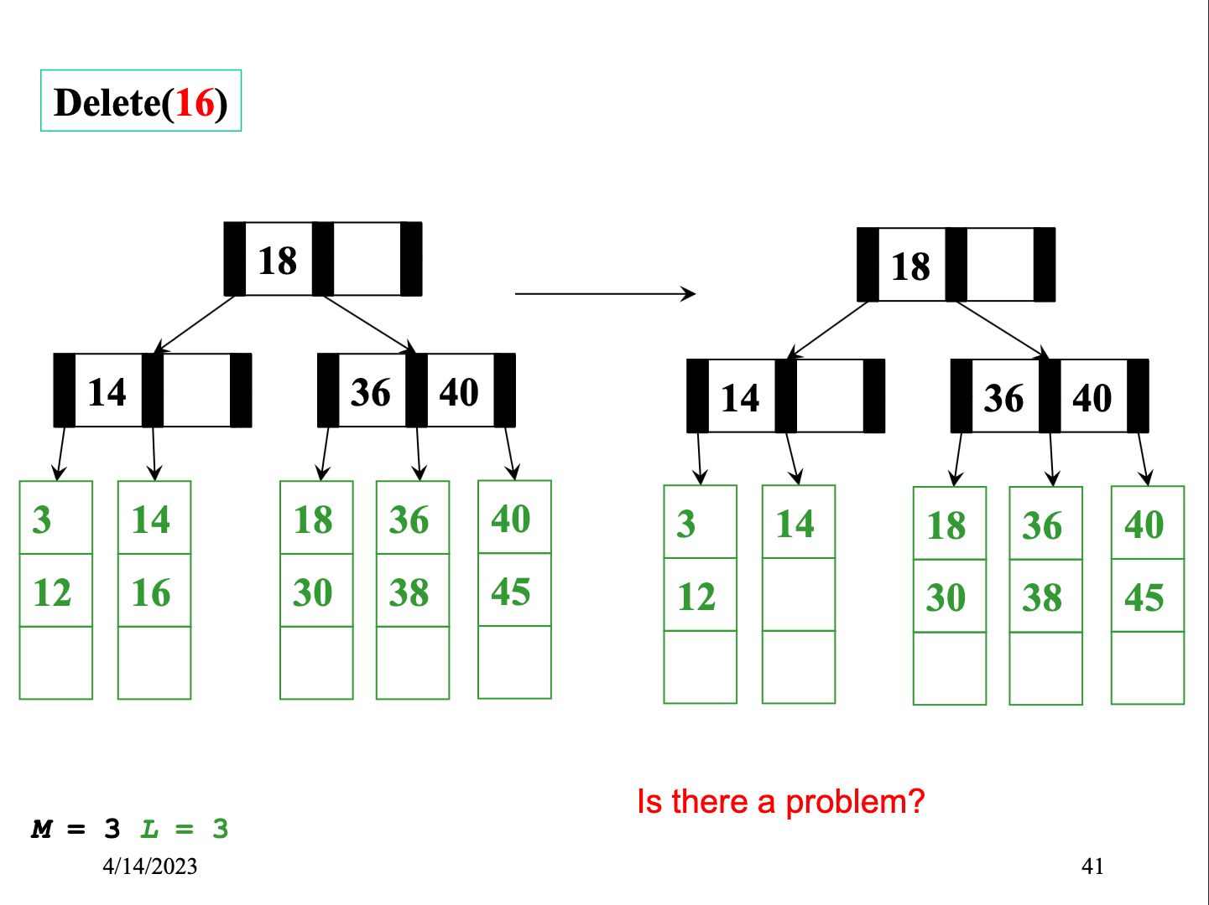

Slide 33
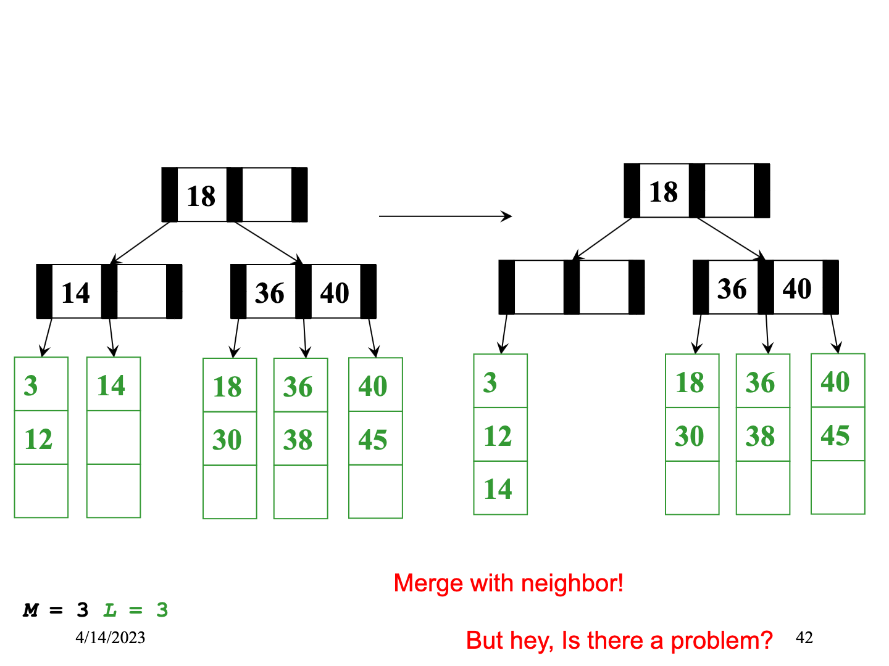

Slide 34
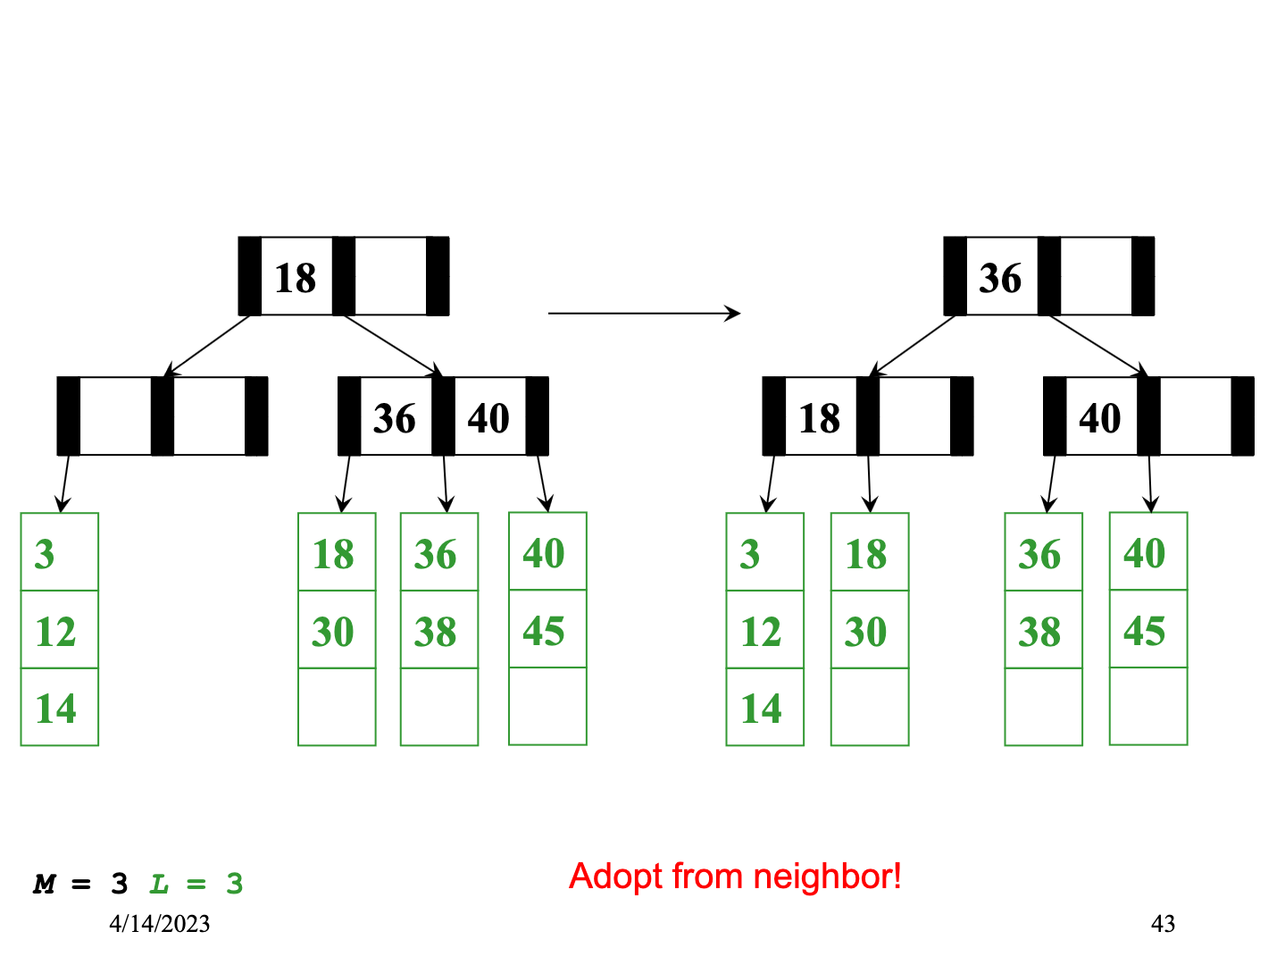

Slide 35
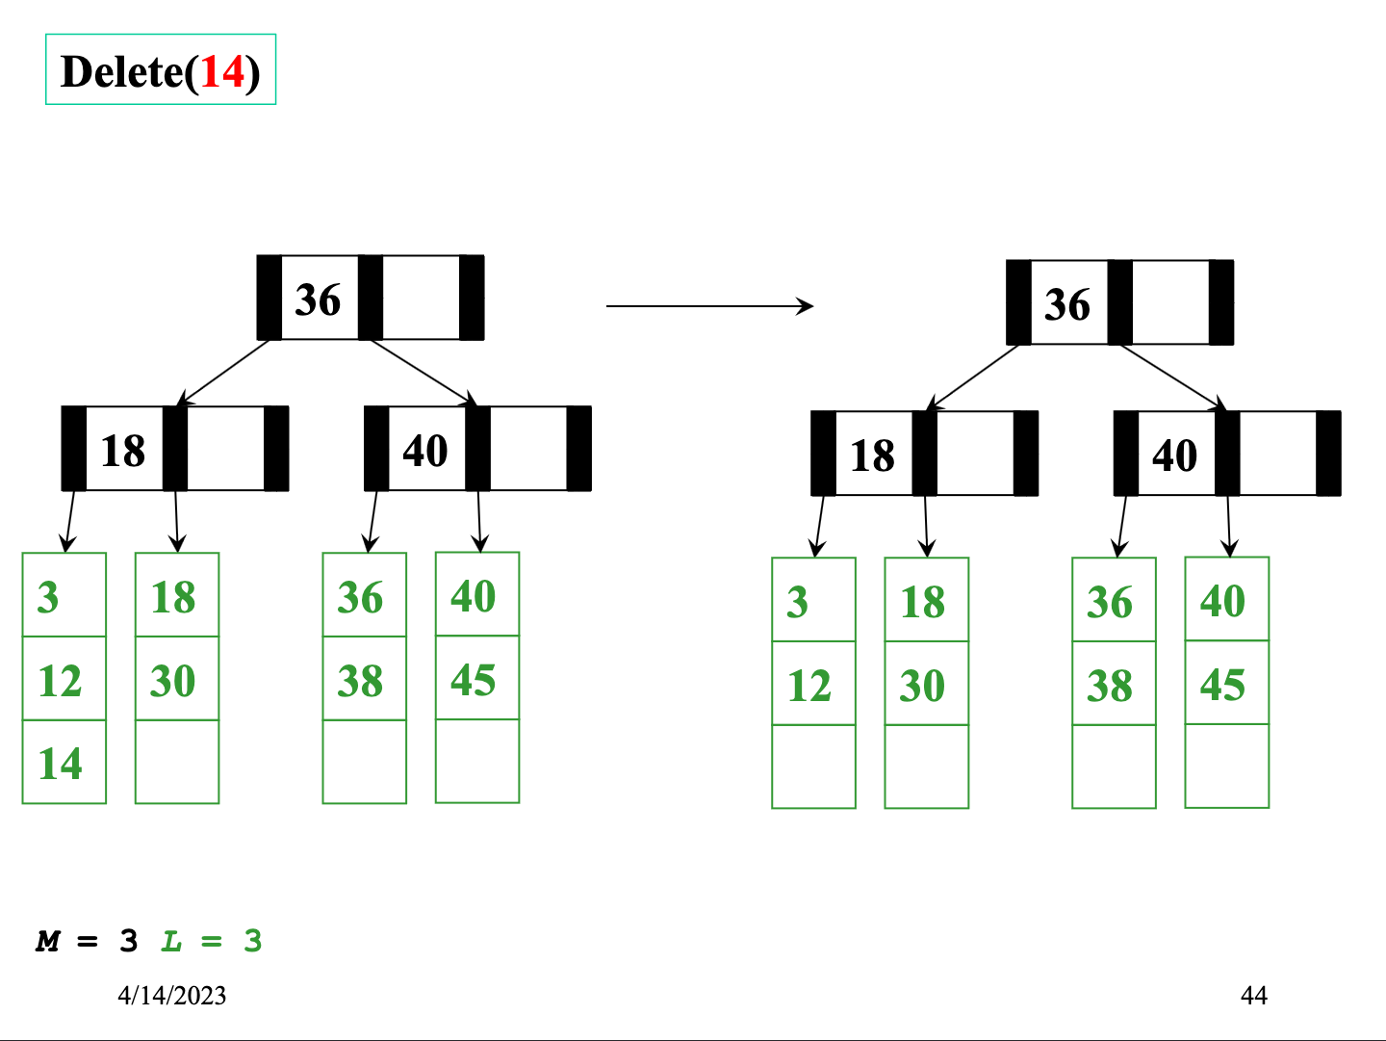

Slide 36
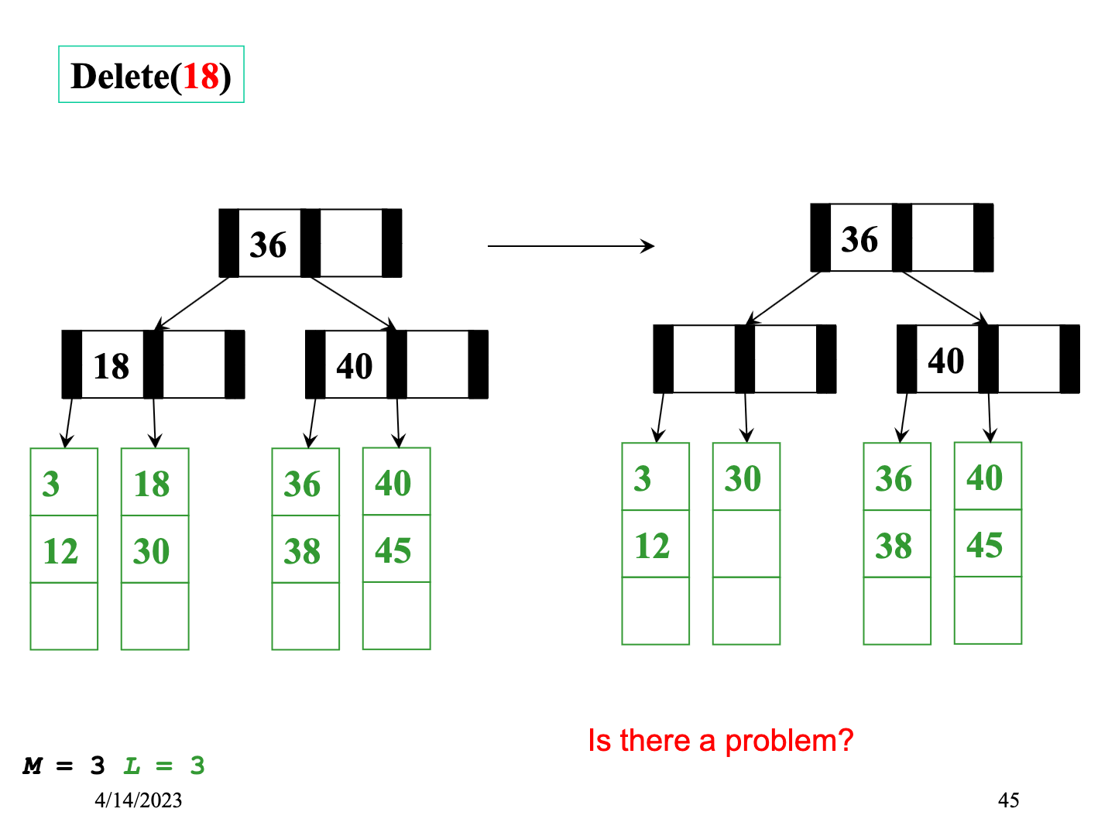

Slide 37
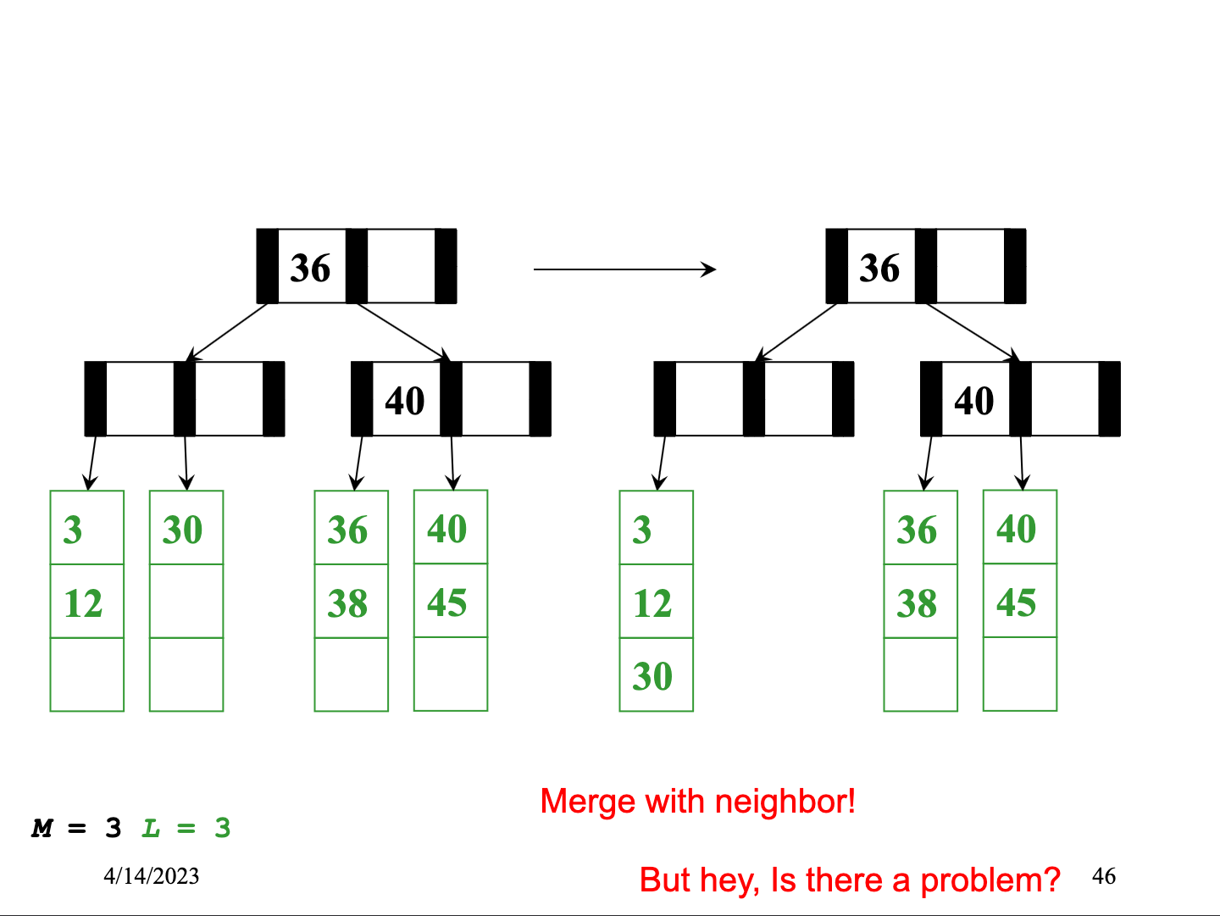

Slide 38
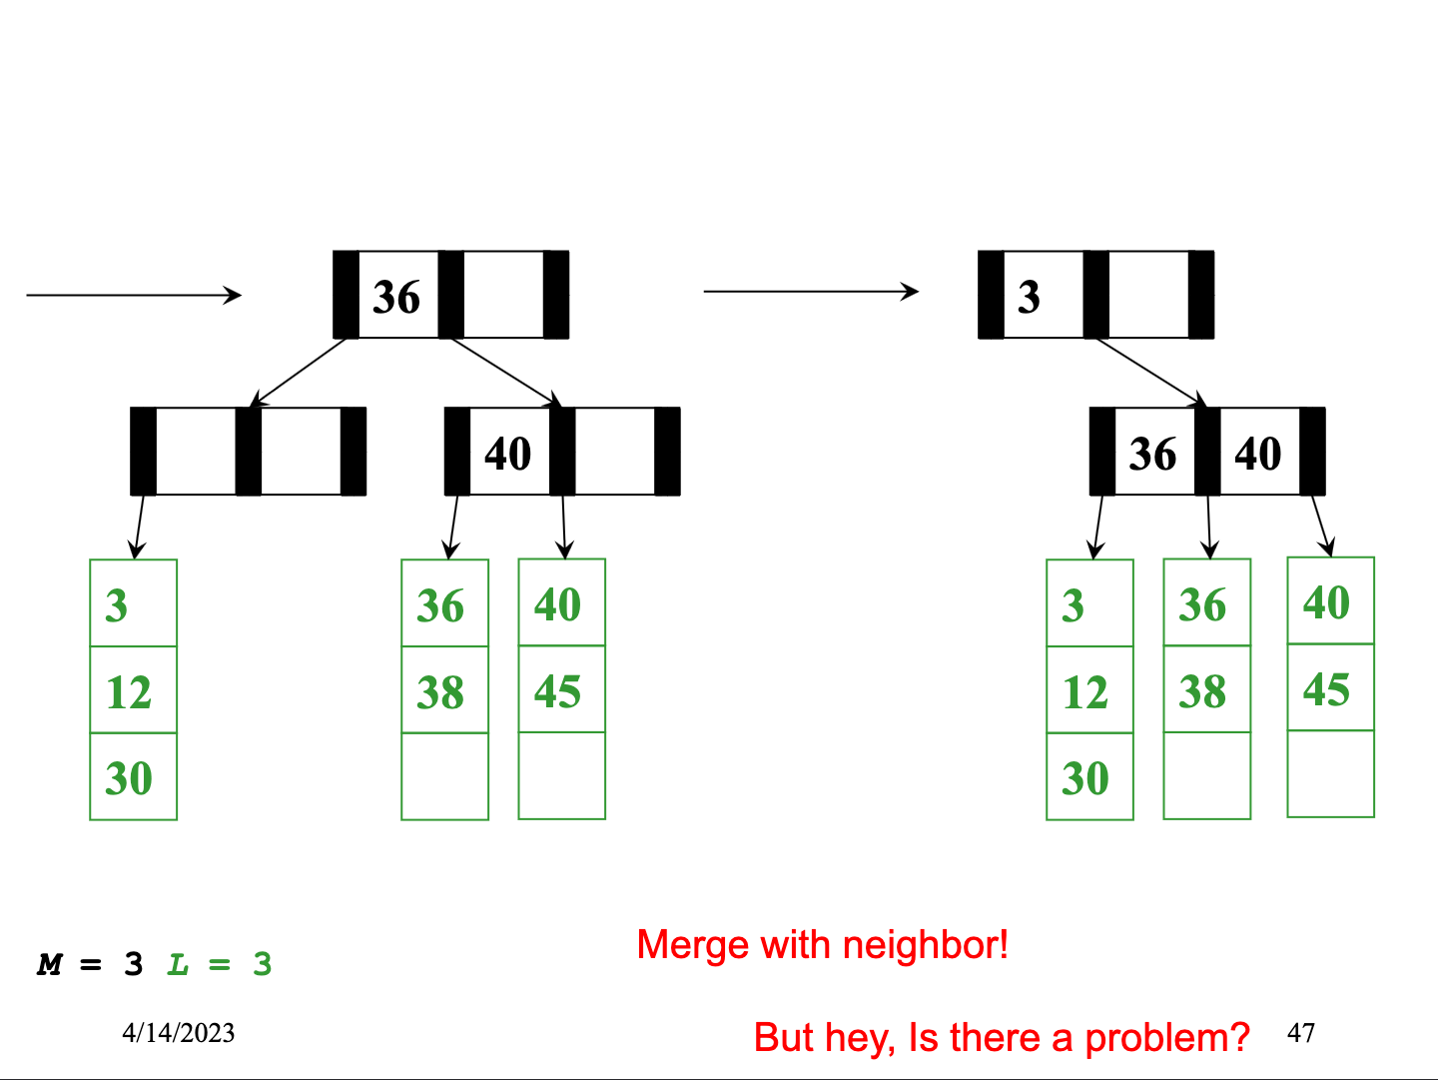

Slide 39
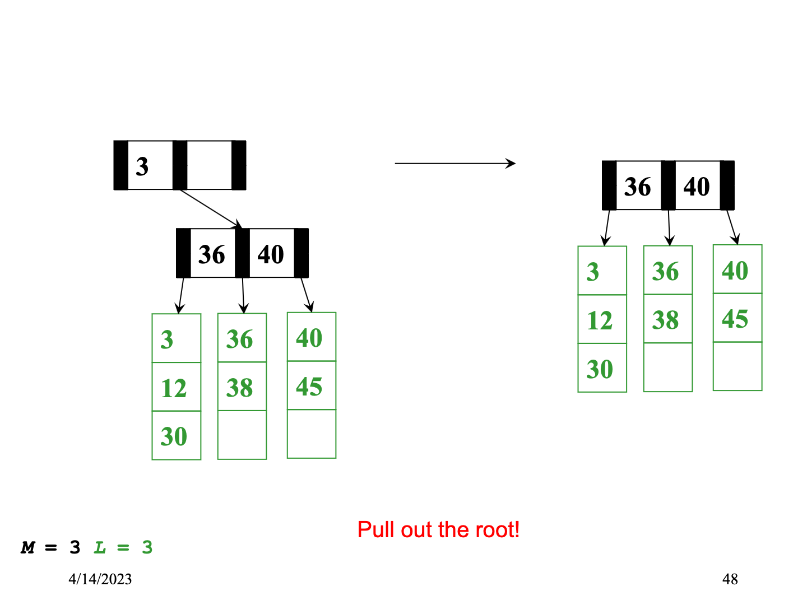

Slide 40
Deletion Algorithm
Remove the data from its leaf
If the leaf now has ⌈L/2⌉-1 items, underflow!
If a neighbor has > ⌈L/2⌉ items, adopt and update parent
Else merge node with neighbor
Guaranteed to have a legal number of items
Parent now has one less node

Slide 41
Deletion Algorithm continued
If step (2) caused the internal node parent to have ⌈M/2⌉-1 children, underflow!
If a neighbor has > ⌈M/2⌉ items, adopt and update parent
Else merge node with neighbor
Guaranteed to have a legal number of items
Parent now has one less node
Merging at a node (step 3) could make the parent underflow too
So repeat step 3 up the tree until a node doesn’t underflow
If the root went from 2 children to 1, delete the root and make the child the root
This is the only case that decreases the tree height

Slide 42
Worst-Case Efficiency of Delete
Find correct leaf: O(log₂M log_{M}n)
Remove from leaf: O(L)
Adopt from or merge with neighbor: O(L)
Adopt or merge all the way up to root: O(M log_{M}n)
Total: O(L + M log_{M}n)
But it’s not that bad:
Merges are not that common
Disk accesses are the name of the game: O(log_{M}n)

Slide 43
Determining M & L
Determining M: how many interior nodes can fit?
Each interior node has M pointers and M-1 keys.
1024 ≥ 4M + 8(M-1)
1024 ≥ 4M + 8M - 8
1024 ≥ 12M - 8
1024+8 ≥ 12M
1032/12 ≥ M
M = 86
Say:
1 disk block = 1024 bytes Key = 8 bytes Pointer = 4 bytes Data(K, V) = 500 bytes (includes key)
Determining L: How much data can fit?
L = 1024 / 500 = about 2

Slide 44
Naïve approach in Java
interface Keyed {
int getKey();
}
class BTreeNode<E implements Keyed> {
static final int M = 128;
int[] keys = new int[M-1];
BTreeNode<E>[] children = new BTreeNode[M];
int numChildren = 0;
}
class BTreeLeaf<E implements Keyed> {
static final int L = 32;
E[] data = (E[])new Object[L];
int numItems = 0;
}
Even if we assume data items have int keys, you cannot get the data representation you want for “really big data”

Slide 45
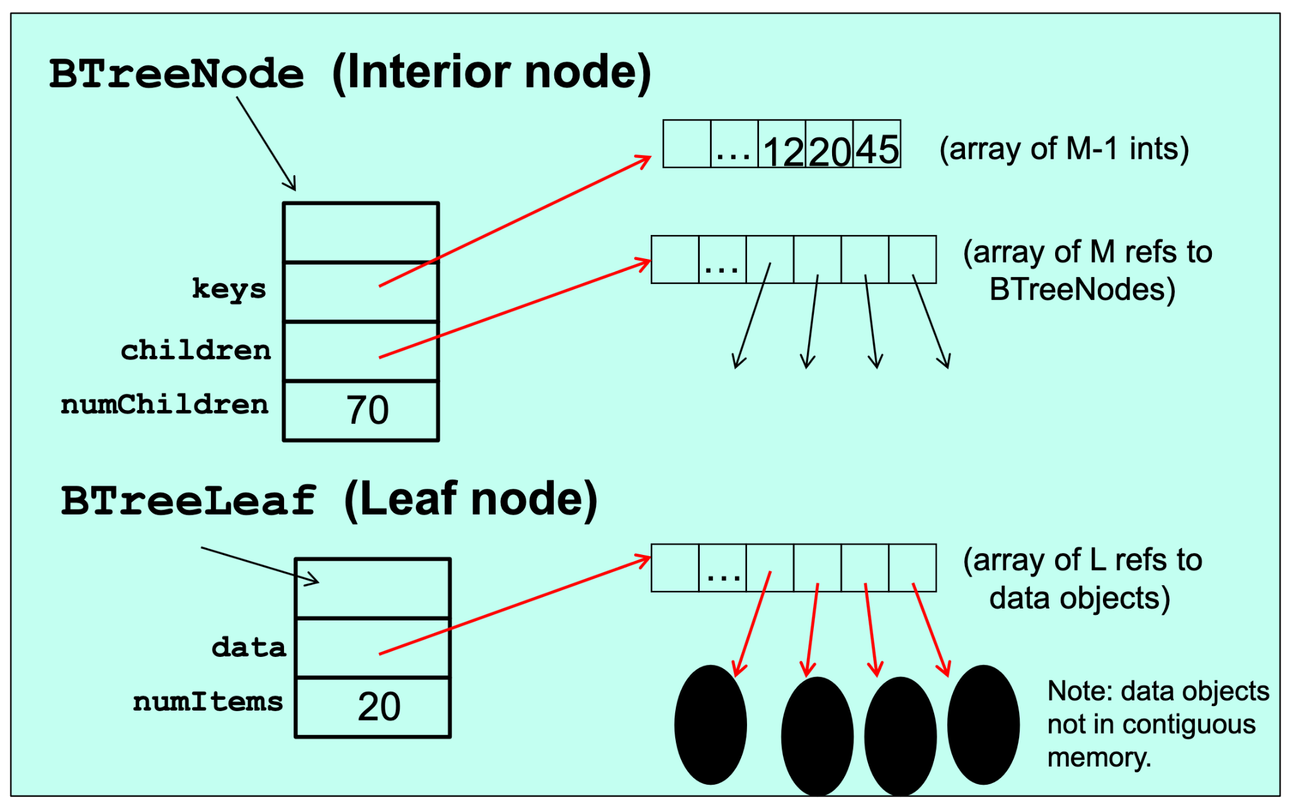
What that looks like in Java
All the red references indicate “unnecessary” indirection that might be avoided in another programming language.

Slide 46
The moral
The whole idea behind B trees was to keep related data in contiguous memory
But that’s “the best you can do” in Java
Again, the advantage is generic, reusable code
But for your performance-critical web-index, not the way to implement your B-Tree for terabytes of data
Other languages (e.g., C++) have better support for “flattening objects into arrays”
Levels of indirection matter!

Slide 47
Conclusion: Balanced Trees
Balanced trees make good dictionaries because they guarantee logarithmic-time find, insert, and delete
Essential and beautiful computer science
But only if you can maintain balance within the time bound
AVL trees maintain balance by tracking height and allowing all children to differ in height by at most 1
B trees maintain balance by keeping nodes at least half full and all leaves at same height
Other great balanced trees (see text; worth knowing they exist)
Red-black trees: all leaves have depth within a factor of 2
Splay trees: self-adjusting; amortized guarantee; no extra space for height information

