Slide 1
CSE 332
Data Structures & Parallelism
AVL Trees
Melissa Winstanley
Spring 2024

Slide 2
Class Updates
P1 due tomorrow night!
No more than 2 late days can be used on this project
Optional: submit to the hidden test runner to get faster feedback on your P1 (before the TAs finish grading) - linked from the course website
Ex1 grades released
Regrades: open after 48 hours, until 1 week from today
P2 released tomorrow
You already know everything for the first checkpoint!

Slide 3
Balanced BST
Observation:
BST: the shallower the better!
For a BST with n nodes inserted in arbitrary order
Average height is O(log n) – see text for proof
Worst case height is O(n)
Simple cases such as inserting in key order lead to the worst-case scenario
Solution: Require a Balance Condition that
ensures depth is always O(log n) – strong enough!
is easy to maintain – not too strong!

Slide 4
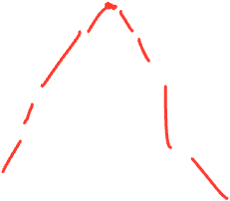
Potential Balance Conditions
Left and right subtrees of the root have equal number of nodes
Left and right subtrees of the root have equal height

Slide 5
Potential Balance Conditions
3. Left and right subtrees of every node have equal number of nodes
4. Left and right subtrees of every node have equal height

Slide 6
The AVL Balance Condition
Left and right subtrees of every node have heights differing by at most 1
Definition: balance(node) = height(node.left) – height(node.right)
AVL property: for every node x, –1 ≤ balance(x) ≤ 1
Ensures small depth
We will prove this by showing that an AVL tree of height h must have a number of nodes exponential in h
Easy (well, efficient) to maintain
Using single and double rotations

Slide 7
The AVL Tree Data Structure
Structural properties
Binary tree property (0,1, or 2 children)
Heights of left and right subtrees of every node differ by at most 1
Result: Worst case depth of any node is: O(log n)
Ordering property:
Same as for BST
8
5
11
2
6
10
13
4
7
9
12
14
15

Slide 8
Ex1: An AVL tree?
6
4
8
1
7
11
10
12

Slide 9
Ex2: An AVL tree?
6
4
8
1
5
7
11
3
2

Slide 10
Ex3: An AVL tree?
5
2
8
1
3
6
11
4
7

Slide 11
An AVL Tree
5
key
5
...
value
2
8
3
height
children
1
3
6
11
4
7

Slide 12
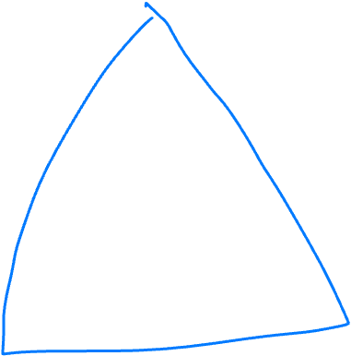
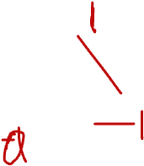
An insert case
6
6
Insert(2)
4
8
4
8
1
5
7
11
1
5
7
11
3
What is the minimum number of changes we could make to make this tree valid?
3
2

Slide 13
AVL tree operations
AVL find:
Same as BST find
AVL insert:
First BST insert, then check balance and potentially “fix” the AVL tree
Four different imbalance cases
AVL delete:
The “easy way” is lazy deletion
Otherwise, like insert we do the deletion and then have several imbalance cases

Slide 14
AVL tree insert
b
Let b be the node where an imbalance occurs.
Four cases to consider. The insertion is in the
left subtree of the left child of b.
right subtree of the left child of b.
left subtree of the right child of b.
right subtree of the right child of b.
Idea: Cases 1 & 4 are solved by a single rotation.
Cases 2 & 3 are solved by a double rotation.
a
c
X
U
V
Z
1 2 3 4

Slide 15
Insert: detect potential imbalance
Insert the new node as in a BST (a new leaf)
For each node on the path from the root to the new leaf, the insertion may (or may not) have changed the node’s height
So after recursive insertion in a subtree, detect height imbalance and perform a rotation to restore balance at that node
All the action is in defining the correct rotations to restore balance
Fact that makes it a bit easier:
There must be a deepest element that is imbalanced after the insert
After rebalancing this deepest node, every node is balanced
So at most one node needs to be rebalanced

Slide 16
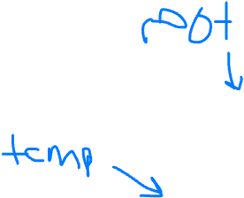
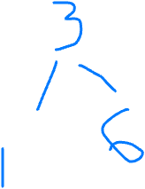
Case #1 Example
Insert(6)
Insert(3)
Insert(1)

Slide 17
Case #1 Example
6
0
6
1
6
2
Insert(6)
Insert(3)
Insert(1)
Third insertion violates balance property
Happens to be at the root
What is the only way to fix this?
3
0
3
1
0
1

Slide 18
Fix: Apply “Single Rotation”
Single rotation: The basic operation we’ll use to rebalance
Move child of unbalanced node into parent position
Parent becomes the “other” child (always okay in a BST!)
Other subtrees move in only way BST allows (next slide)
Single Rotation:
Rotate between self and child
6
2
3
1
3
1
0
0
0
1
6
1

Slide 19
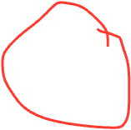
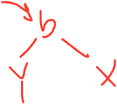
Single Rotation Pseudo-Code
root
b
void RotateWithLeft(Node root) {
Node temp = root.left
root.left = temp.right
temp.right = root
root.height = max(root.right.height(),
root.left.height()) + 1
temp.height = max(temp.right.height(),
temp.left.height()) + 1
root = temp
}
temp
a
X
Z
Y

Slide 20
The general left-left case
Node imbalanced due to insertion somewhere in left-left grandchild increasing height
This is 1 of 4 possible imbalance causes (other three coming)
So we rotate at b, using BST facts: X < a < Y < b < Z
a
h+2
b
h+3
b
h+1
h+2
a
Z
h
X
h+1
X
Y
Y
Z
h+1
h
h
h

Slide 21
Case #3 Example
Insert(1)
Insert(6)
Insert(3)

Slide 22
Two cases to go
Unfortunately, single rotations are not enough for insertions in the left-right subtree or the right-left subtree
First wrong idea: single rotation like we did for left-left
1
2
6
1
6
1
1
0
3
0
3
0

Slide 23
Two cases to go
Unfortunately, single rotations are not enough for insertions in the left-right subtree or the right-left subtree
Second wrong idea: single rotation on the child of the unbalanced node
1
2
1
2
6
3
1
1
3
0
0
6

Slide 24
Sometimes two wrongs make a right
First idea violated the BST property
Second idea didn’t fix balance
But if we do both single rotations, starting with the second, it works! (And not just for this example)
Double Rotation:
Rotate problematic child and grandchild
Rotate between self and new child
1
2
2
1
3
1
6
3
1
1
0
0
1
6
3
0
6
0

Slide 25
Double Rotation Pseudo-Code
void DoubleRotateWithRight(Node root) {
RotateWithLeft(root.right)
RotateWithRight(root)
}
After First Rotation
a
a
Z
c
Z
b
b
c
W
W
Y
X
Y
X

Slide 26
Double Rotation Completed
After First Rotation
After Second Rotation
a
b
Z
b
a
c
c
Z
W
W
Y
X
Y
X

Slide 27
Insert, Summarized
Insert as in a BST
Check back up path for imbalance, which will be 1 of 4 cases:
node’s left-left grandchild is too tall
node’s left-right grandchild is too tall
node’s right-left grandchild is too tall
node’s right-right grandchild is too tall
Only one case occurs because tree was balanced before insert
After the appropriate single or double rotation, the smallest-unbalanced subtree has the same height as before the insertion
So all ancestors are now balanced

Slide 28
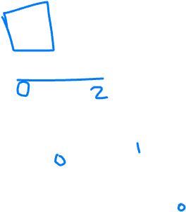
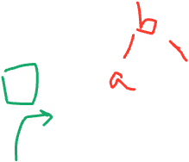
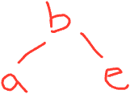
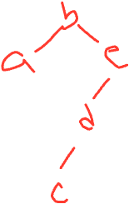
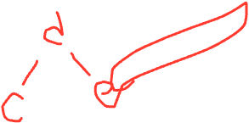
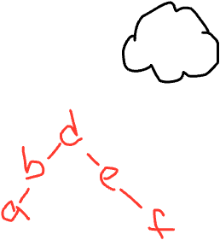
Insert into an AVL tree: a b e c d
(if you have time, add f)

Slide 29
Height of an AVL tree?
height | Minimal AVL Tree | Number of nodes
0
1
2
3

Slide 30
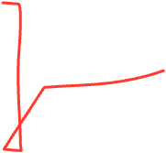
Height of an AVL tree?
Using the AVL balance property, we can determine the minimum number of nodes in an AVL tree of height h
Let S(h) be the minimum # of nodes in an AVL tree of height h, then:
S(h) = S(h-1) + S(h-2) + 1
S(0) = 1
S(1) = 2
Notes:
What does this remind you of? Fibonacci!

Slide 31
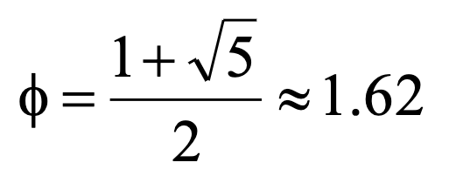
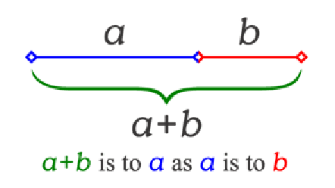
The Golden Ratio
This is a special number
Aside: Since the Renaissance, many artists and architects have proportioned their work (e.g., length:height) to approximate the golden ratio: If (a+b)/a = a/b, then a = ϕb
We will need one special arithmetic fact about ϕ:
ϕ² = ((1+5^{1/2})/2)²
= (1 + 2*5^{1/2} + 5)/4
= (6 + 2*5^{1/2})/4
= (3 + 5^{1/2})/2
= 1 + (1 + 5^{1/2})/2
= 1 + ϕ

Slide 32
The Proof
Theorem: For all h ≥ 0, S(h) > ϕ^{h} – 1
Proof: By induction on h
Base cases:
S(0) = 1 : 1 > ϕ⁰ – 1
1 > 1 - 1
1 > 0
S(1) = 2 : 2 > ϕ¹ – 1
2 > approx 0.62

Slide 33
The Proof
Inductive case (k > 1): Show S(k+1) > ϕ^{k+1} – 1 assuming S(k) > ϕ^{k} – 1 and S(k-1) > ϕ^{k-1} – 1
S(k+1) = 1 + S(k) + S(k-1) by definition of S
> 1 + ϕ^{k} – 1 + ϕ^{k-1} – 1 by induction
= ϕ^{k} + ϕ^{k-1} – 1 by arithmetic (1-1=0)
= ϕ^{k-1} (ϕ + 1) – 1 by arithmetic (factor ϕ^{k-1} )
= ϕ^{k-1} ϕ² – 1 by special property of ϕ: ϕ² = 1 + ϕ
= ϕ^{k+1} – 1 by arithmetic (add exponents)

Slide 34
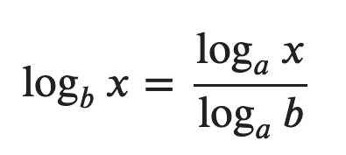
Good news
We know S(k) > ϕ^{k} – 1
Remember that S(h) represented the minimum number of nodes
Therefore in Big-O speak:
n > ϕ^{h} – 1
n > ϕ^{h}
log_{ϕ}(n) > h
Therefore the height of an AVL tree is bounded by log n - which means our find, insert and delete operations are all log n!

Slide 35
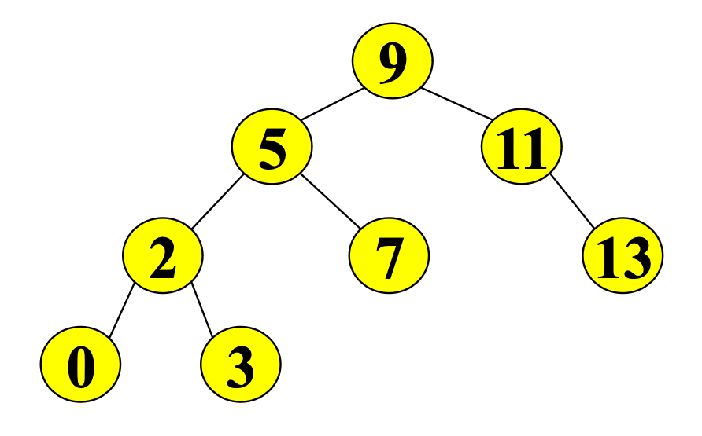
Exercise 4: Single and Double Rotations:
Inserting what integer values would cause the tree to need a:
Single rotation?
Double rotation?
No rotation?

