Slide 1
CSE 332
Data Structures & Parallelism
Priority Queues 2
Melissa Winstanley
Spring 2024

Slide 2
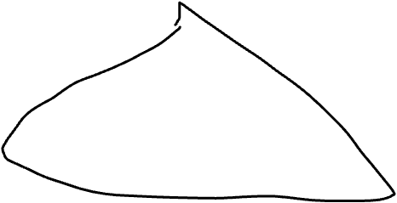
Types of Trees
Binary tree: Every node has ≤2 children
n-ary tree: Every node has ≤n children
Perfect tree: Every row is completely full
Complete tree: All rows except possibly the bottom are completely full, and it is filled from left to right
Notes:
What does this actually mean about the height of the tree?

Slide 3
Properties of a Binary Min-Heap
More commonly known as a binary heap or simply a heap
Structure Property
A complete [binary] tree
Heap Property
Every non-root node has a priority value larger than (or possibly equal to) the priority of its parent
How is this different from a binary search tree?
Notes:
First point is shape
Second point is about values

Slide 4
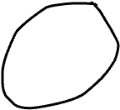
Properties of a Binary Min-Heap
More commonly known as a binary heap or simply a heap
Structure Property
A complete [binary] tree
Heap Property
Every non-root node has a priority value larger than (or possibly equal to) the priority of its parent
Notes:
First point is shape
Second point is about values
We don’t say anything about how the left child relates to the right child?

Slide 5
Is it a heap?
A B
C D
Is this a binary min heap? yes/no
3
5
5
4
1
6
3
5
4
6
7
6
5
8
9
Notes:
A - yes
B - no (wrong values)
C - yes
D - no (wrong shape)

Slide 6
Today - Priority Queues / Heaps
What is a Priority Queue?
Introduction to the heap
Heap operations
Heap implementation
Building a heap

Slide 7
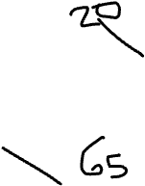
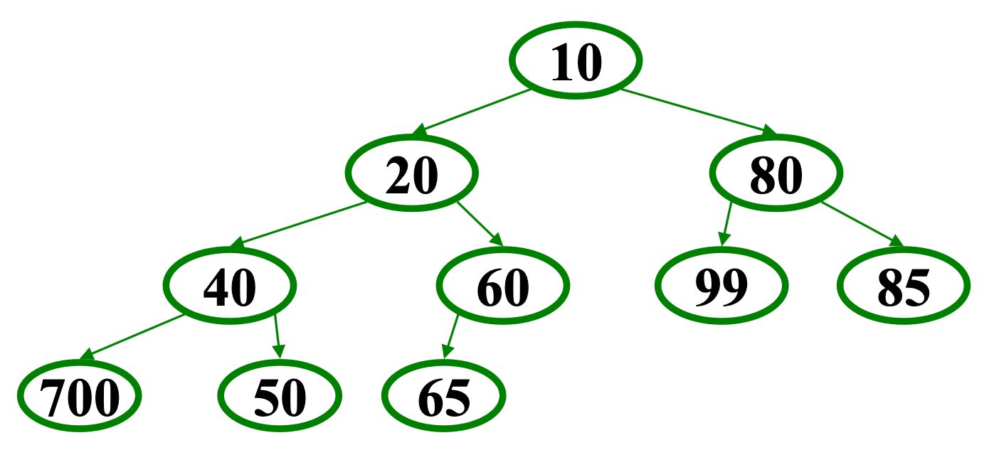
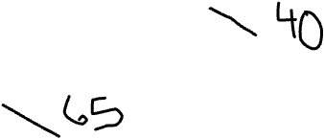
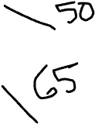
Heap Operations
findMin
insert(val): percolate up
deleteMin: percolate down
Notes:
Find min - where is it? The root!
Example: insert 16
What does the new shape look like?
Step 1: shape
Step 2: ordering
Example: deleteMin
What do we know about the shape? Move that last element to the root
Compare with BOTH children

Slide 8
Heap Operations
findMin
insert(val): percolate up
deleteMin: percolate down
Notes:
Find min - where is it? The root!
Example: insert 16
What does the new shape look like?
Step 1: shape
Step 2: ordering
Example: deleteMin
What do we know about the shape? Move that last element to the root
Compare with BOTH children

Slide 9
Operations: basic idea
findMin:
return root.data
deleteMin:
answer = root.data
Move right-most node in last row to root to restore structure property
“Percolate down” to restore heap order property
insert:
Put new node in next position on bottom row to restore structure property
“Percolate up” to restore heap order property
Overall strategy:
Preserve complete tree structure property
This may break heap order property
Percolate to restore heap order property

Slide 10
A Clever Trick for Storing the Heap
Clearly, insert and deleteMin are worst-case O(log n)
But we promised average-case O(1) insert (how??)
Insert requires access to the “next to use” position in the tree
Walking the tree from root to leaf requires O(log n) steps
insert and deleteMin would have to update the “next to use” reference each time: O(log n)
We should only pay for the functionality we need!!
Why have we insisted the tree be complete? ☺
All complete trees of size n contain the same edges
So why are we even representing the edges?
Here comes the really clever bit about implementing heaps!!!

Slide 11
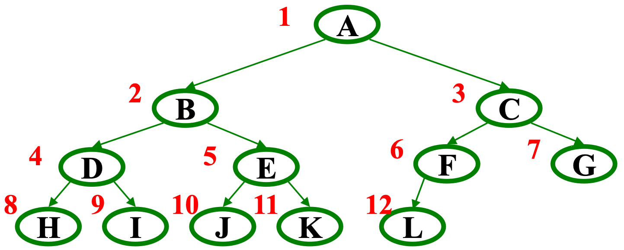
Array Representation of a Binary Heap
From node i:
left child:
right child:
parent:
We skip index 0 to make the math simpler
Actually, it can be a good place to store the current size of the heap
 | A | B | C | D | E | F | G | H | I | J | K | L
0 | 1 | 2 | 3 | 4 | 5 | 6 | 7 | 8 | 9 | 10 | 11 | 12 | 13
Notes:
Left: 2i
Right: 2i + 1
parent: floor(i/2)
Look mom, no pointers!

Slide 12
Today - Priority Queues / Heaps
What is a Priority Queue?
Introduction to the heap
Heap operations
Heap implementation
Building a heap

Slide 13
Pseudocode: insert
void insert(int val) {
if(size==arr.length-1)
resize();
size++;
i=percolateUp(size,val);
arr[i] = val;
}
int percolateUp(int hole,
int val) {
while(hole > 1 &&
val < arr[hole/2]){
arr[hole] = arr[hole/2];
hole = hole / 2;
}
return hole;
}
 | 10 | 20 | 80 | 40 | 60 | 99 | 85 | 700 | 50 | 65
0 | 1 | 2 | 3 | 4 | 5 | 6 | 7 | 8 | 9 | 10 | 11 | 12 | 13

Slide 14
Pseudocode: deleteMin
int percolateDown(int hole,
int val) {
while(2*hole <= size) {
left = 2*hole;
right = left + 1;
if(arr[left] < arr[right]
|| right > size)
target = left;
else
target = right;
if(arr[target] < val) {
arr[hole] = arr[target];
hole = target;
} else
break;
}
return hole;
}
int deleteMin() {
if(isEmpty()) throw…
ans = arr[1];
hole = percolateDown
(1,arr[size]);
arr[hole] = arr[size];
size--;
return ans;
}
 | 10 | 20 | 80 | 40 | 60 | 99 | 85 | 700 | 50 | 65
0 | 1 | 2 | 3 | 4 | 5 | 6 | 7 | 8 | 9 | 10 | 11 | 12 | 13

Slide 15
Example
16
4
4
4
16
32
32
16
32
16
32
16
1. Insert 16
2. Insert 32
3. Insert 4, percDown
57
4. Insert 57
57
80
Insert: 16, 32, 4, 57, 80, 43, 2
Then deleteMin
Do as a tree
What is the result?
5. Insert 80
7. Insert 2, percDown
6. Insert 43
8. deleteMin (2)
4
2
4
32
16
32
4
32
16
57
80
43
57
80
43
16
57
80
43
0 | 1 | 2 | 3 | 4 | 5 | 6 | 7

Slide 16
Other Operations
decreaseKey: given pointer to object in priority queue (e.g., its array index), lower its priority value by p
Change priority and percolate up
increaseKey: given pointer to object in priority queue (e.g., its array index), raise its priority value by p
Change priority and percolate down
remove: given pointer to object in priority queue (e.g., its array index), remove it from the queue
decreaseKey with p = ∞, then deleteMin
Running time for all these operations?

Slide 17
So why O(1) average-case insert?
Yes, insert's worst case is O(log n)
The trick is that it all depends on the order the items are inserted (What is the worst case order?)
Experimental studies of randomly ordered inputs shows the following:
Average 2.607 comparisons per insert (# of percolation passes)
An element usually moves up 1.607 levels
deleteMin is average O(log n)
Moving a leaf to the root usually requires re-percolating that value back to the bottom

Slide 18
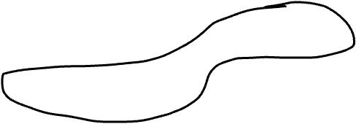
Intuition for O(1) runtime average case
Insert: Place in next spot, percUp
How high do we expect it to go?
Aside: Complete Binary Tree
Each full row has 2x nodes of parent row
Bottom level has ~1/2 of all nodes
Second to bottom has ~1/4 of all nodes
PercUp Intuition:
Move up if value is less than parent
Inserting a random value, likely to have value not near highest, nor lowest; somewhere in middle
Given a random distribution of values in the heap, bottom row should have the upper half of values, 2nd from bottom row, next 1/4
Expect to only raise a level or 2, even if h is large
Worst case: still O(logn)
Expected case: O(1)
Of course, there’s no guarantee; it may percUp to the root

Slide 19
Today - Priority Queues / Heaps
What is a Priority Queue?
Introduction to the heap
Heap operations
Heap implementation
Building a heap

Slide 20
Building a Heap
Suppose you have n items you want to put in a new priority queue
A sequence of n insert operations works
Runtime?
Can we do better?
If we only have access to insert and deleteMin operations, then NO.
There is a faster way - O(n), but that requires the ADT to have a specialized buildHeap operation
Important issue in ADT design: how many specialized operations?
Tradeoff: Convenience, Efficiency, Simplicity

Slide 21
Floyd’s buildHeap Method
Recall our general strategy for working with the heap:
Preserve structure property
Break and restore heap ordering property
Floyd’s buildHeap:
Create a complete tree by putting the n items in array indices 1, . . . n
Treat the array as a heap and fix the heap-order property
Exactly how we do this is where we gain efficiency

Slide 22
Thinking about buildHeap
12
Say we start with this array:
[12,5,11,3,10,2,9,4,8,1,7,6]
To “fix” the ordering can we use:
percolateUp?
percolateDown?
5
11
3
10
2
9
4
8
1
7
6

Slide 23
Floyd’s buildHeap Method
Bottom-up:
Leaves are already in heap order
Work up toward the root one level at a time
void buildHeap() {
for(i = size/2; i>0; i--) {
val = arr[i];
hole = percolateDown(i,val);
arr[hole] = val;
}
}

Slide 24
Thinking about buildHeap
12
Say we start with this array:
[12,5,11,3,10,2,9,4,8,1,7,6]
In tree form for readability
Red for node out of place
Notice no leaves are red
Check/fix each non-leaf, bottom-up (6 steps here)
5
11
3
10
2
9
4
8
1
7
6

Slide 25
buildHeap Example
No change
STEP 1
12
12
5
11
5
11
3
10
2
9
3
10
2
9
4
8
1
7
6
4
8
1
7
6

Slide 26
buildHeap Example
Percolate down
STEP 2
12
12
5
11
5
11
3
10
2
9
3
1
2
9
4
8
1
7
6
4
8
10
7
6

Slide 27
buildHeap Example
No change
STEP 3
12
12
5
11
5
11
3
1
2
9
3
1
2
9
4
8
10
7
6
4
8
10
7
6

Slide 28
buildHeap Example
Percolate down
STEP 4
12
12
5
11
5
2
3
1
2
9
3
1
6
9
4
8
10
7
6
4
8
10
7
11

Slide 29
buildHeap Example
Percolate down
STEP 5
12
12
5
2
1
2
3
1
6
9
3
5
6
9
4
8
10
7
11
4
8
10
7
11

Slide 30
buildHeap Example
Percolate down
STEP 6
12
1
1
2
3
2
3
5
6
9
4
5
6
9
4
8
10
7
11
12
8
10
7
11

Slide 31
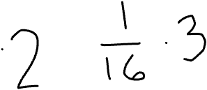
buildHeap Efficiency
Easy argument: buildHeap is O(n log n) where n is size
size/2 loop iterations
Each iteration does one percolateDown, each is O(log n)
This is correct, but there is a more precise (“tighter”) analysis of the algorithm…
void buildHeap() {
for(i = size/2; i>0; i--) {
val = arr[i];
hole = percolateDown(i,val);
arr[hole] = val;
}
}

Slide 32
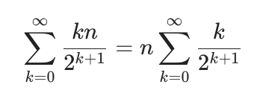
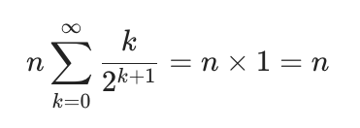
buildHeap Efficiency
No node can percolate down more than the height of its subtree
When i is a leaf: 0
When i is second-from-last level: 1
When i is third-from-last level: 2
Overall Running time:
k = height of tree = log n but it’s actually easier math if we say that it’s infinity

