Slide 1
CSE 332
Data Structures & Parallelism
Priority Queues
Melissa Winstanley
Spring 2024
Notes:
Project: we don’t care about style - we already taught you that! But it will make it harder for you to get help in OH
Exercise 1 is out!

Slide 2
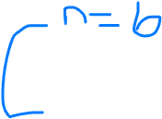
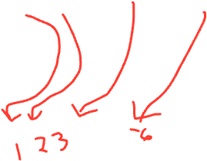
Amortized Complexity
“Cost” of first n inserts is $1 per insert
“Cost” of the (n+1)th insert is $(n+1)
How many “cheap” ($1) inserts can we do before we encounter another “expensive” insert?
Intuition:
(n * $1) + (1 * $(n+1)) + ((n-1) * $1) = $(3n) - cost of entire sequence of 2n inserts
$3n / 2n = $3/2 = O(1) average cost per operation given this sequence
Chapter 11 - a lot more complicated to “prove” that this

Slide 3
Today & Next Time - Priority Queues / Heaps
What is a Priority Queue?
Introduction to the heap
Heap operations
Heap implementation
Building a heap

Slide 4
Scenario
What is the difference between waiting for service at a pharmacy versus an ER?
Pharmacies usually follow the rule: First Come, First Served
Emergency Rooms assign priorities based on each individual's need

Slide 5
Scenario
What is the difference between waiting for service at a pharmacy versus an ER?
Pharmacies usually follow the rule: First Come, First Served
Queue (FIFO)
Emergency Rooms assign priorities based on each individual's need
Priority Queue

Slide 6
A new ADT: Priority Queue
Textbook Chapter 6
We will go back to binary search trees (ch4) and hash tables (ch5) later
Nice to see a new and surprising data structure first
A priority queue holds compare-able data
Unlike stacks and queues need to compare items
Given x and y, is x less than, equal to, or greater than y
What this means can depend on your data
Much of course will require comparable data: e.g. sorting
Integers are comparable, so will use them in examples
But the priority queue ADT is much more general
Typically two fields, the priority and the data

Slide 7
Priority Queue ADT
Assume each item has a “priority”
The lesser item is the one with the greater priority
So “priority 1” is more important than “priority 4”
Just a convention, could also do a maximum priority
Main Operations:
insert
deleteMin
Key property: deleteMin returns and deletes from the queue the item with greatest priority (lowest priority value)
Can resolve ties arbitrarily
6 2
15 23
23 18
45 3 7
insert
deleteMin
Notes:
We can’t get any more abstract than a blob of integers

Slide 8
Aside: ints as data and priority
For simplicity in lecture, we’ll often suppose items are just ints and the int is also the priority
So an operation sequence could be
insert 6 insert 5 x = deleteMin // Now x = 5
int priorities are common, but really just need comparable
Not having “other data” is very rare
Example: print job has a priority and the file to print is the data

Slide 9
Priority Queue Example
insert a with priority 5 after execution:
insert b with priority 3
insert c with priority 4
w = deleteMin
x = deleteMin
insert d with priority 2
insert e with priority 6
y = deleteMin
z = deleteMin
To simplify our examples, we will just use the priority values from now on
Analogy: insert is like enqueue, deleteMin is like dequeue
But the whole point is to use priorities instead of FIFO

Slide 10
Priority Queue Example
insert a with priority 5 after execution:
insert b with priority 3
insert c with priority 4 w = b
w = deleteMin x = c
x = deleteMin y = d
insert d with priority 2 z = a
insert e with priority 6
y = deleteMin
z = deleteMin
To simplify our examples, we will just use the priority values from now on
Analogy: insert is like enqueue, deleteMin is like dequeue
But the whole point is to use priorities instead of FIFO

Slide 11
Applications of Priority Queues
Like all good ADTs, the priority queue arises often
Sometimes “directly”, sometimes less obvious
Run multiple programs in the operating system
“critical” before “interactive” before “compute-intensive”
Maybe let users set priority level
Treat hospital patients in order of severity (or triage)
Select print jobs in order of decreasing length?
Forward network packets in order of urgency
Select most frequent symbols for data compression (cf. CSE123)
Sort: insert all, then repeatedly deleteMin

Slide 12
Preliminary Implementations of Priority Queue ADT
 | insert | deleteMin
Unsorted Array
Unsorted Linked List
Sorted Circular Array
Sorted Linked List
Binary Search Tree (BST)
Note: Worst case, assume arrays have enough space

Slide 13
Preliminary Implementations of Priority Queue ADT
 | insert | deleteMin
Unsorted Array | θ(1) | θ(n)
Unsorted Linked List | θ(1) | θ(n)
Sorted Circular Array | θ(n) | θ(1)
Sorted Linked List | θ(n) | θ(1)
Binary Search Tree (BST) | θ(n) | θ(n)
Note: Worst case, assume arrays have enough space
Notes:
Half the class, work up, other half work down
2.5 minutes

Slide 14
Today - Priority Queues / Heaps
What is a Priority Queue?
Introduction to the heap
Heap operations
Heap implementation
Building a heap

Slide 15
Our Data Structure: The Heap
Or more specifically, a “binary min heap”
Worst case: O(log n) for insert
Worst case: O(log n) for deleteMin
If items arrive in random order, then the average-case of insert is O(1)
Very good constant factors
Key idea: Only pay for functionality needed
We need something better than scanning unsorted items
But we do not need to maintain a full sorted list
We will visualize our heap as a tree, so we need to review some tree terminology
Notes:
Spoiler alert: we’re not ACTUALLY going to use a tree - we’re just thinking about it like a tree.

Slide 16
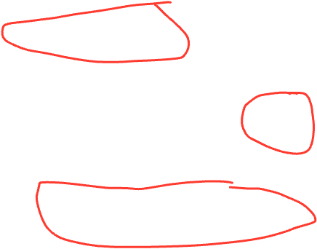
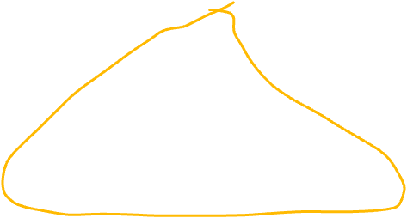
Reviewing Some Tree Terminology
Tree T
root(T):
leaves(T):
children(B):
parent(H):
siblings(E):
ancestors(F):
descendents(G):
subtree(G):

Slide 17
Some More Tree Terminology
Tree T
depth(B):
height(G):
height(T):
degree(B):
branching factor(T):
height – number of edges in path from node to deepest descendent
depth – number of edges in path from node to root

Slide 18
Types of Trees
Binary tree: Every node has ≤2 children
n-ary tree: Every node has ≤n children
Perfect tree: Every row is completely full
Complete tree: All rows except possibly the bottom are completely full, and it is filled from left to right
Notes:
What does this actually mean about the height of the tree?

Slide 19
More on Perfect Trees
Perfect tree: Every row is completely full
Height (h) | # nodes (n) | # leaves
0 | 1 | 1
1 | 3 | 2
2 | 7 | 4
3 | 15 | 8
h
Notes:
All the leaves added together for all previous heights gives you the # of nodes for a level

Slide 20
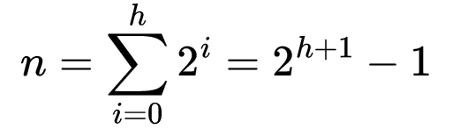
More on Perfect Trees
See Weiss 1.2.3 (p4)
Perfect tree: Every row is completely full
Height (h) | # nodes (n) | # leaves
0 | 1 | 1
1 | 3 | 2
2 | 7 | 4
3 | 15 | 8
h | 2^{h+1} - 1 | 2^{h}
Notes:
All the leaves added together for all previous heights gives you the # of nodes for a level

Slide 21
More on Perfect Trees
Perfect tree: Every row is completely full
How does the height of a perfect tree relate to the number of nodes?
2^{h+1} - 1 = n
2^{h+1} = n
h + 1 = log n
h = O(log n)
Notes:
All the leaves added together for all previous heights gives you the # of nodes for a level
So for our heap, we won’t necessarily always have a perfect tree, but as long as we keep it to complete, we’ll get our O(logn) running time

