Slide 1
CSE 332
Data Structures & Parallelism
Algorithm Analysis 2
Melissa Winstanley
Spring 2024

Slide 2
Today - Algorithm Analysis
What do we care about?
How to compare two algorithms
Analyzing code
How to count different code constructs
Best Case vs Worst Case
Ignoring Constant Factors
Asymptotic Analysis
Big-Oh Definition

Slide 3
Ignoring constant factors
So binary search is O(log n) and linear is O(n)
But which will actually be faster?
Depending on constant factors and size of n; in a particular situation, linear search could be faster….
Could depend on constant factors
How many assignments, additions, etc. for each n
And could depend on size of n – what if n is small?
But there exists some n₀ such that for all n > n₀ binary search “wins”
Let’s look at a couple plots to get some intuition…

Slide 4
Linear search vs Binary search
Let’s give linear search a boost (n / 600)

Slide 5
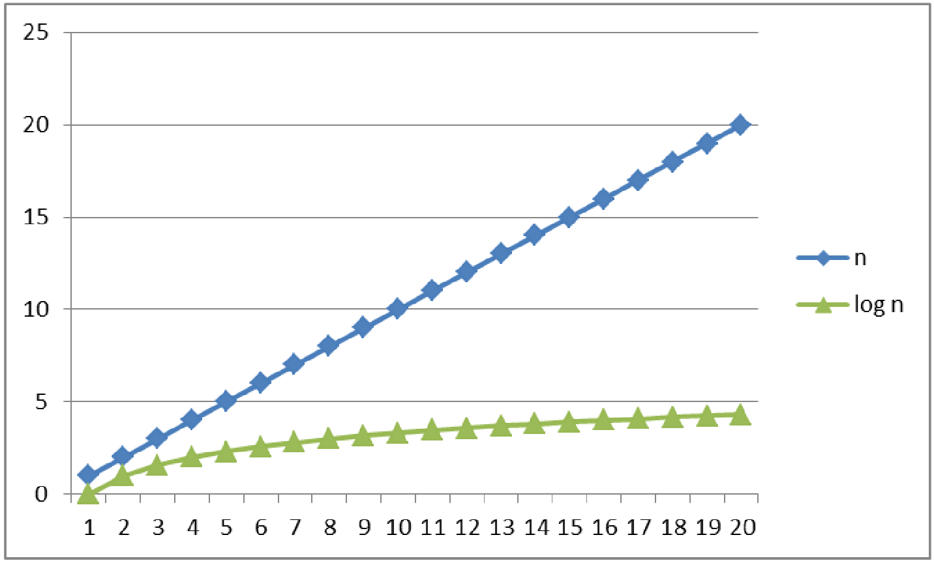
Logarithms and Exponents
Notes:
Just a reminder
Logarithm does grow, just must more slowly

Slide 6
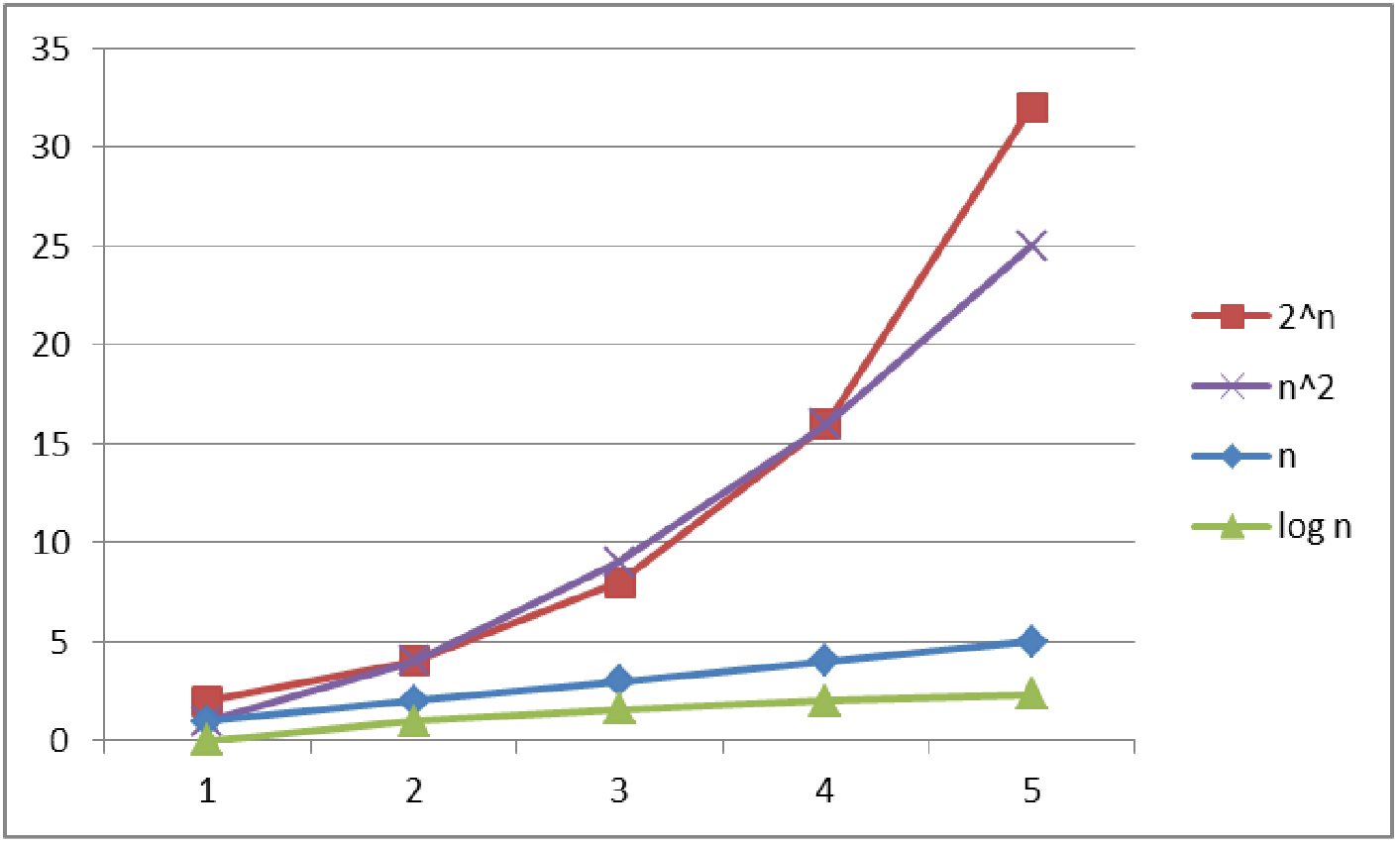
Logarithms and Exponents
Notes:
Just a reminder
Actually who cares about 5?

Slide 7
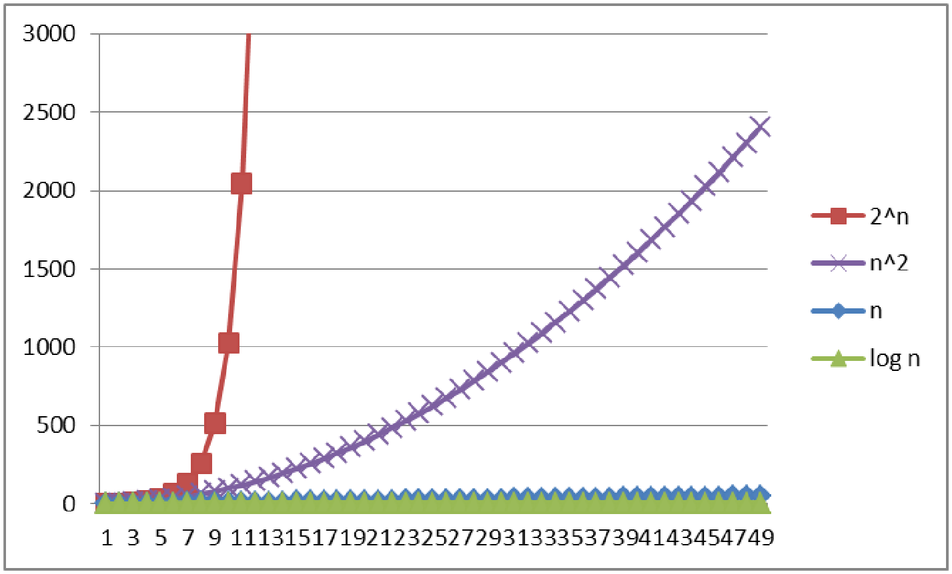
Logarithms and Exponents
Notes:
Just a reminder
Exponential is BAD NEWS
At end of course -> some problems we don’t have good running times for

Slide 8
Today - Algorithm Analysis
What do we care about?
How to compare two algorithms
Analyzing code
Asymptotic Analysis
Big-Oh Definition

Slide 9
Asymptotic notation
About to show formal definition, which amounts to saying:
Eliminate low-order terms
Eliminate coefficients
Examples:
4n + 5
0.5n log n + 2n + 7
n³ + 2^{n} + 3n
n log (10n²)
log log n + log²n
Notes:
Answers:
O(n)
O(nlogn)
O(2^n)
O(nlogn)
logn * logn

Slide 10
Review: Properties of logarithms
log(A*B) = log A + log B
So log(N^{k})= k log N
log(A/B) = log A – log B
X = log₂2^{x}
log(log x) is written log log x
Grows as slowly as 2^{2^y} grows fast
Ex: log₂log₂4billion ~ log₂log₂2³² = log₂32 = 5
(log x)(log x) is written log²x
It is greater than log x for all x > 2

Slide 11
Today - Algorithm Analysis
What do we care about?
How to compare two algorithms
Analyzing code
Asymptotic Analysis
Big-Oh Definition

Slide 12
Big-Oh relates to functions
We use O on a function f(n) (for example n²) to mean the set of functions with asymptotic behavior less than or equal to f(n)
So (3n²+17) is in O(n²)
3n²+17 and n² have the same asymptotic behavior
Confusingly, we also say/write:
(3n²+17) is O(n²)
(3n²+17) = O(n²)
But we would never say O(n²) = (3n²+17)

Slide 13
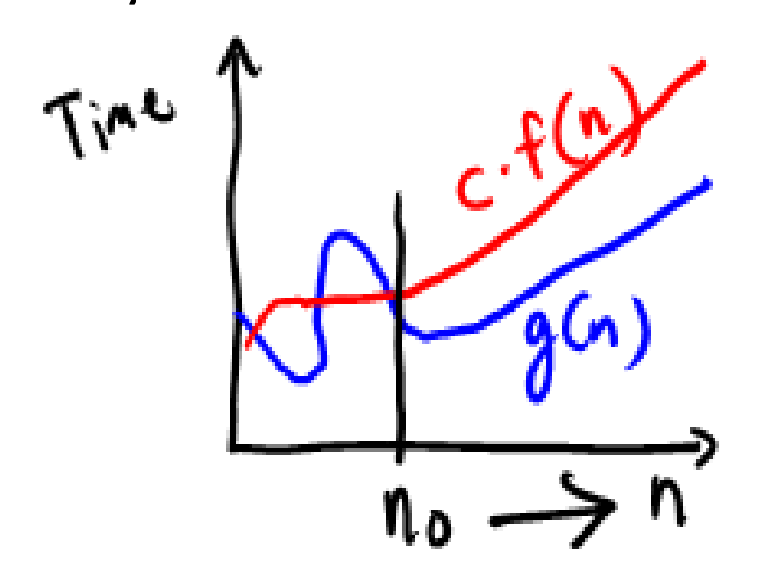
Formally Big-Oh
Definition: g(n) is in O( f(n) ) iff there exist
positive constants c and n₀ such that
g(n) ≤ c f(n) for all n ≥ n₀
Note: n₀ ≥ 1 (and a natural number) and c > 0
Or
g(n) ∈ O( f(n) )
Notes:
g(n) is a function like “3n+4”
This isn’t a picture of a real function, but hypothetically...

Slide 14
Why n₀? Why c?
Definition: g(n) ∈ O( f(n) ) iff there exist
positive constants c and n₀ such that
g(n) ≤ c f(n) for all n ≥ n₀
Notes:
Big O isn’t about immediate behavior it’s about asymptote - we don’t care about low n
Big O isn’t about the minor things inside of a loop - can be easy to reduce

Slide 15
Formally Big-Oh
Definition: g(n) ∈ O( f(n) ) iff there exist
positive constants c and n₀ such that
g(n) ≤ c f(n) for all n ≥ n₀
To show g(n) ∈ O( f(n) ), pick a c large enough to “cover the constant factors” and n₀ large enough to “cover the lower-order terms”
Example: Let g(n) = 3n + 4 and f(n) = n
c = 4 and n₀ = 5 is one possibility
This is “less than or equal to”
So 3n + 4 is also O(n⁵) and O(2^{n}) etc.
Notes:
You’ll get some practice next week in section
3n+4 <= c * n
3n + 4 <= 4 * n
When n=5: 3*5 + 4 <= 4*5
When n=6: 3*6 + 4 <= 4*6
4 <= n
Don’t use the last point to get out of precise answers on an exam!

Slide 16
Examples
True or false?
4+3n is O(n)
n+2logn is O(logn)
logn+2 is O(1)
n⁵⁰ is O(1.1^{n})
Notes:
Do NOT ignore constants that are not multipliers:
n³ is O(n²) : FALSE
3^{n} is O(2^{n}) : FALSE
When in doubt, refer to the definition

Slide 17
Big Oh: Common Categories
From fastest to slowest
O(1) constant (same as O(k) for constant k)
O(log n) logarithmic
O(n) linear
O(n log n) “n log n”
O(n²) quadratic
O(n³) cubic
O(n^{k}) polynomial (where is k is any constant > 1)
O(k^{n}) exponential (where k is any constant > 1)
Usage note: “exponential” does not mean “grows really fast”, it means “grows at rate proportional to kn for some k>1”
Notes:
loglogn goes between 1 and logn
log^2(n) goes between logn and n
Sometimes best and worst case can have different big O categories

Slide 18
More Asymptotic Notation
Upper bound: O( f(n) ) is the set of all functions asymptotically less than or equal to f(n)
g(n) ∈ O( f(n) ) if there exist constants c and n₀ such that g(n) ≤ c f(n) for all n ≥ n₀
Lower bound: 𝛀( f(n) ) is the set of all functions asymptotically greater than or equal to f(n)
g(n) ∈ 𝛀( f(n) ) if there exist constants c and n₀ such that g(n) ≥ c f(n) for all n ≥ n₀
Tight bound: 𝝷( f(n) ) is the set of all functions asymptotically equal to f(n)
Intersection of O( f(n) ) and 𝛀( f(n) ) (can use different c values)
Notes:
Why did I never hear of theta? Seems like the most useful, big O can be use stupidly
Maybe theta is hard to type
We still use big-O but most useful thing is a tight bound, and that’s what we usually use

Slide 19
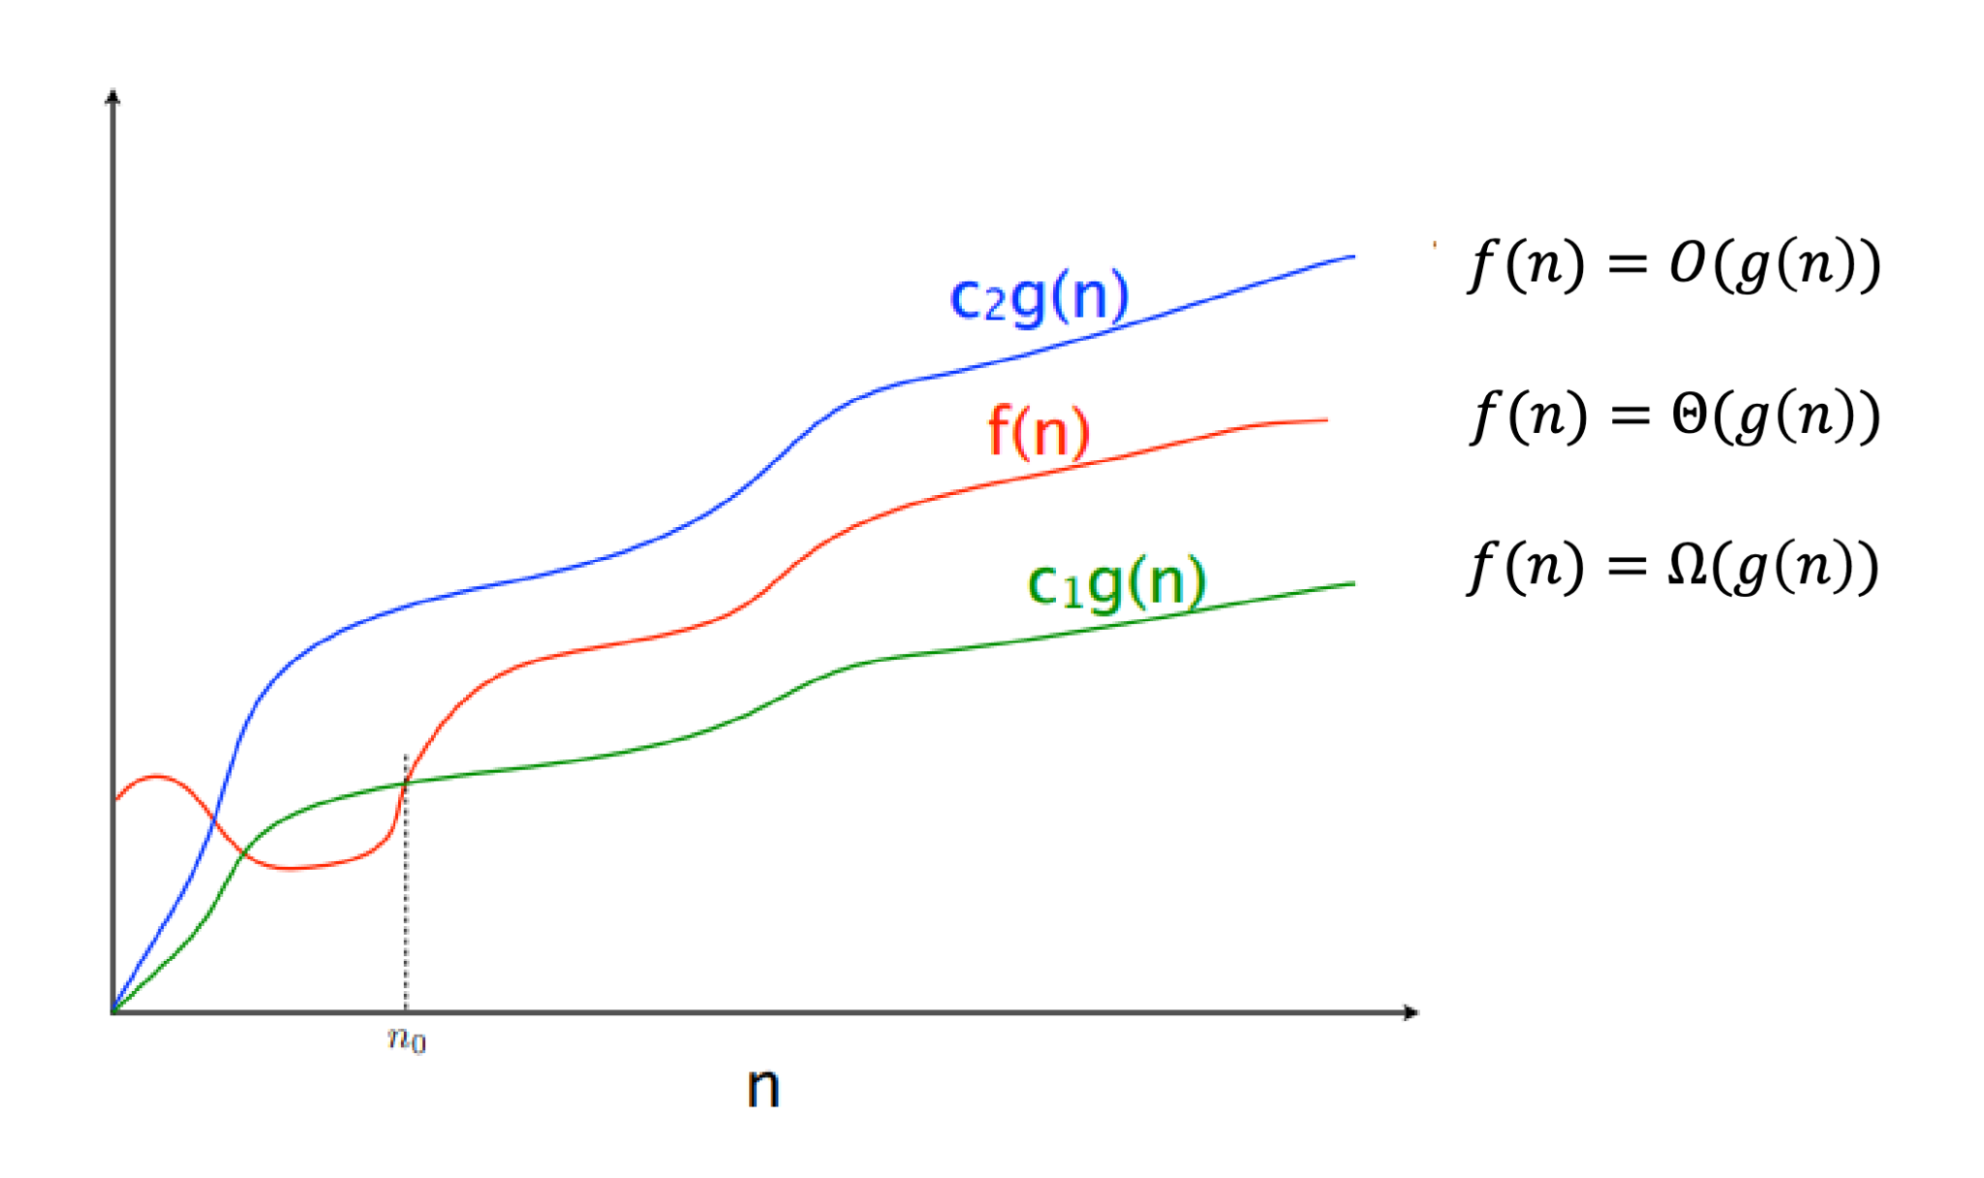
O, Theta, Omega

Slide 20
Regarding use of terms
A common error is to say O( f(n) ) when you mean 𝝷( f(n) )
People often say O() to mean a tight bound
Say we have f(n)=n; we could say f(n) is in O(n), which is true, but only conveys the upper-bound
Since f(n)=n is also O(n⁵), it’s tempting to say “this algorithm is exactly O(n)”
Somewhat incomplete; instead say it is 𝝷(n)
That means that it is not, for example O(log n)
Less common notation:
“little-oh”: like “big-Oh” but strictly less than
Example: sum is o(n²) but not o(n)
“little-omega”: like “big-Omega” but strictly greater than
Example: sum is ω(log n) but not ω(n)

Slide 21
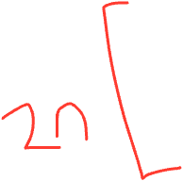
Summary of Complexity cases
Problem size N
Worst-case complexity: max # steps algorithm takes on “most challenging” input of size N
Best-case complexity: min # steps algorithm takes on “easiest” input of size N
Average-case complexity: avg # steps algorithm takes on random inputs of size N
Amortized complexity: max total # steps algorithm takes on M “most challenging” consecutive inputs of size N, divided by M (i.e., divide the max total by M).
Notes:
We tend not to talk about “average case” - what is “average”? How do you know?
Amortized is on a sequence of operations - the set of worst-case sequences!
Example: what if you’re adding to an array? If you fill it up, you have to copy it over
We’re usually reporting either worst case or amortized, depending on the algorithm

Slide 22
What we are analyzing
The most common thing to do is give an O or 𝝷 bound to the worst-case running time of an algorithm
Example: True statements about binary-search algorithm
Common: 𝝷(log n) running-time in the worst-case
Less common: 𝝷(1) in the best-case (item is in the middle)
Less common: Algorithm is 𝛀(log log n) in the worst-case (it is not really, really, really fast asymptotically)
Less common (but very good to know): the find-in-sorted-array problem is 𝛀(log n) in the worst-case
No algorithm can do better (without parallelism)
A problem cannot be O(f(n)) since you can always find a slower algorithm, but can mean there exists an algorithm

Slide 23
Summary
Analysis can be about:
The problem or the algorithm (usually algorithm)
Time or space (usually time)
Or power or dollars or …
Best-, worst-, or average-case (usually worst)
Upper-, lower-, or tight-bound (usually upper or tight)
Notes:
Students have trouble with the differences between the bounds

Slide 24
Summary
 | O | 𝛀 | 𝝷
Best
Worst
Average
💖

Slide 25
Addendum: Timing vs Big-Oh?
At the core of CS is a backbone of theory & mathematics
Examine the algorithm itself, mathematically, not the implementation
Reason about performance as a function of n
Be able to mathematically prove things about performance
Yet, timing has its place
In the real world, we do want to know whether implementation A runs faster than implementation B on data set C
Ex: Benchmarking graphics cards
Evaluating an algorithm? Use asymptotic analysis
Evaluating an implementation of hardware/software? Timing can be useful

Slide 26
Asymptotic Notation Example
Show 10n + 100 ∈ O(n²)
Technique: find values c > 0 and n₀ > 0 such that 10n + 100 is less than c * n²

Slide 27
Asymptotic Notation Example
Show 10n + 100 ∈ O(n²)
Technique: find values c > 0 and n₀ > 0 such that 10n + 100 is less than or equal to c * n²
Let c = 10, n₀ = 6
10n + 100 <= 10n²
n + 10 <= n²
10 <= n² - n
10 <= n*(n-1)
n*(n-1) is strictly increasing, and
10 < 6*(6-1)

