Slide 1
CSE 332
Data Structures & Parallelism
Algorithm Analysis
Melissa Winstanley
Spring 2024

Slide 2
Today & Next Time - Algorithm Analysis
What do we care about?
How to compare two algorithms
Analyzing code
Asymptotic Analysis
Big-Oh Definition

Slide 3
What do we care about?
Correctness:
Does the algorithm do what is intended.
Performance:
Speed time complexity
Memory space complexity
Why analyze?
To make good design decisions
Enable you to look at an algorithm (or code) and identify the bottlenecks, etc.

Slide 4
Q: How should we compare two algorithms?
Sort all students who have taken 332
Chandni
5 seconds
3.5 seconds
0 seconds
Arya
4 seconds
2 seconds
Notes:
Example: I ask the TAs to sort a list of all students who have taken 332

Slide 5
Today - Algorithm Analysis
What do we care about?
How to compare two algorithms
Analyzing code
Asymptotic Analysis
Big-Oh Definition

Slide 6
A: How should we compare two algorithms?
Uh, why NOT just run the program and time it??
Too much variability, not reliable or portable:
Hardware: processor(s), memory, etc.
OS, Java version, libraries, drivers
Other programs running
Implementation dependent
Choice of input
Testing (inexhaustive) may miss worst-case input
Timing does not explain relative timing among inputs (what happens when n doubles in size)
Often want to evaluate an algorithm, not an implementation
Even before creating the implementation (“coding it up”)

Slide 7
Comparing algorithms
When is one algorithm (not implementation) better than another?
Various possible answers (clarity, security, …)
But a big one is performance: for sufficiently large inputs, runs in less time (our focus) or less space
Large inputs (n) because probably any algorithm is “plenty good” for small inputs (if n is 10, probably anything is fast enough)
Answer will be independent of CPU speed, programming language, coding tricks, etc.
Answer is general and rigorous, complementary to “coding it up and timing it on some test cases”
Can do analysis before coding!

Slide 8
Goals for Algorithm Analysis
Identify a function which maps the algorithm’s input size to a measure of resources used
Input of the function: size of the function input (n)
Number of characters in a string, number of items in a list, number of pixels in an image
Output of the function: counts of resources used
Important note: Make sure you know the “units” of your domain and codomain!

Slide 9
Today - Algorithm Analysis
What do we care about?
How to compare two algorithms
Analyzing code
How to count different code constructs
Best Case vs Worst Case
Ignoring Constant Factors
Asymptotic Analysis
Big-Oh Definition

Slide 10
Analyzing code
Basic operations take “some amount of” constant time
Arithmetic
Assignment
Access one Java field or array index
Etc.
(This is an approximation of reality: a very useful “lie”.)
Consecutive statements Sum of time of each statement
Loops Num iterations * time for loop body
Conditionals Time of condition plus time of slower branch
Function Calls Time of function’s body
Recursion Solve recurrence equation

Slide 11
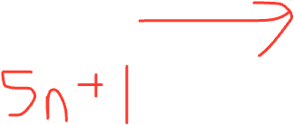
Example 1
b = b + 5
c = b / a
b = c + 100
for (i = 0; i < n; i++) {
sum++;
}
if (j < 5) {
sum++;
} else {
for (i = 0; i < n; i++) {
sum++;
}
}
Notes:
First: ~6 ops => O(1)
Second: ~5n + 2 ops = O(n)
Third: ~5n + 3 ops in WORST case (~3 ops in best case) = O(n)

Slide 12
Example 2
int coolFunction(int n, int sum) {
int i, j;
for (i = 0; i < n; i++) {
for (j = 0; j < n; j++) {
sum++;
}
}
print "This program is great!"
for (i = n; i > 1; i = i / 2) {
sum++;
}
return sum
}
Notes:
N^2 + 1+ log N + 1 =
Worst case: O(n^2)

Slide 13
Using Summation for Loops
for (i = 0; i < n; i++) {
sum++;
}
Notes:
2 + sum from 0 to n-1 of 5

Slide 14
Example 3
List<Integer> beAnnoying(List<Integer> lst){
List m = new ArrayList<Integer>();
for (i = 0; i < lst.size(); i++){
m.add(lst.get(i));
for (j = 0; j < lst.size(); j++){
print(“Hi, I’m annoying”);
}
}
return m;
}

Slide 15
What about memory?
List<Integer> beAnnoying(List<Integer> lst){
List m = new ArrayList<Integer>();
for (i = 0; i < lst.size(); i++){
m.add(lst.get(i));
for (j = 0; j < lst.size(); j++){
print(“Hi, I’m annoying”);
}
}
return m;
}

Slide 16
Today - Algorithm Analysis
What do we care about?
How to compare two algorithms
Analyzing code
How to count different code constructs
Best Case vs Worst Case
Ignoring Constant Factors
Asymptotic Analysis
Big-Oh Definition

Slide 17
Complexity cases
We’ll start by focusing on two scenarios:
Worst-case complexity: max # steps algorithm takes on “most challenging” input of size N
Best-case complexity: min # steps algorithm takes on “easiest” input of size N

Slide 18
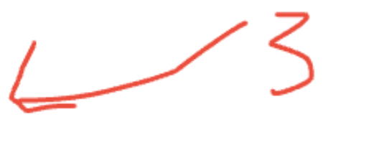
Example - best case? worst case?
b = b + 5
c = b / a
b = c + 100
for (i = 0; i < n; i++) {
sum++;
}
if (j < 5) {
sum++;
} else {
for (i = 0; i < n; i++) {
sum++;
}
}

Slide 19
Example
5
8
13
42
75
79
88
90
95
99
Find an integer in a sorted array
// requires array is sorted
// returns whether k is in array
boolean find(int[]arr, int k){
???
}
0
1
2
3
4
5
6
7
8
9

Slide 20
Linear search - Best Case & Worst Case
5
8
13
42
75
79
88
90
95
99
// requires array is sorted
// returns whether k is in array
boolean find(int[]arr, int k){
for(int i=0; i < arr.length; ++i)
if(arr[i] == k)
return true;
return false;
}
}
0
1
2
3
4
5
6
7
8
9
Best case:
Worst case:

Slide 21
Linear search - Best Case & Worst Case
5
8
13
42
75
79
88
90
95
99
// requires array is sorted
// returns whether k is in array
boolean find(int[]arr, int k){
for(int i=0; i < arr.length; ++i)
if(arr[i] == k)
return true;
return false;
}
}
0
1
2
3
4
5
6
7
8
9
Best case: 6-ish steps = O(1)
Worst case:
5-ish steps * (arr.length) = O(n)
Notes:
Best case doesn’t really tell me anything except how lucky we are

Slide 22
Remember a faster search algorithm?
Notes:
Best case? Worst case?

Slide 23
Worst case analysis
Worst-case complexity: max # steps algorithm takes on “most challenging” input of size N
Does NOT depend on how big N is
Depends on the actual arguments to the algorithm

Slide 24
Today - Algorithm Analysis
What do we care about?
How to compare two algorithms
Analyzing code
How to count different code constructs
Best Case vs Worst Case
Ignoring Constant Factors
Asymptotic Analysis
Big-Oh Definition

Slide 25
Ignoring constant factors
So binary search is O(log n) and linear is O(n)
But which will actually be faster?
Depending on constant factors and size of n; in a particular situation, linear search could be faster….
Could depend on constant factors
How many assignments, additions, etc. for each n
And could depend on size of n – what if n is small?
But there exists some n₀ such that for all n > n₀ binary search “wins”
Let’s look at a couple plots to get some intuition…

Slide 26
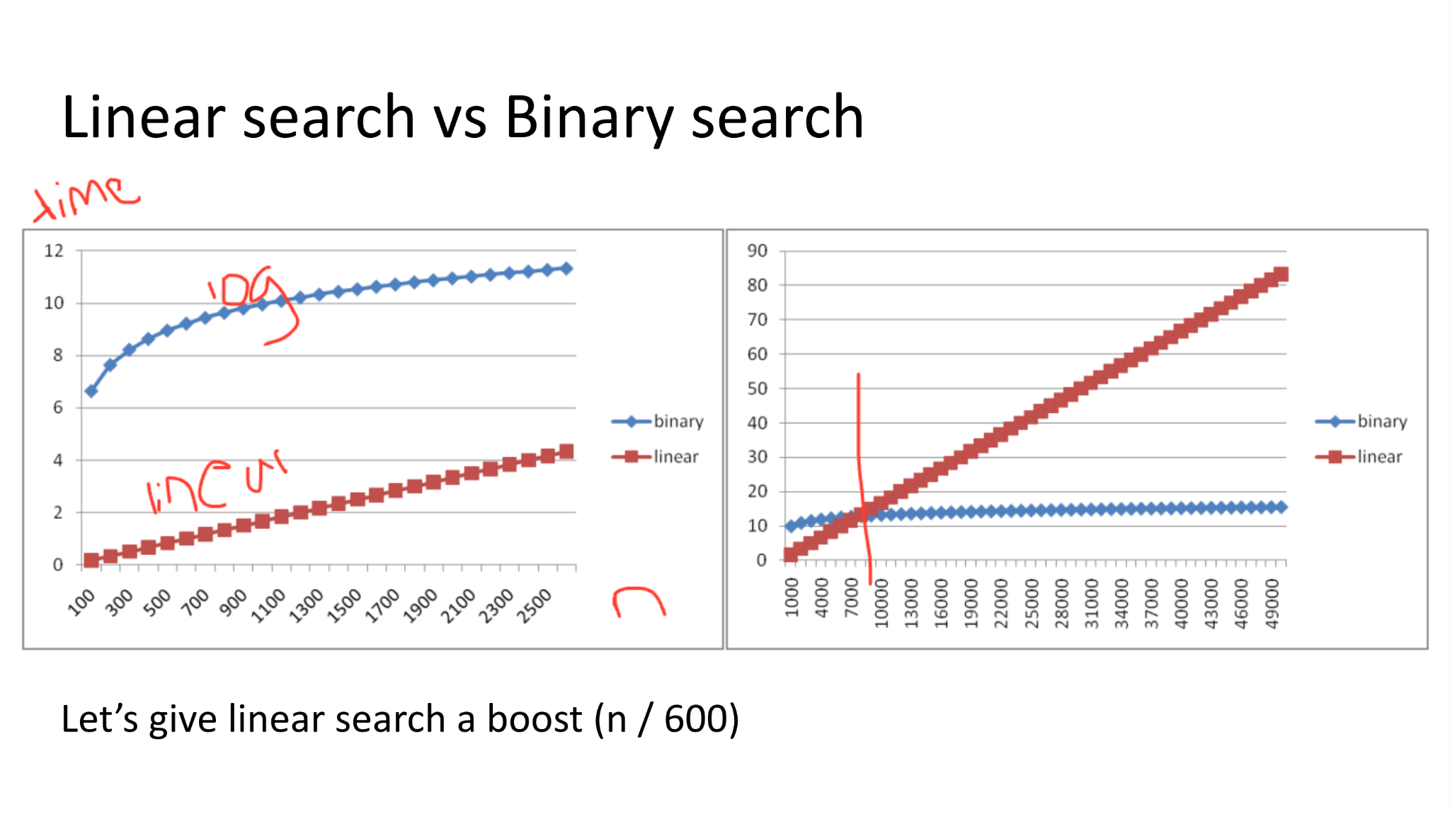
Linear search vs Binary search
Let’s give linear search a boost (n / 600)

