Slide 1
CSE 332
Data Structures & Parallelism
Intro, Stacks & Queues
Melissa Winstanley
Spring 2024

Slide 2
Welcome!
We have 10 weeks to learn fundamental data structures and algorithms for organizing and processing information
“Classic” data structures / algorithms and how to analyze rigorously their efficiency and when to use them
Queues, dictionaries, graphs, sorting, etc.
Parallelism and concurrency (!)

Slide 3
Today
Introductions
Administrative Info
What is this course about?
Review: Queues and stacks

Slide 4
CSE 332 Course Staff
Instructor:
Melissa Winstanley
Teaching Assistants:
Amanda Yuan
Arya GJ
Chandni Rajasekaran
Hans Easton
Hitesh Boinpally
Mohamed Awadalla
Nile Camai
Xunmei Liu
Yijia Zhao

Slide 5
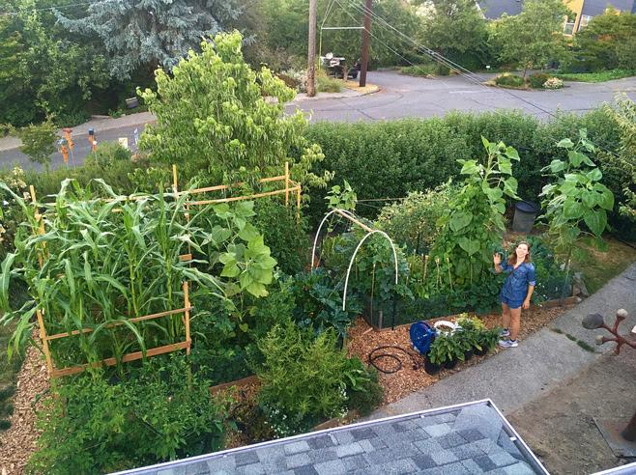
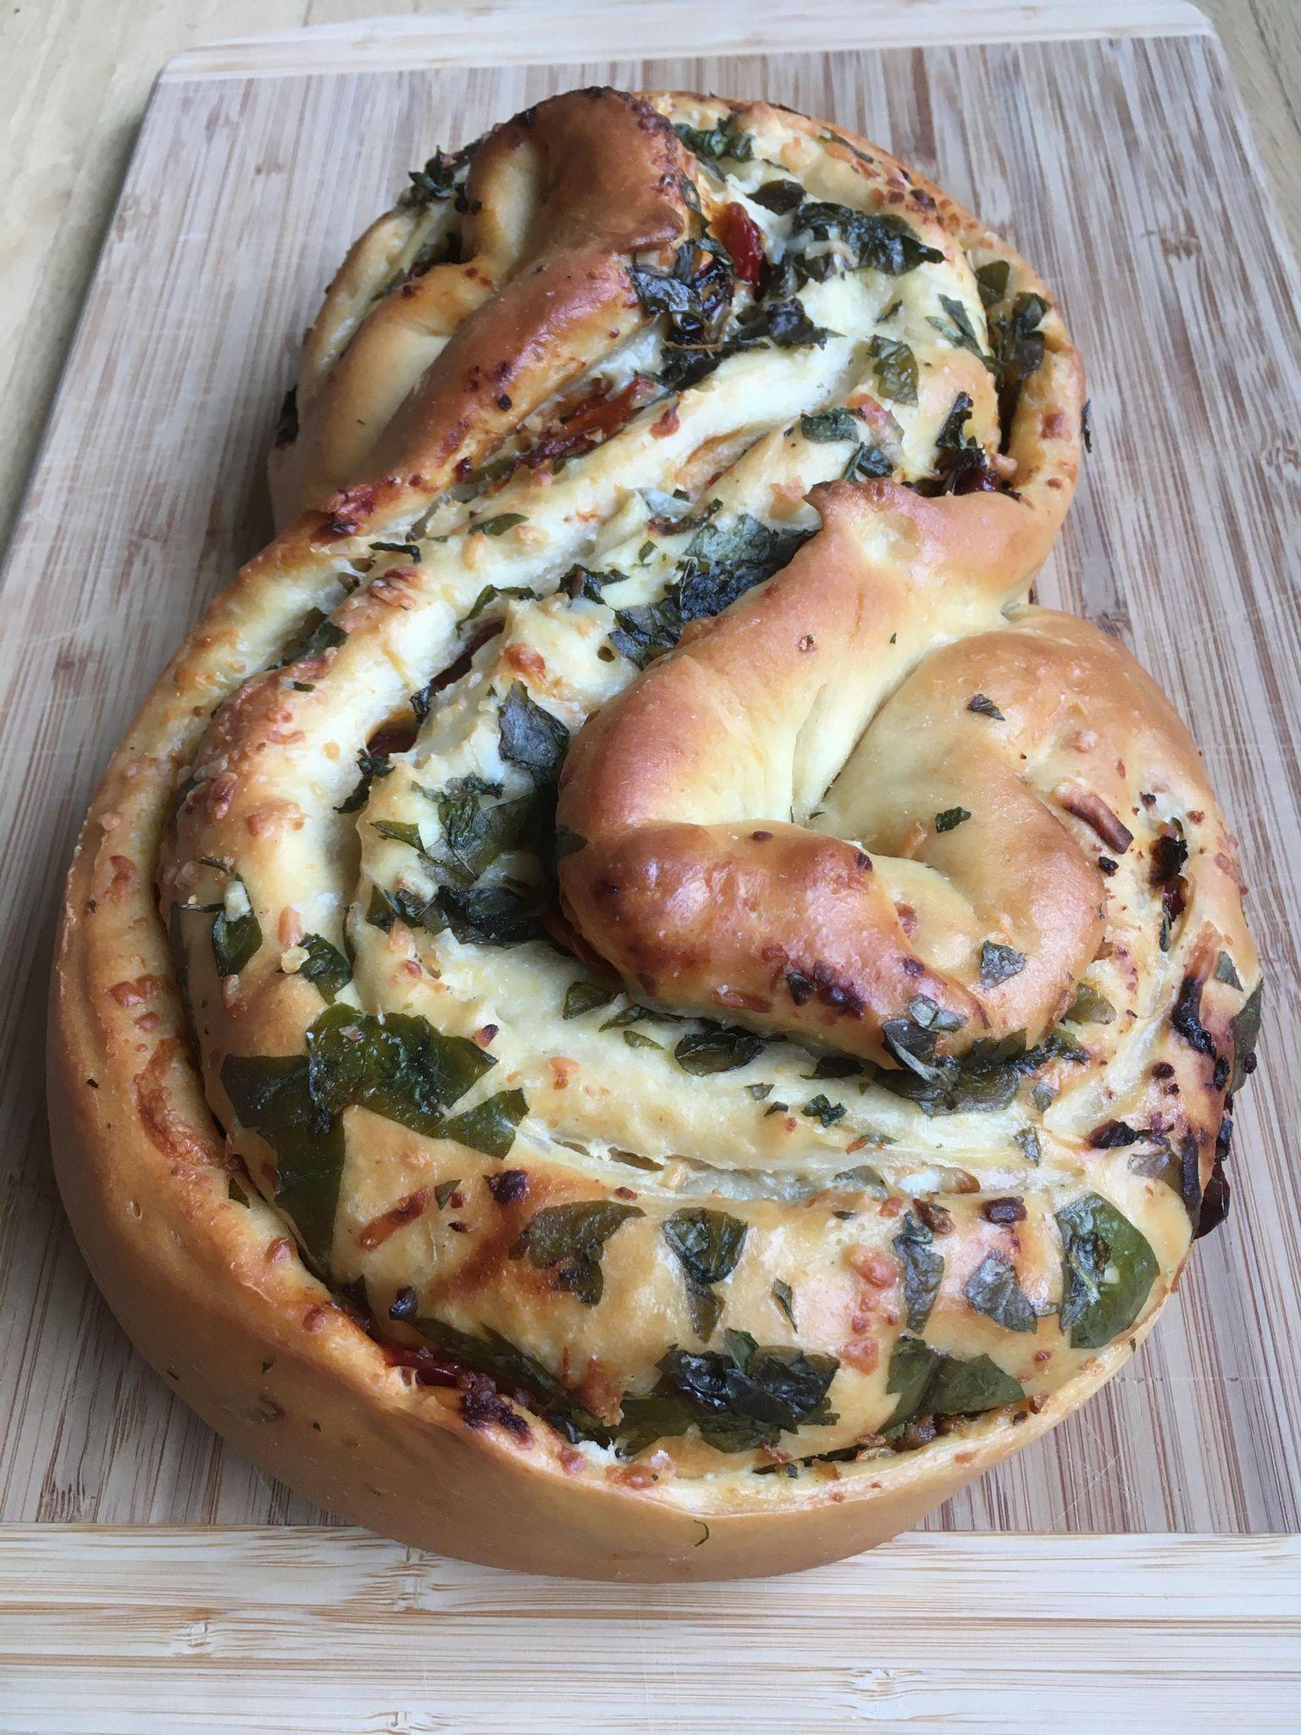
Me (Melissa)
Undergrad and 5th year masters at UW
Research in NLP & computing in the developing world
TA-ing (intro, networks) and teaching my own class
Teaching Computer Science at UW
CSE 143 (Intro II) / CSE 374 (Systems Programming) / DATA 515 (Software Design)
Software Engineer at Meta, Convoy, & Snowflake
Focus on large-scale backend infrastructure and platforms
Extensive work with intern programs
Passionate about making students into software engineers

Slide 6
Credit for the course
Many thanks to:
Ruth Anderson
Winston Jodjana
Nathan Brunelle

Slide 7
Today
Introductions
Administrative Info
What is this course about?
Review: Queues and stacks

Slide 8
Course Information
Instructor: Melissa Winstanley, CSE 214
Office Hours: see course web page, and by appointment (mwinst@cs.washington.edu)
Course Web page:
http://www.cs.uw.edu/332
Text (optional): Data Structures & Algorithm Analysis in Java Mark Allen Weiss, 3rd edition, 2012 (2nd edition also o.k.)

Slide 9
Communication
Course email list: cse332a_sp24@uw
You are already subscribed
You must get and read announcements sent there
Ed STEM Discussion board
Your first stop for questions about course content & assignments
Anonymous feedback link
For good and bad: if you don’t tell us, we won’t know!

Slide 10
Course Meetings
Lecture
Materials posted (sometimes afterwards), but take notes
Ask questions, focus on key ideas (rarely coding details)
No participation points - we’re all adults here
Section
Practice problems!
Answer Java/project/homework questions, etc.
Occasionally may introduce new material
An important part of the course (not optional)
ESPECIALLY THIS WEEK!
Office hours
Use them: please visit us

Slide 11
Course Materials
Lecture and section materials will be posted
But they are visual aids, not always a complete description!
If you have to miss, find out what you missed
Textbook: Weiss 3rd Edition in Java
Good read, but only responsible for lecture/section/hw topics
Parallelism / concurrency units in separate free resources designed for 332

Slide 12
Course Work
~13 Weekly individual homework exercises (25%)
3 programming projects (with phases) (35%)
Use Java and IntelliJ, Gitlab
Done individually
Midterm and final exam (40%)
In-person, in this room (CSE2 G20)
Dates:
Midterm: Friday April 26, during lecture
Final Exam: Thursday June 8, 8:30-10:20am

Slide 13
Collaboration policy
Attempt the work on your own
Then you can talk with classmates
“Whiteboard collaboration”
Do NOT take any photos/notes away from the session
Wait 30 minutes before writing your own solution
ONLY people from this iteration of the class
Search the internet for general concepts only
Cite any sources / collaboration
When in doubt, cite!

Slide 14
Homework for today!!!
Preliminary Survey: due Thursday
Project #1: Checkpoint 0 due Friday
Review Java & install IntelliJ
Reading (optional) in Weiss (see course web page)

Slide 15
Today
Introductions
Administrative Info
What is this course about?
Review: Queues and stacks

Slide 16
Data Structures + Parallelism
About 70% of the course is a “classic data-structures course”
Timeless, essential stuff
Core data structures and algorithms that underlie most software
How to analyze algorithms
Plus a serious first treatment of programming with multiple threads
For parallelism: Use multiple processors to finish sooner
For concurrency: Correct access to shared resources
Will make many connections to the classic material

Slide 17
What 332 is about
Deeply understand the basic structures used in all software
Understand the data structures and their trade-offs
Rigorously analyze the algorithms that use them (math!)
Learn how to pick “the right thing for the job”
Experience the purposes and headaches of multithreading
Practice design, analysis, and implementation
The elegant interplay of “theory” and “engineering” at the core of computer science

Slide 18
Goals
You will understand:
what the tools are for storing and processing common data types
which tools are appropriate for which need
So that you will be able to:
make good design choices as a developer, project manager, or system customer
justify and communicate your design decisions

Slide 19
One view of this course
This is the class where you begin to think like a computer scientist
You stop thinking in Java code
You start thinking that this is a hashtable problem, a stack problem, etc.

Slide 20
Data Structures?
“Clever” ways to organize information in order to enable efficient computation over that information.

Slide 21
Example Trade-Offs
Notes:
List
Also - binary search tree

Slide 22
Trade-Offs
A data structure strives to provide many useful, efficient operations
But there are unavoidable trade-offs:
Time vs. space
One operation more efficient if another less efficient
Generality vs. simplicity vs. performance
That is why there are many data structures and educated CSEers internalize their main trade-offs and techniques
And recognize logarithmic < linear < quadratic < exponential

Slide 23
Getting Serious: Terminology
List?
Abstract Data Type (ADT)
Mathematical description of a “thing” with set of operations on that “thing”
Algorithm
A high level, language-independent description of a step-by-step process
Data structure
A specific organization of data and family of algorithms for implementing an ADT
Implementation of a data structure
A specific implementation in a specific language

Slide 24
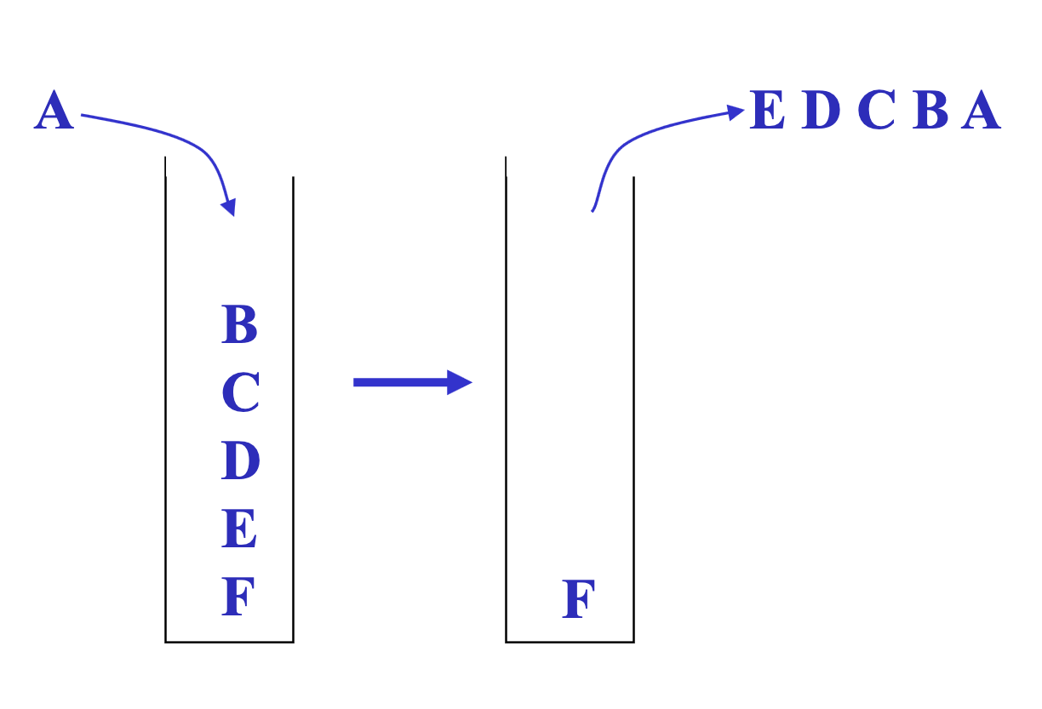
The Stack ADT
Stack operations:
push
pop
top/peek
is_empty

Slide 25
Terminology Example: Stacks
The Stack ADT supports operations:
push: adds an item
pop: raises an error if isEmpty, else returns most-recently pushed item not yet returned by a pop
isEmpty: initially true, later true if there have been same number of pops as pushes
… (Often some more operations)
A Stack data structure could use a linked-list or an array or something else, and associated algorithms for the operations
One implementation is in the library java.util.Stack

Slide 26
Why useful
The Stack ADT is a useful abstraction because:
It arises all the time in programming (see Weiss for more)
Recursive function calls
Balancing symbols (parentheses)
Evaluating postfix notation: 3 4 + 5 *
Clever: Infix ((3+4) * 5) to postfix conversion (see Weiss)
We can code up a reusable library
We can communicate in high-level terms
“Use a stack and push numbers, popping for operators…”
Rather than, “create a linked list and add a node when…”

Slide 27
Today
Introductions
Administrative Info
What is this course about?
Review: Queues and stacks

Slide 28
The Queue ADT
Queue operations:
enqueue
dequeue
is_empty

Slide 29
Circular Array Queue Data Structure
What if queue is empty?
Enqueue?
Dequeue?
What if array is full?
How to test for empty?
What is the complexity of the operations?

Slide 30
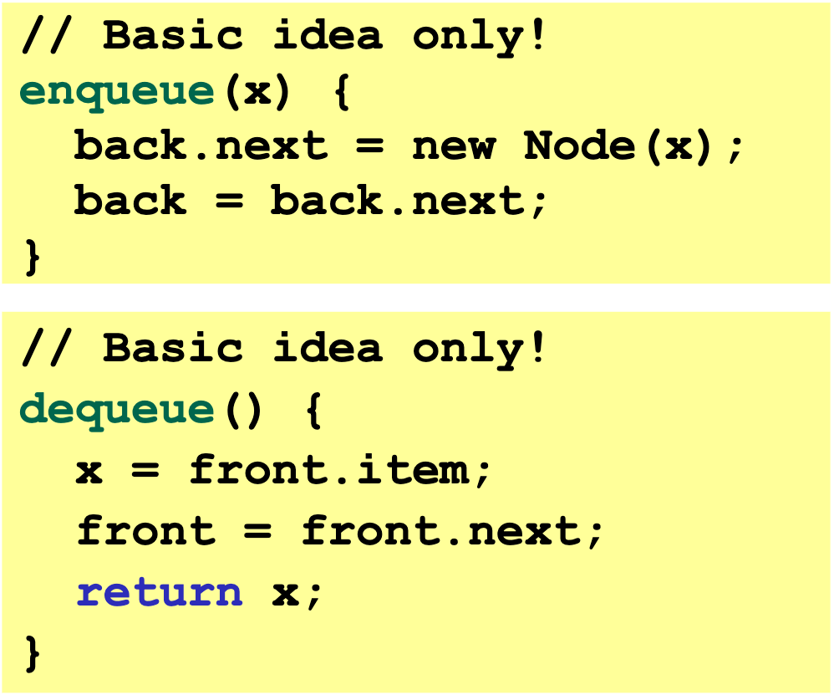
Linked List Queue Data Structure
What if queue is empty?
Enqueue?
Dequeue?
Can list be full?
How to test for empty?
What is the complexity of the operations?

Slide 31
Circular Array vs Linked List
Good about circular array: - if we do want to modify - less error prone - storing only one piece of data
Good about the linked list? - no set size - don't have define size at the start - add elements in between easily

Slide 32
Circular Array vs Linked List
Array:
May waste unneeded space or run out of space
Space per element excellent
Operations very simple / fast
List:
Always just enough space
But more space per element
Operations very simple / fast
Operations not in Queue ADT, but
also:
Constant-time “access to kth element”
For operation “insertAtPosition”, must shift all later elements
Operations not in Queue ADT, but
also:
No constant-time “access to kth element”
For operation “insertAtPosition” must traverse all earlier elements

Slide 33
Homework for today!!!
Preliminary Survey: due Thursday
Project #1: Checkpoint 0 due Friday
Review Java & install IntelliJ
Reading (optional) in Weiss (see course web page)

