Slide 1
CSE 332 Autumn 2024 Lecture 8: Heaps and Dictionaries
Nathan Brunelle
http://www.cs.uw.edu/332

Slide 2
ADT: Priority Queue
What is it?
A collection of items and their “priorities”
Allows quick access/removal to the “top priority” thing
Usually a smaller priority value means the item is “more important”
What Operations do we need?
insert(item, priority)
Add a new item to the PQ with indicated priority
extract
Remove and return the “top priority” item from the queue
Usually the item with the smallest priority value
IsEmpty
Indicate whether or not there are items still on the queue
Note: the “priority” value can be any type/class so long as it’s comparable (i.e. you can use “<“ or “compareTo” with it)

Slide 3
Thinking through implementations
Data Structure | Worst case time to insert | Worst case time to extract
Unsorted Array | $$Θ(1)$$ | $$Θ(n)$$
Unsorted Linked List | $$Θ(1)$$ | $$Θ(n)$$
Sorted Array | $$Θ\left(n\right)$$ | $$Θ(1)$$
Sorted Linked List | $$Θ\left(n\right)$$ | $$Θ\left(1\right)$$
Binary Search Tree | $$Θ\left(n\right)$$ | $$Θ\left(n\right)$$
Binary Heap | $$Θ\left(\log{n}\right)$$ | $$Θ\left(\log{n}\right)$$
For simplicity, Assume we know the maximum size of the PQ in advance (otherwise we’d do an amortized analysis, but get the same answers…)

Slide 4
Trees for Heaps
Binary Trees:
The branching factor is 2
Every node has $≤$ 2 children
Complete Tree:
All “layers” are full, except the bottom
Bottom layer filled left-to-right
1
3
2
4
7
5
6
5
9

Slide 5
(Min) Heap Data Structure
Keep items in a complete binary tree
Maintain the “(Min) Heap Property” of the tree
Every node’s priority is $≤$ its children’s priority
Max Heap Property: every node’s priority is $≥$ its children
1
3
2
4
7
5
6
5
9

Slide 6
Heap Insert
1
1.5
3
2
4
7
5
6
5
9
insert(item, priority){
put item in the “next open” spot (keep tree complete)
while (priority < parent’s priority){
swap item with parent
}
}

Slide 7
Heap Insert
1
3
2
4
7
5
6
5
9
1.5
insert(item, priority){
put item in the “next open” spot (keep tree complete)
while (priority < parent’s priority){
swap item with parent
}
}

Slide 8
Heap Insert
1
3
2
4
1.5
5
6
5
9
7
insert(item, priority){
put item in the “next open” spot (keep tree complete)
while (priority < parent’s priority){
swap item with parent
}
}
Percolate Up

Slide 9
Heap Insert
1
1.5
2
4
3
5
6
5
9
7
insert(item, priority){
put item in the “next open” spot (keep tree complete)
while (priority < parent’s priority){
swap item with parent
}
}
Percolate Up

Slide 10
Heap Insert
1
1.5
2
4
3
5
6
5
9
7
insert(item, priority){
put item in the “next open” spot (keep tree complete)
while (priority < parent’s priority){
swap item with parent
}
}

Slide 11
Heap extract
1
1.5
2
4
3
5
6
extract(){
min = root
curr = bottom-right item
move curr to the root
while(curr $>$ curr.left || curr > curr.right){
swap curr with its smallest child
}
return min
}
5
9
7

Slide 12
Heap extract
7
1.5
2
4
3
5
6
extract(){
min = root
curr = bottom-right item
move curr to the root
while(curr $>$ curr.left || curr > curr.right){
swap curr with its smallest child
}
return min
}
5
9
7

Slide 13
Heap extract
1.5
7
2
4
3
5
6
extract(){
min = root
curr = bottom-right item
move curr to the root
while(curr $>$ curr.left || curr > curr.right){
swap curr with its smallest child
}
return min
}
5
9
Percolate Down

Slide 14
Heap extract
1.5
3
2
4
7
5
6
extract(){
min = root
curr = bottom-right item
move curr to the root
while(curr $>$ curr.left || curr > curr.right){
swap curr with its smallest child
}
return min
}
5
9
Percolate Down

Slide 15
Heap extract
1.5
3
2
4
7
5
6
extract(){
min = root
curr = bottom-right item
move curr to the root
while(curr $>$ curr.left || curr > curr.right){
swap curr with its smallest child
}
return min
}
5
9

Slide 16
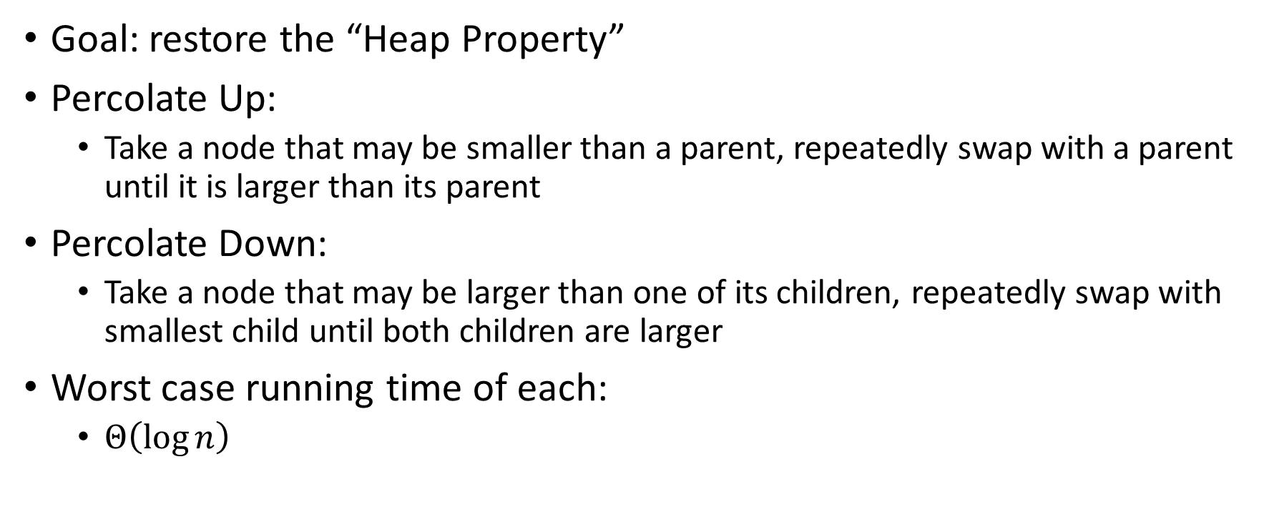
Percolate Up and Down (for a Min Heap)
Goal: restore the “Heap Property”
Percolate Up:
Take a node that may be smaller than a parent, repeatedly swap with a parent until it is larger than its parent
Percolate Down:
Take a node that may be larger than one of its children, repeatedly swap with smallest child until both children are larger
Worst case running time of each:
$Θ\left(\log{n}\right)$

Slide 17
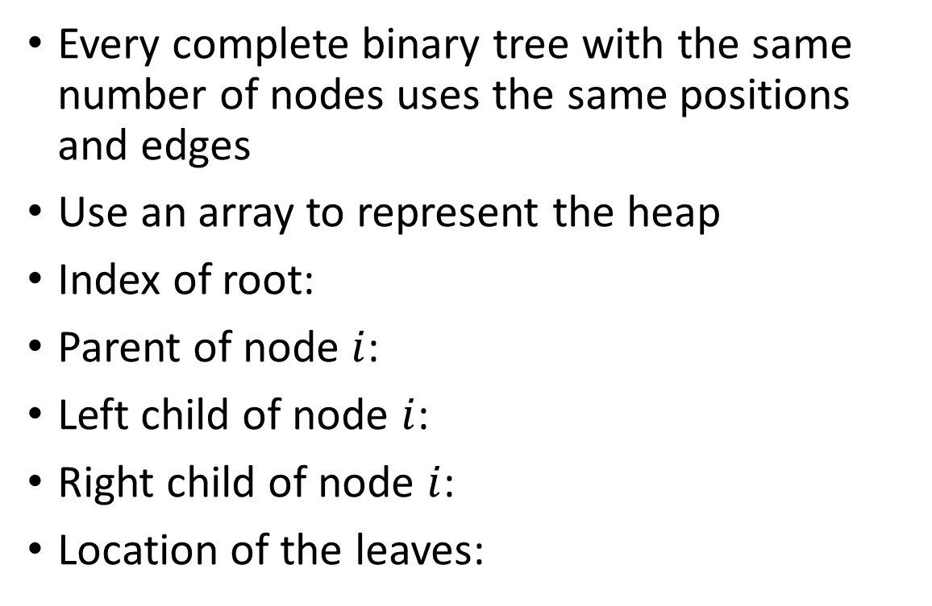
Representing a Heap
1
3
2
4
7
5
6
5
9
0
1
2
3
4
5
6
7
8
9
Every complete binary tree with the same number of nodes uses the same positions and edges
Use an array to represent the heap
Index of root:
Parent of node $i$:
Left child of node $i$:
Right child of node $i$:
Location of the leaves:
1
1
3
2
4
2
7
5
3
6
4
5
6
7
5
9
8
9

Slide 18
Insert Psuedocode
1
3
2
4
7
5
6
5
9
For simplicity, assume is the same as priority
0
1
2
3
4
5
6
7
8
9
10
insert(item){
if(size == arr.length – 1){resize();}
size++;
arr[size] = item;
percolateUp(size)
}
1
1
3
2
4
2
7
5
3
6
4
5
6
7
5
9
8
9

Slide 19
Percolate Up
percolateUp(int i){
int parent = i/2; \\ index of parent
Item val = arr[i]; \\ value at current location
while(i > 1 && arr[i] < arr[parent]){ \\ until location is root or heap property holds
arr[i] = arr[parent]; \\ move parent value to this location
arr[parent] = val; \\ put current value into parent’s location
i = parent; \\ make current location the parent
parent = i/2; \\ update new parent
}
}

Slide 20
extract Psuedocode
extract(){
theMin = arr[1];
arr[1] = arr[size];
size--;
percolateDown(1);
return theMin;
}

Slide 21
Percolate Down
percolateDown(int i){
int left = i*2; \\ index of left child
int right = i*2+1; \\ index of right child
Item val = arr[i]; \\ value at location
while(left <= size){ \\ until location is leaf
int toSwap = right;
if(right > size || arr[left] < arr[right]){ \\ if there is no right child or if left child is smaller
toSwap = left; \\ swap with left
} \\ now toSwap has the smaller of left/right, or left if right does not exist
if (arr[toSwap] < val){ \\ if the smaller child is less than the current value
arr[i] = arr[toSwap];
arr[toSwap] = val; \\ swap parent with smaller child
i = toSwap; \\ update current node to be smaller child
left = i*2;
right = i*2+1;
}
else{ return;} \\ if we don’t swap, then heap property holds
}
}

Slide 22
Other Operations
Increase Key
Given the index of an item in the PQ, make its priority value larger
Min Heap: Then percolate Down
Max Heap: Then percolate Up
Decrease Key
Given the index of an item in the PQ, make its priority value smaller
Min Heap: Then percolate Up
Max Heap: Then percolate Down
Remove
Given the item at the given index from the PQ

Slide 23
Building a Heap From “Scratch”
Suppose we had $n$ items and wanted to “heapify” them
5
5
6
10
3
15
8
7
14
2
1
Violate Heap Property!
1
0
1
2
3
4
5
6
7
8
9
10
6
10
3
2
15
8
3
7
Two ways for “fix” the heap:
Percolate Up
Percolate Down
4
5
6
7
14
2
1
8
9
10

Slide 24
Floyd’s buildHeap method
Working towards the root, one row at a time, percolate down
buildHeap(){
for(int i = size; i>0; i--){
percolateDown(i);
}
}

Slide 25
Floyd’s buildHeap method
Suppose we had $n$ items and wanted to “heapify” them
Violate Heap Property!
Nodes bigger than a child
5
5
6
10
3
15
8
7
14
2
1
1
0
1
2
3
4
5
6
7
8
9
10
6
10
3
2
8
3
7
buildHeap(){
for(int i = size; i>0; i--){
percolateDown(i);
}
}
15
4
5
6
7
14
2
1
8
9
10

Slide 26
Floyd’s buildHeap method
Suppose we had $n$ items and wanted to “heapify” them
Violate Heap Property!
Nodes bigger than a child
5
5
6
10
3
15
8
7
14
2
1
1
0
1
2
3
4
5
6
7
8
9
10
6
10
3
2
8
3
7
buildHeap(){
for(int i = size; i>0; i--){
percolateDown(i);
}
}
1
4
5
6
7
14
2
15
8
9
10

Slide 27
Floyd’s buildHeap method
Suppose we had $n$ items and wanted to “heapify” them
5
5
6
10
3
15
8
7
14
2
1
Violate Heap Property!
1
0
1
2
3
4
5
6
7
8
9
10
6
10
2
2
8
3
7
buildHeap(){
for(int i = size; i>0; i--){
percolateDown(i);
}
}
1
4
5
6
7
14
3
15
8
9
10

Slide 28
Floyd’s buildHeap method
Suppose we had $n$ items and wanted to “heapify” them
5
5
6
10
3
15
8
7
14
2
1
Violate Heap Property!
1
0
1
2
3
4
5
6
7
8
9
10
6
7
2
2
8
3
10
buildHeap(){
for(int i = size; i>0; i--){
percolateDown(i);
}
}
1
4
5
6
7
14
3
15
8
9
10

Slide 29
Floyd’s buildHeap method
Suppose we had $n$ items and wanted to “heapify” them
5
5
6
10
3
15
8
7
14
2
1
Violate Heap Property!
1
0
1
2
3
4
5
6
7
8
9
10
1
7
2
2
8
3
10
buildHeap(){
for(int i = size; i>0; i--){
percolateDown(i);
}
}
6
4
5
6
7
14
3
15
8
9
10

Slide 30
Floyd’s buildHeap method
Suppose we had $n$ items and wanted to “heapify” them
1
5
6
10
3
15
8
7
14
2
1
Violate Heap Property!
1
0
1
2
3
4
5
6
7
8
9
10
2
7
3
2
8
3
10
buildHeap(){
for(int i = size; i>0; i--){
percolateDown(i);
}
}
6
4
5
6
7
14
5
15
8
9
10

Slide 31
How long did this take?
buildHeap(){
for(int i = size; i>0; i--){
percolateDown(i);
}
}
Worst case running time of buildHeap:
No node can percolate down more than the height of its subtree
When i is a leaf:
When i is second-from-last level:
When i is third-from-last level:
Overall Running time:

Slide 32
Dictionary (Map) ADT
Contents:
Sets of key+value pairs
Keys must be comparable
Operations:
insert(key, value)
Adds the (key,value) pair into the dictionary
If the key already has a value, overwrite the old value
Consequence: Keys cannot be repeated
find(key)
Returns the value associated with the given key
delete(key)
Remove the key (and its associated value)

Slide 33
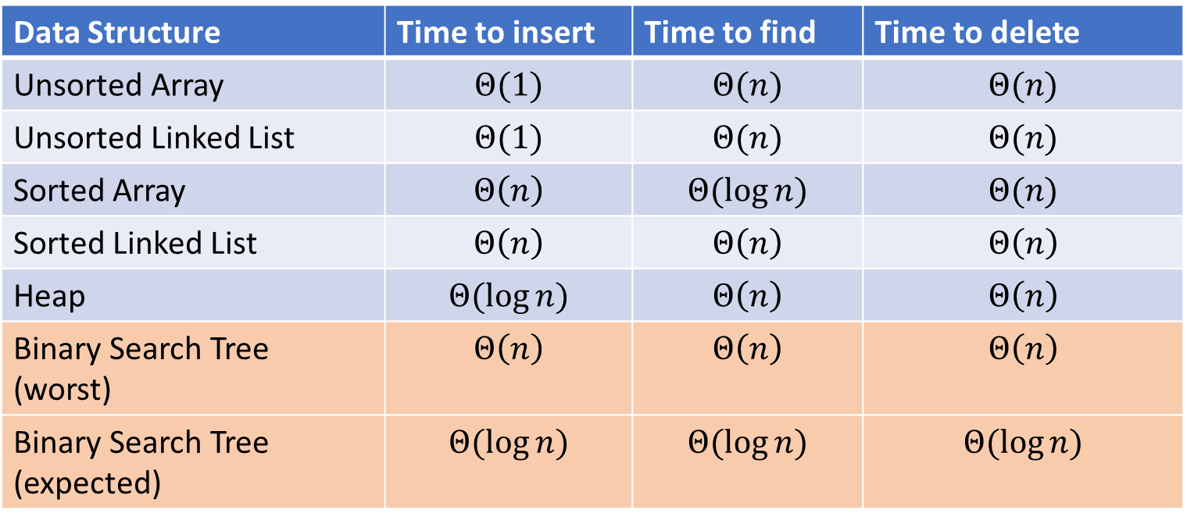
Naïve attempts
Data Structure | Time to insert | Time to find | Time to delete
Unsorted Array | $$Θ(1)$$ | $$Θ(n)$$ | $$Θ(n)$$
Unsorted Linked List | $$Θ(1)$$ | $$Θ(n)$$ | $$Θ(n)$$
Sorted Array | $$Θ\left(n\right)$$ | $$Θ(\log{n})$$ | $$Θ(n)$$
Sorted Linked List | $$Θ\left(n\right)$$ | $$Θ\left(n\right)$$ | $$Θ\left(n\right)$$
Heap | $$Θ(\log{n})$$ | $$Θ\left(n\right)$$ | $$Θ\left(n\right)$$
Binary Search Tree (worst) | $$Θ\left(n\right)$$ | $$Θ\left(n\right)$$ | $$Θ\left(n\right)$$
Binary Search Tree (expected) | $$Θ(\log{n})$$ | $$Θ(\log{n})$$ | $$Θ(\log{n})$$

Slide 34
More Tree “Vocab”
D
U
B
Traversal:
An algorithm for “visiting/processing” every node in a tree
Pre-Order Traversal:
Root, Left Subtree, Right Subtree
D (U S 2) B
In-Order Traversal:
Left Subtree, Root, Right Subtree
(S U 2) D B
Post-Order Traversal
Left Subtree, Right Subtree, Root
S 2 U B D
S
2

Slide 35
Name that Traversal!
AorderTraversal(root){
if (root.left != Null){
process(root.left);
}
if (root.right != Null){
process(root.right);
}
process(root);
}
BorderTraversal(root){
process(root);
if (root.left != Null){
process(root.left);
}
if (root.right != Null){
process(root.right);
}
}
CorderTraversal(root){
if (root.left != Null){
process(root.left);
}
process(root)
if (root.right != Null){
process(root.right);
}
}

Slide 36
Binary Search Tree
7
3
10
1
6
8
16
Binary Tree
Definition:
Tree where each node has at most 2 children
Order Property
All keys in the left subtree are smaller than the root
All keys in the right subtree are larger than the root
Consequence: cannot have repeated values
0
2

Slide 37
Are these BSTs?
7
3
10
7
7
16
1
3
10
0
1
16
16
10
0
7
7
3
10
3
1
8
16
1
0
0

Slide 38
Aside: Why not use an array?
We represented a heap using an array, finding children/parents by index
We will represent BSTs with nodes and references. Why?
We might have “gaps” in our tree
Memory!
$2^{n}$

Slide 39
Find Operation (recursive)
7
3
10
find(key, root){
if (root == Null){
return Null;
{
if (key == root.key){
return root.value;
}
if (key < root.key){
return find(key, root.left);
}
if (key > root.key){
return find(key, root.right);
}
return Null;
}
1
6
16
0

Slide 40
Find Operation (iterative)
7
3
10
find(key, root){
while (root != Null && key != root.key){
if (key < root.key){
root = root.left;
}
else if (key > root.key){
root = root.right;
}
}
if (root == Null){
return Null;
}
return root.value;
}
1
6
16
0

Slide 41
Insert Operation (recursive)
7
3
10
insert(key, value, root){
root = insertHelper(key, value, root);
}
insertHelper(key, value, root){
if(root == null)
return new Node(key, value);
if (root.key < key)
root.right = insertHelper(key, value, root.right);
else
root.left = insertHelper(key, value, root.left);
return root;
}
1
6
16
0
Note: Insert happens only at the leaves!

Slide 42
Insert Operation (iterative)
7
3
10
insert(key, value, root){
if (root == Null){ this.root = new Node(key, value); }
parent = Null;
while (root != Null && key != root.key){
parent = root;
if (key < root.key){ root = root.left; }
else if (key > root.key){ root = root.right; }
}
if (root != Null){ root.value = value; }
else if (key < parent.key){ parent.left = new Node(key, value); }
else{ parent.right = new Node (key, value); }
}
1
6
16
0
Note: Insert happens only at the leaves!

Slide 43
Delete Operation (iterative)
9
3
10
delete(key, root){
while (root != Null && key != root.key){
if (key < root.key){ root = root.left; }
else if (key > root.key){ root = root.right; }
}
if (root == Null){ return; }
// Now root is the node to delete, what happens next?
}
1
6
16
0
5
7

Slide 44
Delete – 3 Cases
9
3
10
1
6
16
0 Children (i.e. it’s a leaf)
1 Child
Replace the deleted node with its child
2 Children
Replace the deleted with the largest node to its left or else the smallest node to its right
0
5
7

Slide 45
Finding the Max and Min
9
3
10
maxNode(root){
if (root == Null){ return Null; }
while (root.right != Null){
root = root.right;
}
return root;
}
1
6
16
Max of a BST:
Right-most Thing
Min of a BST:
Left-most Thing
0
5
7
minNode(root){
if (root == Null){ return Null; }
while (root.left != Null){
root = root.left;
}
return root;
}

Slide 46
Delete Operation (iterative)
9
3
10
delete(key, root){
while (root != Null && key != root.key){
if (key < root.key){ root = root.left; }
else if (key > root.key){ root = root.right; }
}
if (root == Null){ return; }
if (root has no children){
make parent point to Null Instead;
}
if (root has one child){
make parent point to that child instead;
}
if (root has two children){
make parent point to either the max from the left or min from the right
}
}
1
6
16
0
5
7

