Slide 1
CSE 332 Autumn 2024 Lecture 2: Algorithm Analysis pt.1
Nathan Brunelle
http://www.cs.uw.edu/332

Slide 2
“Circular” Array – Queue Data Structure
front=0
5
8
3
4
7
0
1
2
3
4
5
6
7
8
9
back=5
Queue represented as an array of items
A “front” index to indicate the oldest item in the queue
A “back” index to indicate the most recent item in the queue
Actually, the first “open” slot in the array
enqueue Procedure:
dequeue Procedure:
isEmpty Procedure:

Slide 3
“Circular” Array
Intuitively, An array of values arranged in a “circle” rather than a line
If you go beyond the last index, to wrap back around to 0
5
8
3
4
7
…
5
0
1
2
3
4
5
6
7
8
9
…
9
0
8
8
1
front=0
…
7
2
3
back=5
6
3
…
5
4
4
…
7

Slide 4
“Circular” Array – Queue Data Structure
front=0
5
8
3
4
7
0
1
2
3
4
5
6
7
8
9
back=5
Queue represented as an array of items
A “front” index to indicate the oldest item in the queue
A “back” index to indicate the most recent item in the queue
enqueue Procedure:
dequeue Procedure:
isEmpty Procedure:
enqueue(x){
queue[back] = x;
back = (back + 1) % queue.length;
size++;
}
dequeue(){
first = queue[front];
front = (front + 1) % queue.length;
size--;
return first;
}
What if we run out of space?!
isEmpty(){
return size== 0;
}

Slide 5
“Circular” Array – Queue Data Structure
front=0
5
8
3
4
7
0
1
2
3
4
5
6
7
8
9
back=5
Queue represented as an array of items
A “front” index to indicate the oldest item in the queue
A “back” index to indicate the most recent item in the queue
enqueue Procedure:
dequeue Procedure:
isEmpty Procedure:
enqueue(x){
if (size == queue.length-1) {resize();}
queue[back] = x;
back = (back + 1) % queue.length;
size++;
}
dequeue(){
first = queue[front];
front = (front + 1) % queue.length;
size--;
return first;
}
isEmpty(){
return size== 0;
}

Slide 6
Warm up:
I have a pile of string
I have one end of the string in-hand
I need to find the other end in the pile
How can I do this efficiently?

Slide 7
Algorithm Ideas
Ideas:

Slide 8
Algorithm Running Times
How do we express running time?
“linear” meaning the time matched the length of the yarn
Units of “time”
inches
How to express efficiency?
Function, linear $t\left(n\right)=n$

Slide 9
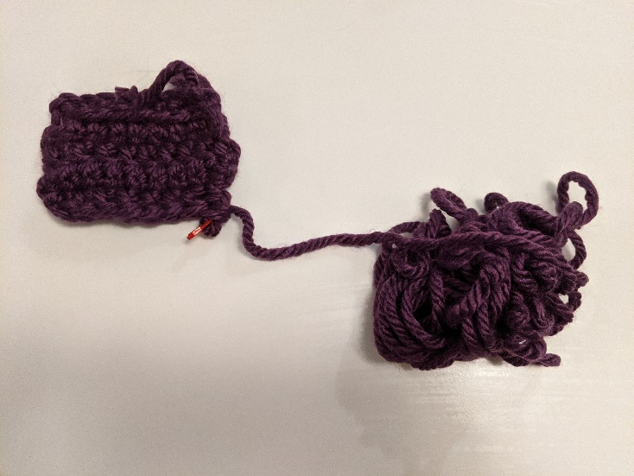
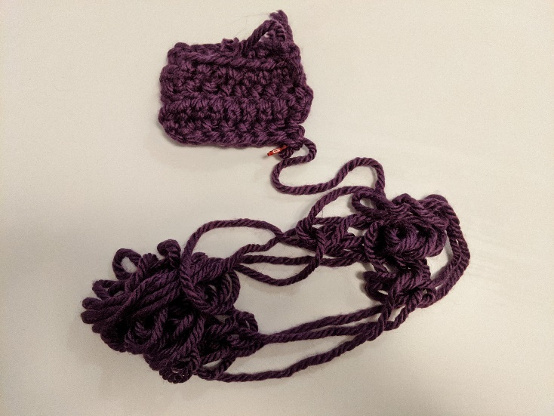
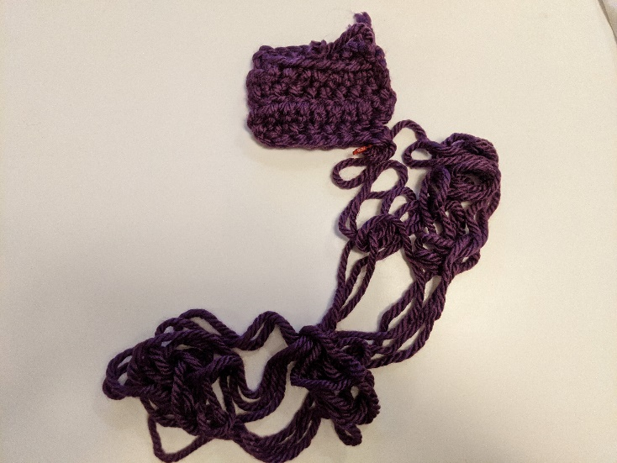
My Approach

Slide 10
End-of-Yarn Finding
Set aside the already-obtained “beginning”
If you see the end of the yarn, you’re done!
Separate the pile of yarn into 2 piles, note which connects to the beginning (call it pile A, the other pile B)
Count the number of strands crossing the piles
If the count is even, pile A contains the end, else pile B does
A
Repeat on pile with end
B

Slide 11
Why Do Resource Analysis?
Allows us to compare algorithms, not implementations
Using observations necessarily couples the algorithm with its implementation
My implementation on my computer takes more time than your implementation on your computer. Do you have a better algorithm or computer?
We can predict an algorithm’s running time before implementing
Understand where the bottlenecks are in our algorithm

Slide 12
Goals for Algorithm Analysis
Identify a function which maps the algorithm’s input size to a measure of resources used
Input of the function: sizes of the input
Number of characters in a string, number of items in a list, number of pixels in an image
Output of the function: counts of resources used
Number of times the algorithm:
Adds two numbers together
does a > or < comparison
Number of bytes of memory needed
Important note: Make sure you know the “units” of your domain (input size) and range (resource used)!

Slide 13
Analysis Process From 123/143
Count the number of “primitive operations”
+, -, compare, arr[i], arr.length, etc
Write that count as an expression using $n$ (the input size)
Put that expression into a “bucket” by ignoring constants and “non-dominant” terms, then put a $O( )$ around it.
$4n^{2}+8n−10$ ends up as $O\left(n^{2}\right)$
$\frac{1}{2}n+80$ ends up as $O\left(n\right)$
$n(n+1)$ ends up as $O\left(n^{2}\right)$

Slide 14
Worst Case Analysis (in general)
If an algorithm has a worst case resource complexity of $f(n)$
Among all possible size-$n$ inputs, the “worst” one will use $f(n)$ “resources”
$f(n)$ gives the maximum count needed from among all inputs of size $n$

Slide 15
Worst Case Analysis (in general)
If an algorithm has a worst case resource complexity of $f(n)$
Among all possible size-$n$ inputs, the “worst” one will use $f(n)$ “resources”
$f(n)$ gives the maximum count needed from among all inputs of size $n$

Slide 16
Worst Case Running Time Analysis
If an algorithm has a worst case running time of $f(n)$
Among all possible size-$n$ inputs, the “worst” one will do $f(n)$ “operations”
$f(n)$ gives the maximum count of operations needed from among all inputs of size $n$

Slide 17
Worst Case Space Analysis
If an algorithm has a worst case space complexity of $f(n)$
Among all possible size-$n$ inputs, the “worst” one will need $f(n)$ “memory units” (usually bits)
$f(n)$ gives the maximum number of bits needed from among all inputs of size $n$

Slide 18
Worst Case Running Time - Example
myFunction(List n){
b = 55 + 5; // 1
c = b / 3; // 1
b = c + 100; // 1
for (i = 0; i < n.size(); i++) { // 1, n times
b++; // 1
}
if (b % 2 == 0) { // 1
c++; // 1
}
else {
for (i = 0; i < n.size(); i++) { // 1, n times
c++; // 1
}
}
return c;
}
Questions to ask:
What are the units of the input size?
# of items in the list
What are the operations we’re counting?
Arithmetic ops (+-*/)
For each line:
How many times will it run?
How long does it take to run?
Does this change with different inputs?
Answer:
$3+2n+1+2n=4n+4$
$O(n)$

Slide 19
Worst Case Running Time – Example 2
beAnnoying(List n){
List m = [];
for (i=0; i < n.size(); i++){ // n times
m.add(n[i]);
for (j=0; j< n.size(); j++){ // n times
print (“Hi, I’m annoying”); // 1
}
}
return;
}
Questions to ask:
What are the units of the input size?
# items
What are the operations we’re counting?
Adding or printing
Printing: $O\left(n^{2}\right)$
For each line:
How many times will it run?
How long does it take to run?
Does this change with the input size?

Slide 20
Worst Case Running Time – General Guide
Add together the time of consecutive statements
Loops: Sum up the time required through each iteration of the loop
If each takes the same time, then [time per loop $×$ number of iterations]
Conditionals: Sum together the time to check the condition and time of the slowest branch
Function Calls: Time of the function’s body
Recursion: Solve a recurrence relation

Slide 21
Defining your running time function
Worst-case complexity:
max number of steps algorithm takes on “most challenging” input
Best-case complexity:
min number of steps algorithm takes on “easiest” input
Average/expected complexity:
avg number of steps algorithm takes on random inputs (context-dependent)
Amortized complexity:
max total number of steps algorithm takes on M “most challenging” consecutive inputs, divided by M (i.e., divide the max total sum by M).

Slide 22
Amortized Complexity Example - ArrayList
public void add(T value){
if(data.length == size)
resize();
data[size] = value;
size++;
}
private void resize(){
T[] oldData = data;
data = (T[]) new Object[data.length*2];
for(int i = 0; i < oldData.length; i++)
data[i] = oldData[i];
}
What is the worst case running time of add?
Input size: size of “this”
Operations counted: indexing
$O\left(n\right)$

Slide 23
Amortized Complexity Example - ArrayList
public void add(T value){
if(data.length == size)
resize();
data[size] = value;
size++;
}
private void resize(){
T[] oldData = data;
data = (T[]) new Object[data.length*2];
for(int i = 0; i < oldData.length; i++)
data[i] = oldData[i];
}
Amortized Analysis Idea:
Suppose we have a program that in total does $n$ adds.
How much time was spent “on average” across all $n$?
Let $c$ be the initial size of data
The first $c$ adds take: $c+c=2c$
The next $2c$ adds: $2c+2c=4c$
The next $4c$ adds: $4c+4c=8c$
Overall: $\frac{14c}{7c}=2c$
Every time we resize, we earn data.length more adds guaranteed to not resize!
Notes:
Amortized: “running average”

