Slide 1
CSE 332 Autumn 2024
Lecture 22: Analysis
Nathan Brunelle + Amanda Yuan
http://www.cs.uw.edu/332

Slide 2
Parallel Algorithm Analysis
How to define efficiency
  Want asymptotic bounds
  Want to analyze the algorithm without regard to a specific number of processors

Slide 3
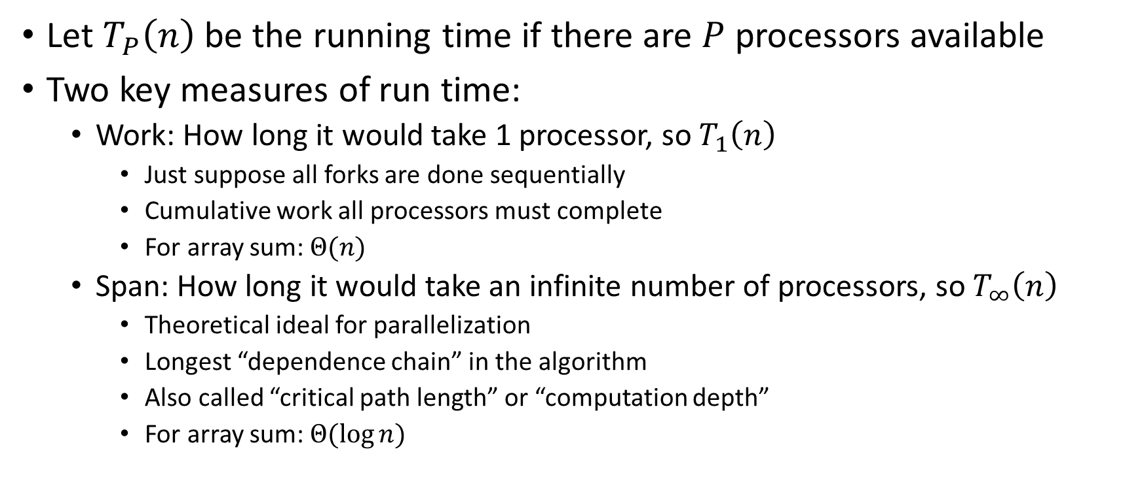
Work and Span
Let $T_{P}\left(n\right)$ be the running time if there are $P$ processors available
Two key measures of run time:
  Work: How long it would take 1 processor, so $T_{1}\left(n\right)$
    Just suppose all forks are done sequentially
    Cumulative work all processors must complete
    For array sum: $Θ(n)$
  Span: How long it would take an infinite number of processors, so $T_{∞}\left(n\right)$
    Theoretical ideal for parallelization
    Longest “dependence chain” in the algorithm
    Also called “critical path length” or “computation depth”
    For array sum: $Θ(log{n})$

Slide 4
Directed Acyclic Graph (DAG)
A directed graph that has no cycles
Often used to depict dependencies
  E.g. software dependencies, Java inheritance, dependencies among threads!
1
3
2

Slide 5
ForkJoin DAG
“Sketches” what parts of the algorithm may be done in parallel vs. must be done in-order
  Each node is a “step” of the algorithm that may depend on other steps (draw an edge) or not
Fork/Compute each create a new node
  When calling fork/compute
    Algorithm creates new threads, there is a dependency from the creating code to the code done by these threads
  When calling join
    There is a dependency from the code done by the other thread to the code after join
Divide
Span
Base Cases
Combine

Slide 6
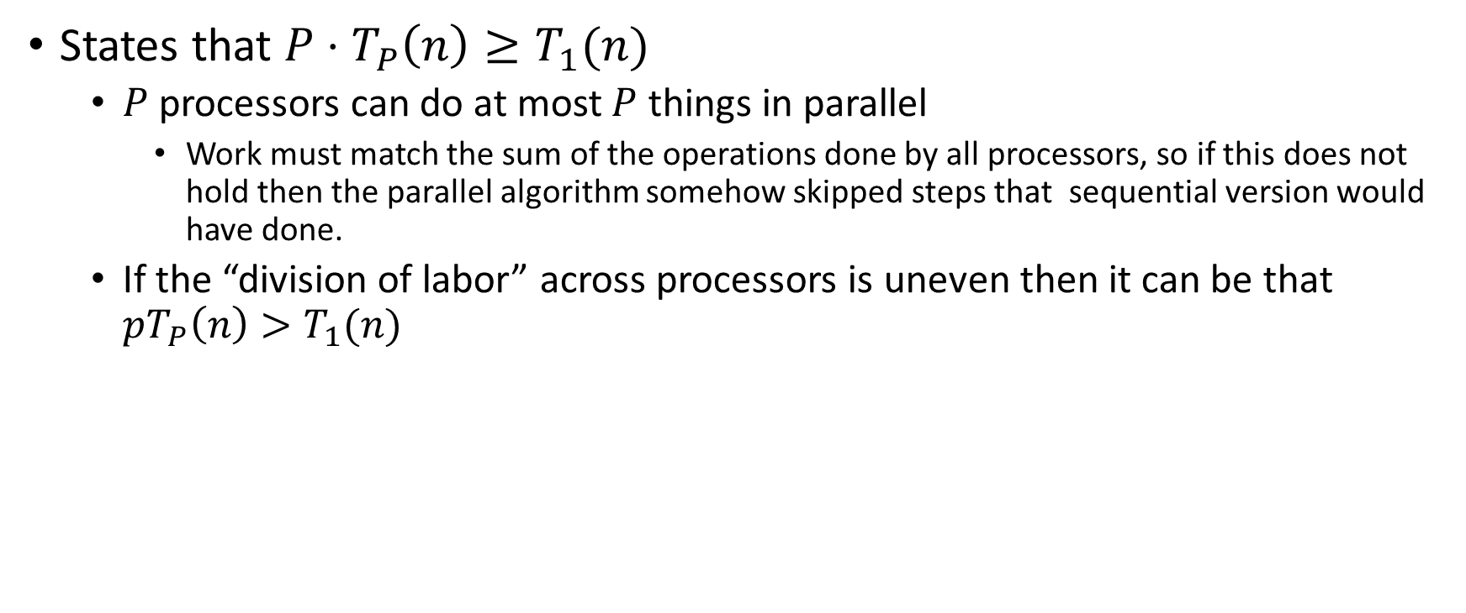
Work Law
States that $P⋅T_{P}\left(n\right)≥T_{1}(n)$
  $P$ processors can do at most $P$ things in parallel
    Work must match the sum of the operations done by all processors, so if this does not hold then the parallel algorithm somehow skipped steps that sequential version would have done.
  If the “division of labor” across processors is uneven then it can be that $pT_{P}\left(n\right)>T_{1}(n)$

Slide 7
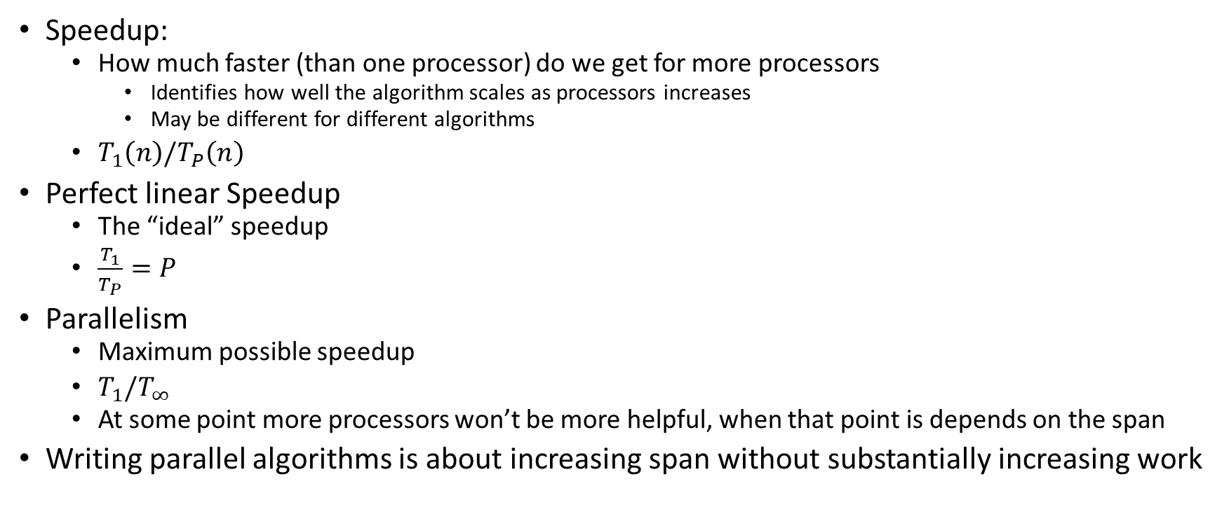
More Vocab
Speedup:
  How much faster (than one processor) do we get for more processors
    Identifies how well the algorithm scales as processors increases
    May be different for different algorithms
  $T_{1}\left(n\right)/T_{P}\left(n\right)$
Perfect linear Speedup
  The “ideal” speedup
  $\frac{T_{1}}{T_{P}}=P$
Parallelism
  Maximum possible speedup
  $T_{1}/T_{∞}$
  At some point more processors won’t be more helpful, when that point is depends on the span
Writing parallel algorithms is about increasing span without substantially increasing work

Slide 8
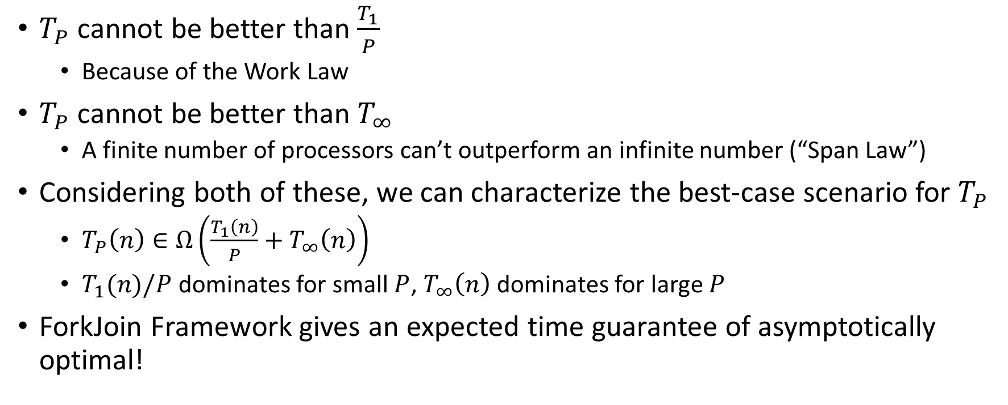

Asymptotically Optimal $T_{P}$
$T_{P}$ cannot be better than $\frac{T_{1}}{P}$
  Because of the Work Law
$T_{P}$ cannot be better than $T_{∞}$
  A finite number of processors can’t outperform an infinite number (“Span Law”)
Considering both of these, we can characterize the best-case scenario for $T_{P}$
  $T_{P}\left(n\right)∈Ω\left(\frac{T_{1}\left(n\right)}{P}+T_{∞}\left(n\right)\right)$
  $T_{1}(n)/P$ dominates for small $P$, $T_{∞}\left(n\right)$ dominates for large $P$
ForkJoin Framework gives an expected time guarantee of asymptotically optimal!

Slide 9
Division of Responsibility
Our job as ForkJoin Users:
  Pick a good algorithm, write a program
  When run, program creates a DAG of things to do
  Make all the nodes a small-ish and approximately equal amount of work
ForkJoin Framework Developer’s job:
  Assign work to available processors to avoid idling
    Abstract away scheduling issues for the user
  Keep constant factors low
  Give the expected-time optimal guarantee

Slide 10
And now for some bad news…
In practice it’s common for your program to have:
  Parts that parallelize well
    Maps/reduces/filters over arrays and other data structures
  Parts that don’t parallelize at all
    Reading a linked list, getting input, or computations where each step needs the results of previous step
These unparallelizable parts can turn out to be a big bottleneck

Slide 11
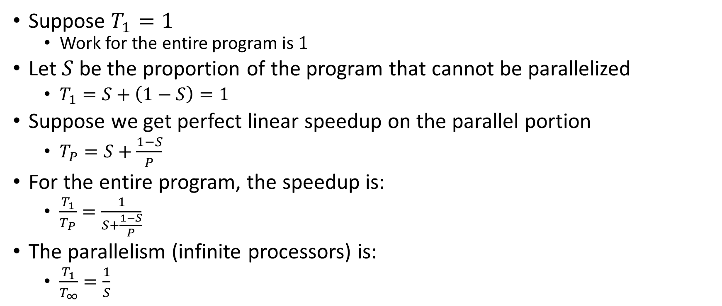
Amdahl’s Law (mostly bad news)
Suppose $T_{1}=1$
  Work for the entire program is $1$
Let $S$ be the proportion of the program that cannot be parallelized
  $T_{1}=S+\left(1−S\right)=1$
Suppose we get perfect linear speedup on the parallel portion
  $T_{P}=S+\frac{1−S}{P}$
For the entire program, the speedup is:
  $\frac{T_{1}}{T_{P}}=\frac{1}{S+\frac{1−S}{P}}$
The parallelism (infinite processors) is:
  $\frac{T_{1}}{T_{∞}}=\frac{1}{S}$

Slide 12

Ahmdal’s Law Example
Suppose 2/3 of your program is parallelizable, but 1/3 is not.
  $S=\frac{1}{3}$
  $T_{1}=\frac{2}{3}+\frac{1}{3}=1$
$T_{P}=S+\frac{1−S}{P}=\frac{1}{3}+\frac{2/3}{P}$
If $T_{1}$ is 100 seconds:
  $T_{P}=33+\frac{67}{P}$
Notes:
Suppose 2/3 of your program is parallelizable, but 1/3 is not.
$$S=\frac{1}{3}$$
$$T_{1}=\frac{2}{3}+\frac{1}{3}=1$$
$$T_{P}=S+\frac{1−S}{P}=\frac{1}{3}+\frac{2/3}{P}$$
If $T_{1}$ is 100 seconds:
$$T_{P}=33+\frac{67}{P}$$
$$T_{3}=33+\frac{67}{3}=33+22=55$$
$$T_{6}=33+\frac{67}{6}=33+11=44$$
$$T_{12}=33+\frac{67}{12}=33+5.5=38.5$$

Slide 13
Conclusion
Even with many many processors the sequential part of your program becomes a bottleneck
Parallelizable code requires skill and insight from the developer to recognize where parallelism is possible, and how to do it well.

Slide 14
Other Reasons to Use Threads
Code Responsiveness:
  While doing an expensive computation, you don’t what your interface to freeze
Processor Utilization:
  If one thread is waiting on a deep-hierarchy memory access you can still use that processor time
Failure Isolation:
  If one portion of your code fails, it will only crash that one portion.

