Slide 1
CSE 332 Autumn 2024
Lecture 18: Graphs 2
Nathan Brunelle
http://www.cs.uw.edu/332

Slide 2

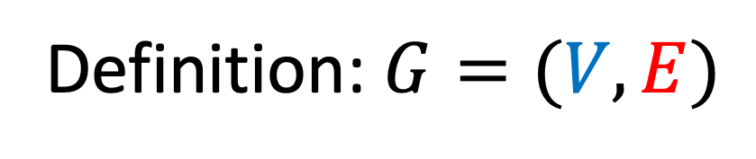

Undirected Graphs
Vertices/Nodes
Definition: $G=(V,E)$
Edges
2
$$V=\{1,2,3,4,5,6,7,8,9\}$$
5
$$E=\{\left(1,2\right),\left(2,3\right),(1,3),…\}$$
8
1
4
9
3
7
6

Slide 3
Directed Graphs
Vertices/Nodes
Definition: $G=(V,E)$
Edges
2
$$V=\{1,2,3,4,5,6,7,8,9\}$$
5
$$E=\{\left(1,2\right),\left(2,3\right),(1,3),…\}$$
8
1
4
9
3
7
6

Slide 4
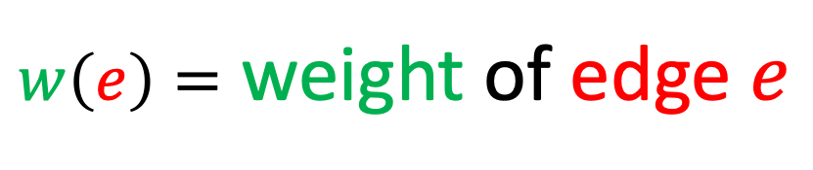


Weighted Graphs
Vertices/Nodes
Definition: $G=(V,E)$
$w\left(e\right)=$ weight of edge $e$
Edges
8
$$V=\{1,2,3,4,5,6,7,8,9\}$$
2
5
10
8
$$E=\{\left(1,2\right),\left(2,3\right),(1,3),…\}$$
7
8
1
2
9
4
5
9
9
12
3
3
3
11
7
1
6
6

Slide 5
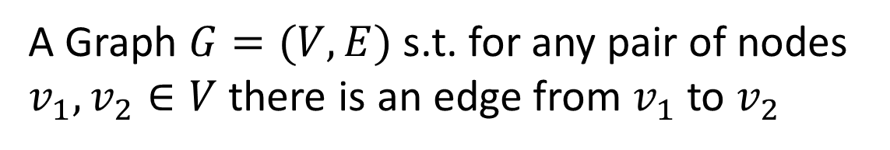
Definition: Complete Graph
A Graph $G=(V,E)$ s.t. for any pair of nodes $v_{1},v_{2}∈V$ there is an edge from $v_{1}$ to $v_{2}$
1
2
1
2
1
2
3
4
3
4
3
4
Complete Undirected Graph
Complete
Directed Graph
Complete Directed Non-simple Graph

Slide 6
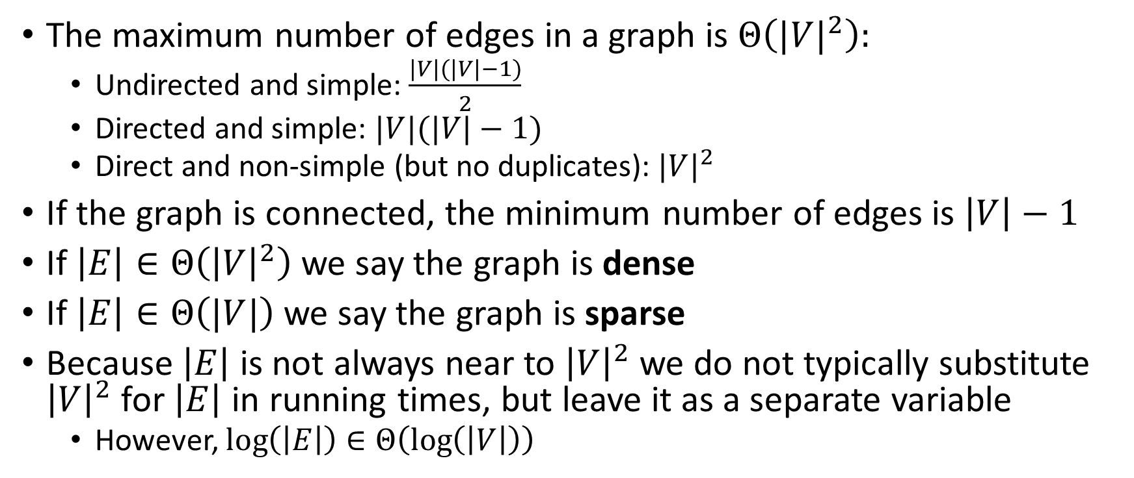
Graph Density, Data Structures, Efficiency
The maximum number of edges in a graph is $Θ\left({|V|}^{2}\right):$
  Undirected and simple: $\frac{|V|(|V|−1)}{2}$
  Directed and simple: $|V|(|V|−1)$
  Direct and non-simple (but no duplicates): ${|V|}^{2}$
If the graph is connected, the minimum number of edges is $\left|V\right|−1$
If $\left|E\right|∈Θ\left({\left|V\right|}^{2}\right)$ we say the graph is dense
If $\left|E\right|∈Θ\left(|V|\right)$ we say the graph is sparse
Because $\left|E\right|$ is not always near to ${\left|V\right|}^{2}$ we do not typically substitute ${\left|V\right|}^{2}$ for $\left|E\right|$ in running times, but leave it as a separate variable
  However, $\log\left(\left|E\right|\right)∈Θ\left(\log\left(\left|V\right|\right)\right)$

Slide 7
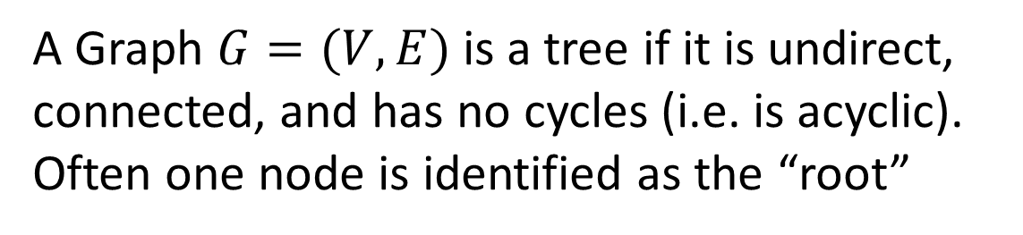
Definition: Tree
A Graph $G=(V,E)$ is a tree if it is undirect, connected, and has no cycles (i.e. is acyclic).
Often one node is identified as the “root”
2
5
4
8
1
4
3
6
5
9
3
1
7
8
6
2
9
A Tree
7
A Rooted Tree

Slide 8
Graph Operations
To represent a Graph (i.e. build a data structure) we need:
  Add Edge
  Remove Edge
  Check if Edge Exists
  Get Neighbors (incoming)
  Get Neighbors (outgoing)

Slide 9
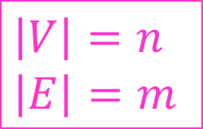
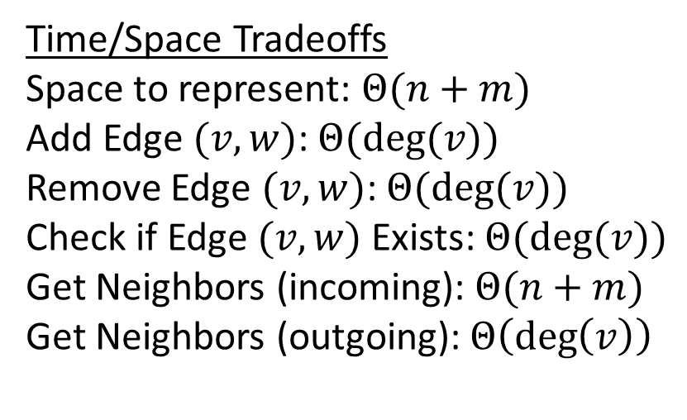
Adjacency List
2
5
1
2
3
8
2
1
3
5
1
4
9
3
1
2
4
6
3
4
3
5
6
7
6
5
2
4
7
8
Time/Space Tradeoffs
Space to represent: $Θ(n+m)$
Add Edge $(v,w)$: $Θ(deg⁡(v))$
Remove Edge $(v,w)$: $Θ(deg⁡(v))$
Check if Edge $(v,w)$ Exists: $Θ(deg⁡(v))$
Get Neighbors (incoming): $Θ(n+m)$
Get Neighbors (outgoing): $Θ\left(\deg\left(v\right)\right)$
6
3
4
7
7
5
6
8
9
$\left|V\right|=n$
$\left|E\right|=m$
8
5
7
9
9
7
8

Slide 10
Adjacency List (Weighted)
2
8
1
2
(10)
3
(12)
10
5
8
7
8
2
1
(10)
3
(9)
5
(8)
1
9
2
4
5
9
9
3
1
(12)
2
(9)
4
(3)
6
(1)
12
3
3
3
4
3
(3)
5
(7)
6
(3)
11
7
1
6
6
5
2
(8)
4
(7)
7
(5)
8
(8)
Time/Space Tradeoffs
Space to represent: $Θ(n+m)$
Add Edge $(v,w)$: $Θ(deg⁡(v))$
Remove Edge $(v,w)$: $Θ(deg⁡(v))$
Check if Edge $(v,w)$ Exists: $Θ(deg⁡(v))$
Get Neighbors (incoming): $Θ(n+m)$
Get Neighbors (outgoing): $Θ\left(\deg\left(v\right)\right)$
6
3
(1)
4
(3)
7
(6)
7
5
(5)
6
(6)
8
(9)
9
(11)
$\left|V\right|=n$
$\left|E\right|=m$
8
5
(8)
7
(9)
9
(2)
9
7
(11)
8
(2)

Slide 11
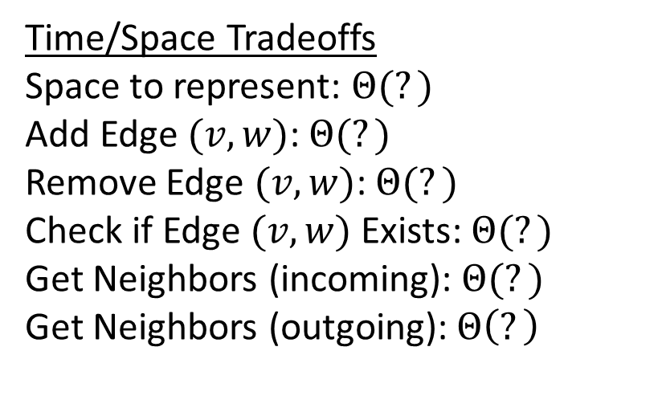
Adjacency Matrix
2
5
1
2
3
4
5
6
7
8
9
8
1
1
1
1
4
9
2
1
1
1
3
1
1
1
1
3
7
4
1
1
1
6
5
1
1
1
1
Time/Space Tradeoffs
Space to represent: $Θ(?)$
Add Edge $(v,w)$: $Θ(?)$
Remove Edge $(v,w)$: $Θ(?)$
Check if Edge $(v,w)$ Exists: $Θ(?)$
Get Neighbors (incoming): $Θ(?)$
Get Neighbors (outgoing): $Θ\left(?\right)$
6
1
1
1
7
1
1
1
1
$\left|V\right|=n$
$\left|E\right|=m$
8
1
1
1
9
1
1

Slide 12
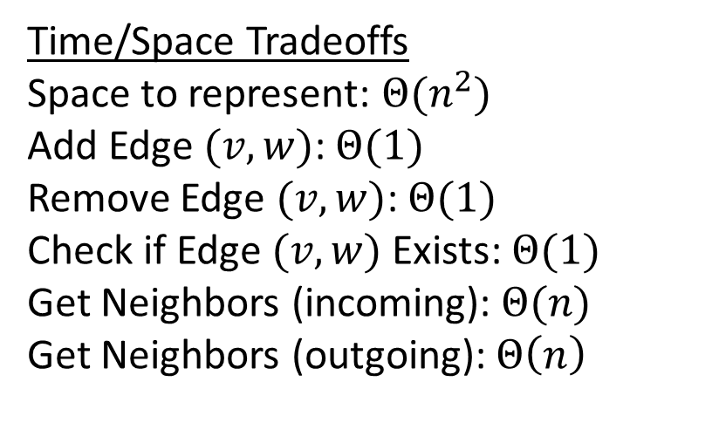
Adjacency Matrix
2
5
1
2
3
4
5
6
7
8
9
8
1
1
1
1
4
9
2
1
1
1
3
1
1
1
1
3
7
4
1
1
1
6
5
1
1
1
1
Time/Space Tradeoffs
Space to represent: $Θ(n^{2})$
Add Edge $(v,w)$: $Θ(1)$
Remove Edge $(v,w)$: $Θ(1)$
Check if Edge $(v,w)$ Exists: $Θ(1)$
Get Neighbors (incoming): $Θ(n)$
Get Neighbors (outgoing): $Θ\left(n\right)$
6
1
1
1
7
1
1
1
1
$\left|V\right|=n$
$\left|E\right|=m$
8
1
1
1
9
1
1

Slide 13
Adjacency Matrix (weighted)
2
8
10
5
8
1
2
3
4
5
6
7
8
9
7
8
1
9
2
1
10
12
4
5
9
9
2
10
9
8
12
3
3
3
12
9
3
1
3
11
4
3
7
3
7
1
6
6
5
8
7
5
8
Time/Space Tradeoffs
Space to represent: $Θ(n^{2})$
Add Edge $(v,w)$: $Θ(1)$
Remove Edge $(v,w)$: $Θ(1)$
Check if Edge $(v,w)$ Exists: $Θ(1)$
Get Neighbors (incoming): $Θ(n)$
Get Neighbors (outgoing): $Θ\left(n\right)$
6
1
3
1
7
5
1
9
11
$\left|V\right|=n$
$\left|E\right|=m$
8
8
9
2
9
11
2

Slide 14
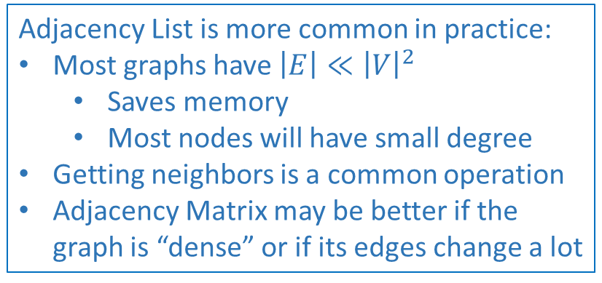
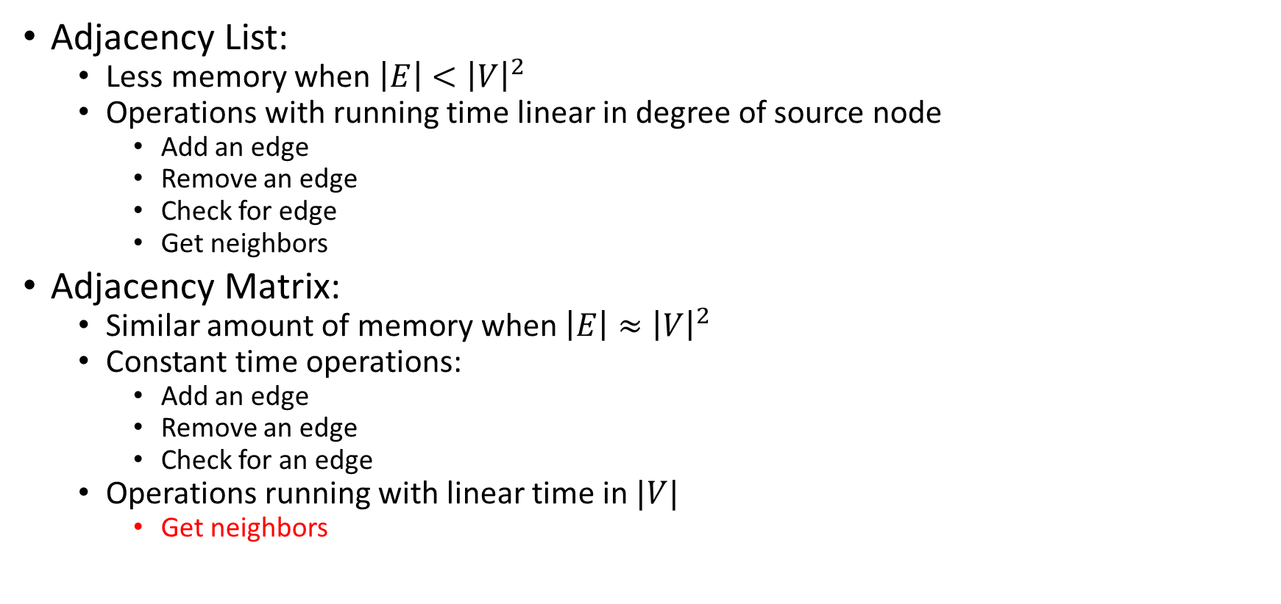
Comparison
Adjacency List:
  Less memory when $\left|E\right|<{\left|V\right|}^{2}$
  Operations with running time linear in degree of source node
    Add an edge
    Remove an edge
    Check for edge
    Get neighbors
Adjacency Matrix:
  Similar amount of memory when $\left|E\right|≈{\left|V\right|}^{2}$
  Constant time operations:
    Add an edge
    Remove an edge
    Check for an edge
  Operations running with linear time in $|V|$
    Get neighbors
Adjacency List is more common in practice:
Most graphs have $\left|E\right|≪{\left|V\right|}^{2}$
  Saves memory
  Most nodes will have small degree
Getting neighbors is a common operation
Adjacency Matrix may be better if the graph is “dense” or if its edges change a lot

Slide 15
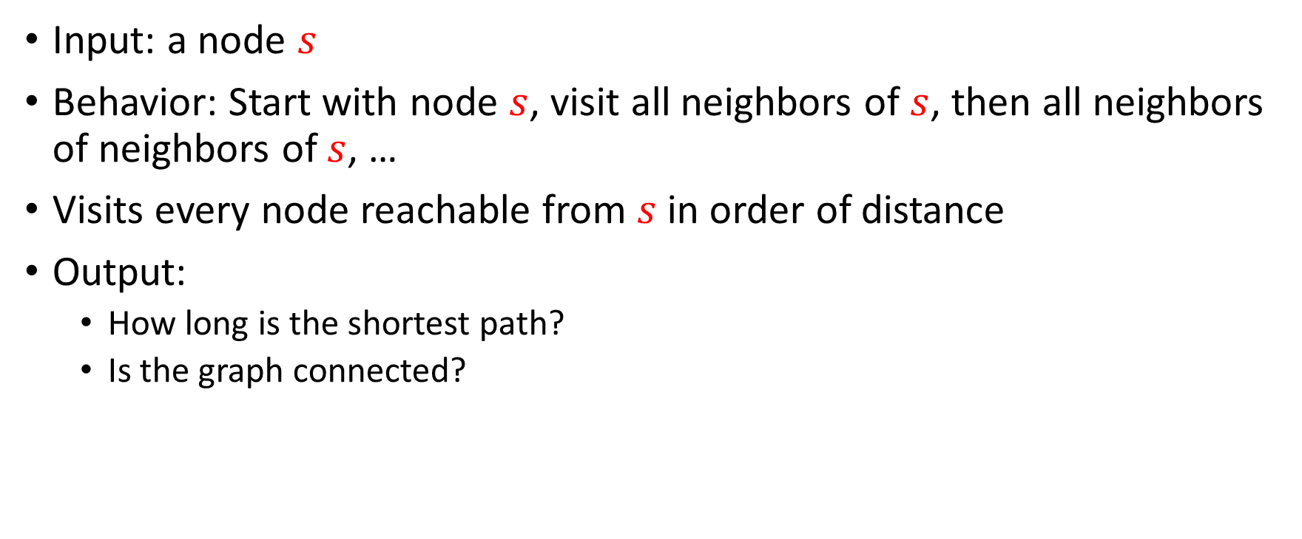
Breadth-First Search
Input: a node $s$
Behavior: Start with node $s$, visit all neighbors of $s$, then all neighbors of neighbors of $s$, …
Visits every node reachable from $s$ in order of distance
Output:
  How long is the shortest path?
  Is the graph connected?
2
5
8
1
4
9
3
7
6

Slide 16

BFS
void bfs(graph, s){
found = new Queue();
found.enqueue(s);
mark s as “visited”;
While (!found.isEmpty()){
current = found.dequeue();
for (v : neighbors(current)){
if (! v marked “visited”){
mark v as “visited”;
found.enqueue(v);
}
}
}
}
2
5
8
1
4
9
3
7
6
Running time: $Θ\left(\left|V\right|+\left|E\right|\right)$

Slide 17
BFS – Worked Example
2
Node | Visited? | Other Info
1 | True
2
3
4
5
6
7
8
9
5
8
1
4
9
3
7
6
For each node:
For each unvisited neighbor:
add that neighbor to a queue
mark that neighbor as visited
Queue:

Slide 18
Find Distance (unweighted)
int findDistance(graph, s, t){
found = new Queue();
layer = 0;
found.enqueue(s);
mark s as “visited”;
While (!found.isEmpty()){
current = found.dequeue();
layer = depth of current;
for (v : neighbors(current)){
if (! v marked “visited”){
mark v as “visited”;
depth of v = layer + 1;
found.enqueue(v);
}
}
}
return depth of t;
}
2
5
8
1
4
9
3
7
6
Idea: when it’s seen, remember its “layer” depth!

Slide 19
Find Distance – Worked Example
2
Node | Visited? | Layer
1
2
3
4
5
6
7
8
9
5
8
1
4
9
3
7
6
For each node:
update current layer
For each unvisited neighbor:
add that neighbor to a queue
mark that neighbor as visited
set neighbor’s layer to be current layer + 1
Queue:

Slide 20
Shortest Path - Idea
2
Node | Visited? | Previous
1
2
3
4
5
6
7
8
9
5
8
1
4
9
3
7
6
For each node:
For each unvisited neighbor:
add that neighbor to a queue
mark that neighbor as visited
set neighbor’s previous to be the current node
Queue:

Slide 21
Depth-First Search

Slide 22
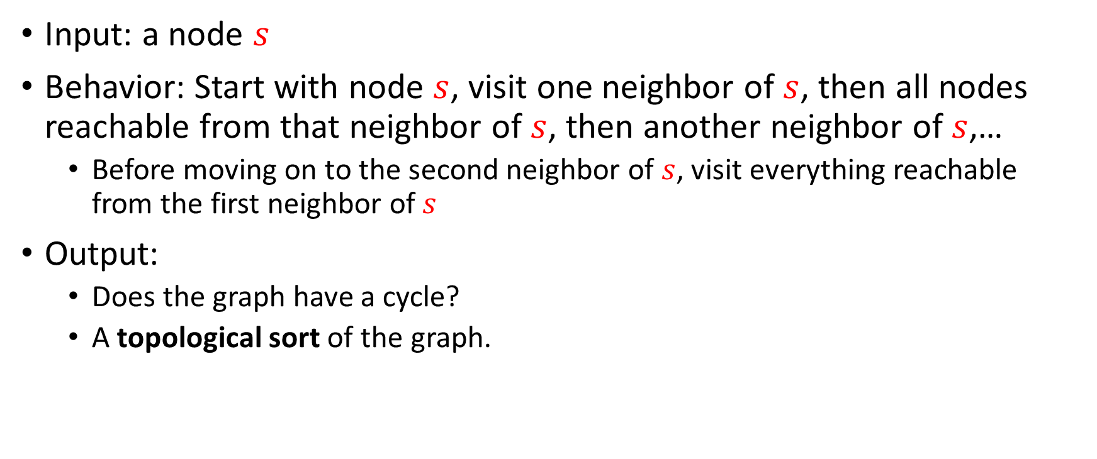
Depth-First Search
Input: a node $s$
Behavior: Start with node $s$, visit one neighbor of $s$, then all nodes reachable from that neighbor of $s$, then another neighbor of $s$,…
  Before moving on to the second neighbor of $s$, visit everything reachable from the first neighbor of $s$
Output:
  Does the graph have a cycle?
  A topological sort of the graph.
1
2
2
5
3
0
8
1
6
4
9
5
3
7
6
4
7

Slide 23
DFS (non-recursive)
void dfs(graph, s){
found = new Stack();
found.pop(s);
mark s as “visited”;
While (!found.isEmpty()){
current = found.pop();
for (v : neighbors(current)){
if (! v marked “visited”){
mark v as “visited”;
found.push(v);
}
}
}
}
2
5
8
1
4
9
3
7
6
Running time: $Θ\left(\left|V\right|+\left|E\right|\right)$

Slide 24
DFS Recursively (more common)
void dfs(graph, curr){
mark curr as “visited”;
for (v : neighbors(current)){
if (! v marked “visited”){
dfs(graph, v);
}
}
mark curr as “done”;
}
2
5
8
1
4
9
3
7
6

Slide 25
DFS – Worked Example
Node | Visited? | Done? | Other Info
1
2
3
4
5
6
7
8
9
2
5
8
1
4
9
3
7
6
Starting from the current node:
for each unvisited neighbor:
mark the neighbor as visited
do a DFS from the neighbor
mark the current node as done
(Call)
Stack:

Slide 26
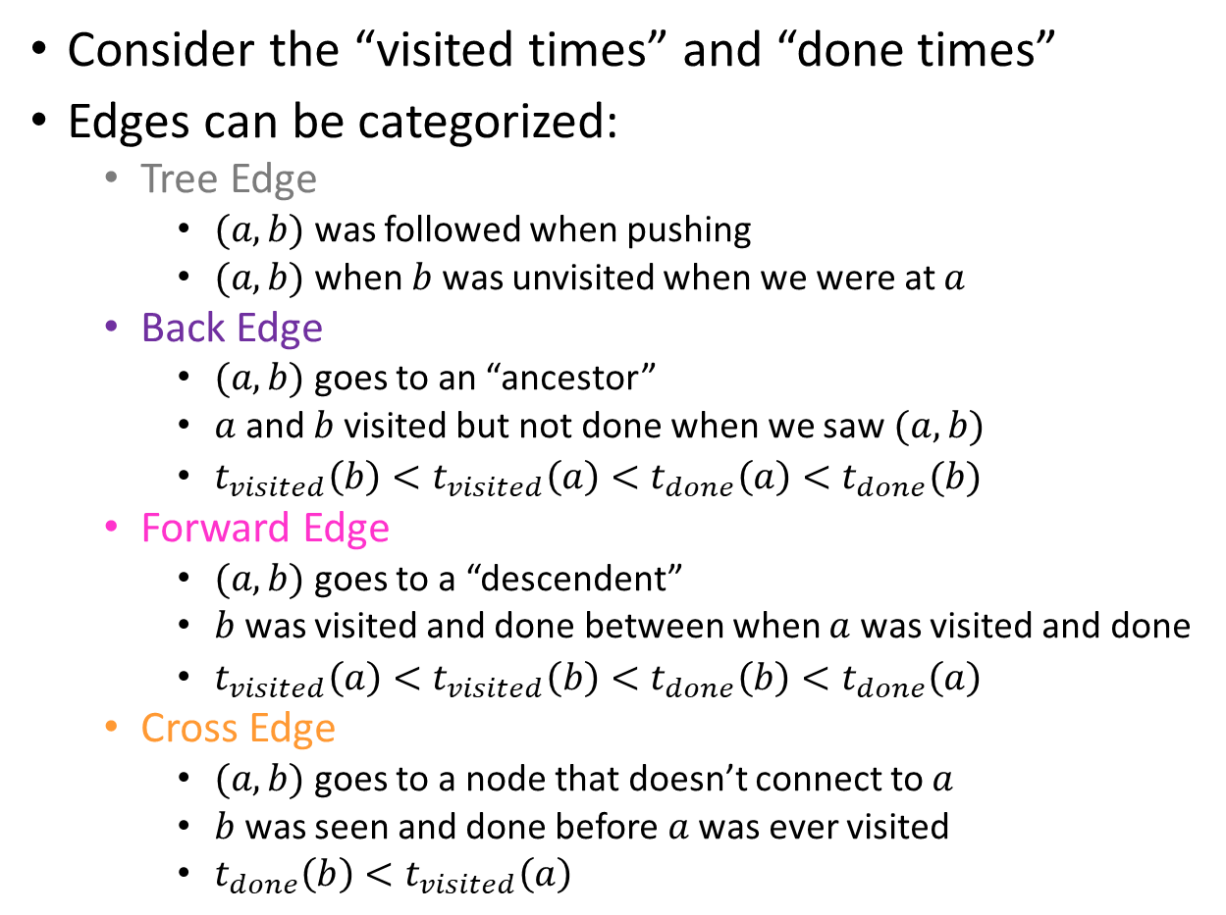
Using DFS
Consider the “visited times” and “done times”
Edges can be categorized:
  Tree Edge
    $(a,b)$ was followed when pushing
    $(a,b)$ when $b$ was unvisited when we were at $a$
  Back Edge
    $(a,b)$ goes to an “ancestor”
    $a$ and $b$ visited but not done when we saw $(a,b)$
    $t_{visited}\left(b\right)<t_{visited}\left(a\right)<t_{done}\left(a\right)<t_{done}(b)$
  Forward Edge
    $(a,b)$ goes to a “descendent”
    $b$ was visited and done between when $a$ was visited and done
    $t_{visited}\left(a\right)<t_{visited}\left(b\right)<t_{done}\left(b\right)<t_{done}\left(a\right)$
  Cross Edge
    $(a,b)$ goes to a node that doesn’t connect to $a$
    $b$ was seen and done before $a$ was ever visited
    $t_{done}\left(b\right)<t_{visited}\left(a\right)$
Visited : 1
Done: 8
Visited : 2
Done: 7
Visited : 3
Done: 6
Visited: 0
Done: 15
2
5
8
1
Visited : 10
Done: 13
4
9
Visited : 9
Done: 14
3
7
6
Visited : 11
Done: 12
Visited : 4
Done: 5

Slide 27
Back Edges
Behavior of DFS:
  “Visit everything reachable from the current node before going back”
Back Edge:
  The current node’s neighbor is an “in progress” node
  Since that other node is “in progress”, the current node is reachable from it
  The back edge is a path to that other node
  Cycle!
2
5
8
1
4
9
3
7
6

Slide 28
Cycle Detection
Idea: Look for a back edge!
boolean hasCycle(graph, curr){
mark curr as “visited”;
cycleFound = false;
for (v : neighbors(current)){
if (v marked “visited” && ! v marked “done”){
cycleFound=true;
}
if (! v marked “visited” && !cycleFound){
cycleFound = hasCycle(graph, v);
}
}
mark curr as “done”;
return cycleFound;
}
2
5
8
1
4
9
3
7
6

Slide 29
Cycle Detection – Worked Example
2
5
Node | Visited? | Done? | Other Info
1
2
3
4
5
6
7
8
9
8
1
4
9
3
7
6
Starting from the current node:
for each non-done neighbor:
if the neighbor is visited:
we found a cycle!
else:
mark the neighbor as visited
do a DFS from the neighbor
mark the current node as done
(Call)
Stack:

Slide 30

Topological Sort
A Topological Sort of a directed acyclic graph $G=(V,E)$ is a permutation of $V$ such that if $\left(u,v\right)∈E$ then $u$ is before $v$ in the permutation
2
5
8
1
1
3
4
6
2
5
9
8
7
4
9
3
7
6

Slide 31
DFS Recursively
Idea: List in reverse order by “done” time
void dfs(graph, curr){
mark curr as “visited”;
for (v : neighbors(current)){
if (! v marked “visited”){
dfs(graph, v);
}
}
mark curr as “done”;
}
2
5
8
1
4
9
3
7
6

Slide 32
DFS: Topological sort
List topSort(graph){
List<Nodes> done = new List<>();
for (Node v : graph.vertices){
if (!v.visited){
finishTime(graph, v, finished);
}
}
done.reverse();
return done;
}
void finishTime(graph, curr, finished){
curr.visited = true;
for (Node v : curr.neighbors){
if (!v.visited){
finishTime(graph, v, finished);
}
}
done.add(curr)
}
Idea: List in reverse order by “done” time
finished:
2
5
8
1
4
9
3
7
6

Slide 33
Topological Sort– Worked Example
2
5
Node | Visited? | Done? | Other Info
1
2
3
4
5
6
7
8
9
8
1
4
9
3
7
6
Starting from the current node:
for each non-done neighbor:
if the neighbor is visited:
we found a cycle!
else:
mark the neighbor as visited
do a DFS from the neighbor
mark the current node as done
add current node to finished
(Call)
Stack:
finished:

