Slide 1
CSE 332 Autumn 2024
Lecture 16: Sorting 3
Nathan Brunelle
http://www.cs.uw.edu/332

Slide 2
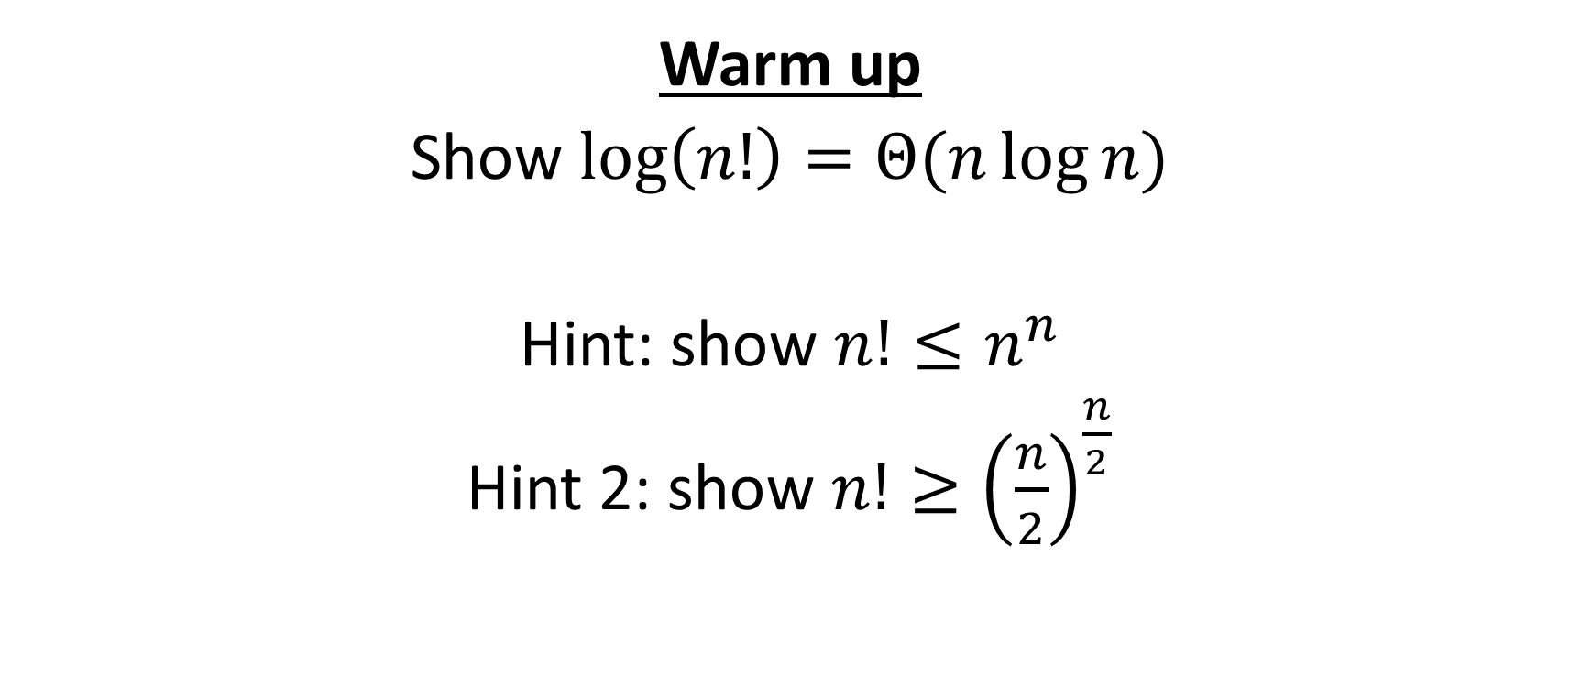
Warm up
Show $\log\left(n!\right)=Θ(n\log{n})$
Hint: show $n!≤n^{n}$
Hint 2: show $n!≥{\left(\frac{n}{2}\right)}^{\frac{n}{2}}$

Slide 3
$$\log{n!}=O\left(n\log{n}\right)$$
$$n!=n⋅\left(n−1\right)⋅\left(n−2\right)⋅…⋅2⋅1$$
$$=$$
$$<$$
$$<$$
$$<$$
$$<$$
$$n^{n}=n⋅ n ⋅ n ⋅…⋅n⋅n$$
$$n!≤n^{n}$$
$$⇒\log\left(n!\right)≤\log\left(n^{n}\right)$$
$$⇒\log\left(n!\right)≤n\log{n}$$
$$⇒\log\left(n!\right)=O(n\log{n})$$

Slide 4
$$\log{n!}=Ω\left(n\log{n}\right)$$
$$n!=n⋅\left(n−1\right)⋅\left(n−2\right)⋅…⋅\frac{n}{2}⋅\left(\frac{n}{2}−1\right)⋅…⋅2⋅1$$
$$>$$
$$>$$
$$>$$
$$=$$
$$>$$
$$>$$
$$=$$
$${\left(\frac{n}{2}\right)}^{\frac{n}{2}}=\frac{n}{2}⋅ \frac{n}{2} ⋅ \frac{n}{2} ⋅…⋅\frac{n}{2}⋅ 1 ⋅…⋅1⋅1$$
$$n!≥{\left(\frac{n}{2}\right)}^{\frac{n}{2}}$$
$$⇒\log\left(n!\right)≥\log\left({\left(\frac{n}{2}\right)}^{\frac{n}{2}}\right)$$
$$⇒\log\left(n!\right)≥\frac{n}{2}\log{\frac{n}{2}}$$
$$⇒\log\left(n!\right)=Ω(n\log{n})$$

Slide 5
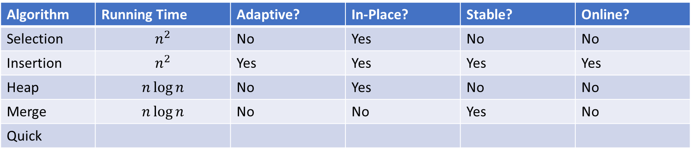
Sorting Algorithm Summary
Algorithm | Running Time | Adaptive? | In-Place? | Stable? | Online?
Selection | $$n^{2}$$ | No | Yes | No | No
Insertion | $$n^{2}$$ | Yes | Yes | Yes | Yes
Heap | $$n\log{n}$$ | No | Yes | No | No
Merge | $$n\log{n}$$ | No | No | Yes | No
Quick

Slide 6
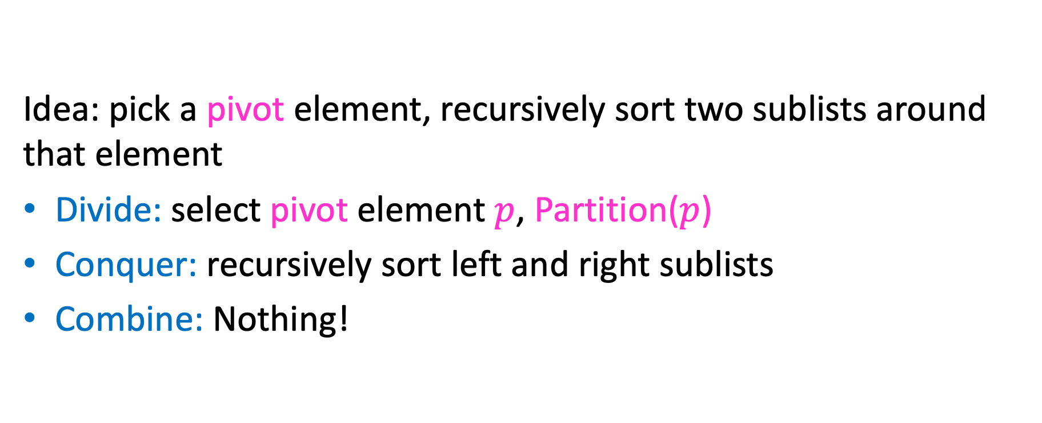
Quicksort
Idea: pick a pivot element, recursively sort two sublists around that element
Divide: select pivot element $p$, Partition($p$)
Conquer: recursively sort left and right sublists
Combine: Nothing!

Slide 7


Partition (Divide step)
Given: a list, a pivot $p$
Start: unordered list
8
5
7
3
12
10
1
2
4
9
6
11
Goal: All elements $<p$ on left, all $>p$ on right
5
7
3
1
2
4
6
8
12
10
9
11

Slide 8
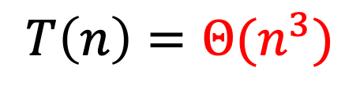
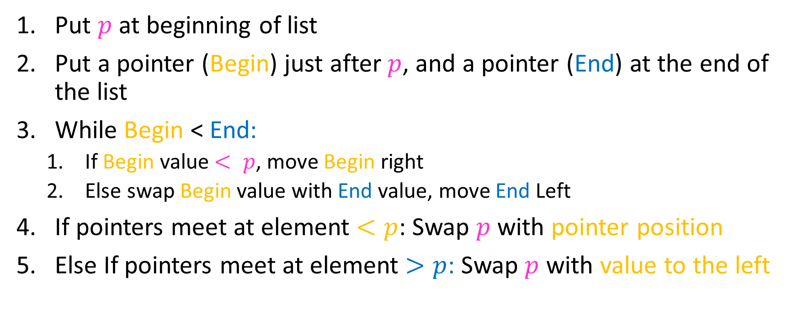
Partition Summary
Put $p$ at beginning of list
Put a pointer (Begin) just after $p$, and a pointer (End) at the end of the list
While Begin < End:
  If Begin value $< p$, move Begin right
  Else swap Begin value with End value, move End Left
If pointers meet at element $<p$: Swap $p$ with pointer position
Else If pointers meet at element $>p$: Swap $p$ with value to the left
Run time?
$$O(n)$$

Slide 9
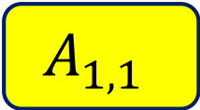
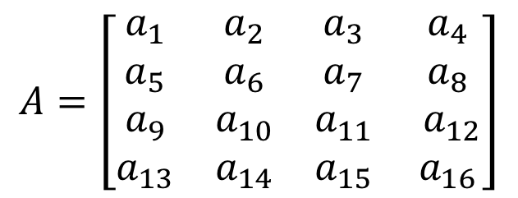
Conquer
2
5
7
3
6
4
1
8
10
9
11
12
All elements $<p$
All elements $>p$
Exactly where it belongs!
Recursively sort Left and Right sublists

Slide 10


Quicksort Run Time (Best)
If the pivot is always the median:
2
5
1
3
6
4
7
8
10
9
11
12
2
1
3
5
6
4
7
8
9
10
11
12
Then we divide in half each time
$$T\left(n\right)=2T\left(\frac{n}{2}\right)+n$$
$$T\left(n\right)=O(n\log{n})$$

Slide 11

Quicksort Run Time (Worst)
If the pivot is always at the extreme:
1
5
2
3
6
4
7
8
10
9
11
12
1
2
3
5
6
4
7
8
10
9
11
12
Then we shorten by 1 each time
$$T\left(n\right)=T\left(n−1\right)+n$$
$$T\left(n\right)=O(n^{2})$$

Slide 12
Good Pivot
What makes a good Pivot?
  Roughly even split between left and right
  Ideally: median
There are ways to find the median in linear time, but it’s complicated and slow and you’re better off using mergesort
In Practice:
  Pick a random value as a pivot
  Pick the middle of 3 random values as the pivot

Slide 13
Properties of Quick Sort
Worst Case Running time:
In-Place?
Adaptive?
Stable?

Slide 14
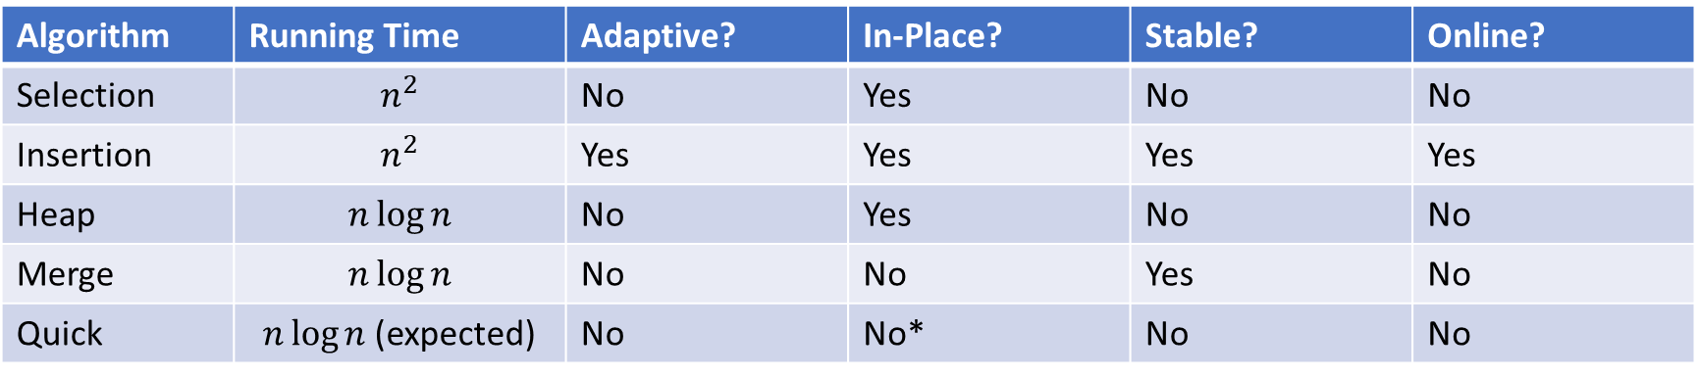
Sorting Algorithm Summary
Algorithm | Running Time | Adaptive? | In-Place? | Stable? | Online?
Selection | $$n^{2}$$ | No | Yes | No | No
Insertion | $$n^{2}$$ | Yes | Yes | Yes | Yes
Heap | $$n\log{n}$$ | No | Yes | No | No
Merge | $$n\log{n}$$ | No | No | Yes | No
Quick | $n\log{n}$ (expected) | No | No* | No | No
*Quick Sort can be done in-place within each stack frame. Some textbooks do not include the memory occupied by the stack frame in space analysis, which would mean concluding Quick Sort is in-place. Others will include stack frame space, and therefore conclude Quick Sort is not in-place. If you try to implement it iteratively, you’ll need another array somewhere (e.g. to store locations of sub-lists)

Slide 15
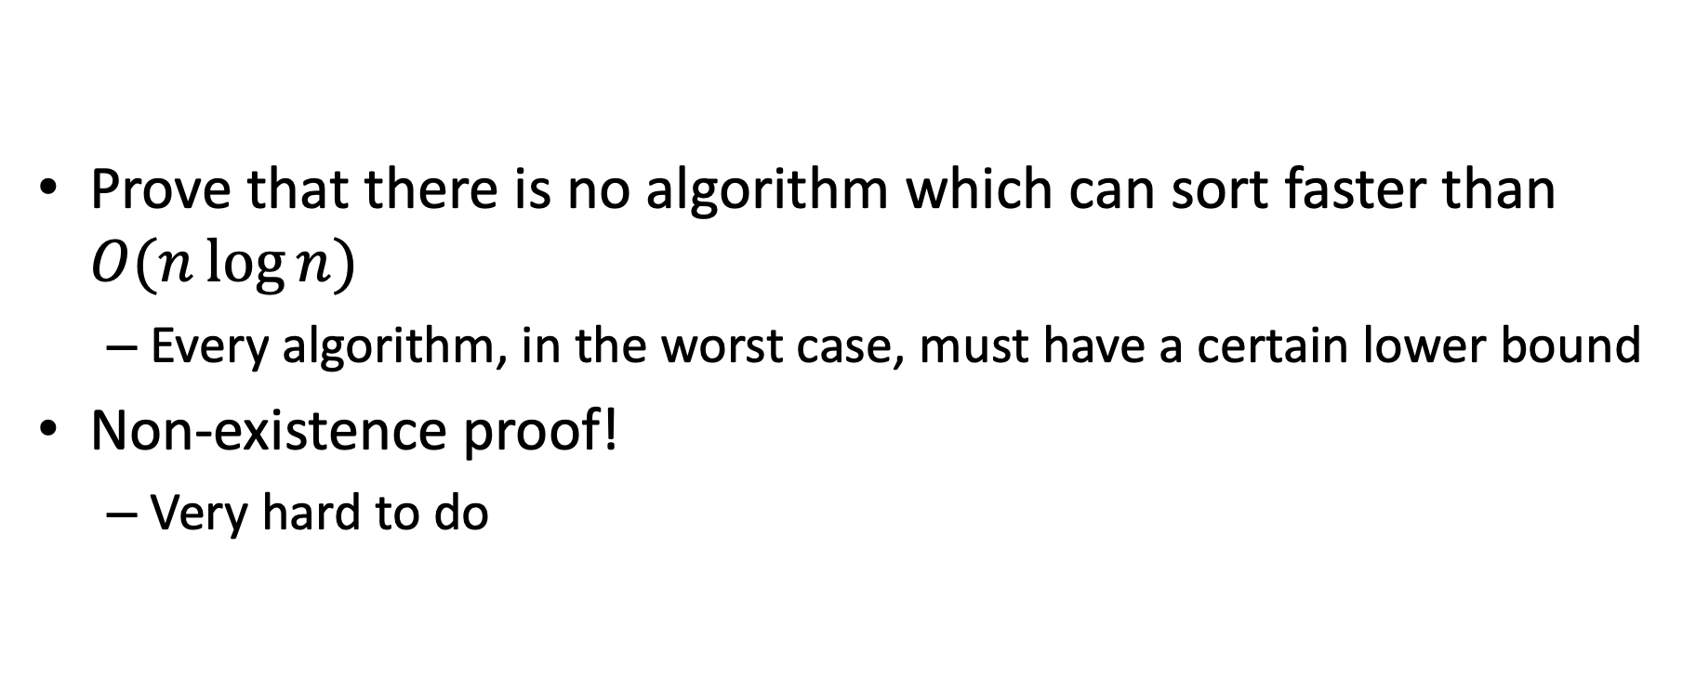
Worst Case Lower Bounds
Prove that there is no algorithm which can sort faster than $O(n\log{n})$
  Every algorithm, in the worst case, must have a certain lower bound
Non-existence proof!
  Very hard to do

Slide 16
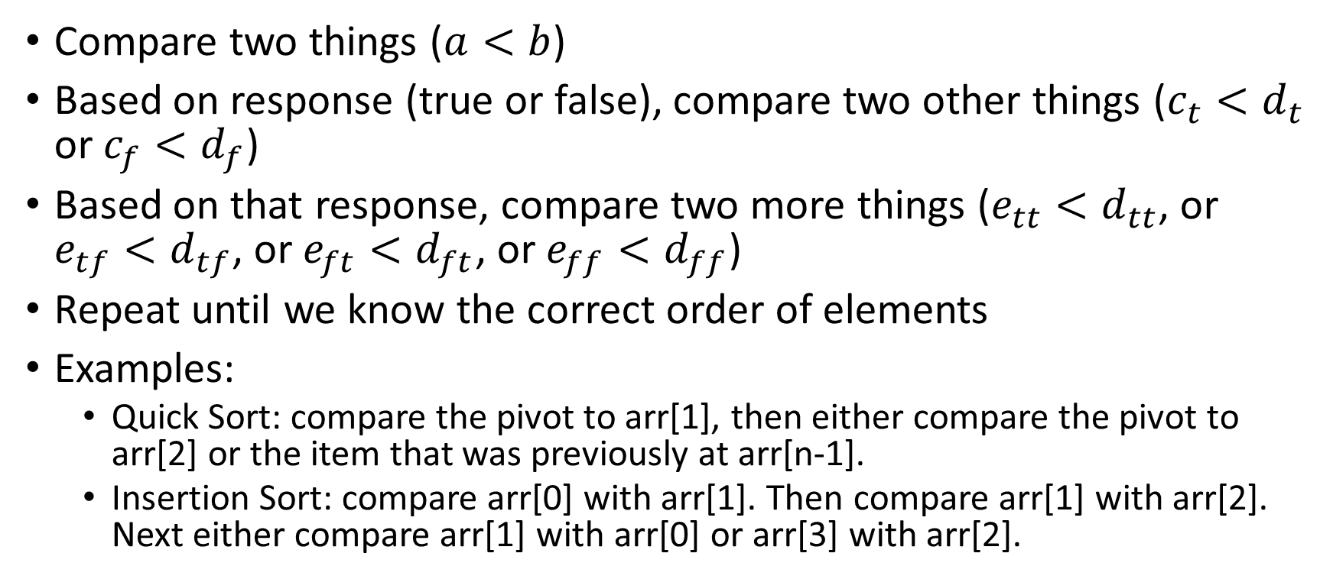
Sorting Algorithm “Template”
Compare two things ($a<b$)
Based on response (true or false), compare two other things ($c_{t}<d_{t}$ or $c_{f}<d_{f}$)
Based on that response, compare two more things ($e_{tt}<d_{tt}$, or $e_{tf}<d_{tf}$, or $e_{ft}<d_{ft}$, or $e_{ff}<d_{ff}$)
Repeat until we know the correct order of elements
Examples:
  Quick Sort: compare the pivot to arr[1], then either compare the pivot to arr[2] or the item that was previously at arr[n-1].
  Insertion Sort: compare arr[0] with arr[1]. Then compare arr[1] with arr[2]. Next either compare arr[1] with arr[0] or arr[3] with arr[2].

Slide 17
Strategy: Decision Tree
Sorting algorithms use comparisons to figure out the order of input elements
Draw tree to illustrate all possible execution paths
One comparison
Possible execution path
Result of comparison
<
>or<?
>
<
>or<?
>
<
>or<?
>
<
>or<?
>
<
>or<?
<
>or<?
>
<
>or<?
>
>
>or<?
>or<?
>or<?
>or<?
>or<?
>or<?
>or<?
>or<?
…
…
…
…
…
…
Permutation of the list
[1,2,3,4,5]
[2,1,3,4,5]
[5,2,4,1,3]
[5,4,3,2,1]

Slide 18



Strategy: Decision Tree
Worst case run time is the longest execution path
i.e., “height” of the decision tree
One comparison
Possible execution path
Result of comparison
<
>or<?
>
<
>or<?
>
<
>or<?
>
<
>or<?
>
<
>or<?
<
>or<?
>
<
>or<?
>
$$\log\left(n!\right)$$
>
>or<?
>or<?
>or<?
>or<?
>or<?
>or<?
>or<?
>or<?
$$Θ(n log{n})$$
…
…
…
…
…
…
Permutation of the list
[1,2,3,4,5]
[2,1,3,4,5]
[5,2,4,1,3]
[5,4,3,2,1]
$n!$Possible permutations

Slide 19
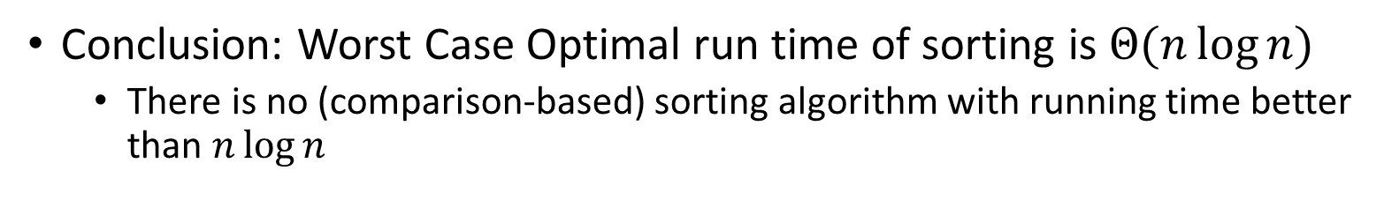
Strategy: Decision Tree
Conclusion: Worst Case Optimal run time of sorting is $Θ(n\log{n})$
  There is no (comparison-based) sorting algorithm with running time better than $n\log{n}$
One comparison
Possible execution path
Result of comparison
<
>or<?
>
<
>or<?
>
<
>or<?
>
<
>or<?
>
<
>or<?
<
>or<?
>
<
>or<?
>
$$\log\left(n!\right)$$
>
>or<?
>or<?
>or<?
>or<?
>or<?
>or<?
>or<?
>or<?
$$Θ(n log{n})$$
…
…
…
…
…
…
Permutation of the list
[1,2,3,4,5]
[2,1,3,4,5]
[5,2,4,1,3]
[5,4,3,2,1]
$n!$Possible permutations

Slide 20
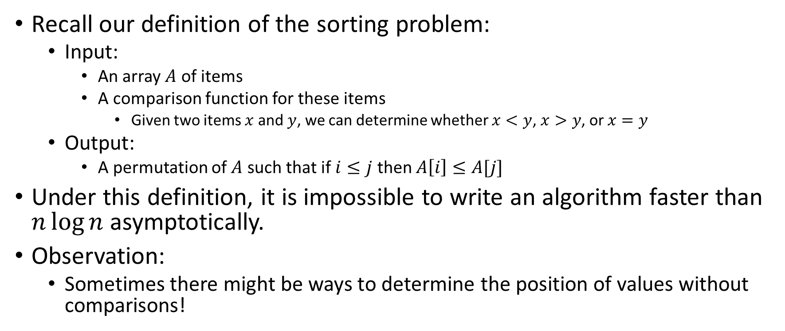
Improving Running time
Recall our definition of the sorting problem:
  Input:
    An array $A$ of items
    A comparison function for these items
      Given two items $x$ and $y$, we can determine whether $x<y$, $x>y$, or $x=y$
  Output:
    A permutation of $A$ such that if $i≤j$ then $A\left[i\right]≤A[j]$
Under this definition, it is impossible to write an algorithm faster than $n\log{n}$ asymptotically.
Observation:
  Sometimes there might be ways to determine the position of values without comparisons!

Slide 21
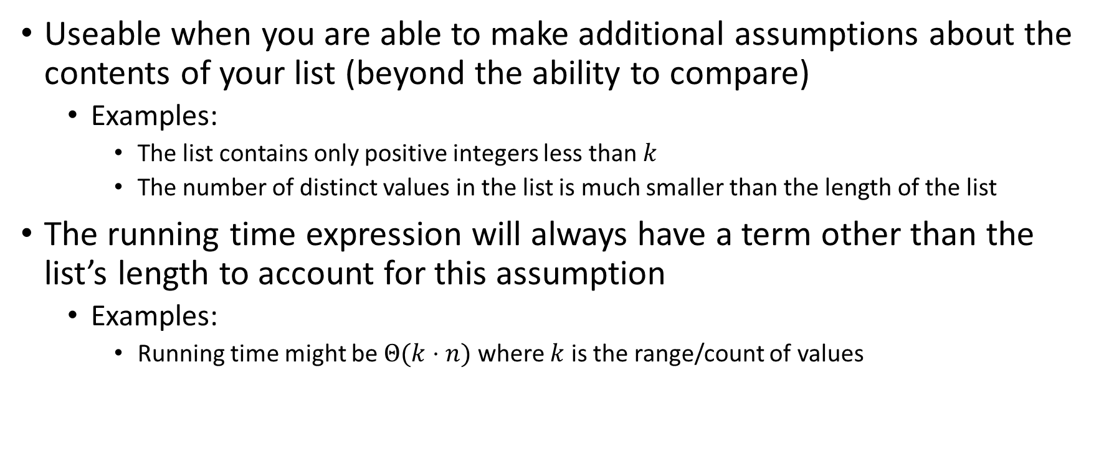
“Linear Time” Sorting Algorithms
Useable when you are able to make additional assumptions about the contents of your list (beyond the ability to compare)
  Examples:
    The list contains only positive integers less than $k$
    The number of distinct values in the list is much smaller than the length of the list
The running time expression will always have a term other than the list’s length to account for this assumption
  Examples:
    Running time might be $Θ(k⋅n)$ where $k$ is the range/count of values

Slide 22
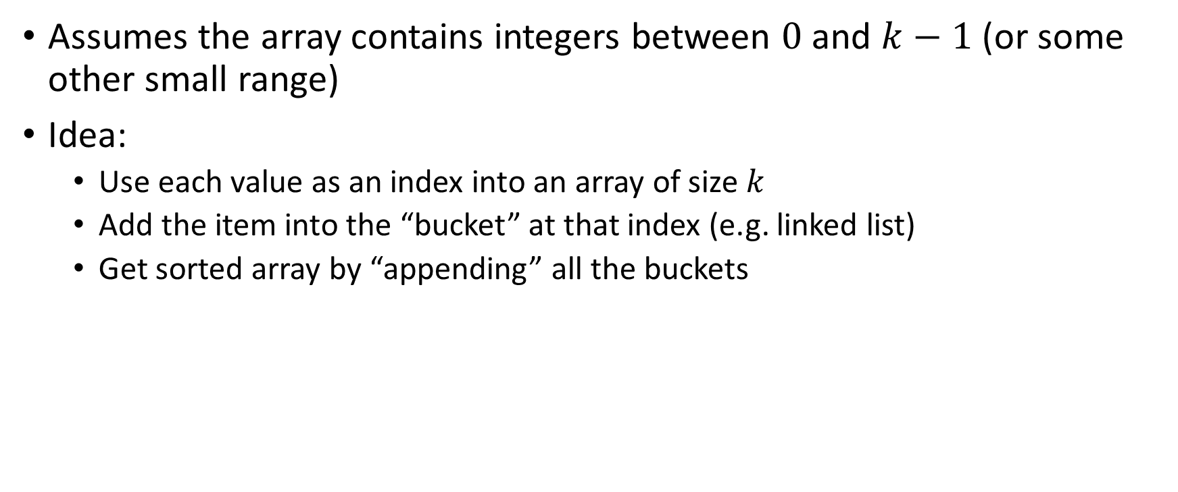
BucketSort
Assumes the array contains integers between $0$ and $k−1$ (or some other small range)
Idea:
  Use each value as an index into an array of size $k$
  Add the item into the “bucket” at that index (e.g. linked list)
  Get sorted array by “appending” all the buckets
0
0
0
0
0
1
1
2
2
2
3
3
0
2
3
0
0
1
2
1
3
0
2
0
0
0
0
0
0
1
1
2
2
2
3
3
0
1
2
3

Slide 23
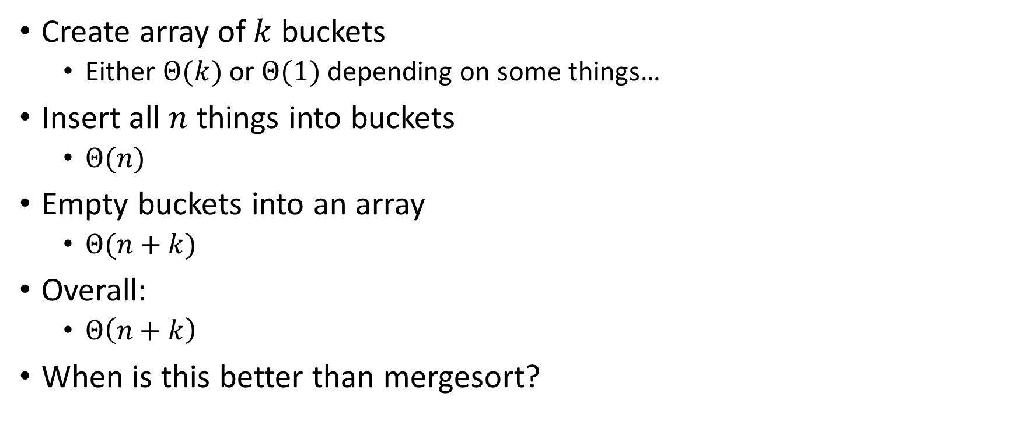
BucketSort Running Time
Create array of $k$ buckets
  Either $Θ(k)$ or $Θ(1)$ depending on some things…
Insert all $n$ things into buckets
  $Θ(n)$
Empty buckets into an array
  $Θ(n+k)$
Overall:
  $Θ\left(n+k\right)$
When is this better than mergesort?

Slide 24
Properties of BucketSort
In-Place?
  No
Adaptive?
  No
Stable?
  Yes!

Slide 25
RadixSort
Radix: The base of a number system
  We’ll use base 10, most implementations will use larger bases
Idea:
  BucketSort by each digit, one at a time, from least significant to most significant
103
801
401
323
255
823
999
101
113
901
555
512
245
800
018
121
0
1
2
3
4
5
6
7
8
9
10
11
12
13
14
15
800
801
401
101
901
121
512
103
323
823
113
255
555
245
018
999
Place each element into a “bucket” according to its 1’s place
0
1
2
3
4
5
6
7
8
9

Slide 26
RadixSort
Radix: The base of a number system
  We’ll use base 10, most implementations will use larger bases
Idea:
  BucketSort by each digit, one at a time, from least significant to most significant
800
801
401
101
901
121
512
103
323
823
113
255
555
245
018
999
800
801
401
101
901
103
512
113
018
121
323
823
245
255
555
999
0
1
2
3
4
5
6
7
8
9
Place each element into a “bucket” according to its 10’s place
0
1
2
3
4
5
6
7
8
9

Slide 27
RadixSort
Radix: The base of a number system
  We’ll use base 10, most implementations will use larger bases
Idea:
  BucketSort by each digit, one at a time, from least significant to most significant
800
801
401
101
901
103
512
113
018
121
323
823
245
255
555
999
018
101
103
113
121
245
255
323
401
512
555
800
801
823
901
999
0
1
2
3
4
5
6
7
8
9
Place each element into a “bucket” according to its 100’s place
0
1
2
3
4
5
6
7
8
9

Slide 28
RadixSort
Radix: The base of a number system
  We’ll use base 10, most implementations will use larger bases
Idea:
  BucketSort by each digit, one at a time, from least significant to most significant
018
101
103
113
121
245
255
323
401
512
555
800
801
823
901
999
Convert back into an array
0
1
2
3
4
5
6
7
8
9
018
811
103
113
121
245
255
323
401
512
555
800
801
823
901
999
0
1
2
3
4
5
6
7
8
9
10
11
12
13
14
15

Slide 29
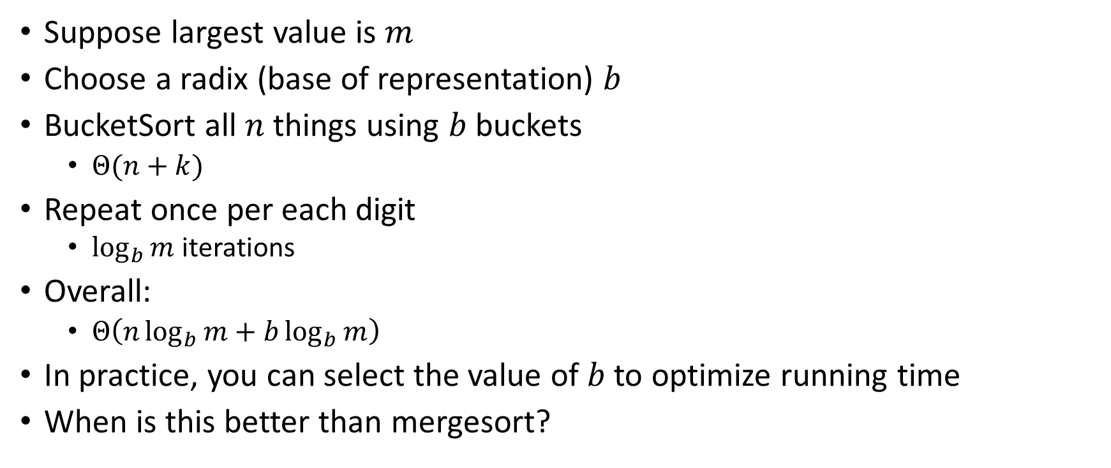
RadixSort Running Time
Suppose largest value is $m$
Choose a radix (base of representation) $b$
BucketSort all $n$ things using $b$ buckets
  $Θ(n+k)$
Repeat once per each digit
  $\log_{b}{m}$ iterations
Overall:
  $Θ\left(n\log_{b}{m}+b\log_{b}{m}\right)$
In practice, you can select the value of $b$ to optimize running time
When is this better than mergesort?

