Slide 1
CSE 332 Autumn 2024
Lecture 15: Sorting 2
Nathan Brunelle
http://www.cs.uw.edu/332

Slide 2
Properties To Consider
Worst case running time
In place:
  We only need to use the pre-existing array to do sorting
  Constant extra space (only some additional variables needed)
  Selection Sort, Insertion Sort, Heap Sort
Adaptive
  The running improves as the given list is closer to being sorted
  It should be linear time for a pre-sorted list, and nearly linear time if the list is nearly sorted
  Insertion Sort
Online
  We can start sorting before we have the entire list.
  Insertion Sort
Stable
  “Tied” elements keep their original order

Slide 3
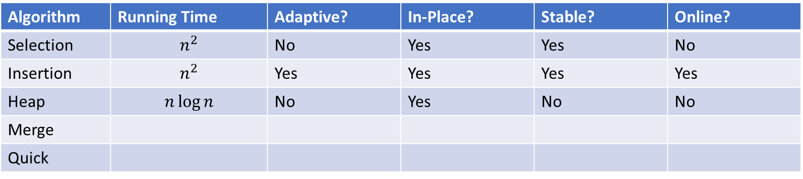
Sorting Algorithm Summary
Algorithm | Running Time | Adaptive? | In-Place? | Stable? | Online?
Selection | $$n^{2}$$ | No | Yes | Yes | No
Insertion | $$n^{2}$$ | Yes | Yes | Yes | Yes
Heap | $$n\log{n}$$ | No | Yes | No | No
Merge
Quick

Slide 4
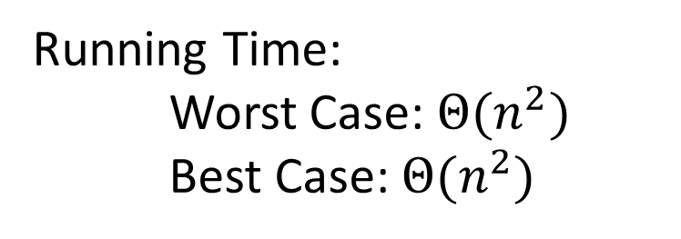
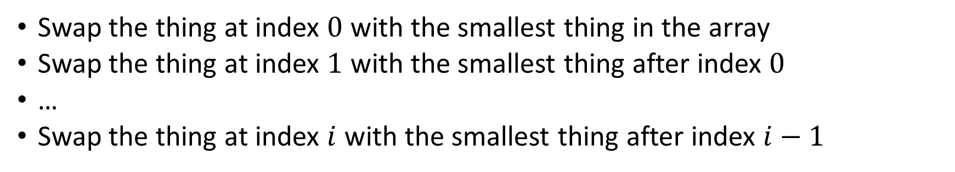
Selection Sort
Swap the thing at index $0$ with the smallest thing in the array
Swap the thing at index $1$ with the smallest thing after index $0$
…
Swap the thing at index $i$ with the smallest thing after index $i−1$
for (i=0; i<a.length; i++){
smallest = i;
for (j=i; j<a.length; j++){
if (a[j]<a[smallest]){ smallest=j;}
}
temp = a[i];
a[i] = a[smallest];
a[smallest] = a[i];
}
Running Time:
Worst Case: $Θ(n^{2})$
Best Case: $Θ(n^{2})$
10
77
5
15
2
22
64
41
18
19
30
21
3
24
23
33
0
1
2
3
4
5
6
7
8
9
10
11
12
13
14
15

Slide 5
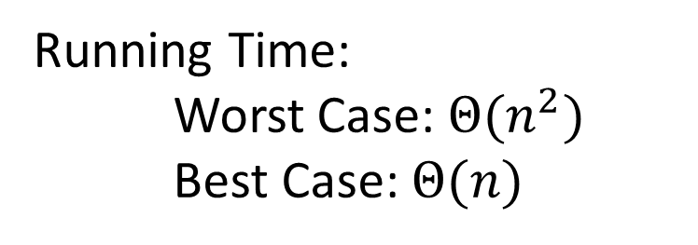
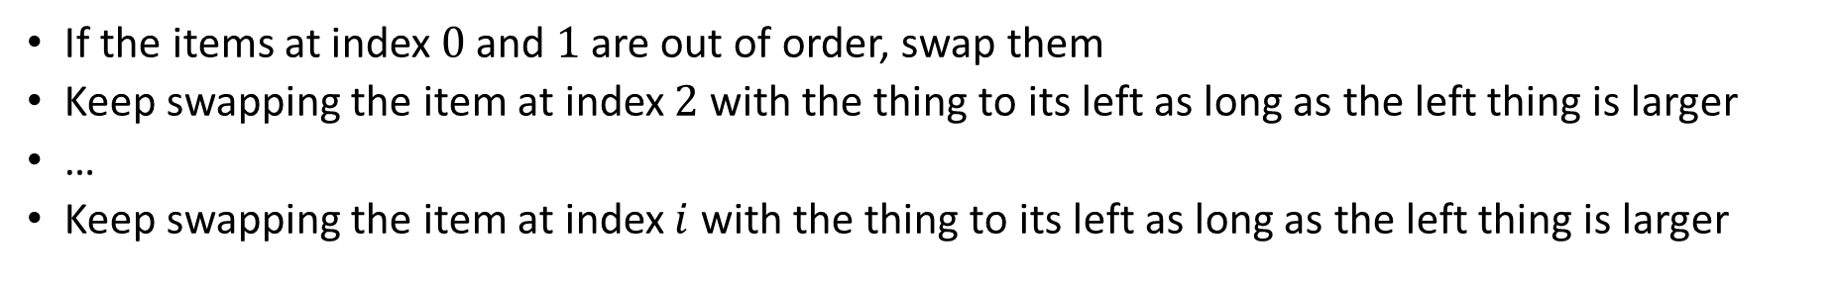
Insertion Sort
If the items at index $0$ and $1$ are out of order, swap them
Keep swapping the item at index $2$ with the thing to its left as long as the left thing is larger
…
Keep swapping the item at index $i$ with the thing to its left as long as the left thing is larger
for (i=1; i<a.length; i++){
prev = i-1;
while(a[i] < a[prev] && prev > -1){
temp = a[i];
a[i] = a[prev];
a[prev] = a[i];
i--;
prev--;
}
}
Running Time:
Worst Case: $Θ(n^{2})$
Best Case: $Θ(n)$
10
77
5
15
2
22
64
41
18
19
30
21
3
24
23
33
0
1
2
3
4
5
6
7
8
9
10
11
12
13
14
15

Slide 6
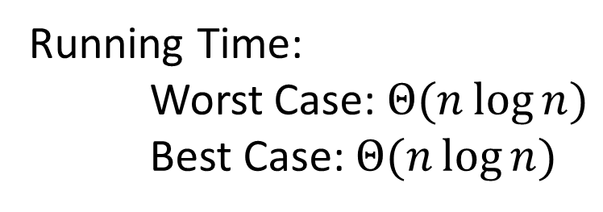
In Place Heap Sort
Build a heap using the same array (Floyd’s build heap algorithm works)
For each item in the heap:
  Call extract
  Put that at the end of the array
buildHeap(a);
for (int i = a.length-1; i>=0; i--){
temp=a[i]
a[i] = a[0];
a[0] = temp;
percolateDown(0);
}
Running Time:
Worst Case: $Θ(n\log{n})$
Best Case: $Θ(n\log{n})$

Slide 7
Divide And Conquer Sorting
Divide and Conquer:
  Recursive algorithm design technique
  Solve a large problem by breaking it up into smaller versions of the same problem

Slide 8

Divide and Conquer
Base Case:
  If the problem is “small” then solve directly and return
Divide:
  Break the problem into subproblem(s), each smaller instances
Conquer:
  Solve subproblem(s) recursively
Combine:
  Use solutions to subproblems to solve original problem
A
B

Slide 9
Merge Sort
5
8
2
9
4
1
Base Case:
  If the list is of length 1 or 0, it’s already sorted, so just return it
Divide:
  Split the list into two “sublists” of (roughly) equal length
Conquer:
  Sort both lists recursively
Combine:
  Merge sorted sublists into one sorted list
5
5
8
2
9
4
1
2
5
8
1
4
9
2
5
8
1
4
9
1
2
4
5
8
9

Slide 10








Merge Sort In Action!
Sort between indices $low$ and $high$
5
8
2
9
4
1
3
7
$$low$$
$$high$$
Base Case: if $low$ == $high$ then that range is already sorted!
Divide and Conquer: Otherwise call mergesort on ranges $\left(low,\frac{low+high}{2}\right)$ and $\left(\frac{low+high}{2}+1, high\right)$
5
8
2
9
4
1
3
7
$$low$$
$$\frac{low+high}{2}$$
$$\frac{low+high}{2}+1$$
$$high$$
2
5
8
9
1
3
4
7
After Recursion:
$$low$$
$$high$$

Slide 11




Merge (the combine part)
2
5
8
9
1
3
4
7
L next
R next
$$\frac{low+high}{2}+1$$
$$low$$
$$\frac{low+high}{2}$$
$$high$$
M next
Create a new array to merge into, and 3 pointers/indices:
L_next: the smallest “unmerged” thing on the left
R_next: the smallest “unmerged” thing on the right
M_next: where the next smallest thing goes in the merged array
One-by-one: put the smallest of L_next and R_next into M_next, then advance both M_next and whichever of L/R was used.

Slide 12
Merge Sort Pseudocode
void mergesort(myArray){
ms_helper(myArray, 0, myArray.length());
}
void mshelper(myArray, low, high){
if (low == high){return;} // Base Case
mid = (low+high)/2;
ms_helper(low, mid);
ms_helper(mid+1, high);
merge(myArray, low, mid, high);
}

Slide 13
Merge Pseudocode
void merge(myArray, low, mid, high){
merged = new int[high-low+1]; // or whatever type is in myArray
l_next = low;
r_next = high;
m_next = 0;
while (l_next <= mid && r_next <= high){
if (myArray[l_next] <= myArray[r_next]){
merged[m_next++] = myArray[l_next++];
}
else{
merged[m_next++] = myArray[r_next++];
}
}
while (l_next <= mid){ merged[m_next++] = myArray[l_next++]; }
while (r_next <= high){ merged[m_next++] = myArray[r_next++]; }
for(i=0; i<=merged.length; i++){ myArray[i+low] = merged[i];}
}

Slide 14
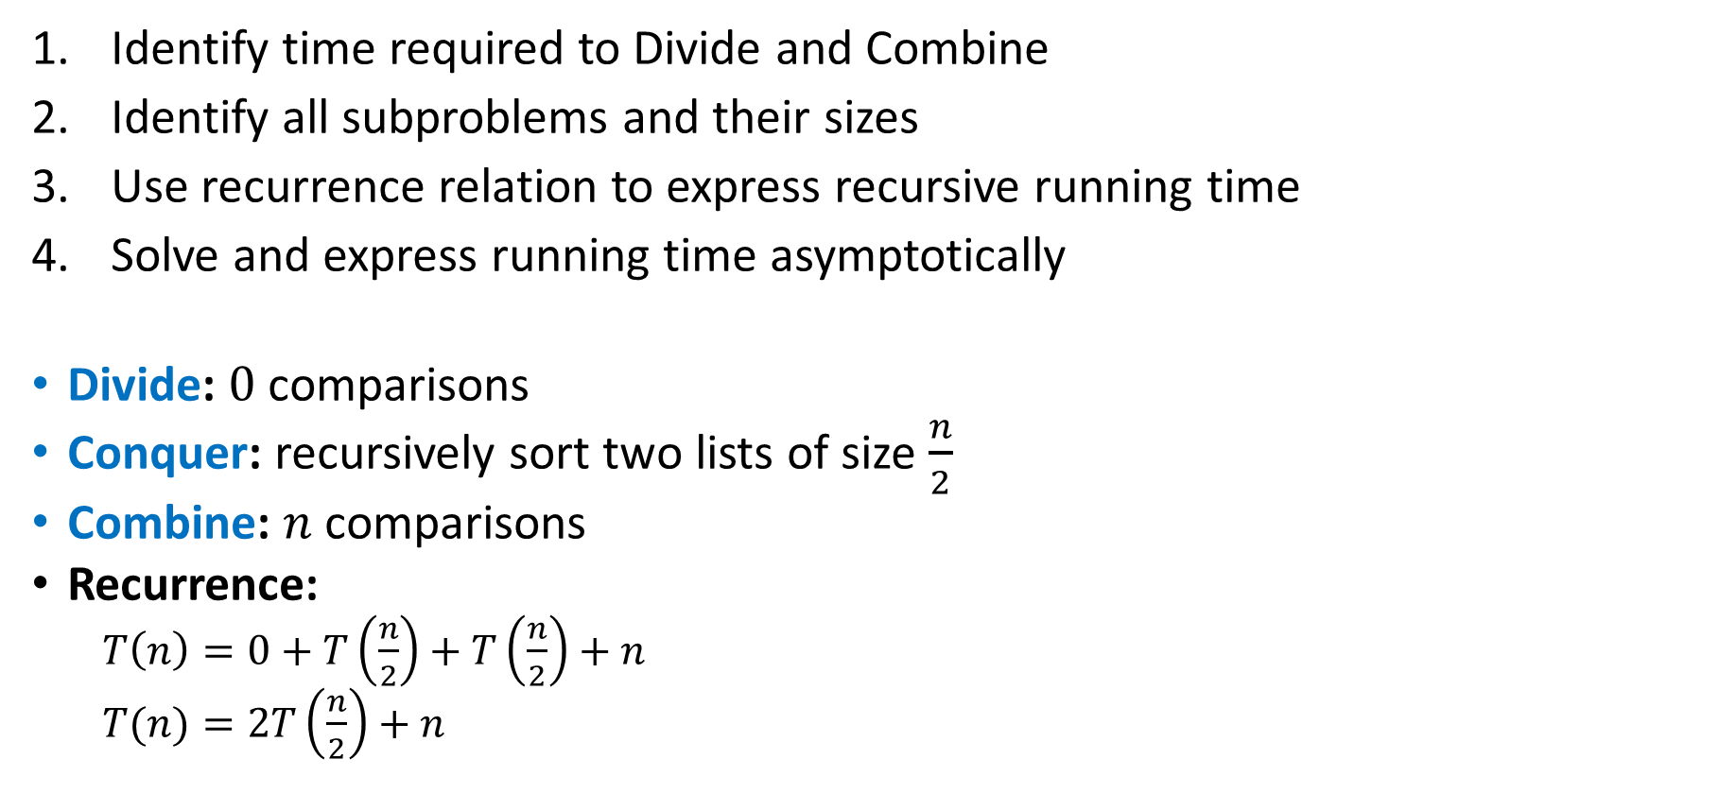
Analyzing Merge Sort
Identify time required to Divide and Combine
Identify all subproblems and their sizes
Use recurrence relation to express recursive running time
Solve and express running time asymptotically
Divide: $0$ comparisons
Conquer: recursively sort two lists of size $\frac{n}{2}$
Combine: $n$ comparisons
Recurrence:
  $T\left(n\right)=0+T\left(\frac{n}{2}\right)+T\left(\frac{n}{2}\right)+n$
  $T(n)=2T\left(\frac{n}{2}\right)+n$

Slide 15
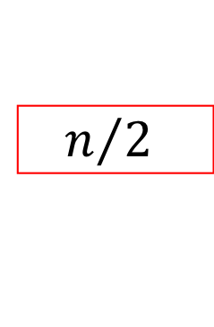


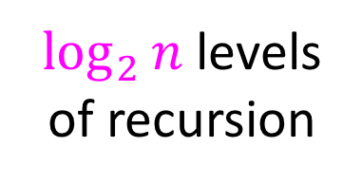




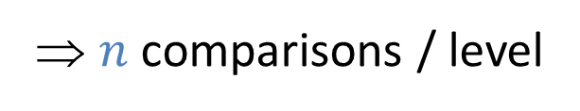


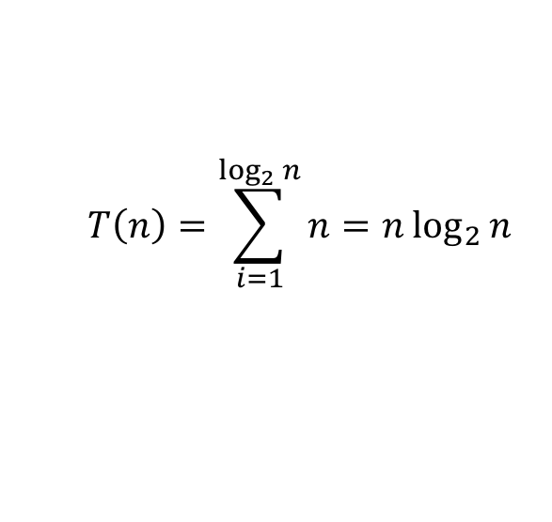
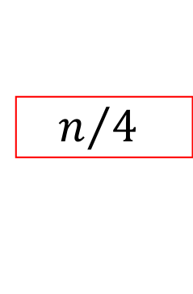
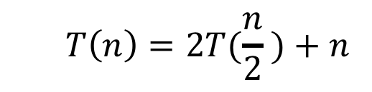








Red box represents a problem instance
Blue value represents time spent at that level of recursion
  $$T\left(n\right)=2T(\frac{n}{2} )+n$$
$$n$$
⇒ $n$ comparisons / level
$$n$$
$$n/2$$
$$\frac{n}{2}$$
$$n/2$$
$$\frac{n}{2}$$
$$\frac{n}{4}$$
$$\frac{n}{4}$$
$$\frac{n}{4}$$
$$\frac{n}{4}$$
$\log_{2}⁡n$ levels
of recursion
$$n/4$$
$$n/4$$
$$n/4$$
$$n/4$$
…
…
…
…
…
$$1$$
$$1$$
$$1$$
$$1$$
$$1$$
$$1$$
$$1$$
$$1$$
$$1$$
$$1$$
$$1$$
$$1$$
  $$T\left(n\right)=\sum_{i=1}^{\log_{2}{n}}{n}=n\log_{2}{n}$$

Slide 16

Properties of Merge Sort
Worst Case Running time:
  $Θ(n\log{n})$
In-Place?
  No!
Adaptive?
  No!
Stable?
  Yes!
  As long as in a tie you always pick l_next

Slide 17
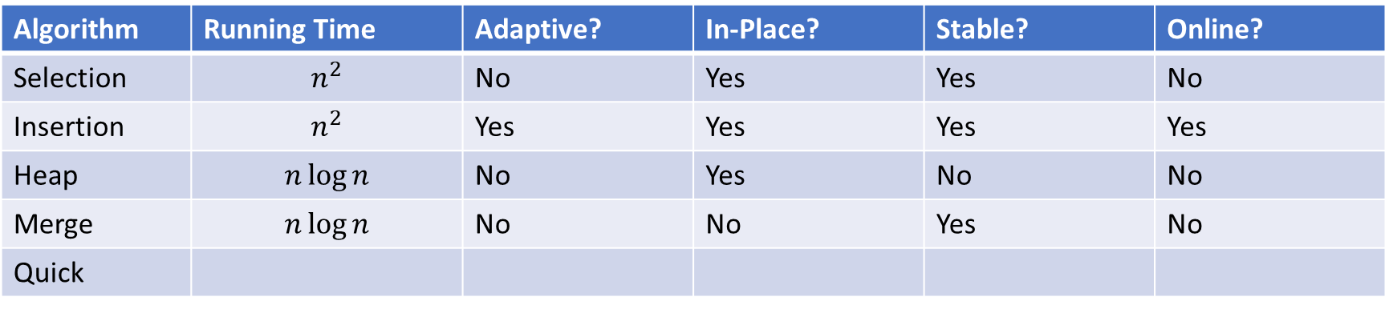
Sorting Algorithm Summary
Algorithm | Running Time | Adaptive? | In-Place? | Stable? | Online?
Selection | $$n^{2}$$ | No | Yes | Yes | No
Insertion | $$n^{2}$$ | Yes | Yes | Yes | Yes
Heap | $$n\log{n}$$ | No | Yes | No | No
Merge | $$n\log{n}$$ | No | No | Yes | No
Quick

Slide 18

Quicksort
Like Mergesort:
  Divide and conquer
  $O(n\log{n})$ run time (kind of…)
Unlike Mergesort:
  Divide step is the “hard” part
  Typically faster than Mergesort

Slide 19
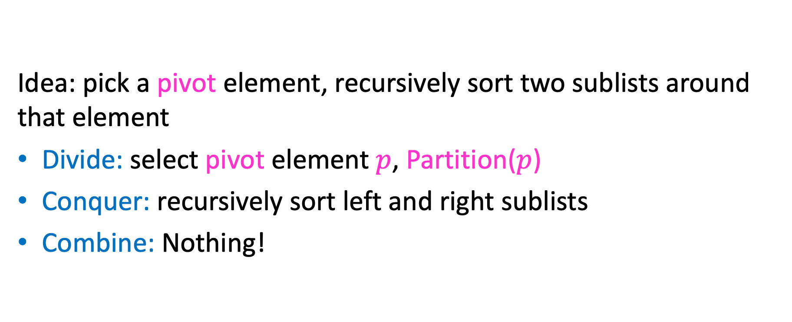
Quicksort
Idea: pick a pivot element, recursively sort two sublists around that element
Divide: select pivot element $p$, Partition($p$)
Conquer: recursively sort left and right sublists
Combine: Nothing!

Slide 20
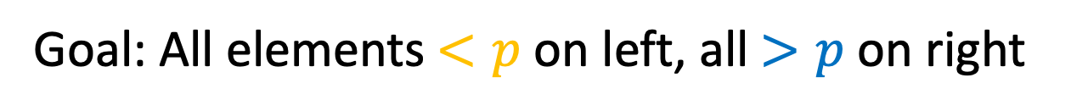

Partition (Divide step)
Given: a list, a pivot $p$
Start: unordered list
8
5
7
3
12
10
1
2
4
9
6
11
Goal: All elements $<p$ on left, all $>p$ on right
5
7
3
1
2
4
6
8
12
10
9
11

Slide 21
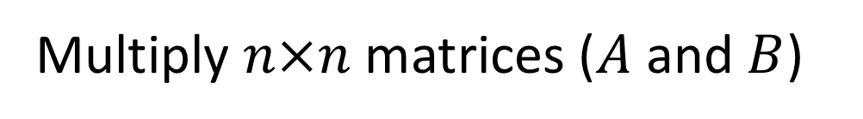
Partition, Procedure
If Begin value $< p$, move Begin right
Else swap Begin value with End value, move End Left
Done when Begin = End
8
5
7
3
12
10
1
2
4
9
6
11
8
5
7
3
12
10
1
2
4
9
6
11
8
5
7
3
12
10
1
2
4
9
6
11
8
5
7
3
11
10
1
2
4
9
6
12

Slide 22
Partition, Procedure
If Begin value $< p$, move Begin right
Else swap Begin value with End value, move End Left
Done when Begin = End
8
5
7
3
11
10
1
2
4
9
6
12
8
5
7
3
6
10
1
2
4
9
11
12
8
5
7
3
6
10
1
2
4
9
11
12
8
5
7
3
6
10
1
2
4
9
11
12

Slide 23
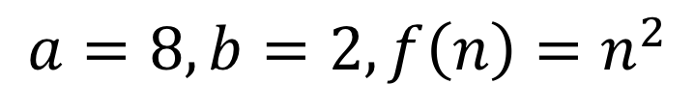
Partition, Procedure
If Begin value $< p$, move Begin right
Else swap Begin value with End value, move End Left
Done when Begin = End
8
5
7
3
6
4
1
2
10
9
11
12
Case 1: meet at element $<p$
Swap $p$ with pointer position (2 in this case)
2
5
7
3
6
4
1
8
10
9
11
12

Slide 24
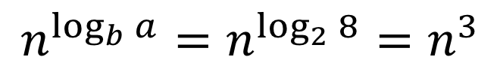
Partition, Procedure
If Begin value $< p$, move Begin right
Else swap Begin value with End value, move End Left
Done when Begin = End
8
5
7
3
6
4
1
2
10
9
11
12
Case 2: meet at element $>p$
Swap $p$ with value to the left (2 in this case)
2
5
7
3
6
4
1
8
10
9
11
12

Slide 25
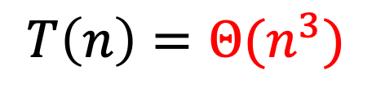
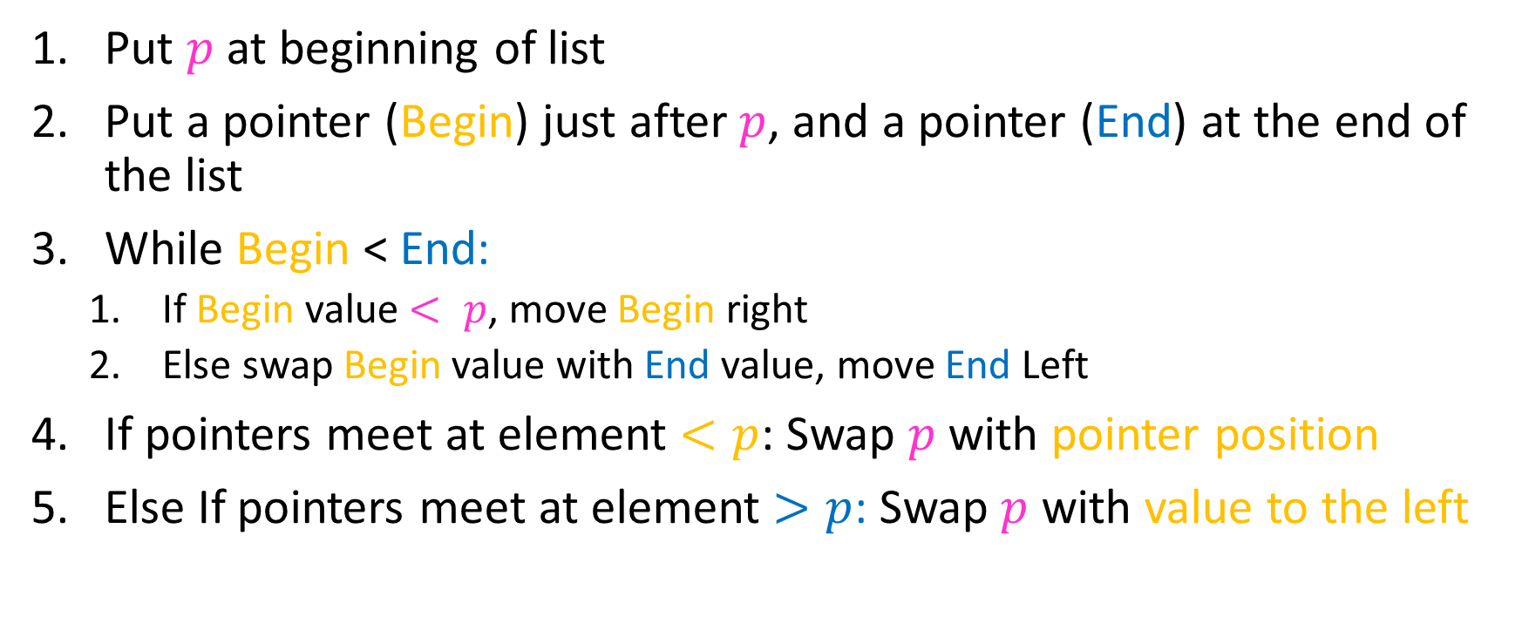
Partition Summary
Put $p$ at beginning of list
Put a pointer (Begin) just after $p$, and a pointer (End) at the end of the list
While Begin < End:
  If Begin value $< p$, move Begin right
  Else swap Begin value with End value, move End Left
If pointers meet at element $<p$: Swap $p$ with pointer position
Else If pointers meet at element $>p$: Swap $p$ with value to the left
Run time?
$$O(n)$$

Slide 26
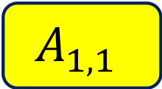
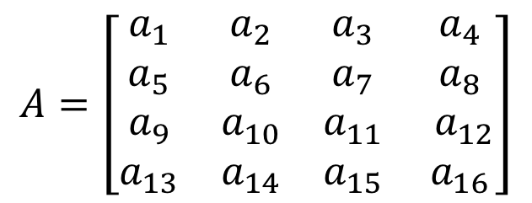
Conquer
2
5
7
3
6
4
1
8
10
9
11
12
All elements $<p$
All elements $>p$
Exactly where it belongs!
Recursively sort Left and Right sublists

Slide 27


Quicksort Run Time (Best)
If the pivot is always the median:
2
5
1
3
6
4
7
8
10
9
11
12
2
1
3
5
6
4
7
8
9
10
11
12
Then we divide in half each time
$$T\left(n\right)=2T\left(\frac{n}{2}\right)+n$$
$$T\left(n\right)=O(n\log{n})$$

Slide 28

Quicksort Run Time (Worst)
If the pivot is always at the extreme:
1
5
2
3
6
4
7
8
10
9
11
12
1
2
3
5
6
4
7
8
10
9
11
12
Then we shorten by 1 each time
$$T\left(n\right)=T\left(n−1\right)+n$$
$$T\left(n\right)=O(n^{2})$$

Slide 29
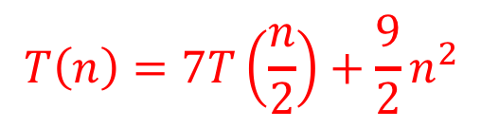



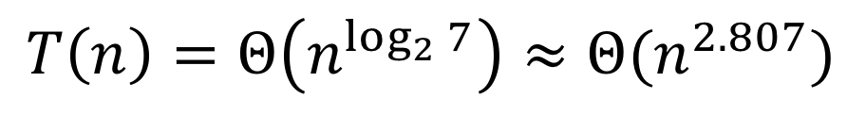

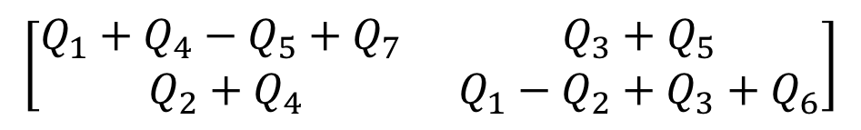

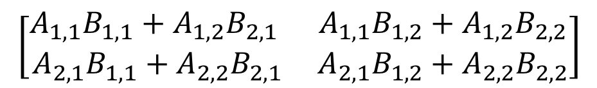
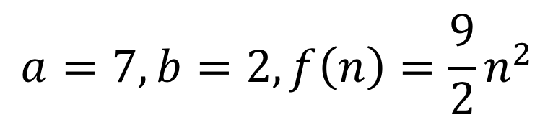

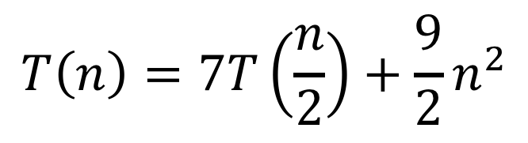
Quicksort Run Time (Worst)
$$T\left(n\right)=T\left(n−1\right)+n$$
$$n$$
$$n$$
$$n−1$$
$$n−1$$
$$T\left(n\right)=1+2+3+…+n$$
$$n−2$$
$$n−2$$
$$T\left(n\right)=\frac{n\left(n+1\right)}{2}$$
…
$$1$$
$$1$$
$$T\left(n\right)=O(n^{2})$$

Slide 30
Quicksort on a (nearly) Sorted List
First element always yields unbalanced pivot
1
2
3
4
5
6
7
8
9
10
11
12
1
2
3
4
5
6
7
8
9
10
11
12
So we shorten by 1 each time
$$T\left(n\right)=T\left(n−1\right)+n$$
$$T\left(n\right)=O(n^{2})$$

Slide 31
Good Pivot
What makes a good Pivot?
  Roughly even split between left and right
  Ideally: median
There are ways to find the median in linear time, but it’s complicated and slow and you’re better off using mergesort
In Practice:
  Pick a random value as a pivot
  Pick the middle of 3 random values as the pivot

Slide 32

Properties of Quick Sort
Worst Case Running time:
  $Θ(n^{2})$
  But $Θ(n\log{n})$ average! And typically faster than mergesort!
In-Place?
  ….Debatable
Adaptive?
  No!
Stable?
  No!

Slide 33
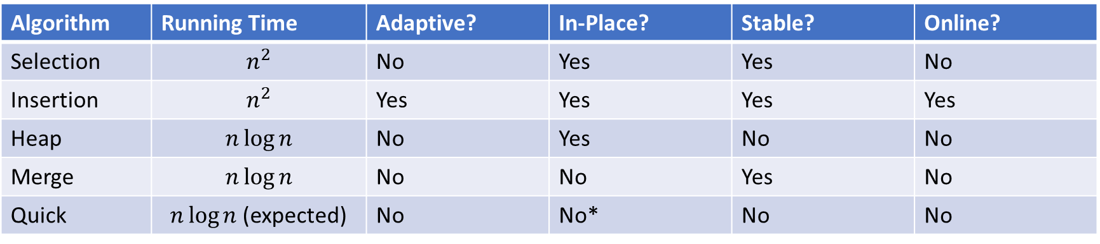
Sorting Algorithm Summary
Algorithm | Running Time | Adaptive? | In-Place? | Stable? | Online?
Selection | $$n^{2}$$ | No | Yes | Yes | No
Insertion | $$n^{2}$$ | Yes | Yes | Yes | Yes
Heap | $$n\log{n}$$ | No | Yes | No | No
Merge | $$n\log{n}$$ | No | No | Yes | No
Quick | $n\log{n}$ (expected) | No | No* | No | No
*Quick Sort can be done in-place within each stack frame. Some textbooks do not include the memory occupied by the stack frame in space analysis, which would mean concluding Quick Sort is in-place. Others will include stack frame space, and therefore conclude Quick Sort is not in-place. If you try to implement it iteratively, you’ll need another array somewhere (e.g. to store locations of sub-lists)

Slide 34
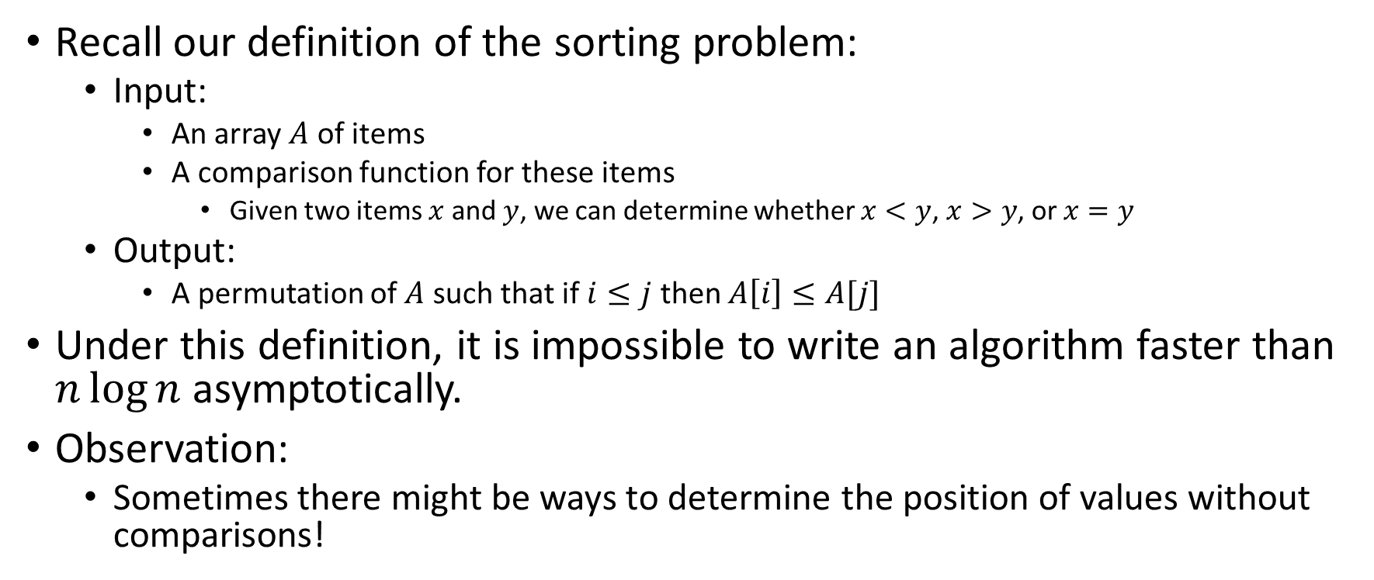
Improving Running time
Recall our definition of the sorting problem:
  Input:
    An array $A$ of items
    A comparison function for these items
      Given two items $x$ and $y$, we can determine whether $x<y$, $x>y$, or $x=y$
  Output:
    A permutation of $A$ such that if $i≤j$ then $A\left[i\right]≤A[j]$
Under this definition, it is impossible to write an algorithm faster than $n\log{n}$ asymptotically.
Observation:
  Sometimes there might be ways to determine the position of values without comparisons!

Slide 35
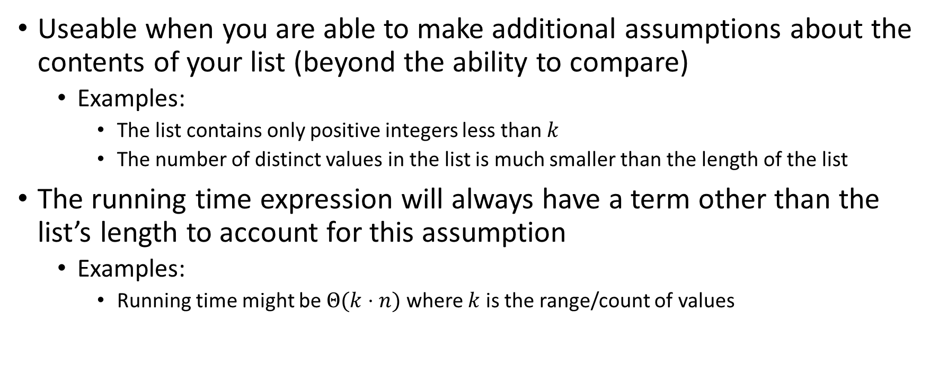
“Linear Time” Sorting Algorithms
Useable when you are able to make additional assumptions about the contents of your list (beyond the ability to compare)
  Examples:
    The list contains only positive integers less than $k$
    The number of distinct values in the list is much smaller than the length of the list
The running time expression will always have a term other than the list’s length to account for this assumption
  Examples:
    Running time might be $Θ(k⋅n)$ where $k$ is the range/count of values

Slide 36
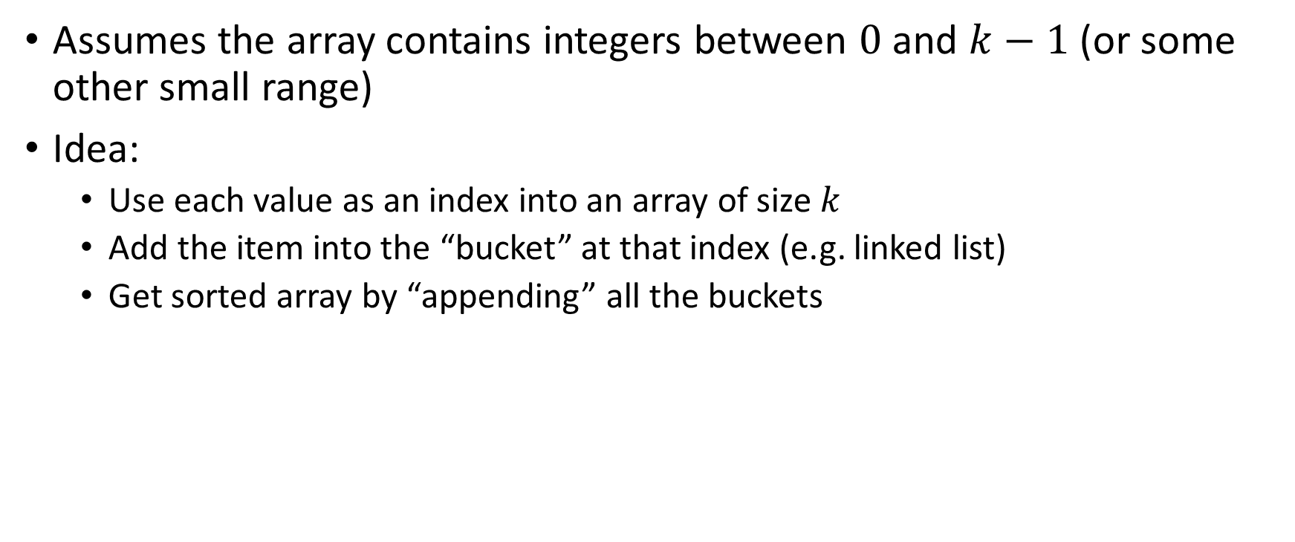
BucketSort
Assumes the array contains integers between $0$ and $k−1$ (or some other small range)
Idea:
  Use each value as an index into an array of size $k$
  Add the item into the “bucket” at that index (e.g. linked list)
  Get sorted array by “appending” all the buckets
0
0
0
0
0
1
1
2
2
2
3
3
0
2
3
0
0
1
2
1
3
0
2
0
0
0
0
0
0
1
1
2
2
2
3
3
0
1
2
3

Slide 37
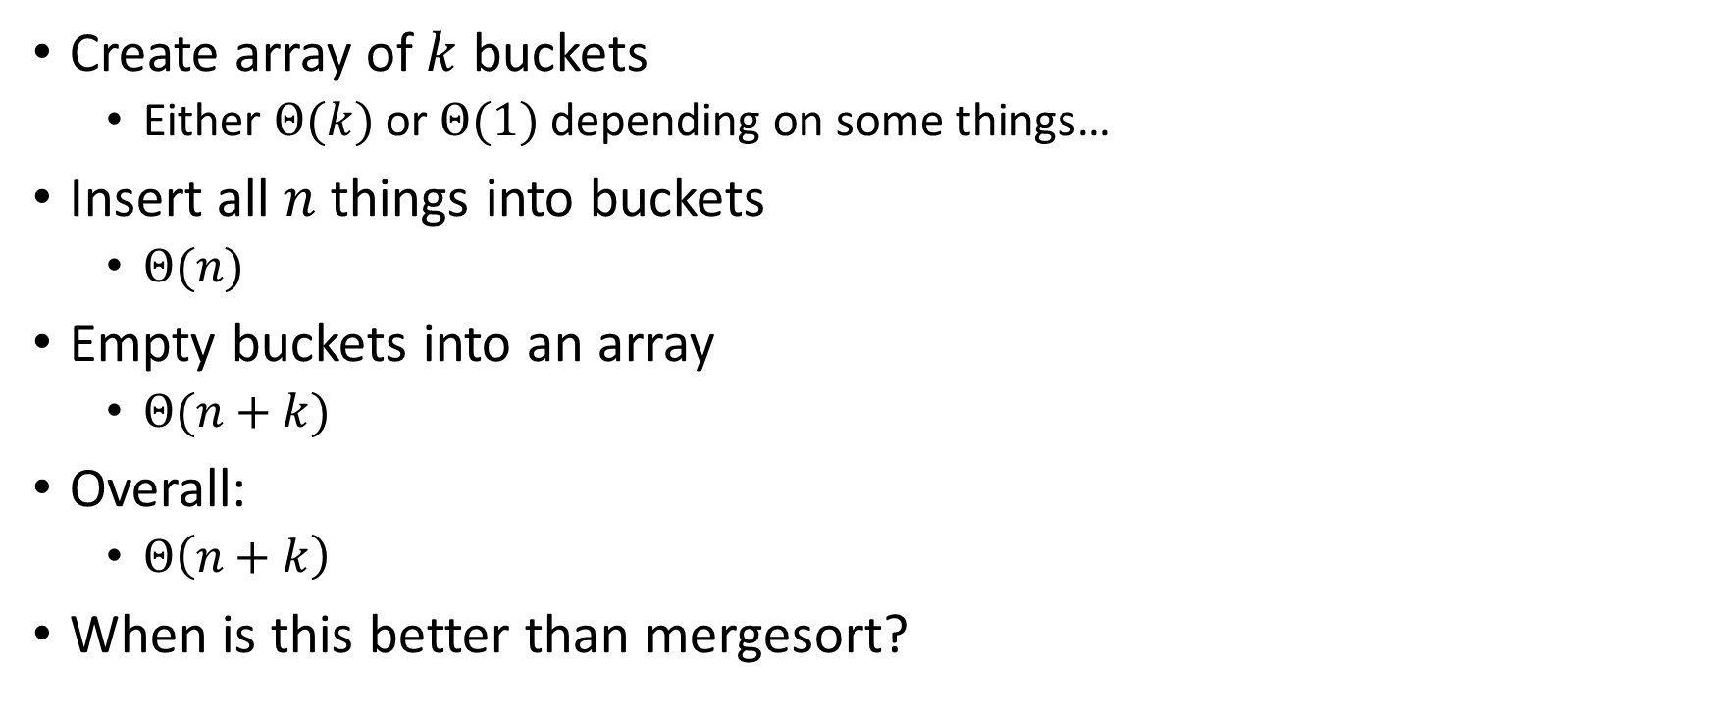
BucketSort Running Time
Create array of $k$ buckets
  Either $Θ(k)$ or $Θ(1)$ depending on some things…
Insert all $n$ things into buckets
  $Θ(n)$
Empty buckets into an array
  $Θ(n+k)$
Overall:
  $Θ\left(n+k\right)$
When is this better than mergesort?

Slide 38
Properties of BucketSort
In-Place?
  No
Adaptive?
  No
Stable?
  Yes!

Slide 39
RadixSort
Radix: The base of a number system
  We’ll use base 10, most implementations will use larger bases
Idea:
  BucketSort by each digit, one at a time, from least significant to most significant
103
801
401
323
255
823
999
101
113
901
555
512
245
800
018
121
0
1
2
3
4
5
6
7
8
9
10
11
12
13
14
15
800
801
401
101
901
121
512
103
323
823
113
255
555
245
018
999
Place each element into a “bucket” according to its 1’s place
0
1
2
3
4
5
6
7
8
9

Slide 40
RadixSort
Radix: The base of a number system
  We’ll use base 10, most implementations will use larger bases
Idea:
  BucketSort by each digit, one at a time, from least significant to most significant
800
801
401
101
901
121
512
103
323
823
113
255
555
245
018
999
800
801
401
101
901
103
512
113
018
121
323
823
245
255
555
999
0
1
2
3
4
5
6
7
8
9
Place each element into a “bucket” according to its 10’s place
0
1
2
3
4
5
6
7
8
9

Slide 41
RadixSort
Radix: The base of a number system
  We’ll use base 10, most implementations will use larger bases
Idea:
  BucketSort by each digit, one at a time, from least significant to most significant
800
801
401
101
901
103
512
113
018
121
323
823
245
255
555
999
018
101
103
113
121
245
255
323
401
512
555
800
801
823
901
999
0
1
2
3
4
5
6
7
8
9
Place each element into a “bucket” according to its 100’s place
0
1
2
3
4
5
6
7
8
9

Slide 42
RadixSort
Radix: The base of a number system
  We’ll use base 10, most implementations will use larger bases
Idea:
  BucketSort by each digit, one at a time, from least significant to most significant
018
101
103
113
121
245
255
323
401
512
555
800
801
823
901
999
Convert back into an array
0
1
2
3
4
5
6
7
8
9
018
811
103
113
121
245
255
323
401
512
555
800
801
823
901
999
0
1
2
3
4
5
6
7
8
9
10
11
12
13
14
15

Slide 43
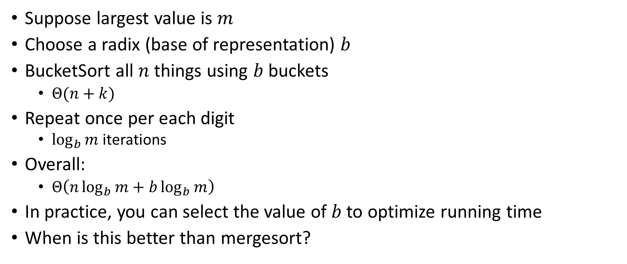
RadixSort Running Time
Suppose largest value is $m$
Choose a radix (base of representation) $b$
BucketSort all $n$ things using $b$ buckets
  $Θ(n+k)$
Repeat once per each digit
  $\log_{b}{m}$ iterations
Overall:
  $Θ\left(n\log_{b}{m}+b\log_{b}{m}\right)$
In practice, you can select the value of $b$ to optimize running time
When is this better than mergesort?

