Slide 1
CSE 332 Autumn 2024
Lecture 14: Sorting
Nathan Brunelle
http://www.cs.uw.edu/332

Slide 2
Sorting
Rearrangement of items into some defined sequence
  Usually: reordering a list from smallest to largest according to some metric
Why sort things?
  Enable things like binary search
    It makes some algorithms faster
  Nicer for human algorithms too
  Data organization

Slide 3
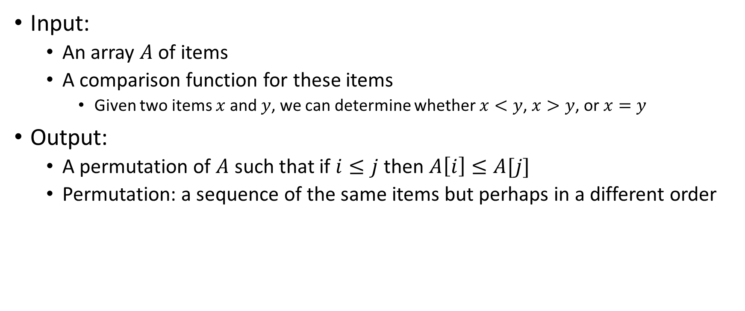
More Formal Definition
Input:
  An array $A$ of items
  A comparison function for these items
    Given two items $x$ and $y$, we can determine whether $x<y$, $x>y$, or $x=y$
Output:
  A permutation of $A$ such that if $i≤j$ then $A\left[i\right]≤A[j]$
  Permutation: a sequence of the same items but perhaps in a different order

Slide 4
Sorting “Landscape”
There is no singular best algorithm for sorting
Some are faster, some are slower
Some use more memory, some use less
Some are super extra fast if your data matches particular assumptions
Some have other special properties that make them valuable
No sorting algorithm can have only all the “best” attributes

Slide 5

“Moving Day” Sorting Algorithm
2
15
77
5
18
10
41
3
22
64
21
19
30
24
23
33
0
1
2
3
4
5
6
7
8
9
10
11
12
13
14
15

Slide 6
Selection Sort
Idea: Find the next smallest element, swap it into the next index in the array
Already In Position
1
2
3
4
5
6
10
8
7
9
12
11
Already In Position
1
2
3
4
5
6
7
8
10
9
12
11

Slide 7
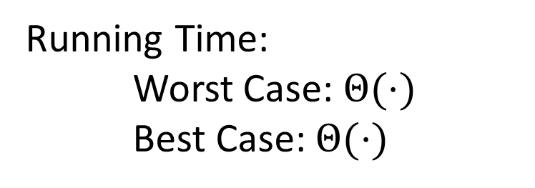
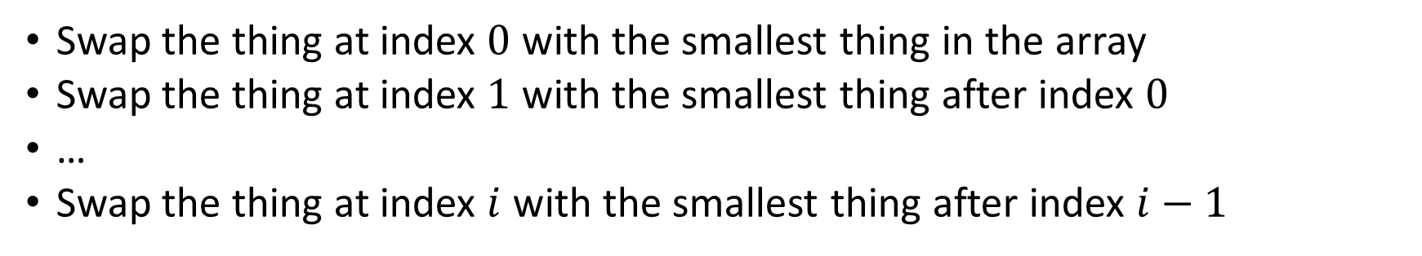
Selection Sort
Swap the thing at index $0$ with the smallest thing in the array
Swap the thing at index $1$ with the smallest thing after index $0$
…
Swap the thing at index $i$ with the smallest thing after index $i−1$
for (i=0; i<a.length; i++){
smallest = i;
for (j=i; j<a.length; j++){
if (a[j]<a[smallest]){ smallest=j;}
}
temp = a[i];
a[i] = a[smallest];
a[smallest] = a[i];
}
Running Time:
Worst Case: $Θ(⋅)$
Best Case: $Θ(⋅)$
10
77
5
15
2
22
64
41
18
19
30
21
3
24
23
33
0
1
2
3
4
5
6
7
8
9
10
11
12
13
14
15

Slide 8
Insertion Sort
Idea: Maintain a sorted list prefix, extend that prefix by “inserting” the next element
Sorted Prefix
3
5
7
8
10
12
9
2
4
6
1
11
3
5
7
8
10
9
12
2
4
6
1
11
3
5
7
8
9
10
12
2
4
6
1
11
Sorted Prefix
3
5
7
8
9
10
12
2
4
6
1
11

Slide 9
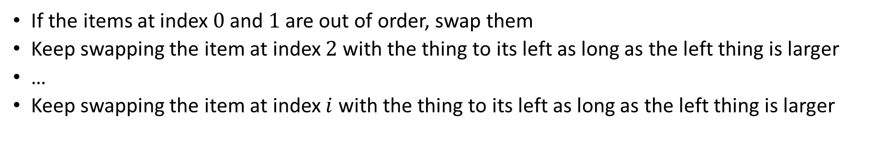
Insertion Sort
If the items at index $0$ and $1$ are out of order, swap them
Keep swapping the item at index $2$ with the thing to its left as long as the left thing is larger
…
Keep swapping the item at index $i$ with the thing to its left as long as the left thing is larger
for (i=1; i<a.length; i++){
prev = i-1;
while(a[i] < a[prev] && prev > -1){
temp = a[i];
a[i] = a[prev];
a[prev] = a[i];
i--;
prev--;
}
}
Running Time:
Worst Case: $Θ(⋅)$
Best Case: $Θ(⋅)$
10
77
5
15
2
22
64
41
18
19
30
21
3
24
23
33
0
1
2
3
4
5
6
7
8
9
10
11
12
13
14
15

Slide 10
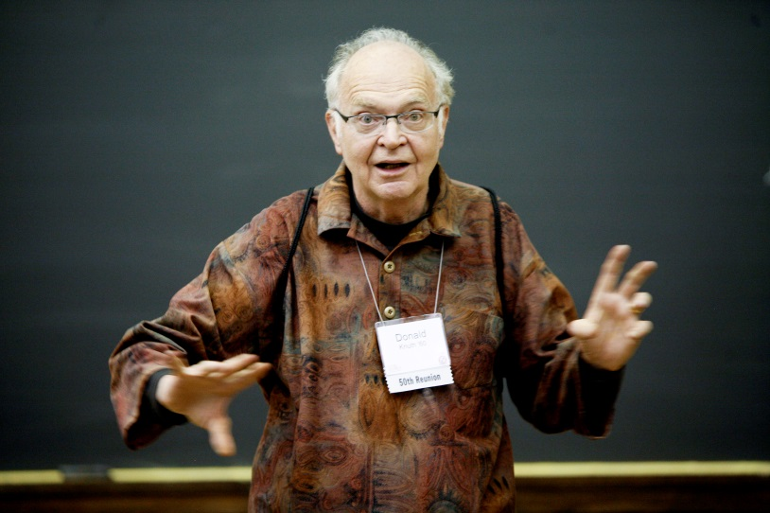
Aside: Bubble Sort – we won’t cover it
"the bubble sort seems to have nothing to recommend it, except a catchy name and the fact that it leads to some interesting theoretical problems” –Donald Knuth, The Art of Computer Programming

Slide 11
Heap Sort
Idea: Build a maxHeap, repeatedly delete the max element from the heap to build sorted list Right-to-Left
10
9
6
8
7
5
2
4
1
3
0
1
2
3
4
5
6
7
8
9
Max Heap Property: Each node is larger than its children
10
9
0
6
8
1
7
5
2
2
3
4
5
6
4
1
3
7
8
9

Slide 12
Heap Sort
Remove the Max element (i.e. the root) from the Heap: replace with last element, call percolateDown(root)
3
9
6
8
7
5
2
4
1
0
1
2
3
4
5
6
7
8
9
3
9
0
6
8
1
7
5
2
2
3
4
5
6
4
1
Percolate Down(node): if node satisfies heap property, done. Else swap with largest child and repeat on that subtree
7
8

Slide 13
Heap Sort
Remove the Max element (i.e. the root) from the Heap: replace with last element, call percolateDown(root)
9
3
6
8
7
5
2
4
1
0
1
2
3
4
5
6
7
8
9
9
3
0
6
8
1
7
5
2
2
3
4
5
6
4
1
Percolate Down(node): if node satisfies heap property, done. Else swap with largest child and repeat on that subtree
7
8

Slide 14
Heap Sort
Remove the Max element (i.e. the root) from the Heap: replace with last element, call percolateDown(root)
9
8
6
3
7
5
2
4
1
0
1
2
3
4
5
6
7
8
9
9
8
0
6
3
1
7
5
2
2
3
4
5
6
4
1
Percolate Down(node): if node satisfies heap property, done. Else swap with largest child and repeat on that subtree
7
8

Slide 15
Heap Sort
Remove the Max element (i.e. the root) from the Heap: replace with last element, call percolateDown(root)
9
8
6
4
7
5
2
3
1
0
1
2
3
4
5
6
7
8
9
9
8
0
6
4
1
7
5
2
2
3
4
5
6
3
1
Percolate Down(node): if node satisfies heap property, done. Else swap with largest child and repeat on that subtree
7
8

Slide 16
Heap Sort
Build a heap
Call deleteMax
Put that at the end of the array
myHeap = buildHeap(a);
for (int i = a.length-1; i>=0; i--){
item = myHeap.deleteMax();
a[i] = item;
}
Running Time:
Worst Case: $Θ(⋅)$
Best Case: $Θ(⋅)$

Slide 17
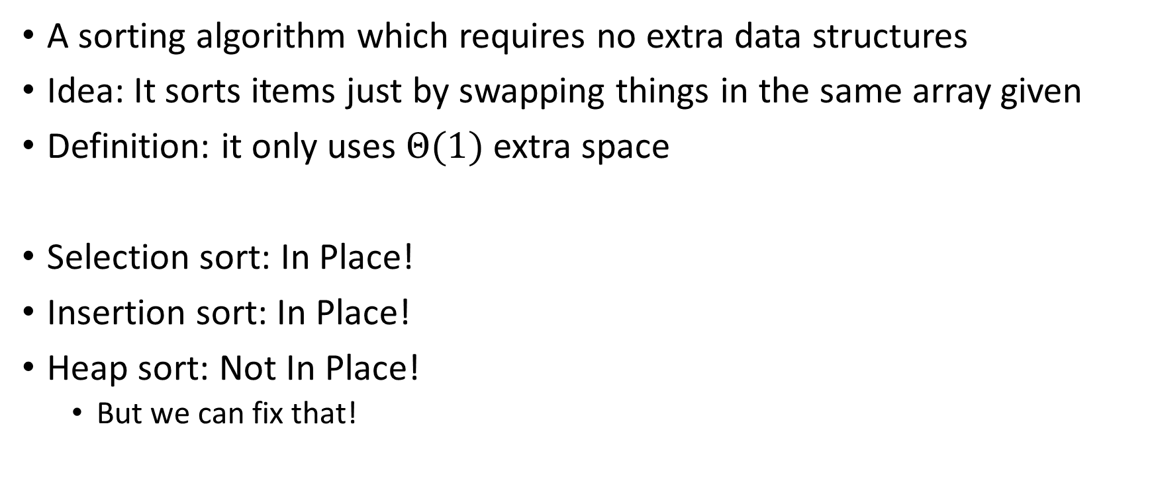
“In Place” Sorting Algorithm
A sorting algorithm which requires no extra data structures
Idea: It sorts items just by swapping things in the same array given
Definition: it only uses $Θ(1)$ extra space
Selection sort: In Place!
Insertion sort: In Place!
Heap sort: Not In Place!
  But we can fix that!

Slide 18
In Place Heap Sort
Idea: When “removing” an element from the heap, swap it with the last item of the heap then “pretend” the heap is one item shorter
10
9
6
8
7
5
2
4
1
3
0
1
2
3
4
5
6
7
8
9
10
9
0
6
8
1
7
5
2
2
3
4
5
6
4
1
3
7
8
9

Slide 19
Heap Sort
Idea: When “removing” an element from the heap, swap it with the last item of the heap then “pretend” the heap is one item shorter
3
9
6
8
7
5
2
4
1
10
0
1
2
3
4
5
6
7
8
9
3
9
0
6
8
1
7
5
2
2
3
4
5
6
4
1
7
8

Slide 20
Heap Sort
Idea: When “removing” an element from the heap, swap it with the last item of the heap then “pretend” the heap is one item shorter
9
8
6
4
7
5
2
3
1
10
0
1
2
3
4
5
6
7
8
9
9
8
0
6
4
1
7
5
2
2
3
4
5
6
3
1
7
8

Slide 21
Heap Sort
Idea: When “removing” an element from the heap, swap it with the last item of the heap then “pretend” the heap is one item shorter
1
8
6
4
7
5
2
3
9
10
0
1
2
3
4
5
6
7
8
9
1
8
0
6
4
1
7
5
2
2
3
4
5
6
3
7

Slide 22
Heap Sort
Idea: When “removing” an element from the heap, swap it with the last item of the heap then “pretend” the heap is one item shorter
1
8
6
4
7
5
2
3
9
10
0
1
2
3
4
5
6
7
8
9
8
7
0
6
4
1
1
5
2
2
3
4
5
6
3
7

Slide 23
Heap Sort
Idea: When “removing” an element from the heap, swap it with the last item of the heap then “pretend” the heap is one item shorter
3
8
6
4
7
5
2
8
9
10
0
1
2
3
4
5
6
7
8
9
3
7
0
6
4
1
1
5
2
2
3
4
5
6

Slide 24
Heap Sort
Idea: When “removing” an element from the heap, swap it with the last item of the heap then “pretend” the heap is one item shorter
3
8
6
4
7
5
2
8
9
10
0
1
2
3
4
5
6
7
8
9
7
4
0
6
3
1
1
5
2
2
3
4
5
6

Slide 25
In Place Heap Sort
Build a heap using the same array (Floyd’s build heap algorithm works)
Call deleteMax
Put that at the end of the array
buildHeap(a);
for (int i = a.length-1; i>=0; i--){
temp=a[i]
a[i] = a[0];
a[0] = temp;
percolateDown(0);
}
Running Time:
Worst Case: $Θ(⋅)$
Best Case: $Θ(⋅)$

Slide 26
Floyd’s buildHeap method
Working towards the root, one row at a time, percolate down
buildHeap(){
for(int i = size; i>0; i--){
percolateDown(i);
}
}

Slide 27
Divide And Conquer Sorting
Divide and Conquer:
  Recursive algorithm design technique
  Solve a large problem by breaking it up into smaller versions of the same problem

Slide 28

Divide and Conquer
Base Case:
  If the problem is “small” then solve directly and return
Divide:
  Break the problem into subproblem(s), each smaller instances
Conquer:
  Solve subproblem(s) recursively
Combine:
  Use solutions to subproblems to solve original problem
A
B

Slide 29
Divide and Conquer Template Pseudocode
def my_DandC(problem){
// Base Case
if (problem.size() <= small_value){
return solve(problem); // directly solve (e.g., brute force)
}
// Divide
List subproblems = divide(problem);
// Conquer
solutions = new List();
for (sub : subproblems){
subsolution = my_DandC(sub);
solutions.add(subsolution);
}
// Combine
return combine(solutions);
}

Slide 30
Merge Sort
5
8
2
9
4
1
Base Case:
  If the list is of length 1 or 0, it’s already sorted, so just return it
Divide:
  Split the list into two “sublists” of (roughly) equal length
Conquer:
  Sort both lists recursively
Combine:
  Merge sorted sublists into one sorted list
5
5
8
2
9
4
1
2
5
8
1
4
9
2
5
8
1
4
9
1
2
4
5
8
9

Slide 31








Merge Sort In Action!
Sort between indices $low$ and $high$
5
8
2
9
4
1
3
7
$$low$$
$$high$$
Base Case: if $low$ == $high$ then that range is already sorted!
Divide and Conquer: Otherwise call mergesort on ranges $\left(low,\frac{low+high}{2}\right)$ and $\left(\frac{low+high}{2}+1, high\right)$
5
8
2
9
4
1
3
7
$$low$$
$$\frac{low+high}{2}$$
$$\frac{low+high}{2}+1$$
$$high$$
2
5
8
9
1
3
4
7
After Recursion:
$$low$$
$$high$$

Slide 32



Merge (the combine part)
2
5
8
9
1
3
4
7
L next
R next
$$\frac{low+high}{2}+1$$
$$low$$
$$\frac{low+high}{2}$$
$$high$$
M next
Create a new array to merge into, and 3 pointers/indices:
L_next: the smallest “unmerged” thing on the left
R_next: the smallest “unmerged” thing on the right
M_next: where the next smallest thing goes in the merged array
One-by-one: put the smallest of L_next and R_next into M_next, then advance both M_next and whichever of L/R was used.

Slide 33
Merge Sort Pseudocode
void mergesort(myArray){
ms_helper(myArray, 0, myArray.length());
}
void mshelper(myArray, low, high){
if (low == high){return;} // Base Case
mid = (low+high)/2;
ms_helper(low, mid);
ms_helper(mid+1, high);
merge(myArray, low, mid, high);
}

Slide 34
Merge Pseudocode
void merge(myArray, low, mid, high){
merged = new int[high-low+1]; // or whatever type is in myArray
l_next = low;
r_next = high;
m_next = 0;
while (l_next <= mid && r_next <= high){
if (myArray[l_next] <= myArray[r_next]){
merged[m_next++] = myArray[l_next++];
}
else{
merged[m_next++] = myArray[r_next++];
}
}
while (l_next <= mid){ merged[m_next++] = myArray[l_next++]; }
while (r_next <= high){ merged[m_next++] = myArray[r_next++]; }
for(i=0; i<=merged.length; i++){ myArray[i+low] = merged[i];}
}

Slide 35
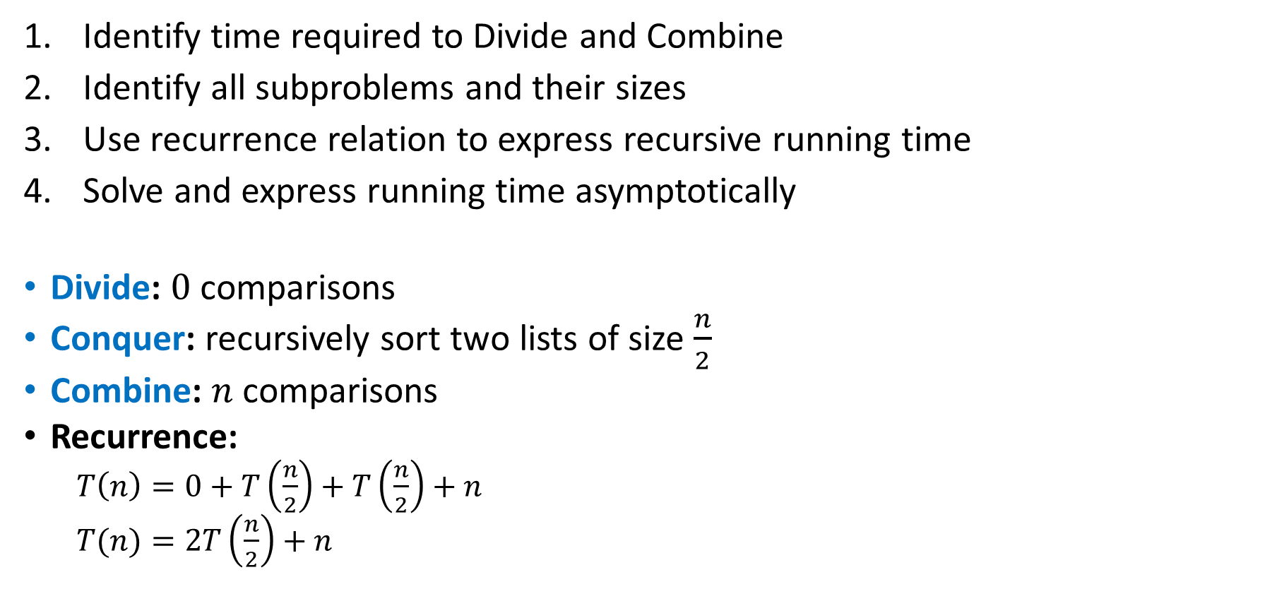
Analyzing Merge Sort
Identify time required to Divide and Combine
Identify all subproblems and their sizes
Use recurrence relation to express recursive running time
Solve and express running time asymptotically
Divide: $0$ comparisons
Conquer: recursively sort two lists of size $\frac{n}{2}$
Combine: $n$ comparisons
Recurrence:
  $T\left(n\right)=0+T\left(\frac{n}{2}\right)+T\left(\frac{n}{2}\right)+n$
  $T(n)=2T\left(\frac{n}{2}\right)+n$

Slide 36
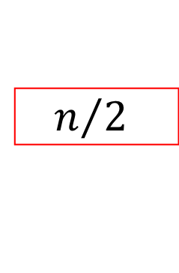


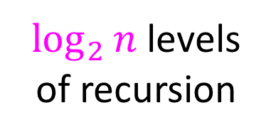




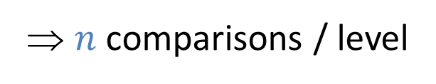


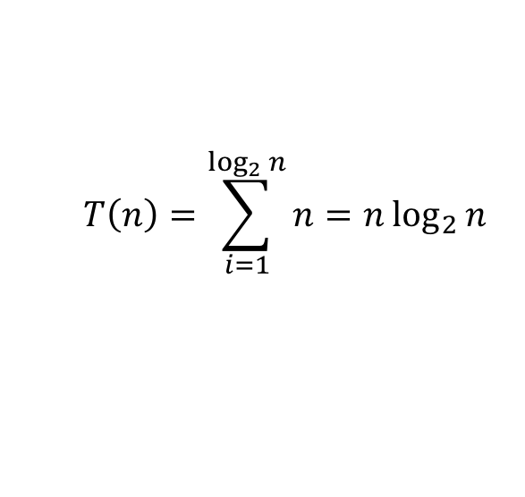
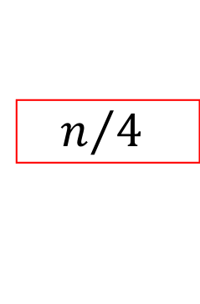
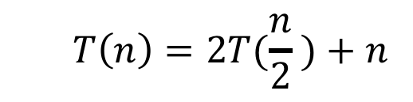








Red box represents a problem instance
Blue value represents time spent at that level of recursion
  $$T\left(n\right)=2T(\frac{n}{2} )+n$$
$$n$$
⇒ $n$ comparisons / level
$$n$$
$$n/2$$
$$\frac{n}{2}$$
$$n/2$$
$$\frac{n}{2}$$
$$\frac{n}{4}$$
$$\frac{n}{4}$$
$$\frac{n}{4}$$
$$\frac{n}{4}$$
$\log_{2}⁡n$ levels
of recursion
$$n/4$$
$$n/4$$
$$n/4$$
$$n/4$$
…
…
…
…
…
$$1$$
$$1$$
$$1$$
$$1$$
$$1$$
$$1$$
$$1$$
$$1$$
$$1$$
$$1$$
$$1$$
$$1$$
  $$T\left(n\right)=\sum_{i=1}^{\log_{2}{n}}{n}=n\log_{2}{n}$$

Slide 37

Properties of Merge Sort
Worst Case Running time:
  $Θ(n\log{n})$
In-Place?
  No!
Adaptive?
  No!
Stable?
  Yes!
  As long as in a tie you always pick l_next

Slide 38

Quicksort
Like Mergesort:
  Divide and conquer
  $O(n\log{n})$ run time (kind of…)
Unlike Mergesort:
  Divide step is the “hard” part
  Typically faster than Mergesort

Slide 39
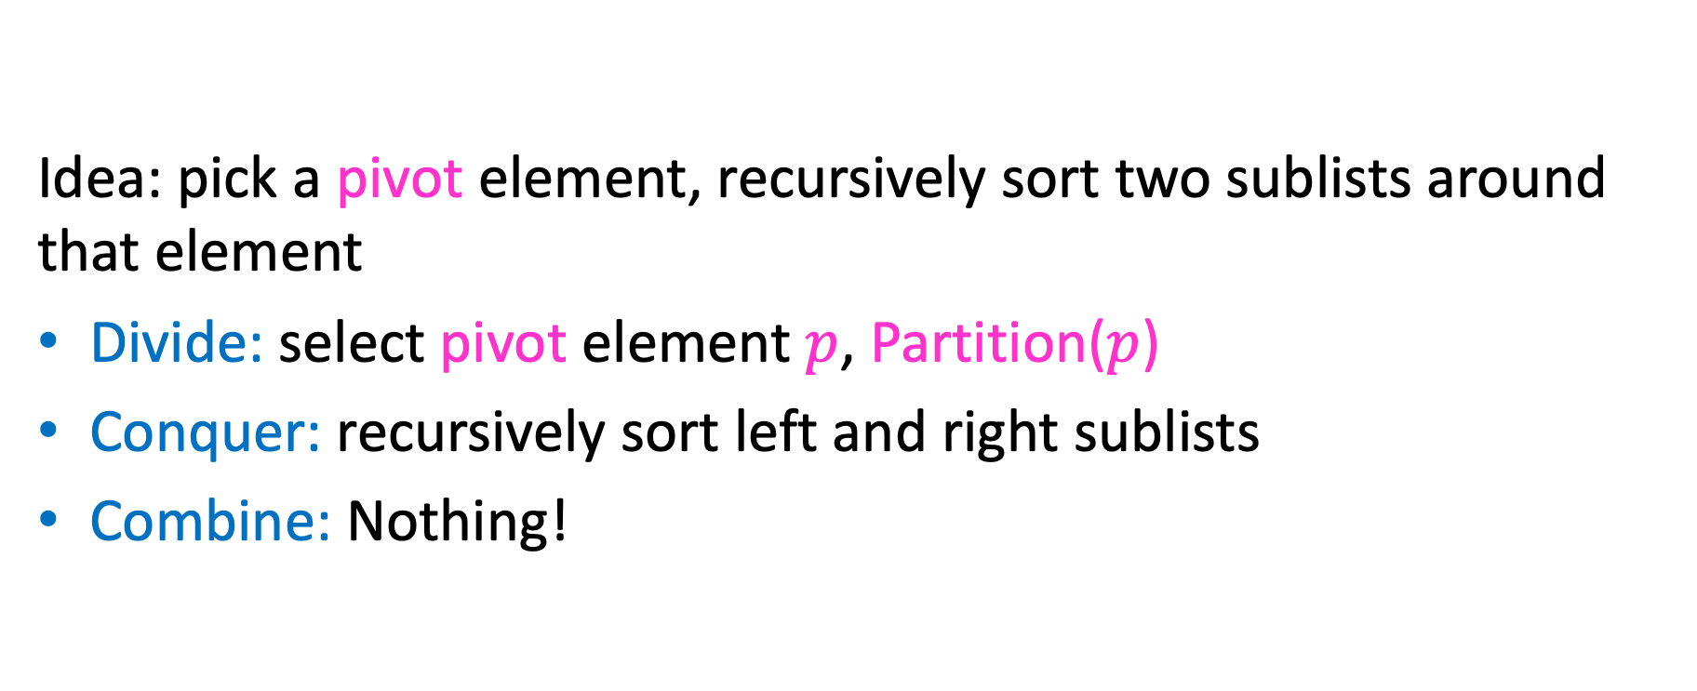
Quicksort
Idea: pick a pivot element, recursively sort two sublists around that element
Divide: select pivot element $p$, Partition($p$)
Conquer: recursively sort left and right sublists
Combine: Nothing!

Slide 40


Partition (Divide step)
Given: a list, a pivot $p$
Start: unordered list
8
5
7
3
12
10
1
2
4
9
6
11
Goal: All elements $<p$ on left, all $>p$ on right
5
7
3
1
2
4
6
8
12
10
9
11

Slide 41
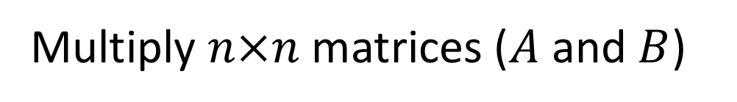
Partition, Procedure
If Begin value $< p$, move Begin right
Else swap Begin value with End value, move End Left
Done when Begin = End
8
5
7
3
12
10
1
2
4
9
6
11
8
5
7
3
12
10
1
2
4
9
6
11
8
5
7
3
12
10
1
2
4
9
6
11
8
5
7
3
11
10
1
2
4
9
6
12

Slide 42
Partition, Procedure
If Begin value $< p$, move Begin right
Else swap Begin value with End value, move End Left
Done when Begin = End
8
5
7
3
11
10
1
2
4
9
6
12
8
5
7
3
6
10
1
2
4
9
11
12
8
5
7
3
6
10
1
2
4
9
11
12
8
5
7
3
6
10
1
2
4
9
11
12

Slide 43
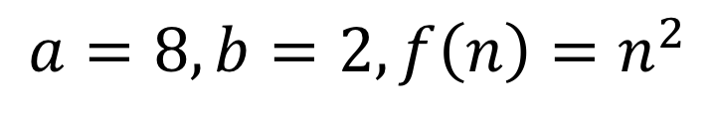
Partition, Procedure
If Begin value $< p$, move Begin right
Else swap Begin value with End value, move End Left
Done when Begin = End
8
5
7
3
6
4
1
2
10
9
11
12
Case 1: meet at element $<p$
Swap $p$ with pointer position (2 in this case)
2
5
7
3
6
4
1
8
10
9
11
12

Slide 44
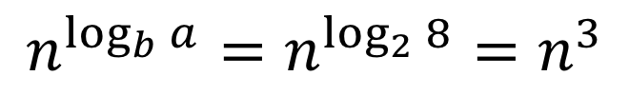
Partition, Procedure
If Begin value $< p$, move Begin right
Else swap Begin value with End value, move End Left
Done when Begin = End
8
5
7
3
6
4
1
2
10
9
11
12
Case 2: meet at element $>p$
Swap $p$ with value to the left (2 in this case)
2
5
7
3
6
4
1
8
10
9
11
12

Slide 45
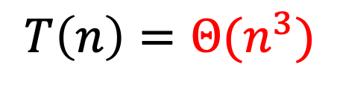
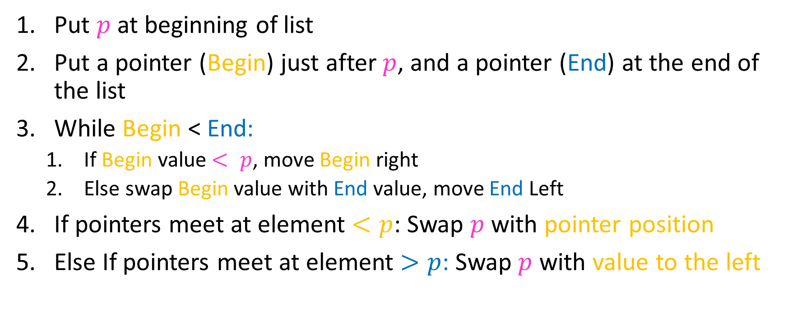
Partition Summary
Put $p$ at beginning of list
Put a pointer (Begin) just after $p$, and a pointer (End) at the end of the list
While Begin < End:
  If Begin value $< p$, move Begin right
  Else swap Begin value with End value, move End Left
If pointers meet at element $<p$: Swap $p$ with pointer position
Else If pointers meet at element $>p$: Swap $p$ with value to the left
Run time?
$$O(n)$$

Slide 46
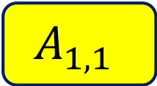
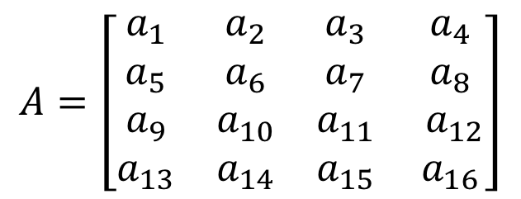
Conquer
2
5
7
3
6
4
1
8
10
9
11
12
All elements $<p$
All elements $>p$
Exactly where it belongs!
Recursively sort Left and Right sublists

Slide 47


Quicksort Run Time (Best)
If the pivot is always the median:
2
5
1
3
6
4
7
8
10
9
11
12
2
1
3
5
6
4
7
8
9
10
11
12
Then we divide in half each time
$$T\left(n\right)=2T\left(\frac{n}{2}\right)+n$$
$$T\left(n\right)=O(n\log{n})$$

Slide 48

Quicksort Run Time (Worst)
If the pivot is always at the extreme:
1
5
2
3
6
4
7
8
10
9
11
12
1
2
3
5
6
4
7
8
10
9
11
12
Then we shorten by 1 each time
$$T\left(n\right)=T\left(n−1\right)+n$$
$$T\left(n\right)=O(n^{2})$$

Slide 49
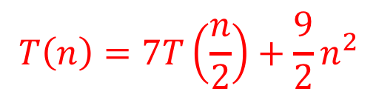



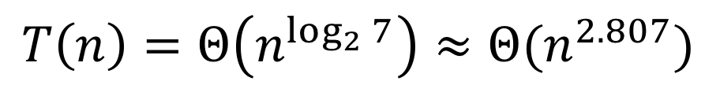

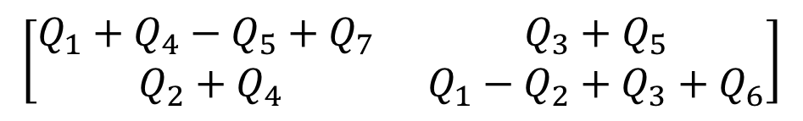

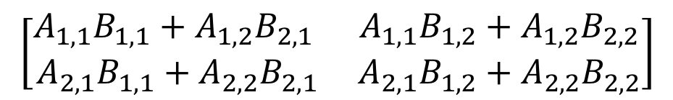
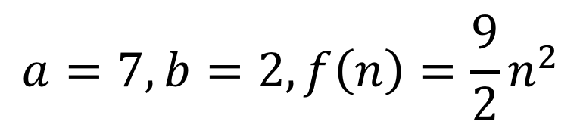

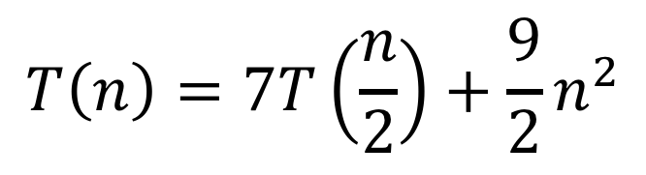
Quicksort Run Time (Worst)
$$T\left(n\right)=T\left(n−1\right)+n$$
$$n$$
$$n$$
$$n−1$$
$$n−1$$
$$T\left(n\right)=1+2+3+…+n$$
$$n−2$$
$$n−2$$
$$T\left(n\right)=\frac{n\left(n+1\right)}{2}$$
…
$$1$$
$$1$$
$$T\left(n\right)=O(n^{2})$$

Slide 50
Quicksort on a (nearly) Sorted List
First element always yields unbalanced pivot
1
2
3
4
5
6
7
8
9
10
11
12
1
2
3
4
5
6
7
8
9
10
11
12
So we shorten by 1 each time
$$T\left(n\right)=T\left(n−1\right)+n$$
$$T\left(n\right)=O(n^{2})$$

Slide 51
Good Pivot
What makes a good Pivot?
  Roughly even split between left and right
  Ideally: median
There are ways to find the median in linear time, but it’s complicated and slow and you’re better off using mergesort
In Practice:
  Pick a random value as a pivot
  Pick the middle of 3 random values as the pivot

Slide 52

Properties of Quick Sort
Worst Case Running time:
  $Θ(n^{2})$
  But $Θ(n\log{n})$ average! And typically faster than mergesort!
In-Place?
  ….Debatable
Adaptive?
  No!
Stable?
  No!

Slide 53
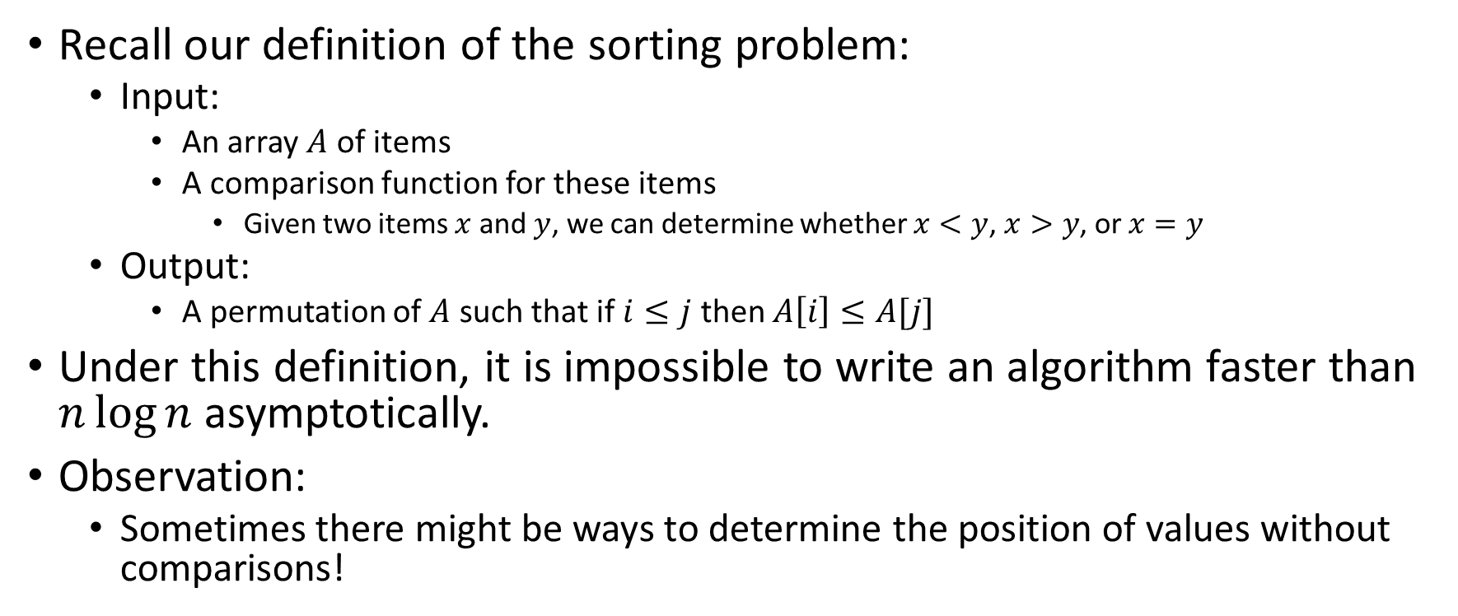
Improving Running time
Recall our definition of the sorting problem:
  Input:
    An array $A$ of items
    A comparison function for these items
      Given two items $x$ and $y$, we can determine whether $x<y$, $x>y$, or $x=y$
  Output:
    A permutation of $A$ such that if $i≤j$ then $A\left[i\right]≤A[j]$
Under this definition, it is impossible to write an algorithm faster than $n\log{n}$ asymptotically.
Observation:
  Sometimes there might be ways to determine the position of values without comparisons!

