Slide 1
CSE 332 Summer 2024
Lecture 9: hashing
Nathan Brunelle
http://www.cs.uw.edu/332

Slide 2
Dictionary (Map) ADT
Contents:
  Sets of key+value pairs
  Keys must be comparable
Operations:
  insert(key, value)
    Adds the (key,value) pair into the dictionary
    If the key already has a value, overwrite the old value
      Consequence: Keys cannot be repeated
  find(key)
    Returns the value associated with the given key
  delete(key)
    Remove the key (and its associated value)

Slide 3
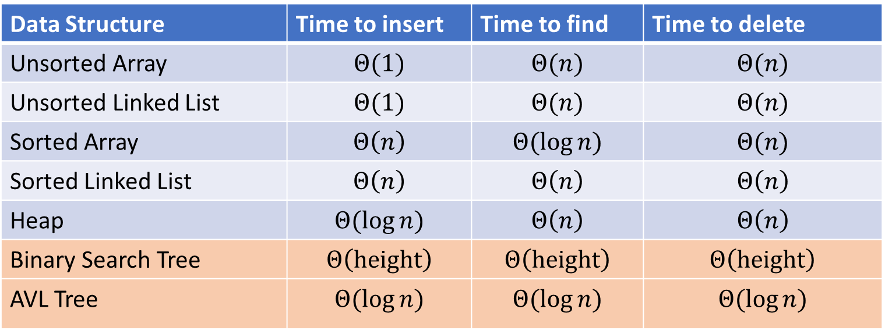
Dictionary Data Structures
Data Structure | Time to insert | Time to find | Time to delete
Unsorted Array | $$Θ(1)$$ | $$Θ(n)$$ | $$Θ(n)$$
Unsorted Linked List | $$Θ(1)$$ | $$Θ(n)$$ | $$Θ(n)$$
Sorted Array | $$Θ\left(n\right)$$ | $$Θ(\log{n})$$ | $$Θ(n)$$
Sorted Linked List | $$Θ\left(n\right)$$ | $$Θ\left(n\right)$$ | $$Θ\left(n\right)$$
Heap | $$Θ(\log{n})$$ | $$Θ\left(n\right)$$ | $$Θ\left(n\right)$$
Binary Search Tree | $$Θ\left(height\right)$$ | $$Θ\left(height\right)$$ | $$Θ\left(height\right)$$
AVL Tree | $$Θ(\log{n})$$ | $$Θ(\log{n})$$ | $$Θ(\log{n})$$

Slide 4
BSTs and AVL Trees
Binary Search Tree:
  A binary tree where for each node, all keys in its left subtree are smaller and all keys in its right subtree are larger
  Find:
    If it matches, return the value.
    If the search key is less than the current node, look left. If it’s greater, look right.
    If we reach an empty spot, find was unsuccessful
  Insert:
    Do a find, if it was successful then update the value
    If it was unsuccessful, add a new node to the empty spot we found.
  Delete:
    If the deleted node is a leaf, just remove it
    If the deleted node had one child, replace it with that one child
    If the deleted node had 2 children, replace it with the largest key to the left
AVL Tree:
  A binary search tree where for each node, the height of its left subtree and the height of its right subtree are off by at most 1.
  Find:
    Same as BST
  Insert:
    Do a BST insert, then rotate if tree is unbalanced (apply one LL, RR, LR, RL case)
  Delete:
    Do a BST delete, then rotate if the tree is unbalanced (apply LL, RR, LR, RL cases as needed from leaf to root)

Slide 5
Other Tree-based Dictionaries
Red-Black Trees
  Similar to AVL Trees in that we add shape rules to BSTs
  More “relaxed” shape than an AVL Tree
    Trees can be taller (though not asymptotically so)
    Needs to move nodes less frequently
  This is what Java’s TreeMap uses!
Tries
  Similar to a Huffman Tree
  Requires keys to be sequences (e.g. Strings)
  Combines shared prefixes among keys to save space
  Often used for text-based searches
    Web search
    Genomes

Slide 6
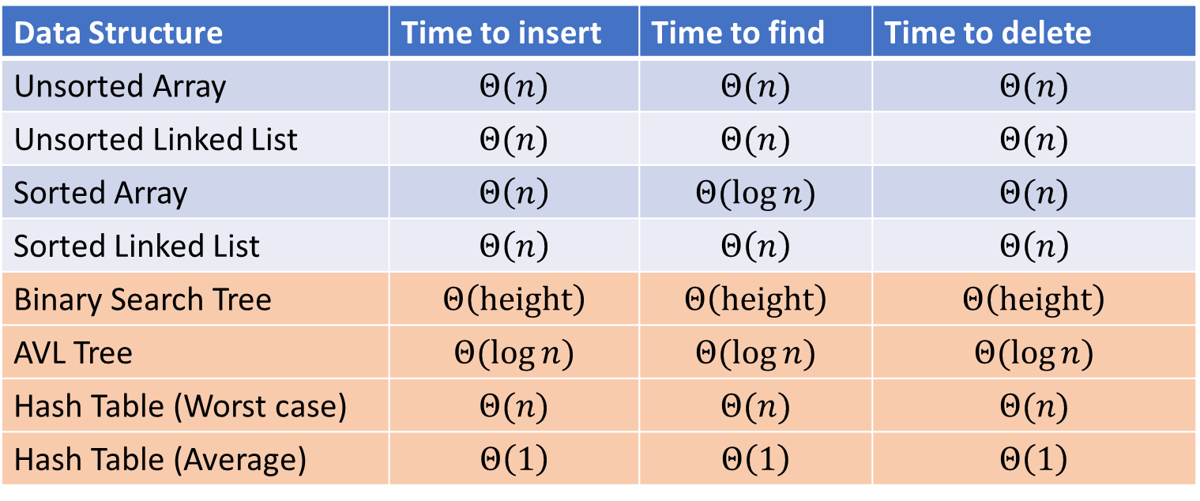
Next topic: Hash Tables
Data Structure | Time to insert | Time to find | Time to delete
Unsorted Array | $$Θ(n)$$ | $$Θ(n)$$ | $$Θ(n)$$
Unsorted Linked List | $$Θ(n)$$ | $$Θ(n)$$ | $$Θ(n)$$
Sorted Array | $$Θ\left(n\right)$$ | $$Θ(\log{n})$$ | $$Θ(n)$$
Sorted Linked List | $$Θ\left(n\right)$$ | $$Θ\left(n\right)$$ | $$Θ\left(n\right)$$
Binary Search Tree | $$Θ\left(height\right)$$ | $$Θ\left(height\right)$$ | $$Θ\left(height\right)$$
AVL Tree | $$Θ(\log{n})$$ | $$Θ(\log{n})$$ | $$Θ(\log{n})$$
Hash Table (Worst case) | $$Θ(n)$$ | $$Θ(n)$$ | $$Θ(n)$$
Hash Table (Average) | $$Θ\left(1\right)$$ | $$Θ\left(1\right)$$ | $$Θ\left(1\right)$$

Slide 7
Dictionary (Map) ADT
Contents:
  Sets of key+value pairs
  Keys must be comparable
Operations:
  insert(key, value)
    Adds the (key,value) pair into the dictionary
    If the key already has a value, overwrite the old value
      Consequence: Keys cannot be repeated
  find(key)
    Returns the value associated with the given key
  delete(key)
    Remove the key (and its associated value)

Slide 8
The Best Data Structure!
Think of every key as a number
Give each key its own index in an array
insert(key, value){
arr[key]=value;
}
find(key){
return arr[key];
}
delete(key){
arr[key] = null;
}

Slide 9
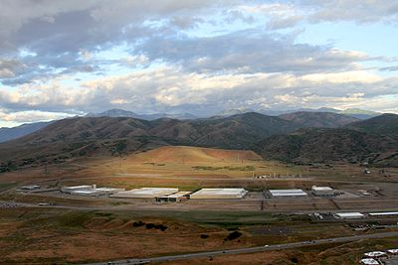
Problem?

Slide 10

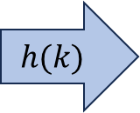
Hash Tables
Idea:
  Have a small array to store information
  Use a hash function to convert the key into an index
    Hash function should “scatter” the keys, behave as if it randomly assigned keys to indices
  Store key at the index given by the hash function
  Do something if two keys map to the same place (should be very rare)
    Collision resolution
Insert / find /
delete
$$h(k)$$
Index between 0 and length-1
& value
Key Object

Slide 11

Example
0
1
2
3
4
5
6
7
8
9
Key: Phone Number
Value: People
Table size: 10
$h\left(phone\right)=$ number as an integer % 10
$h\left(8675309\right)=9$

Slide 12
What Influences Running time?
How long hashing itself takes
Likelihood of collisions
  Size of the array vs number of values in the array
  “quality” of our hash function
What we do when we have a collision

Slide 13
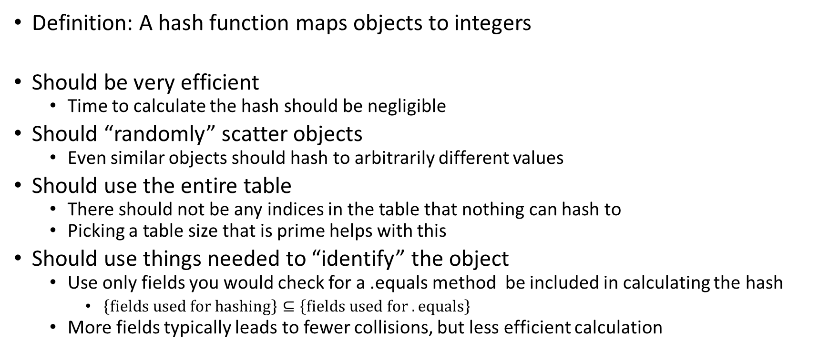
Properties of a “Good” Hash
Definition: A hash function maps objects to integers
Should be very efficient
  Time to calculate the hash should be negligible
Should “randomly” scatter objects
  Even similar objects should hash to arbitrarily different values
Should use the entire table
  There should not be any indices in the table that nothing can hash to
  Picking a table size that is prime helps with this
Should use things needed to “identify” the object
  Use only fields you would check for a .equals method be included in calculating the hash
    $\left\{fields used for hashing\right\}⊆\left\{fields used for .equals\right\}$
  More fields typically leads to fewer collisions, but less efficient calculation

Slide 14

A Bad Hash (and phone number trivia)
$h\left(phone\right)=$ the first digit of the phone number
  Assume 10-digit format
  No US phone numbers start with 1 or 0
  If we’re sampling from this class, 2 is by far the most likely
0
1
2
3
4
5
6
7
8
9

Slide 15
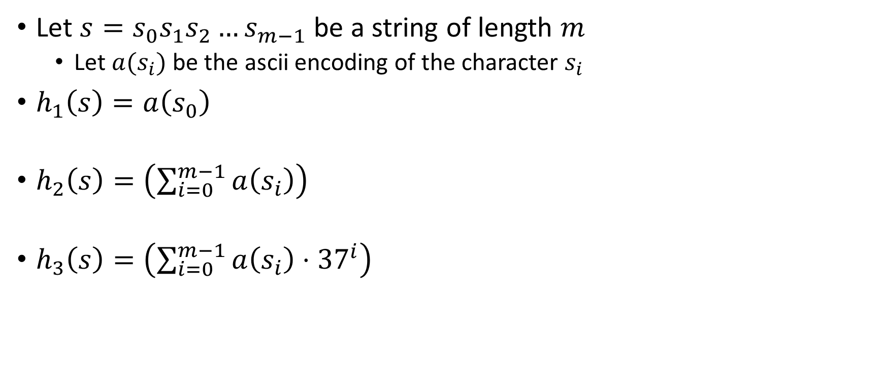
Compare These Hash Functions (for strings)
Let $s=s_{0}s_{1}s_{2}…s_{m−1}$ be a string of length $m$
  Let $a(s_{i})$ be the ascii encoding of the character $s_{i}$
$h_{1}\left(s\right)=a\left(s_{0}\right)$
$h_{2}\left(s\right)=\left(\sum_{i=0}^{m−1}{a\left(s_{i}\right)}\right)$
$h_{3}\left(s\right)=\left(\sum_{i=0}^{m−1}{a\left(s_{i}\right)⋅{37}^{i}}\right)$

Slide 16
Collision Resolution
A Collision occurs when we want to insert something into an already-occupied position in the hash table
2 main strategies:
  Separate Chaining
    Use a secondary data structure to contain the items
      E.g. each index in the hash table is itself a linked list
  Open Addressing
    Use a different spot in the table instead
      Linear Probing
      Quadratic Probing
      Double Hashing
0
1
2
3
4
5
6
7
8
9

Slide 17




Separate Chaining Insert
To insert $k,v$:
  Compute the index using $i=h\left(k\right) \% length$
  Add the key-value pair to the data structure at $table\left[i\right]$
$$k,v$$
$$k,v$$
$$k,v$$
0
1
2
3
4
5
6
7
8
9

Slide 18

Separate Chaining Find
To find $k$:
  Compute the index using $i=h\left(k\right) \% length$
  Call find with the key on the data structure at $table\left[i\right]$
$$k,v$$
$$k,v$$
$$k,v$$
0
1
2
3
4
5
6
7
8
9

Slide 19

Separate Chaining Delete
To delete $k$:
  Compute the index using $i=h\left(k\right) \% length$
  Call delete with the key on the data structure at $table\left[i\right]$
$$k,v$$
$$k,v$$
$$k,v$$
0
1
2
3
4
5
6
7
8
9

Slide 20
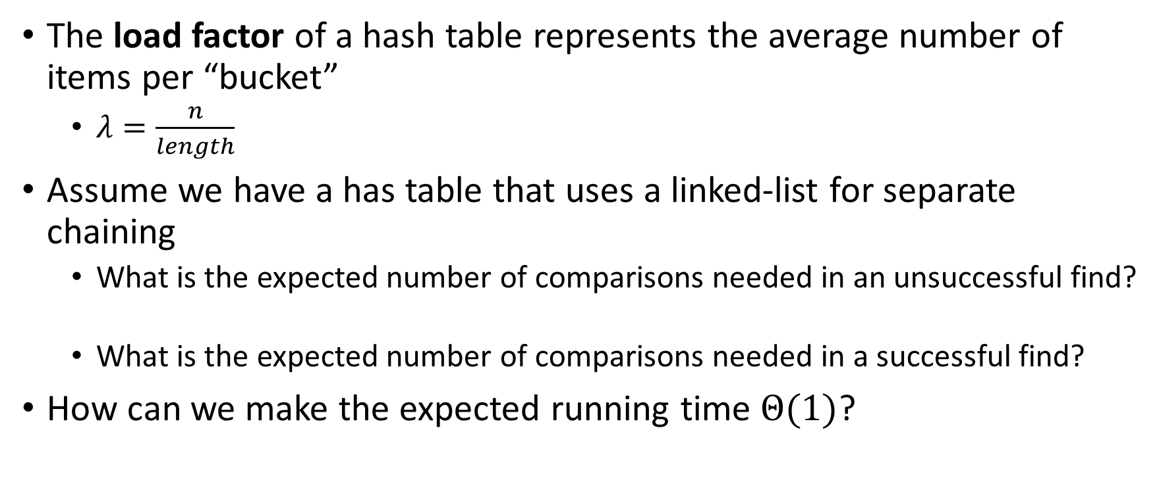
Formal Running Time Analysis
The load factor of a hash table represents the average number of items per “bucket”
  $λ=\frac{n}{length}$
Assume we have a has table that uses a linked-list for separate chaining
  What is the expected number of comparisons needed in an unsuccessful find?
  What is the expected number of comparisons needed in a successful find?
How can we make the expected running time $Θ(1)$?

Slide 21



Load Factor?
$$k,v$$
$$k,v$$
$$k,v$$
0
1
2
3
4
5
6
7
8
9

Slide 22





Load Factor?
$$k,v$$
$$k,v$$
$$k,v$$
$$k,v$$
$$k,v$$
$$k,v$$
$$k,v$$
$$k,v$$
0
1
2
3
4
5
6
7
8
9

Slide 23







Load Factor?
$$k,v$$
$$k,v$$
$$k,v$$
$$k,v$$
$$k,v$$
$$k,v$$
$$k,v$$
$$k,v$$
$$k,v$$
$$k,v$$
$$k,v$$
$$k,v$$
$$k,v$$
$$k,v$$
$$k,v$$
0
1
2
3
4
5
6
7
8
9

Slide 24
Collision Resolution: Linear Probing
When there’s a collision, use the next open space in the table
0
1
2
3
4
5
6
7
8
9

Slide 25

Linear Probing: Insert Procedure
To insert $k,v$
  Calculate $i=h\left(k\right) \% length$
  If $table[i]$ is occupied then try $\left(i+1\right)\% length$
  If that is occupied try $\left(i+2\right)\% length$
  If that is occupied try $\left(i+3\right)\% length$
  …
0
1
2
3
4
5
6
7
8
9

Slide 26
Linear Probing: Find
0
1
2
3
4
5
6
7
8
9

Slide 27
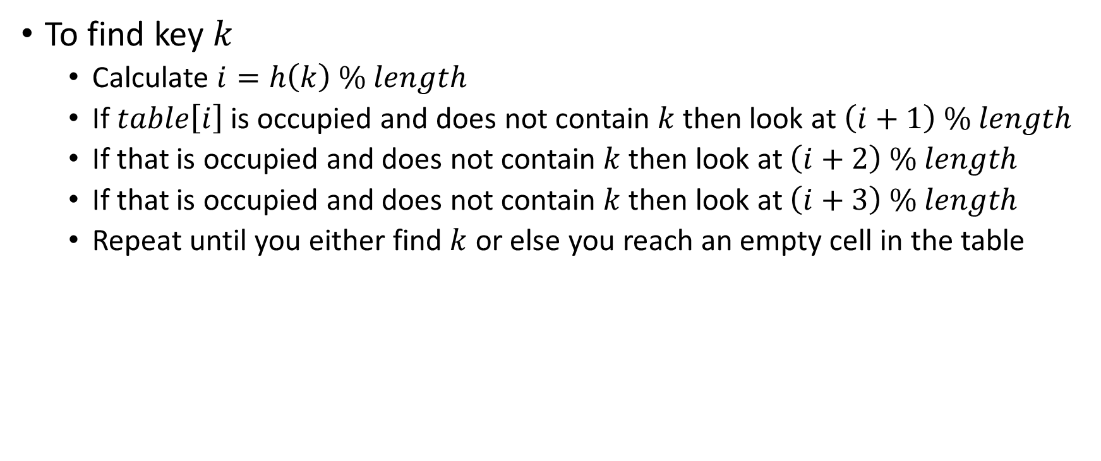
Linear Probing: Find
To find key $k$
  Calculate $i=h\left(k\right) \% length$
  If $table\left[i\right]$ is occupied and does not contain $k$ then look at $\left(i+1\right) \% length$
  If that is occupied and does not contain $k$ then look at $\left(i+2\right) \% length$
  If that is occupied and does not contain $k$ then look at $\left(i+3\right) \% length$
  Repeat until you either find $k$ or else you reach an empty cell in the table
0
1
2
3
4
5
6
7
8
9

Slide 28
Linear Probing: Delete
Suppose A, B, C, D, and E all hashed to 3
Now let’s delete B
Before:
A
B
C
D
E
0
1
2
3
4
5
6
7
8
9
After:
0
1
2
3
4
5
6
7
8
9

Slide 29
Linear Probing: Delete
Suppose A, B, and E all hashed to 3, and C and D hashed to 5
Now let’s delete B
Before:
A
B
C
D
E
0
1
2
3
4
5
6
7
8
9
After:
0
1
2
3
4
5
6
7
8
9

Slide 30
Linear Probing: Delete
Suppose A and E hashed to 3, and B,C, and D hashed to 4
Now let’s delete B
Before:
A
B
C
D
E
0
1
2
3
4
5
6
7
8
9
After:
0
1
2
3
4
5
6
7
8
9

Slide 31
Linear Probing: Delete
Let’s do this together!
0
1
2
3
4
5
6
7
8
9

Slide 32
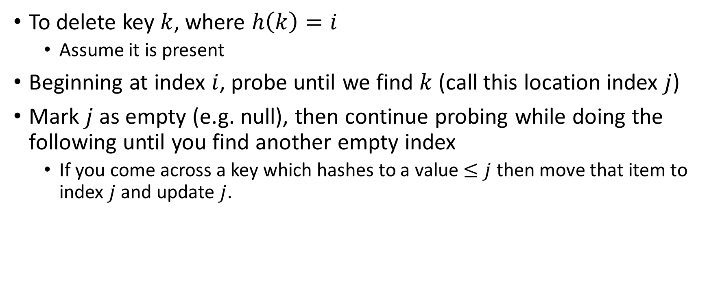
Linear Probing: Delete
To delete key $k$, where $h\left(k\right)=i$
  Assume it is present
Beginning at index $i$, probe until we find $k$ (call this location index $j$)
Mark $j$ as empty (e.g. null), then continue probing while doing the following until you find another empty index
  If you come across a key which hashes to a value $≤j$ then move that item to index $j$ and update $j$.
0
1
2
3
4
5
6
7
8
9

Slide 33


Linear Probing: Delete
Option 1: Fill in with items that hashed to before the empty slot
Option 2: “Tombstone” deletion. Leave a special object that indicates an object was deleted from there
  The tombstone does not act as an open space when finding (so keep looking after its reached)
  When inserting you can replace a tombstone with a new item
$$k,v$$
$$k,v$$
$$k,v$$
$$k,v$$
0
1
2
3
4
5
6
7
8
9

Slide 34

Linear Probing + Tombstone: Find
To find key $k$
  Calculate $i=h\left(k\right) \% length$
  While $table[i]$ has a tombstone or a key other than $k$, $i=\left(i+1\right) \% length$
  If you come across $k$ return $table[i]$
  If you come across an empty index, the find was unsuccessful
0
1
2
3
4
5
6
7
8
9

Slide 35
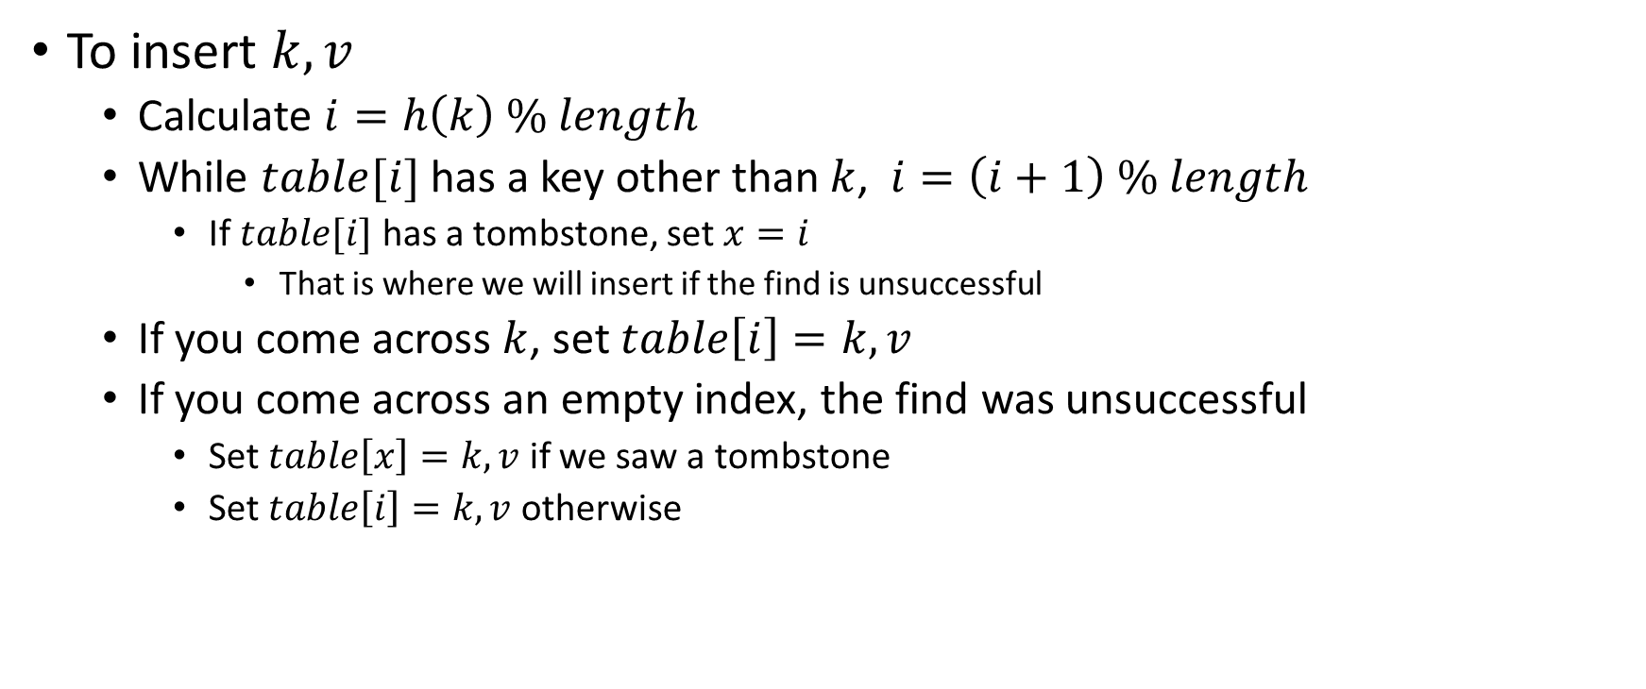
Linear Probing + Tombstone: Insert
To insert $k,v$
  Calculate $i=h\left(k\right) \% length$
  While $table[i]$ has a key other than $k$, $i=\left(i+1\right) \% length$
    If $table[i]$ has a tombstone, set $x=i$
      That is where we will insert if the find is unsuccessful
  If you come across $k$, set $table\left[i\right]=k,v$
  If you come across an empty index, the find was unsuccessful
    Set $table\left[x\right]=k,v$ if we saw a tombstone
    Set $table\left[i\right]=k,v$ otherwise
0
1
2
3
4
5
6
7
8
9

