Slide 1
CSE 332 Autumn 2024 Lecture 10: AVL Trees 2
Nathan Brunelle
http://www.cs.uw.edu/332

Slide 2
Dictionary (Map) ADT
Contents:
Sets of key+value pairs
Keys must be comparable
Operations:
insert(key, value)
Adds the (key,value) pair into the dictionary
If the key already has a value, overwrite the old value
Consequence: Keys cannot be repeated
find(key)
Returns the value associated with the given key
delete(key)
Remove the key (and its associated value)

Slide 3
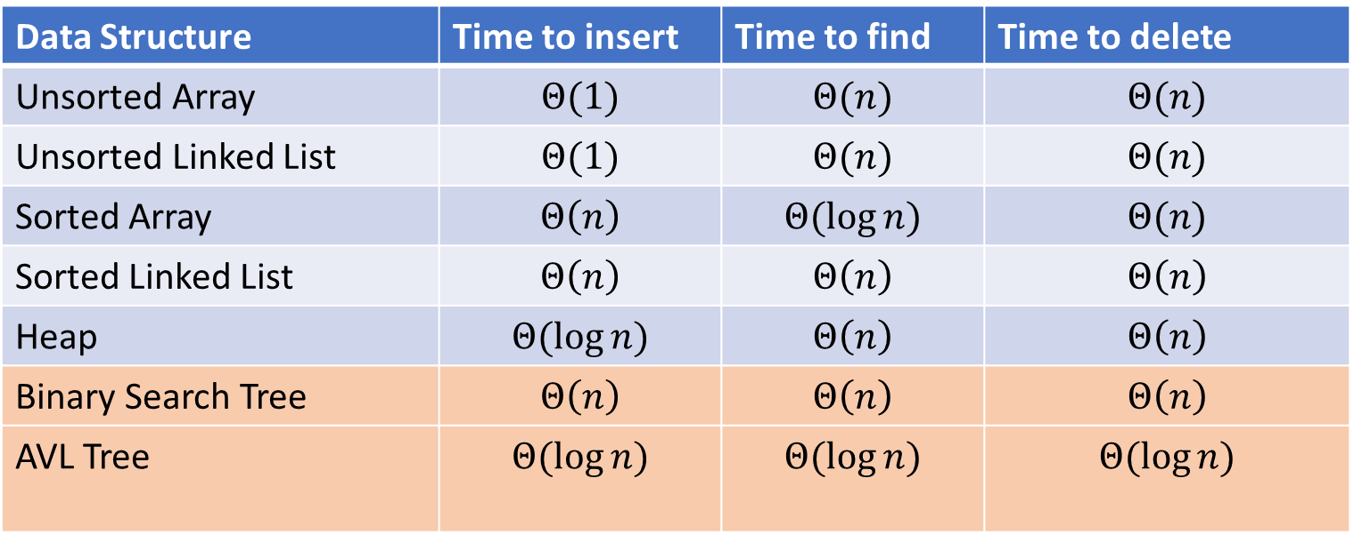
Naïve attempts
Data Structure | Time to insert | Time to find | Time to delete
Unsorted Array | $$Θ(1)$$ | $$Θ(n)$$ | $$Θ(n)$$
Unsorted Linked List | $$Θ(1)$$ | $$Θ(n)$$ | $$Θ(n)$$
Sorted Array | $$Θ\left(n\right)$$ | $$Θ(\log{n})$$ | $$Θ(n)$$
Sorted Linked List | $$Θ\left(n\right)$$ | $$Θ\left(n\right)$$ | $$Θ\left(n\right)$$
Heap | $$Θ(\log{n})$$ | $$Θ\left(n\right)$$ | $$Θ\left(n\right)$$
Binary Search Tree | $$Θ\left(n\right)$$ | $$Θ\left(n\right)$$ | $$Θ\left(n\right)$$
AVL Tree | $$Θ(\log{n})$$ | $$Θ(\log{n})$$ | $$Θ(\log{n})$$

Slide 4
Binary Search Tree
7
3
10
1
6
8
16
Binary Tree
Definition:
Tree where each node has at most 2 children
Order Property
All keys in the left subtree are smaller than the root
All keys in the right subtree are larger than the root
Consequence: cannot have repeated values
0
2

Slide 5
Are these BSTs?
7
3
10
7
7
16
1
3
10
0
1
16
16
10
0
7
7
3
10
3
1
8
16
1
0
0

Slide 6
Aside: Why not use an array?
We represented a heap using an array, finding children/parents by index
We will represent BSTs with nodes and references. Why?
We might have “gaps” in our tree
Memory!
$2^{n}$

Slide 7
Find Operation (recursive)
7
3
10
find(key, root){
if (root == Null){
return Null;
{
if (key == root.key){
return root.value;
}
if (key < root.key){
return find(key, root.left);
}
if (key > root.key){
return find(key, root.right);
}
return Null;
}
1
6
16
0

Slide 8
Find Operation (iterative)
7
3
10
find(key, root){
while (root != Null && key != root.key){
if (key < root.key){
root = root.left;
}
else if (key > root.key){
root = root.right;
}
}
if (root == Null){
return Null;
}
return root.value;
}
1
6
16
0

Slide 9
Insert Operation (recursive)
7
3
10
insert(key, value, root){
root = insertHelper(key, value, root);
}
insertHelper(key, value, root){
if(root == null)
return new Node(key, value);
if (root.key < key)
root.right = insertHelper(key, value, root.right);
else
root.left = insertHelper(key, value, root.left);
return root;
}
1
6
16
0
Note: Insert happens only at the leaves!

Slide 10
Insert Operation (iterative)
7
3
10
insert(key, value, root){
if (root == Null){ this.root = new Node(key, value); }
parent = Null;
while (root != Null && key != root.key){
parent = root;
if (key < root.key){ root = root.left; }
else if (key > root.key){ root = root.right; }
}
if (root != Null){ root.value = value; }
else if (key < parent.key){ parent.left = new Node(key, value); }
else{ parent.right = new Node (key, value); }
}
1
6
16
0
Note: Insert happens only at the leaves!

Slide 11
Delete Operation (iterative)
9
3
10
delete(key, root){
while (root != Null && key != root.key){
if (key < root.key){ root = root.left; }
else if (key > root.key){ root = root.right; }
}
if (root == Null){ return; }
// Now root is the node to delete, what happens next?
}
1
6
16
0
5
7

Slide 12
Delete – 3 Cases
9
3
10
1
6
16
0 Children (i.e. it’s a leaf)
1 Child
Replace the deleted node with its child
2 Children
Replace the deleted with the largest node to its left or else the smallest node to its right
0
5
7

Slide 13
Finding the Max and Min
9
3
10
maxNode(root){
if (root == Null){ return Null; }
while (root.right != Null){
root = root.right;
}
return root;
}
1
6
16
Max of a BST:
Right-most Thing
Min of a BST:
Left-most Thing
0
5
7
minNode(root){
if (root == Null){ return Null; }
while (root.left != Null){
root = root.left;
}
return root;
}

Slide 14
Delete Operation (iterative)
9
3
10
delete(key, root){
while (root != Null && key != root.key){
if (key < root.key){ root = root.left; }
else if (key > root.key){ root = root.right; }
}
if (root == Null){ return; }
if (root has no children){
make parent point to Null Instead;
}
if (root has one child){
make parent point to that child instead;
}
if (root has two children){
make parent point to either the max from the left or min from the right
}
}
1
6
16
0
5
7

Slide 15
Worst Case Analysis
For each of Find, insert, Delete:
Worst case running time matches height of the tree
What is the maximum height of a BST with $n$ nodes?
$Θ(n)$

Slide 16
Improving the worst case
How can we get a better worst case running time?
Add rules about the shape of our BST
AVL Tree
A BST with some shape rules
Algorithms need to change to accommodate those

Slide 17
“Balanced” Binary Search Trees
We get better running times by having “shorter” trees
Trees get tall due to them being “sparse” (many one-child nodes)
Idea: modify how we insert/delete to keep the tree more “full”

Slide 18
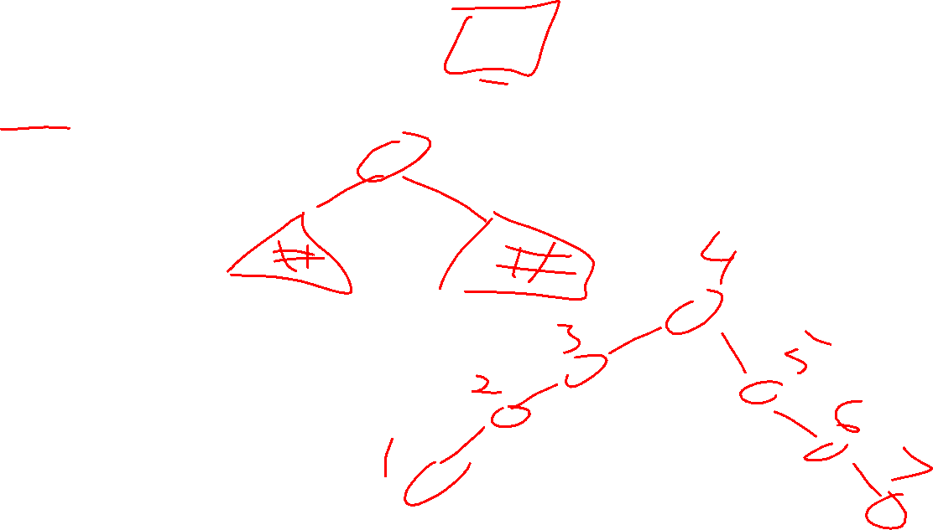
Idea 1: Both Subtrees of Root have same # Nodes

Slide 19
Idea 2: Both Subtrees of Root have same height

Slide 20
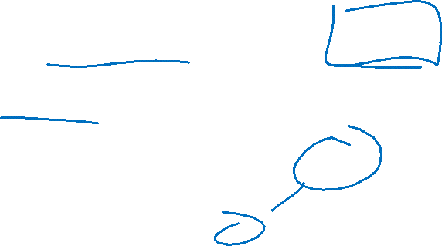
Idea 3: Both Subtrees of every Node have same # Nodes

Slide 21
Idea 4: Both Subtrees of every Node have same height

Slide 22
AVL Tree
A Binary Search tree that maintains that the left and right subtrees of every node have heights that differ by at most one.
height of left subtree and height of right subtree off by at most 1
Not too weak (ensures trees are short)
Not too strong (works for any number of nodes)
Idea of AVL Tree:
When you insert/delete nodes, if tree is “out of balance” then modify the tree
Modification = “rotation”

Slide 23
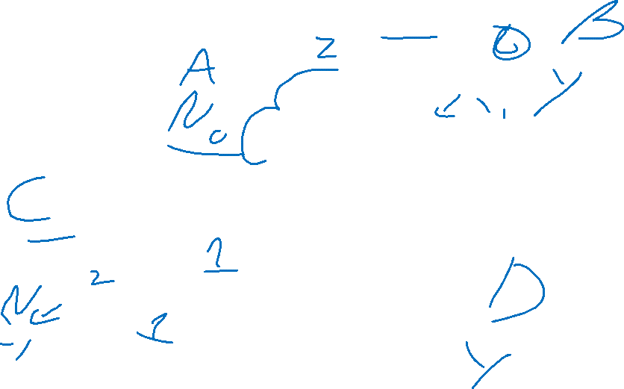
Is it an AVL Tree?
9
9
3
10
3
10
6
16
1
1
6
0
5
0
5
9
9
3
10
3
10
6
16
1
6
16
5
0
5
7

Slide 24
Using AVL Trees
Key = 9
Value = “hello”
Height = 3
Left = Node 3
Right = Node 10
Each node has:
Key
Value
Height
Left child
Right child
9
3
10
1
6
16
0
5
7

Slide 25
Inserting into an AVL Tree
Starts out the same way as BST:
“Find” where the new node should go
Put it in the right place (it will be a leaf)
Next check the balance
If the tree is still balanced, you’re done!
Otherwise we need to do rotations

Slide 26
Insert Example
10
9
3
11
1
6
16
0
2
7

Slide 27
Insert Example
-1
9
3
11
1
6
16
0
2
7

Slide 28
Not Balanced!
Solution: rotate the whole tree to the right
9
Height = 3
Height = 1
3
11
1
6
16
0
2
7
-1

Slide 29
Balanced!
3
1
9
0
2
6
11
-1
7
16

Slide 30



Right Rotation
Make the left child the new root
Make the old root the right child of the new
Make the new root’s right subtree the old root’s left subtree
$$h+3$$
$$h+2$$
$$b$$
$$a$$
$$h+2$$
$$h$$
$$h+1$$
$$b$$
$$z$$
$$x$$
$$h+1$$
$$a$$
Right Rotation
$$h+1$$
$$h$$
$$h$$
$$h$$
$$x$$
$$y$$
$$y$$
$$z$$
$$c$$
$$c$$

Slide 31
Insert Example
20
9
3
11
1
6
10
16
0
2
18

Slide 32
Not Balanced!
9
Solution: rotate the deepest unbalanced root to the left
3
11
1
6
10
16
0
2
18
Height = 1
Height =-1
20

Slide 33
Balanced!
9
3
11
1
6
10
18
0
2
16
20

Slide 34


Left Rotation
Make the right child the new root
Make the old root the left child of the new
Make the new root’s left subtree the old root’s right subtree
$$h+3$$
$$a$$
$$h+2$$
$$b$$
$$h$$
$$h+1$$
$$h+1$$
$$x$$
$$h+2$$
$$b$$
$$a$$
$$z$$
Left Rotation
$$h$$
$$h+1$$
$$h$$
$$h$$
$$y$$
$$z$$
$$x$$
$$y$$
$$c$$
$$c$$

Slide 35
Insertion Story So Far
After insertion, update the heights of the node’s ancestors
Check for unbalance
If unbalanced then at the deepest unbalanced root:
If the left subtree was deeper then rotate right
If the right subtree was deeper then rotate left
This is incomplete!
There are some cases where this doesn’t work!
9
9
5
Insert 7
Right Rotation
5
5
9
7
7

Slide 36
Insertion Story So Far
After insertion, update the heights of the node’s ancestors
Check for unbalance
If unbalanced then at the deepest unbalanced root:
Case LL: If we inserted in the left subtree of the left child then rotate right
Case RR: If we inserted in the right subtree of the right child then rotate left
Case LR: If we inserted into the right subtree of the left child then ???
Case RL: If we inserted into the left subtree of the right child then ???
Cases LR and RL require 2 rotations!

Slide 37
Case LR
From deepest unbalanced root:
Rotate left at the left child
Rotate right at the root
9
9
9
Insert 7
Rotate Left at 5
5
Rotate Right at 9
7
5
7
7
5
9
5

Slide 38
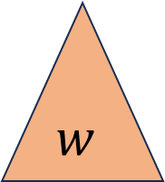
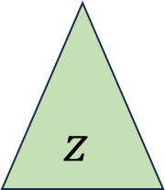


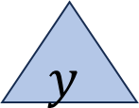
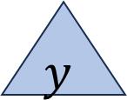

Case LR in General
Imbalance caused by inserting in the left child’s right subtree
Rotate left at the left child
Rotate right at the unbalanced node
$$h+3$$
$$h+3$$
$$a$$
$$h+2$$
$$a$$
$$c$$
Rotate
Left at $b$
Rotate Right at $a$
$$h+2$$
$$h+2$$
$$h$$
$$h+1$$
$$h$$
$$c$$
$$z$$
$$a$$
$$b$$
$$z$$
$$b$$
$$h+1$$
$$h+1$$
$$h$$
$$h+1$$
$$c$$
$$b$$
$$y$$
$$h$$
$$h$$
$$w$$
$$w$$
$$x$$
$$y$$
$$z$$
$$h$$
$$x$$
$$y$$
$$w$$
$$x$$
$$d$$
$$d$$
$$d$$
$$d$$
$$d$$
$$d$$

Slide 39
Case RL in General
Imbalance caused by inserting in the right child’s left subtree
Rotate right at the right child
Rotate left at the unbalanced node
$$h+3$$
$$a$$
$$h+2$$
$$c$$
$$h+3$$
$$a$$
Rotate Right at $b$
Rotate Left at $a$
$$h+2$$
$$b$$
$$h$$
$$c$$
$$h+1$$
$$b$$
$$h$$
$$w$$
$$h+2$$
$$a$$
$$h+1$$
$$w$$
$$h+1$$
$$c$$
$$h$$
$$h+1$$
$$b$$
$$h$$
$$h$$
$$z$$
$$x$$
$$w$$
$$x$$
$$y$$
$$z$$
$$h$$
$$x$$
$$y$$
$$y$$
$$z$$
$$d$$
$$d$$
$$d$$
$$d$$
$$d$$
$$d$$

Slide 40
Insert Summary
After a BST insertion, update the heights of the node’s ancestors
From leaf to root, check if each node is unbalanced
If a node is unbalanced then at the deepest unbalanced node:
Case LL: If we inserted in the left subtree of the left child then: rotate right
Case RR: If we inserted in the right subtree of the right child then: rotate left
Case LR: If we inserted into the right subtree of the left child then: rotate left at the left child and then rotate right at the root
Case RL: If we inserted into the left subtree of the right child then: rotate right at the right child and then rotate left at the root
Done after either reaching the root or applying one of the above cases

Slide 41
Delete Summary
Tldr: same cases, reverse direction of rotation, may need to repeat with ancestors
After a BST deletion, update the heights of the node’s ancestors
From leaf to root, check if each node is unbalanced
If a node is unbalanced then at the deepest unbalanced node:
Case LL: If we deleted in the left subtree of the left child then: rotate left
Case RR: If we deleted in the right subtree of the right child then: rotate right
Case LR: If we deleted into the right subtree of the left child then: rotate right at the left child and then rotate left at the root
Case RL: If we deleted into the left subtree of the right child then: rotate left at the right child and then rotate right at the root
Continue checking until reach the root

