Slide 1
CSE 332 Autumn 2023
Lecture 26: Topological Sort and Minimum Spanning Trees
Nathan Brunelle
http://www.cs.uw.edu/332

Slide 2
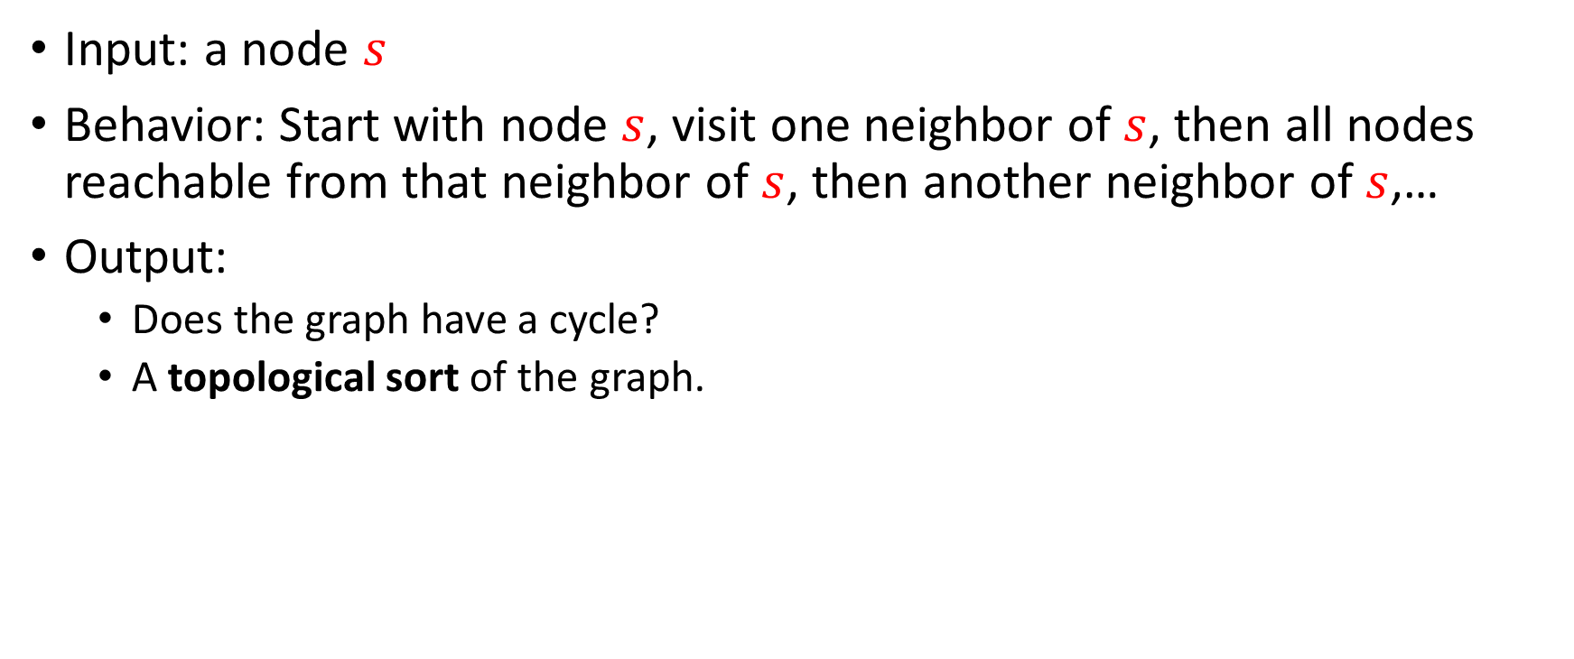
Depth-First Search
Input: a node $s$
Behavior: Start with node $s$, visit one neighbor of $s$, then all nodes reachable from that neighbor of $s$, then another neighbor of $s$,…
Output:
  Does the graph have a cycle?
  A topological sort of the graph.
1
2
2
5
3
0
8
1
6
4
9
5
3
7
6
4
7

Slide 3
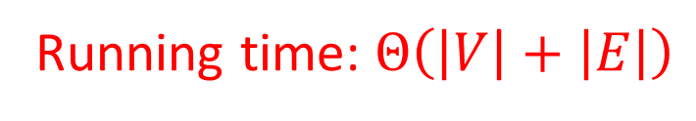
DFS (non-recursive)
void dfs(graph, s){
found = new Stack();
found.pop(s);
mark s as “visited”;
While (!found.isEmpty()){
current = found.pop();
for (v : neighbors(current)){
if (! v marked “visited”){
mark v as “visited”;
found.push(v);
}
}
}
}
2
5
8
1
4
9
3
7
6
Running time: $Θ\left(\left|V\right|+\left|E\right|\right)$

Slide 4
DFS Recursively (more common)
void dfs(graph, curr){
mark curr as “visited”;
for (v : neighbors(current)){
if (! v marked “visited”){
dfs(graph, v);
}
}
mark curr as “done”;
}
2
5
8
1
4
9
3
7
6

Slide 5
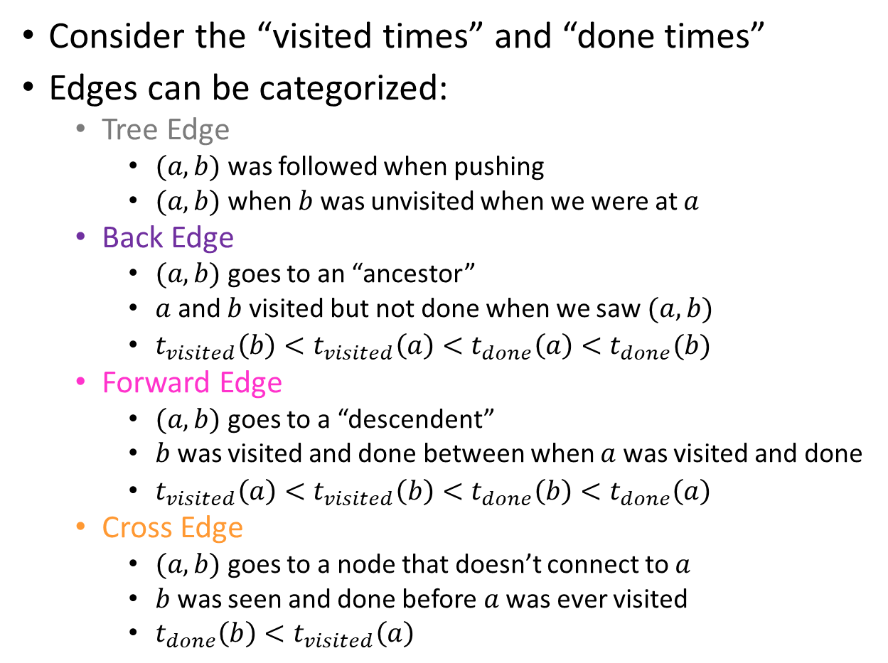
Using DFS
Consider the “visited times” and “done times”
Edges can be categorized:
  Tree Edge
    $(a,b)$ was followed when pushing
    $(a,b)$ when $b$ was unvisited when we were at $a$
  Back Edge
    $(a,b)$ goes to an “ancestor”
    $a$ and $b$ visited but not done when we saw $(a,b)$
    $t_{visited}\left(b\right)<t_{visited}\left(a\right)<t_{done}\left(a\right)<t_{done}(b)$
  Forward Edge
    $(a,b)$ goes to a “descendent”
    $b$ was visited and done between when $a$ was visited and done
    $t_{visited}\left(a\right)<t_{visited}\left(b\right)<t_{done}\left(b\right)<t_{done}\left(a\right)$
  Cross Edge
    $(a,b)$ goes to a node that doesn’t connect to $a$
    $b$ was seen and done before $a$ was ever visited
    $t_{done}\left(b\right)<t_{visited}\left(a\right)$
Visited : 1
Done: 8
Visited : 2
Done: 7
Visited : 3
Done: 6
Visited: 0
Done: 15
2
5
8
1
Visited : 10
Done: 13
4
9
Visited : 9
Done: 14
3
7
6
Visited : 11
Done: 12
Visited : 4
Done: 5

Slide 6
Cycle Detection
Idea: Look for a back edge!
boolean hasCycle(graph, curr){
mark curr as “visited”;
cycleFound = false;
for (v : neighbors(current)){
if (v marked “visited” && ! v marked “done”){
cycleFound=true;
}
if (! v marked “visited” && !cycleFound){
cycleFound = hasCycle(graph, v);
}
}
mark curr as “done”;
return cycleFound;
}
2
5
8
1
4
9
3
7
6

Slide 7

Topological Sort
A Topological Sort of a directed acyclic graph $G=(V,E)$ is a permutation of $V$ such that if $\left(u,v\right)∈E$ then $u$ is before $v$ in the permutation
2
5
8
1
1
3
4
6
2
5
9
8
7
4
9
3
7
6

Slide 8
DFS Recursively
void dfs(graph, curr){
mark curr as “visited”;
for (v : neighbors(current)){
if (! v marked “visited”){
dfs(graph, v);
}
}
mark curr as “done”;
}
2
5
8
1
4
9
3
7
6

Slide 9
DFS Recursively
Idea: List in reverse order by “done” time
void dfs(graph, curr){
mark curr as “visited”;
for (v : neighbors(current)){
if (! v marked “visited”){
dfs(graph, v);
}
}
mark curr as “done”;
}
2
5
8
1
4
9
3
7
6

Slide 10
DFS: Topological sort
List topSort(graph){
List<Nodes> done = new List<>();
for (Node v : graph.vertices){
if (!v.visited){
finishTime(graph, v, finished);
}
}
done.reverse();
return done;
}
void finishTime(graph, curr, finished){
curr.visited = true;
for (Node v : curr.neighbors){
if (!v.visited){
finishTime(graph, v, finished);
}
}
done.add(curr)
}
Idea: List in reverse order by “done” time
finished:
2
5
8
1
4
9
3
7
6

Slide 11
Definition: Tree
A connected graph with no cycles
10
B
E
7
H
A
Note: A tree does not need a root, but they often do!
D
5
9
I
12
3
C
3
11
G
F

Slide 12
Definition: Tree
A connected graph with no cycles
D
3
7
10
B
E
3
7
H
C
F
E
A
12
D
5
9
5
I
12
3
Pick some arbitrary root node and rearrange tree
3
A
G
C
11
11
G
10
9
F
B
H
I

Slide 13
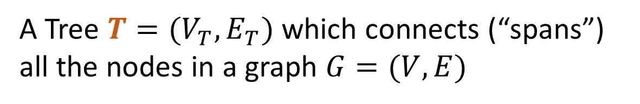

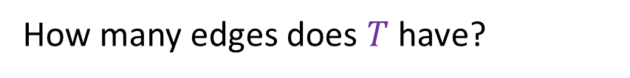
Definition: Spanning Tree
A Tree $T=(V_{T},E_{T})$ which connects (“spans”) all the nodes in a graph $G=(V,E)$
How many edges does $T$ have?
B
8
10
E
8
$$V−1$$
8
7
H
E
8
A
9
2
10
B
H
D
5
9
5
2
I
12
A
G
I
3
Pick some arbitrary root node and rearrange tree
C
3
6
11
1
F
G
3
1
F
6
C
D
Any set of V-1 edges in the graph that doesn’t have any cycles is guaranteed to be a spanning tree!
Any set of V-1 edges that connects all the nodes in the graph is guaranteed to be a spanning tree!
Notes:
Some set of edges from the graph, which forms a tree with all of the nodes in a graph. Subset of the edges, which has no cycles, and connects all the nodes.

Slide 14
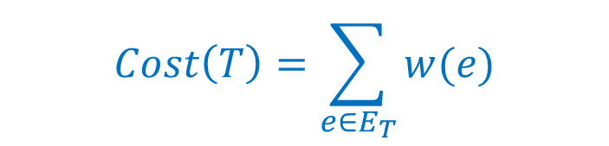
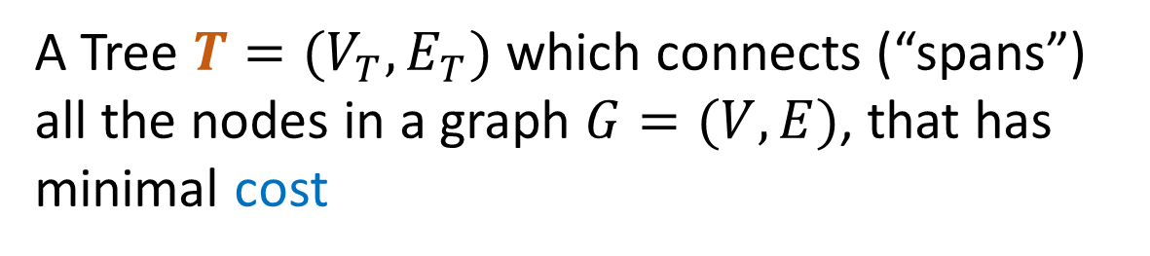
Definition: Minimum Spanning Tree
A Tree $T=(V_{T},E_{T})$ which connects (“spans”) all the nodes in a graph $G=(V,E)$, that has minimal cost
B
8
10
E
8
$$Cost\left(T\right)=\sum_{e∈E_{T}}{w(e)}$$
7
H
A
9
2
D
5
9
I
12
3
C
3
11
G
1
F
6

Slide 15
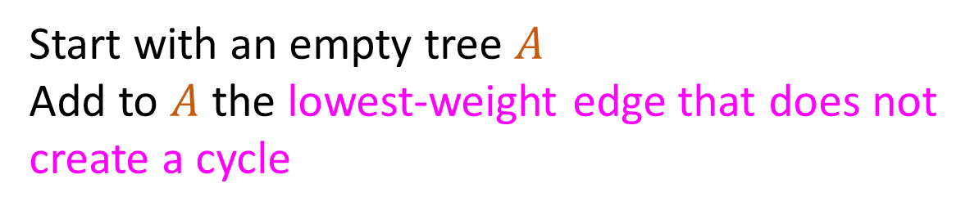
Kruskal’s Algorithm
Start with an empty tree $A$
Add to $A$ the lowest-weight edge that does not create a cycle
B
8
10
E
8
7
H
A
9
2
D
5
9
I
12
3
C
3
11
G
1
F
6

Slide 16
Kruskal’s Algorithm
Start with an empty tree $A$
Add to $A$ the lowest-weight edge that does not create a cycle
B
8
10
E
8
7
H
A
9
2
D
5
9
I
12
3
C
3
11
G
1
F
6

Slide 17
Kruskal’s Algorithm
Start with an empty tree $A$
Add to $A$ the lowest-weight edge that does not create a cycle
B
8
10
E
8
7
H
A
9
2
D
5
9
I
12
3
C
3
11
G
1
F
6

Slide 18
Kruskal’s Algorithm
Start with an empty tree $A$
Add to $A$ the lowest-weight edge that does not create a cycle
B
8
10
E
8
7
H
A
9
2
D
5
9
I
12
3
C
3
11
G
1
F
6

Slide 19
Kruskal’s Algorithm
Start with an empty tree $A$
Add to $A$ the lowest-weight edge that does not create a cycle
B
8
10
E
8
7
H
A
9
2
D
5
9
I
12
3
C
3
11
G
1
F
6

Slide 20
Kruskal’s Algorithm
Start with an empty tree $A$
Add to $A$ the lowest-weight edge that does not create a cycle
B
8
10
E
8
7
H
A
9
2
D
5
9
I
12
3
C
3
11
G
1
F
6

Slide 21
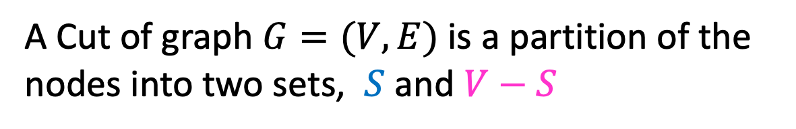
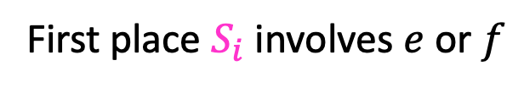


Definition: Cut
A Cut of graph $G=(V,E)$ is a partition of the nodes into two sets, $S$ and $V−S$
B
8
10
E
8
7
H
A
9
2
D
5
9
$$S$$
I
12
3
C
3
11
G
1
F
6
Edge $\left(v_{1},v_{2}\right)∈E$ crosses a cut if $v_{1}∈S$ and $v_{2}∈V−S$ (or opposite), e.g. $(A,C)$
A set of edges $R$ Respects a cut if no edges cross the cut
e.g. $R=\{\left(A,B\right),\left(E,G\right),\left(F,G\right)\}$
Notes:
Go over some examples of edges that cross the cut and edges that do not

Slide 22

Cut Theorem
If a set of edges $A$ is a subset of a minimum spanning tree $T$, let $(S, V−S)$ be any cut which $A$ respects. Let $e$ be the least-weight edge which crosses $(S, V−S)$. $A∪\{e\}$ is also a subset of a minimum spanning tree.
Notes:
If I take any cut at all in the graph, then the least weight edge across that cut is guaranteed to be part of some minimum spanning tree. The least weight edge that crosses any cut in .
We need a bit more mechanics to make this work for kruskals.
Suppose A is a subset of a minimum spanning tree, meaning, we are on our way to building. There is a minimum spanning tree T, where every edge in A is part of this minimum spanning tree T
Define some cut (S,V-S), which A respects. It is safe to add e to A and we will have made more progress
Repeat v-1 times. If we know we can start with some arbitrary subset, then we can add this edge e . There is some minimum spanning tree that has this edge f,g. If I used some other edge instead, an

Slide 23

Cut Theorem
If a set of edges $A$ is a subset of a minimum spanning tree $T$, let $(S, V−S)$ be any cut which $A$ respects. Let $e$ be the least-weight edge which crosses $(S, V−S)$. $A∪\{e\}$ is also a subset of a minimum spanning tree.
B
8
10
E
8
7
H
A
9
2
D
5
9
I
12
3
C
3
11
G
1
F
6
Notes:
If I take any cut at all in the graph, then the least weight edge across that cut is guaranteed to be part of some minimum spanning tree. The least weight edge that crosses any cut in .
We need a bit more mechanics to make this work for kruskals.
Suppose A is a subset of a minimum spanning tree, meaning, we are on our way to building. There is a minimum spanning tree T, where every edge in A is part of this minimum spanning tree T
Define some cut (S,V-S), which A respects. It is safe to add e to A and we will have made more progress
Repeat v-1 times. If we know we can start with some arbitrary subset, then we can add this edge e . There is some minimum spanning tree that has this edge f,g. If I used some other edge instead, an

Slide 24

Cut Theorem
If a set of edges $A$ is a subset of a minimum spanning tree $T$, let $(S, V−S)$ be any cut which $A$ respects. Let $e$ be the least-weight edge which crosses $(S, V−S)$. $A∪\{e\}$ is also a subset of a minimum spanning tree.
B
8
10
E
8
7
H
A
9
2
D
5
9
I
12
3
C
3
11
G
1
F
6
Notes:
If I take any cut at all in the graph, then the least weight edge across that cut is guaranteed to be part of some minimum spanning tree. The least weight edge that crosses any cut in .
We need a bit more mechanics to make this work for kruskals.
Suppose A is a subset of a minimum spanning tree, meaning, we are on our way to building. There is a minimum spanning tree T, where every edge in A is part of this minimum spanning tree T
Define some cut (S,V-S), which A respects. It is safe to add e to A and we will have made more progress
Repeat v-1 times. If we know we can start with some arbitrary subset, then we can add this edge e . There is some minimum spanning tree that has this edge f,g. If I used some other edge instead, an

Slide 25

Cut Theorem
If a set of edges $A$ is a subset of a minimum spanning tree $T$, let $(S, V−S)$ be any cut which $A$ respects. Let $e$ be the least-weight edge which crosses $(S, V−S)$. $A∪\{e\}$ is also a subset of a minimum spanning tree.
B
8
10
E
8
7
H
A
9
2
D
5
9
I
12
3
C
3
11
G
1
F
6
Notes:
If I take any cut at all in the graph, then the least weight edge across that cut is guaranteed to be part of some minimum spanning tree. The least weight edge that crosses any cut in .
We need a bit more mechanics to make this work for kruskals.
Suppose A is a subset of a minimum spanning tree, meaning, we are on our way to building. There is a minimum spanning tree T, where every edge in A is part of this minimum spanning tree T
Define some cut (S,V-S), which A respects. It is safe to add e to A and we will have made more progress
Repeat v-1 times. If we know we can start with some arbitrary subset, then we can add this edge e . There is some minimum spanning tree that has this edge f,g. If I used some other edge instead, an

Slide 26

Cut Theorem
If a set of edges $A$ is a subset of a minimum spanning tree $T$, let $(S, V−S)$ be any cut which $A$ respects. Let $e$ be the least-weight edge which crosses $(S, V−S)$. $A∪\{e\}$ is also a subset of a minimum spanning tree.
B
8
10
E
8
7
H
A
9
2
D
5
9
I
12
3
C
3
11
G
1
F
6
Notes:
If I take any cut at all in the graph, then the least weight edge across that cut is guaranteed to be part of some minimum spanning tree. The least weight edge that crosses any cut in .
We need a bit more mechanics to make this work for kruskals.
Suppose A is a subset of a minimum spanning tree, meaning, we are on our way to building. There is a minimum spanning tree T, where every edge in A is part of this minimum spanning tree T
Define some cut (S,V-S), which A respects. It is safe to add e to A and we will have made more progress
Repeat v-1 times. If we know we can start with some arbitrary subset, then we can add this edge e . There is some minimum spanning tree that has this edge f,g. If I used some other edge instead, an

Slide 27

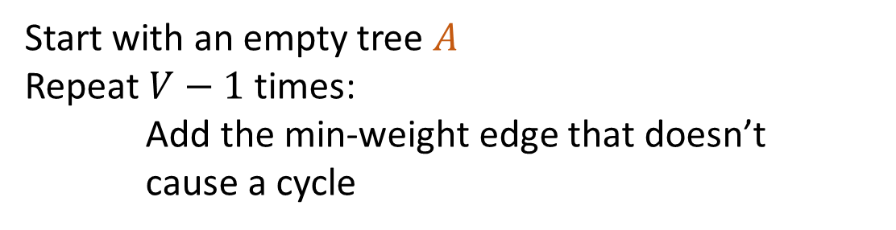
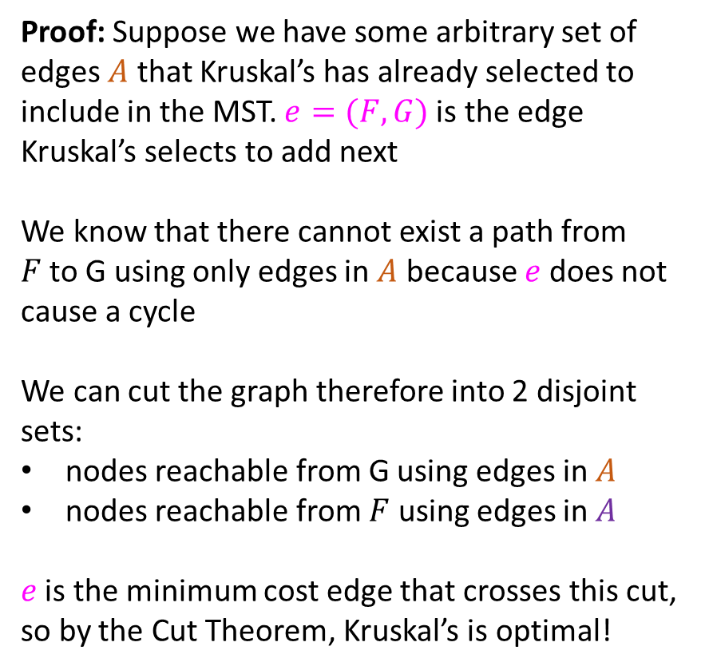

Proof of Kruskal’s Algorithm
Start with an empty tree $A$
Repeat $V−1$ times:
Add the min-weight edge that doesn’t cause a cycle
Proof: Suppose we have some arbitrary set of edges $A$ that Kruskal’s has already selected to include in the MST. $e=(F,G)$is the edge Kruskal’s selects to add next
We know that there cannot exist a path from $F$to G using only edges in $A$ because $e$ does not cause a cycle
We can cut the graph therefore into 2 disjoint sets:
nodes reachable from G using edges in $A$
nodes reachable from $F$ using edges in $A$
$e$ is the minimum cost edge that crosses this cut, so by the Cut Theorem, Kruskal’s is optimal!
B
8
10
E
8
7
H
A
9
2
D
5
9
I
12
3
C
3
$$e$$
11
G
1
F
6
$$S$$

Slide 28
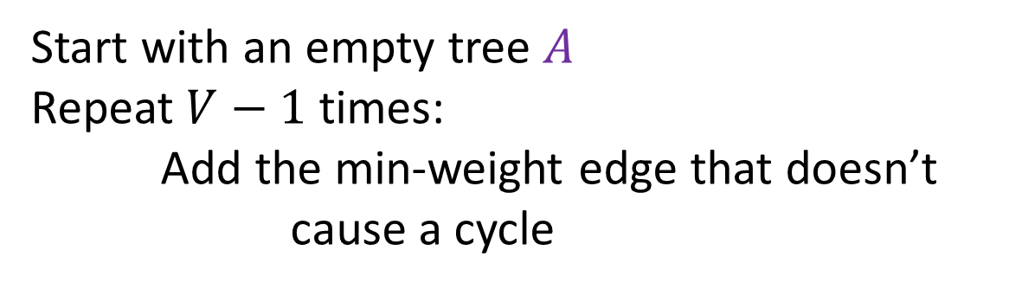
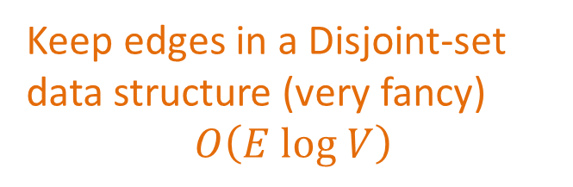


Kruskal’s Algorithm Runtime
Start with an empty tree $A$
Repeat $V−1$ times:
Add the min-weight edge that doesn’t cause a cycle
Keep edges in a Disjoint-set data structure (very fancy)
$$O\left(E log V\right)$$
B
8
10
E
8
7
H
A
9
2
D
5
9
I
12
3
C
3
$$e$$
11
G
1
F
6
$$S$$

Slide 29
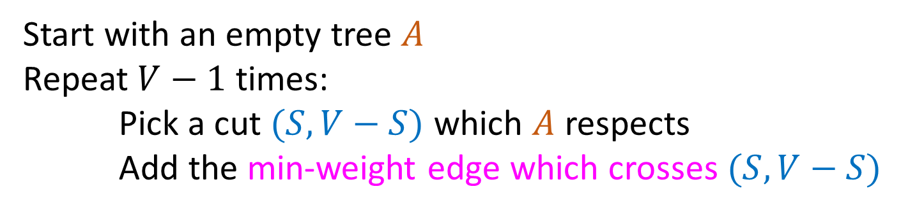
General MST Algorithm
Start with an empty tree $A$
Repeat $V−1$ times:
Pick a cut $(S,V−S)$ which $A$ respects
Add the min-weight edge which crosses $(S,V−S)$
B
8
10
E
8
7
H
A
9
2
D
5
9
I
12
3
C
3
11
G
1
F
6

Slide 30
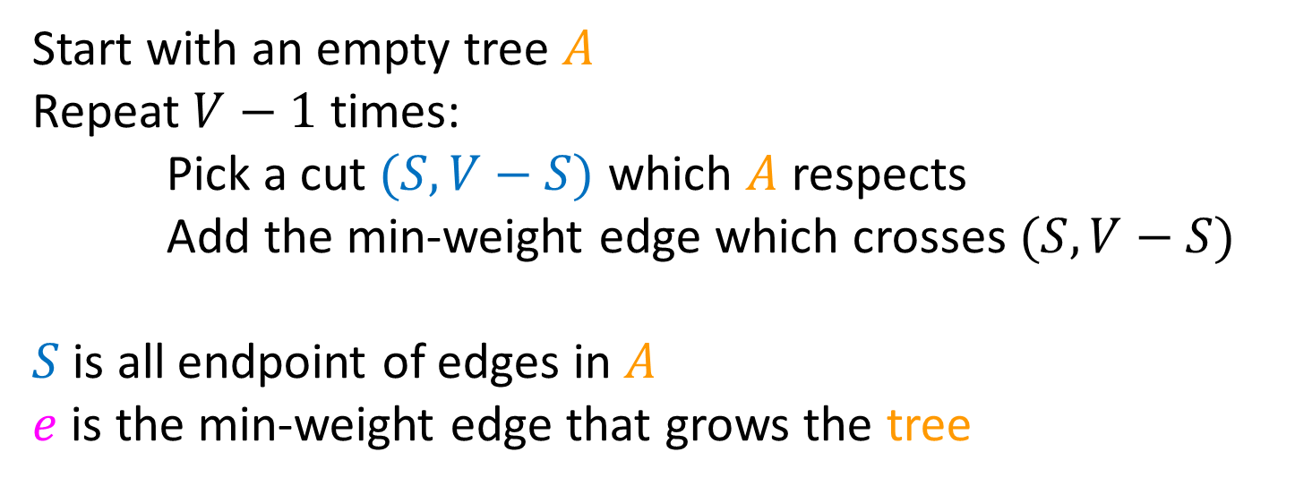
Prim’s Algorithm
Start with an empty tree $A$
Repeat $V−1$ times:
Pick a cut $(S,V−S)$ which $A$ respects
Add the min-weight edge which crosses $(S,V−S)$
$S$ is all endpoint of edges in $A$
$e$ is the min-weight edge that grows the tree
B
8
10
E
6
7
H
A
9
2
D
5
9
I
12
3
C
3
11
G
1
F
7

Slide 31
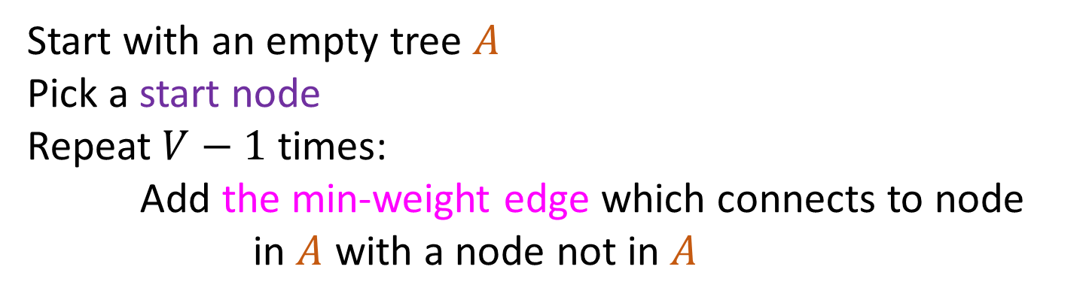
Prim’s Algorithm
Start with an empty tree $A$
Pick a start node
Repeat $V−1$ times:
Add the min-weight edge which connects to node in $A$ with a node not in $A$
B
8
10
E
6
7
H
A
9
2
D
5
9
I
12
3
C
3
11
G
1
F
7

Slide 32
Prim’s Algorithm
Start with an empty tree $A$
Pick a start node
Repeat $V−1$ times:
Add the min-weight edge which connects to node in $A$ with a node not in $A$
B
8
10
E
6
7
H
A
9
2
D
5
9
I
12
3
C
3
11
G
1
F
7

Slide 33
Prim’s Algorithm
Start with an empty tree $A$
Pick a start node
Repeat $V−1$ times:
Add the min-weight edge which connects to node in $A$ with a node not in $A$
B
8
10
E
6
7
H
A
9
2
D
5
9
I
12
3
C
3
11
G
1
F
7

Slide 34
Prim’s Algorithm
Start with an empty tree $A$
Pick a start node
Repeat $V−1$ times:
Add the min-weight edge which connects to node in $A$ with a node not in $A$
B
8
10
E
6
7
H
A
9
2
D
5
9
I
12
3
C
3
11
G
1
F
7

Slide 35
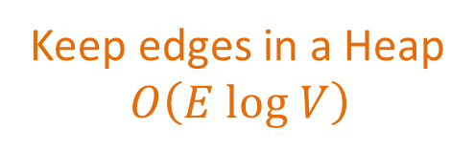
Prim’s Algorithm
Start with an empty tree $A$
Pick a start node
Repeat $V−1$ times:
Add the min-weight edge which connects to node in $A$ with a node not in $A$
Keep edges in a Heap
$$O\left(E log V\right)$$
B
8
10
E
6
7
H
A
9
2
D
5
9
I
12
3
C
3
11
G
1
F
7

Slide 36
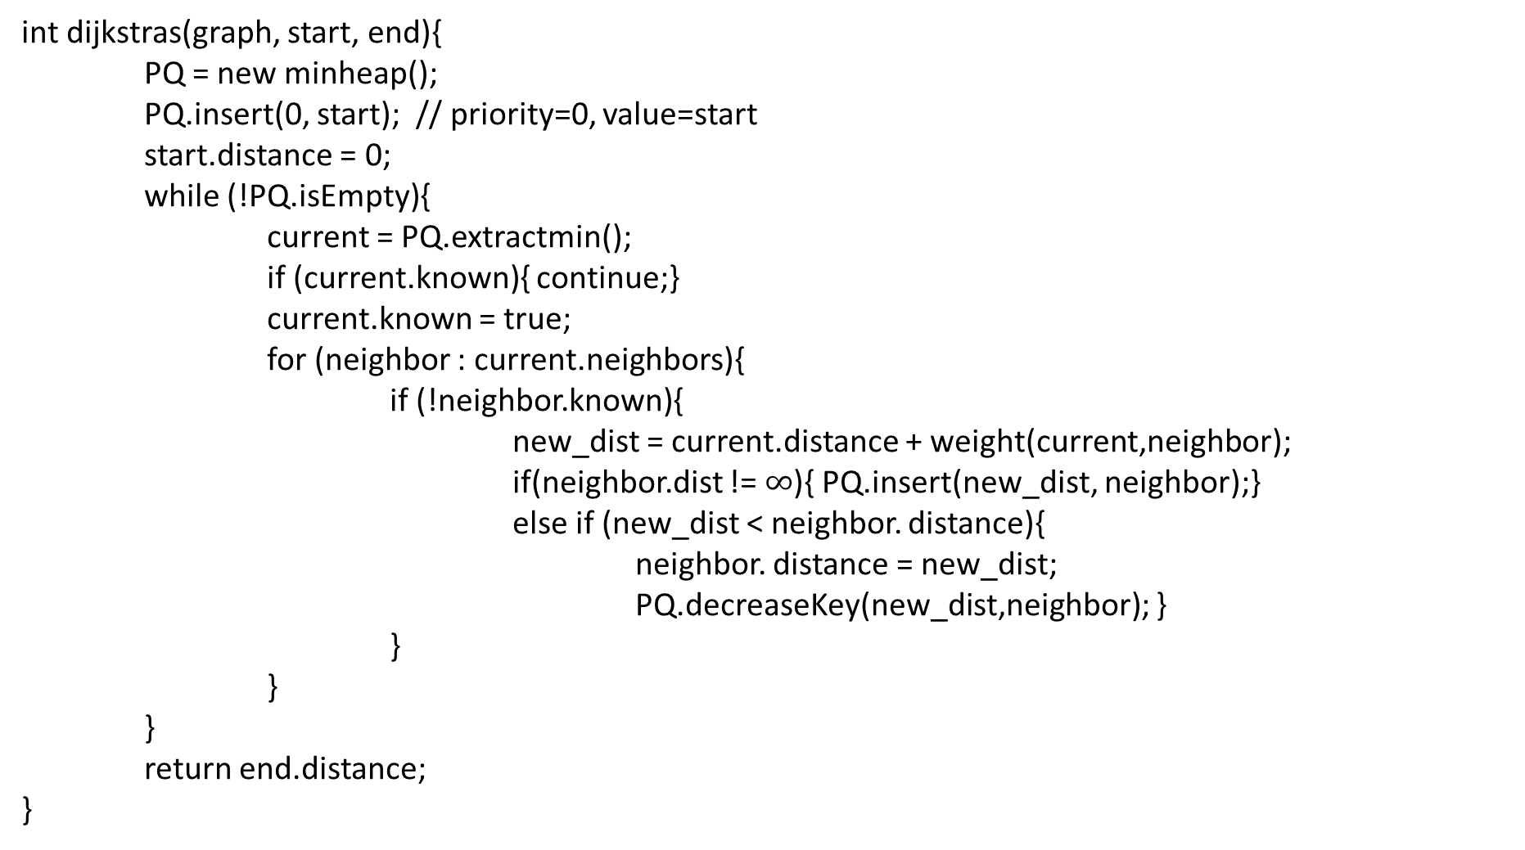
Dijkstra’s Algorithm
1
8
10
4
6
int dijkstras(graph, start, end){
PQ = new minheap();
PQ.insert(0, start); // priority=0, value=start
start.distance = 0;
while (!PQ.isEmpty){
current = PQ.extractmin();
if (current.known){ continue;}
current.known = true;
for (neighbor : current.neighbors){
if (!neighbor.known){
new_dist = current.distance + weight(current,neighbor);
if(neighbor.dist != $∞$){ PQ.insert(new_dist, neighbor);}
else if (new_dist < neighbor. distance){
neighbor. distance = new_dist;
PQ.decreaseKey(new_dist,neighbor); }
}
}
}
return end.distance;
}
7
7
0
9
2
3
5
9
8
12
3
2
3
11
6
1
5
7

Slide 37
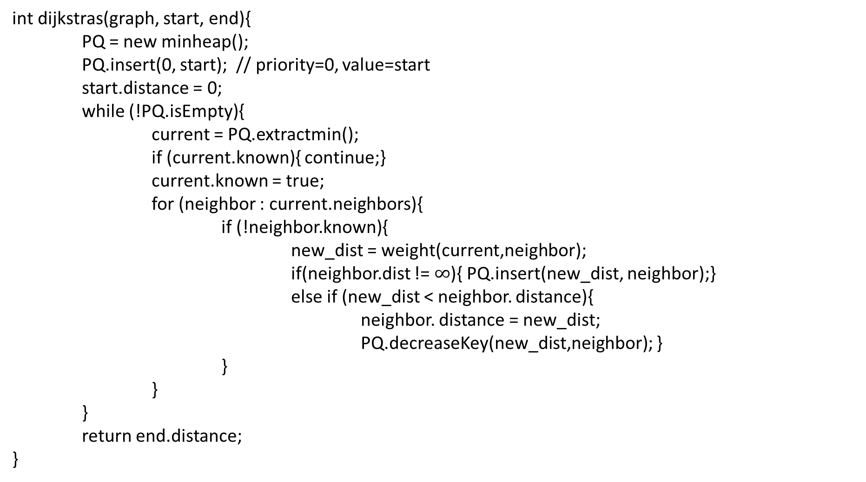
Prim’s Algorithm
1
8
10
4
6
int dijkstras(graph, start, end){
PQ = new minheap();
PQ.insert(0, start); // priority=0, value=start
start.distance = 0;
while (!PQ.isEmpty){
current = PQ.extractmin();
if (current.known){ continue;}
current.known = true;
for (neighbor : current.neighbors){
if (!neighbor.known){
new_dist = weight(current,neighbor);
if(neighbor.dist != $∞$){ PQ.insert(new_dist, neighbor);}
else if (new_dist < neighbor. distance){
neighbor. distance = new_dist;
PQ.decreaseKey(new_dist,neighbor); }
}
}
}
return end.distance;
}
7
7
0
9
2
3
5
9
8
12
3
2
3
11
6
1
5
7

Slide 38
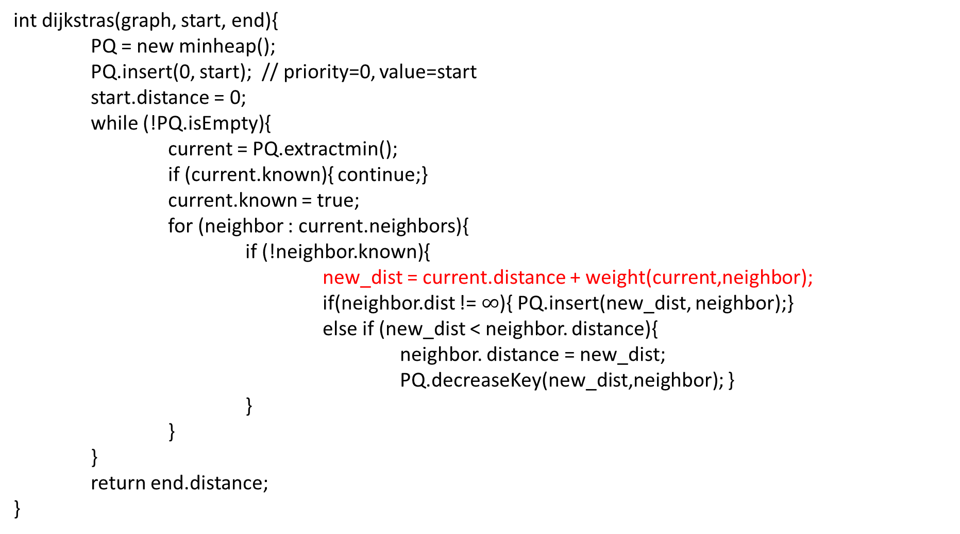
Dijkstra’s Algorithm
1
8
10
4
6
int dijkstras(graph, start, end){
PQ = new minheap();
PQ.insert(0, start); // priority=0, value=start
start.distance = 0;
while (!PQ.isEmpty){
current = PQ.extractmin();
if (current.known){ continue;}
current.known = true;
for (neighbor : current.neighbors){
if (!neighbor.known){
new_dist = current.distance + weight(current,neighbor);
if(neighbor.dist != $∞$){ PQ.insert(new_dist, neighbor);}
else if (new_dist < neighbor. distance){
neighbor. distance = new_dist;
PQ.decreaseKey(new_dist,neighbor); }
}
}
}
return end.distance;
}
7
7
0
9
2
3
5
9
8
12
3
2
3
11
6
1
5
7

Slide 39
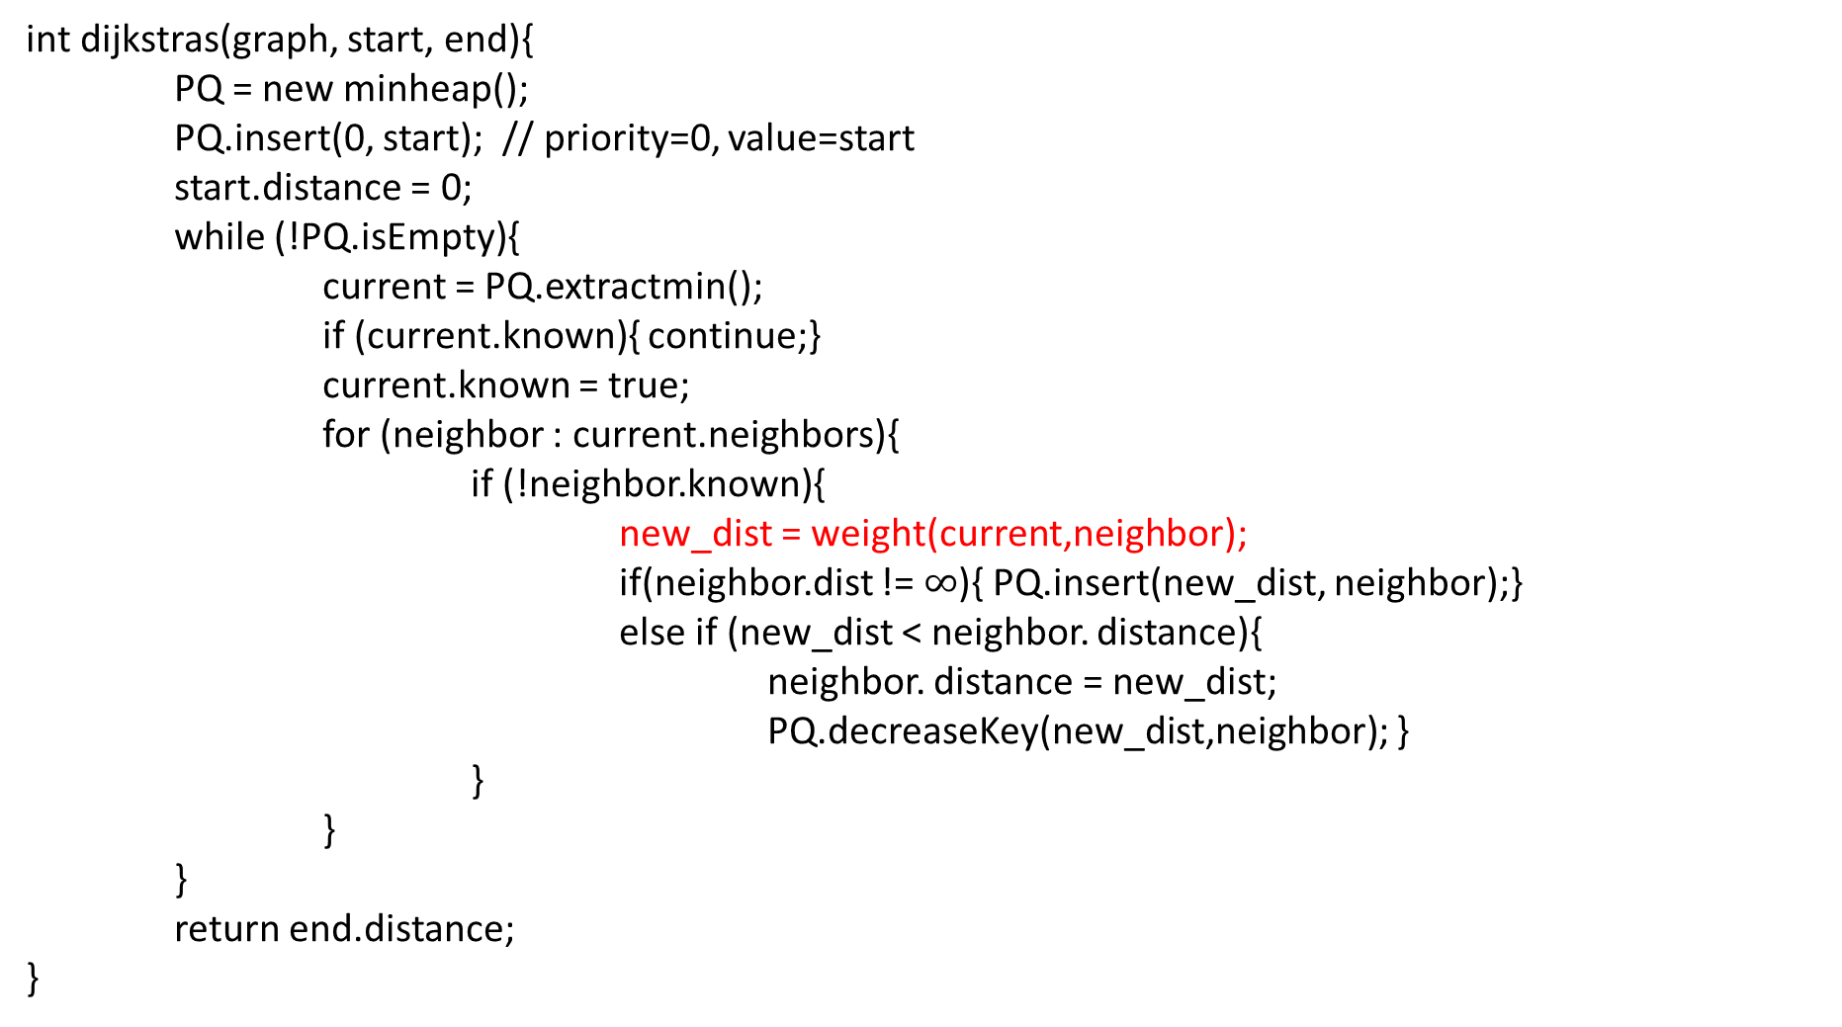
Prim’s Algorithm
1
8
10
4
6
int dijkstras(graph, start, end){
PQ = new minheap();
PQ.insert(0, start); // priority=0, value=start
start.distance = 0;
while (!PQ.isEmpty){
current = PQ.extractmin();
if (current.known){ continue;}
current.known = true;
for (neighbor : current.neighbors){
if (!neighbor.known){
new_dist = weight(current,neighbor);
if(neighbor.dist != $∞$){ PQ.insert(new_dist, neighbor);}
else if (new_dist < neighbor. distance){
neighbor. distance = new_dist;
PQ.decreaseKey(new_dist,neighbor); }
}
}
}
return end.distance;
}
7
7
0
9
2
3
5
9
8
12
3
2
3
11
6
1
5
7

