Slide 1
CSE 332 Autumn 2023
Lecture 22: ForkJoin Analysis
Nathan Brunelle
http://www.cs.uw.edu/332

Slide 2
New Story
Heap Containing Objects and Static Fields
Threads, each with its own unshared:
Call Stack
Program Counter
Local Variables (primitives and references to Heap objects)

Slide 3
Back to Summing an Array
Goal: Find the sum of an array
Idea: 4 threads each find the sum of one quarter of the array
Process:
  Create 4 thread objects, each given a portion of the work
  Call start() on each thread object to run it in parallel
  Wait for threads to finish using join()
  Add together their 4 answers for the final result
+
+
+
+
+

Slide 4
Parallel Sum
5
8
2
9
4
1
5
Base Case:
  If the list’s length is smaller than the Sequential Cutoff, find the sum sequentially
Divide:
  Split the list into two “sublists” of (roughly) equal length, create a thread to sum each sublist.
Conquer:
  Call start() for each thread
Combine:
  Sum together the answers from each thread
5
8
2
9
4
1
ans=15
ans=14
ans=29

Slide 5
Divide and Conquer with Threads
class SumThread extends java.lang.Thread {
public void run(){ // override
if(hi – lo < SEQUENTIAL_CUTOFF) // “base case”
for(int i=lo; i < hi; i++) ans += arr[i];
else {
SumThread left = new SumThread(arr,lo,(hi+lo)/2); // divide
SumThread right= new SumThread(arr,(hi+lo)/2,hi); // divide
left.start(); // conquer
right.start(); // conquer
left.join(); // don’t move this up a line – why?
right.join();
ans = left.ans + right.ans; // combine
}
}
}
int sum(int[] arr){ // just make one thread!
SumThread t = new SumThread(arr,0,arr.length);
t.run();
return t.ans; }

Slide 6
ForkJoin Framework
This strategy is common enough that Java (and C++, and C#, and…) provides a library to do it for you!
What you would do in Threads | What to instead in ForkJoin
Subclass Thread | Subclass RecursiveTask<V>
Override run | Override compute
Store the answer in a field | Return a V from compute
Call start | Call fork
join synchronizes only | join synchronizes and returns the answer
Call run to execute sequentially | Call compute to execute sequentially
Have a topmost thread and call run | Create a pool and call invoke

Slide 7
Divide and Conquer with ForkJoin
class SumTask extends RecursiveTask<Integer> {
int lo; int hi; int[] arr; // fields to know what to do
SumTask(int[] a, int l, int h) { … }
protected Integer compute(){// return answer
if(hi – lo < SEQUENTIAL_CUTOFF) { // base case
int ans = 0; // local var, not a field
for(int i=lo; i < hi; i++) {
ans += arr[i]; }
return ans;}
else {
SumTask left = new SumTask(arr,lo,(hi+lo)/2); // divide
SumTask right= new SumTask(arr,(hi+lo)/2,hi); // divide
left.fork(); // fork a thread and calls compute (conquer)
int rightAns = right.compute(); //call compute directly (conquer)
int leftAns = left.join(); // get result from left
return leftAns + rightAns; // combine
}
}
}

Slide 8
Divide and Conquer with ForkJoin (continued)
static final ForkJoinPool POOL = new ForkJoinPool();
int sum(int[] arr){
SumTask task = new SumTask(arr,0,arr.length)
return POOL.invoke(task); // invoke returns the value compute returns
}

Slide 9
Find Max with ForkJoin
class MaxTask extends RecursiveTask<Integer> {
int lo; int hi; int[] arr; // fields to know what to do
SumTask(int[] a, int l, int h) { … }
protected Integer compute(){// return answer
if(hi – lo < SEQUENTIAL_CUTOFF) { // base case
int ans = Integer.MIN_VALUE; // local var, not a field
for(int i=lo; i < hi; i++) {
ans = Math.max(ans, arr[i]);}
return ans;
else {
MaxTask left = new MaxTask(arr,lo,(hi+lo)/2); // divide
MaxTask right= new MaxTask(arr,(hi+lo)/2,hi); // divide
left.fork(); // fork a thread and calls compute (conquer)
int rightAns = right.compute(); //call compute directly (conquer)
int leftAns = left.join(); // get result from left
return Math.max(rightAns, leftAns); // combine
}
}
}

Slide 10
Other Problems that can be solved similarly
Element Search
  Is the value 17 in the array?
Counting items with a certain property
  How many elements of the array are divisible by 5?
Checking if the array is sorted
Find the smallest rectangle that covers all points in the array
Find the first thing that satisfies a property
  What is the leftmost item that is divisible by 20?

Slide 11
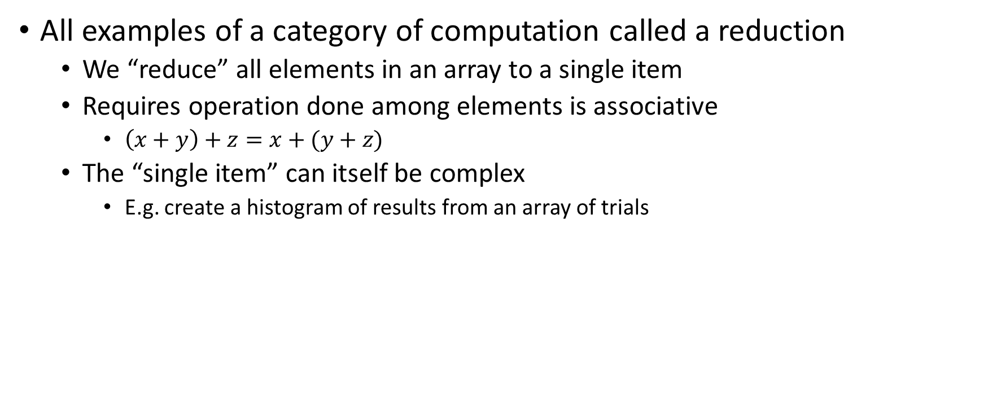
Reductions
All examples of a category of computation called a reduction
  We “reduce” all elements in an array to a single item
  Requires operation done among elements is associative
    $\left(x+y\right)+z=x+(y+z)$
  The “single item” can itself be complex
    E.g. create a histogram of results from an array of trials

Slide 12
Map
Perform an operation on each item in an array to create a new array of the same size
Examples:
  Vector addition:
    sum[i] = arr1[i] + arr2[i]
  Function application:
    out[i] = f(arr[i]);

Slide 13
Map with ForkJoin
class AddTask extends RecursiveAction {
int lo; int hi; int[] arr; // fields to know what to do
AddTask(int[] a, int[] b, int[] sum, int l, int h) { … }
protected void compute(){// return answer
if(hi – lo < SEQUENTIAL_CUTOFF) { // base case
for(int i=lo; i < hi; i++) {
sum[i] = a[i] + b[i];}
else {
AddTask left = new AddTask(a,b,sum,lo,(hi+lo)/2); // divide
AddTask right= new AddTask(a,b,sum,(hi+lo)/2,hi); // divide
left.fork(); // fork a thread and calls compute (conquer)
right.compute(); //call compute directly (conquer)
left.join(); // get result from left
return; // combine
}
}
}

Slide 14
Map with ForkJoin (continued)
static final ForkJoinPool POOL = new ForkJoinPool();
Int[] add(int[] a, int[] b){
ans = new int[a.length];
AddTask task = new AddTask(a, b, ans, 0, a.length)
POOL.invoke(task);
return ans;
}

Slide 15
Maps and Reductions
“Workhorse” constructs in parallel programming
Many problems can be written in terms of maps and reductions
With practice, writing them will become second nature
  Like how over time for loops and if statements have gotten easier

Slide 16
Parallel Algorithm Analysis
How to define efficiency
  Want asymptotic bounds
  Want to analyze the algorithm without regard to a specific number of processors

Slide 17
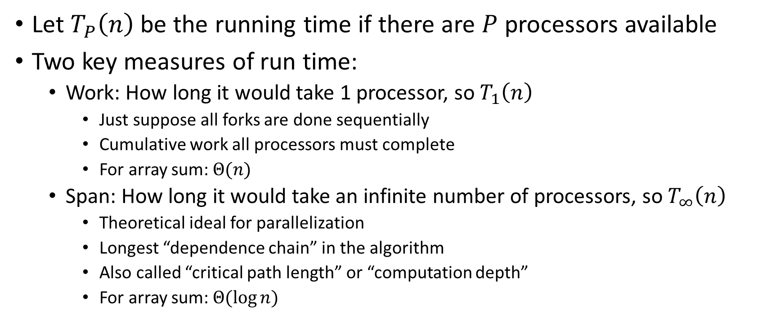
Work and Span
Let $T_{P}\left(n\right)$ be the running time if there are $P$ processors available
Two key measures of run time:
  Work: How long it would take 1 processor, so $T_{1}\left(n\right)$
    Just suppose all forks are done sequentially
    Cumulative work all processors must complete
    For array sum: $Θ(n)$
  Span: How long it would take an infinite number of processors, so $T_{∞}\left(n\right)$
    Theoretical ideal for parallelization
    Longest “dependence chain” in the algorithm
    Also called “critical path length” or “computation depth”
    For array sum: $Θ(log{n})$

Slide 18
Directed Acyclic Graph (DAG)
A directed graph that has no cycles
Often used to depict dependencies
  E.g. software dependencies, Java inheritance, dependencies among threads!
1
3
2

Slide 19
ForkJoin DAG
Fork and Join each create a new node
  Fork branches into two threads
    Those two threads “depended on” their source thread to be created
  Join combines to threads
    The thread doing the combining “depends on” the other threads to finish
Divide
Base Cases
Combine

Slide 20
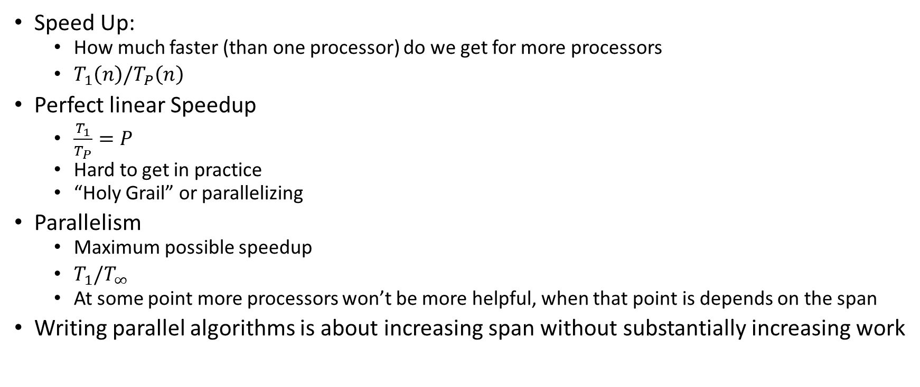
More Vocab
Speed Up:
  How much faster (than one processor) do we get for more processors
  $T_{1}\left(n\right)/T_{P}\left(n\right)$
Perfect linear Speedup
  $\frac{T_{1}}{T_{P}}=P$
  Hard to get in practice
  “Holy Grail” or parallelizing
Parallelism
  Maximum possible speedup
  $T_{1}/T_{∞}$
  At some point more processors won’t be more helpful, when that point is depends on the span
Writing parallel algorithms is about increasing span without substantially increasing work

Slide 21
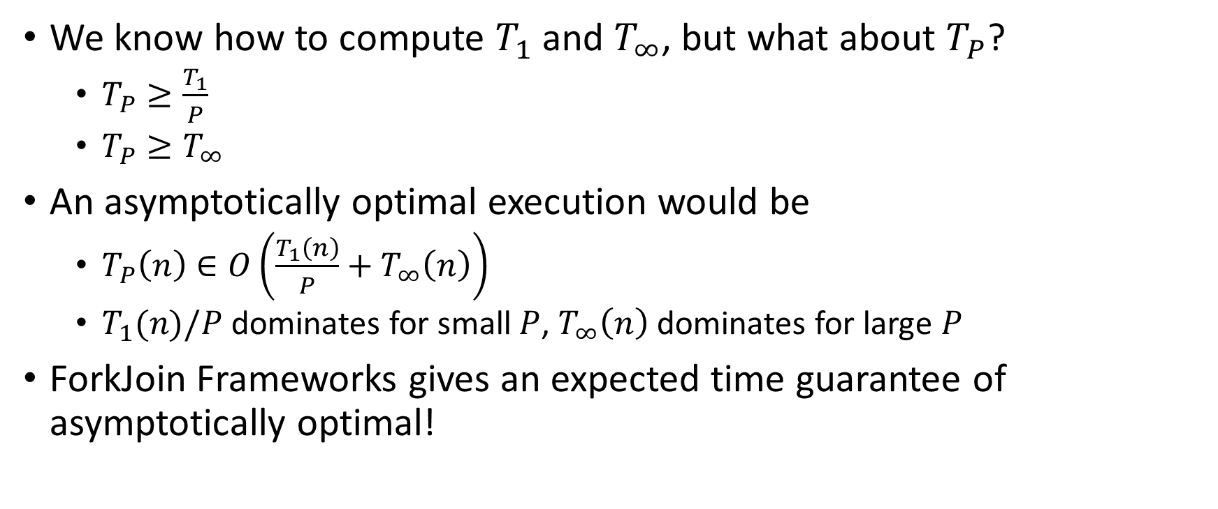
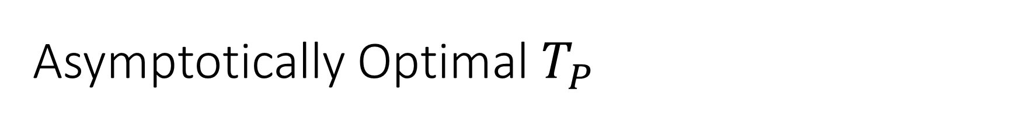
Asymptotically Optimal $T_{P}$
We know how to compute $T_{1}$ and $T_{∞}$, but what about $T_{P}$?
  $T_{P}≥\frac{T_{1}}{P}$
  $T_{P}≥T_{∞}$
An asymptotically optimal execution would be
  $T_{P}\left(n\right)∈O\left(\frac{T_{1}\left(n\right)}{P}+T_{∞}\left(n\right)\right)$
  $T_{1}(n)/P$ dominates for small $P$, $T_{∞}\left(n\right)$ dominates for large $P$
ForkJoin Frameworks gives an expected time guarantee of asymptotically optimal!

Slide 22
Division of Responsibility
Our job as ForkJoin Users:
  Pick a good algorithm, write a program
  When run, program creates a DAG of things to do
  Make all the nodes a small-ish and approximately equal amount of work
ForkJoin Framework Developer’s job:
  Assign work to available processors to avoid idling
    Abstract away scheduling issues for the user
  Keep constant factors low
  Give the expected-time optimal guarantee

Slide 23
And now for some bad news…
In practice it’s common for your program to have:
  Parts that parallelize well
    Maps/reduces over arrays and other data structures
  And parts that don’t parallelize at all
    Reading a linked list, getting input, or computations where each step needs the results of previous step
These unparallelized parts can turn out to be a big bottleneck

Slide 24
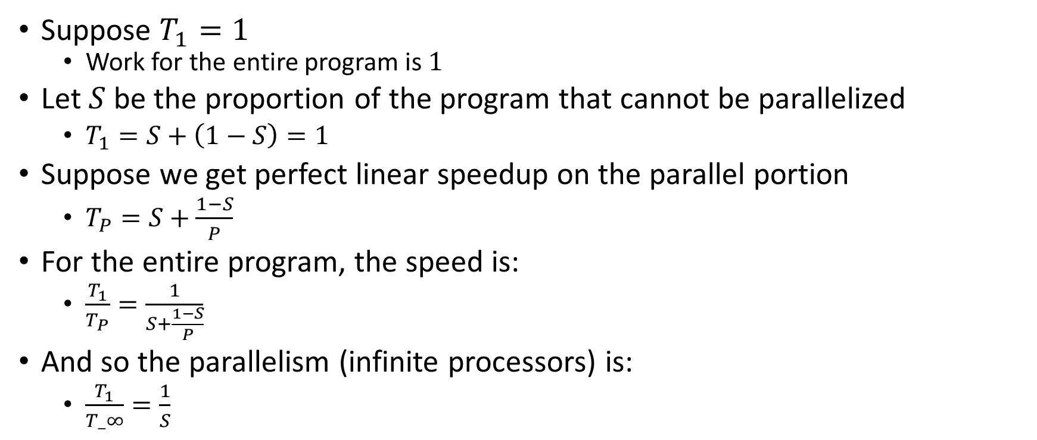
Amdahl’s Law (mostly bad news)
Suppose $T_{1}=1$
  Work for the entire program is $1$
Let $S$ be the proportion of the program that cannot be parallelized
  $T_{1}=S+\left(1−S\right)=1$
Suppose we get perfect linear speedup on the parallel portion
  $T_{P}=S+\frac{1−S}{P}$
For the entire program, the speed is:
  $\frac{T_{1}}{T_{P}}=\frac{1}{S+\frac{1−S}{P}}$
And so the parallelism (infinite processors) is:
  $\frac{T_{1}}{T_∞}=\frac{1}{S}$

Slide 25
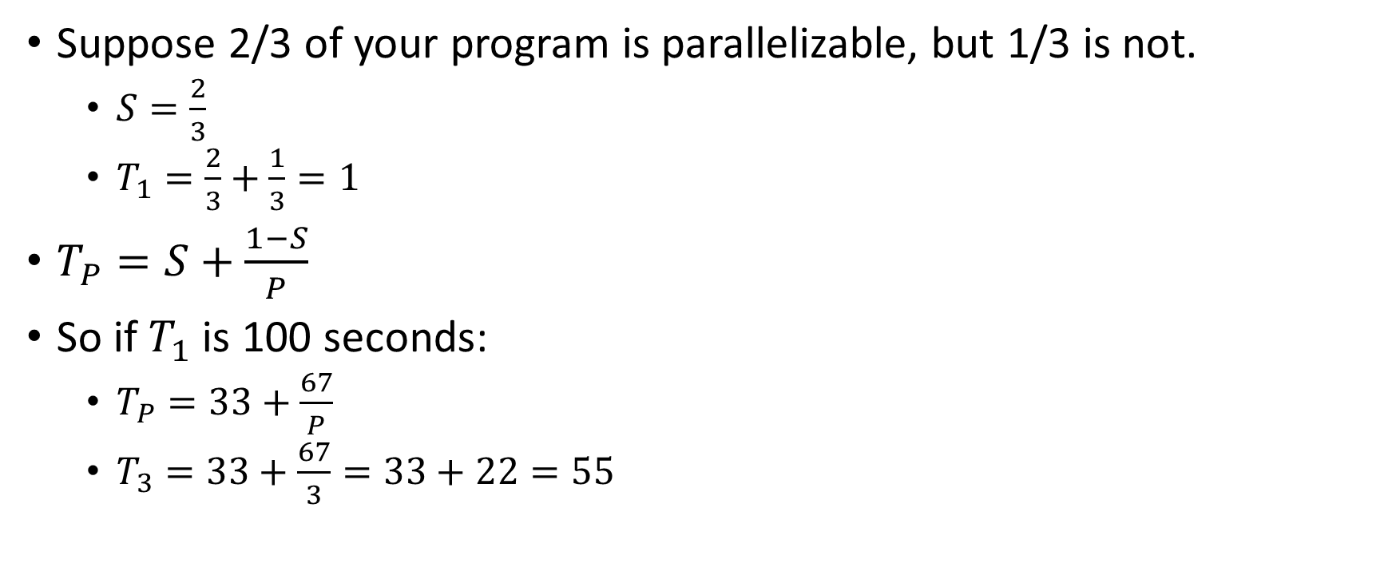
Ahmdal’s Law Example
Suppose 2/3 of your program is parallelizable, but 1/3 is not.
  $S=\frac{2}{3}$
  $T_{1}=\frac{2}{3}+\frac{1}{3}=1$
$T_{P}=S+\frac{1−S}{P}$
So if $T_{1}$ is 100 seconds:
  $T_{P}=33+\frac{67}{P}$
  $T_{3}=33+\frac{67}{3}=33+22=55$

Slide 26
Conclusion
Even with many many processors the sequential part of your program becomes a bottleneck
Parallelizable code requires skill and insight from the developer to recognize where parallelism is possible, and how to do it well.

