Slide 1
CSE 332 Autumn 2023 Lecture 14: Hashing and Sorting
Nathan Brunelle
http://www.cs.uw.edu/332

Slide 2
Collision Resolution: Linear Probing
When there’s a collision, use the next open space in the table
0
1
2
3
4
5
6
7
8
9

Slide 3
Linear Probing: Insert Procedure
To insert $k,v$
Calculate $i=h\left(k\right) \% size$
If $table[i]$ is occupied then try $\left(i+1\right)\% size$
If that is occupied try $\left(i+2\right)\% size$
If that is occupied try $\left(i+3\right)\% size$
…
0
1
2
3
4
5
6
7
8
9

Slide 4
Linear Probing: Find
$i=h\left(k\right)\%size$
If $i$ has the key or it’s empty, then we’re done
Otherwise:
Check $\left(i+1\right)\%size$ if it’s there, done else
Check $\left(i+2\right)\%size$ if it’s there, done else
Check $\left(i+3\right)\%size$
…
Until we hit an empty cell

Slide 5
Linear Probing: Find
To find key $k$
Calculate $i=h\left(k\right) \% size$
If $table\left[i\right]$ is occupied and does not contain $k$ then look at $\left(i+1\right) \% size$
If that is occupied and does not contain $k$ then look at $\left(i+2\right) \% size$
If that is occupied and does not contain $k$ then look at $\left(i+3\right) \% size$
Repeat until you either find $k$ or else you reach an empty cell in the table

Slide 6
Linear Probing: Delete
Problem: don’t want to leave an empty space when deleting
Option 1: when we delete, move the “last thing” with a matching hash to that location
Option 2: “tombstone” deletion. When deleting something, leave a special marker to indicate something used to be there

Slide 7
Linear Probing: Delete
Option 1: Find the last thing with a matching hash, move that into the spot you deleted from
Option 2: Called “tombstone” deletion. Leave a special object that indicates an object was deleted from there
The tombstone does not act as an open space when finding (so keep looking after its reached)
When inserting you can replace a tombstone with a new item
$$k,v$$
$$k,v$$
$$k,v$$
$$k,v$$
0
1
2
3
4
5
6
7
8
9

Slide 8
Downsides of Linear Probing
What happens when $λ$ approaches 1?
Runnings times get longer and longer
What happens when $λ$ exceeds 1?
Run out of space
We need a really small $λ$

Slide 9
Quadratic Probing: Insert Procedure
To insert $k,v$
Calculate $i=h\left(k\right) \% size$
If $table[i]$ is occupied then try $\left(i+1^{2}\right)\% size$
If that is occupied try $\left(i+2^{2}\right)\% size$
If that is occupied try $\left(i+3^{2}\right)\% size$
If that is occupied try $\left(i+4^{2}\right)\% size$
…
0
1
2
3
4
5
6
7
8
9

Slide 10
Quadratic Probing: Example
Insert:
76
40
48
5
55
47
0
1
2
3
4
5
6

Slide 11
Using Quadratic Probing
If you probe $tablesize$ times, you start repeating the same indices
If $tablesize$ is prime and $λ<\frac{1}{2}$ then you’re guaranteed to find an open spot in at most $tablesize/2$ probes
Helps with the clustering problem of linear probing, but does not help if many things hash to the same value

Slide 12
Double Hashing: Insert Procedure
Given $h$ and $g$ are both good hash functions
To insert $k,v$
Calculate $i=h\left(k\right) \% size$
If $table[i]$ is occupied then try $\left(i+g\left(k\right)\right) \% size$
If that is occupied try $\left(i+2⋅g\left(k\right)\right)\% size$
If that is occupied try $\left(i+3⋅g\left(k\right)\right)\% size$
If that is occupied try $\left(i+4⋅g\left(k\right)\right)\% size$
…
0
1
2
3
4
5
6
7
8
9

Slide 13
Rehashing
If your load factor $λ$ gets too large, copy everything over to a larger hash table
To do this: make a new array with a new hash function
Re-insert all items into the new hash table with the new hash function
New hash table should be “roughly” double the size (but probably still want it to be prime)

Slide 14
Sorting
Rearrangement of items into some defined sequence
Usually: reordering a list from smallest to largest according to some metric
Why sort things?

Slide 15
More Formal Definition
Input:
An array $A$ of items
A comparison function for these items
Given two items $x$ and $y$, we can determine whether $x<y$, $x>y$, or $x=y$
Output:
A permutation of $A$ such that if $i≤j$ then $A\left[i\right]≤A[j]$
Permutation: a sequence of the same items but perhaps in a different order

Slide 16
Sorting “Landscape”
There is no singular best algorithm for sorting
Some are faster, some are slower
Some use more memory, some use less
Some are super extra fast if your data meets certain assumptions
Some have other special properties that make them valuable
No sorting algorithm can have only all the “best” attributes

Slide 17
“Moving Day” Sorting Algorithm
2
15
77
5
18
10
41
3
22
64
21
19
30
24
23
33
0
1
2
3
4
5
6
7
8
9
10
11
12
13
14
15

Slide 18
Selection Sort
Idea: Find the next smallest element, swap it into the next index in the array
Already In Position
1
2
3
4
5
6
10
8
7
9
12
11
Already In Position
1
2
3
4
5
6
7
8
10
9
12
11

Slide 19
Selection Sort
Swap the thing at index $0$ with the smallest thing in the array
Swap the thing at index $1$ with the smallest thing after index $0$
…
Swap the thing at index $i$ with the smallest thing after index $i−1$
for (i=0; i<a.length; i++){
smallest = i;
for (j=i; j<a.length; j++){
if (a[j]<a[smallest]){ smallest=j;}
}
temp = a[i];
a[i] = a[smallest];
a[smallest] = a[i];
}
Running Time:
Worst Case: $Θ(⋅)$
Best Case: $Θ(⋅)$
10
77
5
15
2
22
64
41
18
19
30
21
3
24
23
33
0
1
2
3
4
5
6
7
8
9
10
11
12
13
14
15

Slide 20
Insertion Sort
Idea: Maintain a sorted list prefix, extend that prefix by “inserting” the next element
Sorted Prefix
3
5
7
8
10
12
9
2
4
6
1
11
3
5
7
8
10
9
12
2
4
6
1
11
3
5
7
8
9
10
12
2
4
6
1
11
Sorted Prefix
3
5
7
8
9
10
12
2
4
6
1
11

Slide 21
Insertion Sort
If the items at index $0$ and $1$ are out of order, swap them
Keep swapping the item at index $2$ with the thing to its left as long as the left thing is larger
…
Keep swapping the item at index $i$ with the thing to its left as long as the left thing is larger
for (i=1; i<a.length; i++){
prev = i-1;
while(a[i] < a[prev] && prev > -1){
temp = a[i];
a[i] = a[prev];
a[prev] = a[i];
i--;
prev--;
}
}
Running Time:
Worst Case: $Θ(⋅)$
Best Case: $Θ(⋅)$
10
77
5
15
2
22
64
41
18
19
30
21
3
24
23
33
0
1
2
3
4
5
6
7
8
9
10
11
12
13
14
15

Slide 22
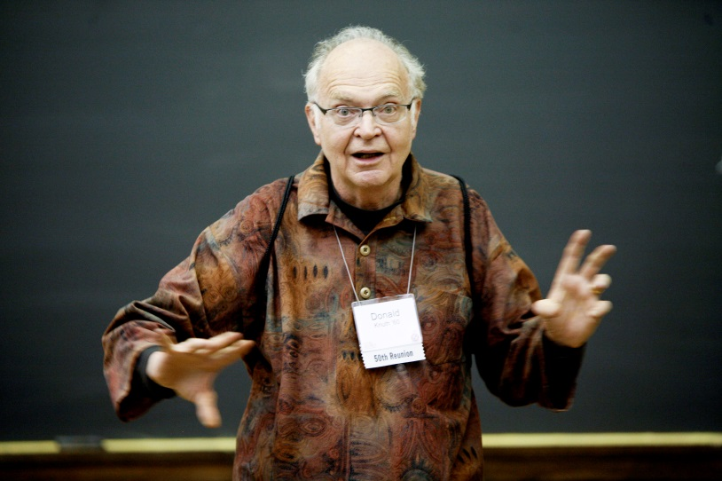
Aside: Bubble Sort – we won’t cover it
"the bubble sort seems to have nothing to recommend it, except a catchy name and the fact that it leads to some interesting theoretical problems” –Donald Knuth, The Art of Computer Programming

Slide 23
Heap Sort
Idea: Build a maxHeap, repeatedly delete the max element from the heap to build sorted list Right-to-Left
10
9
6
8
7
5
2
4
1
3
0
1
2
3
4
5
6
7
8
9
Max Heap Property: Each node is larger than its children
10
9
0
6
8
1
7
5
2
2
3
4
5
6
4
1
3
7
8
9

Slide 24
Heap Sort
Remove the Max element (i.e. the root) from the Heap: replace with last element, call percolateDown(root)
3
9
6
8
7
5
2
4
1
0
1
2
3
4
5
6
7
8
9
3
9
0
6
8
1
7
5
2
2
3
4
5
6
4
1
Percolate Down(node): if node satisfies heap property, done. Else swap with largest child and repeat on that subtree
7
8

Slide 25
Heap Sort
Remove the Max element (i.e. the root) from the Heap: replace with last element, call percolateDown(root)
9
3
6
8
7
5
2
4
1
0
1
2
3
4
5
6
7
8
9
9
3
0
6
8
1
7
5
2
2
3
4
5
6
4
1
Percolate Down(node): if node satisfies heap property, done. Else swap with largest child and repeat on that subtree
7
8

Slide 26
Heap Sort
Remove the Max element (i.e. the root) from the Heap: replace with last element, call percolateDown(root)
9
8
6
3
7
5
2
4
1
0
1
2
3
4
5
6
7
8
9
9
8
0
6
3
1
7
5
2
2
3
4
5
6
4
1
Percolate Down(node): if node satisfies heap property, done. Else swap with largest child and repeat on that subtree
7
8

Slide 27
Heap Sort
Remove the Max element (i.e. the root) from the Heap: replace with last element, call percolateDown(root)
9
8
6
4
7
5
2
3
1
0
1
2
3
4
5
6
7
8
9
9
8
0
6
4
1
7
5
2
2
3
4
5
6
3
1
Percolate Down(node): if node satisfies heap property, done. Else swap with largest child and repeat on that subtree
7
8

Slide 28
Heap Sort
Build a heap
Call deleteMax
Put that at the end of the array
myHeap = buildHeap(a);
for (int i = a.length-1; i>=0; i--){
item = myHeap.deleteMax();
a[i] = item;
}
Running Time:
Worst Case: $Θ(⋅)$
Best Case: $Θ(⋅)$

Slide 29
“In Place” Sorting Algorithm
A sorting algorithm which requires no extra data structures
Idea: It sorts items just by swapping things in the same array given
Definition: it only uses $Θ(1)$ extra space
Selection sort: In Place!
Insertion sort: In Place!
Heap sort: Not In Place!
But we can fix that!

Slide 30
In Place Heap Sort
Idea: When “removing” an element from the heap, swap it with the last item of the heap then “pretend” the heap is one item shorter
10
9
6
8
7
5
2
4
1
3
0
1
2
3
4
5
6
7
8
9
10
9
0
6
8
1
7
5
2
2
3
4
5
6
4
1
3
7
8
9

Slide 31
Heap Sort
Idea: When “removing” an element from the heap, swap it with the last item of the heap then “pretend” the heap is one item shorter
3
9
6
8
7
5
2
4
1
10
0
1
2
3
4
5
6
7
8
9
3
9
0
6
8
1
7
5
2
2
3
4
5
6
4
1
7
8

Slide 32
Heap Sort
Idea: When “removing” an element from the heap, swap it with the last item of the heap then “pretend” the heap is one item shorter
9
8
6
4
7
5
2
3
1
10
0
1
2
3
4
5
6
7
8
9
9
8
0
6
4
1
7
5
2
2
3
4
5
6
3
1
7
8

Slide 33
Heap Sort
Idea: When “removing” an element from the heap, swap it with the last item of the heap then “pretend” the heap is one item shorter
1
8
6
4
7
5
2
3
9
10
0
1
2
3
4
5
6
7
8
9
1
8
0
6
4
1
7
5
2
2
3
4
5
6
3
7

Slide 34
Heap Sort
Idea: When “removing” an element from the heap, swap it with the last item of the heap then “pretend” the heap is one item shorter
1
8
6
4
7
5
2
3
9
10
0
1
2
3
4
5
6
7
8
9
8
7
0
6
4
1
1
5
2
2
3
4
5
6
3
7

Slide 35
Heap Sort
Idea: When “removing” an element from the heap, swap it with the last item of the heap then “pretend” the heap is one item shorter
3
8
6
4
7
5
2
8
9
10
0
1
2
3
4
5
6
7
8
9
3
7
0
6
4
1
1
5
2
2
3
4
5
6

Slide 36
Heap Sort
Idea: When “removing” an element from the heap, swap it with the last item of the heap then “pretend” the heap is one item shorter
3
8
6
4
7
5
2
8
9
10
0
1
2
3
4
5
6
7
8
9
7
4
0
6
3
1
1
5
2
2
3
4
5
6

Slide 37
In Place Heap Sort
Build a heap using the same array (Floyd’s build heap algorithm works)
Call deleteMax
Put that at the end of the array
buildHeap(a);
for (int i = a.length-1; i>=0; i--){
temp=a[i]
a[i] = a[0];
a[0] = temp;
percolateDown(0);
}
Running Time:
Worst Case: $Θ(⋅)$
Best Case: $Θ(⋅)$

Slide 38
Floyd’s buildHeap method
Working towards the root, one row at a time, percolate down
buildHeap(){
for(int i = size; i>0; i--){
percolateDown(i);
}
}

