Slide 1
CSE 332 Autumn 2023
Lecture 10: AVL and B Trees
Nathan Brunelle
http://www.cs.uw.edu/332

Slide 2
AVL Tree
A Binary Search tree that maintains that the left and right subtrees of every node have heights that differ by at most one.
  height of left subtree and height of right subtree off by at most 1
  Not too weak (ensures trees are short)
  Not too strong (works for any number of nodes)
Idea of AVL Tree:
  When you insert/delete nodes, if tree is “out of balance” then modify the tree
  Modification = “rotation”

Slide 3
Using AVL Trees
Key = 9
Value = “hello”
Height = 3
Left = Node 3
Right = Node 10
Each node has:
  Key
  Value
  Height
  Left child
  Right child
9
3
10
1
6
16
0
5
7

Slide 4
Inserting into an AVL Tree
Starts out the same way as BST:
  “Find” where the new node should go
  Put it in the right place (it will be a leaf)
Next check the balance
  If the tree is still balanced, you’re done!
  Otherwise we need to do rotations

Slide 5
Insert Example
-1
9
3
10
1
6
16
0
2
7

Slide 6
Not Balanced!
Solution: rotate the whole tree to the right
9
Height = 3
Height = 1
3
10
1
6
16
0
2
7
-1

Slide 7
Balanced!
3
1
9
0
2
6
10
-1
7
16

Slide 8

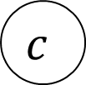




















Right Rotation
Make the left child the new root
Make the old root the right child of the new
Make the new root’s right subtree the old root’s left subtree
$$h+3$$
$$h+2$$
$$b$$
$$a$$
$$h+2$$
$$h$$
$$h+1$$
$$b$$
$$z$$
$$x$$
$$h+1$$
$$a$$
Right Rotation
$$h+1$$
$$h$$
$$h$$
$$h$$
$$x$$
$$y$$
$$y$$
$$z$$
$$c$$
$$c$$

Slide 9
Insert Example
20
9
3
11
1
6
10
16
0
2
18

Slide 10
Not Balanced!
Solution: rotate the deepest imbalance to the left
9
Height = 2
3
11
Height = 3
16
Height = 2
1
6
10
0
2
Height = 0
18
20

Slide 11
Balanced!
9
3
11
1
6
10
18
0
2
16
20

Slide 12





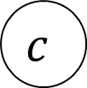


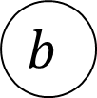













Left Rotation
Make the right child the new root
Make the old root the left child of the new
Make the new root’s left subtree the old root’s right subtree
$$h+3$$
$$a$$
$$h+2$$
$$b$$
$$h+1$$
$$h+1$$
$$h+1$$
$$x$$
$$h+2$$
$$b$$
$$a$$
$$z$$
Left Rotation
$$h$$
$$h+1$$
$$h$$
$$h$$
$$y$$
$$z$$
$$x$$
$$y$$
$$c$$
$$c$$

Slide 13
Insertion Story So Far
After insertion, update the heights of the node’s ancestors
Check for imbalance
If there’s imbalance then at the deepest root of imbalance:
  If the left subtree was deeper then rotate right
  If the right subtree was deeper then rotate left
This is incomplete!
There are some cases where this doesn’t work!
9
9
5
Insert 7
Right Rotation
5
5
9
7
7

Slide 14
Insertion Story So Far
After insertion, update the heights of the node’s ancestors
Check for imbalance
If there’s imbalance then at the deepest root of imbalance:
  Case LL: If we inserted in the left subtree of the left child then rotate right
  Case RR: If we inserted in the right subtree of the right child then rotate left
  Case LR: If we inserted into the right subtree of the left child then ???
  Case RL: If we inserted into the left subtree of the right child then ???
Cases LR and RL require 2 rotations!

Slide 15
Case LR
From “root” of the deepest imbalance:
  Rotate left at the left child
  Rotate right at the root
9
9
9
Insert 7
Rotate Left at 5
5
Rotate Right at 9
7
5
7
7
5
9
5

Slide 16
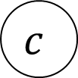
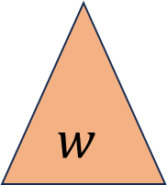





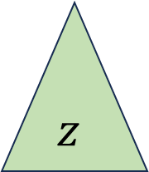














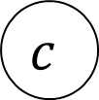

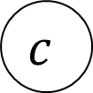




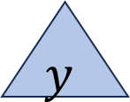

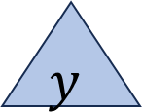












Case LR in General
Imbalance caused by inserting in the left child’s right subtree
Rotate left at the left child
Rotate right at the imbalanced node
$$h+3$$
$$h+3$$
$$a$$
$$h+2$$
$$a$$
$$c$$
Rotate Left at $b$
Rotate Right at $a$
$$h+2$$
$$h+2$$
$$h$$
$$h$$
$$c$$
$$z$$
$$h+1$$
$$b$$
$$z$$
$$b$$
$$h+1$$
$$a$$
$$h+1$$
$$h$$
$$h+1$$
$$c$$
$$b$$
$$y$$
$$h$$
$$h$$
$$w$$
$$w$$
$$x$$
$$y$$
$$z$$
$$h$$
$$x$$
$$y$$
$$w$$
$$x$$
$$d$$
$$d$$
$$d$$
$$d$$
$$d$$
$$d$$

Slide 17




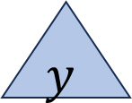
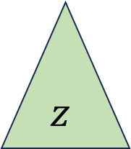

















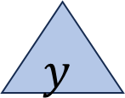









Case RL in General
Imbalance caused by inserting in the right child’s left subtree
Rotate right at the right child
Rotate left at the imbalanced node
$$h+3$$
$$a$$
$$h+2$$
$$c$$
$$h+3$$
$$a$$
Rotate Right at $b$
Rotate Left at $a$
$$h+2$$
$$b$$
$$h$$
$$c$$
$$h+1$$
$$b$$
$$h$$
$$w$$
$$h+2$$
$$a$$
$$h+1$$
$$w$$
$$h+1$$
$$c$$
$$h$$
$$h+1$$
$$b$$
$$h$$
$$h$$
$$z$$
$$x$$
$$w$$
$$x$$
$$y$$
$$z$$
$$h$$
$$x$$
$$y$$
$$y$$
$$z$$
$$d$$
$$d$$
$$d$$
$$d$$
$$d$$
$$d$$

Slide 18
Insert Summary
After a BST insertion, update the heights of the node’s ancestors
Check for imbalance
If there’s imbalance then at the deepest root of imbalance:
  Case LL: If we inserted in the left subtree of the left child then: rotate right
  Case RR: If we inserted in the right subtree of the right child then: rotate left
  Case LR: If we inserted into the right subtree of the left child then: rotate left at the left child and then rotate right at the root
  Case RL: If we inserted into the left subtree of the right child then: rotate right at the right child and then rotate left at the root

Slide 19
Memory Hierarchy
Large memory is slow to access.
We use different “layers” or memory to balance quantity of storage with speed of access.
Ideally the data we want is in small memory, but we may need to go deep
CPU
Size: 1 KB
Speed: Free
L1 Cache
Size: 128 KB
Speed: 2 cycles per lookup
L2 Cache
Size: 2 MB
Speed: 30 cycles per lookup
Main Memory
Size: 2 GB
Speed: 250 cycles per lookup
Disk
Size: 1 TB
Speed: 8,000,000 cycles per lookup

Slide 20
B Trees Motivation
Memory Locality
  Observation: in practice, when you read from memory you’re likely to soon thereafter read from nearby memory
  When memory is “fetched”, it’s collected in blocks at a time
  Works well for arrays (they’re contiguous is memory)
  May not be helpful for linked lists, BSTs, etc. (pointers could go wherever)
Solution: Have a BST-like data structure which can take advantage of locality

Slide 21
First Idea
BST nodes have a lot of information inside them
We don’t need that information for “intermediate” nodes
Solution: Delay loading anything except keys as long as possible
Key = 9
Value = “hello”
Left = Node 3
Right = Node 10
9
3
10
1
6
16
0
5
7

Slide 22
Second Idea
Nodes may not be close to each other in memory
In the worst case, each step in a traversal could go deep in memory
Solution: Increase branching factor of tree load blocks of keys at a time
  M-ary tree: each node has at most M children
  Choose M to snugly fit in a block

Slide 23

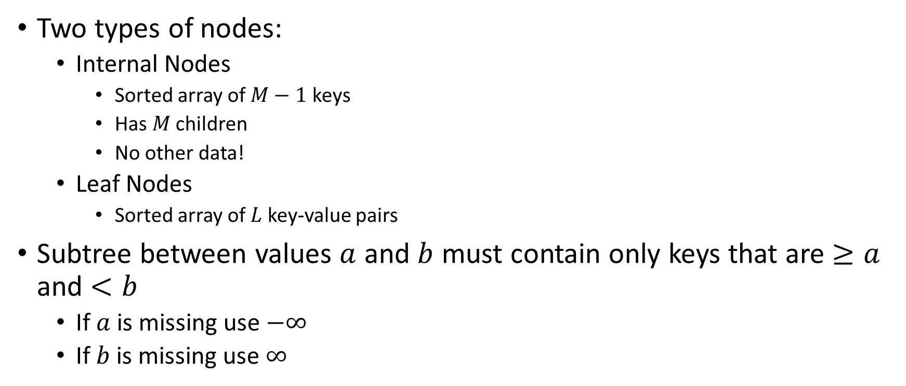


B Trees (aka B+ Trees)
13
38
3
5
9
20
25
55
Two types of nodes:
  Internal Nodes
    Sorted array of $M−1$ keys
    Has $M$ children
    No other data!
  Leaf Nodes
    Sorted array of $L$ key-value pairs
Subtree between values $a$ and $b$ must contain only keys that are $≥a$ and $<b$
  If $a$ is missing use $−∞$
  If $b$ is missing use $∞$
1
3
5
9
13
20
25
38
55
2
4
6
10
14
24
27
40
90
7
17
30
50
$$a$$
$$b$$
$$a≤k<b$$

Slide 24
Find
Start at the root node
Binary search to identify correct subtree
Repeat until you reach a leaf node
Binary search the leaf to get the value
13
38
3
5
9
20
25
55
1
3
5
9
13
20
25
38
55
2
4
6
10
14
24
27
40
90
7
17
30
50

Slide 25
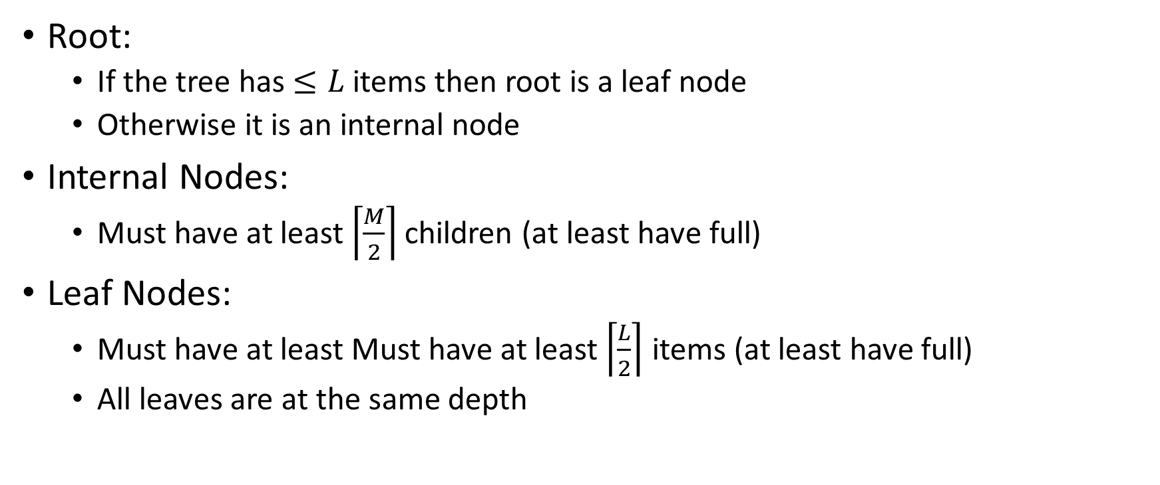
B Tree Structure Requirements
Root:
  If the tree has $≤L$ items then root is a leaf node
  Otherwise it is an internal node
Internal Nodes:
  Must have at least $\left\lceil \frac{M}{2}\right\rceil$ children (at least have full)
Leaf Nodes:
  Must have at least Must have at least $\left\lceil \frac{L}{2}\right\rceil$ items (at least have full)
  All leaves are at the same depth

Slide 26
Insertion Summary
Binary search to find which leaf should contain the new item
If there’s room, add it to the leaf array (maintaining sorted order)
If there’s not room, split
  Make a new leaf node, move the larger half of the items to it
  If there’s room in the parent internal node, add new leaf to it (with new key bound value)
  If there’s not room in the parent internal node, split that!
    Make a new internal node and have it point to the half the leaves (with correct key bound values)
    If there’s room in the parent internal node, add this internal node to it
    If there’s not room, repeat this process until there is!

Slide 27
Insertion TLDR
Find where the item goes by repeated binary search
If there’s room, just add it
If there’s not room, split things until there is

Slide 28
Insert Example
Insert 22
13
38
3
5
9
20
25
55
1
3
5
9
13
20
25
38
55
2
4
6
10
14
24
27
40
90
7
17
30
50

Slide 29
Insert Example
Insert 22
13
38
3
5
9
20
25
55
1
3
5
9
13
20
25
38
55
2
4
6
10
14
22
27
40
90
7
17
24
30
50

Slide 30
Insert Example
Insert 26
13
38
3
5
9
20
25
55
1
3
5
9
13
20
25
38
55
2
4
6
10
14
24
27
40
90
7
17
30
50

Slide 31
Insert Example
Insert 26
13
38
3
5
9
20
25
27
55
1
3
5
9
13
20
25
27
38
55
2
4
6
10
14
24
26
30
40
90
7
17
50

Slide 32
Insert Example
Insert 8
13
38
3
5
9
20
25
55
1
3
5
9
13
20
25
38
55
2
4
6
10
14
24
27
40
90
7
17
30
50

Slide 33
Insert Example
5
Split!
5
7
Insert 8
6
6
8
7
8
3
5
9
Split!
3
5
9
1
3
5
9
7
1
3
5
7
9
2
4
6
10
8
2
4
6
8
10

Slide 34
Insert Example
13
38
Insert 8
20
25
55
3
5
9
13
20
25
38
55
14
24
27
40
90
1
3
5
7
9
17
30
50
2
4
6
8
10

Slide 35
Insert Example
Insert 8
7
13
38
3
5
9
20
25
55
1
3
5
7
9
13
20
25
38
55
2
4
6
8
10
14
24
27
40
90
17
30
50

